Slide 1
INSIGHT INTO THE DEVELOPMENT OF KOMBUCHA TYPE BEVERAGES – from the fermentation monitoring to the study of consumer acceptance
Oral communication for the University of Engineering – Hebei, China
Tuesday June 18th
SARAH SUFFYS
Doctoral student in chemical bioengineering

Slide 2
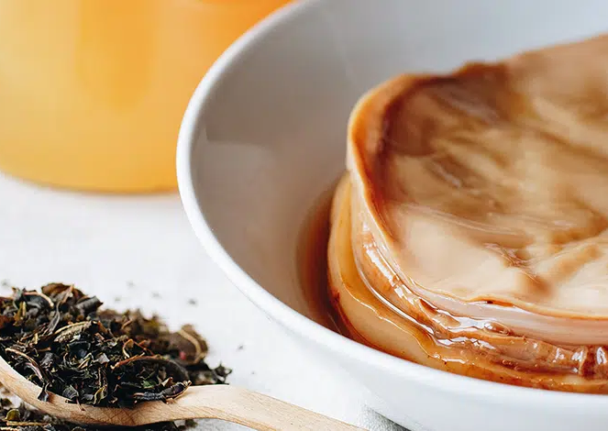
MICROBoost Project
FOODWAL – Win4Excellence
Work Packages:
→ Development of fermented beverages with high nutritional and organoleptic value
→ Organoleptic evaluation and acceptability of new microbiotics

Slide 3
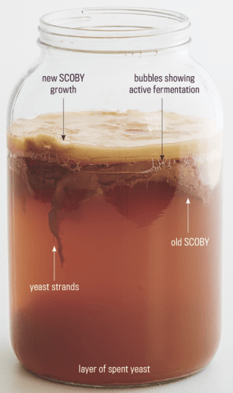
WHAT IS KOMBUCHA ?
From the Japanese "Kombu Cha": "Tea Algae"
Fermented beverage from sweet tea
Native to China, Korea and Japan (220 BC)
SCOBY: Symbiotic culture of Bacteria and Yeast
Protective Biofilm
Multiple Health Benefits:
Popular for its detoxifying, antioxidant and energizing properties
Active against digestive problems
…

Slide 4
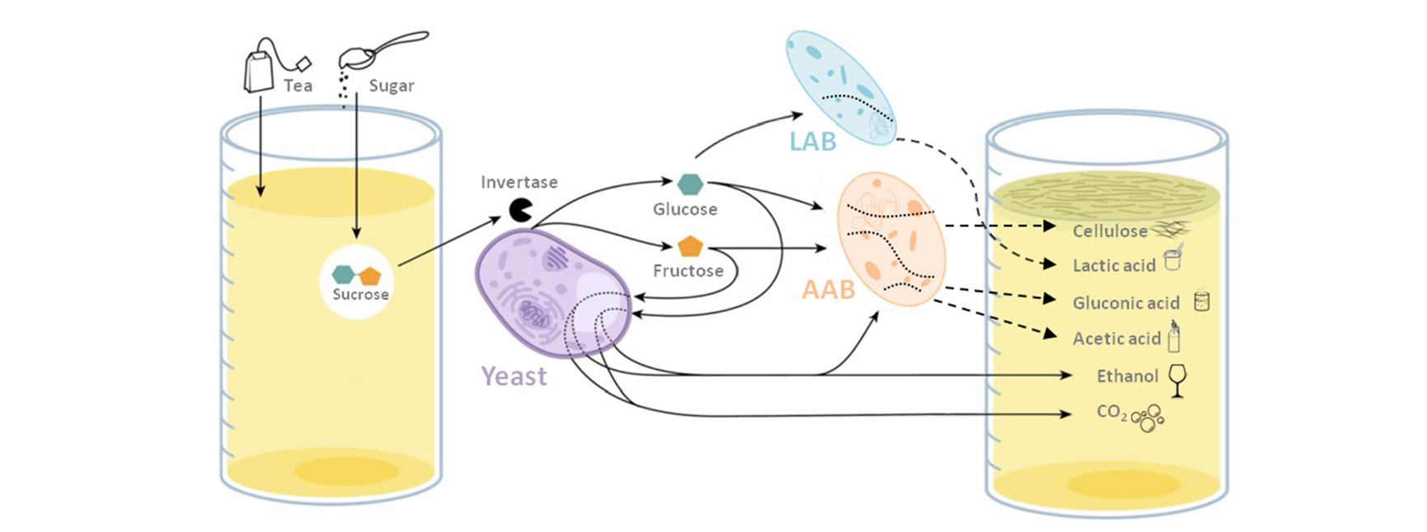
Diez-Ozaeta and Astiazaran (2022)

Slide 7
Context
Aromatic Profile | Fermentation
Consumer acceptance of a food product Flavors: a complex combination of VOCs Key aromatic components “Odor-active compounds” → Monitoring | Renewed interest: natural, economical, versatile technology Improved shelf life, nutritional and sensory profiles → Production of natural beverages as alternatives to conventional soft drinks

Slide 8
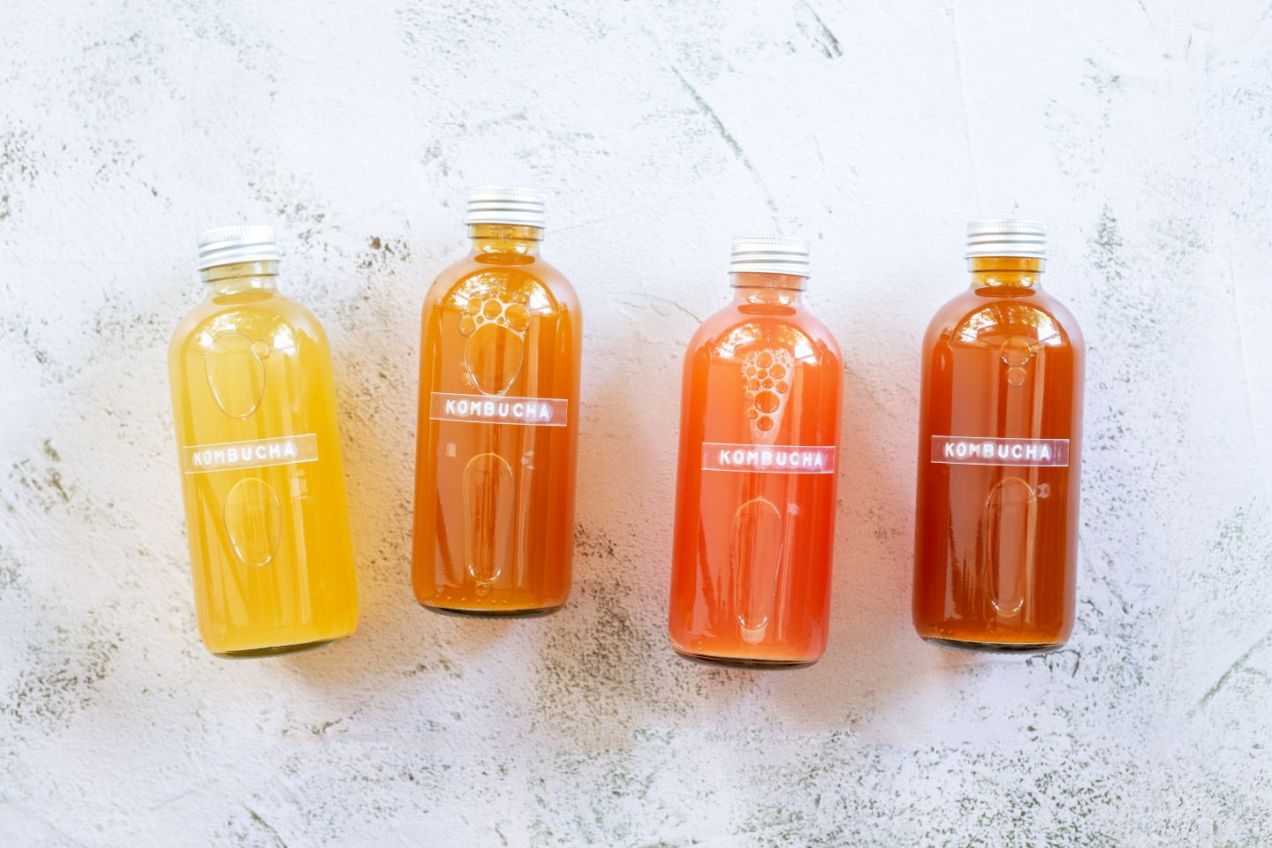
Therapeutic effects
Chemical composition | Variation parameters
Tea polyphenols Carbohydrates Synthesized secondary metabolites Organic acids Amino acids Vitamins Hydrolytic enzymes | Fermentable matrix Composition / initial sugar content Fermentation time Incubation temperature Composition / inoculum rate Liquid inoculum Concentration

Slide 9
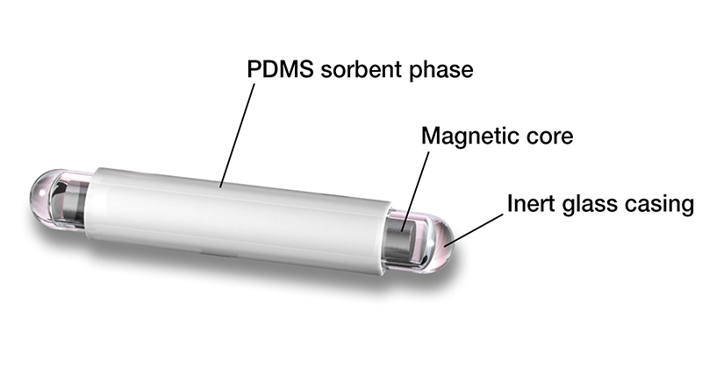
Aromatic compounds
Origin | Classification
Fermentable matrix Sugar substrate type Microbial metabolites synthesized during fermentation | Carboxylic acids Alcohols Aldehydes Ketones Esters Benzenoids
Duration
Temperature
Fermentation

Slide 10
OBJECTIVES
Study of sensory profile = key factor for the development of kombucha as a mass-market beverage
Need for advanced analytical tools = to understand kinetics of aromatic compounds during fermentation
Control & Monitoring of beverage flavors according to consumer preferences

Slide 11
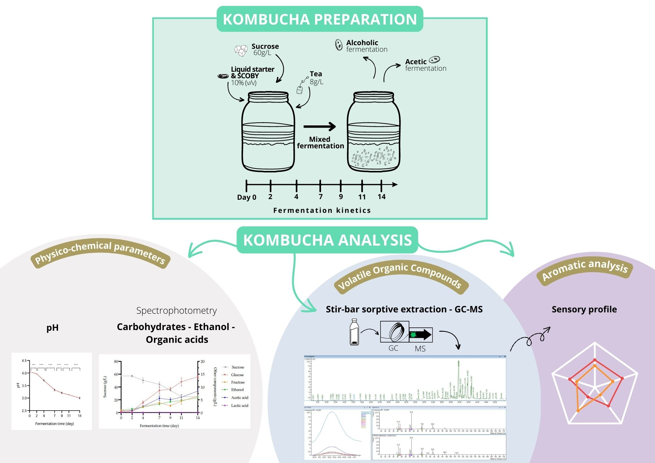

Slide 12
Results & Discussions
Physico-chemical characterization of kombucha during fermentation
Decrease in pH
Growth of MO present in the consortium
Accumulation of organic acids and metabolic products
Figure 1. pH evolution of kombucha samples in function of fermentation time (day) at 30°C (mean ± SD; n=3; Student’s t-test; ****, p< 0.0001; ***, p< 0.001; **, p< 0.01; *, p< 0.05; ns, non-significant)

Slide 13
→ Initial sucrose substrate decreases: degradation to Glc + Fru
Metabolism Yeast: ethanol production
2) Acetic bacteria metabolism: acetic acid production
(Lactic bacteria metabolism: lactic acid production)
3) Glc utilization by AAB: cellulose production
Figure 2. Evolution of carbohydrates, alcohol, and acids concentration (g/L) in function of fermentation time (day) at 30°C (mean ± SD; n=3)

Slide 14
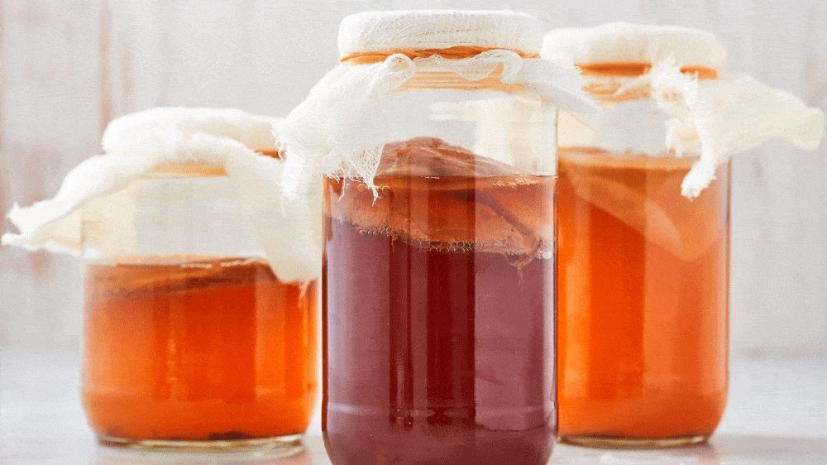
Results & Discussions
Study of the development kinetics of volatile organic compounds
Chemical analysis of the main VOCs and the metabolic pathways involved in fermentation
Aromatic characterization of kombucha and establishment of sensory profiles

Slide 15
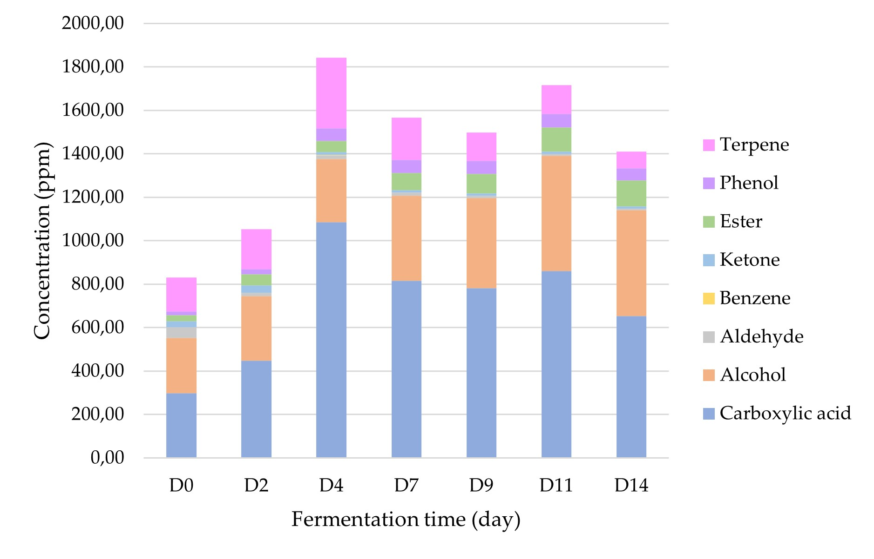
Study of the development kinetics of volatile organic compounds
Chemical analysis of the main VOCs and the metabolic pathways involved in fermentation
87 VOCs identified (including 28 carb. acids, 23 alcohols and 9 terpenes)
Terpenes (Squalene, Limonene) & Carboxylic acids (hexadecanoic and pentadecanoic acids) from tea
Nutrients + carbonaceous substrates
→ metabolite synthesis by MOs
Increased VOCs released during fermentation
Complex microbial consortium: 2ary metabolic pathways / interspecific interactions
Figure 3. Changes in average contents (ppm) of different classes of VOCs with kombucha fermentation time (day) at 30°C

Slide 16
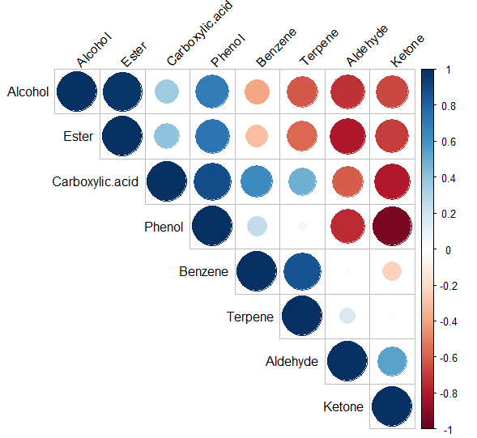
Dynamic balance between VOC classes / fermentation
Carboxylic acids, Alcohols
→
Aldehydes, Ketones
→
Esters, Phenols, Terpenes
Corr < 1
Ketones / Carb. Acids and Phenols Aldehydes / Alcohols and Esters
Corr > 1
Phenols / Esters and Carb. acids
Figure 4. Correlation between different classes of VOCs during kombucha fermentation stages conducted at 30°C (a color gradient denotes the Spearman’s correlation coefficients)

Slide 17
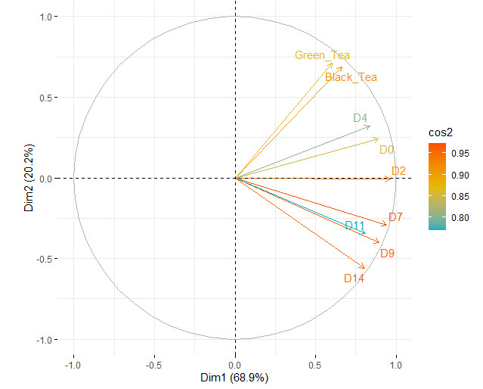
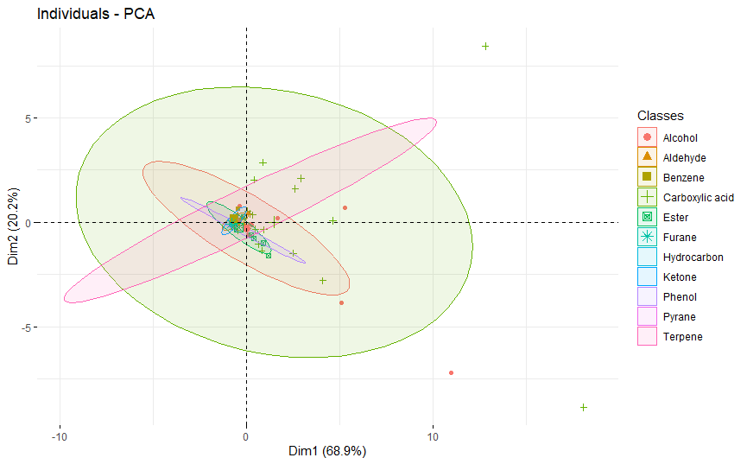
(A) | (B)
Figure 5. Principal component analysis (mean values for VOCs averaged across kombucha fermentation time (day)) plots of variables correlation (cos² color scale) (A) and individuals’ representation (ellipses corresponds to VOCs classes) (B) (labelled individuals are those best represented on the plan)
PCA → Variation VOCs x Fermentation stages
Dim 1: explains 68.1% variability
Similar variable groups: Tea / Early F / Late F
(B) Significant variation by Carboxylic acids / Alcohols / Terpenes

Slide 18
Results & Discussions
Study of the development kinetics of volatile organic compounds
Chemical analysis of the main VOCs and the metabolic pathways involved in fermentation
Aromatic characterization of kombucha and establishment of sensory profiles

Slide 19
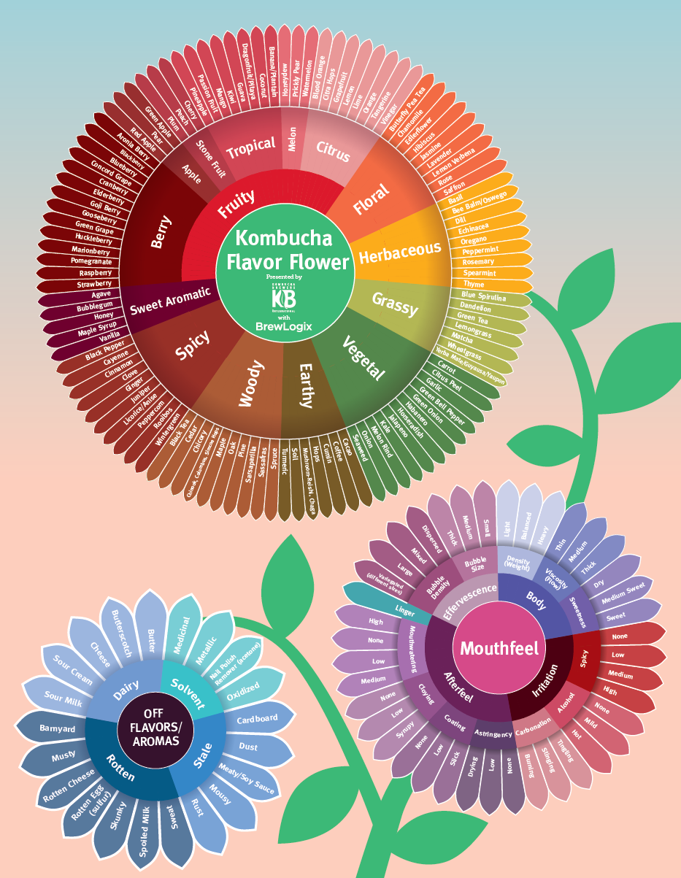
Aromatic characterization of kombucha and establishment of sensory profiles
VOC concentration (ppm)
$$OAV=\frac{C}{OT}$$
Odor-activity value
Odor Threshold in water
OAV < 1 | No perceptible aroma
OAV > 1 | Significant contribution from aroma

Slide 20
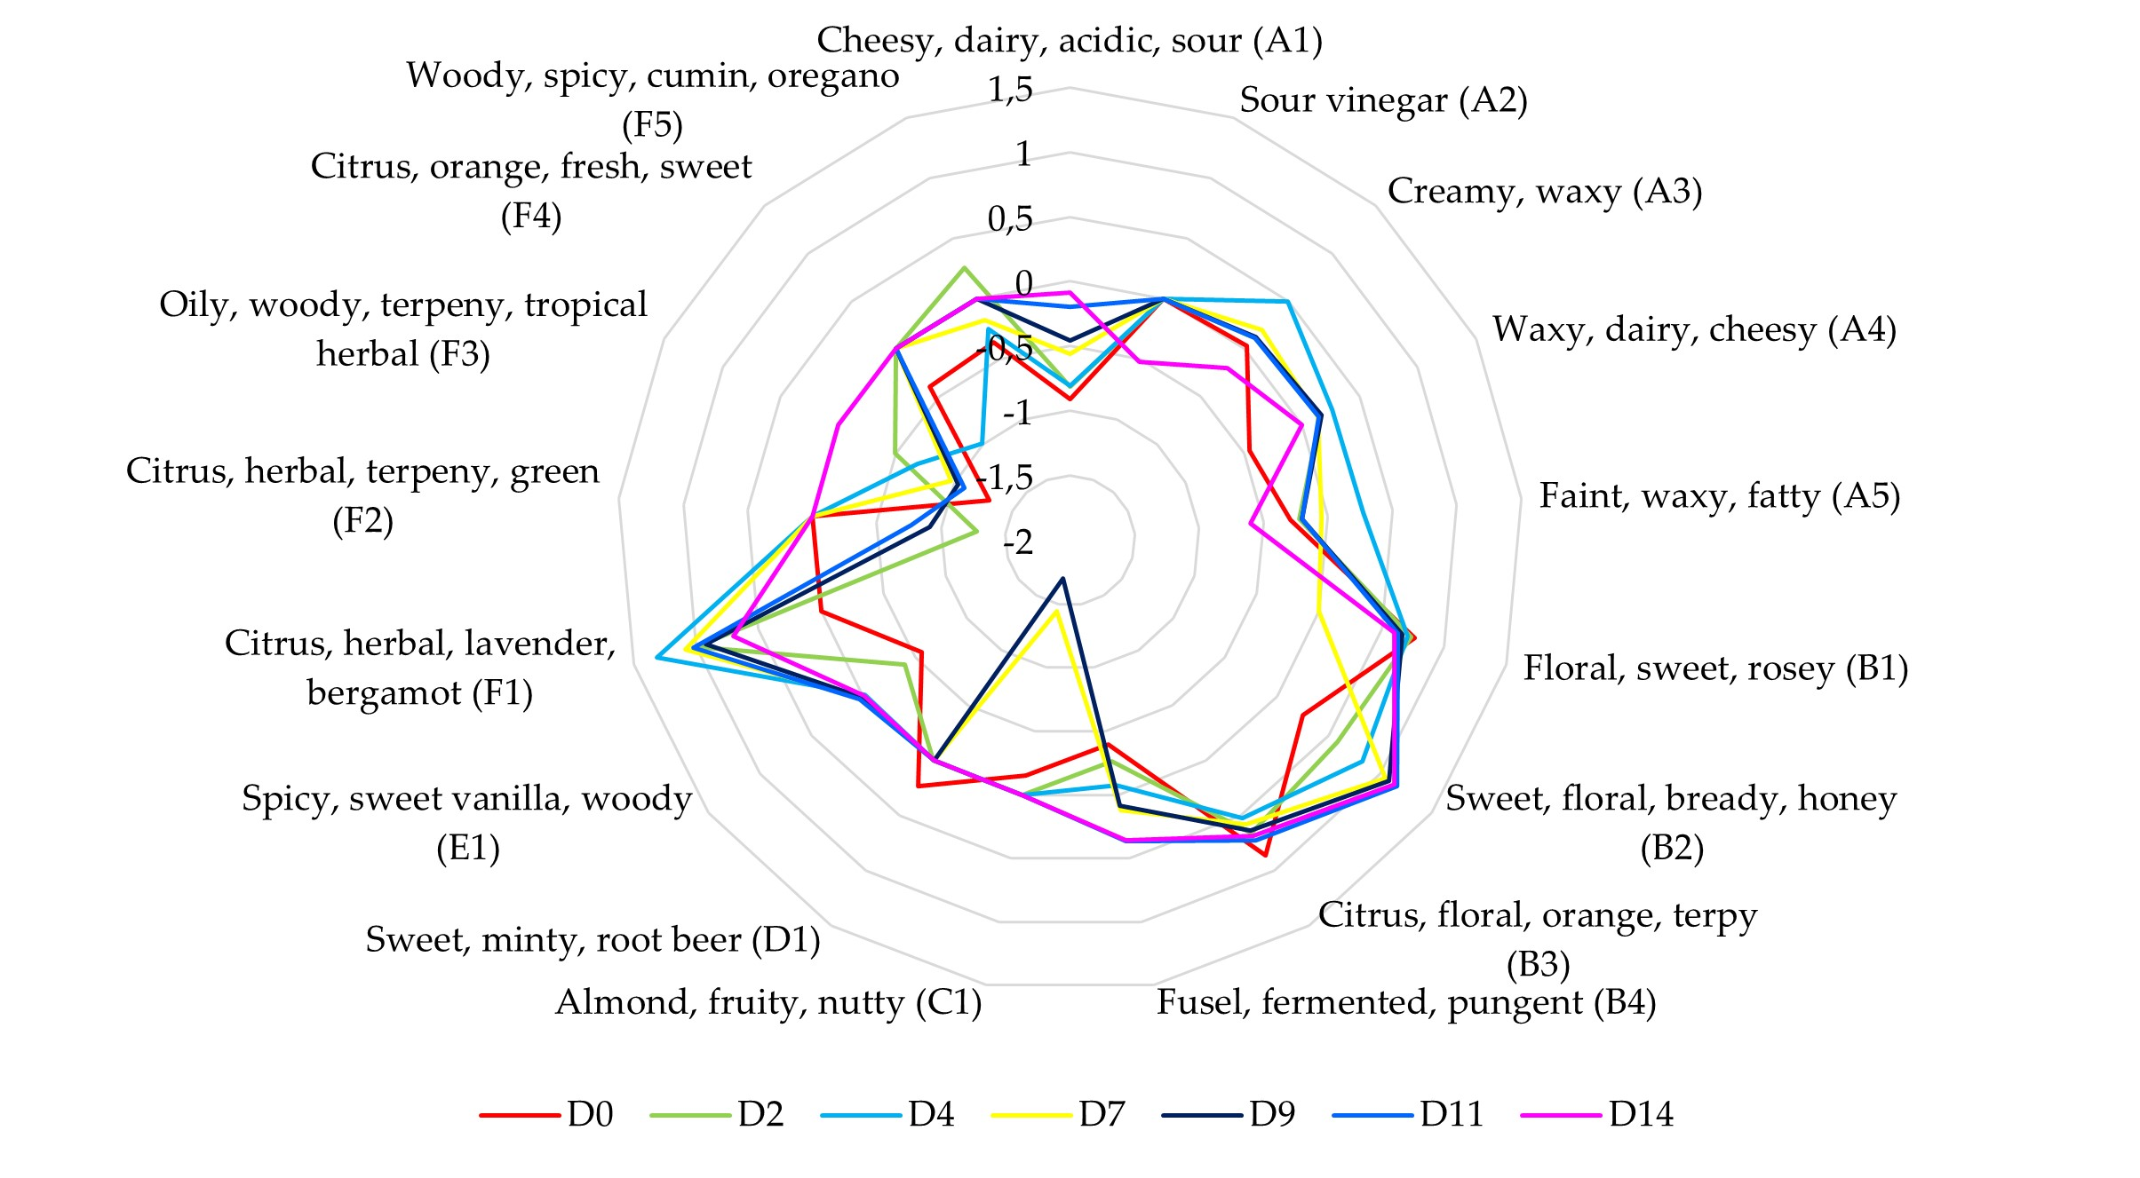
Aromatic analysis: 17 VOCs
Carboxylic acids / Alcohols / Ester / Phenol / Terpenes
D0: Tea aromas (Perception +)
Aroma profile variation with Fermentation
D0: Geraniol/ Linalol
→
D4-D7: α-farnesene
→
From D7: 2-phenylethanol
→
D14: methylbutan-1-ol
Estimated beverage flavors
Figure 6. Estimated sensory profile are expressed as the log of the OAV for most representative volatile organic compounds (%area > 1%) with kombucha fermentation time (day) at 30°C (OAV = concentration/ perception threshold)

Slide 21
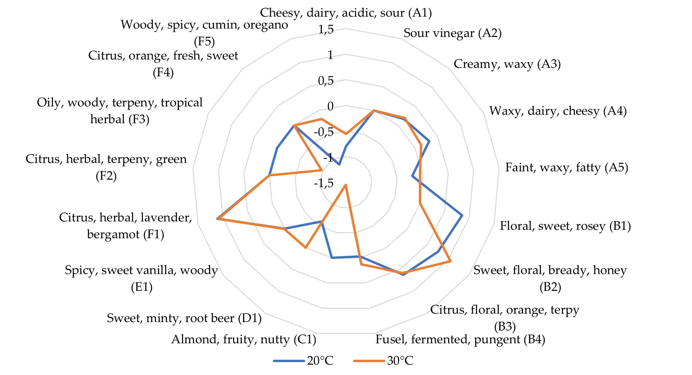
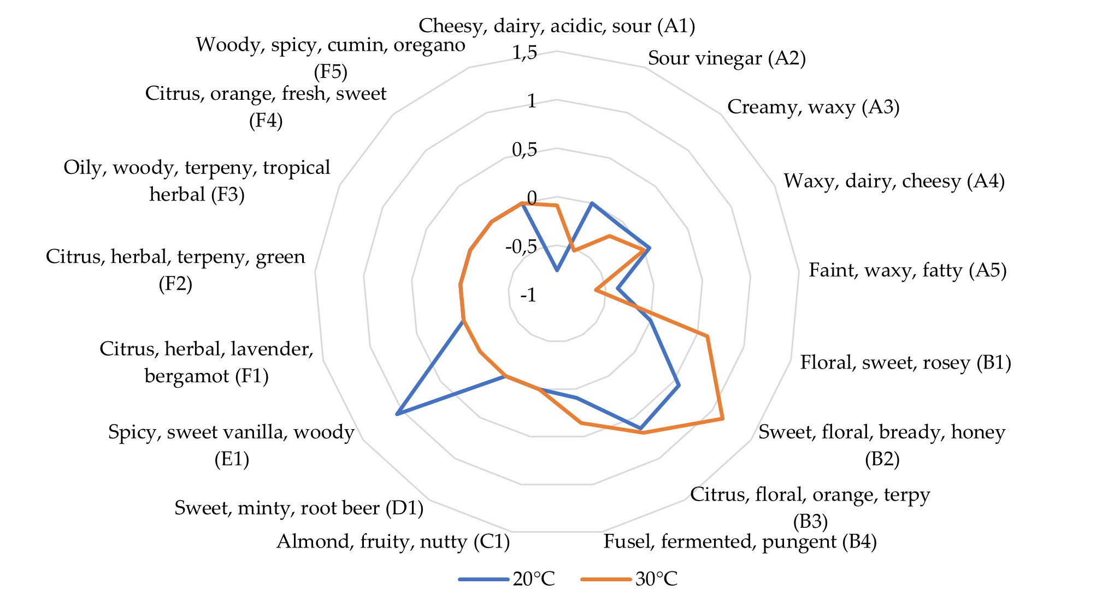
(A) | (B)
Figure 7. Variation of the estimated sensory profile (expressed as the log of OAV; OAV = concentration/ perception threshold) of most representative volatile compounds (%area > 1%) with temperature (°C) on kombucha fermentation (A) intermediate stage (D7) and (B) on final stage (D14)
T° increase → Alcohol synthesis // Carb. acids and phenols
inhibition
30°C-D7 ≠ 20°C-D14 : MO comfort in environmental conditions
Aroma control by monitoring F parameters + relationships

Slide 22
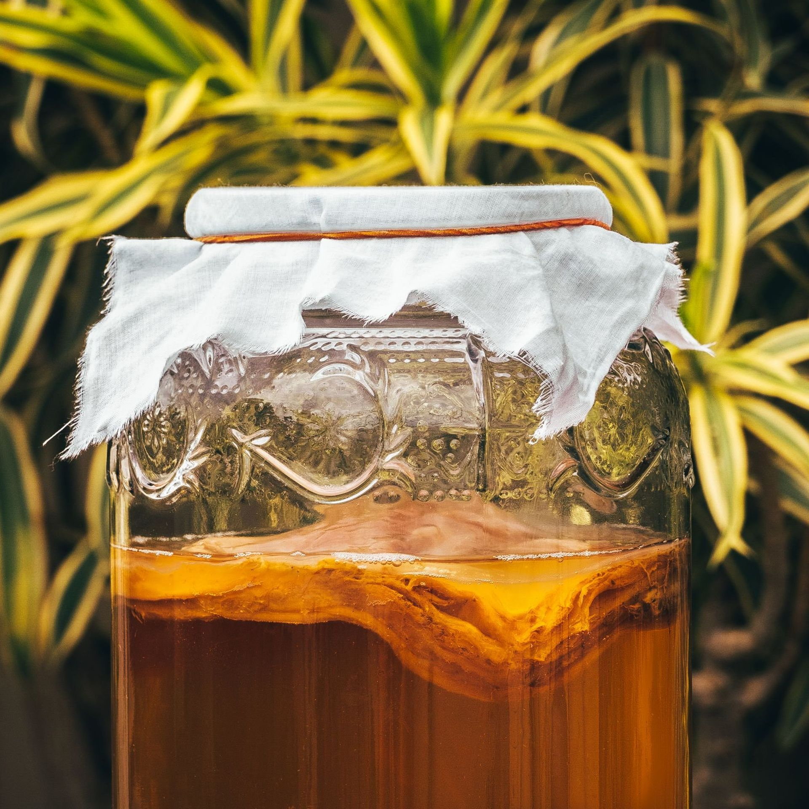
Conclusions
Kinetics of pH, main components, VOCs and aromatic compounds analyzed during kombucha fermentation
Decrease in pH = acidification of fermentation medium → synthesis of organic acids by the microbiome
+ Food safety
Evolution of major compounds: fermentative pathways of the microbial consortium illustrated = Glycolysis & AAB pathways
87 VOCs detected in kombucha during fermentation → including 28 carboxylic acids, 23 alcohols, 10 ketones, 9 terpenes, 7 esters, 7 aldehydes, 2 phenols and 1 benzene
Variation in VOC profile during fermentation
17 aroma compounds: based on OAV
Aroma variations during F
Aromatic signature of Kombucha

Slide 23
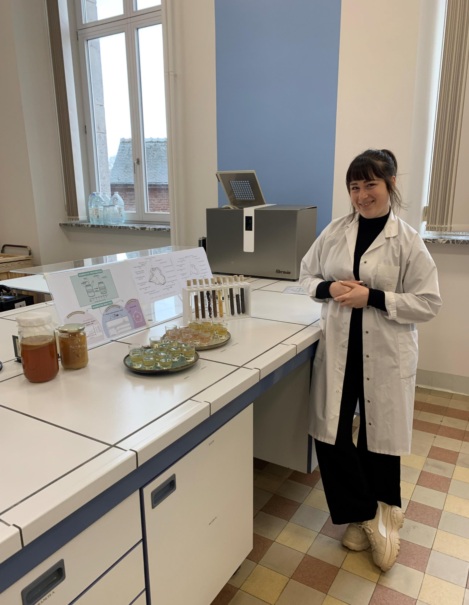
Prospects
Characterization of beverage microbial population → confirm VOC synthesis relationships / metabolic pathways involved during fermentation
Identification of MO present in the starting SCOBY + potential evolution/specification study
Sensory analysis
Study of dependence on fermentation parameters
Health aspects: antioxidant / anti-inflammatory properties
Study of interactions between beverage microbiomes and consumer intestinal tracts
Functional beverages: diversify fermentable matrices (cereals, infusions, etc.)

Slide 24
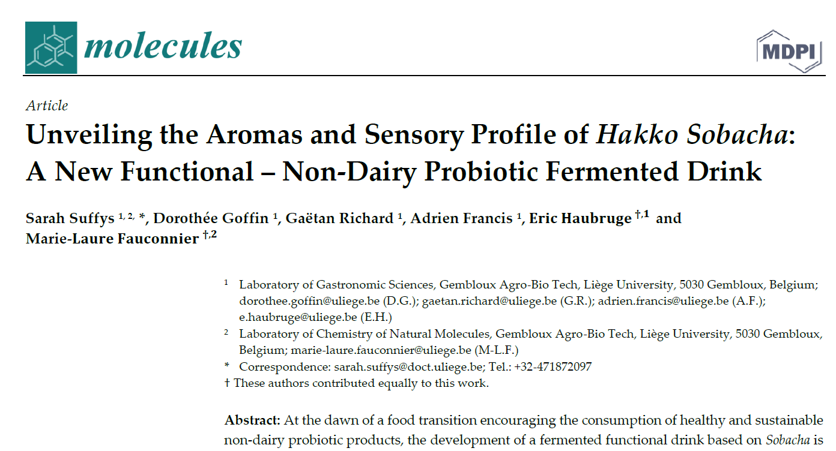

Slide 25
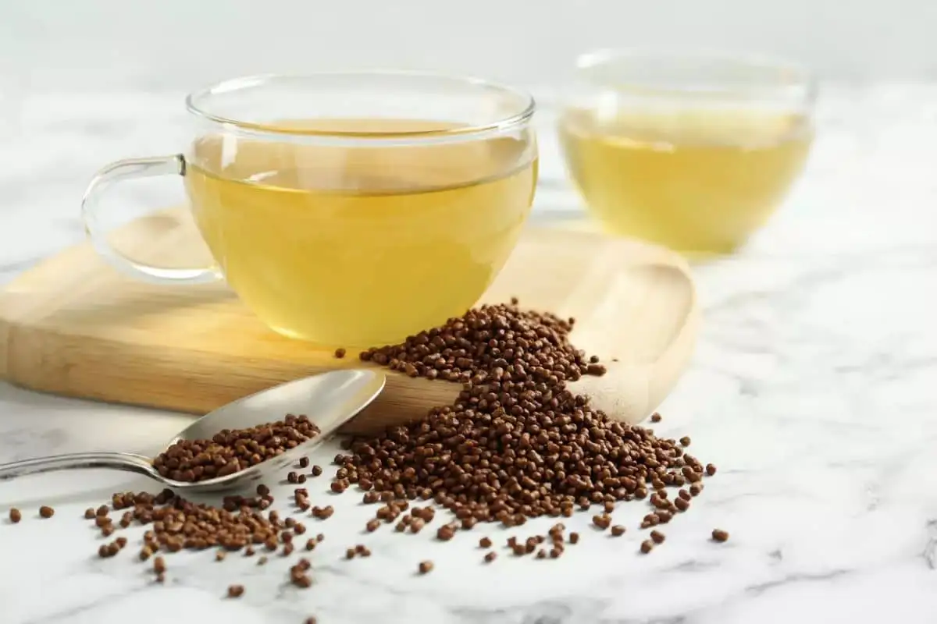
WHAT IS SOBACHA ?
From the Japanese "Soba Cha": "Buckwheat Tea"
Japanese infusion of roasted buckwheat seeds
Native to Northeast Asia
Multiple health benefits
Pseudo cereal = Alternative to dietary products
Specific aromas

Slide 27
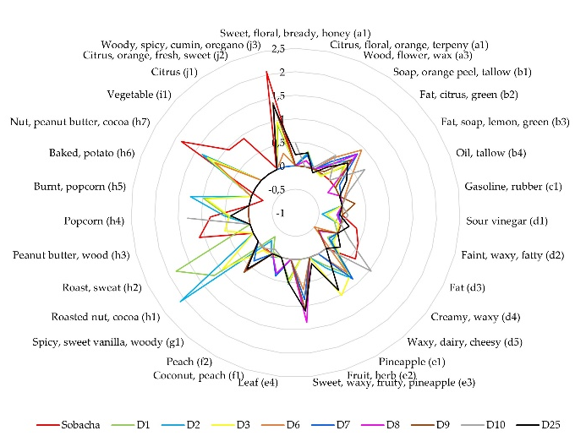
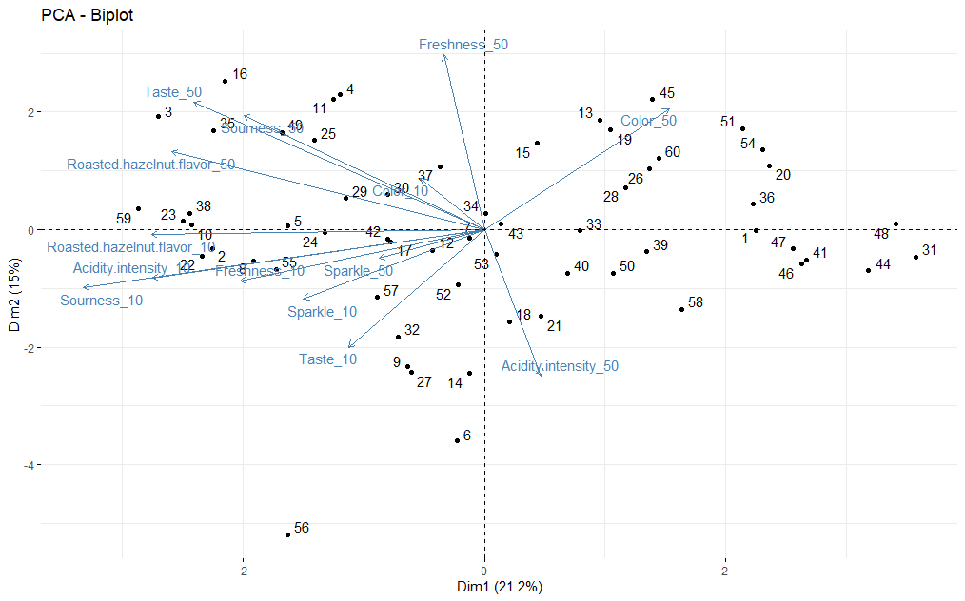
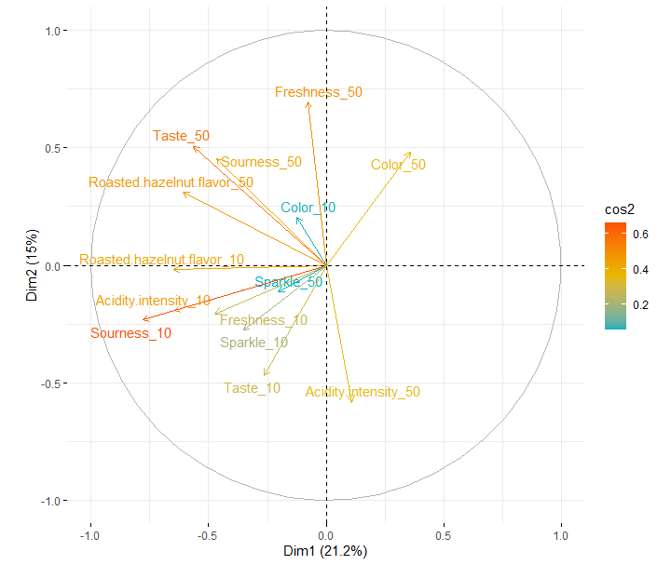
Aromatic characterisation of Hakko Sobacha
Sensory analysis of Hakko Sobacha
(A)
(B)
Figure 9. Principal component analysis (PCA) plots of Hakko Sobacha sensory evaluation (A) variables and individuals and (B) variable correlations (cos2 colour scale).
Figure 8. Estimated aromatic profiles expressed as the log of the OAV for VOCs (% area > 5%) with Hakko Sobacha (kasha concentration of 10 g/L) fermentation time (day) at 25 °C (OAV = concentration/perception threshold).

Slide 28
DOES KOMBUCHA INTAKE IMPROVE THE GENERAL WELL-BEING OF CANCER THERAPY PATIENTS? A SYSTEMATIC REVIEW
1. DIRECT effects of kombucha on cancer | 2. INDIRECT effects of kombucha on cancer
Cytotoxicity | Antimicrobial effect: antibacterial, antifungal, antiviral effects
Pro apoptotic capacity | Antioxidant capacity
Anti proliferation capacity | Anti-inflammatory capacity
Anti angiogenic effect | Metabolic effects: obesity prevention, hepatoprotective effect, antidiabetic effect, hypercholesterolemia, radioprotective effect, colitis amelioration, sclerosis amelioration
Kombucha’s mechanisms of action and direct effect on cancer
3. IMPACT of kombucha intake on CANCER TREATMENT
Positive impact | Negative impact
Chemotherapy, Targeted therapy, Immunotherapy, Radiotherapy, Surgery

Slide 29
Thank you for your attention ☺ Any questions ? sarah.suffys@doct.uliege.be

Slide 30
1.Gou, M.; Bi, J.; Chen, Q.; Wu, X.; Fauconnier, M.L.; Qiao, Y. Advances and Perspectives in Fruits and Vegetables Flavor Based on Molecular Sensory Science. Food Reviews International 2021, doi:10.1080/87559129.2021.2005088.
2. Teng, T.S.; Chin, Y.L.; Chai, K.F.; Chen, W.N. Fermentation for Future Food Systems. EMBO reports 2021, 22, e52680, doi:10.15252/embr.202152680.
3. Lonǎr, E.; Djurić, M.; Malbaša, R.; Kolarov, L.J.; Klašnja, M. Influence of Working Conditions Upon Kombucha Conducted Fermentation of Black Tea. Food and Bioproducts Processing 2006, 84, 186–192, doi:10.1205/FBP.04306.
4. Dufresne, C.; Farnworth, E. Tea, Kombucha, and Health: A Review. Food Research International 2000, 33, 409–421, doi:10.1016/S0963-9969(00)00067-3.
5. Teoh, A.L.; Heard, G.; Cox, J. Yeast Ecology of Kombucha Fermentation. International Journal of Food Microbiology 2004, 95, 119–126, doi:10.1016/j.ijfoodmicro.2003.12.020.
6. Laavanya, D.; Shirkole, S.; Balasubramanian, P. Current Challenges, Applications and Future Perspectives of SCOBY Cellulose of Kombucha Fermentation. Journal of Cleaner Production 2021, 295, 126454, doi:10.1016/J.JCLEPRO.2021.126454.
7. Bishop, P.; Pitts, E.R.; Budner, D.; Thompson-Witrick, K.A. Kombucha: Biochemical and Microbiological Impacts on the Chemical and Flavor Profile. Food Chemistry Advances 2022, 1, 100025, doi:10.1016/j.focha.2022.100025.
8. Oliveira, Í.A.C.L. de; Rolim, V.A. de O.; Gaspar, R.P.L.; Rossini, D.Q.; de Souza, R.; Bogsan, C.S.B. The Technological Perspectives of Kombucha and Its Implications for Production. Fermentation 2022, 8, 185, doi:10.3390/fermentation8040185.
9. Sievers, M.; Lanini, C.; Weber, A.; Schuler-Schmid, U.; Teuber, M. Microbiology and Fermentation Balance in a Kombucha Beverage Obtained from a Tea Fungus Fermentation. Systematic and Applied Microbiology 1995, 18, 590–594, doi:10.1016/S0723-2020(11)80420-0.
10. McNeil, B.; Harvey, L.M.; Rowan, N.J.; Giavasis, I. Fermentation Monitoring and Control of Microbial Cultures for Food Ingredient Manufacture. Microbial Production of Food Ingredients, Enzymes and Nutraceuticals 2013, 125–143, doi:10.1533/9780857093547.1.125.
11. Markov, S.L.; Malbaša, R.V.; Hauk, M.J.; Cvetković, D.D. Investigation of Tea Fungus Microbe Assotiations: I: The Yeasts. Acta periodica technologica 2001, 133–138.
12. Règlement (UE) n o 1169/2011 du Parlement européen et du Conseil du 25 octobre 2011 concernant l’information des consommateurs sur les denrées alimentaires, modifiant les règlements (CE) n o 1924/2006 et (CE) n o 1925/2006 du Parlement européen et du Conseil et abrogeant la directive 87/250/CEE de la Commission, la directive 90/496/CEE du Conseil, la directive 1999/10/CE de la Commission, la directive 2000/13/CE du Parlement européen et du Conseil, les directives 2002/67/CE et 2008/5/CE de la Commission et le règlement (CE) n o 608/2004 de la Commission Texte présentant de l’intérêt pour l’EEE; 2011; Vol. 304;.
13. Watawana, M.I.; Jayawardena, N.; Gunawardhana, C.B.; Waisundara, V.Y. Health, Wellness, and Safety Aspects of the Consumption of Kombucha. Journal of Chemistry 2015, 2015, doi:10.1155/2015/591869.
14. Melini, F.; Melini, V.; Luziatelli, F.; Ficca, A.G.; Ruzzi, M. Health-Promoting Components in Fermented Foods: An Up-to-Date Systematic Review. Nutrients 2019, 11, doi:10.3390/NU11051189.
15. Martínez Leal, J.; Valenzuela Suárez, L.; Jayabalan, R.; Huerta Oros, J.; Escalante-Aburto, A. A Review on Health Benefits of Kombucha Nutritional Compounds and Metabolites. CyTA - Journal of Food 2018, 16, 390–399, doi:10.1080/19476337.2017.1410499.
16. Jayabalan, R.; Malbaša, R.V.; Lončar, E.S.; Vitas, J.S.; Sathishkumar, M. A Review on Kombucha Tea—Microbiology, Composition, Fermentation, Beneficial Effects, Toxicity, and Tea Fungus. Comprehensive Reviews in Food Science and Food Safety 2014, 13, 538–550, doi:10.1111/1541-4337.12073.
17. Gaggìa, F.; Baffoni, L.; Galiano, M.; Nielsen, D.S.; Jakobsen, R.R.; Castro-Mejía, J.L.; Bosi, S.; Truzzi, F.; Musumeci, F.; Dinelli, G.; et al. Kombucha Beverage from Green, Black and Rooibos Teas: A Comparative Study Looking at Microbiology, Chemistry and Antioxidant Activity. Nutrients 2019, 11, doi:10.3390/nu11010001.
18. Jayabalan, R.; Malini, K.; Sathishkumar, M.; Swaminathan, K.; Yun, S.E. Biochemical Characteristics of Tea Fungus Produced during Kombucha Fermentation. Food Science and Biotechnology 2010 19:3 2010, 19, 843–847, doi:10.1007/S10068-010-0119-6.
19. Jayabalan, R.; Marimuthu, S.; Swaminathan, K. Changes in Content of Organic Acids and Tea Polyphenols during Kombucha Tea Fermentation. Food Chemistry 2007, 102, 392–398, doi:10.1016/j.foodchem.2006.05.032.
Greenwalt, C.J.; Steinkraus, K.H.; Ledford, R.A. Kombucha, the Fermented Tea: Microbiology, Composition, and Claimed Health Effects. Journal of food protection 2000, 63, 976–981, doi:10.4315/0362-028X-63.7.976.
21. Talebi, M.; Frink, L.A.; Patil, R.A.; Armstrong, D.W. Examination of the Varied and Changing Ethanol Content of Commercial Kombucha Products. Food Analytical Methods 2017, 10, 4062–4067, doi:10.1007/S12161-017-0980-5/FIGURES/4.
22. Harrison, K.; Curtin, C. Microbial Composition of SCOBY Starter Cultures Used by Commercial Kombucha Brewers in North America. Microorganisms 2021, 9, 1060, doi:10.3390/microorganisms9051060.
23. Sengun, I.Y.; Karabiyikli, S. Importance of Acetic Acid Bacteria in Food Industry. Food Control 2011, 22, 647–656, doi:10.1016/J.FOODCONT.2010.11.008.
24. Arumugam, M.; Raes, J.; Pelletier, E.; Paslier, D.L.; Yamada, T.; Mende, D.R.; Fernandes, G.R.; Tap, J.; Bruls, T.; Batto, J.M.; et al. Enterotypes of the Human Gut Microbiome. Nature 2011, 473, 174–180, doi:10.1038/NATURE09944.
25. Behera, S.S.; Ray, R.C.; Das, U.; Panda, S.K.; Saranraj, P. Microorganisms in Fermentation. Learning Materials in Biosciences 2019, 1–39, doi:10.1007/978-3-030-16230-6_1.
26. Dutta, H.; Paul, S.K. Kombucha Drink: Production, Quality, and Safety Aspects. Production and Management of Beverages 2019, 259–288, doi:10.1016/B978-0-12-815260-7.00008-0.
27. LiangLiang, G.; XiaoYan, H.; Yue, L.; QingFu, C. Production Technology Optimization on Fermented Tea of Golden Buckwheat. Guizhou Agricultural Sciences 2014, 42, 169–174.
28. Pederson, C.S. (Carl S. Microbiology of Food Fermentations. 1979, 384, doi:10.3/JQUERY-UI.JS.
29. Filippis, F.D.; Troise, A.D.; Vitaglione, P.; Ercolini, D. Different Temperatures Select Distinctive Acetic Acid Bacteria Species and Promotes Organic Acids Production during Kombucha Tea Fermentation. Food Microbiology 2018, 73, 11–16, doi:10.1016/J.FM.2018.01.008.
30. Chakravorty, S.; Bhattacharya, S.; Chatzinotas, A.; Chakraborty, W.; Bhattacharya, D.; Gachhui, R. Kombucha Tea Fermentation: Microbial and Biochemical Dynamics. International Journal of Food Microbiology 2016, 220, 63–72, doi:10.1016/j.ijfoodmicro.2015.12.015.
31. Reva, O.N.; Zaets, I.E.; Ovcharenko, L.P.; Kukharenko, O.E.; Shpylova, S.P.; Podolich, O.V.; Vera, J.P. de; Kozyrovska, N.O. Metabarcoding of the Kombucha Microbial Community Grown in Different Microenvironments. AMB Express 2015, 5, doi:10.1186/S13568-015-0124-5.
32. Salmerón, I.; Thomas, K.; Pandiella, S.S. Effect of Potentially Probiotic Lactic Acid Bacteria on the Physicochemical Composition and Acceptance of Fermented Cereal Beverages. Journal of Functional Foods 2015, 15, 106–115, doi:10.1016/j.jff.2015.03.012.
33. Laureys, D.; Britton, S.J.; De Clippeleer, J. Kombucha Tea Fermentation: A Review. Journal of the American Society of Brewing Chemists 2020, 78, 165–174, doi:10.1080/03610470.2020.1734150.
34. Zhen-jun Zhao, Y.S.; Wu, H.; Zhou, C.; Xian-chun Hu, J.Z. Flavour Chemical Dynamics during Fermentation of Kombucha Tea. Emirates Journal of Food and Agriculture 2018, 732–741, doi:10.9755/ejfa.2018.v30.i9.1794.
35. Chen, C.; Liu, B.Y. Changes in Major Components of Tea Fungus Metabolites during Prolonged Fermentation. Journal of Applied Microbiology 2000, 89, 834–839, doi:10.1046/J.1365-2672.2000.01188.X.
36. Zhang, J.; Van Mullem, J.; Dias, D.R.; Schwan, R.F. The Chemistry and Sensory Characteristics of New Herbal Tea-Based Kombuchas. Journal of Food Science 2021, 86, 740–748, doi:10.1111/1750-3841.15613.
37. Starowicz, M. Analysis of Volatiles in Food Products. Separations 2021, 8, 157, doi:10.3390/separations8090157.
38. Ochiai, N.; Sasamoto, K.; David, F.; Sandra, P. Recent Developments of Stir Bar Sorptive Extraction for Food Applications: Extension to Polar Solutes. Journal of Agricultural and Food Chemistry 2018, 66, 7249–7255, doi:10.1021/ACS.JAFC.8B02182/ASSET/IMAGES/LARGE/JF-2018-02182Z_0005.JPEG.
39. Dufresne, C.; Farnworth, E. Tea, Kombucha, and Health: A Review. Food Research International 2000, 33, 409–421, doi:10.1016/S0963-9969(00)00067-3.
40. Food & Feed Analysis - a Division of R-Biopharm AG Available online: https://food.r-biopharm.com/ (accessed on 15 December 2022).

Slide 31
41. Staff, D.A. (FDA); Register, O. of the F. Code of Federal Regulations: Title 21: Food and Drugs; Office of the Federal Register, 2005;
42. David, F.; Sandra, P. Stir Bar Sorptive Extraction for Trace Analysis. Journal of chromatography. A 2007, 1152, 54–69, doi:10.1016/J.CHROMA.2007.01.032.
43. Margoum, C.; Guillemain, C.; Yang, X.; Coquery, M.; Margoum, C.; Guillemain, C.; Yang, X. Stir Bar Sorptive Extraction Coupled to Liquid Chromatography-Tandem Mass Spectrometry for the Determination of Pesticides in Water Samples: Method Validation and Measurement Uncertainty Title : 1 Stir Bar Sorptive Extraction Coupled to Liquid Chromatography-Tandem Mass Spectrometry for the 2 Determination of Pesticides in Water Samples: Method Validation and Measurement Uncertainty. Talanta 2013, 116, 1–7, doi:10.1016/j.talanta.2013.04.066ï.
44. Vedenin, A.; Suvorkin, V.; Kachur, E. Stir Bar Sorptive Extraction-Thermal Desorption-Capillary GC-MS Applied for Analysis of Amphetamine Derivatives in Biological Fluids.
45. Salmerón, I.; Thomas, K.; Pandiella, S.S. Effect of Substrate Composition and Inoculum on the Fermentation Kinetics and Flavour Compound Profiles of Potentially Non-Dairy Probiotic Formulations. LWT - Food Science and Technology 2014, 55, 240–247, doi:10.1016/j.lwt.2013.07.008.
46. Parker, J.K.; Elmore, S.; Methven, L. Flavour Development, Analysis and Perception in Food and Beverages; Elsevier, 2014; ISBN 978-1-78242-111-5.
47. Linstrom, P.J.; Mallard, W.G. The NIST Chemistry WebBook: A Chemical Data Resource on the Internet. J. Chem. Eng. Data 2001, 46, 1059–1063, doi:10.1021/je000236i.
48. The Good Scents Company - Flavor, Fragrance, Food and Cosmetics Ingredients Information Available online: http://www.thegoodscentscompany.com/ (accessed on 10 January 2023).
49. Gou, M.; Chen, Q.; Wu, X.; Liu, G.; Fauconnier, M.-L.; Bi, J. Novel Insight into the Evolution of Volatile Compounds during Dynamic Freeze-Drying of Ziziphus Jujuba Cv. Huizao Based on GC–MS Combined with Multivariate Data Analysis. Food Chemistry 2023, 410, 135368, doi:10.1016/j.foodchem.2022.135368.
50. Villarreal-Soto, S.A.; Beaufort, S.; Bouajila, J.; Souchard, J.P.; Renard, T.; Rollan, S.; Taillandier, P. Impact of Fermentation Conditions on the Production of Bioactive Compounds with Anticancer, Anti-Inflammatory and Antioxidant Properties in Kombucha Tea Extracts. Process Biochemistry 2019, 83, 44–54, doi:10.1016/J.PROCBIO.2019.05.004.
51. Zailani, N.S.; Adnan, A. SUBSTRATES AND METABOLIC PATHWAYS IN SYMBIOTIC CULTURE OF BACTERIA AND YEAST (SCOBY) FERMENTATION: A MINI REVIEW. Jurnal Teknologi 2022, 84, 155–165, doi:10.11113/jurnalteknologi.v84.18534.
52. Villarreal-Soto, S.A.; Beaufort, S.; Bouajila, J.; Souchard, J.-P.; Taillandier, P. Understanding Kombucha Tea Fermentation: A Review. Journal of Food Science 2018, 83, 580–588, doi:10.1111/1750-3841.14068.
53. Neffe-Skocińska, K.; Sionek, B.; Ścibisz, I.; Kołożyn-Krajewska, D. Acid Contents and the Effect of Fermentation Condition of Kombucha Tea Beverages on Physicochemical, Microbiological and Sensory Properties. http://mc.manuscriptcentral.com/tcyt 2017, 15, 601–607, doi:10.1080/19476337.2017.1321588.
54. Czaja, W.; Krystynowicz, A.; Bielecki, S.; Brown, R.M. Microbial Cellulose—the Natural Power to Heal Wounds. Biomaterials 2006, 27, 145–151, doi:10.1016/J.BIOMATERIALS.2005.07.035.
55. Balentine, D.A.; Wiseman, S.A.; Bouwens, L.C.M. The Chemistry of Tea Flavonoids. Critical Reviews in Food Science and Nutrition 1997, 37, 693–704, doi:10.1080/10408399709527797.
56. Wang, Y.; Sun, D.; Chen, H.; Qian, L.; Xu, P. Fatty Acid Composition and Antioxidant Activity of Tea (Camellia Sinensis L.) Seed Oil Extracted by Optimized Supercritical Carbon Dioxide. International Journal of Molecular Sciences 2011, 12, 7708–7719, doi:10.3390/ijms12117708.
57. Liu, G.; Yang, M.; Fu, J. Identification and Characterization of Two Sesquiterpene Synthase Genes Involved in Volatile-Mediated Defense in Tea Plant (Camellia Sinensis). Plant Physiology and Biochemistry 2020, 155, 650–657, doi:10.1016/j.plaphy.2020.08.004.
58. Zhou, Y.; Liu, X.; Yang, Z. Characterization of Terpene Synthase from Tea Green Leafhopper Being Involved in Formation of Geraniol in Tea (Camellia Sinensis) Leaves and Potential Effect of Geraniol on Insect-Derived Endobacteria. Biomolecules 2019, 9, 808, doi:10.3390/biom9120808.
59. Gershenzon, J.; Dudareva, N. The Function of Terpene Natural Products in the Natural World. Nature Chemical Biology 2007 3:7 2007, 3, 408–414, doi:10.1038/nchembio.2007.5.
Vieira, A.J.; Beserra, F.P.; Souza, M.C.; Totti, B.M.; Rozza, A.L. Limonene: Aroma of Innovation in Health and Disease. Chemico-Biological Interactions 2018, 283, 97–106, doi:10.1016/j.cbi.2018.02.007.
61. Fisher, C.; Scott, T.R. Food Flavours. 1997, doi:10.1039/9781847550866.
62. Chan, M.; Sy, H.; Finley, J.; Robertson, J.; Brown, P.N. Determination of Ethanol Content in Kombucha Using Headspace Gas Chromatography with Mass Spectrometry Detection: Single-Laboratory Validation. Journal of AOAC International 2021, 104, 122–128, doi:10.1093/JAOACINT/QSAA094.
63. Bamforth, C.W.; Cook, D.J. Food, Fermentation, and Micro-Organisms: Second Edition. Food, Fermentation, and Micro-organisms 2019, 1–245, doi:10.1002/9781119557456.
64. Lemfack, M.C.; Gohlke, B.O.; Toguem, S.M.T.; Preissner, S.; Piechulla, B.; Preissner, R. MVOC 2.0: A Database of Microbial Volatiles. Nucleic Acids Research 2018, 46, D1261, doi:10.1093/NAR/GKX1016.
65. Guittin, C.; Maçna, F.; Sanchez, I.; Barreau, A.; Poitou, X.; Sablayrolles, J.-M.; Mouret, J.-R.; Farines, V. The Impact of Must Nutrients and Yeast Strain on the Aromatic Quality of Wines for Cognac Distillation. Fermentation 2022, 8, 51, doi:10.3390/fermentation8020051.
66. Yang, L.; Liu, H.; Jin, Y.; Liu, J.; Deng, L.; Wang, F. Recent Advances in Multiple Strategies for the Synthesis of Terpenes by Engineered Yeast. Fermentation 2022, 8, 615, doi:10.3390/fermentation8110615.
67. Ferremi Leali, N.; Binati, R.L.; Martelli, F.; Gatto, V.; Luzzini, G.; Salini, A.; Slaghenaufi, D.; Fusco, S.; Ugliano, M.; Torriani, S.; et al. Reconstruction of Simplified Microbial Consortia to Modulate Sensory Quality of Kombucha Tea. Foods 2022, 11, 3045, doi:10.3390/foods11193045.
68. Chakravorty, S.; Bhattacharya, S.; Chatzinotas, A.; Chakraborty, W.; Bhattacharya, D.; Gachhui, R. Kombucha Tea Fermentation: Microbial and Biochemical Dynamics. International Journal of Food Microbiology 2016, 220, 63–72, doi:10.1016/J.IJFOODMICRO.2015.12.015.
69. Saberi, S.; Cliff, M.A.; van Vuuren, H.J.J. Impact of Mixed S. Cerevisiae Strains on the Production of Volatiles and Estimated Sensory Profiles of Chardonnay Wines. Food Research International 2012, 48, 725–735, doi:10.1016/j.foodres.2012.06.012.
70. Abaci, N.; Senol Deniz, F.S.; Orhan, I.E. Kombucha – An Ancient Fermented Beverage with Desired Bioactivities: A Narrowed Review. Food Chemistry: X 2022, 14, 100302, doi:10.1016/j.fochx.2022.100302.
71. Bullerman, L.B. SPOILAGE | Fungi in Food – An Overview. In Encyclopedia of Food Sciences and Nutrition (Second Edition); Caballero, B., Ed.; Academic Press: Oxford, 2003; pp. 5511–5522 ISBN 978-0-12-227055-0.
72. Ignat, M.V.; Salanță, L.C.; Pop, O.L.; Pop, C.R.; Tofană, M.; Mudura, E.; Coldea, T.E.; Borșa, A.; Pasqualone, A. Current Functionality and Potential Improvements of Non-Alcoholic Fermented Cereal Beverages. Foods 2020, 9, 1031, doi:10.3390/foods9081031.
73. Blandino, A.; Al-Aseeri, M.E.; Pandiella, S.S.; Cantero, D.; Webb, C. Cereal-Based Fermented Foods and Beverages. Food Research International 2003, 36, 527–543, doi:10.1016/S0963-9969(03)00009-7.
74. Aly, M.M.A.; Hassan, A.A.; El-Hadidie, S.T. Production of Cereal-Based Probiotic Beverages. World Applied Sciences Journal 2012, 19, 1367–1380, doi:10.5829/idosi.wasj.2012.19.10.2797.

