Slide 1


Wiring roads, steering drivers?
EASST – 4S Amsterdam 2024
Namur’s intelligent transport system and the regulation of urban mobilities
Nathan FLORE – PhD candidate (aspirant FNRS)

Slide 2
Introduction: the research project
5 year PhD research (Belgian national research funding agence – FNRS)
Research question: how do ‘intelligent transport systems’ transform mobility regulation?
Research design: case study including Namur, Luxembourg and Lyon
Data collection methods: document analysis, semi-structured interviews (n = 19), observation
Data analysis methods: content analysis (tagging)
A science and technology studies and political science perspective

Slide 3
Current state of the smart city literature
A first ‘critical’ tradition (Hollands, 2008)
Smart imaginaries (Picon, 2013; Sadowski et Bendor, 2019; Söderström et al, 2014)
Smart city and power exercise (Andrejevic, 2020; Klauser et al, 2014; Sadowski et Pasquale, 2015; Vanolo, 2014)
Recently – empirical contributions based on case studies (Coletta et al, 2019; Douay, 2018; Dowling et al, 2021; Vincent, 2020; Zaza, 2019)

Slide 4
Combining two strands of the smart city literature
Smart regulation projects are part of broader smart programs
Local smart programs are often intended to display an attractive image of municipalities
Therefore there is a need to combine:
The literature on local smart city imaginaries and on the knowledge economy
Empirical descriptions of centralised smart regulation

Slide 5
The ‘Intelligent transport system’
Namur’s online mobility platform
The application of ICTs to transport and mobility governance
Namur’s variable message signs
PICTURES: SEE THE COMPLETE VERSION (RESERVED ACCESSED)

Slide 6
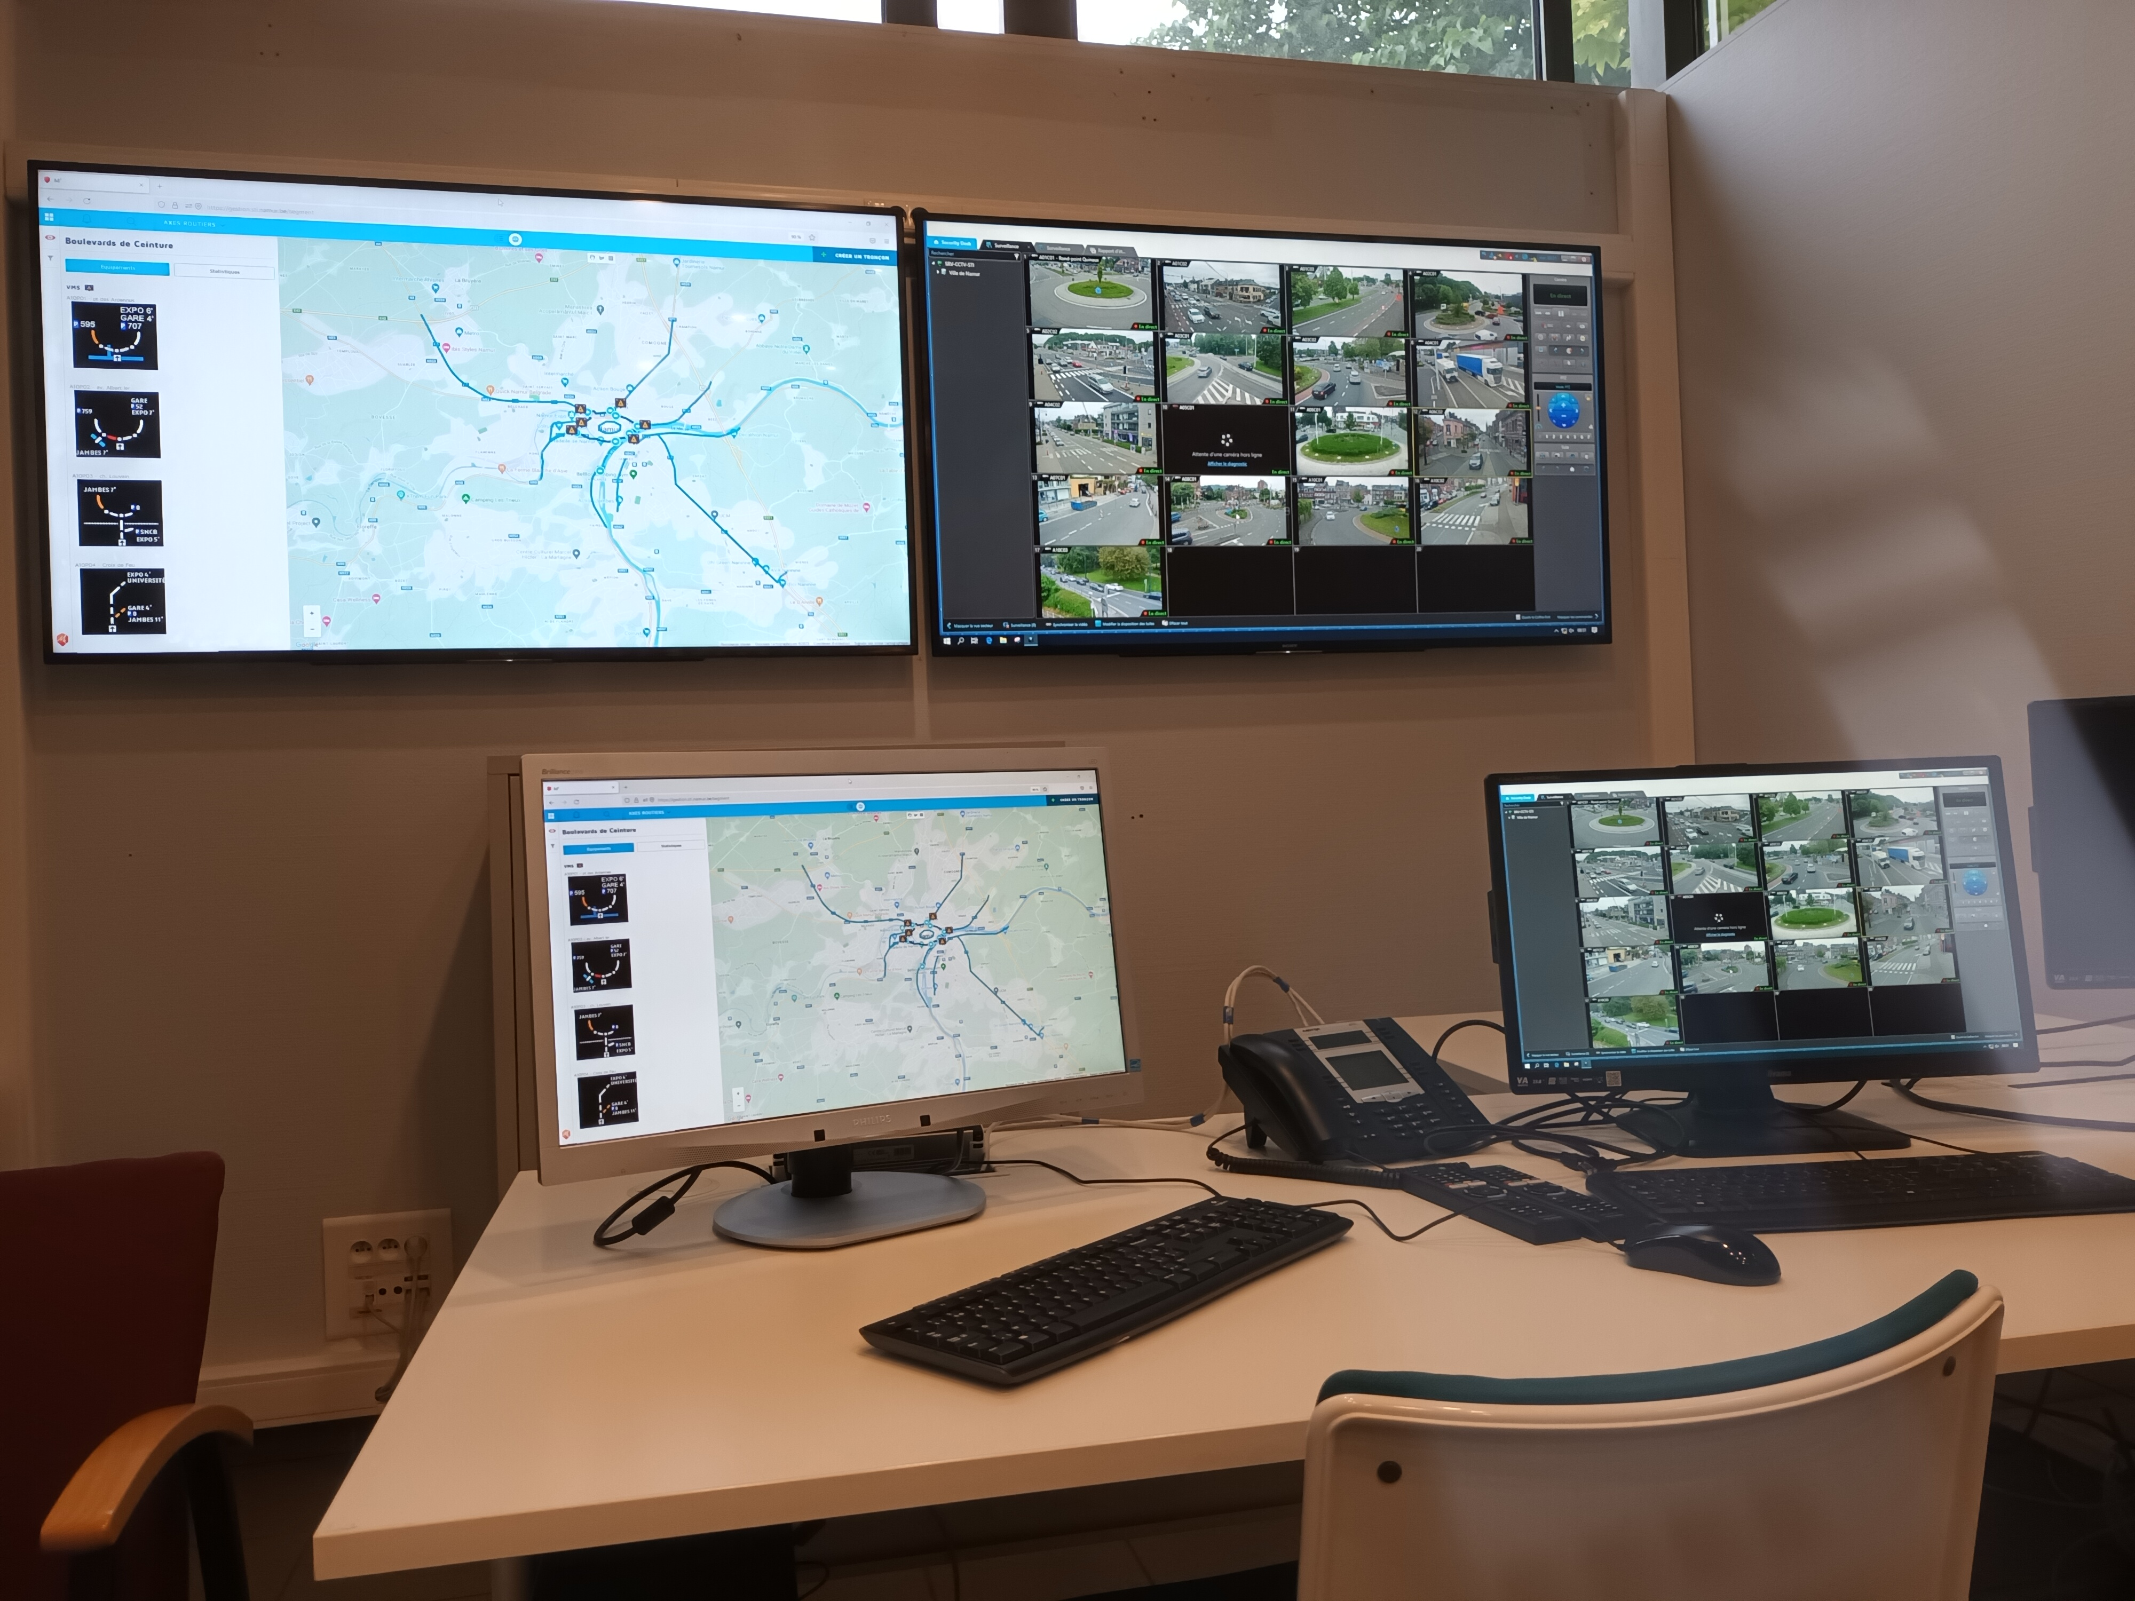
The « control room »
https://www.le-nid.be/sites/default/files/projets/20200923_exposition_sti_final.pdf
Author’s picture

Slide 7
Wiring roads, steering drivers, optimising infrastructure exploitation
The ITS as a technological tool for mobility regulation
Steering drivers: nudging and the modulation of the “choice architecture” (Thaler et Sunstein, 2008) ; environmentality (Gabrys, 2014)
Flexible daily modal shift
‘Traficolor’ system and car diversions
B. Cybernetical ambitions
traffic self-regulation through ICT: automated traffic diversion
C. Optimization as the overall goal: the functional optimisation of the governed city (Ménard, 2017)

Slide 8
Is the ITS-induced mobility regulation effective?
A huge amount of data and few indicators; public procurements
ICT maintenance: a daily duty
Human resources in a medium city: allocating operators to the system’s supervision
Waze and Google maps as alternative mobility regulators
Structural frictions:
The architecture of the road network (no ring road)
The ITS against the preeminence of infrastructure (pedestrian crossings, crossroads)
The low congestion downtown
Covid-19 and mobility transformations
Evaluation

Slide 9
Going beyond the control lens
The ITS regulation seems rather ineffective empirically
Heuristic question: what is successful in this ITS project?
Namur smart city program
Namur’s identity building
A vision of a local knowledge economy; The ITS as an attractive sign for the creative class (Florida, 2004)
Empirically, the ITS serves both the city’s communication and the regulation of mobility

Slide 10

"Namur positions itself as a smart city by considering its service offerings, mobility, heritage, culture and tourism, waste management, and more. It shapes its projects based on its rich history, central geographical location, status as a regional capital, and identity as an innovative university city."
Building Namur’ status in a competitive Europe
Reference: source : Namur capitale (ND). Namur Ville intelligente. https://www.namur.be/fr/ma-ville/ville-intelligente/namur-ville-intelligente (consulté le 30 octobre 2023).
N.B. : FEDER = ERDF

Slide 11
Conclusion
Flagship projects as infrastructure control centers AND symbols of « smart city ambitions » (Caprotti 2019)
There is a need for more empirical research on local smart programs and projects
Empirical research could account for the multiple goals of smart projects
Studying the coproduction of smart systems and municipal identities makes the analysis richer and more accurate

Slide 12
References
Andrejevic, M. (2019). Automated media. Routledge.
Caprotti, F. (2019). Spaces of visibility in the smart city: Flagship urban spaces and the smart urban imaginary. Urban Studies, 56(12), 2465-2479.
Coletta, C., Heaphy, L., & Kitchin, R. (2019). From the accidental to articulated smart city: The creation and work of ‘Smart Dublin’. European urban and regional studies, 26(4), 349-364.
Douay, N. (2018). La «Smart City» comme nouvelle narration des politiques urbaines hongkongaises: le cas du projet urbain de «Kowloon East». Flux, (4), 22-37.
Dowling, R., McGuirk, P., Maalsen, S., & Sadowski, J. (2021). How smart cities are made: A priori, ad hoc and post hoc drivers of smart city implementation in Sydney, Australia. Urban Studies, 58(16), 3299-3315.
Florida, R. L. (2004). The rise of the creative class : and how it’s transforming work, leisure, community and everyday life. Basic Books.
Gabrys, J. (2014). Programming environments: Environmentality and citizen sensing in the smart city. Environment and planning D: Society and space, 32(1), 30-48.
Hollands, R. G. (2008). Will the real smart city please stand up?: Intelligent, progressive or entrepreneurial? City (London, England), 12(3), 303–320.
Klauser, F., Paasche, T., & Söderström, O. (2014). Michel Foucault and the smart city: Power dynamics inherent in contemporary governing through code. Environment and Planning D: Society and Space, 32(5), 869-885.
Ménard, F. (2017). Penser la ville intelligente. Urbanisme, (407), 32-36.
Sadowski, J., & Bendor, R. (2019). Selling smartness: Corporate narratives and the smart city as a sociotechnical imaginary. Science, Technology, & Human Values, 44(3), 540-563.
Söderström, O., Paasche, T., & Klauser, F. (2020). Smart cities as corporate storytelling. In The Routledge companion to smart cities (pp. 283-300). Routledge.
Thaler, R. H., & Sunstein, C. R. (2009). Nudge: Improving decisions about health, wealth, and happiness. Penguin.
Vanolo, A. (2014). Smartmentality: The smart city as disciplinary strategy. Urban studies, 51(5), 883-898.
Vincent, M. (2020). Faire la smart city dans une ville moyenne française: De la numérisation des services publics à l’attractivité territoriale, les trajectoires entrepreneuriales de Béthune et Nevers. Sciences Po cities and digital technology chair Working Paper.
Zaza, O. (2019). La fabrique publique de la smart city parisienne, Science Po cities and digital technology chair working papers.

