Slide 1

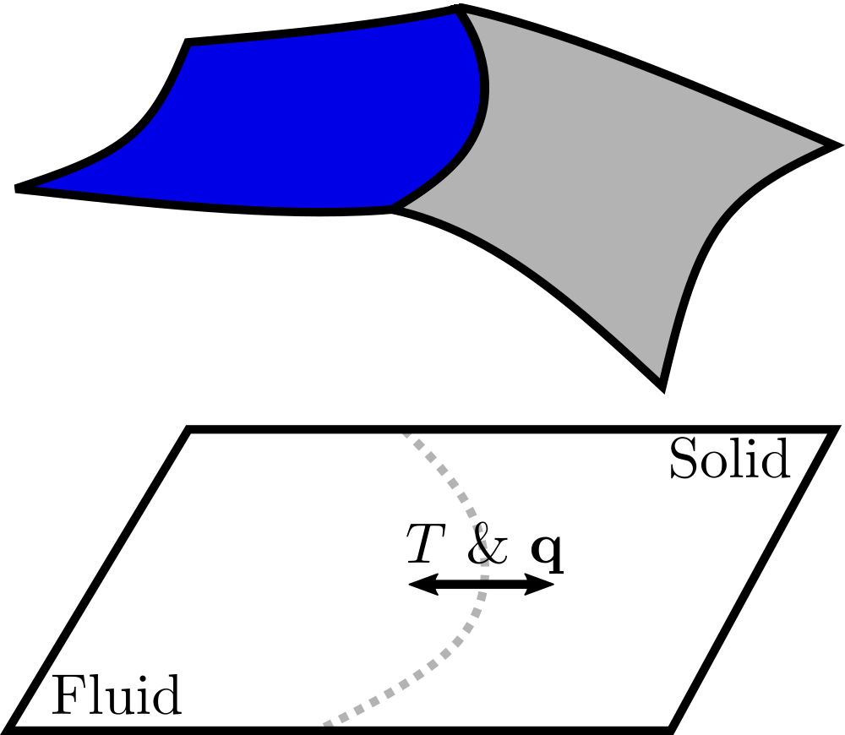
A Cartesian extended discontinuous Galerkin solver
for conjugate heat transfer
Nayan Levaux, A. Bilocq, P. Schrooyen, V. Terrapon, K. Hillewaert

Slide 2

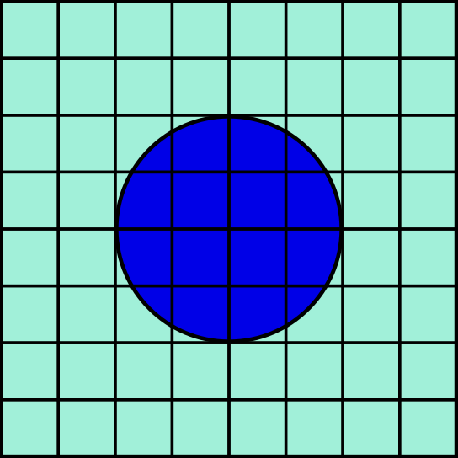
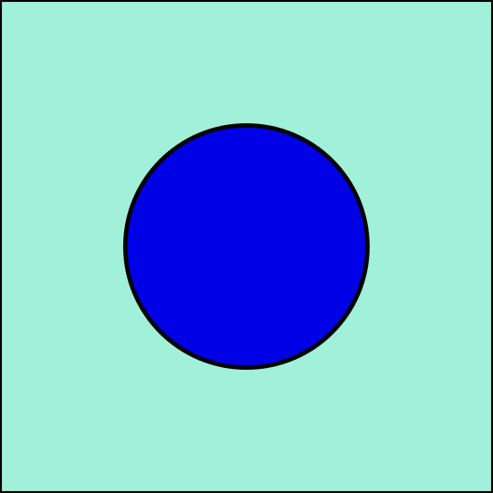
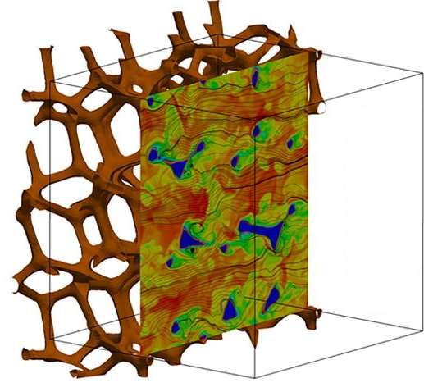

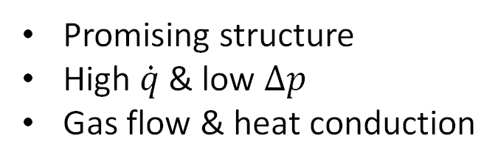

Motivation
Conjugate heat transfer
Open-cell solid foam
Cut-cell
Fluid
Solid
[Das, 2018]
Immersed approach
Temperature
Challenges
Complex geometry
Complex flow patterns
Coupled physics
Promising structure
High $\dot{q}$ & low $∆p$
Gas flow & heat conduction
Simple mesh generation
Numerical errors at interface
Multiphysics coupling
Notes:
CHT: Conduction & convection between a solid and a surrounding fluid

Slide 3
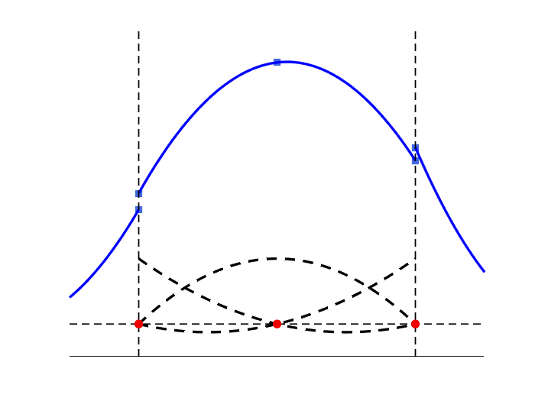
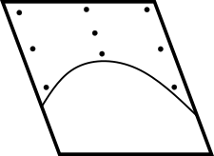

Methodology
How to tackle lack of accuracy and Multiphysics coupling?
High-order DG
on cartesian grid
High-order
cut-cells
Bi-directional
Strong coupling

Slide 4
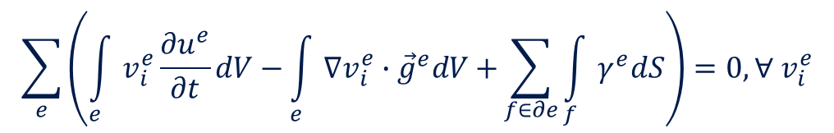




Cartesian discontinuous Galerkin
$$\sum_{e}{\left(\int_{e}{v_{i}^{e}\frac{∂u^{e}}{∂t}dV}−\int_{e}{∇v_{i}^{e}∙{\vec{g}}^{e}dV+}\sum_{f∈∂e}{\int_{f}{γ^{e}dS}}\right)}=0, ∀ v_{i}^{e}$$
Discontinuities
$$v_{1}^{e}$$
$$v_{2}^{e}$$
$$v_{3}^{e}$$
1
Classical FEM
0
$$u^{e}\left(x\right)=\sum_{i=0}^{p}{u_{i}^{e}v_{i}^{e}(x)}$$
Continuous within volume
Doubling of DOF at interface
Locality

Slide 5
Cartesian discontinuous Galerkin
$$\sum_{e}{\left(\int_{e}{v_{i}^{e}\frac{∂u^{e}}{∂t}dV}−\int_{e}{∇v_{i}^{e}∙{\vec{g}}^{e}dV+}\sum_{f∈∂e}{\int_{f}{γ^{e}dS}}\right)}=0, ∀ v_{i}^{e}$$
Discontinuities
$$v_{1}^{e}$$
$$v_{2}^{e}$$
$$v_{3}^{e}$$
1
Appropriate numerical flux
0
Weakly impose BCs & solution continuity
Impose flux continuity
$$u^{e}\left(x\right)=\sum_{i=0}^{p}{u_{i}^{e}v_{i}^{e}(x)}$$
Cartesian mesh
Vectorization of operation
Continuous within volume
Doubling of DOF at interface
Locality
adapted data-structures
grouping elements with same operations
matrix-matrix multiplications

Slide 6
Methodology
How to tackle lack of accuracy and Multiphysics coupling?
Solid
High-order DG
on cartesian grid
High-order
cut-cells
Bi-directional
Strong coupling

Slide 7
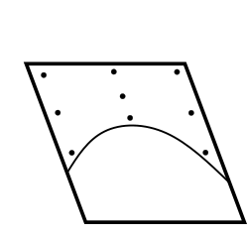
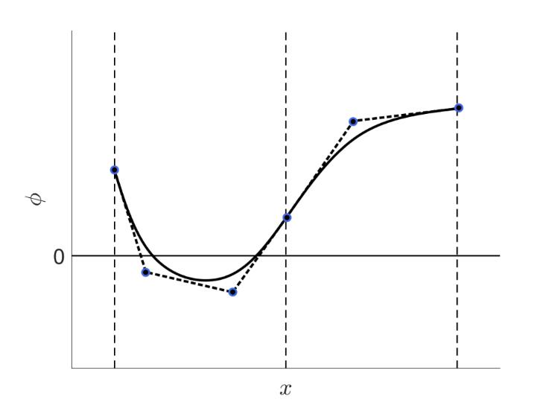
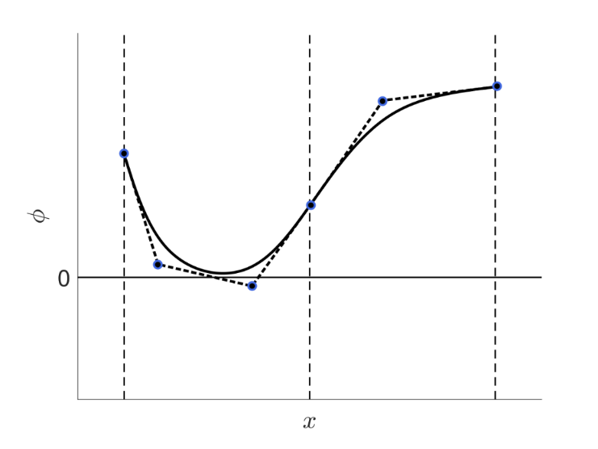
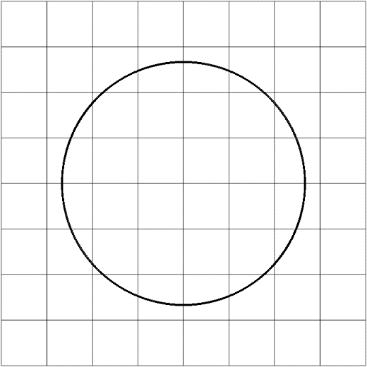
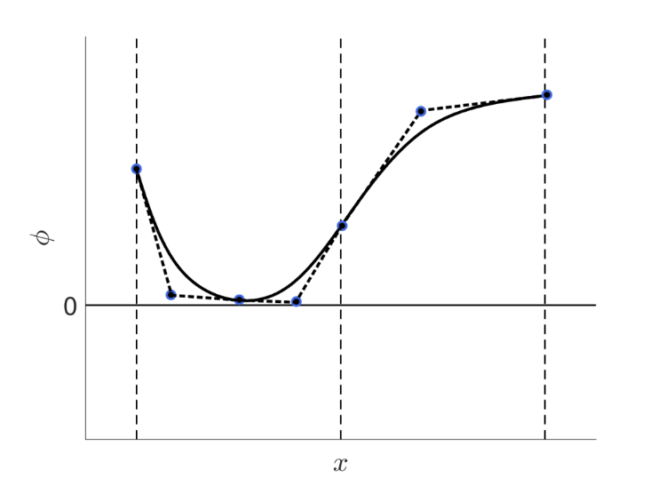

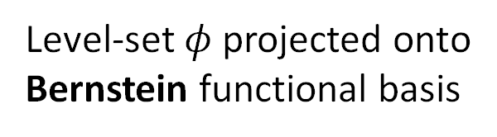


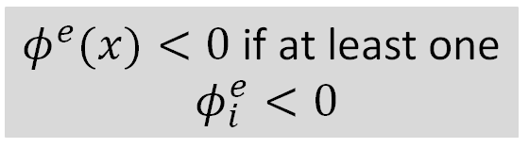

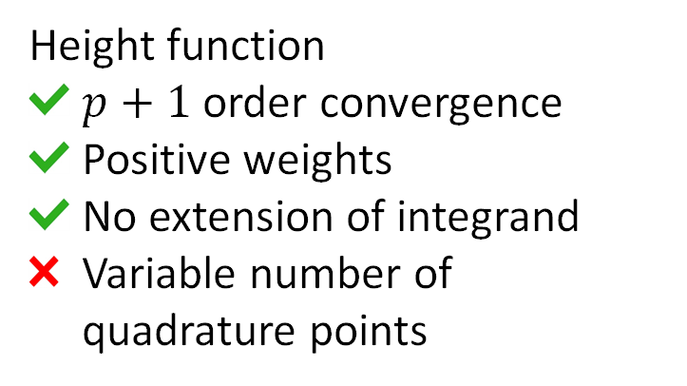

High-order cut-cells
Geometry description
Detection of cut-cells
Integration on cut-cell
$$φ>0$$
$$φ<0$$
$$φ>0$$
[Johnen, 2012]
[Saye, 2014 & 2022]
Level-set $φ$projected onto
Bernstein functional basis
$φ^{e}(x)<0$ if at least one
$φ_{i}^{e}<0$
Height function
$p+1$ order convergence
Positive weights
No extension of integrand
Variable number of quadrature points
False-positive
False-positive
Refinement

Slide 8
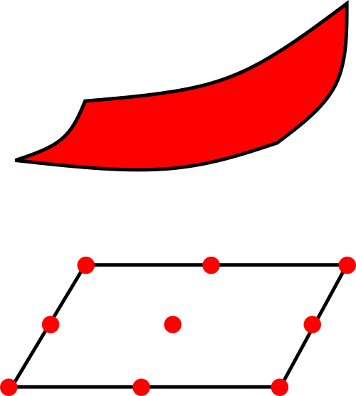
High-order cut-cells
Immersed boundary
Like classical DG, but with specific quadrature rule
set of DOF on whole element

Slide 9
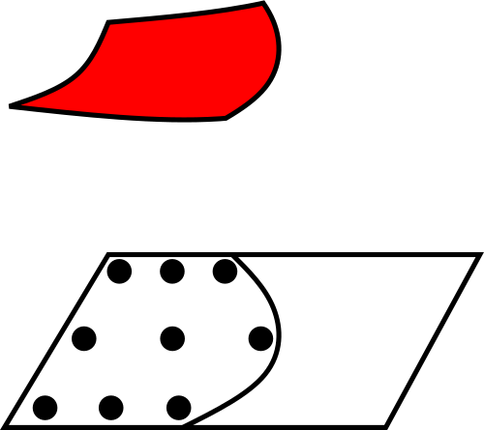
High-order cut-cells
Immersed boundary
Like classical DG, but with specific quadrature rule
set of DOF on whole element
Collocation with special quadrature
Flux computation
Redistribution

Slide 10
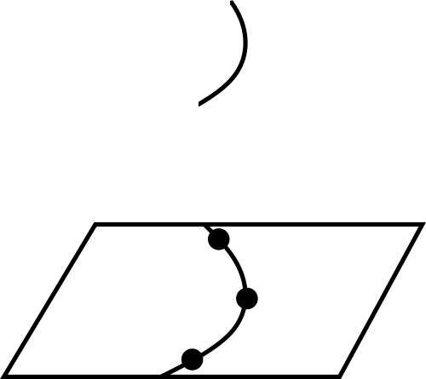
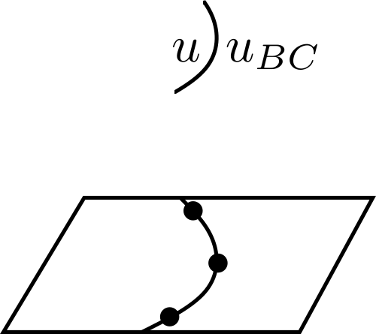
High-order cut-cells
Immersed boundary
Like classical DG, but with specific quadrature rule
set of DOF on whole element
Collocation with special quadrature
Flux computation
Redistribution
Curved face: prescribe boundary conditions
What if Multiphysics?

Slide 11
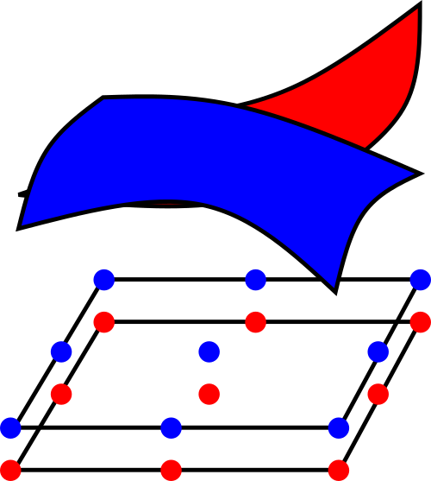
High-order cut-cells
Immersed boundary
Like classical DG, but with specific quadrature rule
set of DOF on whole element
Collocation with special quadrature
Flux computation
Redistribution
Curved face: prescribe boundary conditions
What if Multiphysics?
Immersed interfaces
Double set of DOF on cut-cells
Curved interface: prescribe boundary conditions

Slide 12
Methodology
How to tackle lack of accuracy and Multiphysics coupling?
Solid
High-order DG
on cartesian grid
High-order
cut-cells
Bi-directional
Strong coupling

Slide 13





Coupling strategies for CHT
Standard thermal coupling
DG allows weak imposition of both Dirichlet & Neumann conditions
Standard thermal coupling
Choice based on Biot number for stability reason
Fluid solver
Fluid solver
Fluid solver
$$q$$
$$T$$
$$T$$
$$q$$
$$T \& q$$
Solid solver
Solid solver
Solid solver
[Thomas, 2020]
Flux forward,
temperature back
Temperature forward,
flux back
Bidirectional
strong coupling
Better robustness

Slide 14
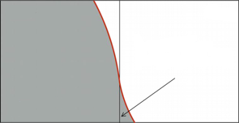
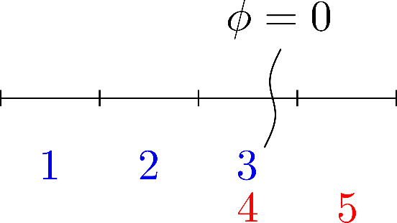




Challenges: conditioning
Cell-agglomeration
Jacobian of residual
[Müller, 2017]
Ill-conditioned small cut-cell
tgt
src
Solid
-1
1
1.1
$$v^{merged}= v^{tgt}+v^{extended}$$
$$J=$$
$$v^{src}Q$$
Solution on small cut-cell expressed by one of larger cell
Still, problem quite stiff!

Slide 15
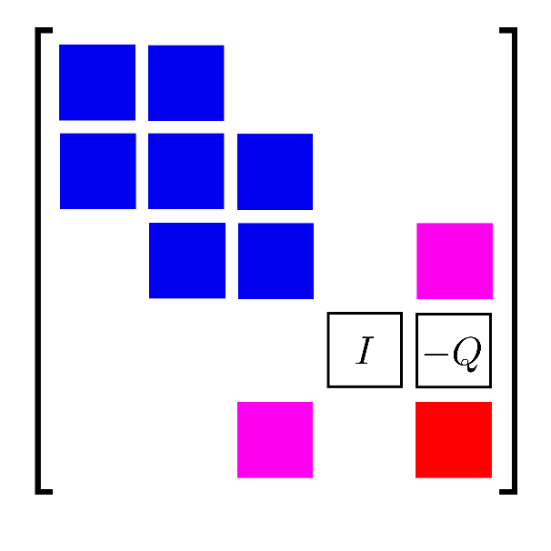
Challenges: conditioning
Cell-agglomeration
Jacobian of residual
[Müller, 2017]
Ill-conditioned small cut-cell
tgt
src
Solid
-1
1
1.1
$$v^{merged}= v^{tgt}+v^{extended}$$
$$J=$$
$$v^{src}Q$$
Solution on small cut-cell expressed by one of larger cell
Still, problem quite stiff!

Slide 16

Challenges: conditioning
Cell-agglomeration
Jacobian of residual
[Müller, 2017]
Ill-conditioned small cut-cell
tgt
src
Solid
-1
1
1.1
$$v^{merged}= v^{tgt}+v^{extended}$$
$$J=$$
$$v^{src}Q$$
Solution on small cut-cell expressed by one of larger cell
Still, problem quite stiff!
In single/double precision
Direct solver (GMRES does not converge)

Slide 17
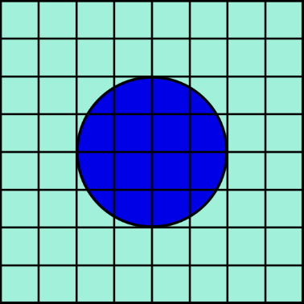
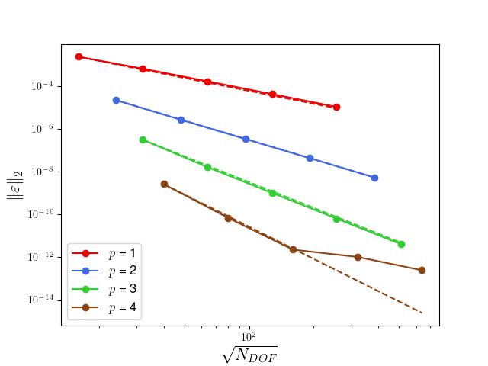
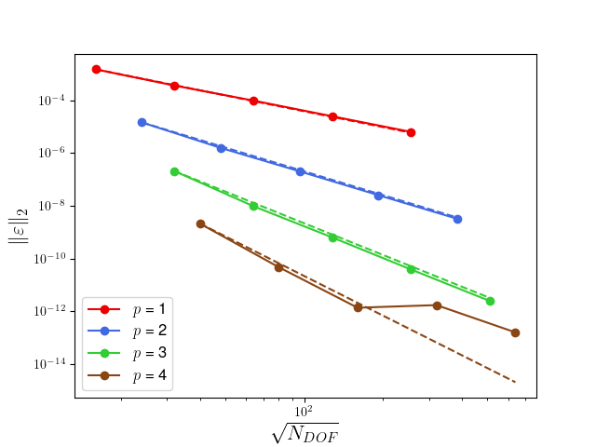
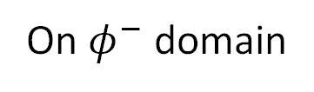
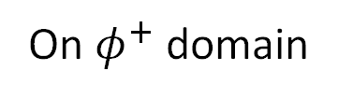
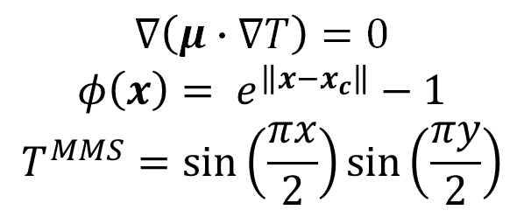


Verification on Manufactured solution
$$∇\left(μ∙∇T\right)=0$$
$$φ\left(x\right)= e^{\left\|x−x_{c}\right\|}−1$$
$$T^{MMS}=\sin\left(\frac{πx}{2}\right)\sin\left(\frac{πy}{2}\right)$$
Incomplete interior penalty method
Penalty factor on cut-cell with Owens et al.
Exchange temperature and heat flux at interface
Damped inexact Newton method
$$φ^{−}$$
$$φ^{+}$$
On $φ^{+}$ domain
On $φ^{−}$ domain
Solid

Slide 18
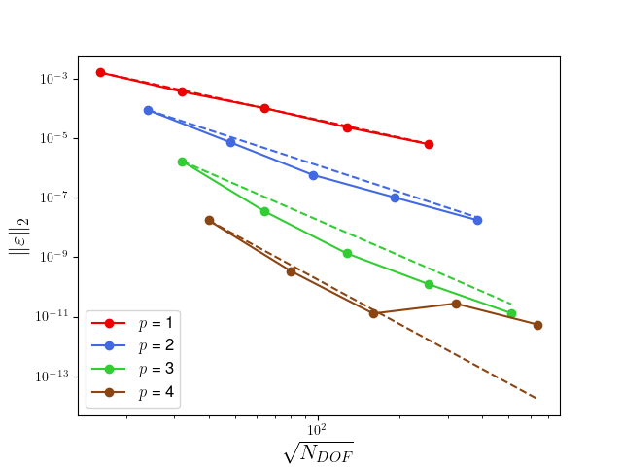
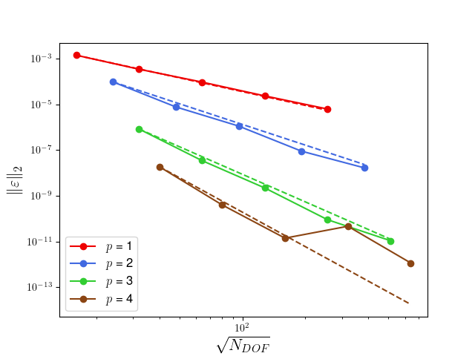
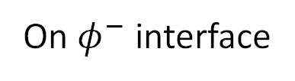
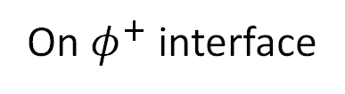
Verification on Manufactured solution
$$∇\left(μ∙∇T\right)=0$$
$$φ\left(x\right)= e^{\left\|x−x_{c}\right\|}−1$$
$$T^{MMS}=\sin\left(\frac{πx}{2}\right)\sin\left(\frac{πy}{2}\right)$$
Incomplete interior penalty method
Penalty factor on cut-cell with Owens et al.
Exchange temperature and heat flux at interface
Damped inexact Newton method
$$φ^{−}$$
$$φ^{+}$$
On $φ^{+}$ interface
On $φ^{−}$ interface
Solid

Slide 19

Conclusion & perspectives
Bi-directional strong coupling conditions
for conjugate heat transfer in an extended DG solver
C++, object-oriented programming, collaborative code
(software forge spirit)
ForDGe
What’s next
CHT testcases
Parallisation with MPI
AMR
Pre-conditioning for using GMRES
What’s next
CHT testcases
Parallisation with MPI
AMR
Pre-conditioning for using GMRES
Other Multiphysics applications
Open-cell solid foam
Notes:
Video of Amaury?

Slide 20
A Cartesian extended discontinuous Galerkin solver
for conjugate heat transfer
Nayan Levaux, A. Bilocq, P. Schrooyen, V. Terrapon, K. Hillewaert

Slide 21
References
[Das, 2018] Das, S., Panda, A., Deen, N. G., & Kuipers, J. A. M. (2018). A sharp-interface immersed boundary method to simulate convective and conjugate heat transfer through highly complex periodic porous structures. Chem. Eng. Sci., 191, 1-18.
[Johnen, 2012] Johnen, A., Remacle, J. F., & Geuzaine, C. (2014). Geometrical validity of high-order triangular finite elements. Eng. Comput., 30, 375-382.
[Saye, 2015] Saye, R. I. (2015). High-Order Quadrature Methods for Implicitly Defined Surfaces and Volumes
in Hyperrectangles. SIAM J. Sci. Comput. 37, A993-A1019.
[Saye, 2022] Saye, R. I. (2022). High-order quadrature on multi-component domains implicitly defined by multivariate polynomials. J. Comput. Phys. 448, 110720.
[Thomas, 2020] Thomas D., Efficient and flexible implementation of an interfacing tool for numerical simulations of fluid-structure interaction problems, PhD thesis, Université de Liège, Liège, Belgium.
[Müller, 2017] Müller, B., Krämer-Eis, S., Kummer, F., & Oberlack, M. (2017). A high-order discontinuous Galerkin method for compressible flows with immersed boundaries, Int. J. Numer. Meth. Engng, 110,3-30.
Notes:
Should I put an image of CHT?

