Slide 1
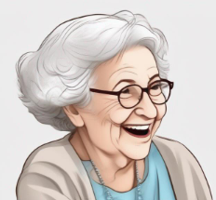
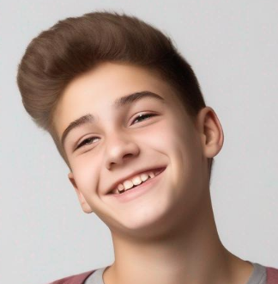
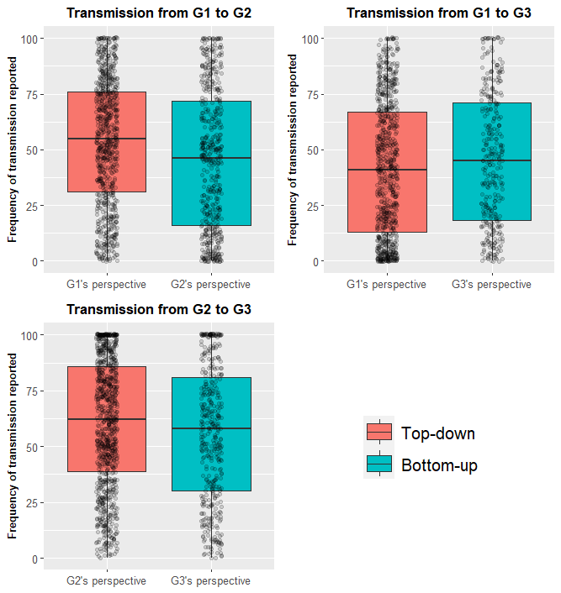
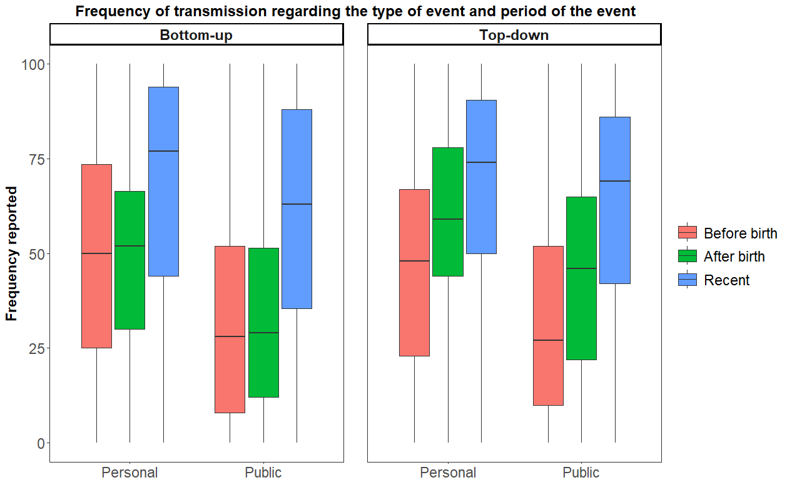
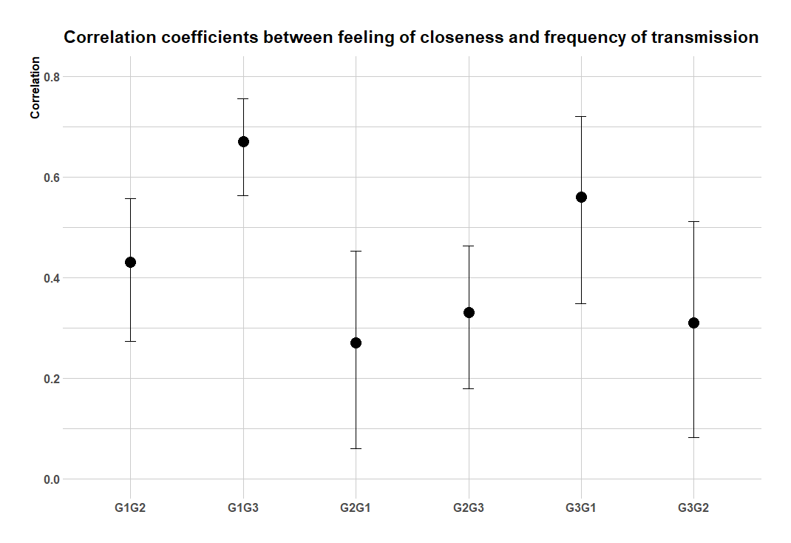
"How frequently does your grand-mother talk about her life?": Intergenerational transmission of memories in the family
David Baudet^{1,2,3}, Aline Cordonnier ⁴, Olivier Luminet ^{3,4} & Christine Bastin^{1,2,3}
¹ GIGA-CRC-IVI, University of Liège, Belgium. ² Psychology and Cognitive Neuroscience, University of Liège, Belgium. ³ FNRS - Fonds National de la Recherche Scientifique, Belgium. ⁴ Research Institute for Psychological Sciences, University of Louvain (UCLouvain), Louvain-la-Neuve, Belgium
Within family, intergenerational transmission…
- occurs spontaneously (Bohanek et al., 2009 ; Fivush & Merrill, 2016)
- helps the development of autobiographical memory (Reese, 2002)
is a way to validate each other’s feelings and make sense of the world (Cordonnier et al., 2022; Fivush et al., 2011)
Do people perceive discussing frequently about the past with their family members ?
Introduction
Top-down perception of transmission
Method
TRANSMISSION
TRANSMISSION
G1 (n = 129)
G2 (n = 153)
G3 (n = 69)
Bottom-up perception of transmission
p ≤ 0.01
**
Results
Grandparents report transmitting more frequently to their grandchildren than grandchildren report receiving from their grandparents.
Transmission perceived as more frequent for personal events, and for recent events.
Transmitters perceive sharing more frequently events shared with receiver.
Grandchildren report hearing more frequently older stories (before they were born) of their grandparents.
Frequency of transmission is correlated to feeling of closeness, particularly between grandparents and grandchildren !
Overall, intergenerational transmission is perceived as frequent, but large interindividual variability.
Different perceptions between generations. Different functions? (Socioemotional Selectivity regulation Theory; Carstensen, 2006)
Mostly, recent and personal events : create discussions ? (Bluck et al., 2005)
Correlation between feeling of closeness and transmission : transmission might play a different role between grandparents and grandchildren.
Conclusion
Bluck, S., Alea, N., Habermas, T., & Rubin, D. C. (2005). A tale of three functions: The self-reported uses of autobiographical memory. Social Cognition, 23(1), 91–117. https://doi.org/10.1521/SOCO.23.1.91.59198
Bohanek, J. G., Fivush, R., Zaman, W., Lepore, C. E., Merchant, S., & Duke, M. P. (2009). Narrative Interaction in Family Dinnertime Conversations. Merrill-Palmer Quarterly (Wayne State University. Press), 55(4), 488. https://doi.org/10.1353/MPQ.0.0031
Carstensen, L. L. (2006). The influence of a sense of time on human development. Science, 312(5782), 1913-1915.
Cordonnier, A., Rosoux, V., Gijs, A.-S., & Luminet, O. (2022). Collective memory: An hourglass between the collective and the individual. Memory, Mind & Media, 1. https://doi.org/10.1017/mem.2022.1
Fivush, R., Habermas, T., Waters, T. E. A., & Zaman, W. (2011). The making of autobiographical memory: Intersections of culture, narratives and identity. Wiley-Blackwell, 46(5), 321–345. https://doi.org/10.1080/00207594.2011.596541
Fivush, R., & Merrill, N. (2016). An ecological systems approach to family narratives. Memory Studies, 9(3), 305–314. https://doi.org/10.1177/1750698016645264
Reese, E. (2002). Social Factors in the Development of Autobiographical Memory: The State of the Art. Social Development, 11(1), 124–142. https://doi.org/10.1111/1467-9507.00190
david.baudet@uliege.be
Notes:
Zaromb, F., Butler, A. C., Agarwal, P. K., & Roediger, H. L. (2014). Collective memories of three wars in United States history in younger and older adults. Memory & cognition, 42(3), 383-399.
Cheriet, N., Folville, A., & Bastin, C. (2021). Shared event‐memory for a public event in young and older adults. Applied Cognitive Psychology, 35(4), 1035-1043.

