Slide 1
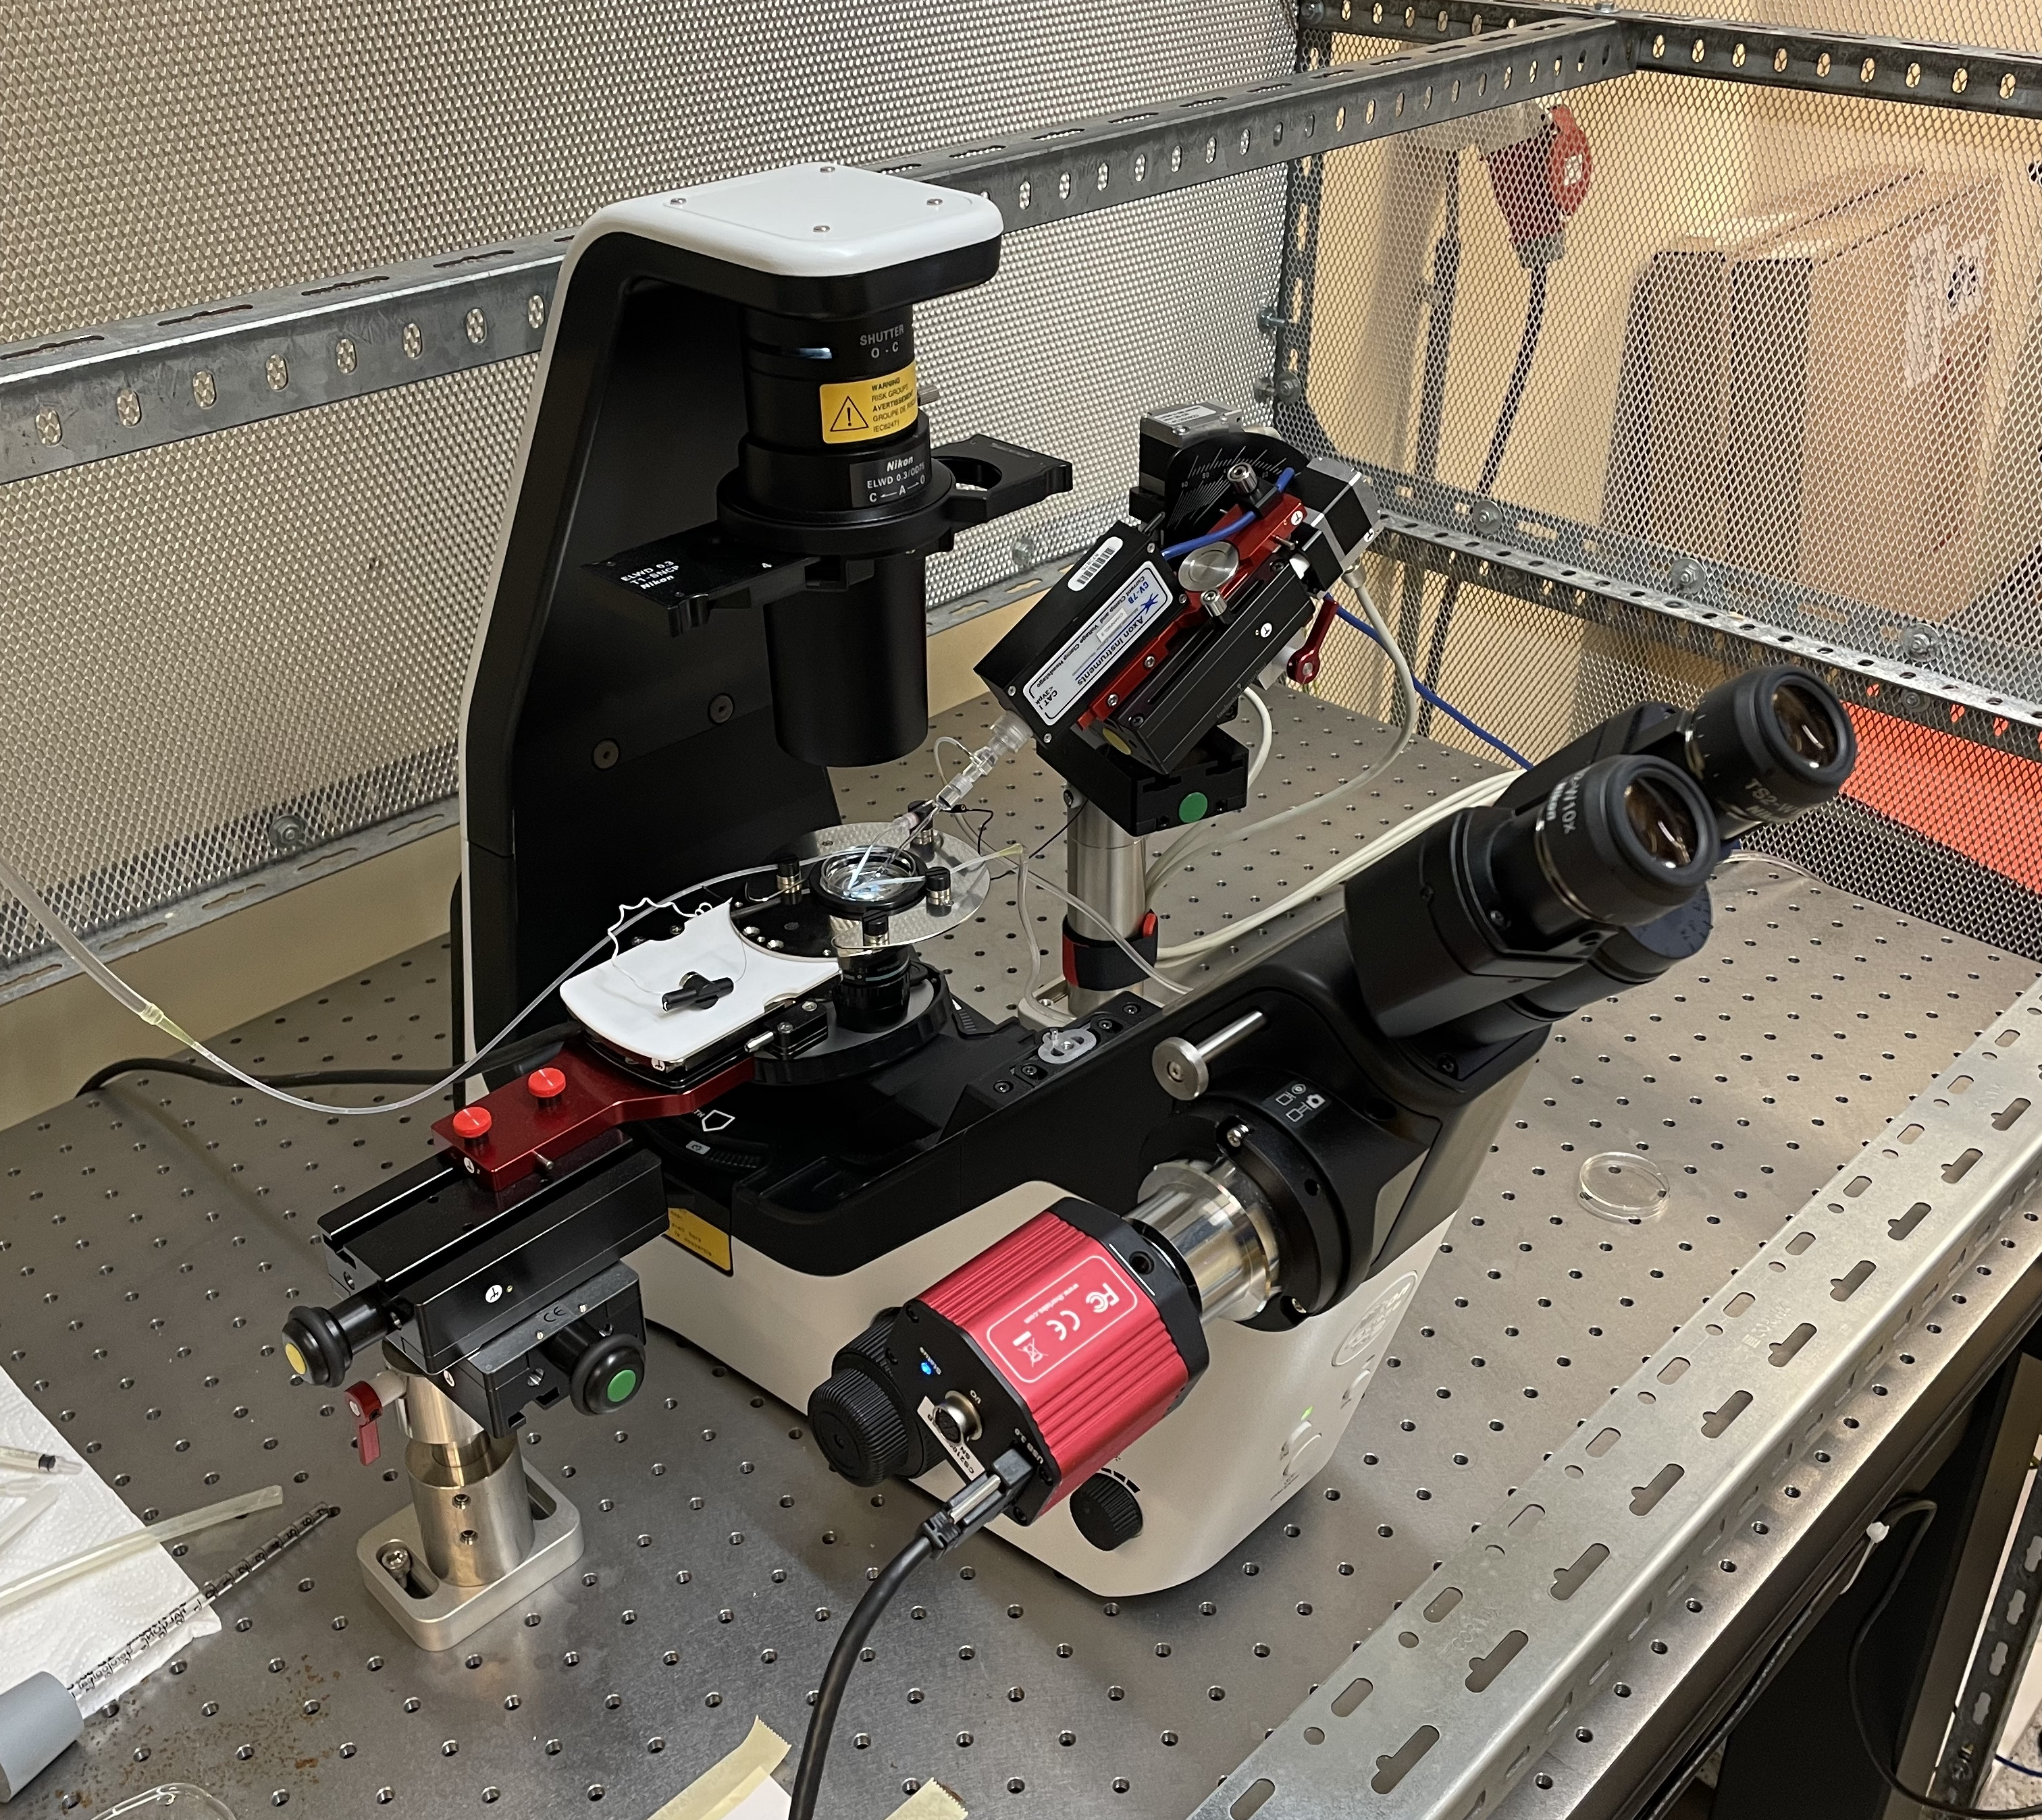
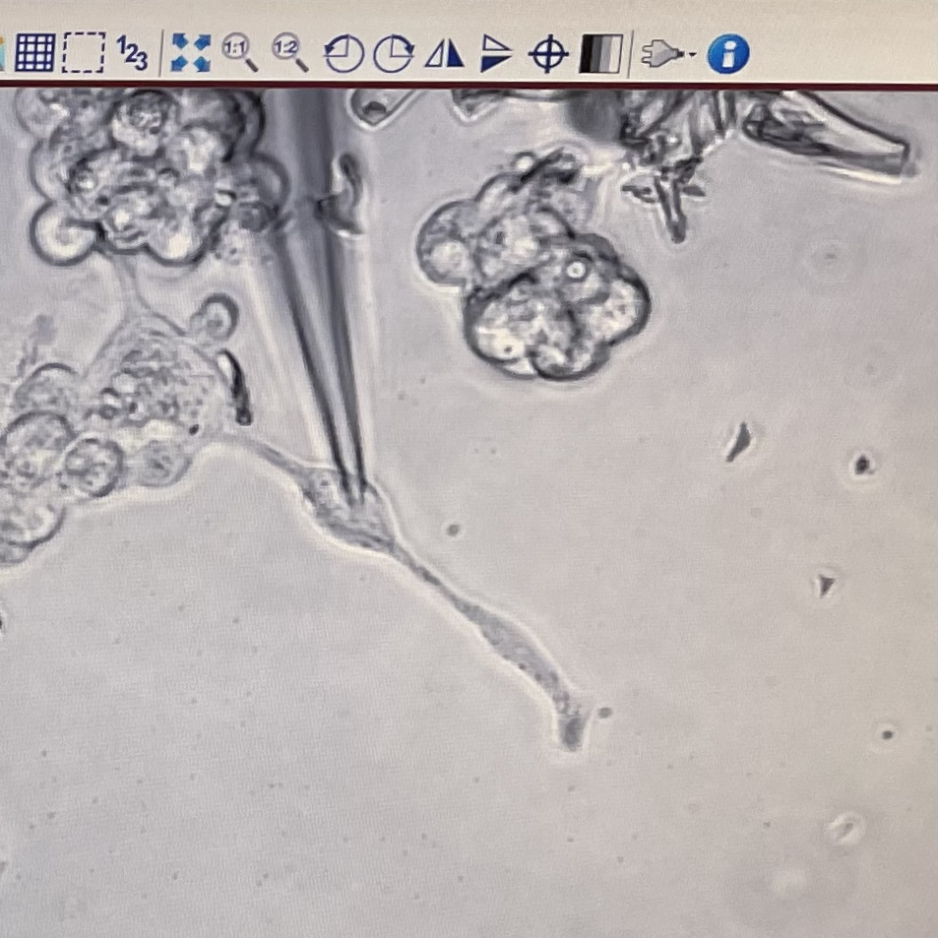
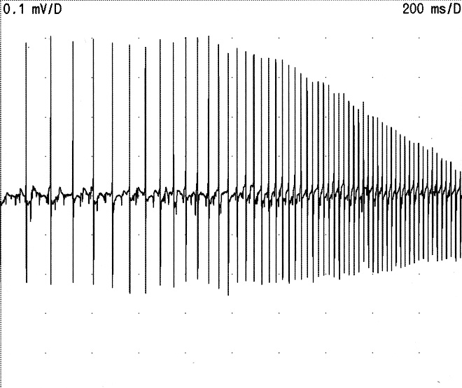
Neurophysiology of Muscle Channelopathies (from electrical myotonia to patch clamp)
Nurcan Inci François Wang

Slide 2
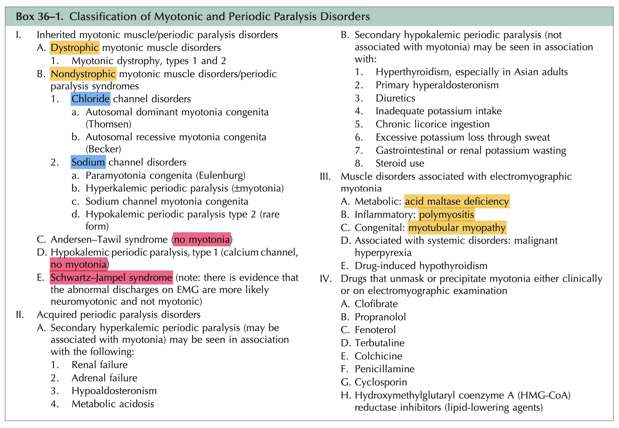

Slide 3
Nondystrophic Myotonic Muscle Disorders
Characterized by MUSCLE STIFFNESS -> muscle weakness and pain
Stiffness = delayed relaxation after muscle contraction = symptomatic translation of hyperexcitability related to dysfunction of muscle ion channels (Nav1.4, CIC-1) linked to mutations in the SCN4A & CLCN1 genes
Prolonged activation
Delayed recovery from inactivation
Leak currents

Slide 4
Mutations in the SCN4A gene
Mutations in the CLCN1 gene
Hyperkalemic periodic paralysis
Hypokalemic periodic paralysis
Paramyotonia congenita
Myotonia fluctuans
Myotonia permanens
Myotonia responsive to acetozolamide (Diamox)
Malignant hyperthermia
Congenital myasthenic syndrome
Sudden infant death (1.4%)
Myotonia congenita (Thomsen & Becker)
Myotonia levior
Paramyotonia congenita
Under the influence of other genetic or environmental factors (epigenetics), the same mutation can lead to different phenotypic presentations.

Slide 5
Treatments
Guidelines on clinical presentation and management of nondystrophic myotonias, Stunnenberg et al, 2020
Mexiletine (150 - 900 mg/d) : Mexitil® (classe IB antiarrhythmic) - EMA (European Medicines Agency) approval as orphan drug designation for NDMs - Double-blind placebo-controlled randomized trials - Increases the rapid inactivation of the Na channel - If ECG abnormal or history of arrhythmia, consult with cardiology prior to use - Side-effects : gastrointestinal discomfort, dizziness, tremor, ataxia - Monitoring : ECG, liver function tests, consider complete blood count
Lamotrigine (25 - 300 mg) : Lamotrigine® (antiepileptic with action in depressive episodes and bipolar disorders) - Double-blind placebo-controlled randomized trials - Increases the rapid inactivation of the Na channel - Side-effects : skin rash, headache, fatigue, nausea - Monitoring : liver function tests, urée/créatinine

Slide 6
Treatments
Guidelines on clinical presentation and management of nondystrophic myotonias, Stunnenberg et al, 2020
Acetazolamide (250 - 750 mg/d) : Diamox® (inhibitor of carbonic anhydrase) - Non-randomized, open-label trial - Would increase the probability of opening the CL channel - Side-effects : nephrolithiasis, paresthesias, rash, agranulocytosis, electrolyte abnormalities, gastrointestinal discomfort - Contraindicated if sulfa allergy - Monitoring: metabolic panel (Na, K, CO₂), liver function tests, complete blood count, renal ultrasound if high risk of nephrolithiasis
Ranolazine (1000 - 2000 mg/d) : Ranexa® - Non-randomized, open-label trial - Increases the rapid inactivation of the Na channel - Side-effects : constipation, dizziness, headache - Contraindicated with simvastatine > 20 mg, with dilitiazem et verapamil => limit dose to 500 mg - Monitoring: EKG, blood urea nitrogen/creatinine if renal impairment
Others : procainamide, flecainide, phenytoin, tocainide, carbamazepine etc…

Slide 7
Mechanical myotonia
The reflex contraction of the muscle after percussion is prolonged

Slide 8
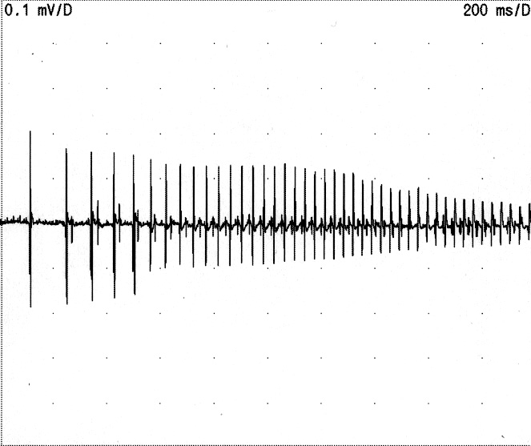
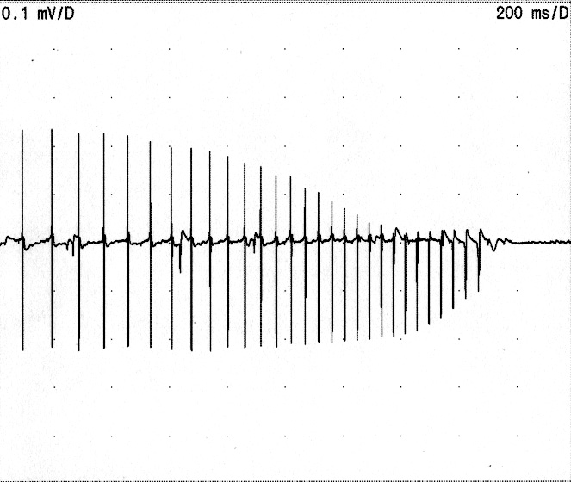
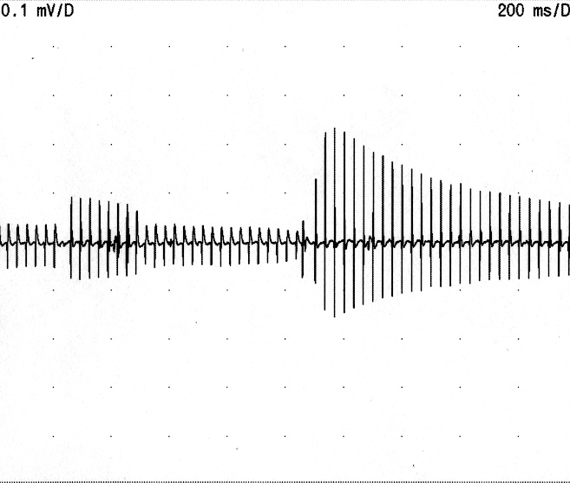
Electrical myotonia(myotonic salve)
Wax
&
Wane

Slide 9
Electrical myotonia(myotonic salve)
Muscle fiber potential discharging repetitively with an internal frequency of 20 to 100 Hz
Induced by needle movement in the muscle or muscle percussion, sometimes spontaneous, or even subintrant
Sound of a starting moped or a diving plane
Reflects muscle hyperexcitability secondary to spontaneous depolarizations and/or insufficient or too slow repolarizations
Variant of the SCN4A gene c.3917G>A : G1306E (hyperkalemic periodic paralysis)
Notes:
NM_000334.4(SCN4A):c.3917G>A (p.Gly1306Glu) G1306E

Slide 10
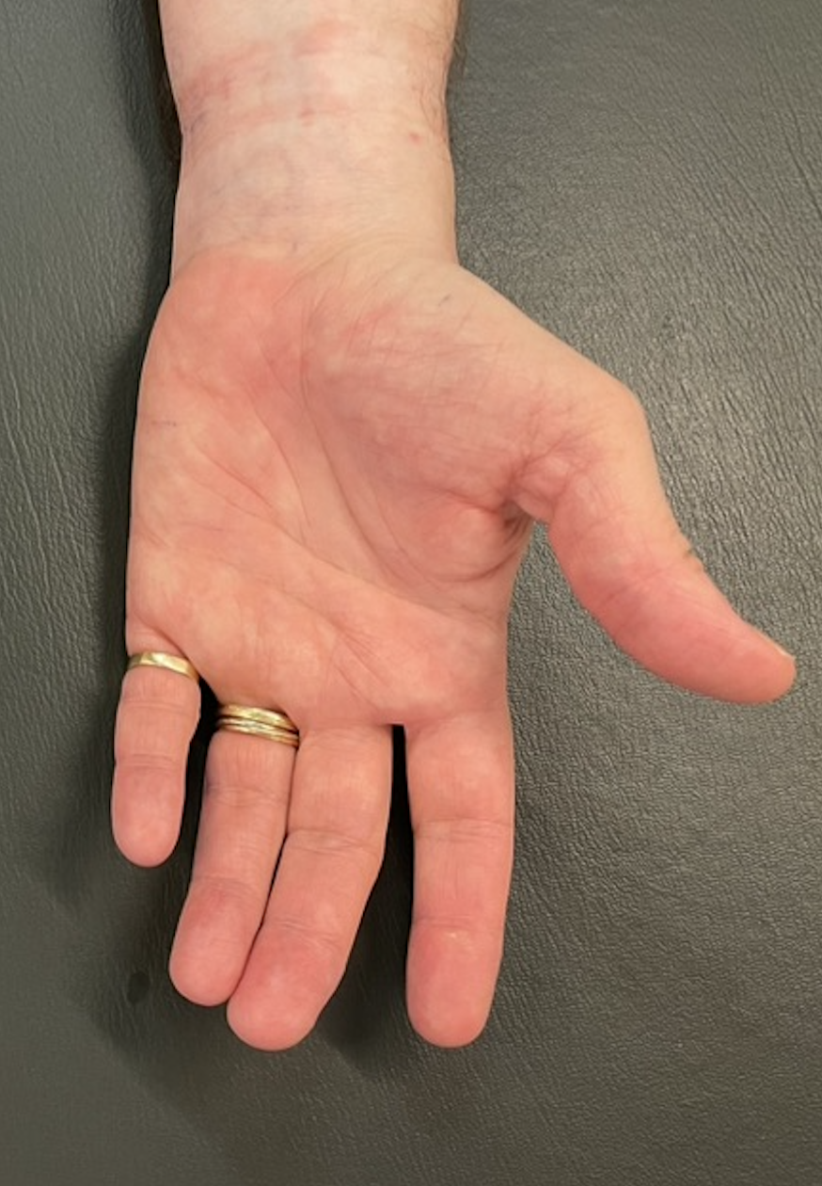
SHORT EXERCISE TESTS
E0
+
Anode
-
Cathode
CMAP measurement in baseline condition
Voluntary muscle contraction against resistance (finger spreading) for 10’’
CMAP measurement immediately after exertion, then every 10’’ for 1’
Repeat steps 2. and 3. twice
Repeat steps 1. to 4. after muscle cooling (cold pack) for 7’
E1
E2

Slide 11
LONG EXERCISE TEST
E0
+
Anode
-
Cathode
CMAP measurement in baseline condition
Voluntary muscle contraction against resistance (finger spreading) for (25’’ – 5’’ of rest) X 10
CMAP measurement immediately after exertion, then after 1’, 5’, 10’, 15’, 20’, 25’, 30’, 35’, 40’, 45’
E1
E2
Long exercise
Time (min)

Slide 12
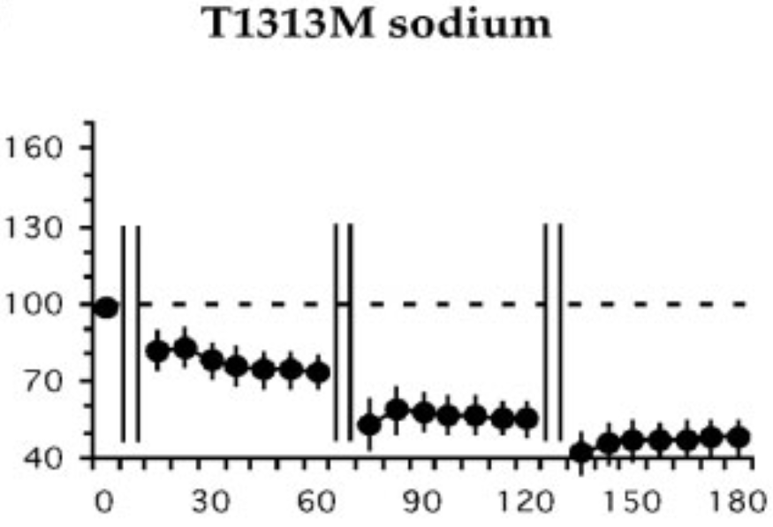
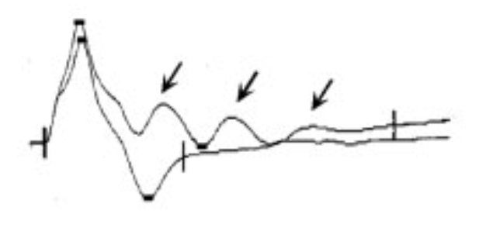
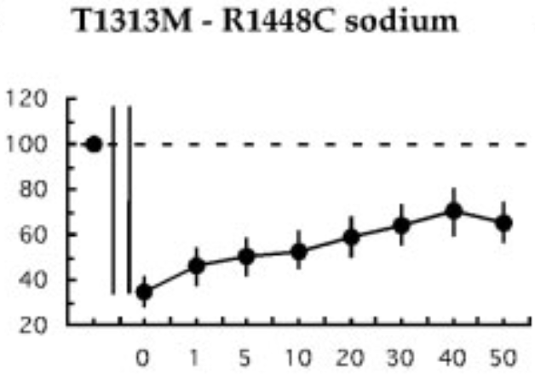
Pattern I (Fournier et al, 2004)
8 families with the pathogenic variant c.4307T>C (p.Leu1436Pro) of the SCN4A gene: L1436P
8 families in a retrospective epidemiologic study in France
(Stemberg et al., 2024)
Not yet classified as a paramyotonia congenita
Index case: 7 women/1 man
Clinical myotonia, no paralysis, muscle pain and soreness (proximally and hands), muscle stiffness (during & after physical activities, without warm up), no muscle atrophy (1 case of calf hypertrophy), muscle weakness (often moderate and related to pain -> difficulty climbing stairs), AGGRAVATED BY COLD
Clinical phenotype : Paramyotonia congenita
Sodium channel mutations (SCN4A gene) : T1313M, R1448C
Needle-EMG : abundant myotonic discharges
CMAP after short exercise: - postexercice myotonic potential - reduction in amplitude that intensifies with the repetition of the exercise
Cases | 1 | 2 | 3 | 4 | 5 | 6 | 7
Myotonic salves | +++ | +++ | +++ | +++ | +++ | +++ | +++
Myogenic traces | - | - | - | - | - | - | -
Short exercise | - | - | - | - | - | - | -
Idem after cooling | + | + | + | - | + | - | +
Long exercise | - | - | - | - | - | - | -
10 Hz decrement | - | - | - | - | - | - | -
Postexercise myotonic potential | - | - | - | - | - | - | -
CMAP after long exercise: - reduction in amplitude immediately and lately after effort
Sensitivity : 100%
Pattern I (Fournier et al, 2006)
CMAP after short exercise after 7’ muscle cooling: - exacerbation of the reduction in amplitude

Slide 13
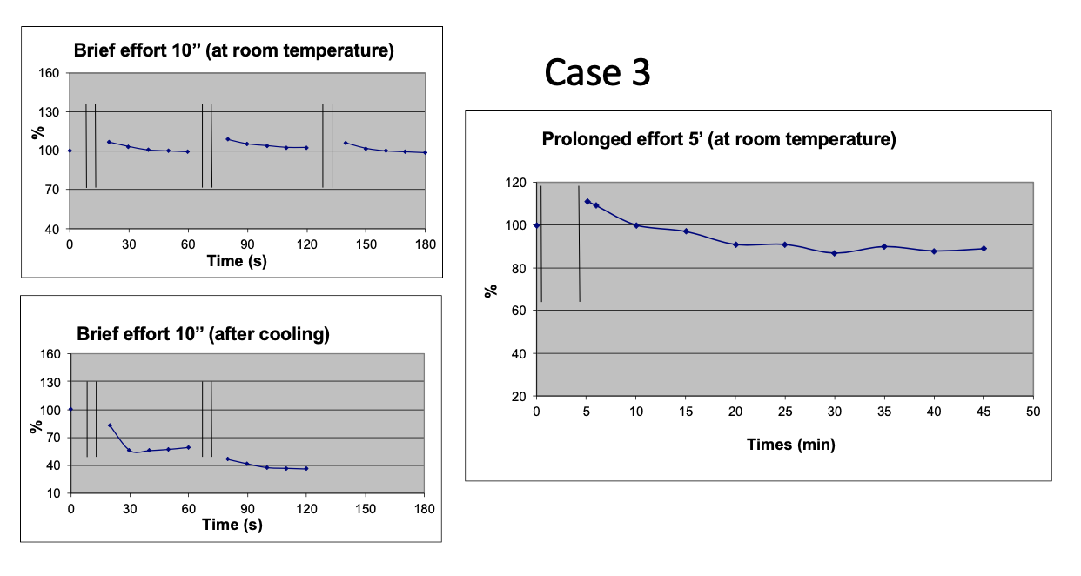
3 trials of 10 ’’ voluntary effort with 1’ of rest between efforts (during which CMAP amplitude is measured every 10 ’’)
10 X 25 ’’ voluntary effort with 5 ‘’ of rest between efforts
1
2
3
Measurements of the CMAP amplitude immediately after effort, then after 1 ’, 5 ’, 10 ’ -> 50 ’
1
2
Similary, after 7 ‘ of muscle cooling with a cold pack

Slide 14
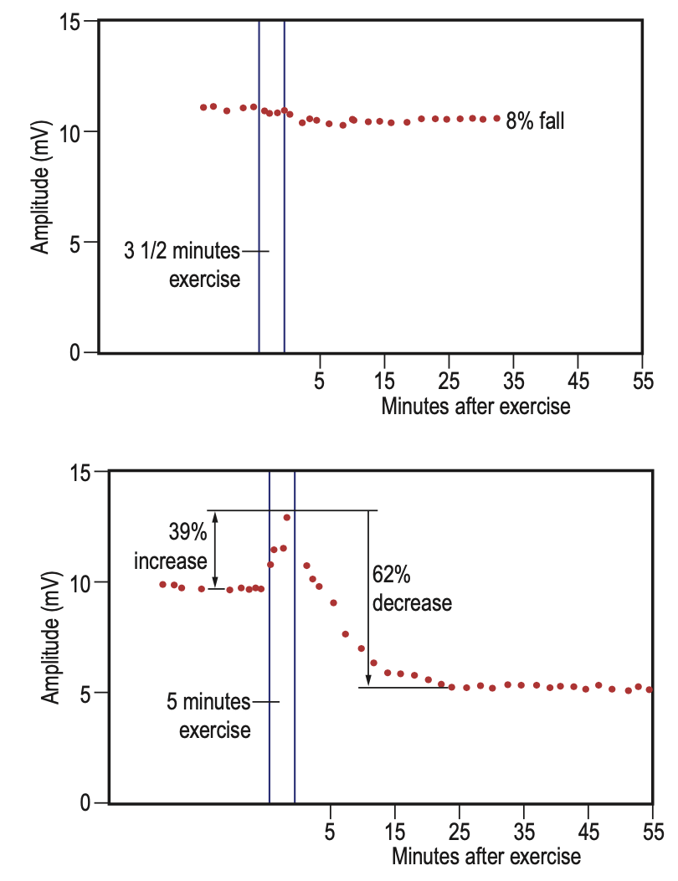
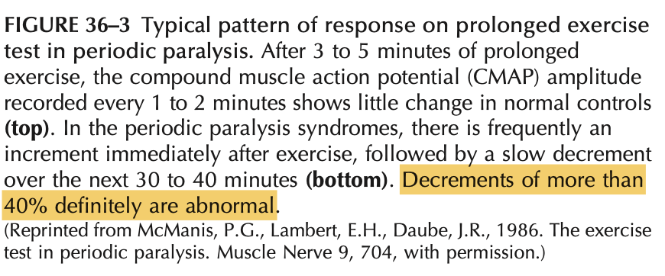
Test de McManis et al (1986)
For confirmation of PP, our data endorse the diagnostic utility of peak-to-nadir LET methodology using 40% amplitude or 50% area decrement cutoffs for PreTP ≤ 50%.

Slide 15
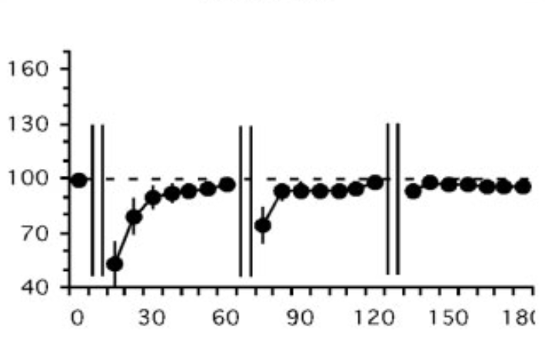
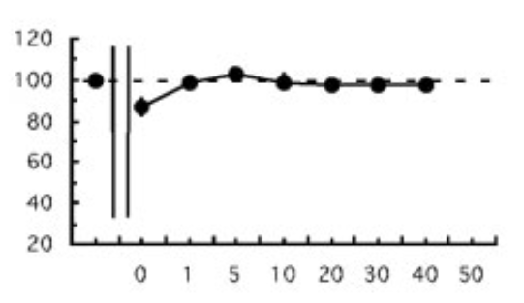
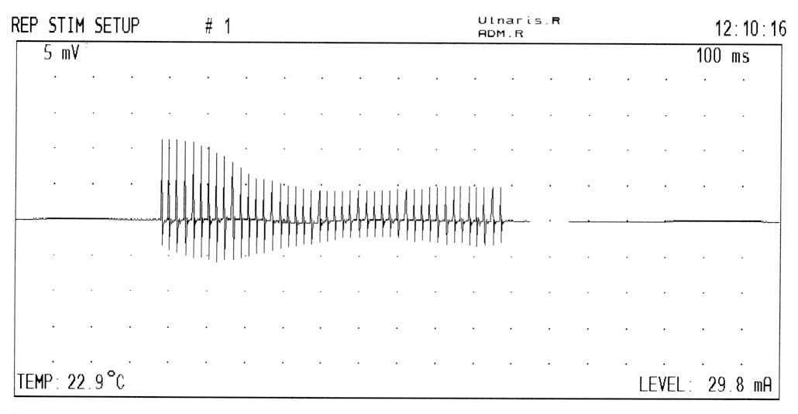
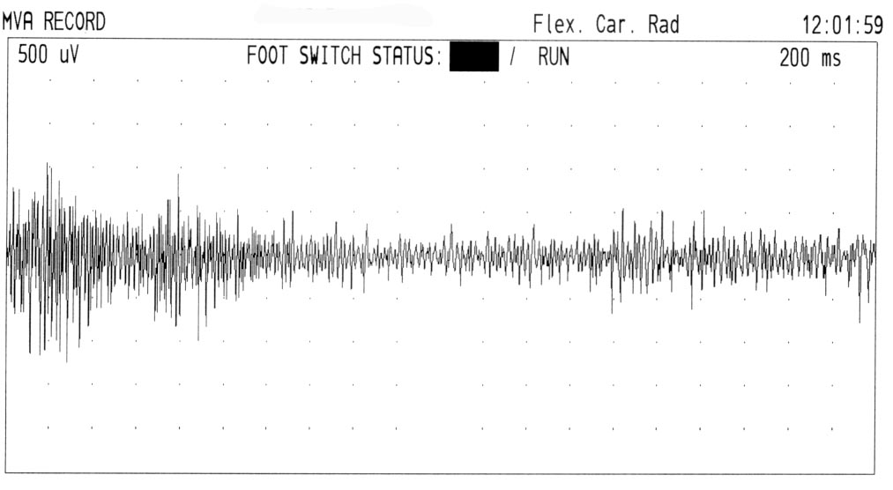
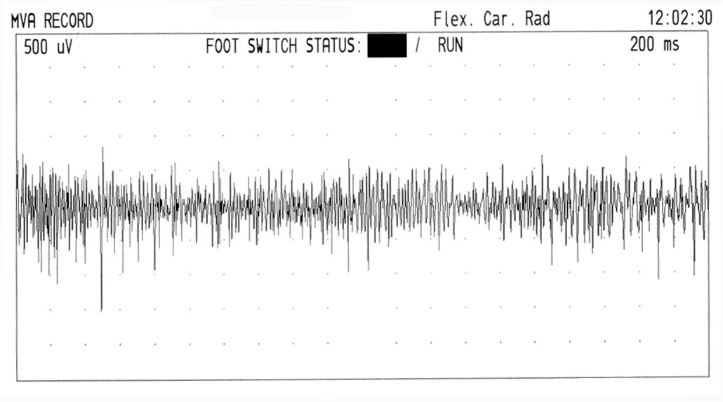
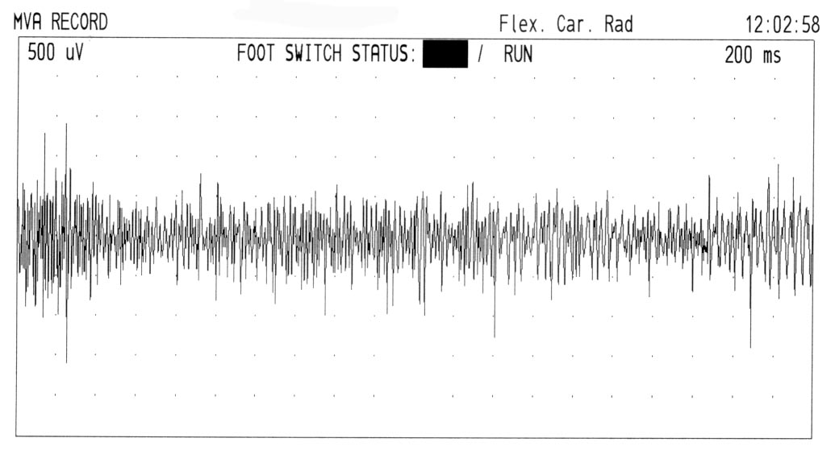
Pattern II (Fournier et al, 2004)
In 2003, diagnosis of Becker myotonia: - variant du CLCN1 gene c.1471+1G>A (splice mutation) - variant du CLCN1 gene c.209C>T : S70L
Muscle blockages at the beginning of exertion (especially after a period of rest) -> falls when exertion is sudden, no worsening in cold, pseudo-athletic appearance
Abundant myotonic salves, no myogenic EMG traces
Clinical phenotype : Myotonia congenita
Chlore channel mutations (CLCN-1 gene):
Needle-EMG : abundant myotonic discharges
CMAP after short exercise: - inconsistent postexercice myotonic potential - immediate reduction in amplitude improving thereafter
Repetitive nerve stimulation
- 56%
CMAP after long exercise: - minor reduction in amplitude immediately or no change after effort
Sensitivity : 83%
CMAP decrement > 25% during 10 Hz RNS
30 s
Surface EMG 3 X 4 ’’ voluntary effort with 30 ’’ of rest between efforts
Pattern II (Fournier et al, 2006)
CMAP after short exercise after 7’ muscle cooling: - in patients showing no change at ambient temperature during short/long efforts (pattern III) -> immediate reduction in amplitude improving thereafter
1
2
3
« warm-up »

Slide 16
Is the decrement at 10 Hz pathognomonic of the recessive form (Becker) ?
CMAP decrement > 25% during 10 Hz RNS
Yes : in several textbooks of Neurophysiology
No : decrement depends more on the type of mutation of the CLCN1 gene than on the dominant or recessive nature of the disease 3/6 families with a dominant mutation + decrement > 25% 1/3 family with a Becker form without decrement (Colding-Jørgensen et al, 2003)

Slide 17
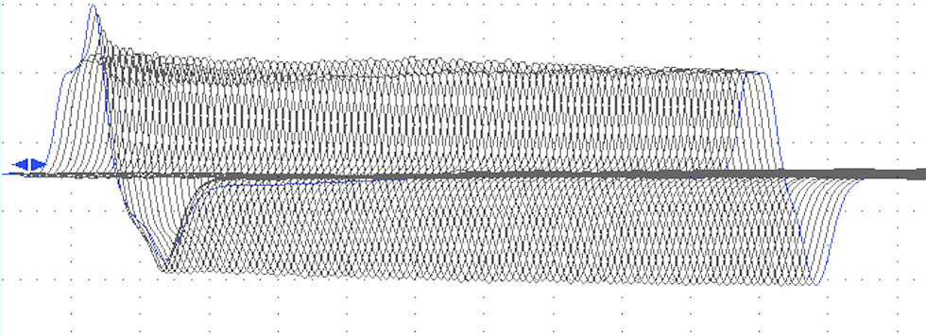
Pattern II (Fournier et al, 2004)
In 2021, diagnosis of Thomsen myotonia: - variant of the CLCN1 gene c.406G>A p.Asp136Asn
Muscle weakness and pain
Abundant mechanical and electrical myotonias
Clinical phenotype : Myotonia congenita
Chlore channel mutations (CLCN-1 gene) :
Needle-EMG : abundant myotonic discharges
CMAP after short exercise: - inconsistent postexercice myotonic potential - immediate reduction in amplitude improving thereafter
CMAP after long exercise: - minor reduction in amplitude immediately or no change after effort
Sensitivity : 83%
Repetitive nerve stimulation
30 s
- 38%
Pattern II (Fournier et al, 2006)
CMAP after short exercise after 7’ muscle cooling: - in patients showing no change at ambient temperature during short/long efforts (pattern III) -> immediate reduction in amplitude improving thereafter
CMAP decrement > 25% during 10 Hz RNS

Slide 18
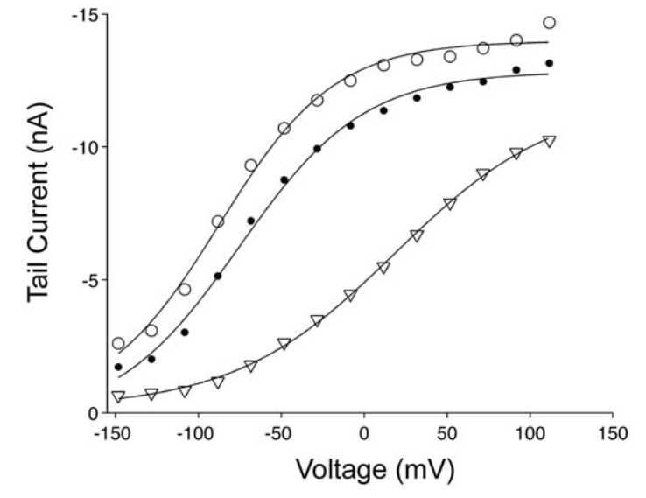
The probability of CIC-1 channel opening is proportional to the {Cl}_{INT}
Certain CLCN1 mutations (T310M) significantly accentuate this dependance
During pregnancy, {Cl}_{INT} decreases
=> some patients with myotonia congenita only experience symtoms when they are pregnant
Mrs LP, born on March 9, 1990 : she knows she is pregnant when she experiences « blockages » in her jaw and hands…
Chloride tail currents (CIC-1/patch clamp)
1
Before progesterone
3
After wash
2
During 100 μM progesterone

Slide 19
+1,7%
A young lady with a clinical profile of myotonia congenita
-50%
The same lady at the beginning of her menstrual cycle

Slide 20
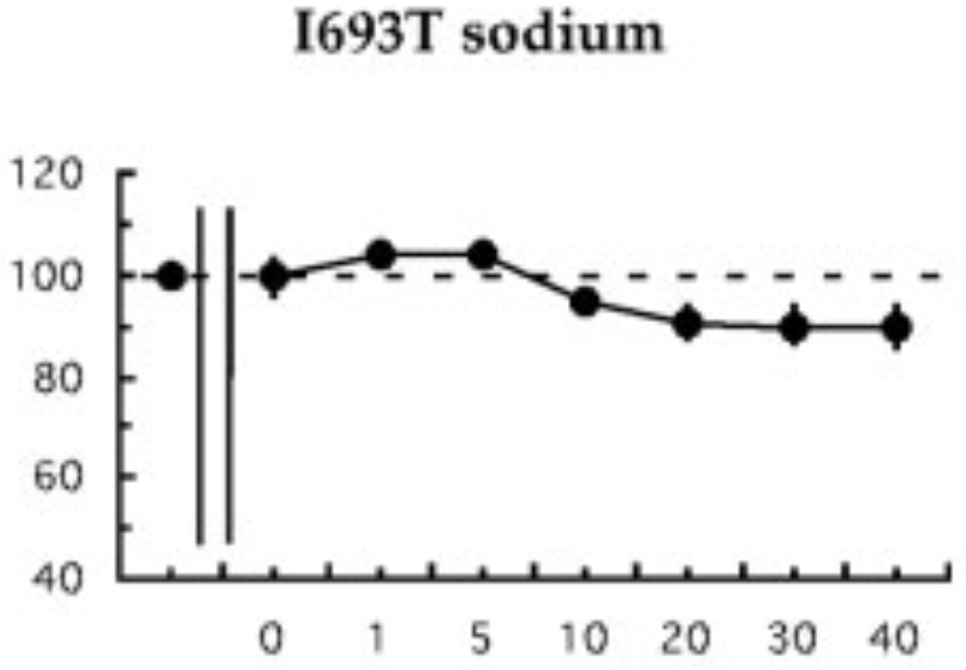
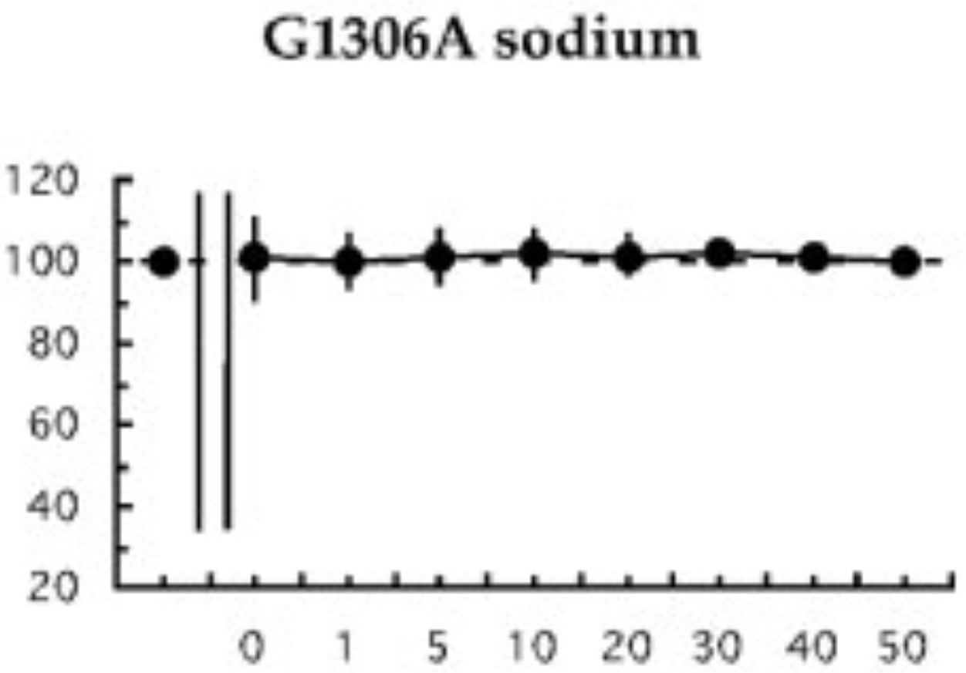
Pattern III (Fournier et al, 2004)
8 families with the pathogenic variant c.4307T>C (p.Leu1436Pro) of the SCN4A gene: L1436P
Not yet classified as a paramyotonia congenita
Index case: 7 women/1 man
Clinical myotonia, no paralysis, muscle pain and soreness (proximally and hands), muscle stiffness (during & after physical activities, without warm up), no muscle atrophy (1 case of calf hypertrophy), muscle weakness (often moderate and related to pain -> difficulty climbing stairs), AGGRAVATED BY COLD
Clinical phenotype : other forms of myotonia
Sodium channel mutations (SCN4A gene) : G1306A, I693T Chlore channel mutations (CLCN-1 gene)
Needle-EMG : abundant myotonic discharges
CMAP after short exercise: - no postexercice myotonic potential - no reduction in amplitude
CMAP after long exercise: - no reduction in amplitude
Sensitivity : 63%
Cases | 1 | 2 | 3 | 4 | 5 | 6 | 7
Myotonic salves | +++ | +++ | +++ | +++ | +++ | +++ | +++
Myogenic traces | - | - | - | - | - | - | -
Short exercise | - | - | - | - | - | - | -
Idem after cooling | + | + | + | - | + | - | +
Long exercise | - | - | - | - | - | - | -
10 Hz decrement | - | - | - | - | - | - | -
Postexercise myotonic potential | - | - | - | - | - | - | -
Pattern III (Fournier et al, 2006) => pattern I ou II
CMAP after short exercise after 7’ muscle cooling: - reduction in amplitude: sodium or chloride channelopathy (especially dominant forms) depending on the pattern

Slide 21
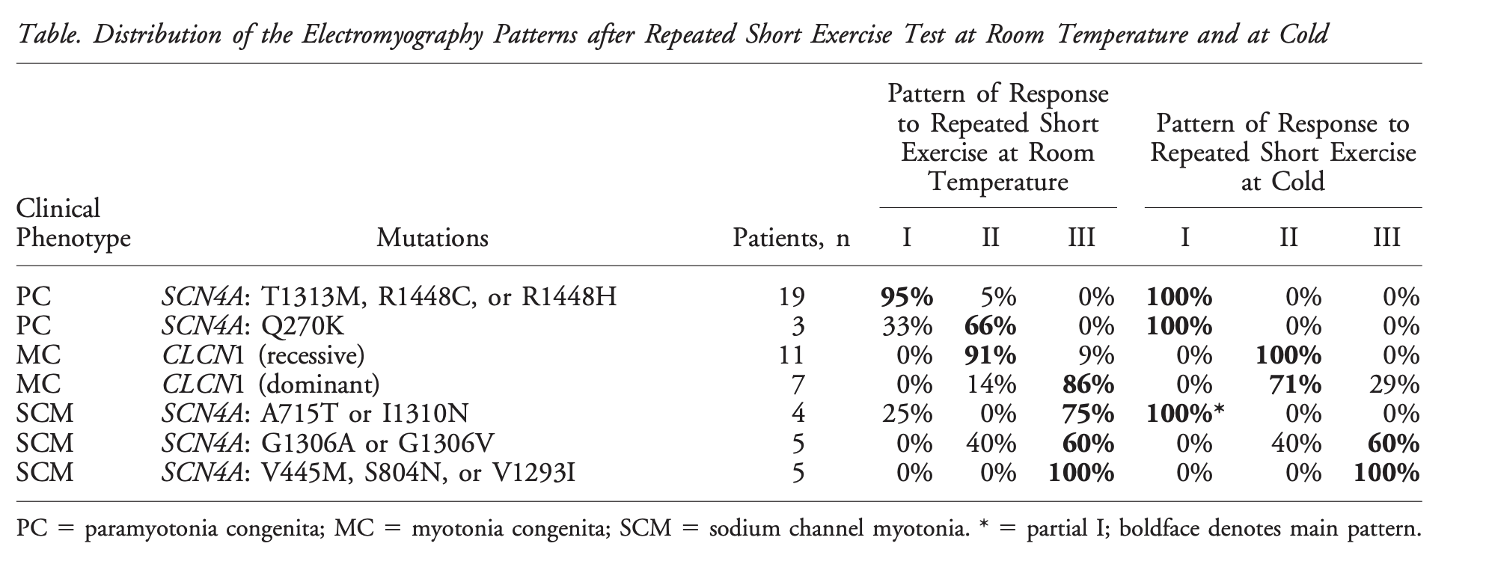
L1436P
(Fournier et al, 2006)

Slide 22
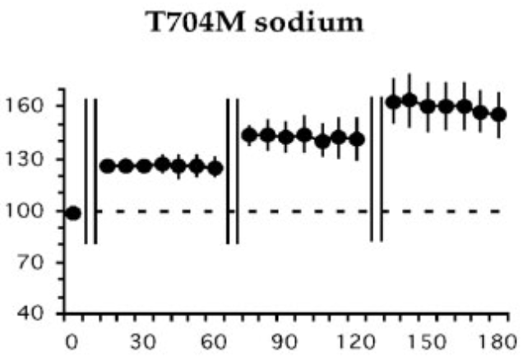
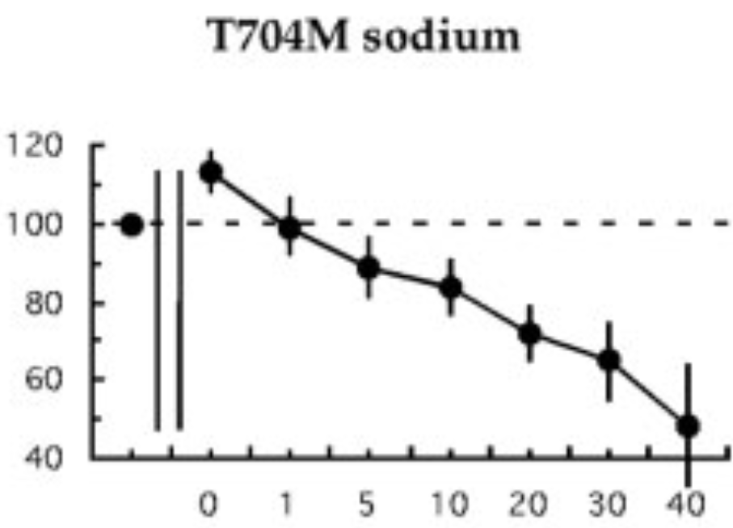
With Isabelle Lievens, we have 2 families with the variant c.3917G>A of the SCN4A gene : G1306E
But with a pattern III
Pattern IV (Fournier et al, 2004)
Clinical phenotype: hyperkalemic periodic paralysis
Sodium channel mutations (SCN4A gene) : T704M
Needle-EMG: rare or absent myotonic discharges
CMAP after short exercise: - no postexercice myotonic potential - progressive increase in amplitude
G1306E
CMAP after long exercise: - immediate increase after effort -> reduction in amplitude
Sensitivity: 83%
Without episodes of paralysis
Infantile form (floppy infant) with SNEL : Severe Neonatal Episodic Laryngospasm and responsive to Flecainide = classe 1C antiarrhythmic (Portaro et al, 2016)

Slide 23
Pattern IV (Fournier et al, 2004)
Clinical phenotype: hyperkalemic periodic paralysis
Sodium channel mutations (SCN4A gene) : T704M
Needle-EMG: rare or absent myotonic salves
CMAP after short exercise: - no postexercice myotonic potential - progressive increase in amplitude
NO GENETIC EXPLANATION
CMAP after long exercise: - immediate increase after effort -> reduction in amplitude
Sensitivity: 83%
> 40%

Slide 24
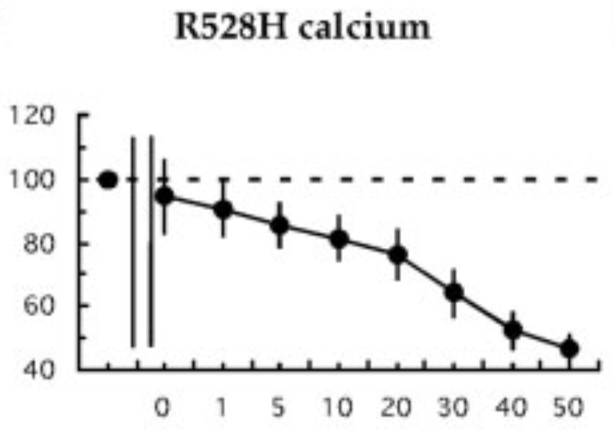
Pattern V (Fournier et al, 2004)
Clinical phenotype: hypokalemic periodic paralysis
Calcium channel mutations (CACNA1S gene) : R528H
Needle-EMG : no myotonic discharges
CMAP after short exercise: - no postexercice myotonic potential - no reduction in amplitude
CMAP after long exercise: - progressive decrease in amplitude after effort
Sensitivity : 84%
No personal
cases

Slide 26
Clinical picture of myotonia congenita if > 50% of Cl⁻ channels are non-functional
1 chlorid channel = 4 monomers
1 mutated allele & 1 non-mutated allele
2 mutated alleles
=> 100% of Cl⁻ are non-functional
4N0M | 3N1M | 2N2M | 3M1N
3N1M | 2N2M | 2N2M | 3M1N
3N1M | 2N2M | 2N2M | 3M1N
3N1M | 2N2M | 3M1N | 4M0N
4M0N | 4M0N | 4M0N | 4M0N
4M0N | 4M0N | 4M0N | 4M0N
4M0N | 4M0N | 4M0N | 4M0N
4M0N | 4M0N | 4M0N | 4M0N
If the channel is non-functional when at least 3 monomers are Modified => less then 50% of Cl⁻ channel are non-functional (5/16) => Heterozygous for the AR form (subclinical myotonia in men)
Homozygous for the AR form (more severe than the AD form)
If the channel is non-functional when at least 2 monomers are Modified => more then 50% of Cl⁻ channel are non-functional (15/16 ou 11/16) => AD form

