Slide 1

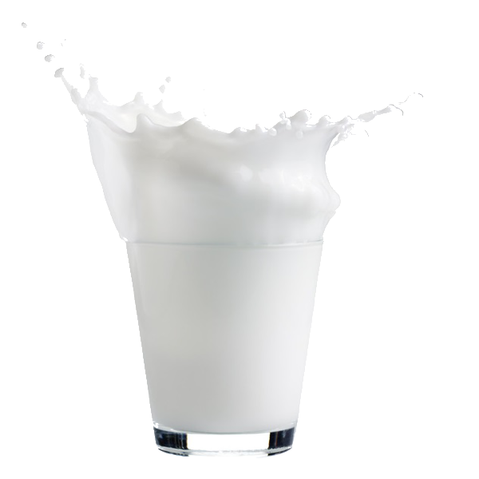

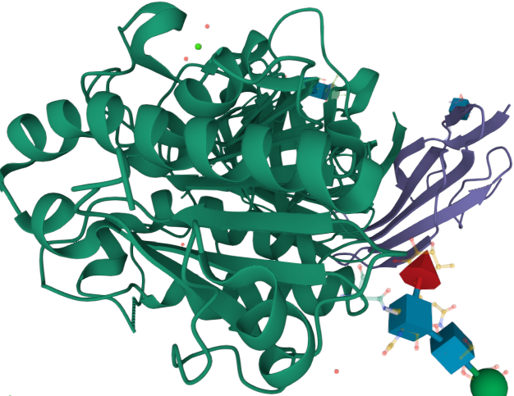










Improving taste and flavor in dairy products through milk analysis of free fatty by Mid-infrared (MIR) spectrometry
Octave CHRISTOPHE^{a,b}, Romain Reding^{c}, Julie LEBLOIS^{d} Denis Pittois^{e}, Cédric Grignard^{e} and Frédéric DEHARENGª
ªWalloon Agricultural Research Center (CRA-W) Belgium ^{b}University of Liège, Gembloux Agro-Bio Tech, Belgium ^{c}CONVIS, 9084 Ettelbruck, Luxembourg ^{d}Elevéo asbl, AWE groupe 5590 Ciney, Belgium ^{e}Luxembourg Institute of Science and Technology (LIST), Luxembourg
Introduction
The dairy sector deals with a recurring issue: a defect of taste appearing due to degradation of fat, commonly called lipolysis.
Lipolysis happens after the milking, through the physical shocks induced by freezing, pumping, transfer and storage of the milk. Physical break of fat globules makes triglycerides accessible to enzymes and degraded into free fatty acids (FFA).
Among them, the volatile short chain FFA lead to organoleptic issues through undesired tastes.
??
Lipase
Lipolysis why it’s bad ? → Cause bad taste of the milk
Triglycerides
Glycerol
Free Fatty Acids (FFA)
Figure 1: Graphical representation of the lipolysis of triglycerides into Free Fatty Acid in milk
Butyric acid (C4:0)
Caproic acid (C6:0)
Caprylic acid (C8:0)
Capric acid (C10:0)
Rancid taste
Rancid taste
Other FFA (C12:0 → C18:3) → effect on milk transformation + Inhibition of bacteria
Results
a)Quantification
20% of the samples were above the limit of quantification (LOQ).
A protocol for inducing lipolysis is therefore needed to create models for quantifying FFAs.
Homogenisation of the sample → strong lipolysis over time + compatible with Mid infrared spectroscopy.
Decreasing the diameter of fat globules
Destruction of milk fat membrane
→ Triglycerides more
available to lipolysis
Milk Fat globule
b)Modelling
Figure 2: Illustration of the homogenization of milk fat globule
792 samples analysed → GCMS/MS to obtain the FFA values.
Models were built for free fatty acid using several algorithms: Principal Component Regression (PCR), Partial Least Square regression (PLSr), Elasticnet regression, Kernel Ridge regression (KRR) and Support Vector Machine-Regression (SVM-R)
A cross validation 10 groups subset and random external validation with 20% of total sample → evaluate models
Table 1: Modelling performances of each Free Fatty acid with the best algorithm based on lowest RMSE from the external validation
FFA | Algo | R²_{cal} | R²_{cv} | R²_{val} | RMSE_{cal} | RMSE_{cv} | RMSE_{val} | RPD_{cal} | RPD_{cv} | RPD_{val}
C4 | KRR | 0.85 | 0.73 | 0.76 | 14.79 | 19.85 | 16.75 | 2.58 | 1.92 | 2.28
C6 | ElasticNet | 0.77 | 0.68 | 0.57 | 9.74 | 11.58 | 12.70 | 2.10 | 1.77 | 1.61
C8 | SVM-R | 0.85 | 0.54 | 0.40 | 4.95 | 8.71 | 9.72 | 2.61 | 1.48 | 1.33
C10 | KRR | 0.59 | 0.52 | 0.38 | 8.88 | 9.62 | 9.15 | 1.56 | 1.44 | 1.51
C12 | PCR | 0.35 | 0.31 | 0.08 | 6.45 | 6.65 | 6.34 | 1.24 | 1.21 | 1.26
C14 | KRR | 0.52 | 0.40 | 0.02 | 9.91 | 11.06 | 11.04 | 1.44 | 1.29 | 1.29
C16 | KRR | 0.50 | 0.36 | 0.20 | 22.40 | 25.25 | 21.82 | 1.41 | 1.25 | 1.45
C18 | PLS | 0.70 | 0.59 | 0.49 | 11.18 | 12.99 | 12.48 | 1.81 | 1.56 | 1.62
Conclusion: This work presents encouraging performances of Free Fatty acid prediction and exhibit the potential to detect specific milk flavor issues.
Acknowledgement:
Figure 2: C4 model including spontaneous lipolysis and
homogenized sample with kernel Ridge Regression
LinkedIn
o.christophe@cra.wallonie.be

