Slide 1
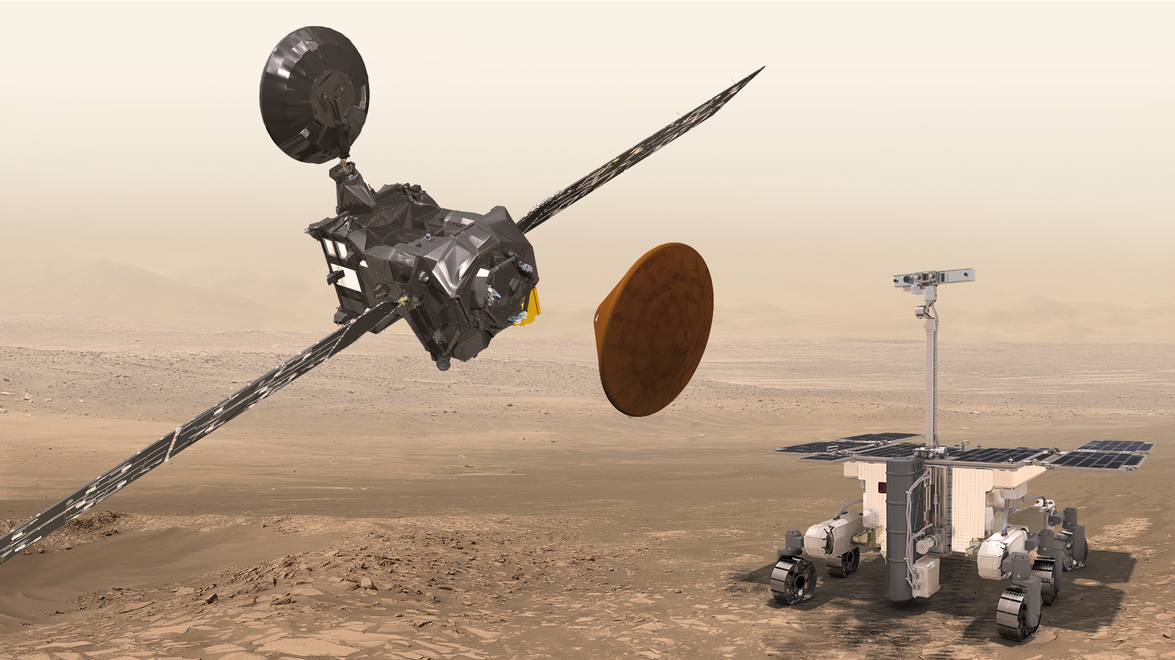
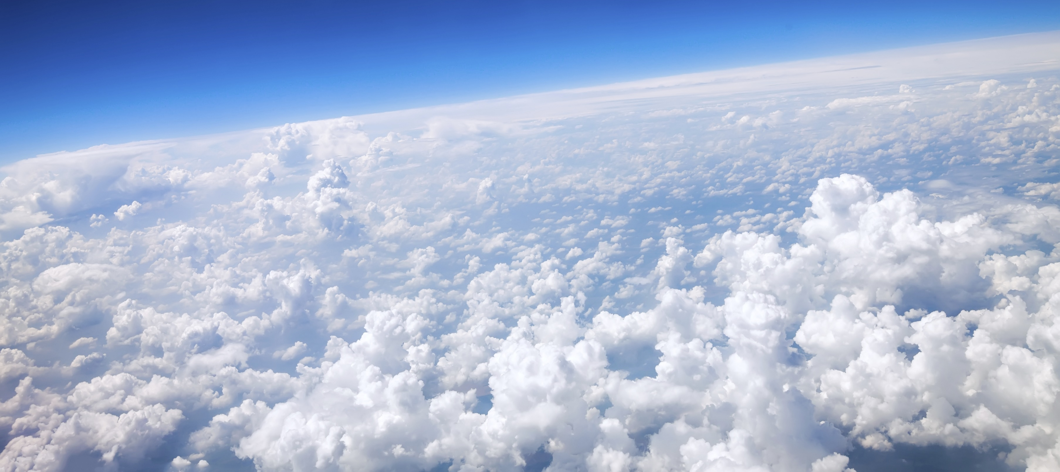

PhD day

Slide 2


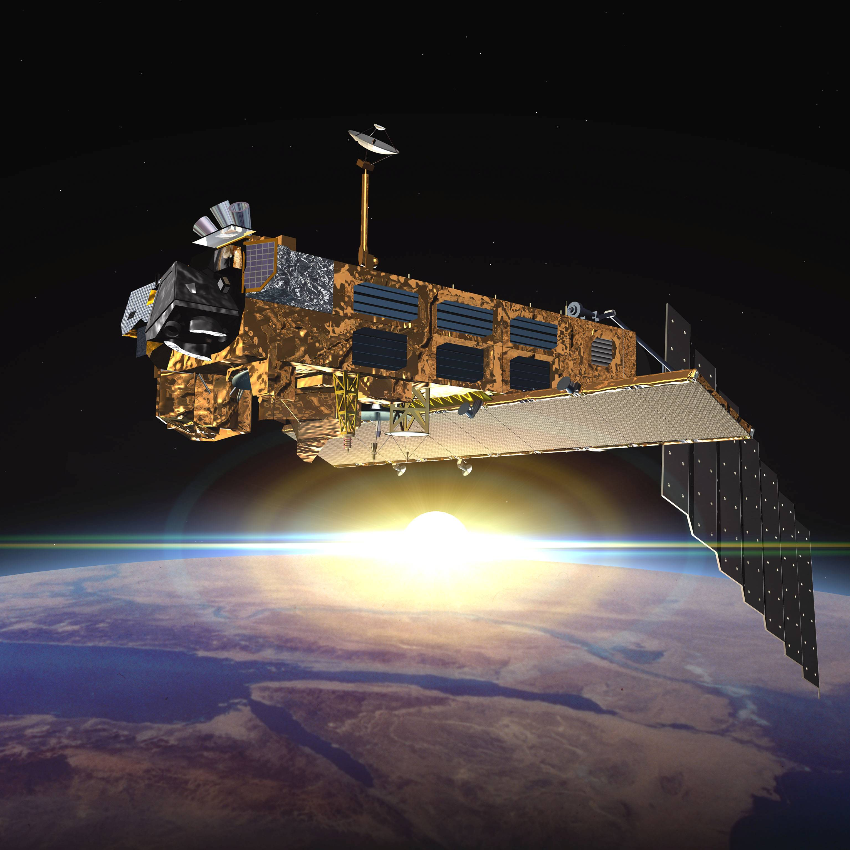
Content
Introduction
Circulation in the atmosphere
Age of air
Trace gases and SF₆
The BASCOE model
First results
What’s next?

Slide 3
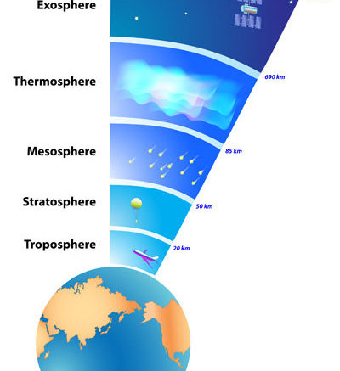
Atmospheric science
Troposphere: air quality, weather, greenhouse gas emissions, surface interactions…
Stratosphere: Important circulations. Not a lot of measurements.
The “ignorosphere”
Mesosphere: deep branch of the Brewer-Dobson circulation
Figure from ESA

Slide 4

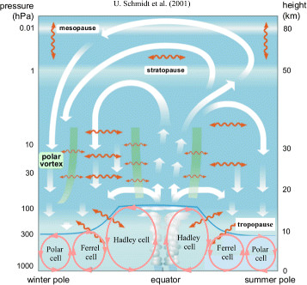
Circulation in the atmosphere
Brewer-Dobson circulation (BDC)
Upwelling of air in the tropics, downwelling at the Poles
Deep branch + shallow branch
Climate models predict: BDC speeds up
=> How to quantify?

Slide 5
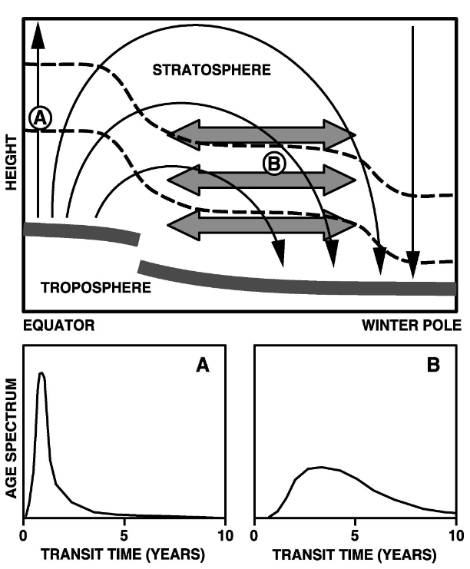
Age of air (AoA)
A measure for transit time
across the tropopause
Computed from trace-gas measurements
Can be computed from models
Concept: air parcels
Lots of air molecules
± Uniform properties
Mix of ages! => age spectrum
Waugh & Hall. 2002 review paper

Slide 6
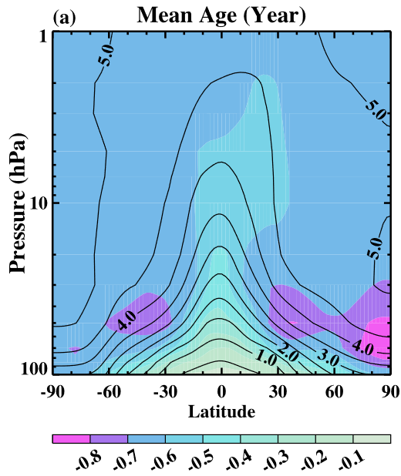
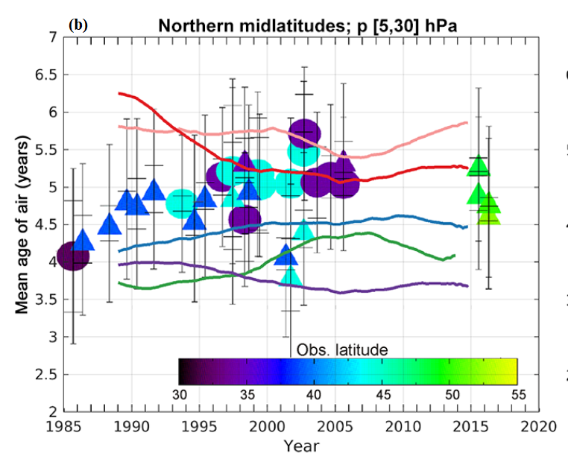
Age of air trends
AoA predicted to decrease
No agreement between model simulations!
Trends in AoA might not mean trends in the BDC…
Left: Li et al.(2012). Right: Chabrillat et al. (2018)

Slide 7
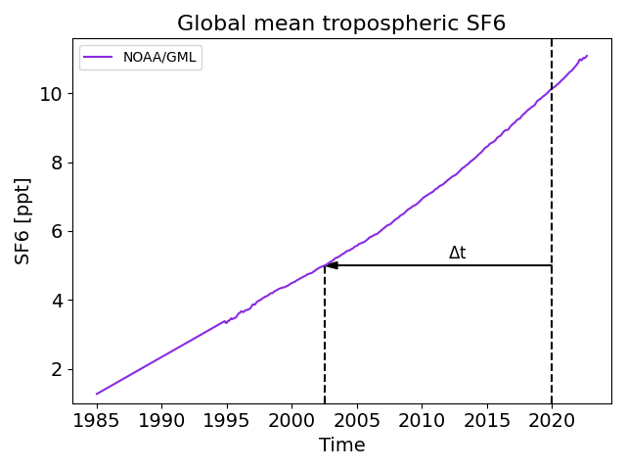
Tracer requirements?
Linear increase in the troposphere
No sinks or sources in the rest of the atmosphere
(long lifetime)
Clock tracers (model)
CO₂, N₂O, CFC-11…
SF₆ (sulfur hexafluoride)
Important greenhouse gas

Slide 8
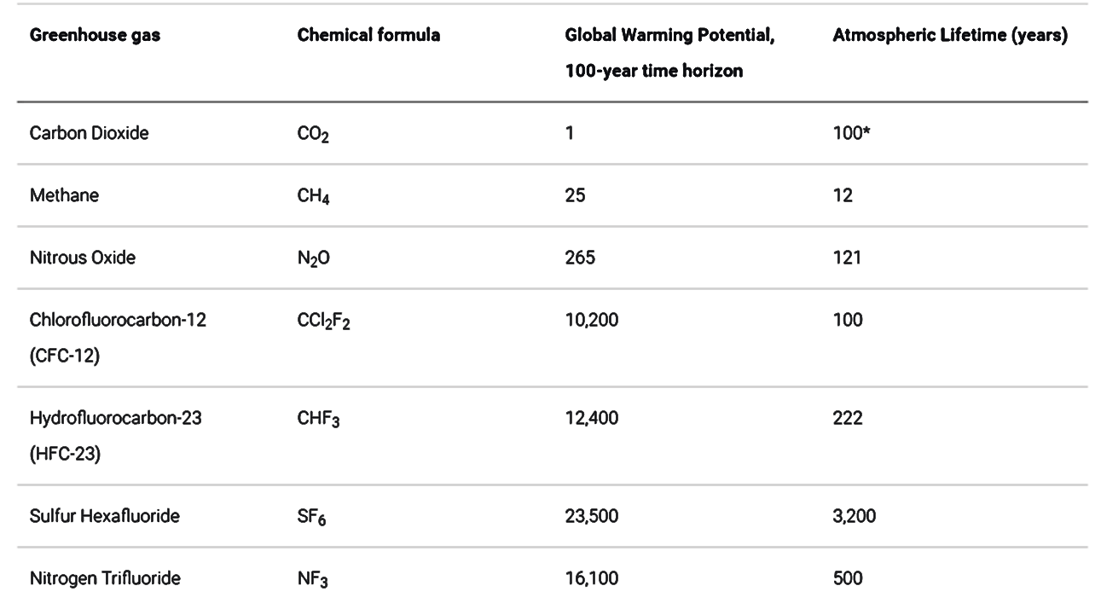
Which trace gases?

Slide 9
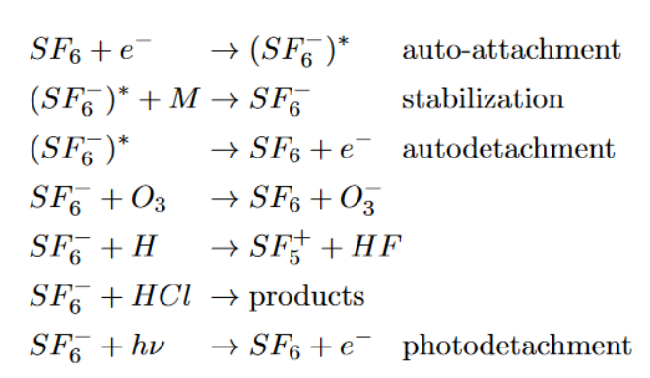
SF₆ in the BASCOE model
BASCOE = Belgian Assimilation System for Chemical ObsErvations
Chemical transport model (CTM)
Driven by a reanalysis data set: winds
ERA5, MERRA2
SF₆ has sinks in the mesosphere

Slide 10
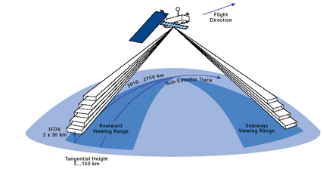
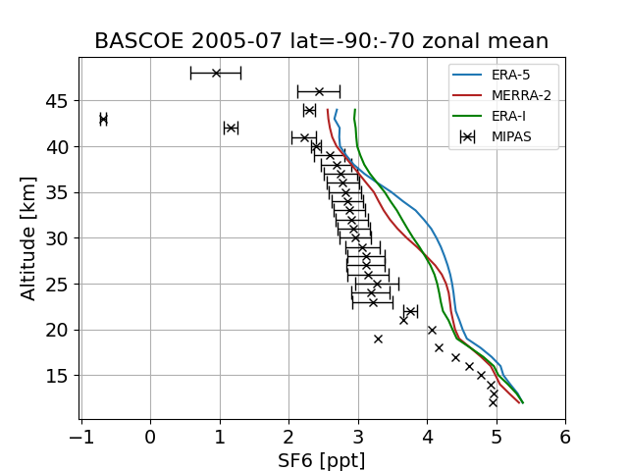
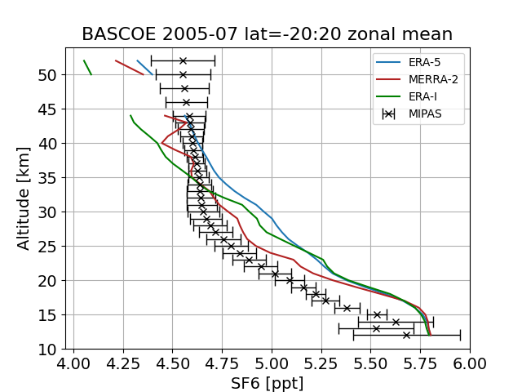
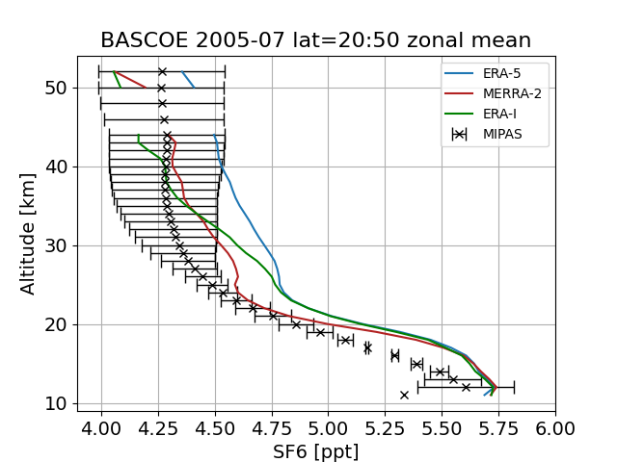
SF₆ profiles
Comparing with satellite
observations: MIPAS
Interpolate the model
Over estimation of SF6 in the middle atmosphere

Slide 11
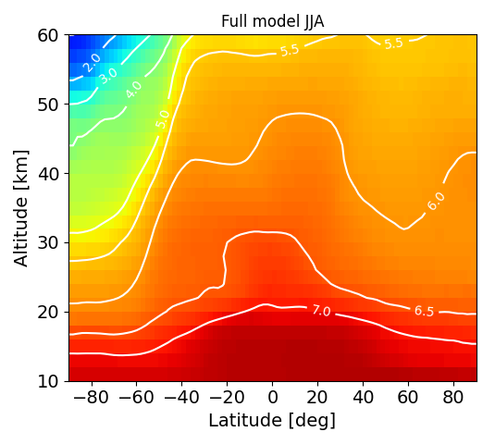
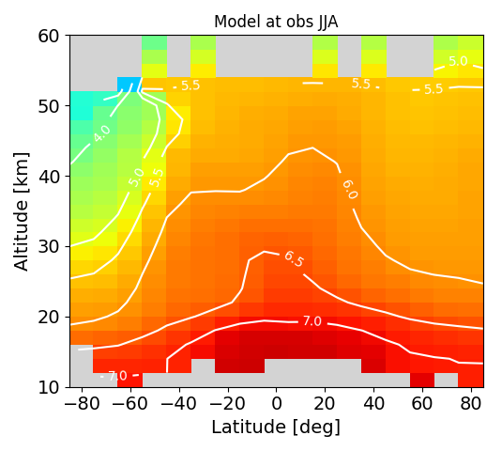
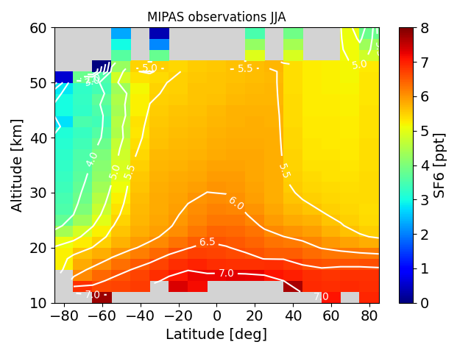
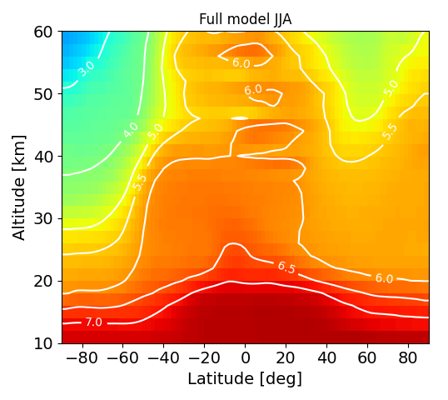
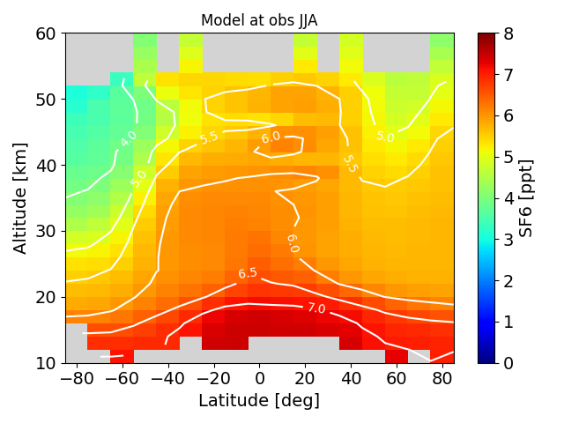
Model output and the effect of sampling
Average of JJA in 2011
Top: ERA5
Bottom: MERRA2

Slide 12
First results
Meetings with CAIRT about AoA
Communication with G. Stiller about AoA correction method
Online discussion with T. Reddmann and R. Eichinger about BASCOE model results
Poster at EGU23 conference in Vienna and the Limb workshop 2023 in Brussels

Slide 13
What’s next?
Calculating the lifetime of SF₆
Quantifying the sampling bias. Calculating trends.
Comparing to other observations, e.g. in-situ data.
Understanding the differences between the reanalysis data sets.
  Study of water vapour signal after Hunga Tonga eruption
  Running the model at different resolutions

Slide 14
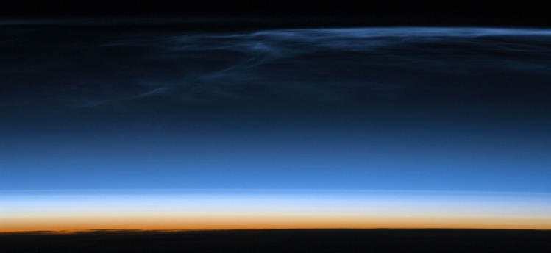

thank you!
Questions?
sarah.vervalcke@student.uliège.be
sarah.vervalcke@aeronomie.be

Slide 15



Appendix: AoA correction
Iterative procedure using a convolution of the age spectrum and the tropospheric reference

Slide 16
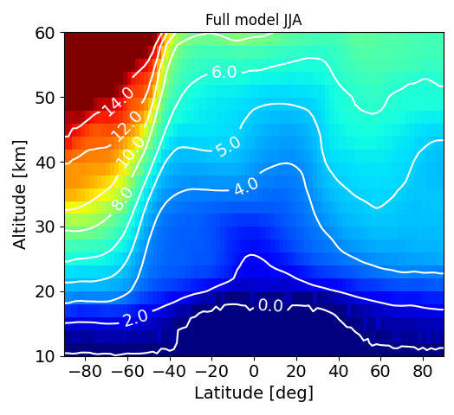
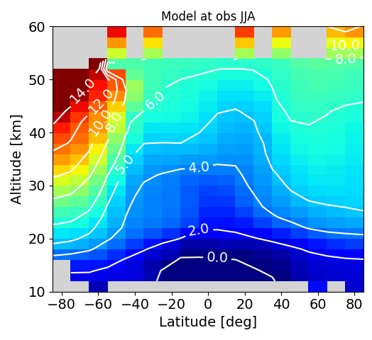
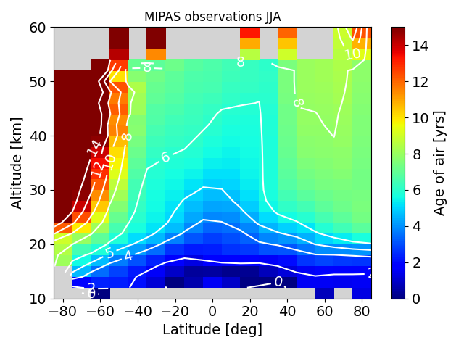
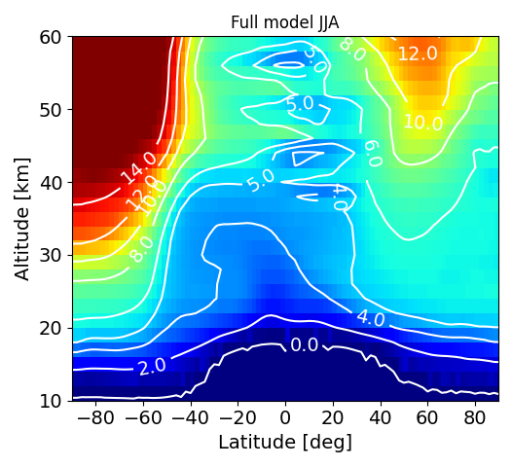
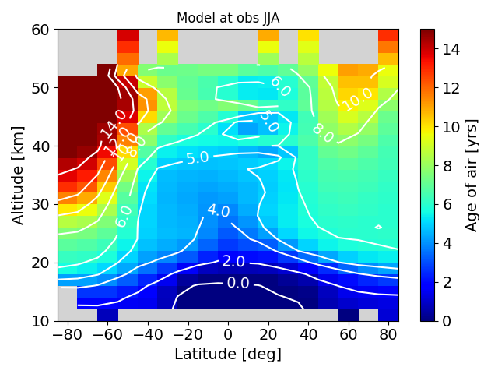
Appendix: AoA lat-lev plots
Average of JJA in 2011
Top: ERA5
Bottom: MERRA2

