Slide 1
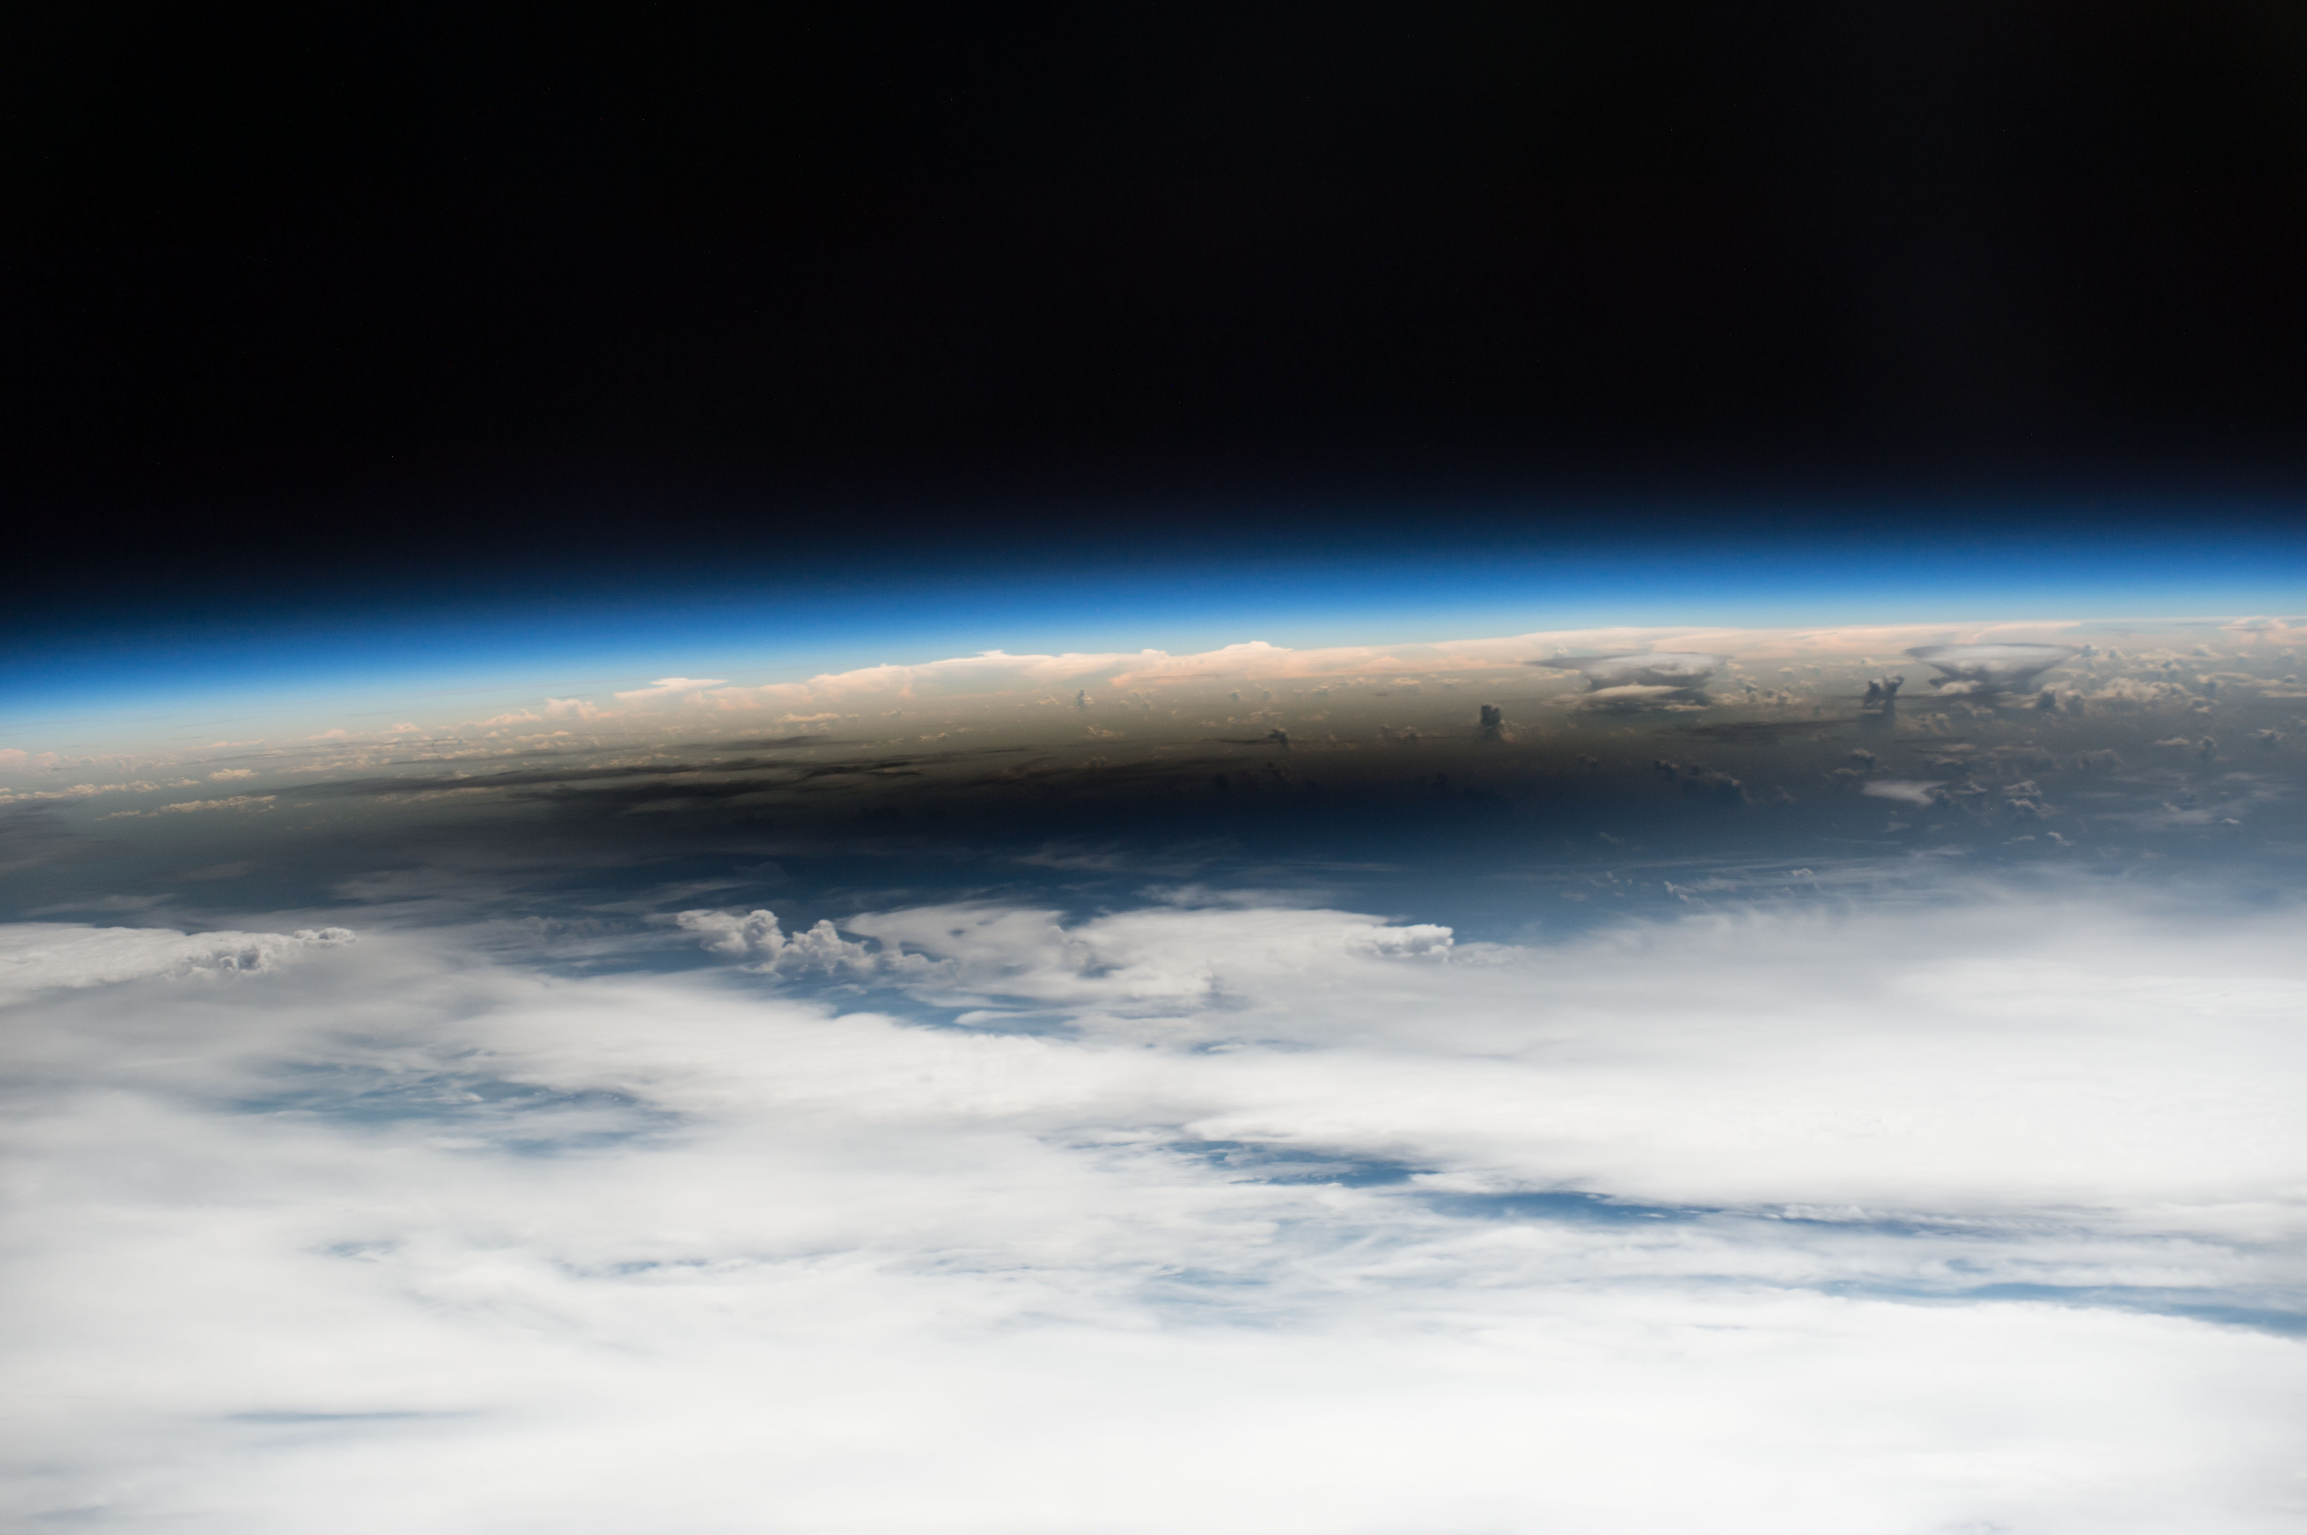
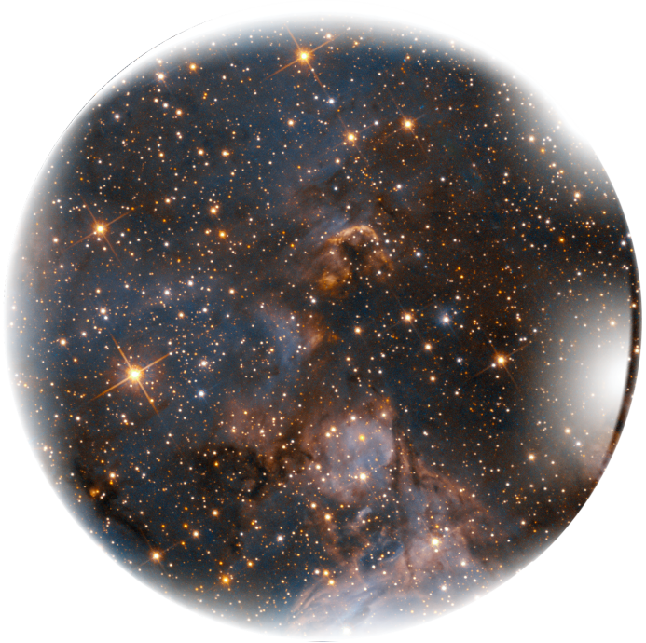
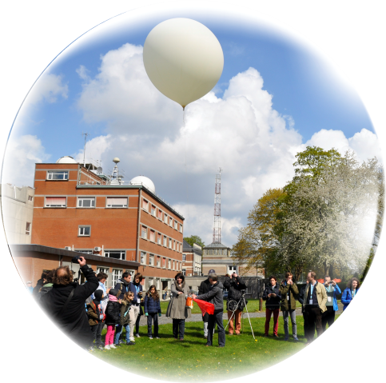


SF₆ in BASCOE

Slide 2
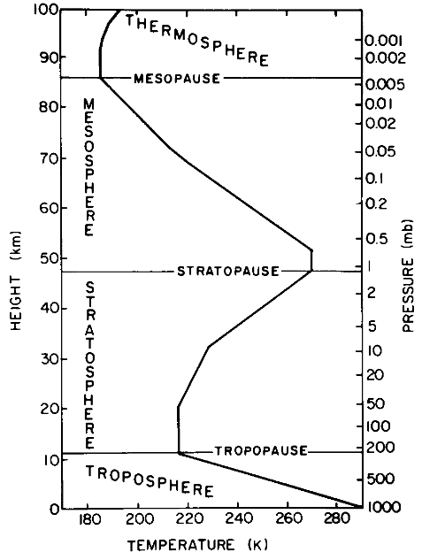
The middle atmosphere
Upper troposphere (tropopause region) + stratosphere + mesosphere + lower thermosphere
Ca 10-100km
Contains the ozone layer.
Brewer-Dobson circulation from Tropics to Poles.
Ozone layer
Notes:
Where

Slide 3
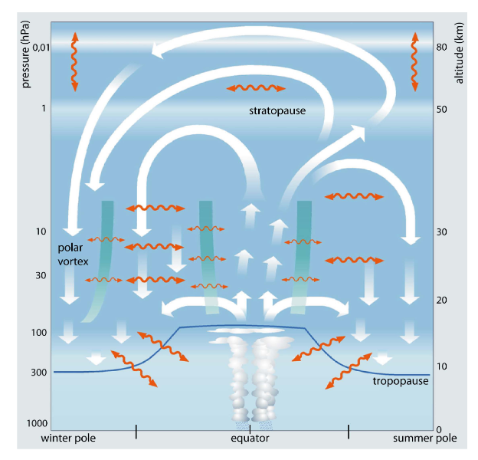
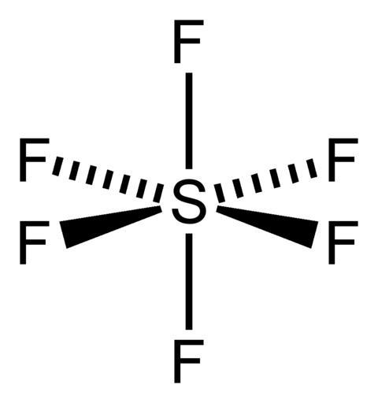
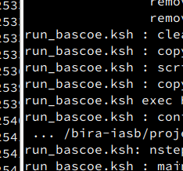

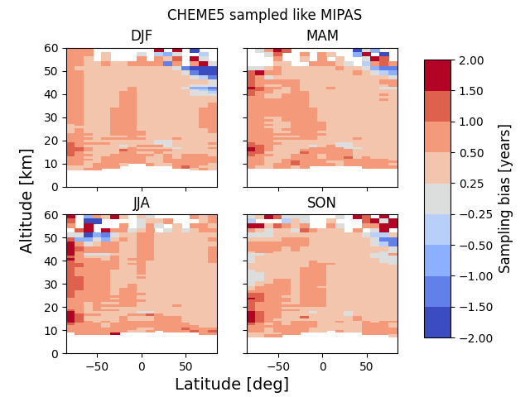
The Brewer-Dobson circulation
SF₆ chemistry in BASCOE
BASCOE simulations
Validation of simulation results
Sampling bias

Slide 4

The Brewer-Dobson circulation
Motivation
SF₆ chemistry in BASCOE
BASCOE simulations
Modelling
Validation of simulation results
Sampling bias
Science (in progress)

Slide 5
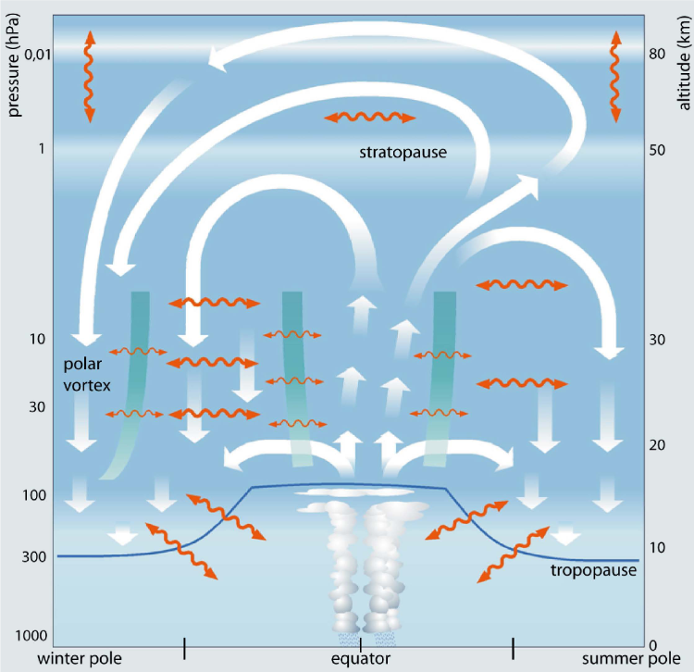
The Brewer-Dobson circulation
deep branch
The Brewer-Dobson circulation (BDC) is a global circulation in the middle atmosphere.
The BDC is driven by breaking planetary waves and gravity waves.
The BDC is the combined effect of the residual circulation and mixing in the stratosphere and the mesosphere.
The residual circulation consists of 2 stratospheric branches: deep (slow) and shallow (fast)
deep branch
deep branch
mixing
mixing
shallow branch
Bönisch et al. (2011), ACP
Notes:
Why/What
transition branch in the tropical tropopause region?

Slide 6
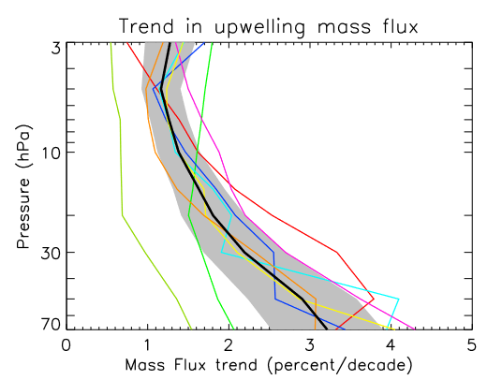
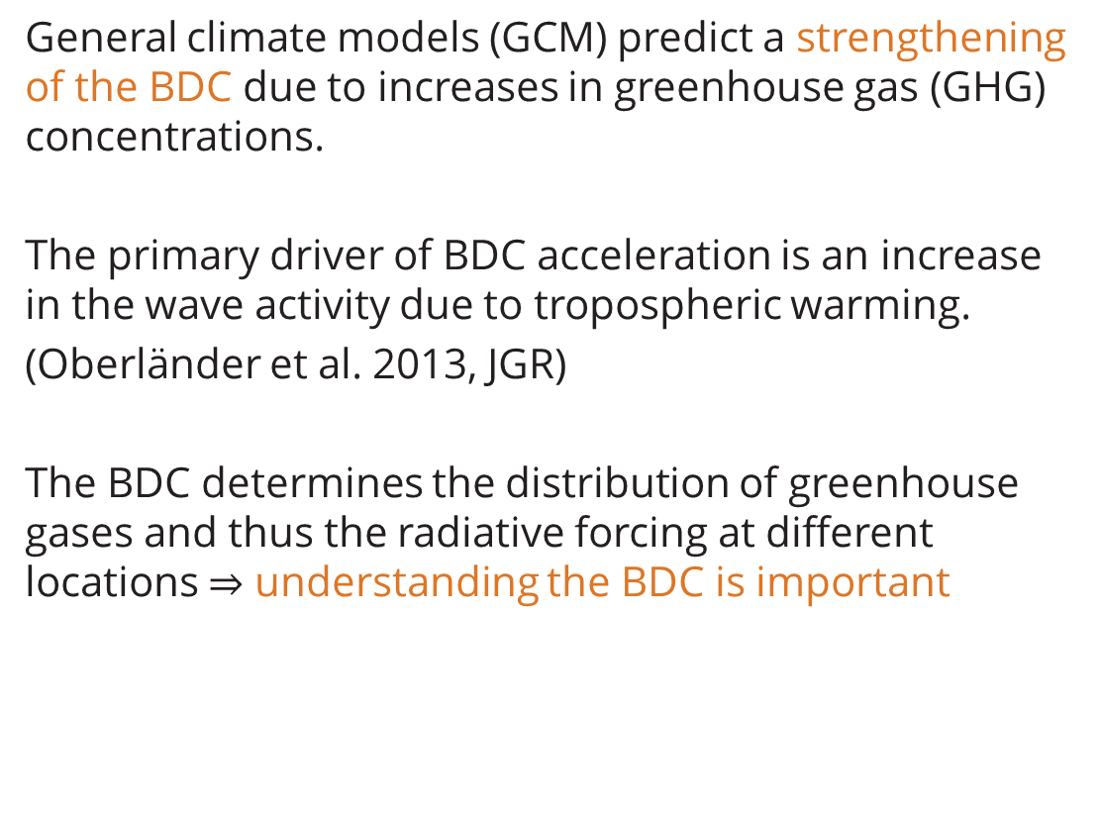
The Brewer-Dobson circulation & climate change
General climate models (GCM) predict a strengthening of the BDC due to increases in greenhouse gas (GHG) concentrations.
The primary driver of BDC acceleration is an increase in the wave activity due to tropospheric warming.
(Oberländer et al. 2013, JGR)
The BDC determines the distribution of greenhouse gases and thus the radiative forcing at different locations $⇒$ understanding the BDC is important
Butchart (2014) Rev. Geo., Hardiman et al. (2013) Q. J. R. Meteorol. Soc.
Linear fit to 2006-2099 for 8 different models (colored lines).
Black line: multi model mean

Slide 7
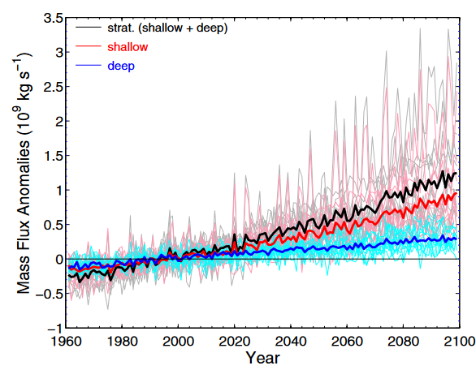
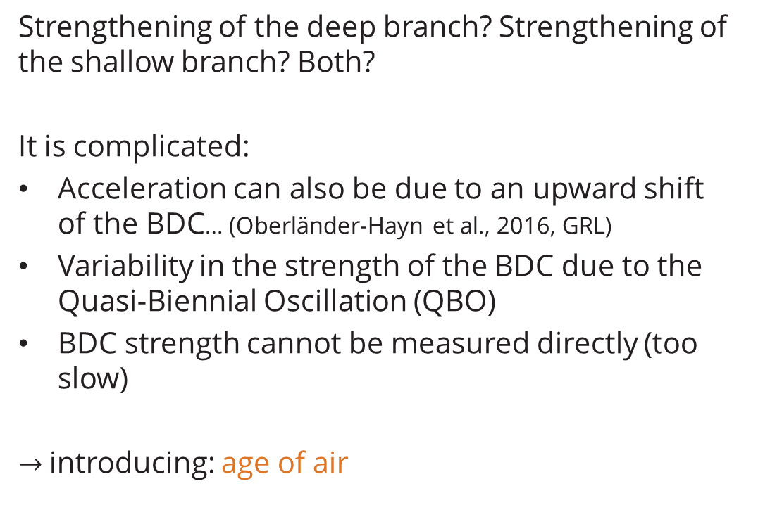
The Brewer-Dobson circulation & climate change
Strengthening of the deep branch? Strengthening of the shallow branch? Both?
It is complicated:
Acceleration can also be due to an upward shift
of the BDC… (Oberländer-Hayn et al., 2016, GRL)
Variability in the strength of the BDC due to the Quasi-Biennial Oscillation (QBO)
BDC strength cannot be measured directly (too
slow)
$→$introducing: age of air
Lin & Fu (2013), JGR
Chemistry climate models from CCMVal-2
Notes:
Figure: Increase in both deep and shallow branch, but shallow branch has a stronger increase (from model intercomparison). Mass flux anomalies are wrt a 1980-2009 climatology. Upward shift of the BDC due to tropopause lift. To keep things simple: introduce age of air

Slide 8

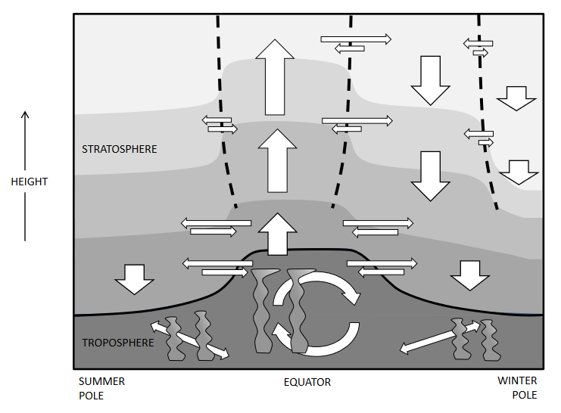
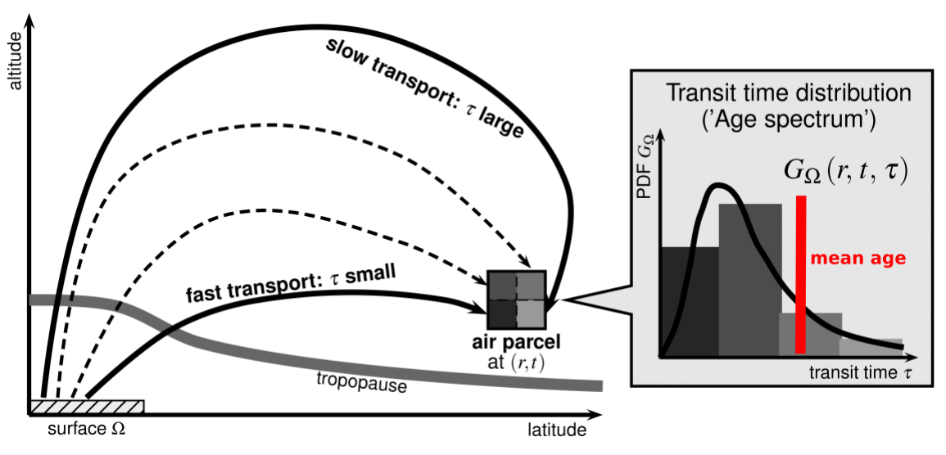

Age of air (AoA)
Definition: A measure of the transport time of an air parcel
travelling from the tropopause/surface to a certain location in the
stratosphere (Stiller, 2008, ACP; Waugh & Hall, 2002, Rev. Geo.)
∴ AoA = measure for the strength of the BDC
Due to mixing air parcels have a distribution of ages!
We are interested in the mean age.
Age spectrum described by an “inverse Gaussian”:
Where Γ = mean age and
Δ = width
SPARC lifetime report (2013)
Credit: F. Ploeger
Notes:
Could be diagnosed, because at this moment no clear conclusions from AoA trends

Slide 9

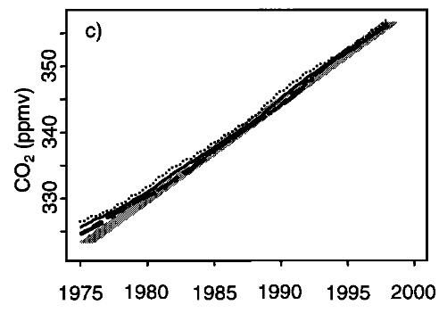
Age of air (AoA)
When I say “age of air”, I mean “mean age of air”.
AoA is simulated in a model (from clock tracer, transport only) or computed from real chemical compounds (modelled or measured) such as CO₂ and SF₆ .
AoA is independent of the species, but: need linear increase* and inertness (longevity).
*If it is slightly nonlinear, this can be corrected!
SPARC lifetime report (2013)
BDC change could in theory be diagnosed from AoA trends computed from observations.
Andrews et al. 2001a, JGR
Notes:
Emphasize the difference between model AoA and AoA computed from real tracers

Slide 10
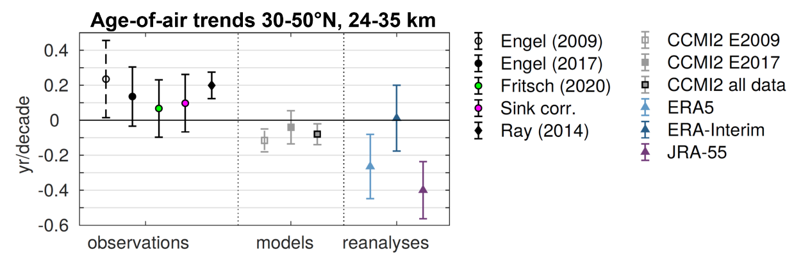
Age of air trends
Observations, models and reanalyses do not agree on AoA trends
ESA (2023) CAIRT report for Assessment (credit: M. Abalos, H. Garny)

Slide 11
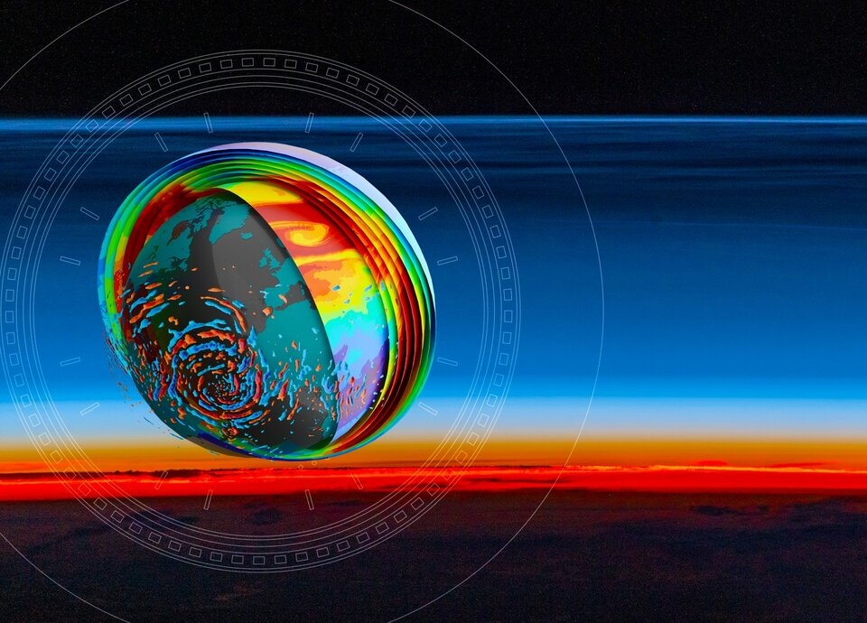
CAIRT
Changing Atmosphere Infra-Red Tomography Explorer: a candidate mission for ESA Earth Explorer 11
Diagnosing the circulation using AoA is one of the scientific objectives of CAIRT
High resolution trace gas measurements to determine absolute single profile AoA within 0.5 years

Slide 12
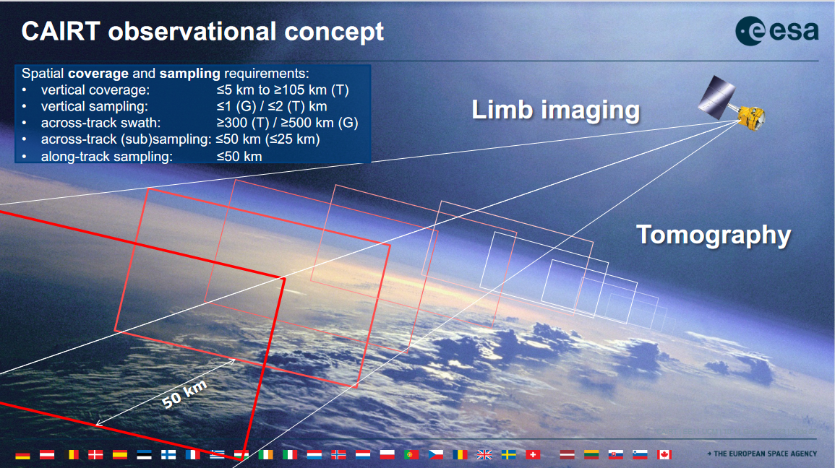
CAIRT
~400km
5-115km
May 17: seminar by Quentin Errera

Slide 13
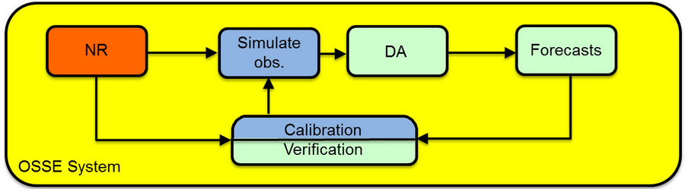
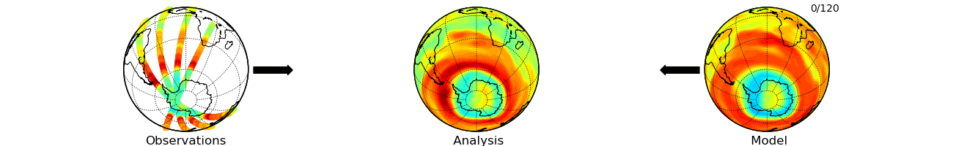
What I will do for CAIRT
CAIRT validation via an Observing System Simulation Experiment (OSSE).
NR: nature run (produces synthetic observations)
DA: data assimilation (see gif below)
Profiles of chemical species simulated by CLaMS* will be assimilated by BASCOE, developed at BIRA-IASB.
* The Chemical Lagrangian Model of the Stratosphere
The goal: see if we can constrain age of air enough to have an accuracy of 0.5 years.
Notes:
CAIRT in phase A of development
Gif: case of ozone around 20 km during the development of the ozone hole above the South Pole. The animation period is between September 1 (image 0/120) and October 1 (image 120/120), 2008

Slide 14


Updating BASCOE
The Belgian Assimilation System for Chemical ObsErvations (BASCOE)
Based on a chemistry transport model (CTM)
  Needs input meteorology (winds, temperature)
  Needs initial conditions and (upper & lower) boundary conditions
Includes ~58 chemical species
  Kinetic PreProcessor (KPP) computes the chemistry
  More than 200 chemical reactions
Already includes several important trace gases useful to study the BDC: CO₂, CFC’s, N₂O …
Not yet SF₆ !
Notes:
CTM is different from a chemistry climate model in that it cannot compute meteorology

Slide 15
The Brewer-Dobson circulation
SF₆ chemistry in BASCOE
BASCOE simulations
Validation of simulation results
Sampling bias

Slide 16
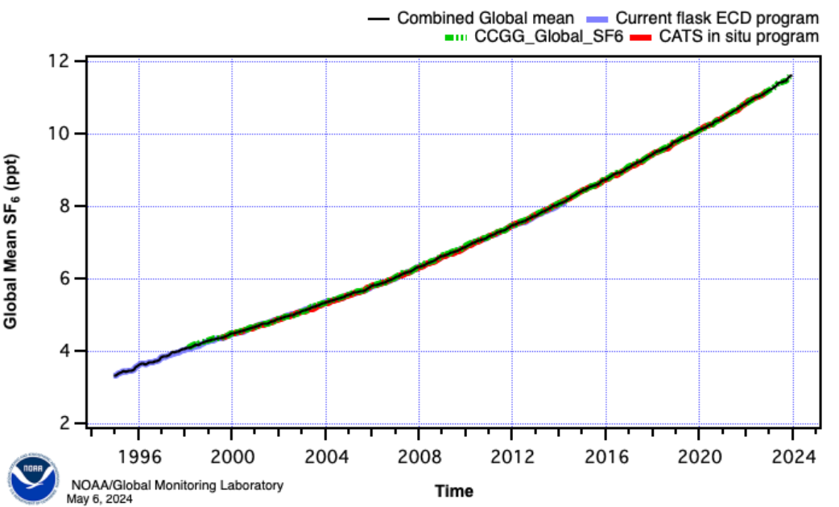
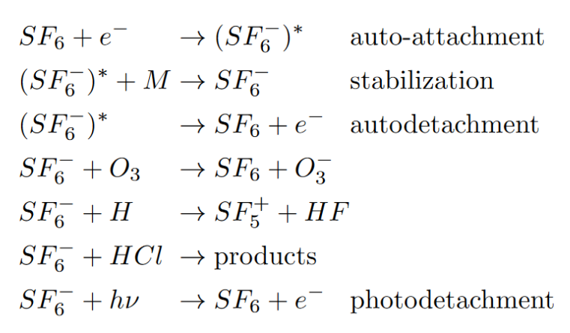
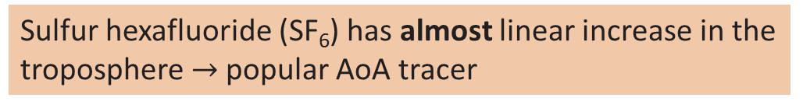
SF₆ chemistry in BASCOE
Sulfur hexafluoride (SF₆) has almost linear increase in the troposphere $→$popular AoA tracer
Inert in the stratosphere but destroyed in the mesosphere by electron attachment.
Include sink reaction and several recovery reactions in BASCOE chemistry module.
Chemistry scheme follows Loeffel et al. (2022) EGU ACP

Slide 17




SF₆ chemistry in BASCOE
Reaction rates taken from Reddmann et al. (2001) AGU JGR
Need for electron density
Computation of the photodetachment rate
with the photolysis module in BASCOE
UV-photolysis not
included (negligible!)
Notes:
We added three new species! We need all the reaction rate constants for KPP.

Slide 18
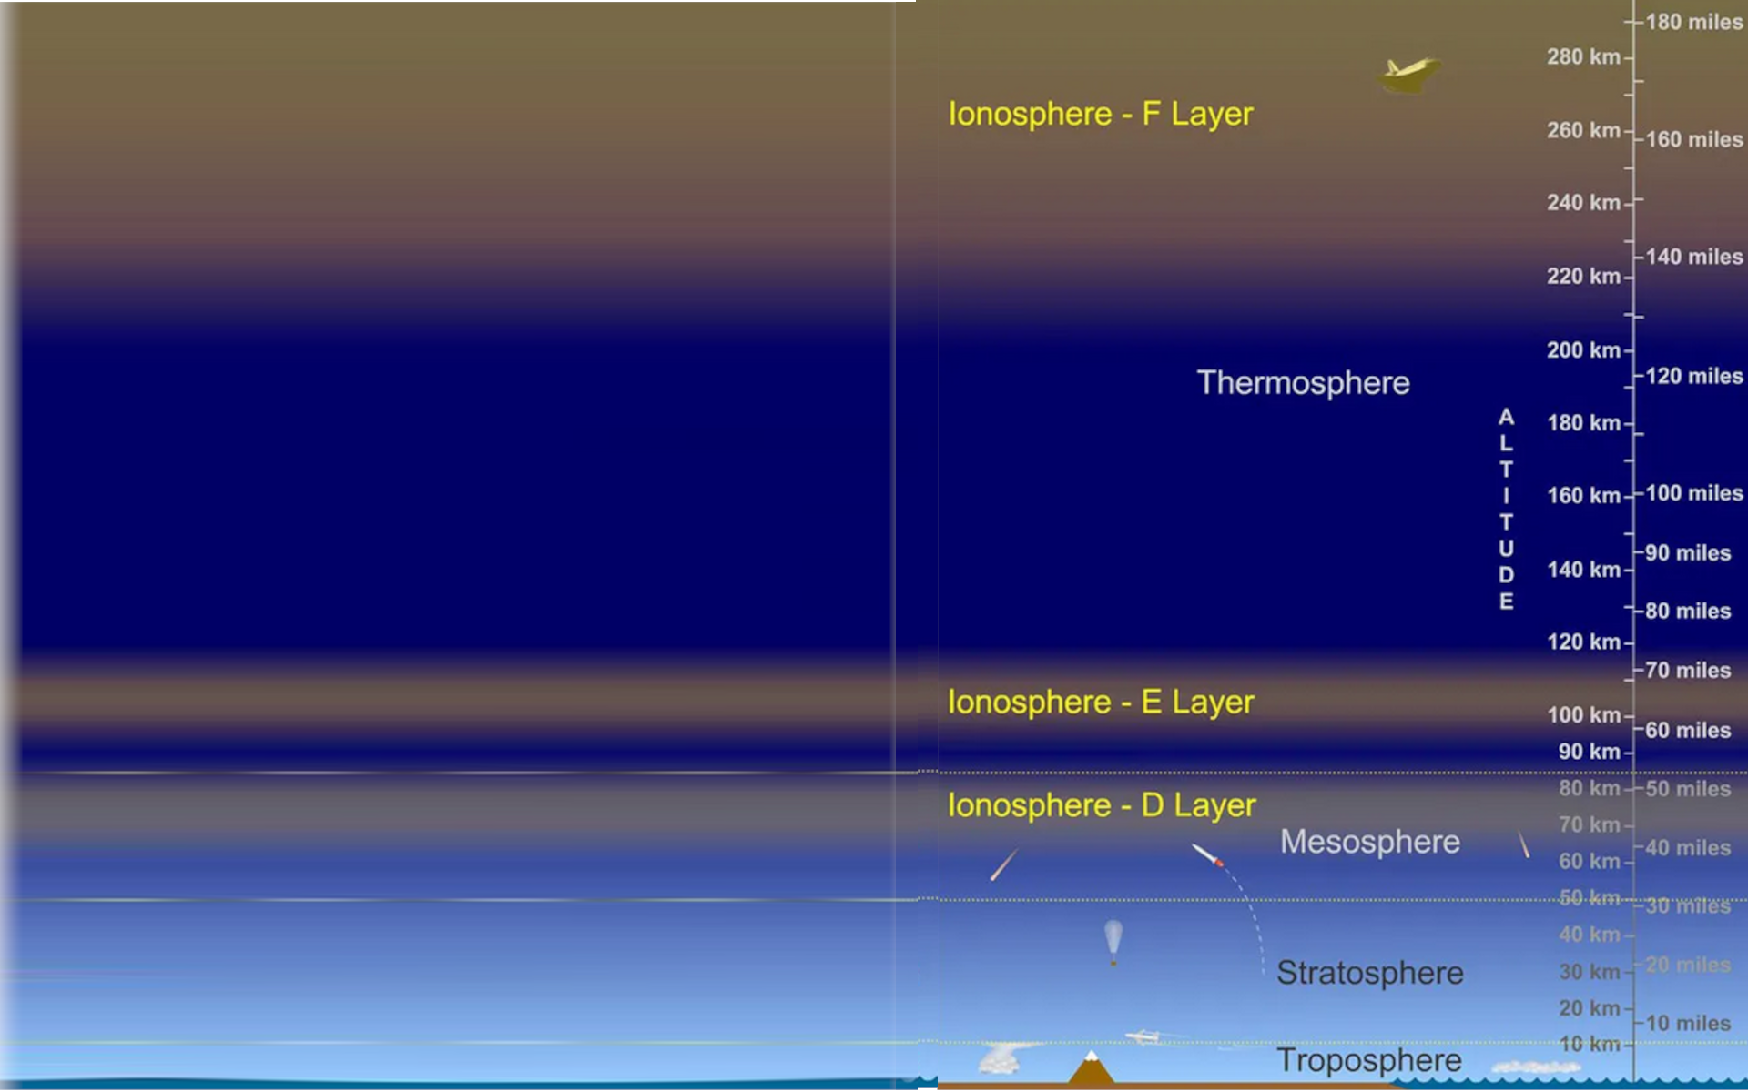
Electron density
Electron module: electron climatology from EMAC (ECHAM/MESSy Atmospheric Chemistry) and KASIMA (Kouker et al. 1999, Karlsruhe Simulation model of the Middle Atmosphere)
D-region electrons (60km to 90-95km)
Electrons produced by photo-ionization and cosmic rays
Assumption of photochemical equilibrium
Ionization of NO, N₂, O₂ and O
Not all of these components are included.
Some only relevant above 80 km or concentrations not known
~ BASCOE model top

Slide 19
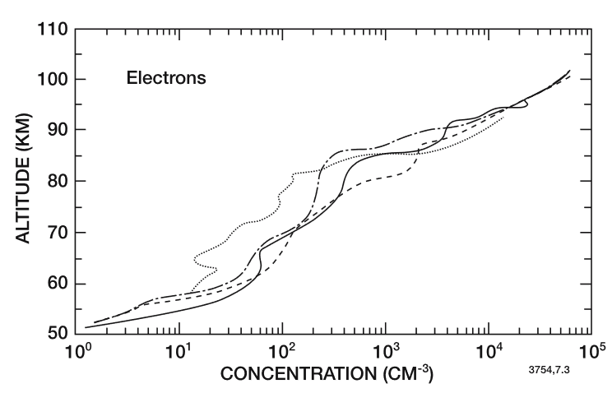
Electron density
Ionization of NO, N₂, O₂ and O
NO climatology = analytical function of the O₂ column
Cosmics contribution = constant
Function with dependence on
  Altitude
  Day of year (in NO clim.)
  Scale height
  Latitude
  Solar zenith angle to determine day/night
  Air density
For electron attachment to SF₆: electrons needed up to about 80km
Fig 7.3 from Brasseur & Solomon (2005)
Wallops Island, Virginia 38°N, ZA=60°, different seasons

Slide 20
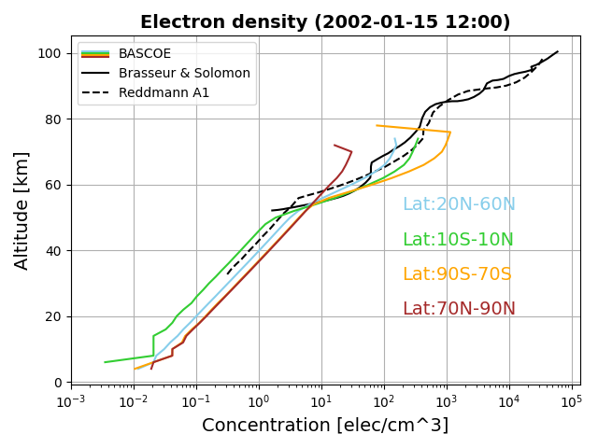
Electron density
After implementing the electron function, we check the computed electron density:
Curve from Brasseur & Solomon (2005): 38°N

Slide 21
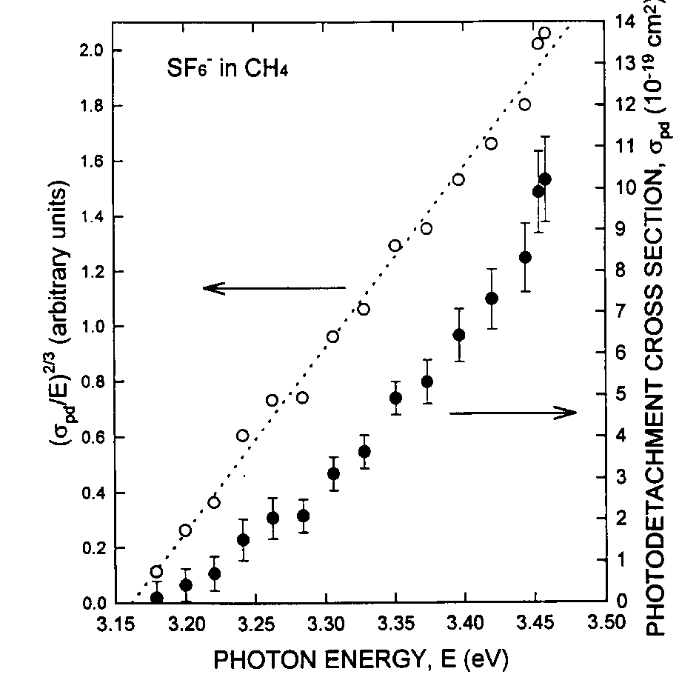

SF₆ chemistry in BASCOE
Photodetachment is computed like a photolysis rate
$$J= \int{Φ\left(λ,T\right)σ\left(λ,T\right)F\left(θ,λ\right)dλ}$$
using cross sections σ from Datskos et al. (1995), CPL. Ф is the quantum yield and F is the solar irradiance
Update for BASCOE: read file with cross sections
Notes:
Skip (too technical)

Slide 22
The Brewer-Dobson circulation
SF₆ chemistry in BASCOE
BASCOE simulations
Validation of simulation results
Sampling bias

Slide 23


BASCOE simulations
BASCOE uses input meteorology from reanalysis data sets: ERA5 and MERRA2
Reanalyses have their own native grid. Large horizontal resolution is reduced to a 2° x 2,5° lat-lon grid.
ERA5: 137 vertical levels
MERRA2: 72 vertical levels
Find appropriate subsets of the native vertical grids.
Computationally too expensive!

Slide 24
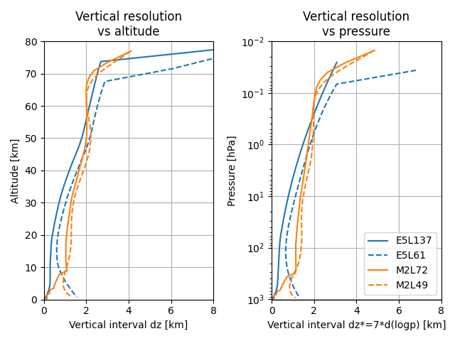
New vertical grids
Construct grids close to the original vertical resolution:
A priori for the vertical interval (dz)
Fit a polynomial to dz
Integrate vertically to find the vertical levels, starting at the surface
Ensure that the top 2 levels of the new grid match the levels of the reanalysis!

Slide 25
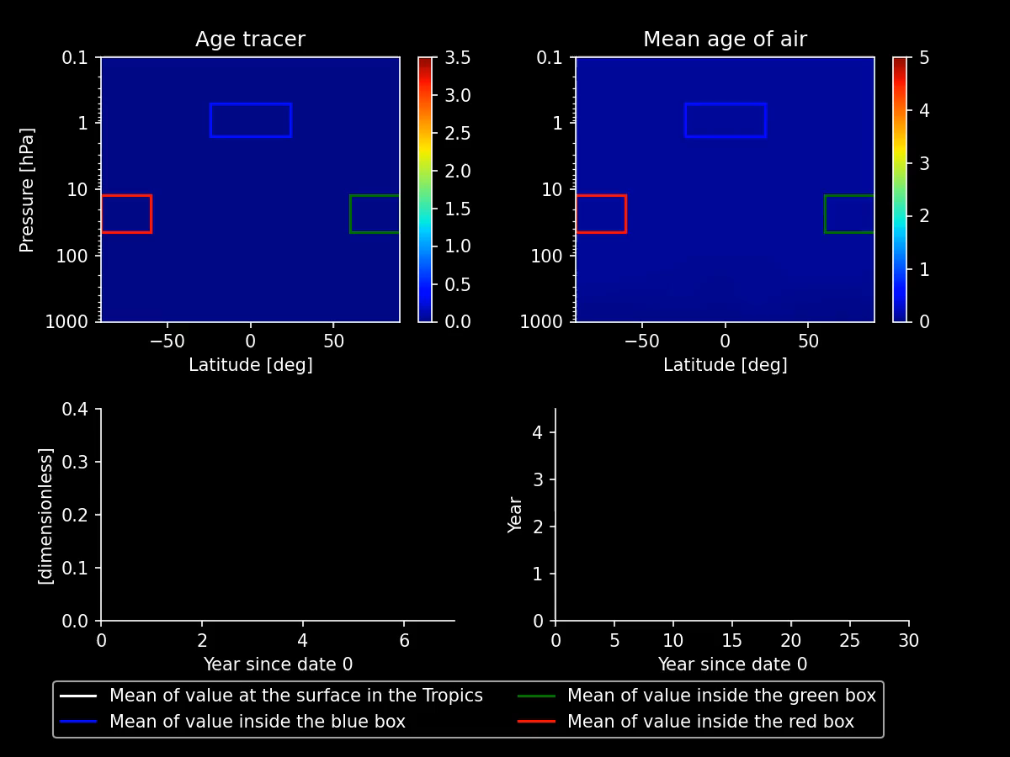
Perpetual QBO simulations
To determine if reduced grids are good:
compare model AoA on different grids
No chemistry calculation needed (fast!)
Only two years of reanalysis data (1980-1981) that are used in loop.
CAIRT UCM presentation

Slide 26
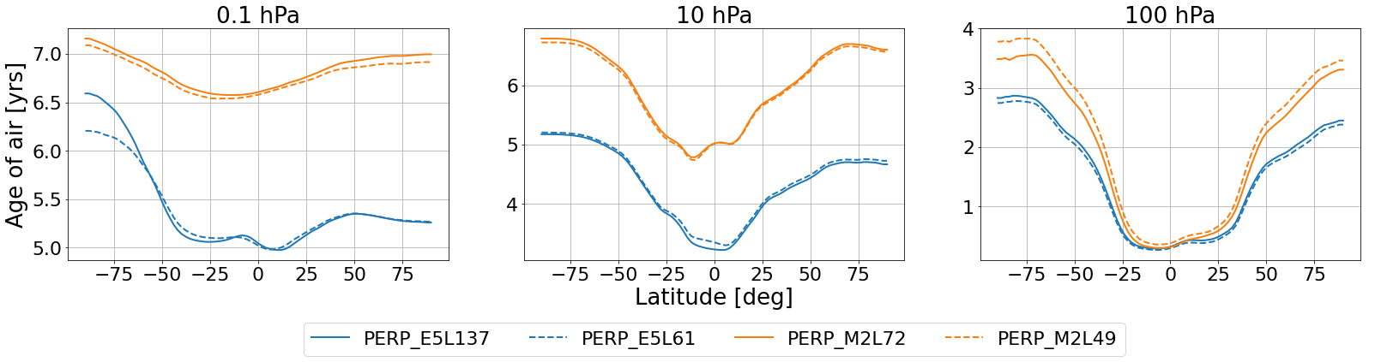

Perpetual QBO simulations
To determine if reduced grids are good:
compare model AoA on different grids.
Plots for June in the last year of the simulation.

Slide 27
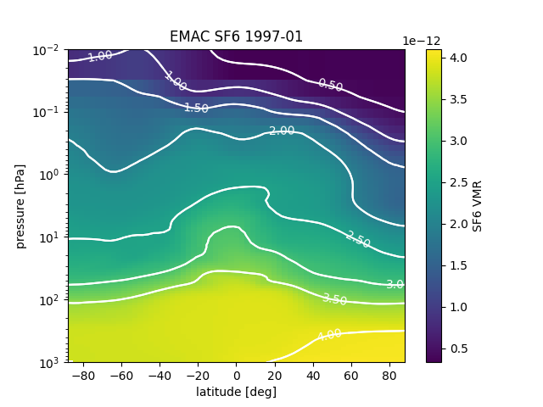


BASCOE simulations
Finally: run BASCOE with ERA5 on 61 vertical levels and MERRA2 on 49 vertical levels
Horizontal resolution 2° x 2.5° lat-lon.
Start: 1997
End: 2012 (now extended)
Initial condition for SF₆: EMAC monthly mean simulation results
Lower boundary conditions: Gidden et al. (2019) GMD and Meinshausen et al. (2016) GMD
MIPAS 2002/07 – 2012/04

Slide 28
The Brewer-Dobson circulation
SF₆ chemistry in BASCOE
BASCOE simulations
Validation of simulation results
Sampling bias

Slide 29
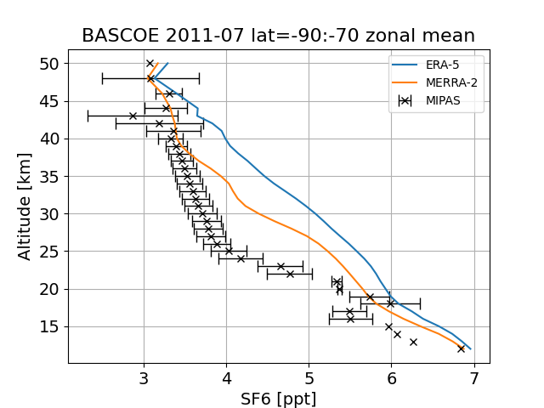
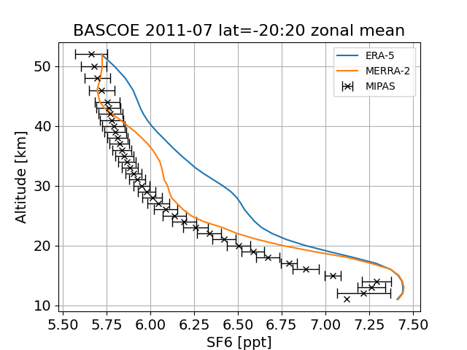
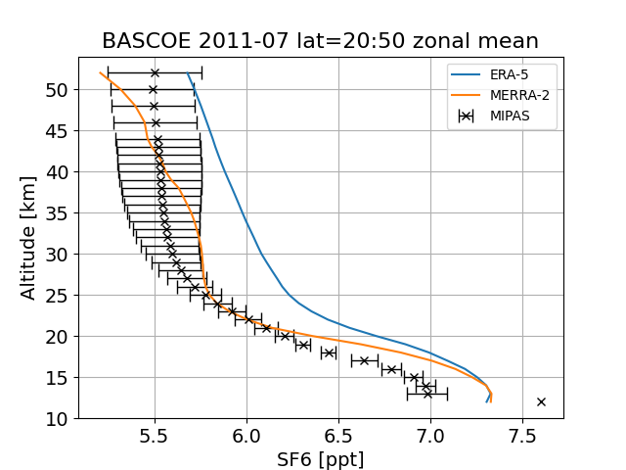
Validation part 1: comparison with observations
To compare with satellite data: get the model in observation space
  BASCOE interpolates model output at the locations of available observations (MIPAS, ACE-FTS) during runtime
MIPAS (Michelson Interferometer for Passive Atmospheric Sounding): Fourier Transform spectrometer operational between 2002-07 and 2012-04 with failure in 2004.

Slide 30
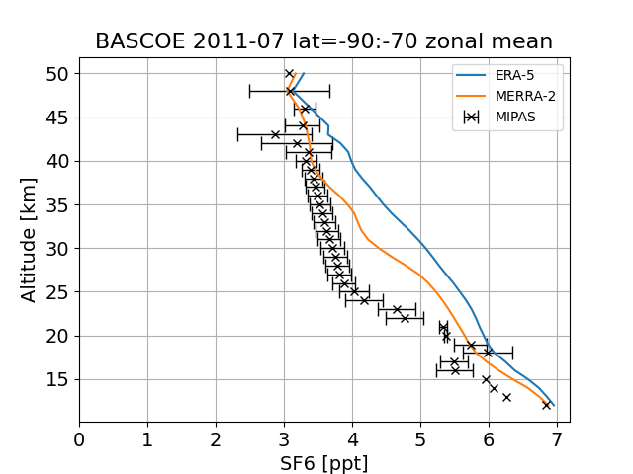
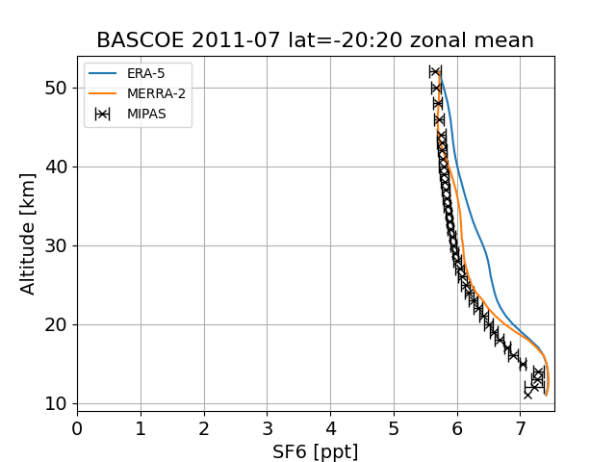
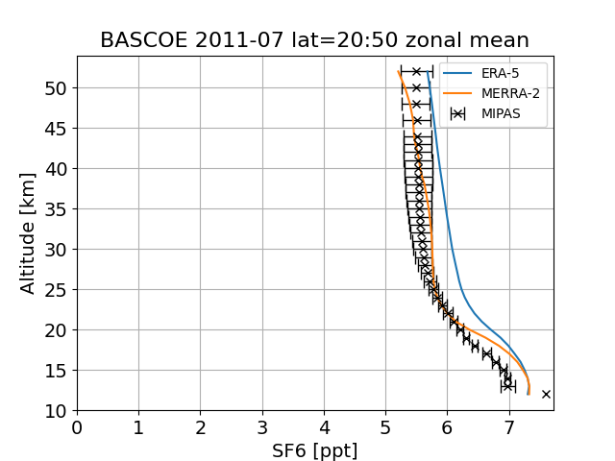
Validation part 1: comparison with observations
To compare with satellite data: get the model in observation space
  BASCOE interpolates model output at the locations of available observations (MIPAS, ACE-FTS) during runtime
MIPAS (Michelson Interferometer for Passive Atmospheric Sounding): Fourier Transform spectrometer operational between 2002-07 and 2012-04 with failure in 2004.
(it’s not as bad as it looks)

Slide 31
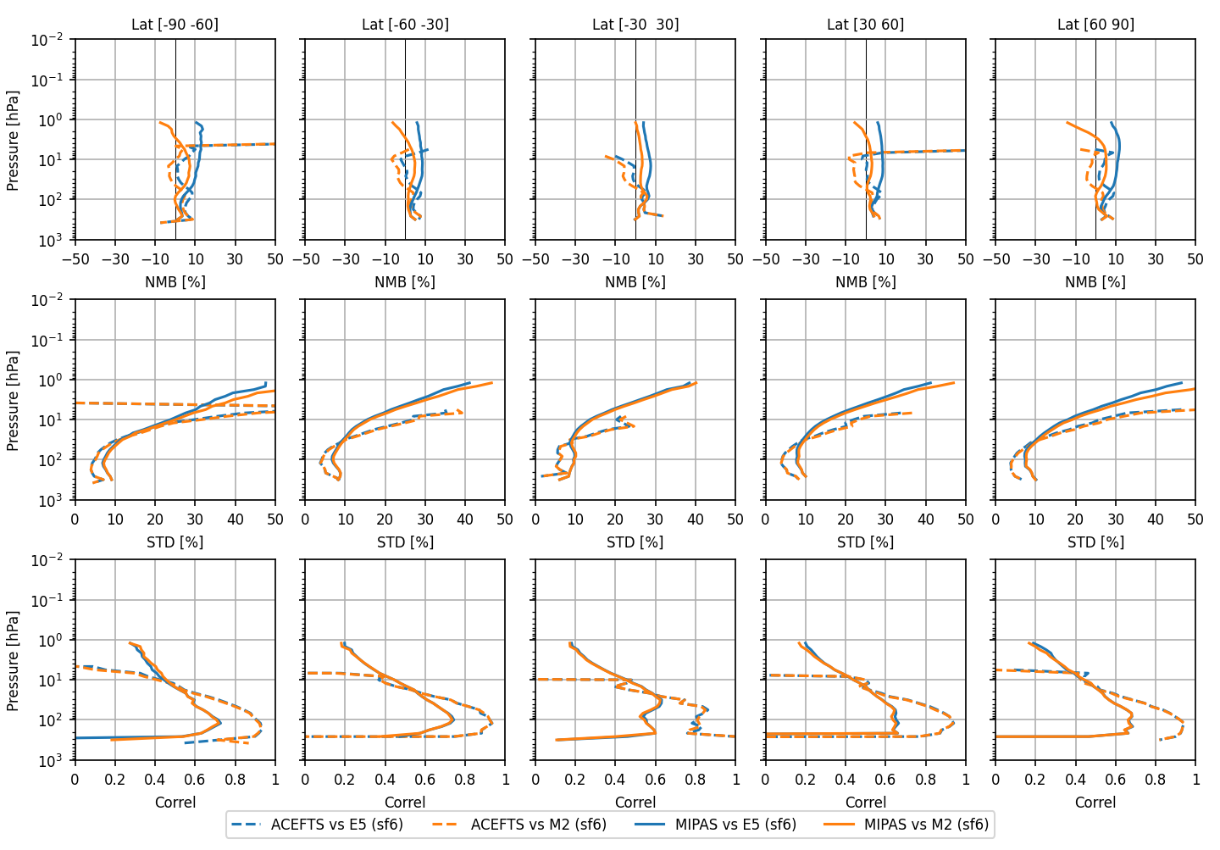
Validation part 1: comparison with observations
Bias
Standard
deviation
Correlations
(For MIPAS: only 2005-2012)

Slide 32
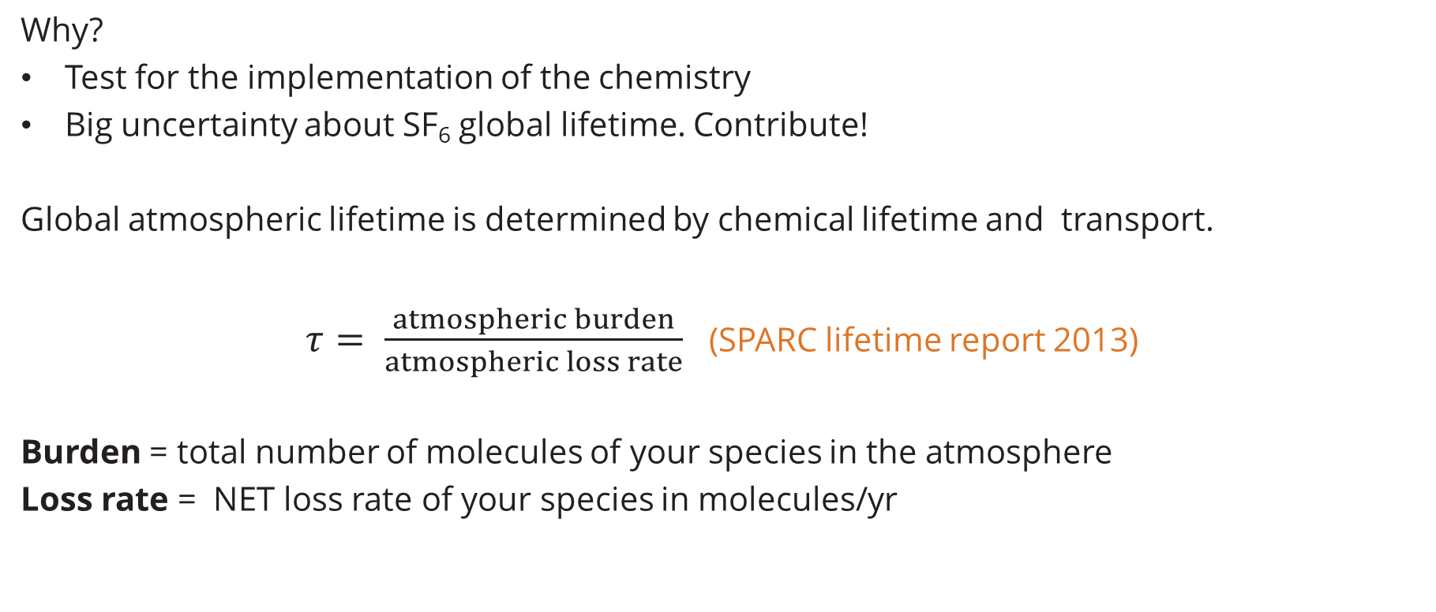
Validation part 2: atmospheric lifetime
Why?
Test for the implementation of the chemistry
Big uncertainty about SF₆ global lifetime. Contribute!
Global atmospheric lifetime is determined by chemical lifetime and transport.
$τ= \frac{atmospheric burden}{atmospheric loss rate}$ (SPARC lifetime report 2013)
Burden = total number of molecules of your species in the atmosphere
Loss rate = NET loss rate of your species in molecules/yr

Slide 33
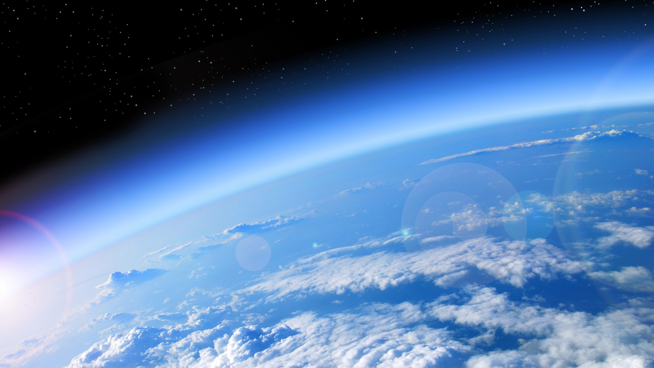
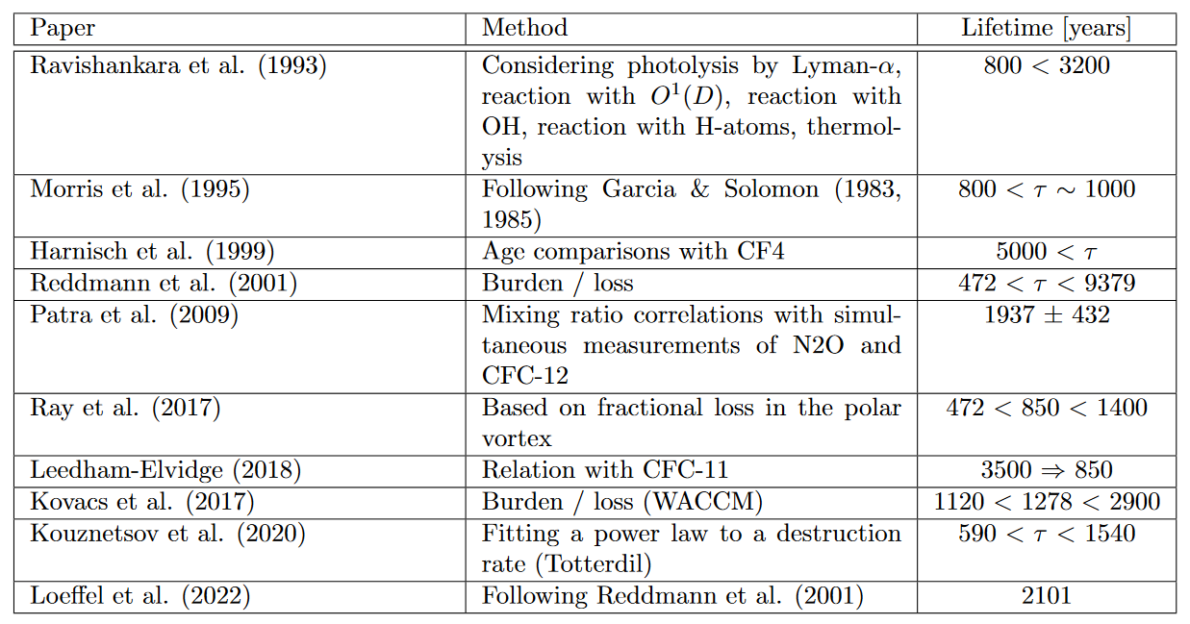
Literature overview of the published values of SF₆ lifetime

Slide 34

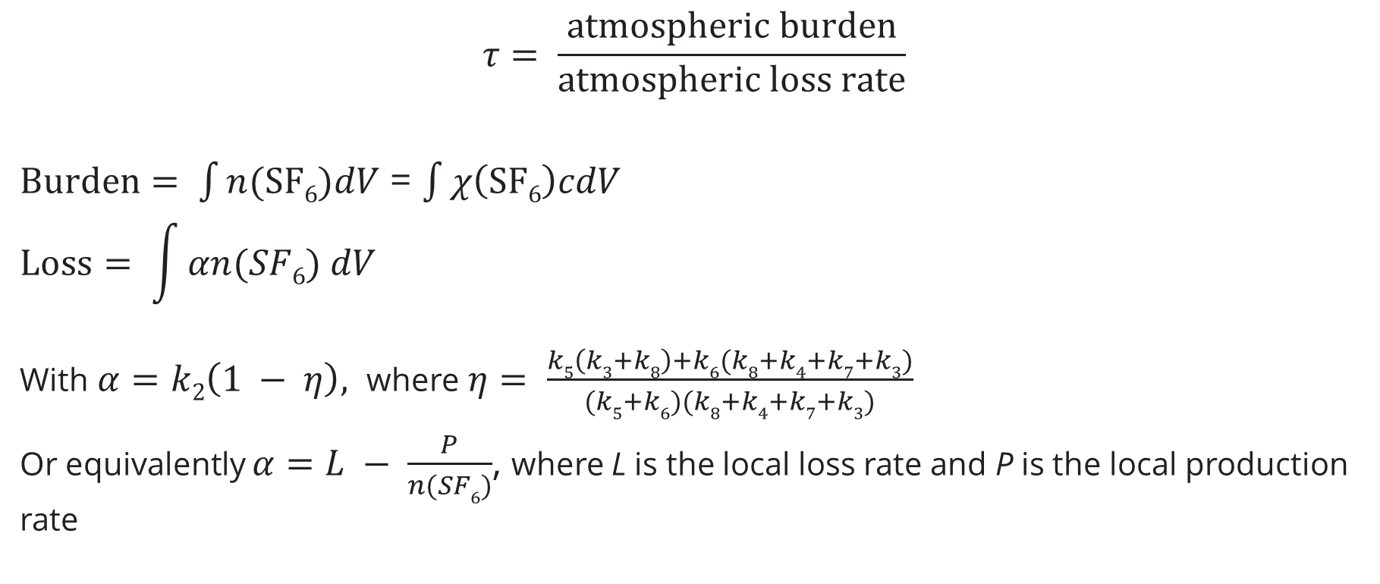
Validation part 2: atmospheric lifetime
$$τ= \frac{atmospheric burden}{atmospheric loss rate}$$
$Burden= \int{n(SF6)dV}$ = $\int{χ\left(SF6\right)cdV}$
$$Loss= \int{αn(SF6) dV}$$
With $α=k2\left(1 − η\right),$ where $η= \frac{k5\left(k3+k8\right)+k6(k8+k4+k7+k3)}{(k5+k6)(k8+k4+k7+k3)}$
Or equivalently $α=L − \frac{P}{n(SF6)}$, where L is the local loss rate and P is the local production rate
Compute from a snapshot
Notes:
L and P are computed by KPP and outputted by BASCOE

Slide 35
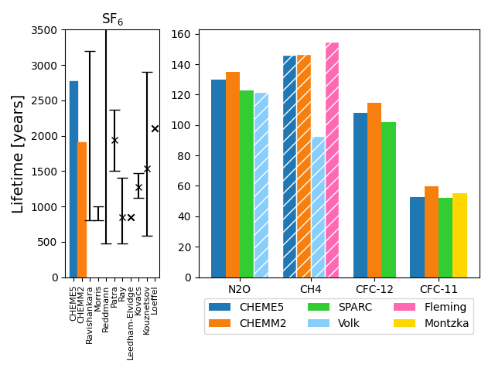
Validation part 2: atmospheric lifetime
CHEME5 = BASCOE run with ERA5 on 61 levels
CHEMM2 = BASCOE run with MERRA2 on 49 levels
For SF₆: large difference between ERA5 and MERRA2
Hatched = stratospheric lifetime (troposphere not included in the loss rates)

Slide 36
The Brewer-Dobson circulation
SF₆ chemistry in BASCOE
BASCOE simulations
Validation of simulation results
Sampling bias

Slide 37
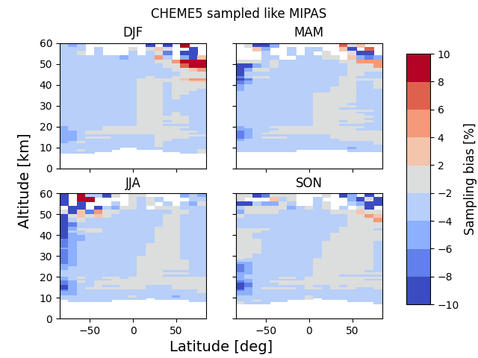

Sampling bias (work in progress)
Normalized difference between the model “in model space” and the model “in observation space” (e.g. at MIPAS locations), computed from SF₆.
$$sampling bias= \frac{mod at obs −mod}{mod at obs}$$
Bias computed per month, then averaged over the MIPAS observation period (2002-2012) per season
Notes:
(Mod at obs - full model) / mod at obs

Slide 38
Sampling bias (work in progress)
Difference between the model “in model space” and the model “in observation space”, computed from mean age of air. Bias of 0.25 years important for CAIRT?
From SF₆
From AoA

Slide 39
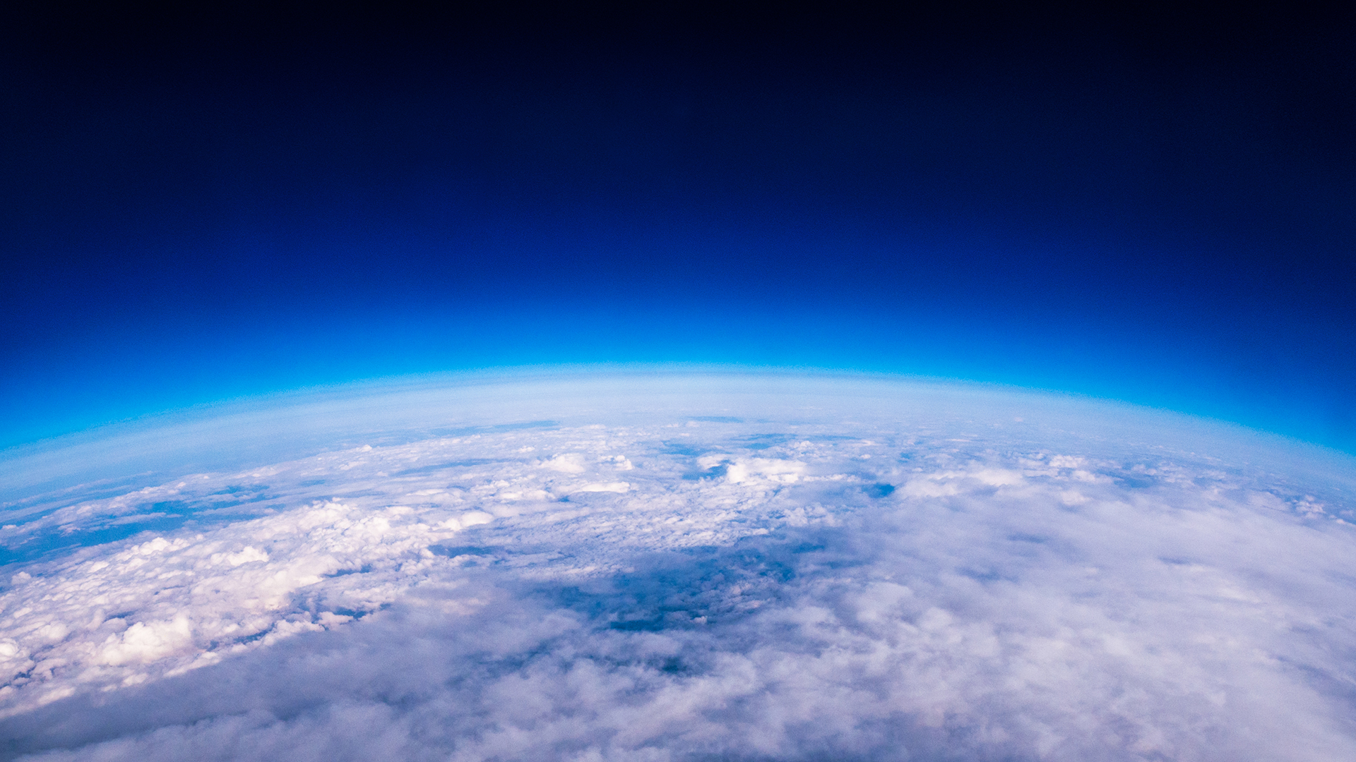
Summary
GCM predict increase in BDC strength due to rising GHG
BDC studies via trace gases in the middle atmosphere
Age of air as BDC diagnostic: computed from long lived trace gases with linear increase
SF₆ included in BASCOE chemistry transport model
Check implementation:
  Compare with satellite observations (MIPAS, ACE-FTS)
  Compute global atmospheric lifetime of SF₆: works good for other species as well
Compute mean age of air from SF₆ (nonlinearity correction)
Look at sampling bias: origin not yet known
What’s next: OSSE for CAIRT

Slide 40

thank you!

Slide 41
References (figures)
Slide 2: Holton, J. R., Andrews, D. G., & Leovy, C. B. (1987). Middle Atmosphere Dynamics (Vol. 40). Academic Press Inc.
Slide 5: Bönisch, H., Engel, A., Birner, T., Hoor, P., Tarasick, D. W., & Ray, E. A. (2011). On the structural changes in the Brewer-Dobson circulation after 2000. Atmospheric Chemistry and Physics, 11(8), 3937–3948. https://doi.org/10.5194/acp-11-3937-2011
Slide 6: Butchart, N. (2014). The Brewer-Dobson circulation. Reviews of Geophysics, 52(2), 157–184. https://doi.org/10.1002/2013RG000448
Slide 7: Lin, P., & Fu, Q. (2013). Changes in various branches of the Brewer-Dobson circulation from an ensemble of chemistry climate models. Journal of Geophysical Research Atmospheres, 118(1), 73–84. https://doi.org/10.1029/2012JD018813
Slide 8: Newman, P. A., Ko, M. K., Reimann, S., Strahan, S. E., Atlas, E. L., Burkholder, J. B., ... & Stolarski, R. S. (2013, December). Lifetimes of stratospheric ozone-depleting substances, their replacements, and related species. In AGU Fall Meeting Abstracts (Vol. 2013, pp. A23F-0354).
Slide 9: ESA (2023). Report for Assessment: Earth Explorer 11 Candidate Mission CAIRT, European Space Agency, Noordwijk, The Netherlands, ESA-EOPSM-CAIR-RP-4372, 122pp
Andrews, A. E., Boering, K. A., Daube, B. C., Wofsy, S. C., Loewenstein, M., Jost, H., Podolske, J. R., Webster, C. R., Herman, R. L., Scott, D. C., Flesch, G. J., Moyer, E. J., Elkins, J. W., Dutton, G. S., Hurst, D. F., Moore, F. L., Ray, E. A., Romashkin, P. A., & Strahan, S. E. (2001). Mean ages of stratospheric air derived from in situ observations of CO2, CH4, and N2O. Journal of Geophysical Research Atmospheres, 106(D23), 32295–32314. https://doi.org/10.1029/2001JD000465
Slide 10: Lahoz, W. A., & Schneider, P. (2014). Data assimilation: making sense of Earth Observation. Frontiers in Environmental Science, 2, 16.

Slide 42
References (figures)
Slide 13: NOAA (n.d.) The OSSE checklist, a supplement to Future Observing System Simulation Experiments by Ross N. Hoffman and Robert Atlas. https://www.aoml.noaa.gov/qosap/osse-checklist/
Data assimilation: https://strato.aeronomie.be/bascoe
Slide 16: NOAA (n.d.). Sulfur hexafluoride (SF6) - Combined Dataset. Global Monitoring Laboratory. NOAA Global Monitoring Laboratory - Halocarbons and other Atmospheric Trace Species
Slide 18: UCAR (n.d.). The Thermosphere. Center for science education. The Thermosphere | Center for Science Education (ucar.edu)
Slide 19: Brasseur, G. P., & Solomon, S. (2005). Aeronomy of the Middle Atmosphere.
Slide 21: Datskos, P. G., Carter, J. G., & Christophorou, L. G. (1995). Photodetachment of SF6−. Chemical physics letters, 239(1-3), 38-43.
Slide 25: From CAIRT User Consultation Meeting presentation

Slide 43
References
Loeffel, S., Eichinger, R., Garny, H., Reddmann, T., Fritsch, F., Versick, S., Stiller, G., & Haenel, F. (2022). The impact of sulfur hexafluoride (SF6) sinks on age of air climatologies and trends. Atmospheric Chemistry and Physics, 22(2), 1175–1193. https://doi.org/10.5194/acp-22-1175-2022
Reddmann, T., Ruhnke, R., & Kouker, W. (2001). Three-dimensional model simulations of SF6 with mesospheric chemistry. Journal of Geophysical Research Atmospheres, 106(D13), 14525–14537. https://doi.org/10.1029/2000JD900700
Stiller, G. P., von Clarmann, T., Haenel, F., Funke, B., Glatthor, N., Grabowski, U., Kellmann, S., Kiefer, M., Linden, A., Lossow, S., & López-Puertas, M. (2012). Observed temporal evolution of global mean age of stratospheric air for the 2002 to 2010 period. Atmospheric Chemistry and Physics, 12(7), 3311–3331. https://doi.org/10.5194/acp-12-3311-2012
Oberländer‐Hayn, S., Gerber, E. P., Abalichin, J., Akiyoshi, H., Kerschbaumer, A., Kubin, A., ... & Oman, L. D. (2016). Is the Brewer‐Dobson circulation increasing or moving upward?. Geophysical Research Letters, 43(4), 1772-1779.
Chabrillat, S., Vigouroux, C., Christophe, Y., Engel, A., Errera, Q., Minganti, D., Monge-Sanz, B. M., Segers, A., & Mahieu, E. (2018). Comparison of mean age of air in five reanalyses using the BASCOE transport model. Atmospheric Chemistry and Physics, 18(19), 14715–14735. https://doi.org/10.5194/acp-18-14715-2018

Slide 44
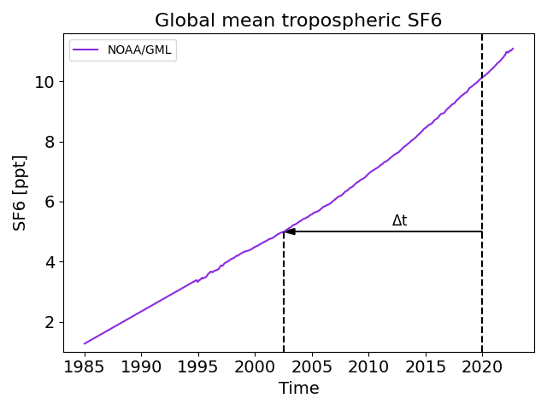


Appendix 1: Age of air computation
Use global mean tropospheric SF₆ as a reference for the age of air.
SF₆ emission not perfectly linear…
Correction method:
Calculate lag time with a tropospheric reference
Calculate age spectrum with first guess Γ
Calculate new (“propagated”) SF₆
If new SF₆ matched original SF₆, then Γ = mean age

Slide 45
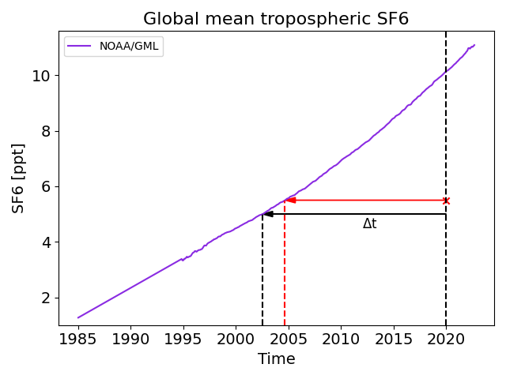
Appendix 1: Age of air computation
SF₆ emission not perfectly linear…
Correction method:
Calculate lag time with a tropospheric reference
Calculate age spectrum with first guess Γ
Calculate new (“propagated”) SF₆
If new SF₆ matched original SF₆, then Γ = mean age

