Slide 1
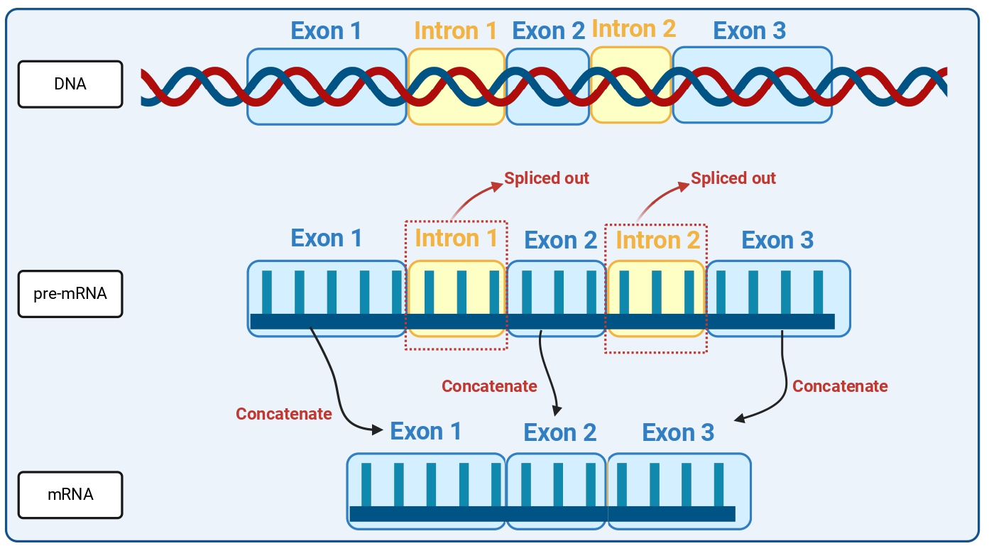
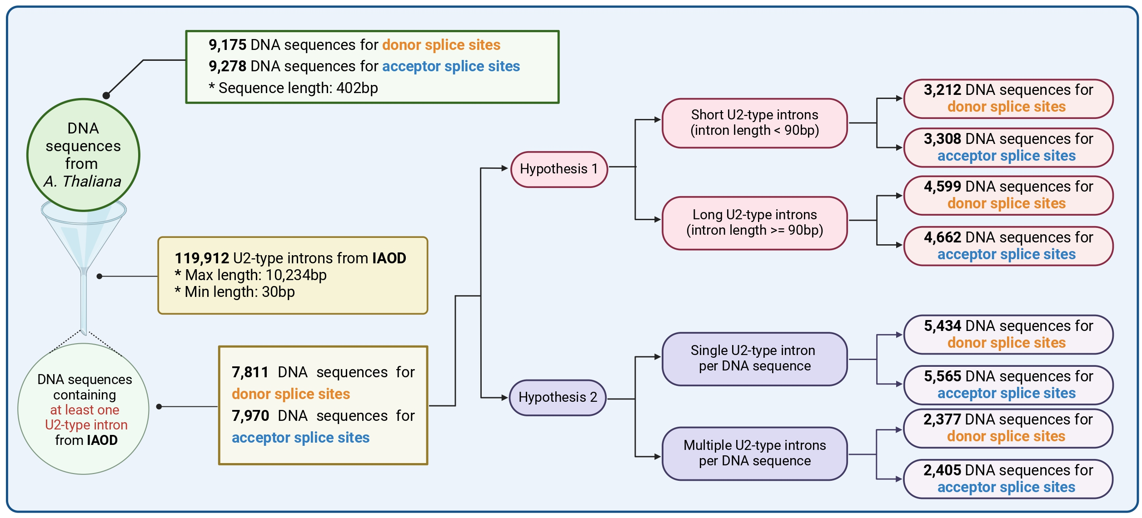
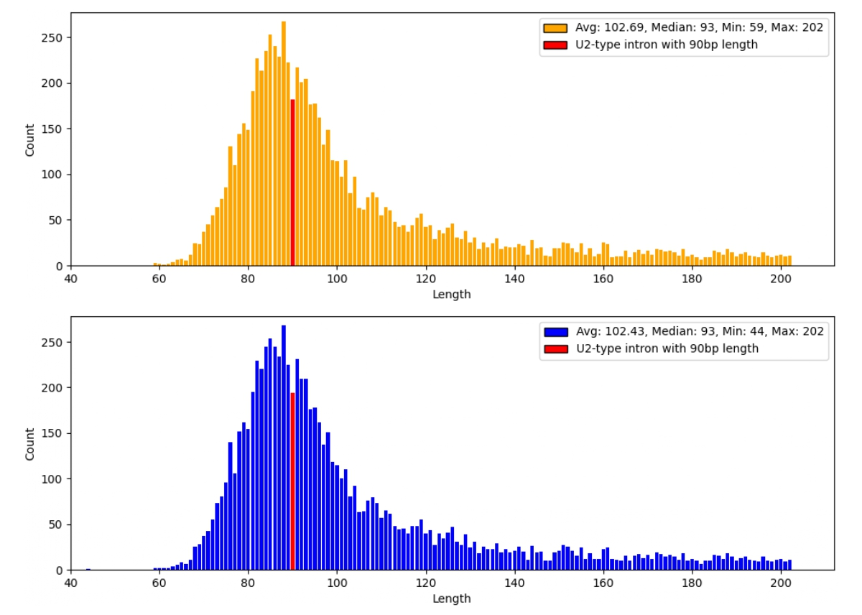
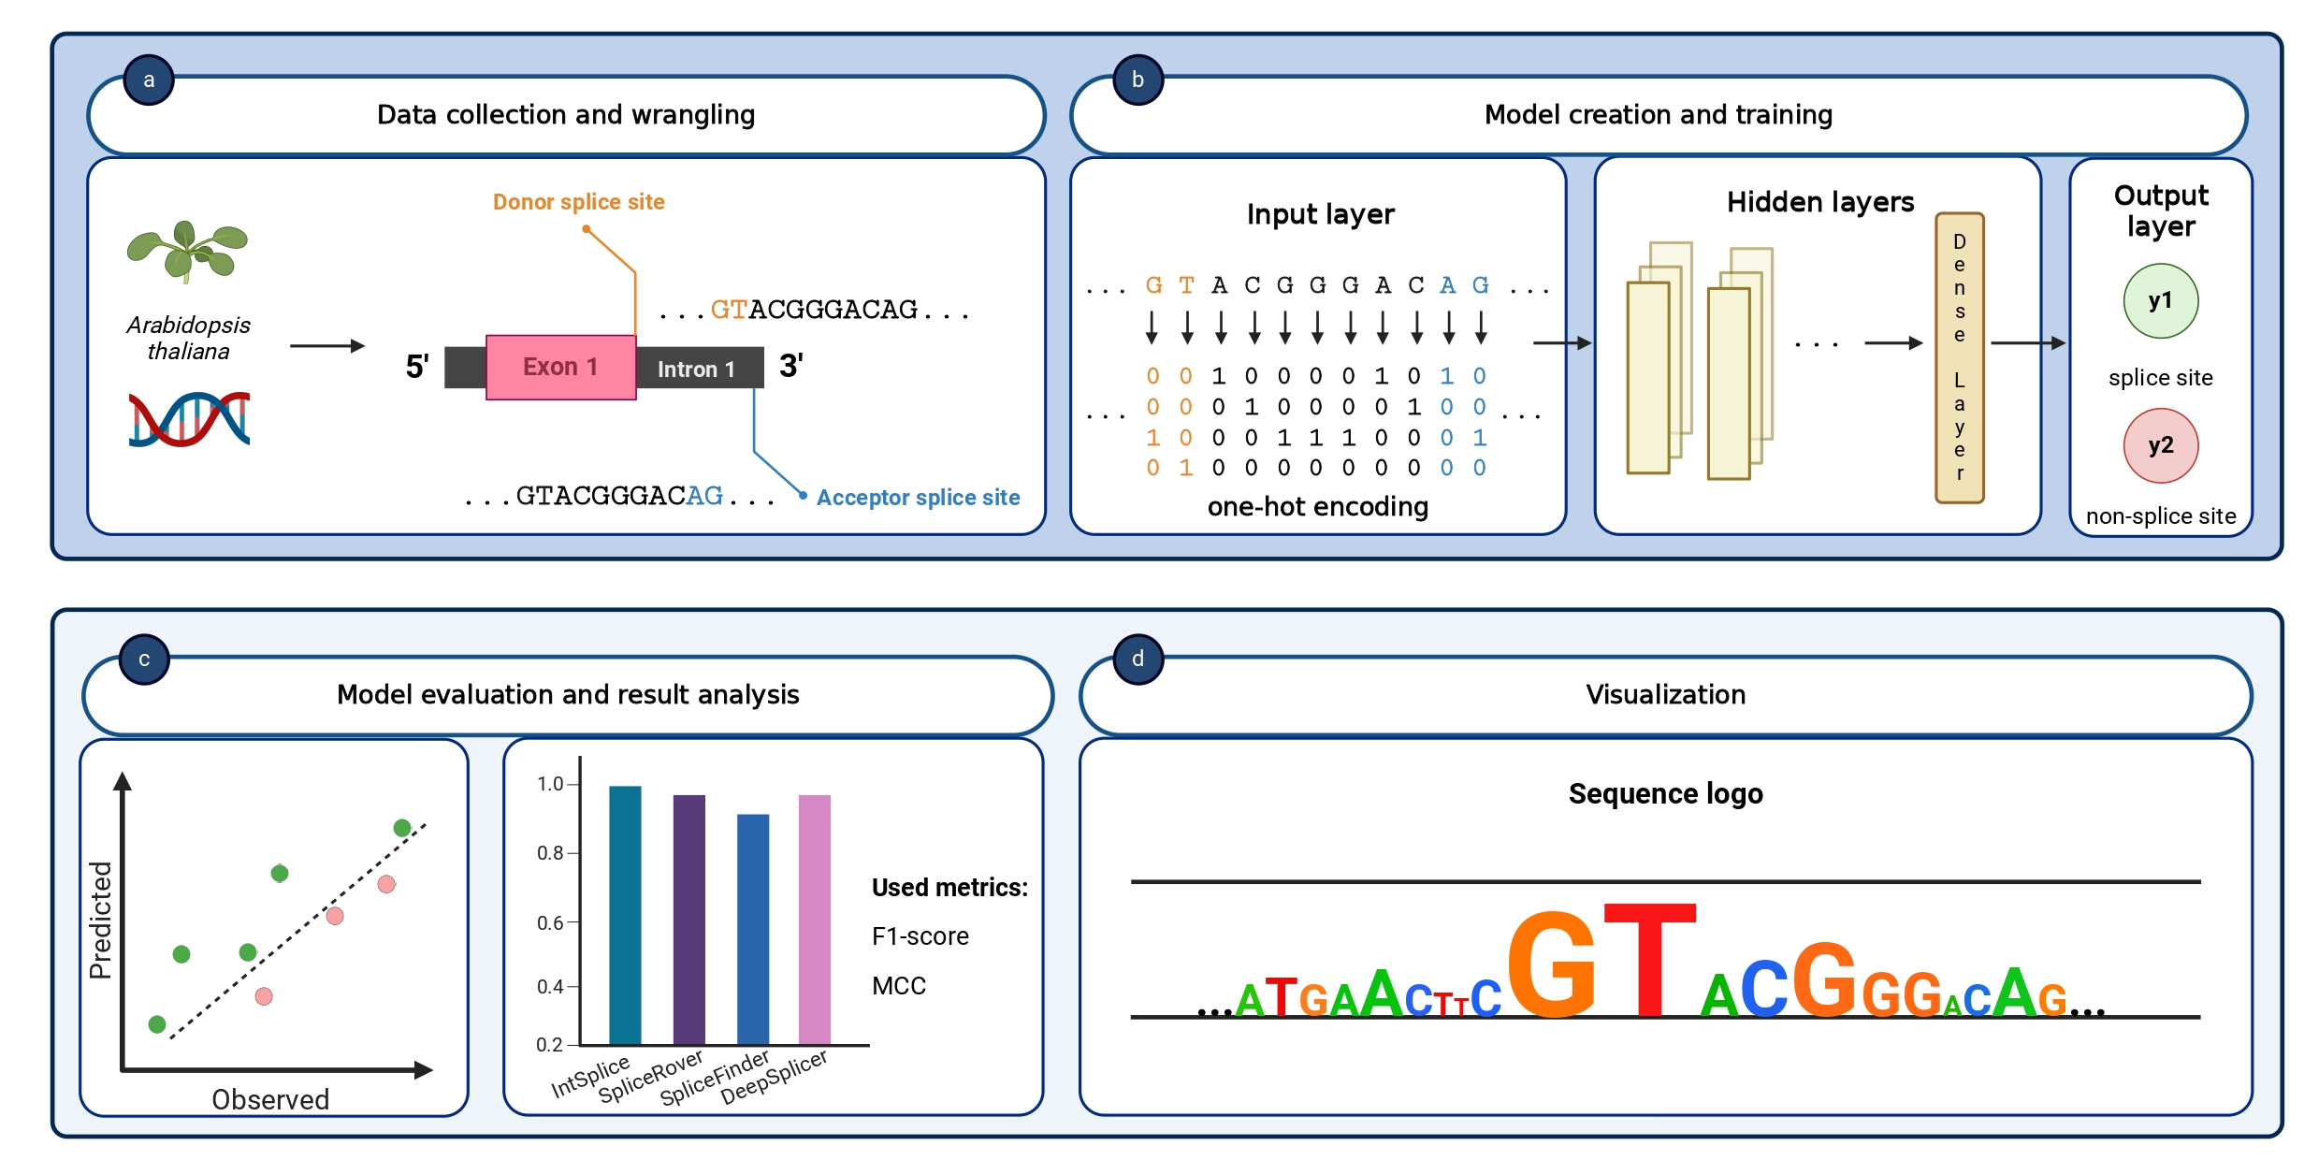
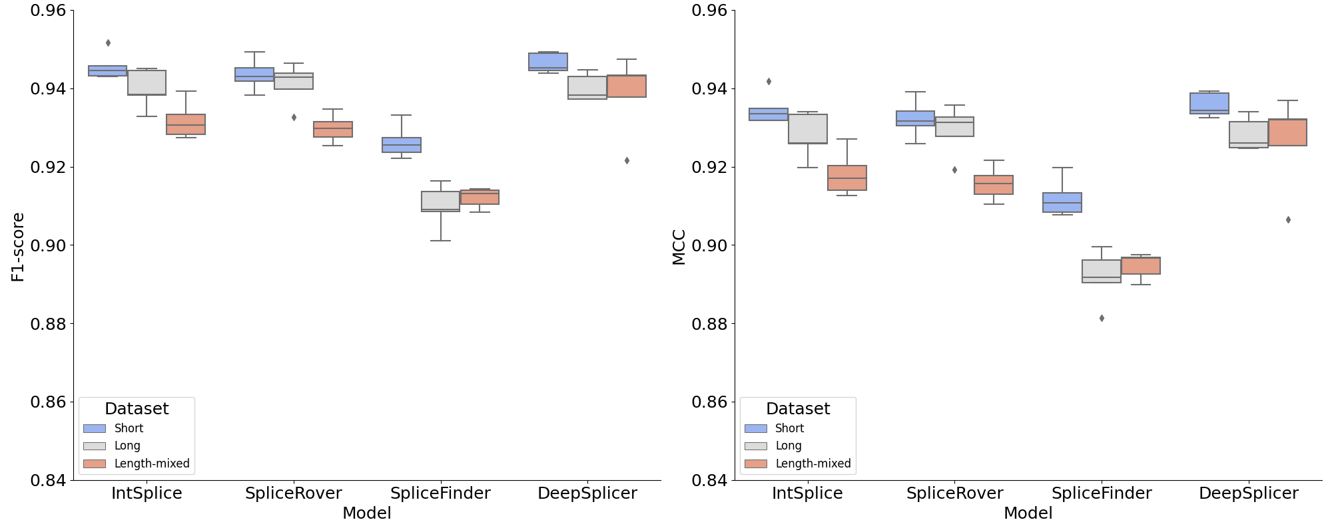
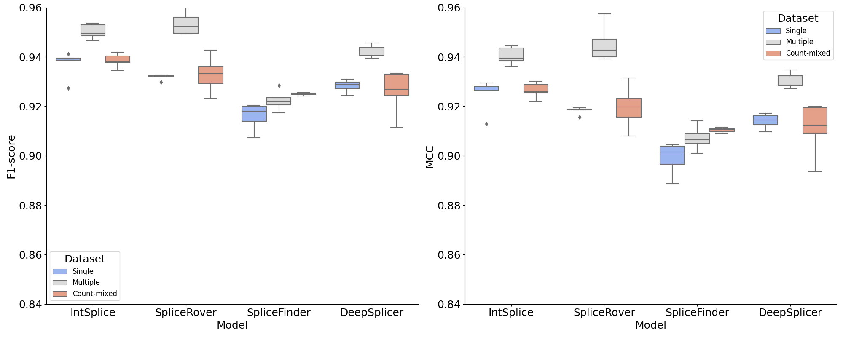
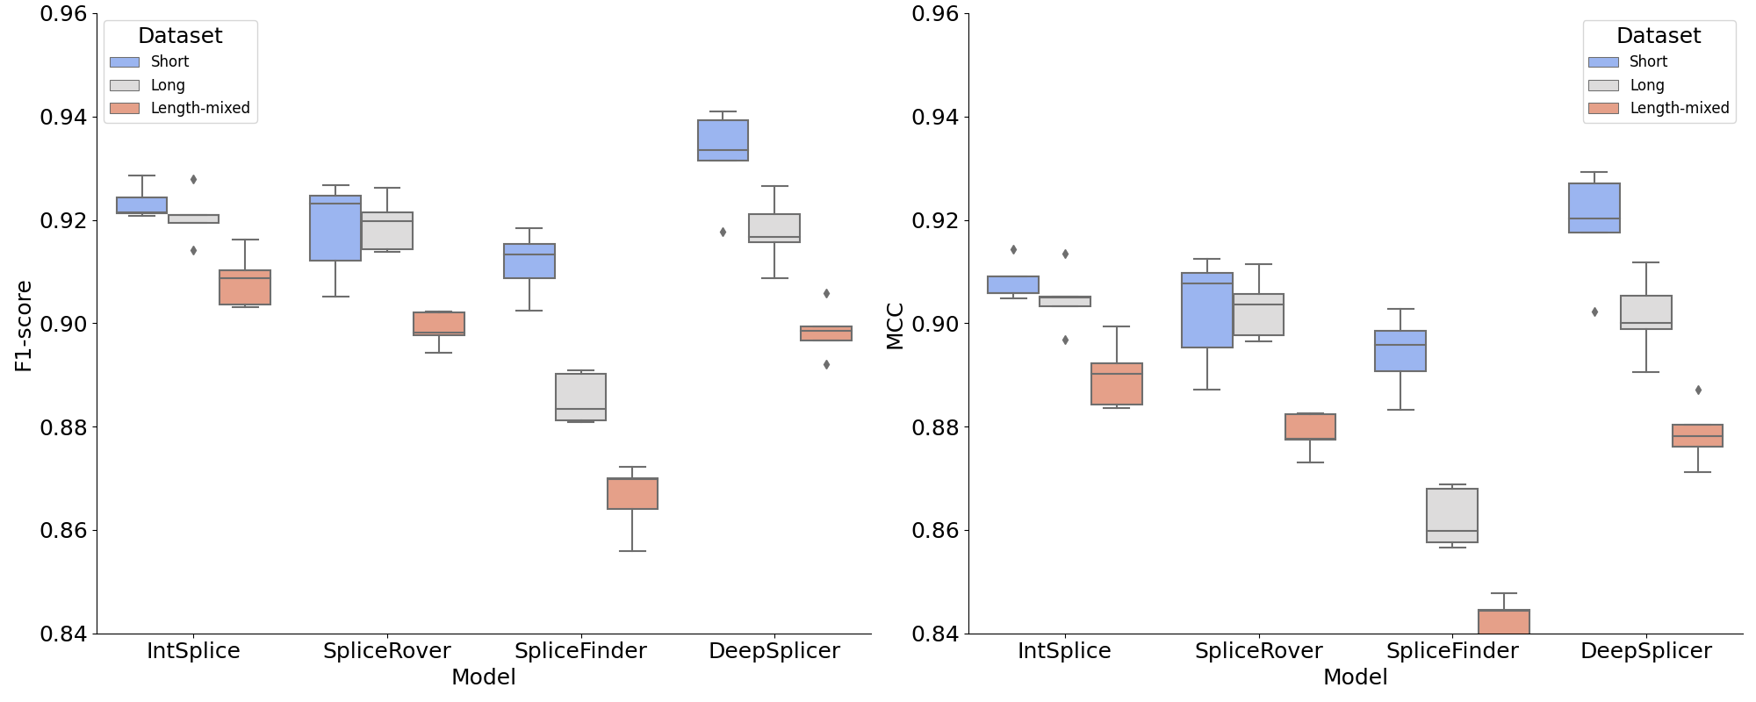
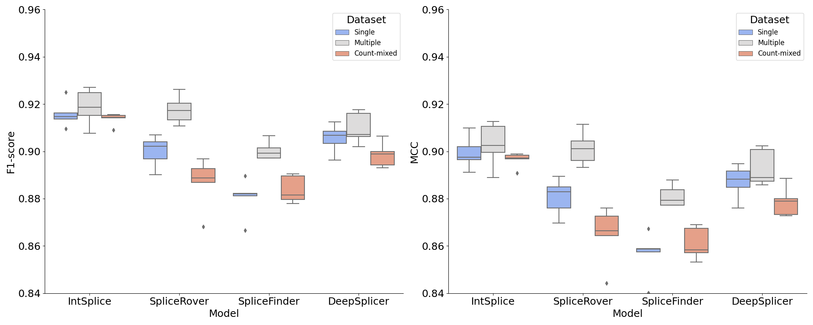
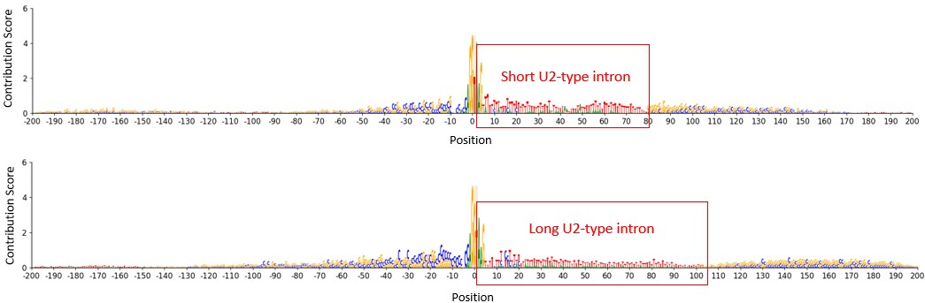
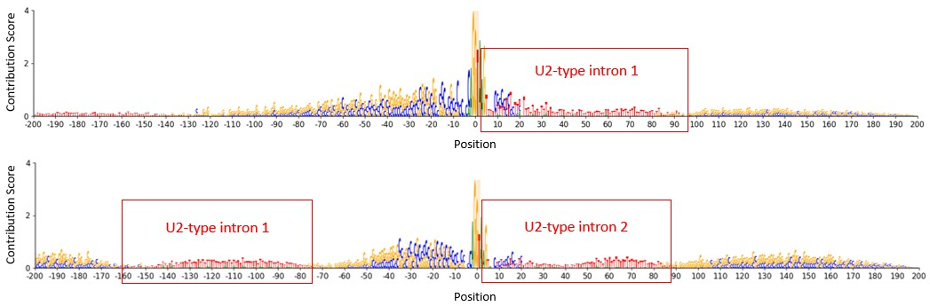



Impact of u2-type introns on splice site prediction in arabidopsis thaliana using deep learning
CENTER FOR BIOSYSTEMS AND BIOTECH DATA SCIENCE
Espoir Kabanga, Soeun Yun, Arnout Van Messem, Wesley De Neve
Abstract
In this study, we use deep learning to explore how intron characteristics affect the accuracy of splice site predictions in Arabidopsis thaliana. Focusing on U2-type introns due to their prevalence in plant genomes and their relevance for large-scale data analysis, we demonstrate that both the length of U2-type introns and the number of U2-type introns present in a DNA sequence substantially influence prediction outcomes. Our findings highlight that deep learning models trained on data with shorter introns or multiple introns per sequence produce better predictions. Moreover, these findings align with observations from laboratory experiments, suggesting the practical value of computational approaches in understanding gene splicing.
Splicing mechanism
Hypotheses and data description
U2-type intron length distribution
Study workflow
Short versus long U2-type intron results
Description of results
Single versus multiple U2-type intron results
Donor splice sites
Higher effectiveness in predicting splice sites on datasets with short U2-type introns
Higher effectiveness in predicting splice sites on datasets with multiple U2-type introns per sequence
Models are capable of distinguishing short U2-type introns from long U2-introns within a sequence
Models are capable of distinguishing sequences with single U2-type introns from sequences with multiple U2-type introns
Donor splice sites
Acceptor splice sites
Acceptor splice sites
Conclusions
This work highlights the complexity and importance of intron characteristics in splice site prediction
This work demonstrates the necessity of advanced models to capture nuanced biological signals for accurate splice site prediction
Contact: espoir.kabanga@ghent.ac.kr
[1] Dewey et al., Compensatory relationship between splice sites and exonic splicing signals depending on the length of vertebrate introns, BMC Bioinformatics, 2006
[2] Crabb et al., Retention of spliceosomal components along ligated exons ensures efficient removal of multiple introns, RNA, 2010

