Slide 1

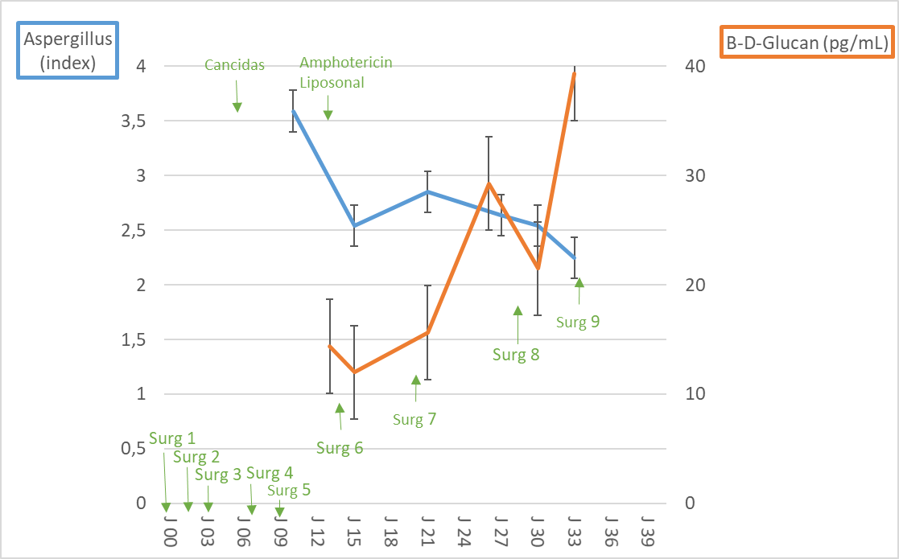
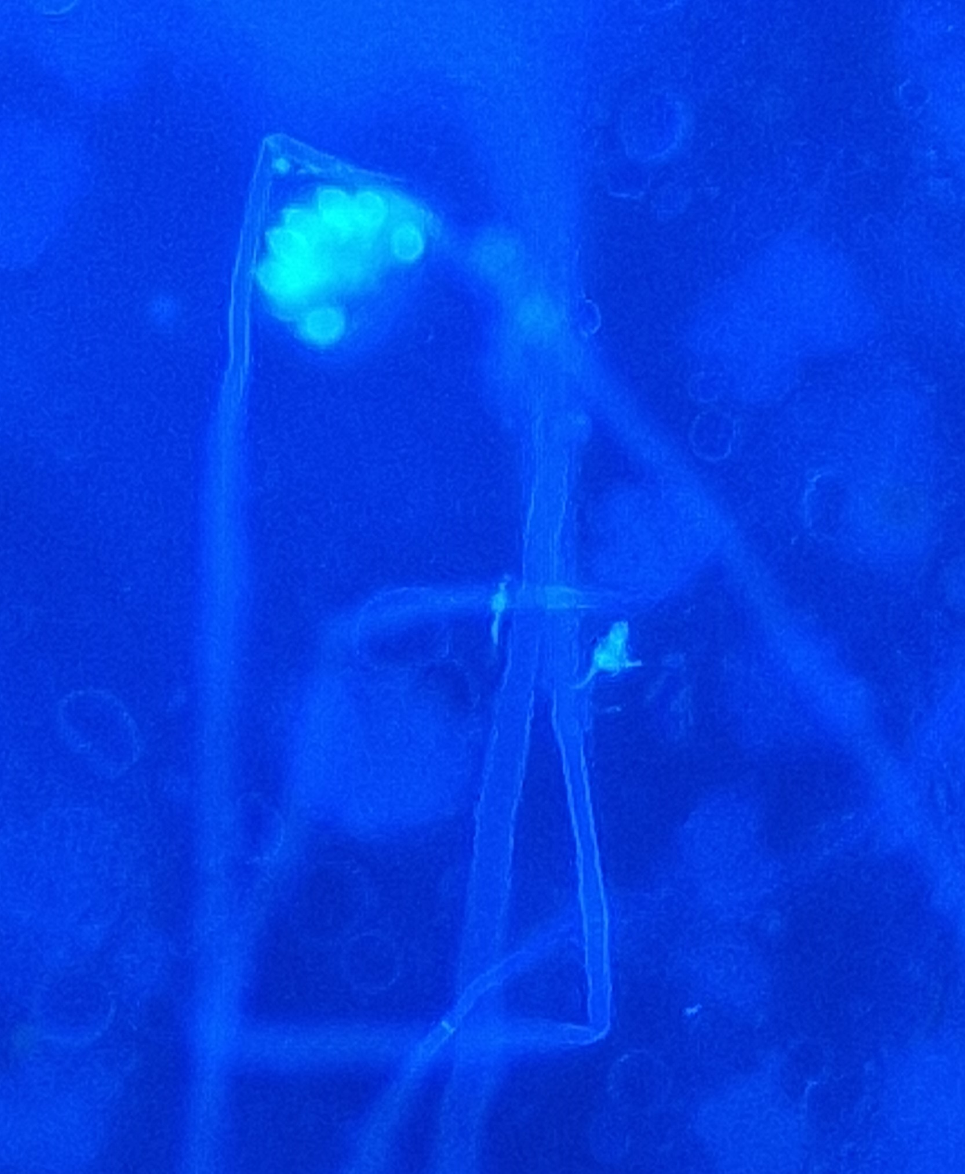
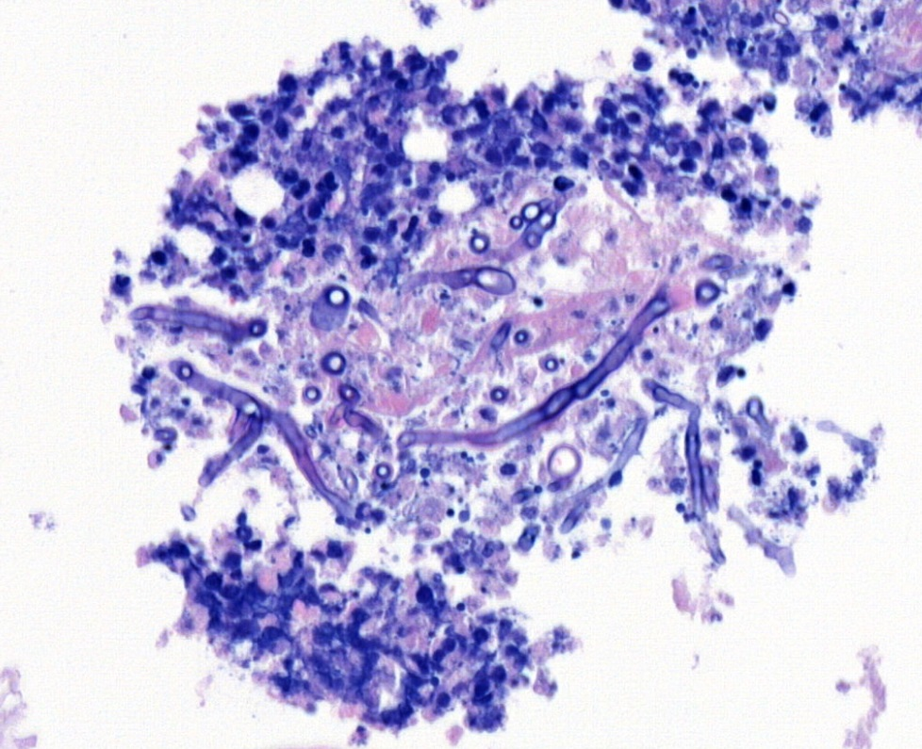
P4223
Aspergillus fumigatus fasciitis and peritonitis: a rare postoperative case
M-A Bovy¹, P. Beckers ², F. Defawe³, F. Lifrange³, M-P Hayette², N. Layios¹
(1) Department of ICU, University Hospital of Liege, 4000 Liege, Belgium ,(2) Department of Microbiology, University Hospital of Liege, 4000 Liege, Belgium
(3) Department of Anatomical Pathology, University Hospital of Liege, 4000 Liege, Belgium
Background: Aspergillus Fumigatus peritonitis is a rare nosocomial entity. It is mostly associated with peritoneal dialysis but is uncommun postoperatively in immunocompetent adults[1]. An ancillary case series described only 10/500 (2%) of cases of postoperative invasive aspergillosis[2]. Early diagnosis and prognosis could be ameliorated by serial biomarkers.
Case description: We describe a rare incidence of fasciitis and secondary peritonitis caused by Aspergillus fumigatus following radical prostatectomy. The patient developed multi-organ failure due to Fournier's gangrene which originated from nearing peritoneal drains. Repeated surgical debridements, small bowel and colonic resections and empirical caspofungin treatment were undertaken because of mold-like macroscopic appearance. Notably, blood cultures throughout the treatment period were negative for fungi and levels of galactomannan and β-D-Glucan were consistently high, in parallel with the clinical course (Fig.1).
Fig.1. Mold biomarkers during ICU stay
Cultures of peritoneal fluid and bile (after resection of necrotic gallbladder) grew Aspergillus Fumigatus after enrichment (Fig. 2a). Despite the switch of the antifungal regimen to L-amphotericin B on day 14 and multiple debridements, this mold was consistently detected in peritoneal fluid samples with macroscopic confirmation. The patient succumbed on day 39. Wound swabs and biopsy confirmed Aspergillus Fumigatus presence, and histopathological analysis revealed mycelial filaments in adipose tissue at the wound margins (Fig. 2b).
Fig. 2a. Immunofluorescence microscopy revealing Aspergillus fumigatus in the patient's bile
Fig. 2b. Hematoxylin and Eosin stained section showing Aspergillus Fumigatus in the patient's adipose tissue
Discussion: This case raised questions about the origin of the fungal contamination—whether exogenous, originating from airborne spores in the surgical (ongoing construction work) or postoperative environment or endogenous, resulting from alterations in the patient's mycobiota[3, 4]. Exogenous non-airborne contamination such as potentially in our case, has been described in a liver transplant patient but not in immunocompetent patients [5]. Serial analysis of Galactomannan in peritoneal fluid has been proposed as an early diagnostic tool in non-neutropenic patients to ameliorate prognosis of intraabdominal aspergillosis but is still not available in routine clinical practice [6].
References: (1) Dotis, J et al., J Mycol Med 2020; (2) Pasqualotto et al., CMI 2006; (3) Jensen et al, J Infect 2010; (4) Limon et al, Cell Host Microbe 2017; (5 )Sartin, Eur J Clin Microbiol Infect Dis 1994; (6) Dichtl et al, Infection 2016.

