Slide 1
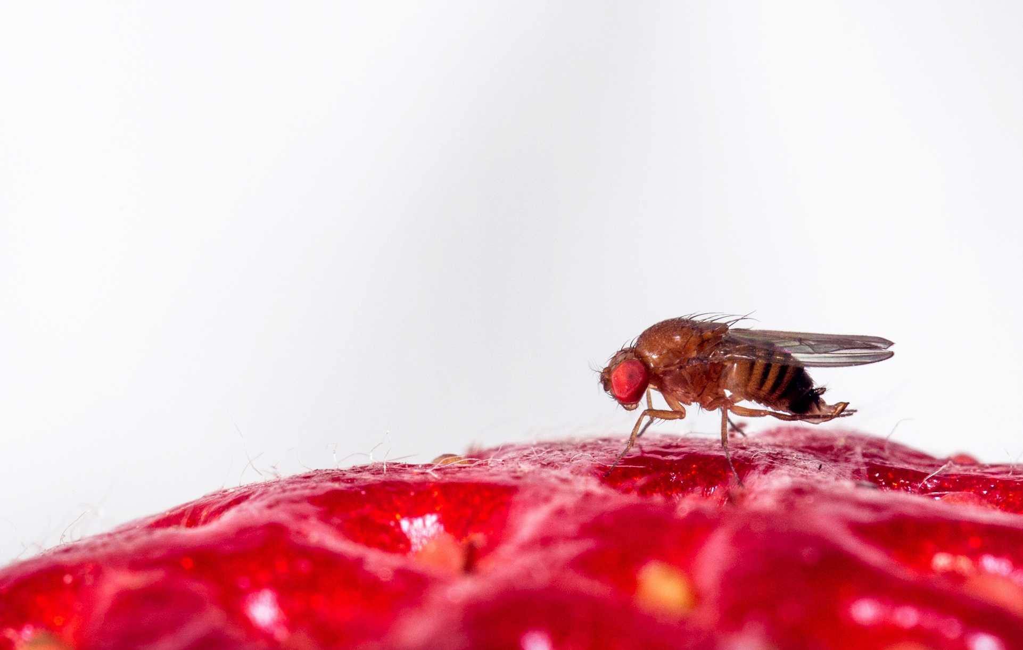
PhD student: Chloé Galland
Supervisor: Professor François Verheggen
Biocontrol of pest by semiochemicals and entomopathogenics fungi

Slide 2
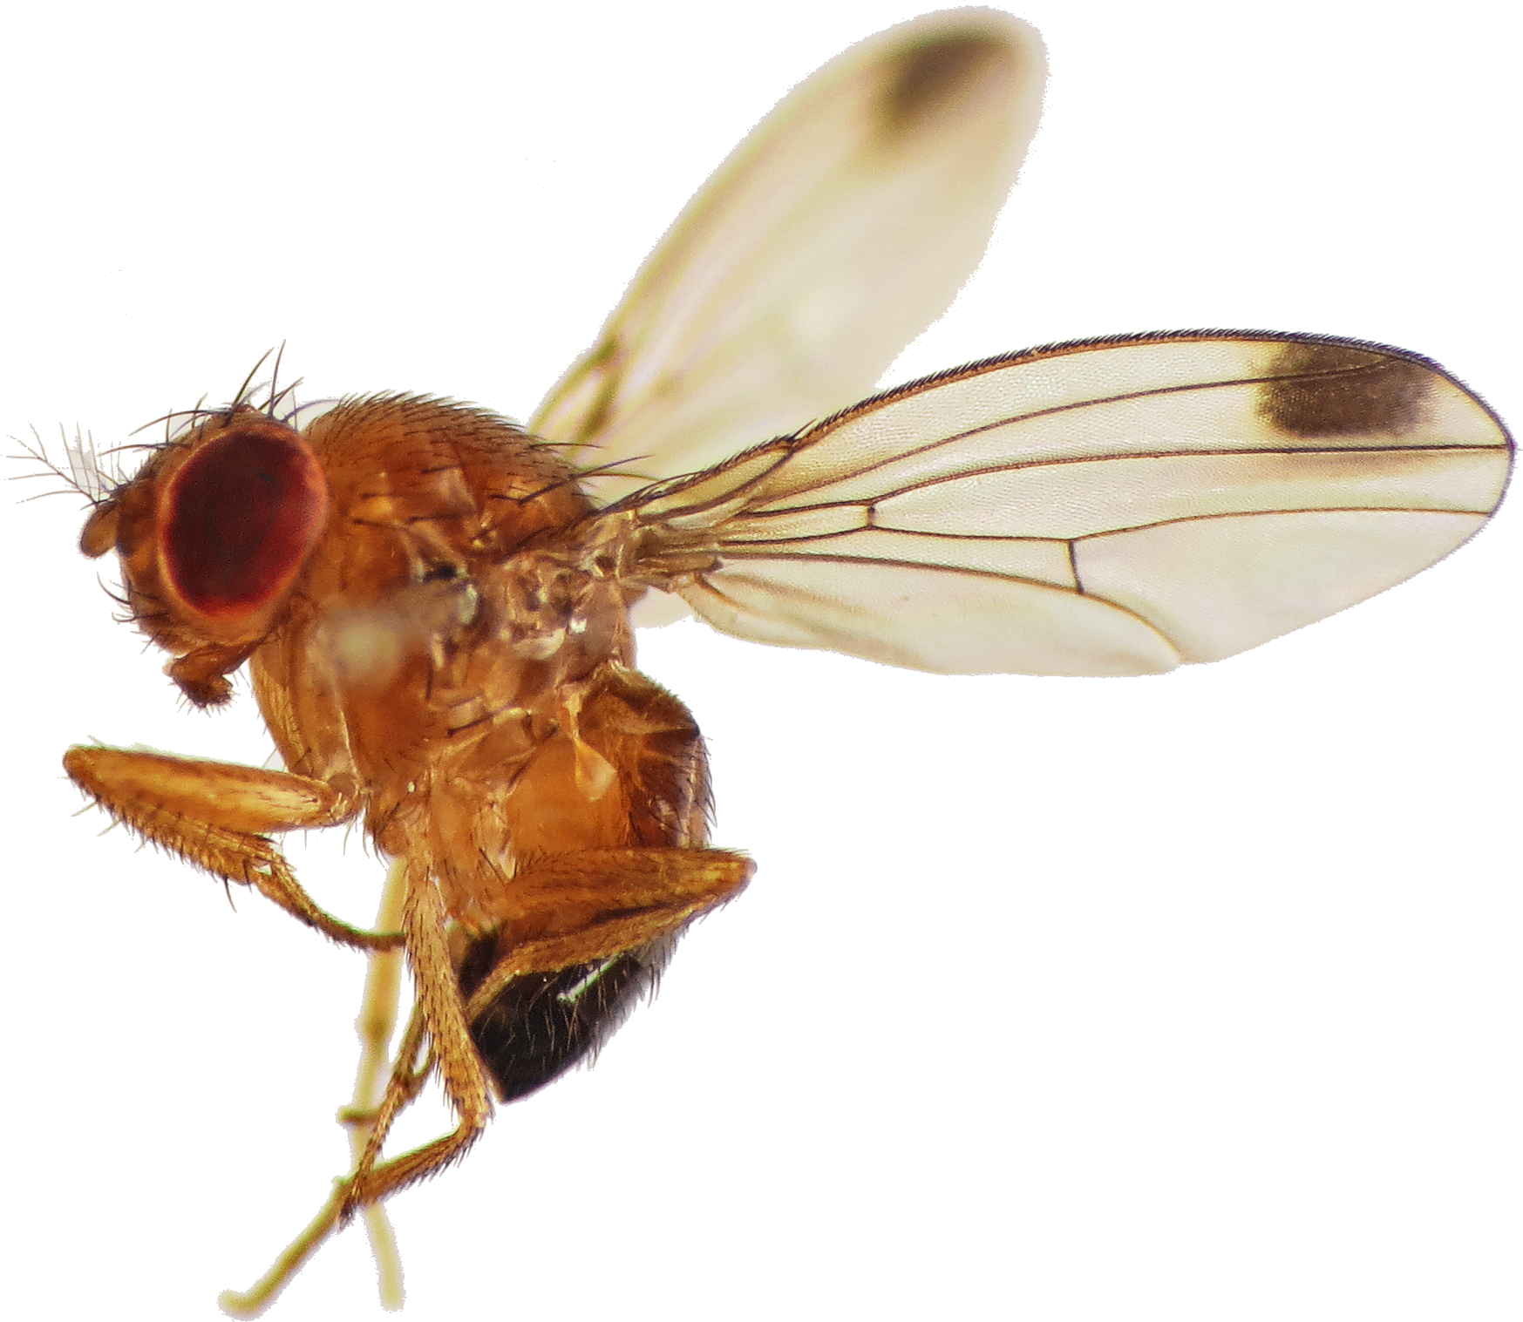
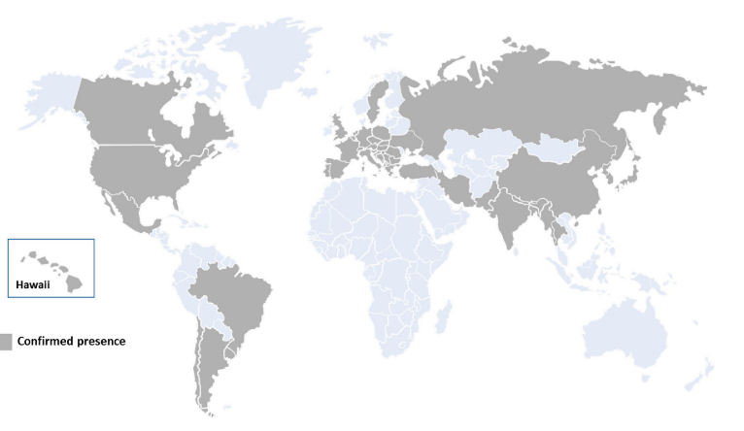
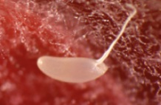
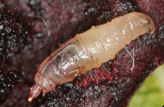
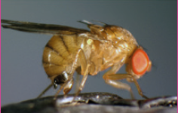
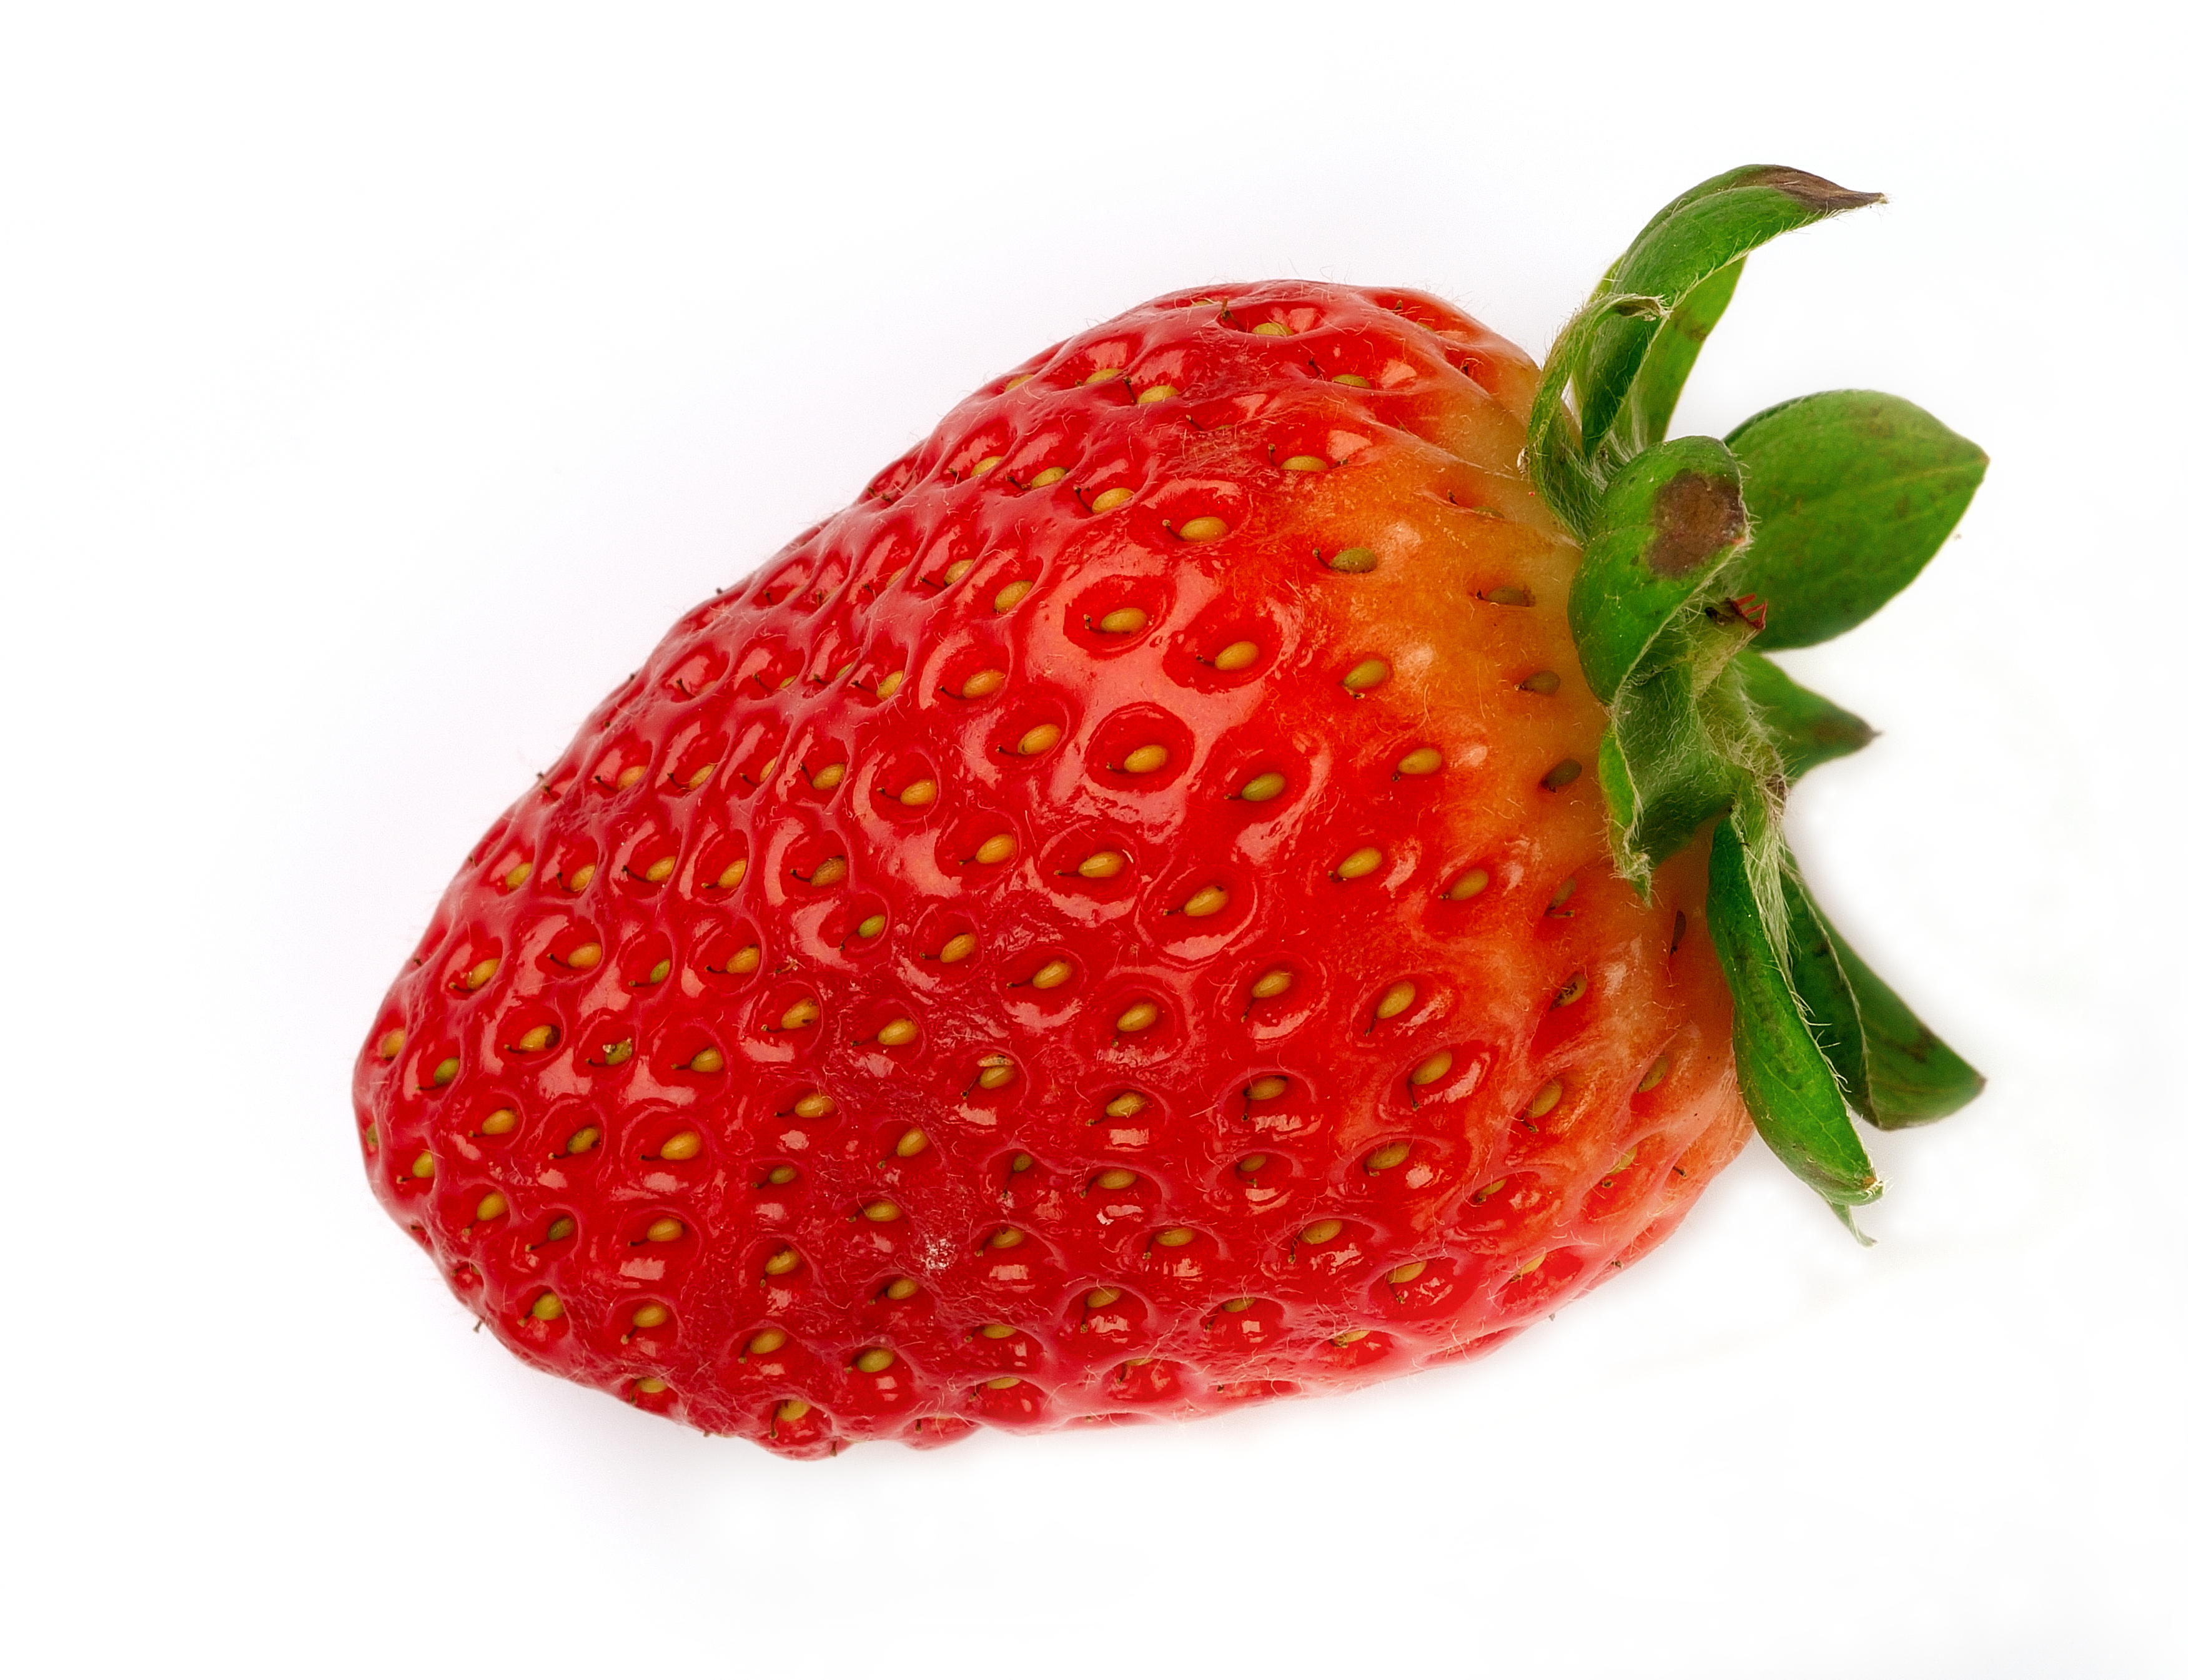
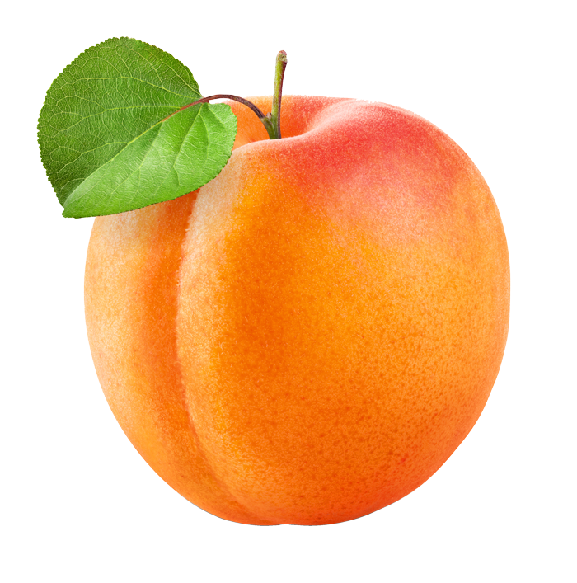
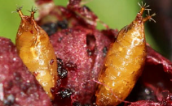
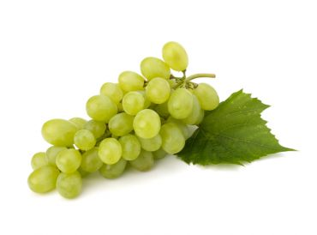
Introduction
M & M
Results
Conclusion
Drosophila suzukii
Invasive specie
20 °C
14 – 21 days
Laying their eggs in ripe fruits
Short generation time
Large number of potential hosts
Spreads quickly in Europe and causes important damages
Notes:
Two thousand and twelve in europe
Damages tissus

Slide 3
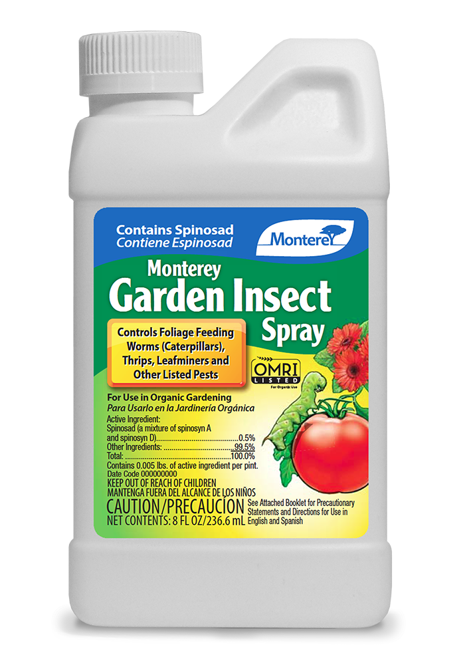
Introduction
M & M
Results
Conclusion
Biological control
parasitoids
Damages
Human health
Environment
Behavioural resistance
Takes refuge in wild plants
Physiological resistance
Increasing of dose to kill pest
Physical
use of nets
post-harvest
IPM
Semiochemicals
Attract & Kill

Slide 4
Introduction
M & M
Results
Conclusion
Attract & Kill

Slide 5
Introduction
Attractant Repellent
Entomopathogenic fungi
Perspectives
Materials & methods
Tested molecule
Control

Slide 6
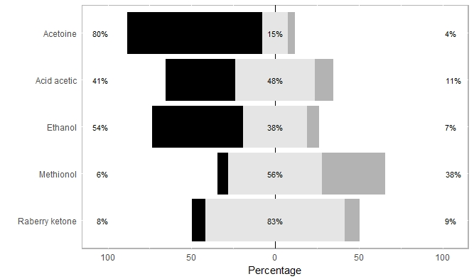
Introduction
Attractant Repellent
Entomopathogenic fungi
Perspectives
Results - attractant
Attractant
No choice
Control

Slide 7
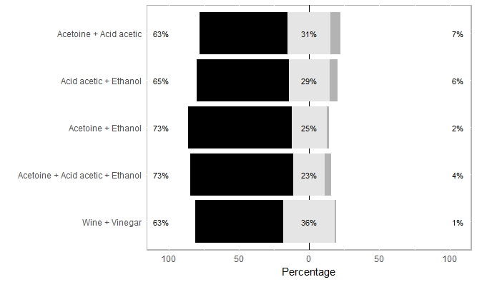
Introduction
Attractant Repellent
Entomopathogenic fungi
Perspectives
Results - attractant
Attractant
No choice
Control

Slide 8
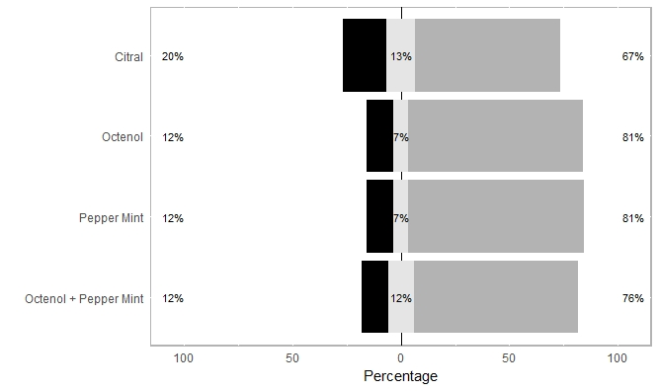
Introduction
Attractant Repellent
Entomopathogenic fungi
Perspectives
Results - repellent
Attractant
No choice
Control

Slide 9
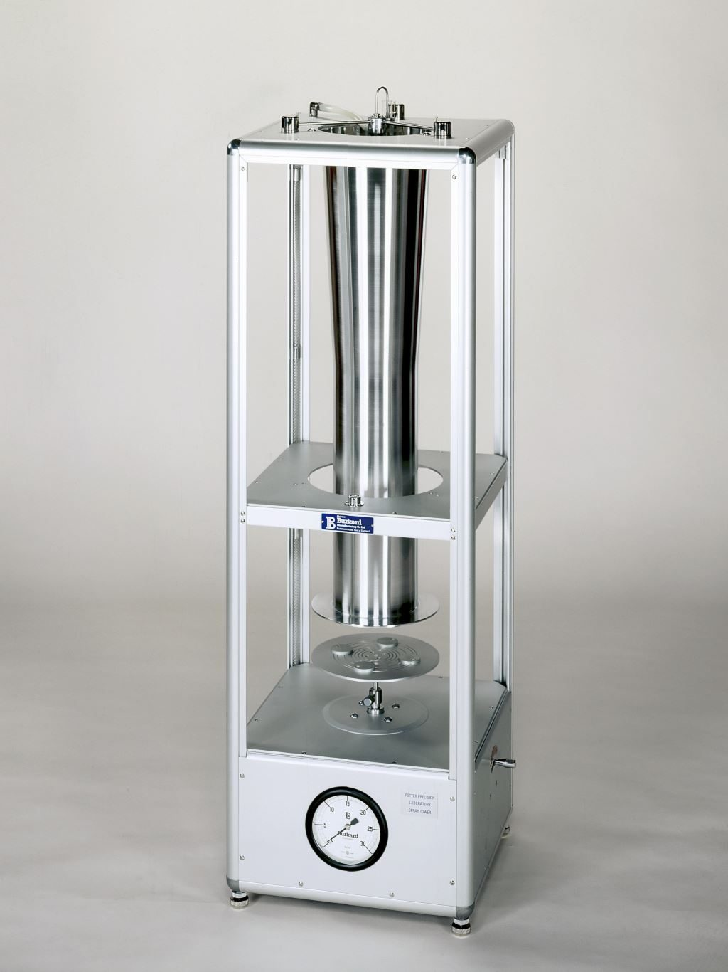
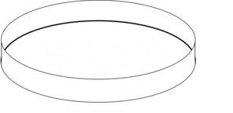
Introduction
Attractant Repellent
Entomopathogenic fungi
Perspectives
Materials & methods
X 10 / fungi
2 millions of conidias / mL
Notes:
micro drops
homogeneous
5 fungis
One hundred flies / fungi

Slide 10
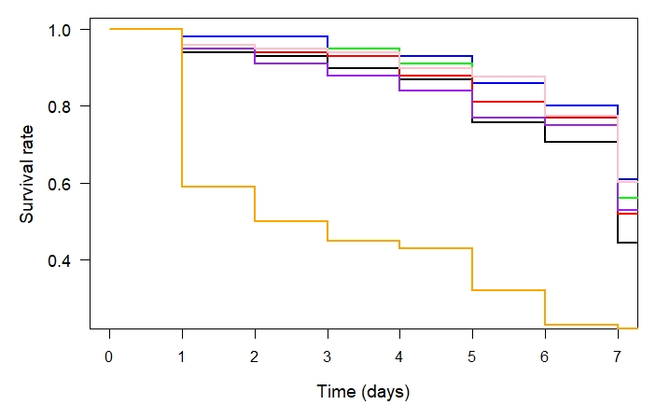
Introduction
Attractant Repellent
Entomopathogenic fungi
Perspectives
Results - survival
No difference between control and fungi
Observation “morbidity”
Loss of conidias
MUCL 8115
Control
MUCL 1555
MUCL 15122
MUCL 15122
MUCL 9645
Insecticide
Notes:
Two thousands conidias / fly

Slide 11
Introduction
Attractant Repellent
Entomopathogenic fungi
Perspectives
Attractant and Repellent
Improve attractant
Find the best design for attractant and repellent
Write an article
Combinate attractant and fungi
Entomopathogenic fungi
Validate or invalidate hypothesis : number of conidias is not sufficient
Minimal dose

Slide 12
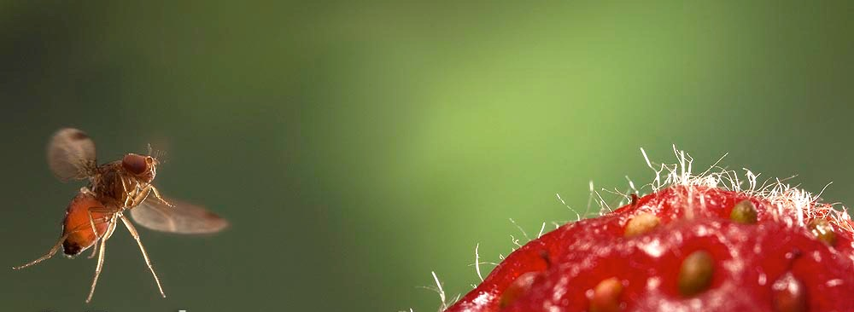
Thank you for your attention

Slide 13
