Slide 1
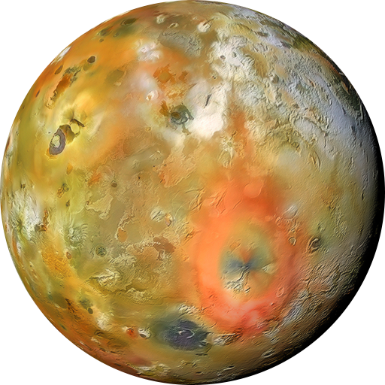
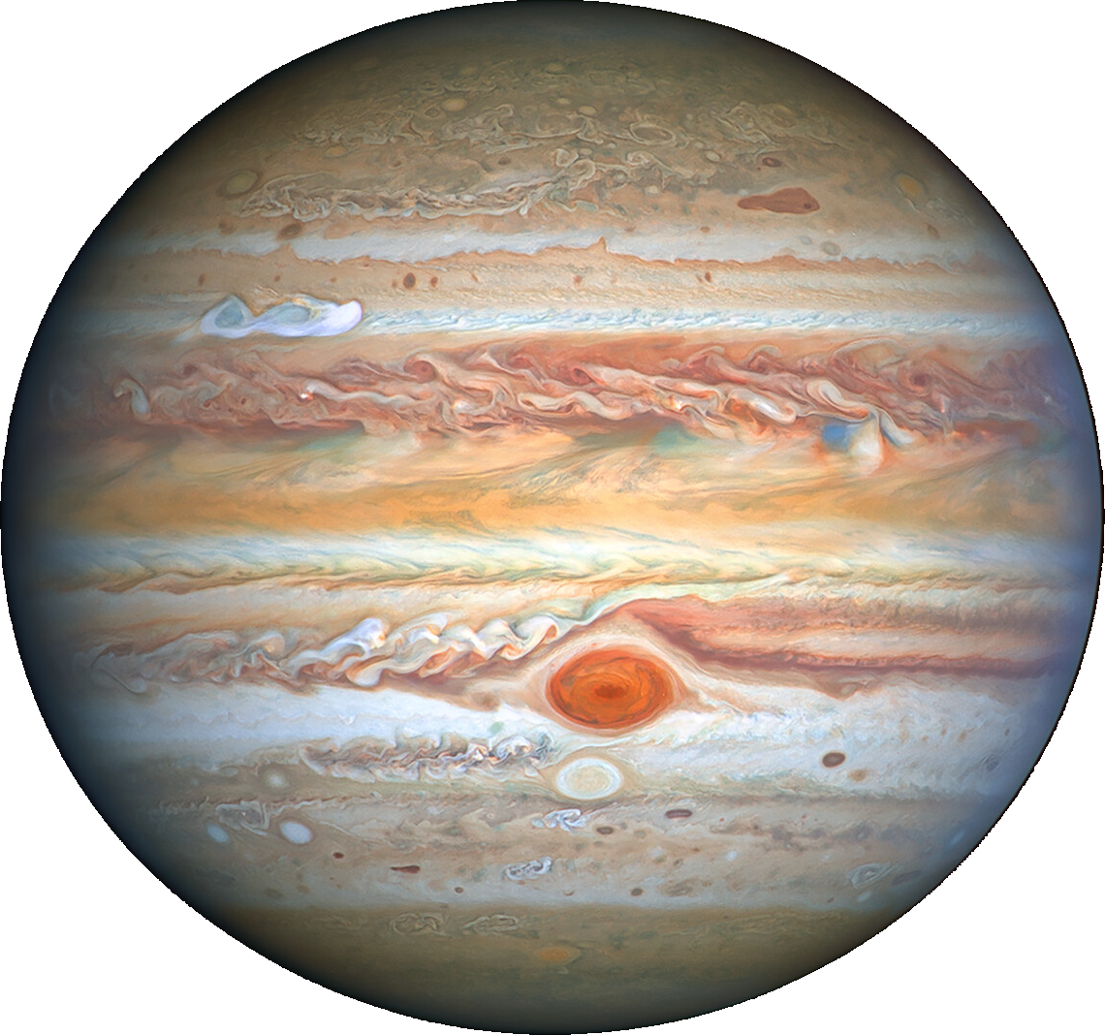
Investigating Io’s sodium jet with TRAPPIST
Linus Head
Université de Liège – LPAP
B. Bonfond, D. Grodent, E. Jehin, J. Manfroid, N. Schneider, Z. Yao, B. Zhang
Thursday 16th May 2024

Slide 2
Example of Slide Title
Test text point 1
Test text point 2
Subpoint for text 2

Slide 3
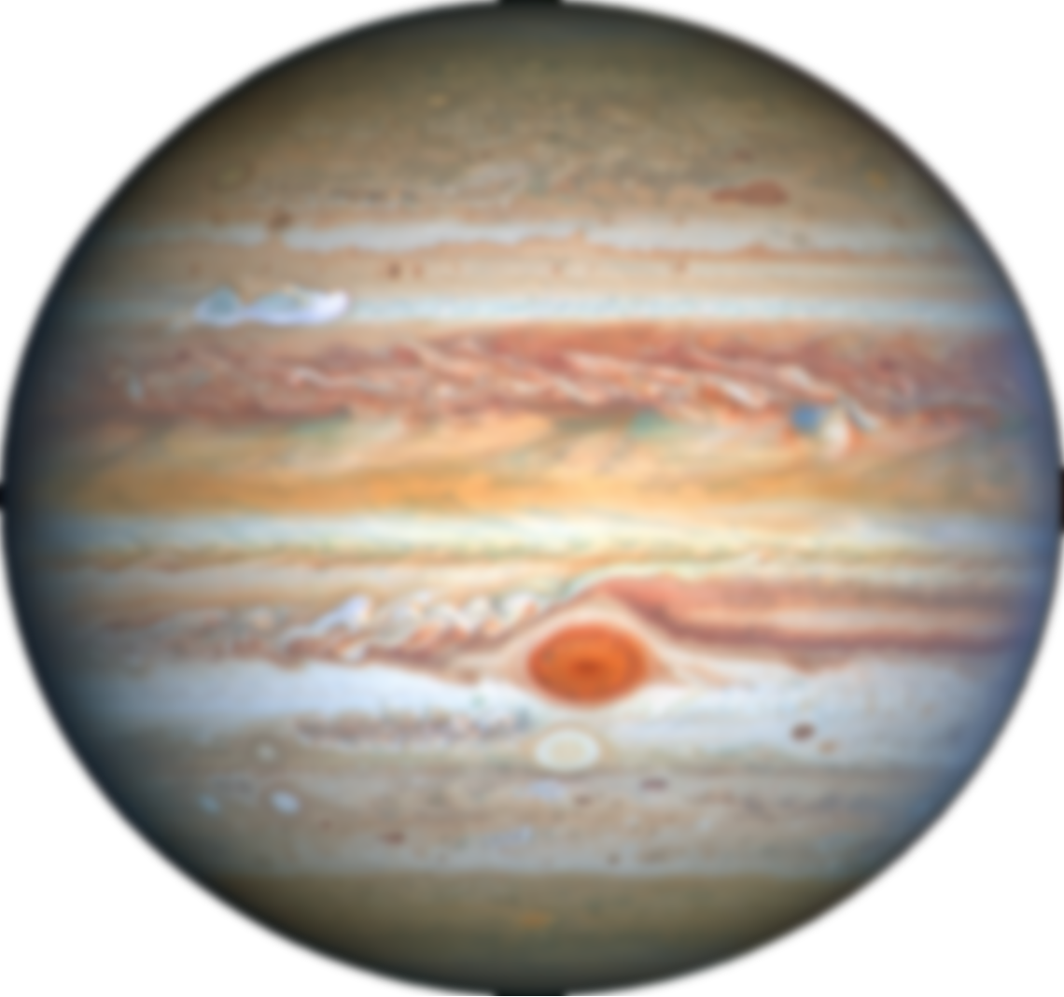
The Neutral Cloud
Test text point 1
Test text point 2
Subpoint for text 2
Io Neutral Cloud
99% sulphur, oxygen
1% sodium
Reflected sunlight from sodium makes it a great tracer
Notes:
So, today we’re going to be dealing with the neutral cloud of Io
In addition to the famous Io plasma torus, Io also has a cloud of neutral particles surrounding.
These are mainly sulphur dioxide, sulphur monoide, or sulphur and oxygen atoms, which in total account for 99% of the mass of the neutral cloud.
One trace element of great importance for us observers here on Earth is neutral sodium, which constitutes about 1% of the neutral cloud.
However, due to sodium’s excellent ability to scatter sunlight, it’s by far the brightest constituent of the neutral cloud and hence the easiest to detect.

Slide 4
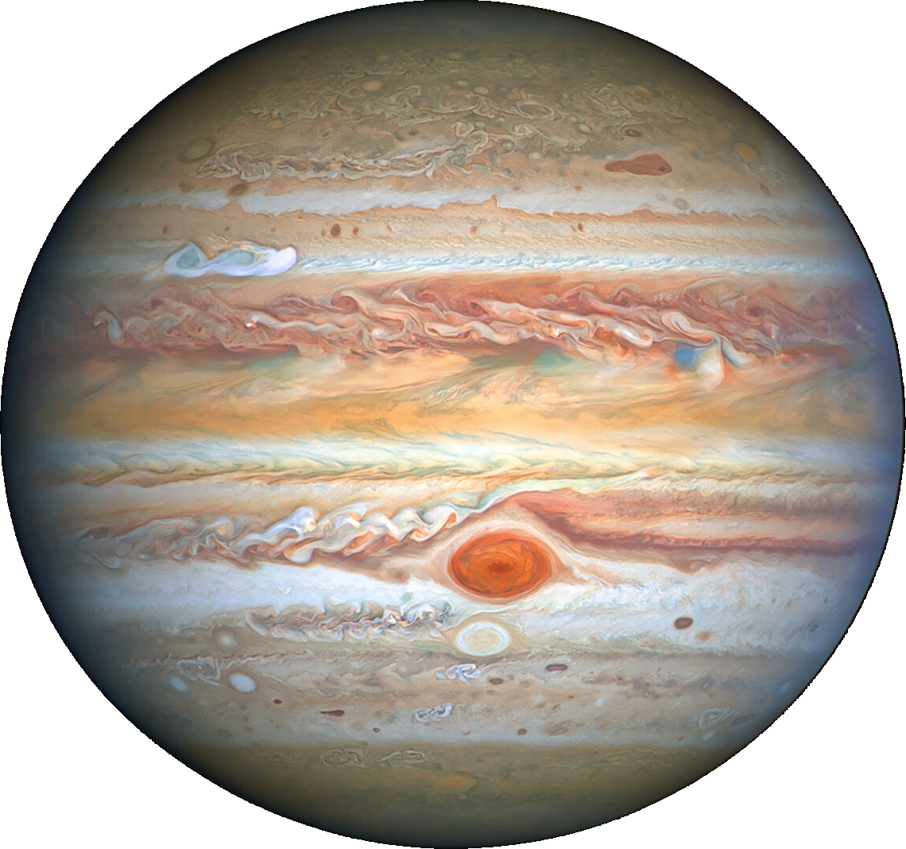
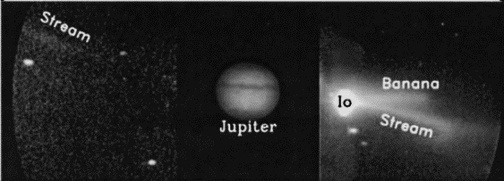
The Neutral Cloud
Plasma-torus flow
+
Jet
+
Atmospheric particle
Ionised by torus
Accelerated to corotation with magnetic field
Reneutralisation and release
July 21st 1995
Io Neutral Clouds
Appearance depends on viewing geometry
Jet
Wilson et al. (2002)
Notes:
Of course, when we’re talking about the sodium cloud, we should really be talking about the sodium cloudS, plural
Since actually there are few different sodium clouds, each with different origins; it tends to look a bit like this from Earth.
Here’s an actual image of the sodium emission around Io, where we see the same shape.
In this talk, we’ll be concentrating exclusively on the jet, which is this bit here.
These are caused when neutral particles from Io are ionised by collision with the plasma torus. This causes them to immediately feel the influence of Jupiter’s magnetic field, and basically instantaneously accelerated to corotation velocity.
In the case of the jet, these particles are very quickly reneutralised, maintaining their gyration velocity, but no longer feeling Jupiter’s magnetic field, and so they are released in the form of the jet, like a stone being released from a sling.

Slide 5
Example of Slide Title
Test text point 1
Test text point 2
Subpoint for text 2
Jets
From pickup-ion neutralisation near Io.
“Banana”
From atmospheric sputtering.
Streams
From pickup-ion neutralisation in the plasma torus.
Notes:
If we look at the sodium cloud from above, the different components become a little clearer.
We have, broadly, three main components to the sodium cloud.
The jets, the streams, and the banana
In this talk, we’ll be concentrating exclusively on the jet.
These are caused when neutral particles from Io are ionised by collision with the plasma torus. This causes them to immediately feel the influence of Jupiter’s magnetic field, and basically instantaneously accelerated to corotation velocity.
In the case of the jet, these particles are very quickly reneutralised, maintaining their corotation velocity, but no longer feeling Jupiter’s magnetic field, and so they are released in the form the jet, like a rock being released from a sling.
And so the jet ends up with this fan-like shape.

Slide 6
The Wider Magnetosphere
How does the jet affect the wider magnetosphere?
Extended Sodium Nebula
Large (1000 R_{J}) cloud of neutral sodium around Jupiter
Where does the jet come from?
Plasma Torus
Sulphur and oxygen ions from Io
Notes:
Now, the wider magnetosphere has a few relevant structures as well.
Firstly, the famous Io Plasma Torus, a donut-shaped ring of plasma originating from Io that corotates with Jupiter’s magnetic field.
And secondly, the extended sodium nebula, which is a very large cloud of neutral sodium surrounding Jupiter, actually one of the largest structures in the solar system.
And with this, we can ask ourselves two unresolved and rather fundamental questions about the jet
Where does it come from?
Where does it go?

Slide 7
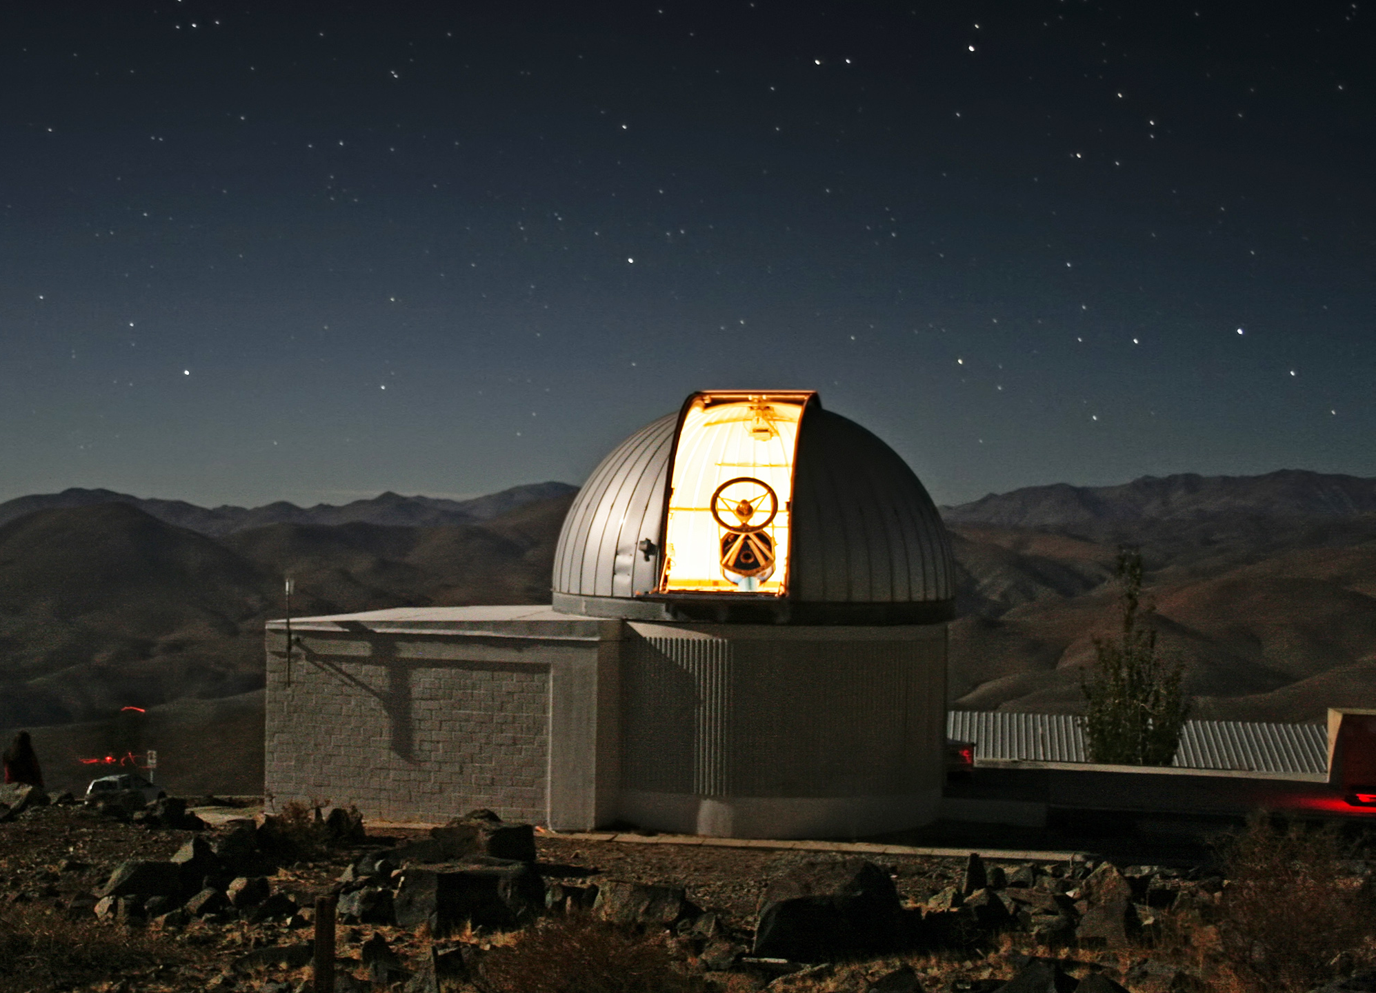
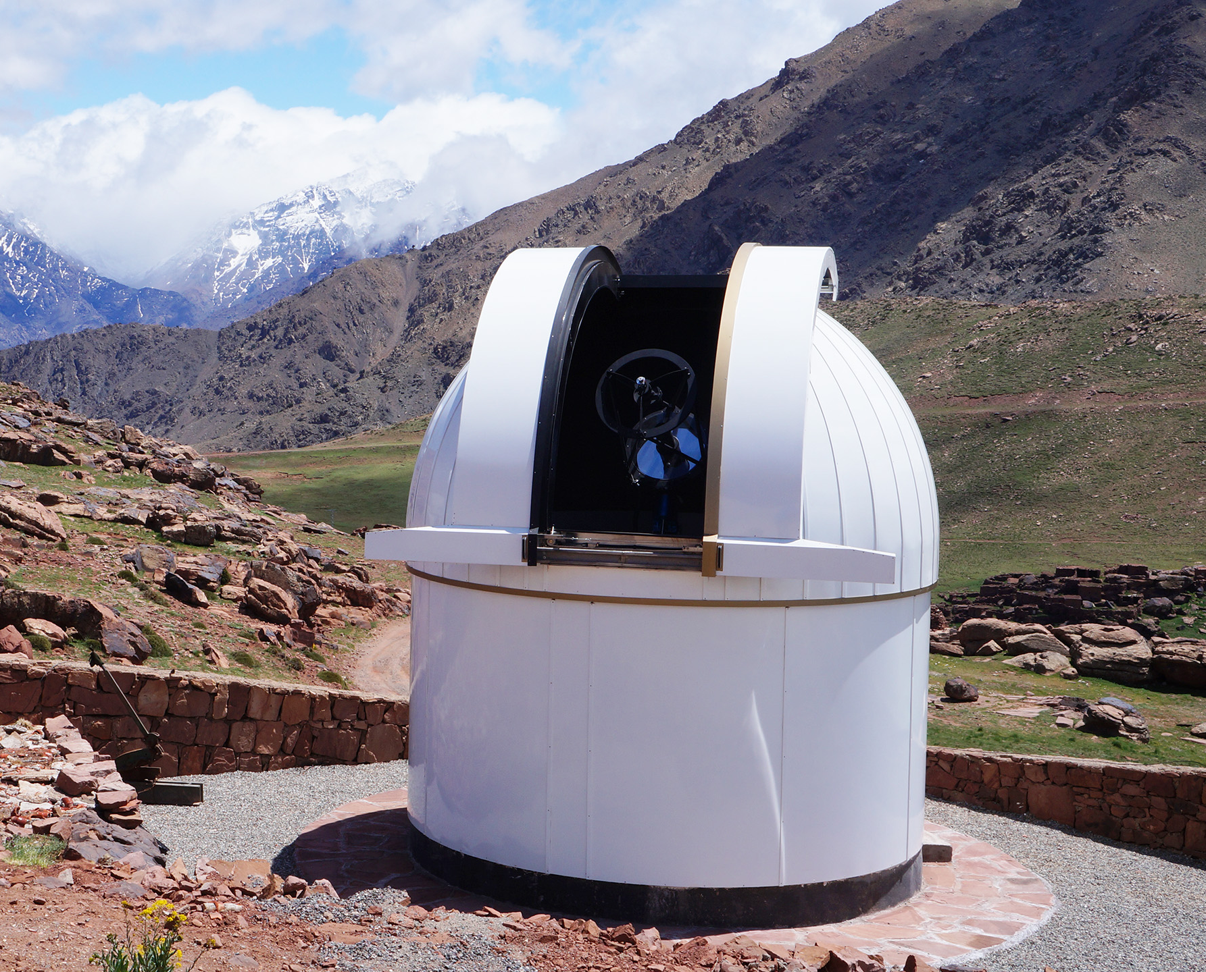
TRAPPIST
TRAPPIST-North
Morocco
TRAPPIST-South
Chile
Twin telescopes, both equipped with Na I filters
Notes:
Now, in an effort to answer these questions, we at the University of Liège have leveraged our possession of two telescopes, the two TRAPPIST telescopes, to perform a monitoring of the neutral sodium emission around Io.
Now, TRAPPIST is not really made to observe the sodium emission around Io, so it has a relatively high brightness threshold for jet detection, but the real advantage of TRAPPIST is we can get time whenever we want, which is obviously useful for monitoring purposes

Slide 8
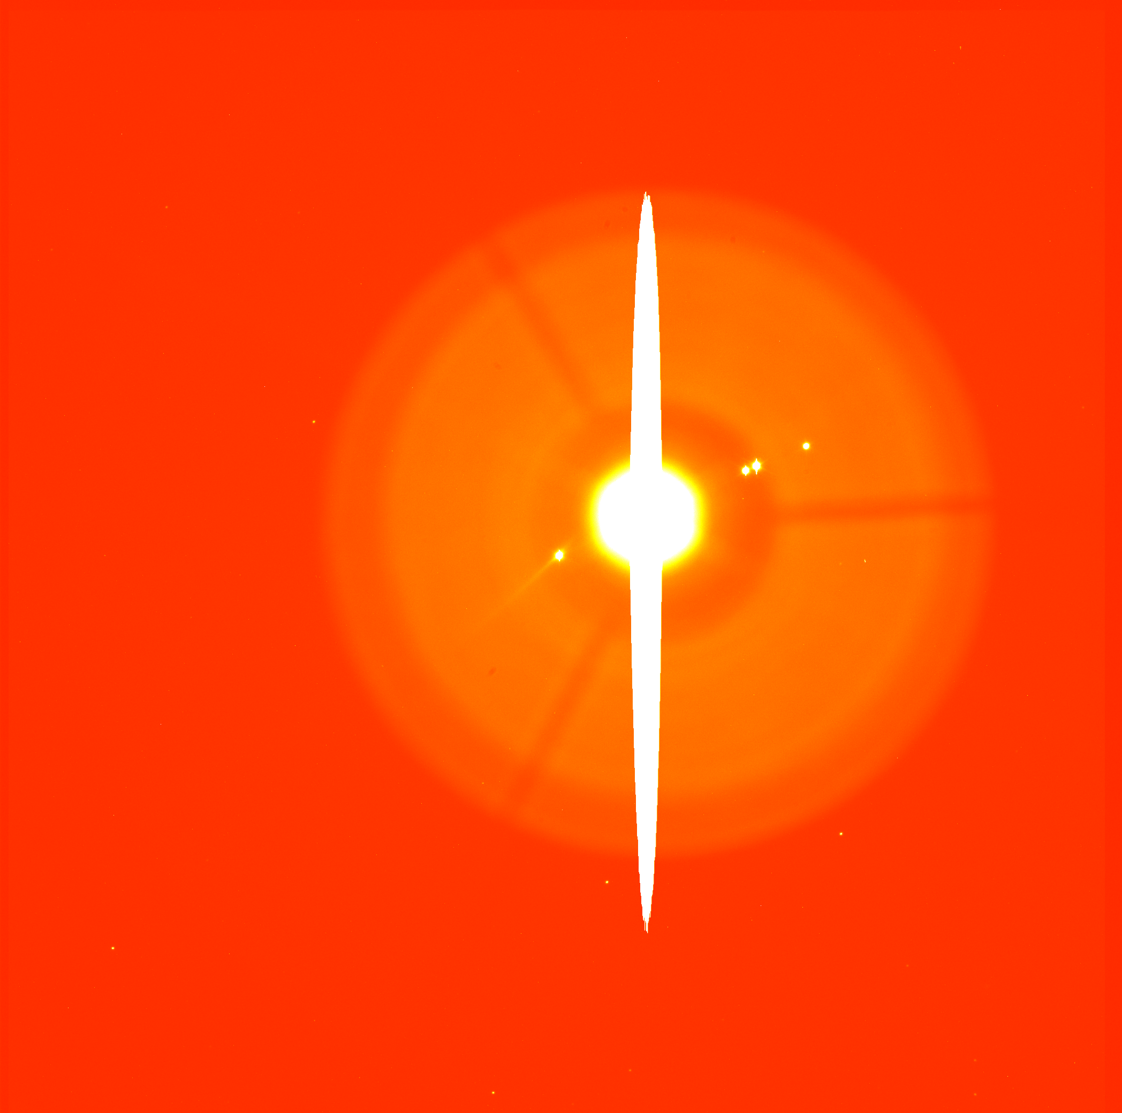
4th December 2014
Background reflection
Io
Saturation pattern
Jupiter
Field of view: 20’ × 20’
Resolution: 0.6”
De Becker and Head et al. (2023)
Notes:
Here’s an example of one of our images, taken by TRAPPIST-South using its sodium filter.
This is actually the very first image taken by TRAPPIST-South of Io, on the 4th December 2014.
We have Jupiter, obviously saturating the detector.
Io is in the middle here.
The background pattern that we see here is the reflection of the telescope mounting apparatus
If we zoom in a bit…

Slide 9
4th December 2014
Notes:
…we can see the jet extending away from Io.
But we can also remove the background pattern to make it even clearer

Slide 10
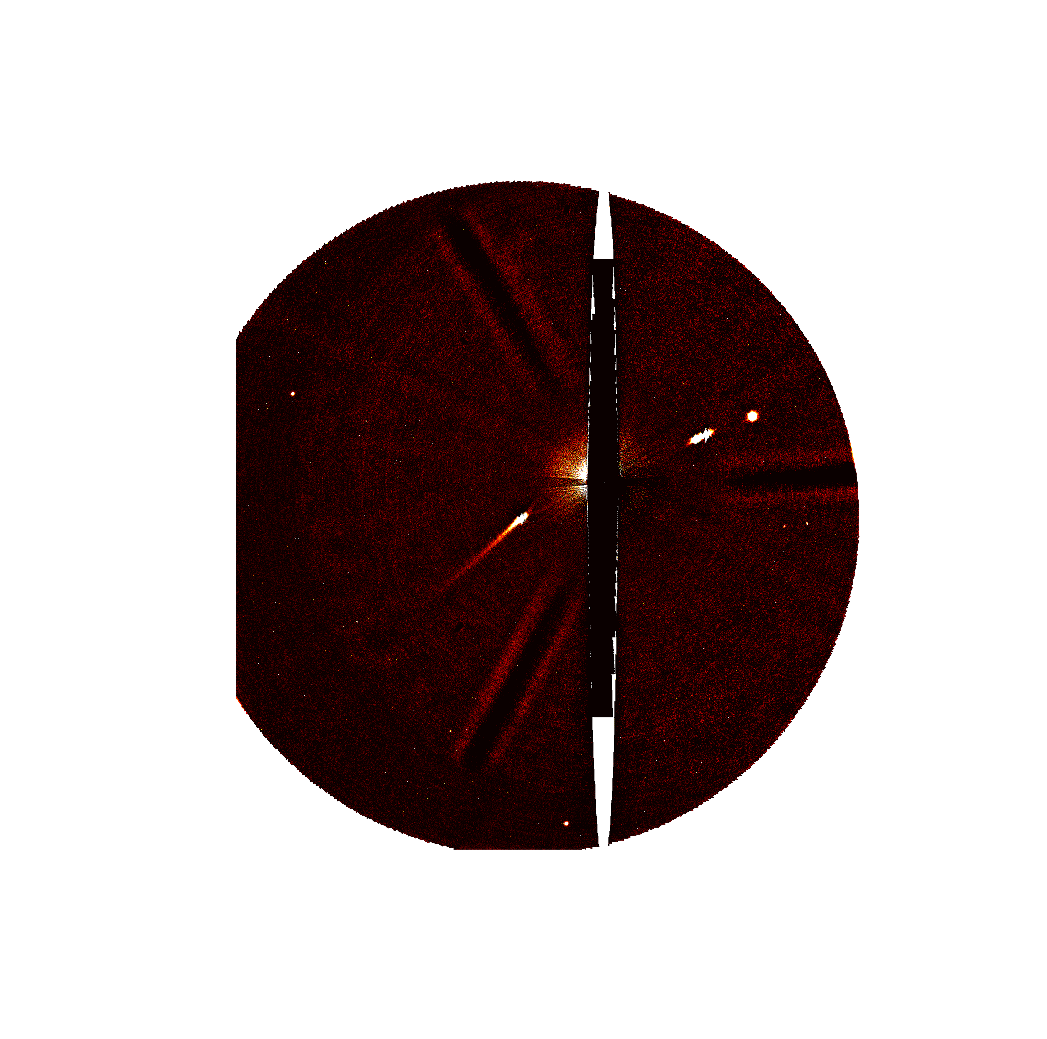
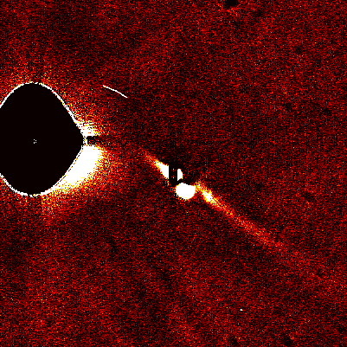
4th December 2014
15th October 2023
27th February 2024
Notes:
And when we do that, we get a lovely clear image of the sodium jet.
This is truly a wonderful image, and really proves the capabilities of the TRAPPIST telescopes to monitor the sodium jet.
And so, naturally, we never saw anything like it again.
It wasn’t until the 27th February 2024 that we would see anything as clear as this jet, and even then, the positions of the other moons were not as favourable as they are in this image
Now, in the interest of time, I won’t give an exhaustive breakdown of all the jets we saw.
We saw a jet with TRAPPIST on about one-third of the nights that we observed, to give you some kind of idea, and normally these jets are far more modest, like this one.
We’re fairly certain that the jet is always there, to some extent, it’s just that it’s not always bright enough to be seen with TRAPPIST.
But I’d like to focus on these more spectacular jets, and in particular how spectacularly disconnected from the rest of the magnetosphere they appear to be.

Slide 11
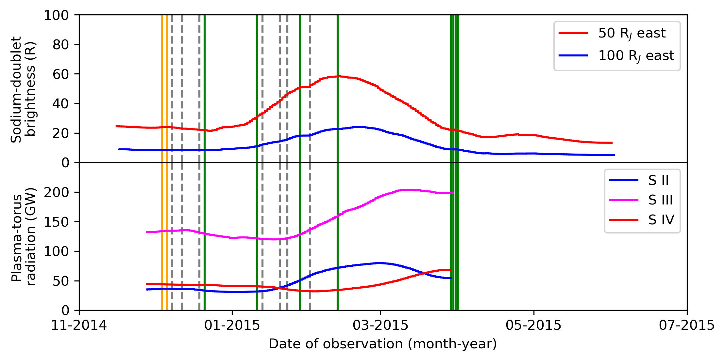
Magnetospheric Response
Eruption!
(Kurdalagon)
Notes:
Here, we have the brightness of both the extended sodium nebula and the Io plasma torus for the period spanning late 2014 to 2015.
That very bright jet was seen at the start here, and the nebula and plasma torus did… precisely nothing.
Yes, we see a brightening in both of them here, but this is months later following an eruption of Kurdalaegon.
The material in the jet is travelling at such speed that it traverses the magnetosphere within days, not months, and so it can’t be a delayed response to this jet.
There were no spectacular jets brought about by this eruption, nor any particular surplus of jets to feed the wider magnetosphere, and so, if these brightenings are indeed caused by this eruption, then they must proceed via some other process.

Slide 12
Magnetospheric Response
Extended nebula
(Yoneda et al. 2015)
Bright jet seen
Plasma torus
(Yoshikawa et al. 2018)
Normal jet seen
No jet seen
Eruption!
(Kurdalagon)
Notes:
Here, we have the brightness of both the extended sodium nebula and the Io plasma torus for the period spanning late 2014 to 2015.
That very bright jet was seen at the start here, and the nebula and plasma torus did… precisely nothing.
Yes, we see a brightening in both of them here, but this is months later following an eruption of Kurdalaegon.
The material in the jet is travelling at such speed that it traverses the magnetosphere within days, not months, and so it can’t be a delayed response to this jet.
There were no spectacular jets brought about by this eruption, nor any particular surplus of jets to feed the wider magnetosphere, and so, if these brightenings are indeed caused by this eruption, AS WAS SUGGESTED BY YOSHIKAWA ET AL AT THE TIME, then they appear to proceed via some other process.

Slide 13
Interaction with Magnetosphere
Surface Frost
Extended Sodium Cloud
Tsang et al. (2016)
Roth et al. (2020)
Atmosphere
Tsang et al. (2012)
Yoneda et al. (2015)
Morgenthaler et al. (2024)
…but disputed.
Roth et al. (2024)
De Becker and Head et al. (2023)
Volcanism
Roth et al. (2020)
Yoshikawa et al. (2018)
Plasma Torus
Jets
De Becker and Head et al. (2023)
Plumes
Established link
Disputed link
Established disconnect
Notes:
And this really highlights the fact that there are still substantial gaps in our understanding of the relations between the various components of the Io-Jupiter-Magnetosphere system.
I won’t go over this in detail, since Lorenz Roth’s talk earlier already did so, but in general, we’re still not very sure how the conditions at Io change the brightness of the plasma torus or the extended nebula.
We can see that the jets too are looking rather isolated in this diagram – they don’t seem to have much of an effect on the rest of the magnetosphere, and the origins of its variable brightness are still a bit of mystery.
However, we do have some ideas, such as volcanic plumes.

Slide 14
Plume Origin of Jets
Plumes
Jets
To jet
Na
Charge exchange + dissociation
Pickup ionisation
NaX⁺
NaX
Plasma Torus
SO₂
This mechanism would be enhanced at the poles due to increased SO₂ photoionisation and the thinner atmosphere, augmenting NaX escape!
Schmidt et al. (2023)
Morgenthaler et al. (2024)
Notes:
Now, while the particle velocities from volcanic eruptions are not high enough to escape Io ballistically, material that is floated upwards in volcanic plumes does reach the necessary altitude to start interacting with the plasma torus in a meaningful way.
Sodium in the plume is then fed into the jet via the processes I mentioned earlier.
The amount of available sodium would be enhanced near the poles of Io due to the thinner atmosphere and the longer exposure to sunlight, leading to more photoionised sulphur dioxide ions which charge-exchange with sodium-bearing molecules to generate even more sodium-bearing ions, which enhances the total amount of sodium escaping from Io.
And so we would expect the jet to be brighter in the presence of volcanic plumes near Io’s poles.
And we have a little bit of evidence that this is perhaps what’s happening, since we have TRAPPIST images of Io taken during Juno’s latest flybys.

Slide 15
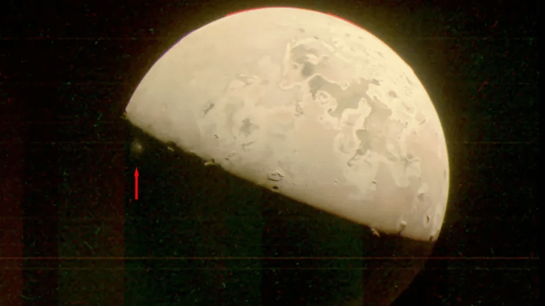
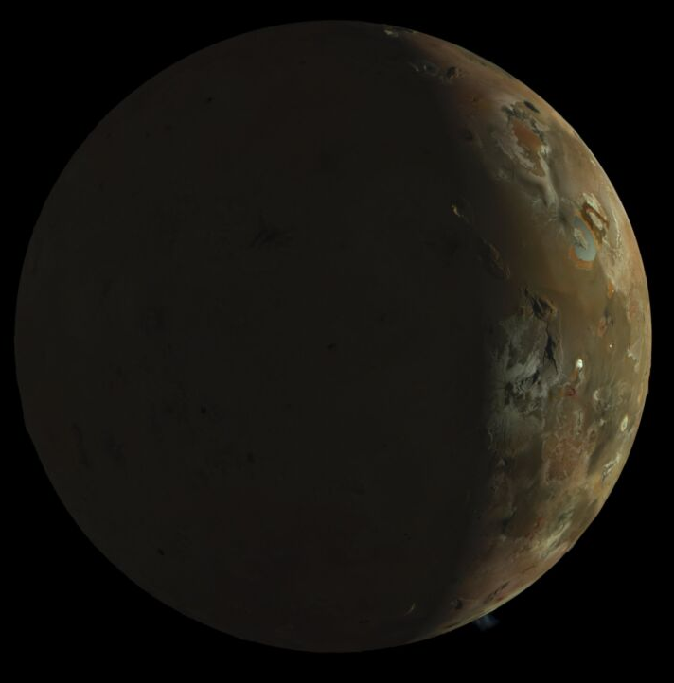
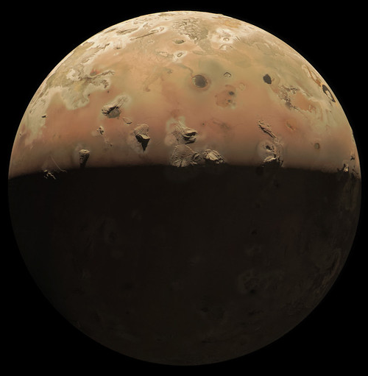
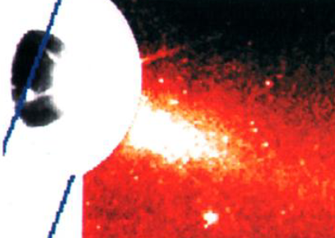
Juno Flybys
Plumes
Jets
Image credit: NASA/JPL-Caltech/SwRI/MSSS
15th Oct. 2023
Equatorial plume (Prometheus)
30th Dec. 2023
No plume
3rd Feb. 2024
Polar plume
1996
Image artefact!
Image artefact!
Burger et al. (1999)
Notes:
During the first flyby in October, we saw a plume from Prometheus, which is near Io’s equator
We saw no jet or perhaps a very small jet, but that’s fine since this is an equatorial volcano, so no enhanced sodium molecule transport
And we also saw a plume from Prometheus and a very small jet when the Galileo probe was there in the 90s.
This really is a very small jet, despite what it looks like.
Then, in December, no plume was seen.
But we also didn’t see a jet, so no problem there.
Then, in February, we saw a polar plume from XXXXX AND a nice strong jet at the same time.
Obviously, we need to not forget that we’re only seeing part of Io so we may be missing plumes, and also these are only 3 or 4 data points, but so far we haven’t seen anything that contradicts this polar-plume origin for enhancements in the jet.
There we go, that’s all I wanted to talk about. Thank you very much for listening.

