Slide 1
Botanicals: a sustainable strategy in crop protection?
Laboratory of Chemistry
of Natural Molecules
Marie-Laure Fauconnier, Manon Genva and Clément Burgeon
21/05/2024
Notes:
PAGE D'INTRODUCTION 1 / page permettant l'insertion du titre de la présentation ainsi que d'autres infos (date, lieu, orateur, sous-titre,…)
Si vous souhaitez modifier la photo de fond :
Allez dans le menu « Affichage » > « Masques » > « Masque des diapositives »
Supprimez l’image du drapeau déjà présente
Allez dans « Insertion » > « Photo » et chargez votre image (en veillant à la bonne qualité de celle-ci)
Placez celle-ci en « Arrière-plan » via le menu « Réorganiser »

Slide 2
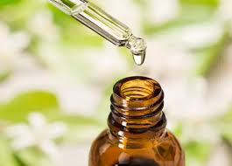
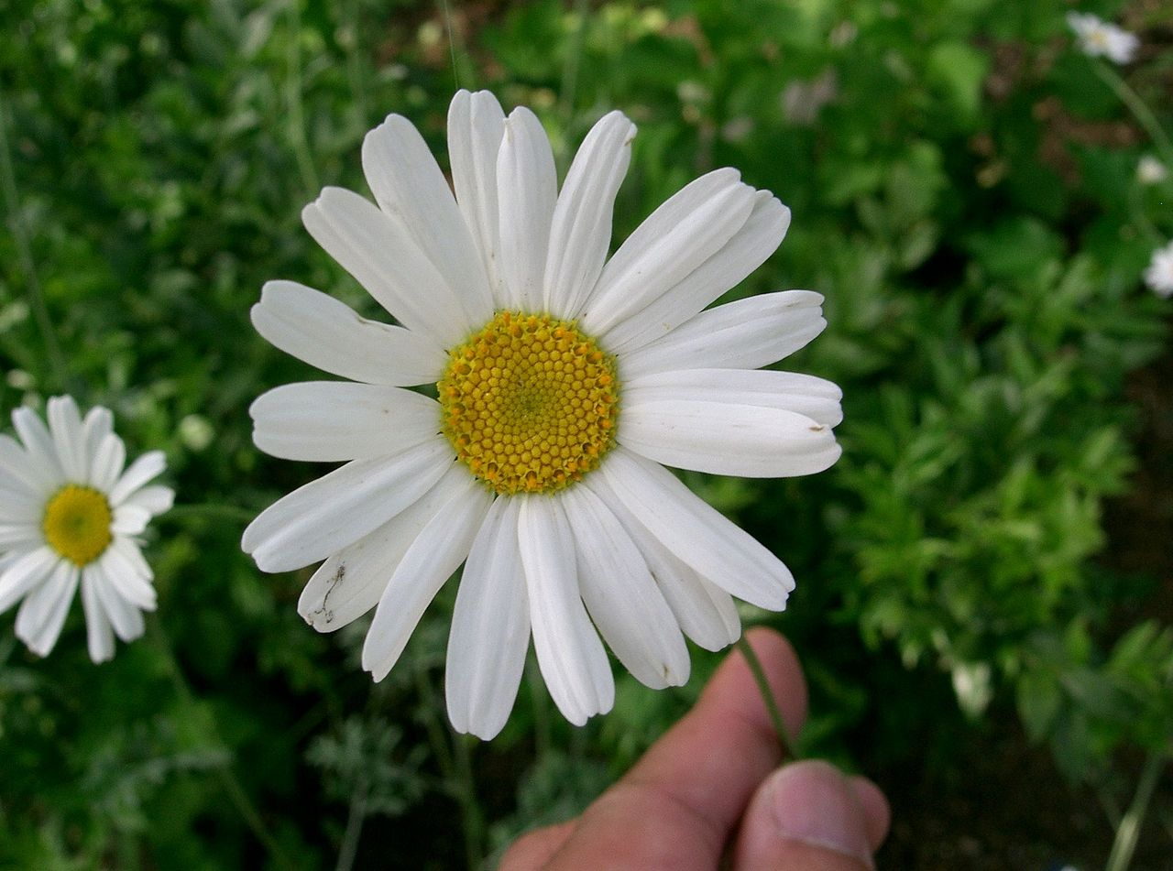
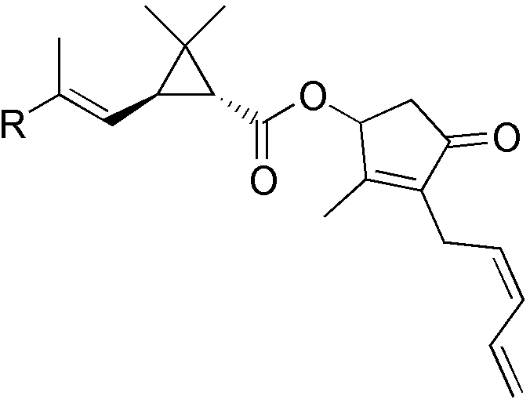
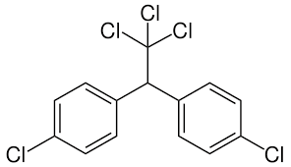
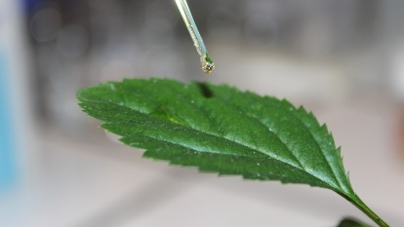
Botanicals: what’s that?
Common definition:
A substance obtained from a plant and used typically in medicinal or cosmetic products.
➔ Also in the field of crop protection
Not new …before 1940: very common
(tobacco extract, rotenone, pyrethrum …)
1940-2000 DDT and many chemically synthetized pesticides: botanical pesticide research slow down
2000: resistance, environmental and human health concerns ➔ research on botanicals coming back into fashion

Slide 3
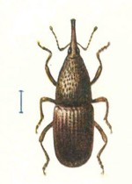
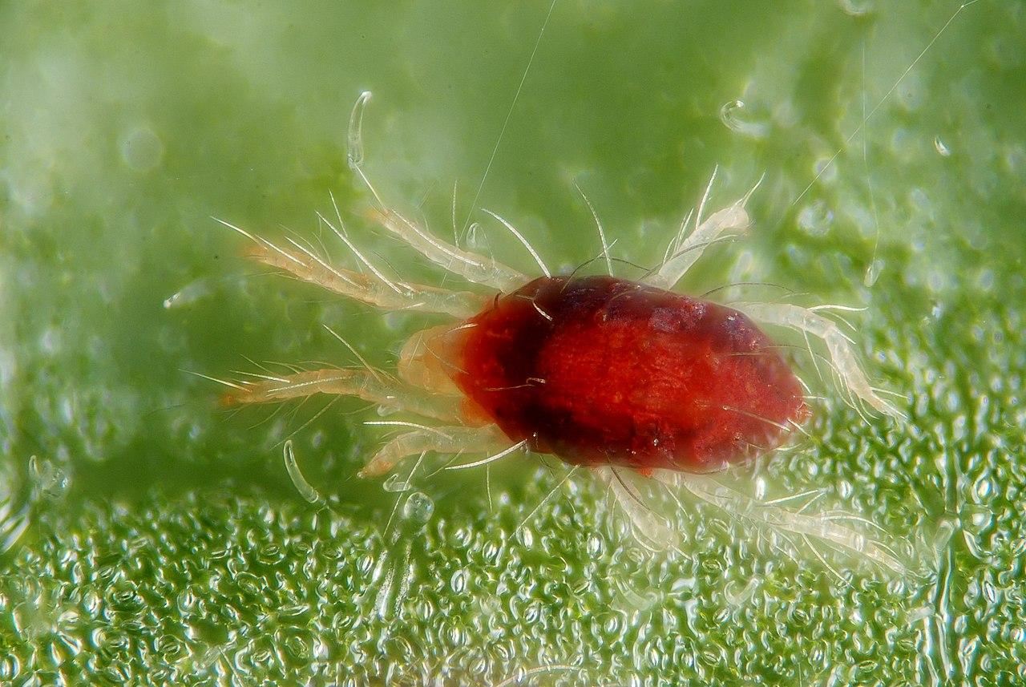
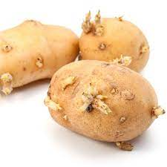
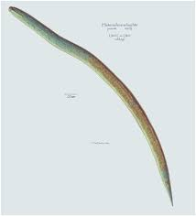
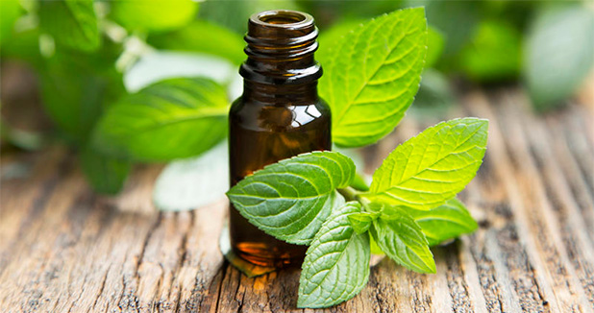
Botanicals: what’s that?
For the agronomist botanicals are
Herbicides
Insecticides
Fungicides
Nematicides
Molluscicides
Rodenticides
Virucides
Acaricides
Bactericides
Anti-sprouting agents
Soil quality improvement agents
    Key words in Google Scholar: essential oils and …
    -Insecticide → 125000 ref
      Herbicide → 69000 ref
      Bactericide-fungicide → 91000 ref
      Acaricide-nematicide → 37500 ref
Biocides

Slide 4
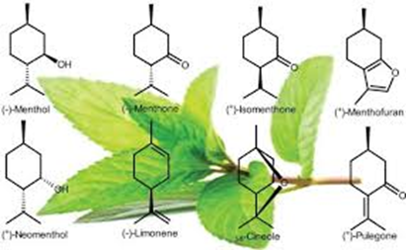
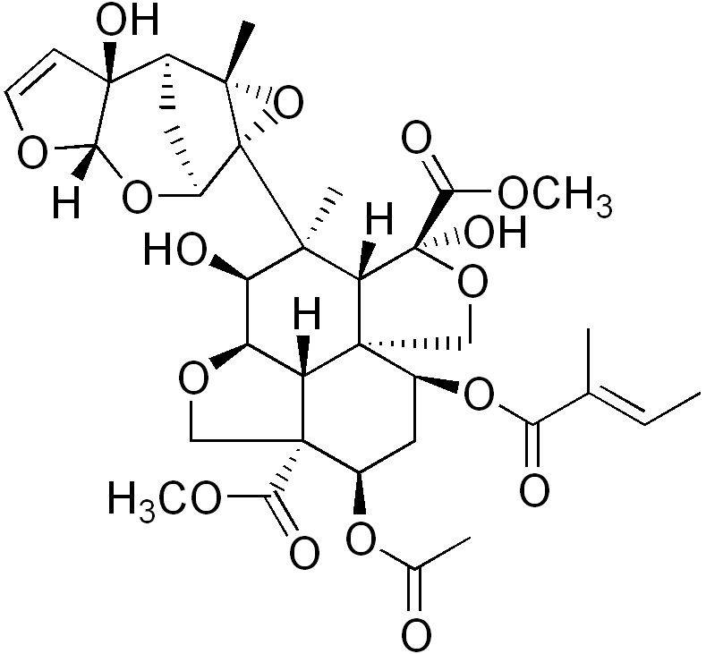
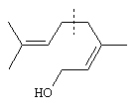
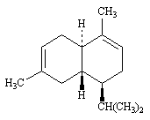
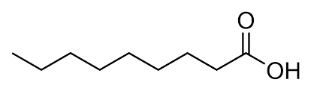
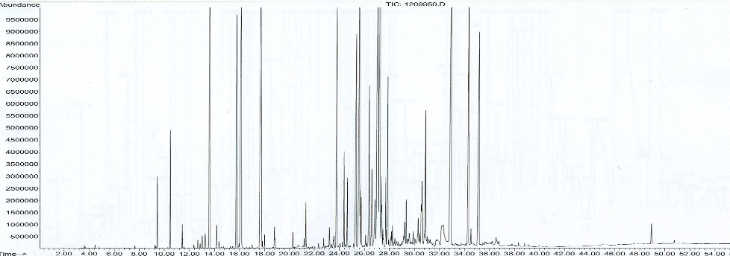
Botanicals: what’s that?
For the chemist:
A pure compound or purified fraction requiring an extraction method and one/several purification steps (e.g. azadyractin from neem oil)
A complex extract requiring an extraction method (solvent, SC-CO₂, hydrodistillation, steam distillation; e.g. essential oils)
An analog of botanical obtained by synthesis/biosynthesis from biosourced (or not) reagents (pelargonic acid)
Volatile / non-volatile compounds; apolar or polar compounds
Compounds belonging to various chemical functions (terpenoids, acids, alcohols, ketones, esters, S and N containing compounds, phenolics)

Slide 5

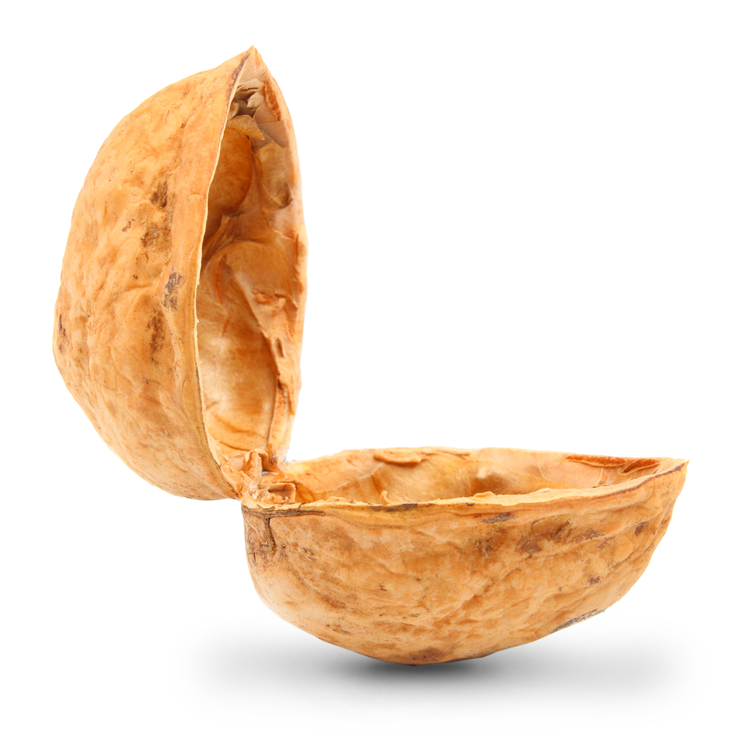
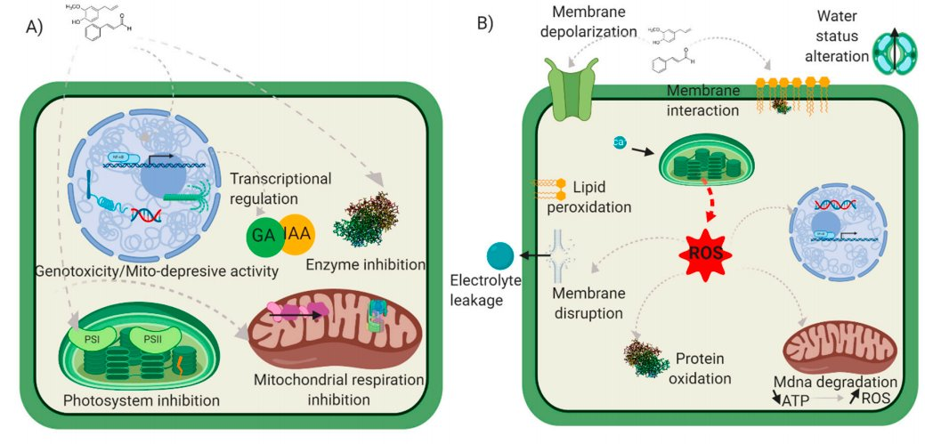
Pro and con of botanicals in a nutshell
    Advantages and constraints
    Advantages:
      - reduced side effects (human, not targeted organisms, environment)
      - low persistence
      - multiple action modes due to complex composition (less resistance)
      - good acceptability by consumers
    Constraints:
      variability (composition)➔ standardization
      phytotoxicity
      for volatile botanicals: volatility / flavor
      (encapsulation + new mode of injection)
      cost (only for high value crops?)
      regulatory aspects (US versus EU)

Slide 6
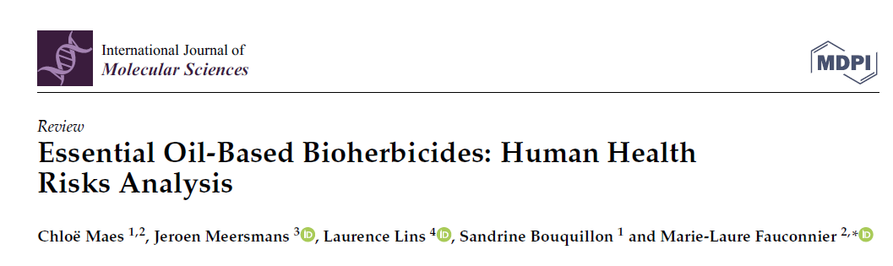
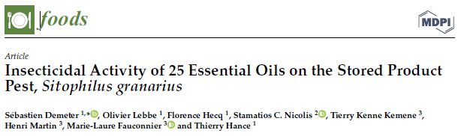
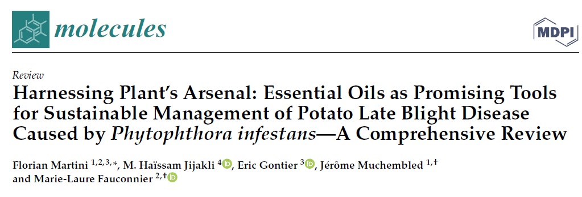
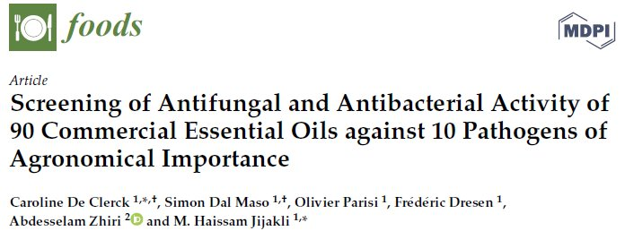
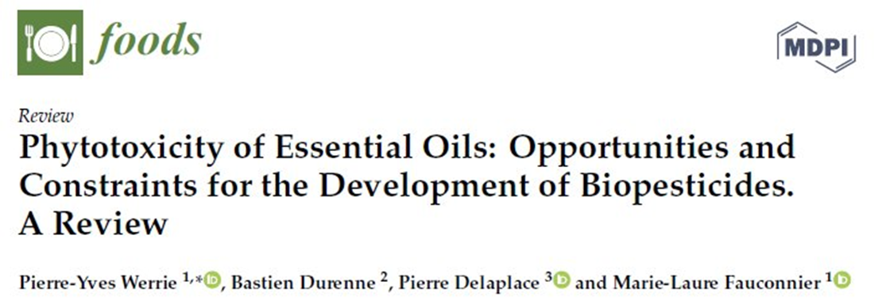
Sustainability
Botanicals
Numerous advantages
Numerous scientific studies
Increasing number of publications
Better elucidated modes of action
Registered commercial products
But what about sustainability?
In Google scholar botanicals and sustainability
➔ 30,000 ref
BUT almost nothing on sustainability OF botanicals !

Slide 7
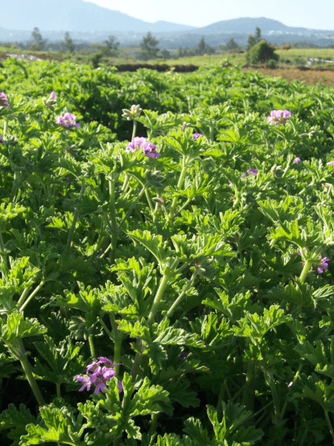
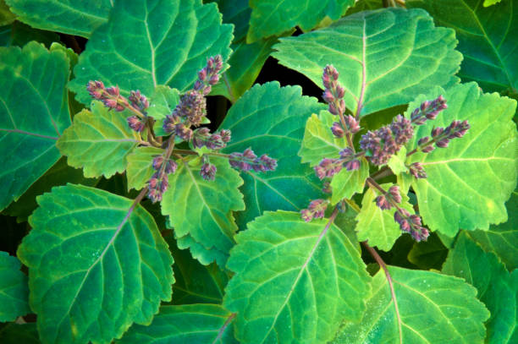
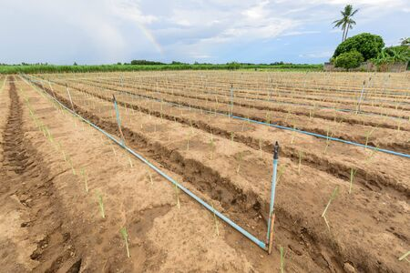
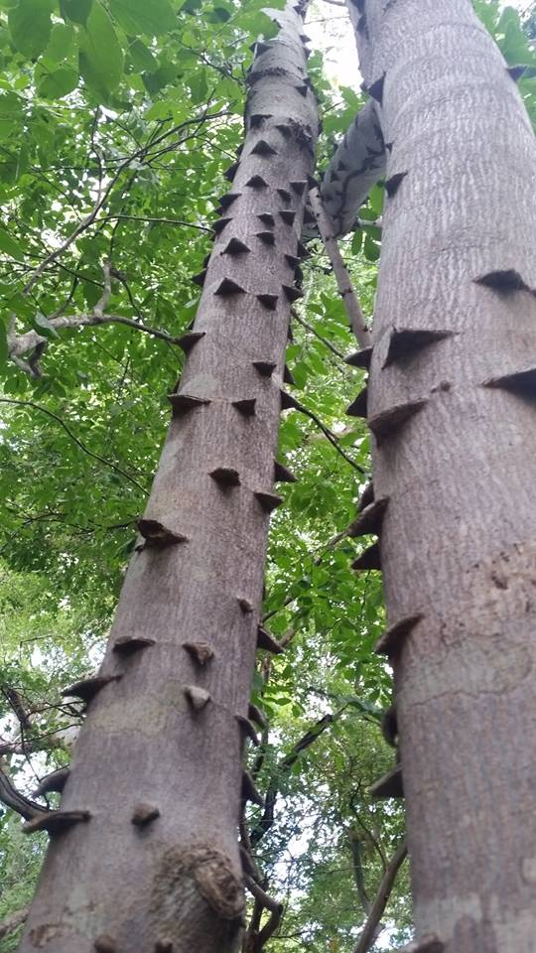
Sustainability
To produce botanicals, we need plants:
often produced in the South for use in protecting our crops in the North
Cultivated plants
  Require cultivation area that cannot be used for food production
  Production yields can be low (e.g. 1 ha of geranium ➔ 20-40 kg of essential oil)
  Require watering (competition with food production)
  Require labor often at a time when other fieldwork is ongoing
Wild plants
  Depending on the harvested organ (trunk or roots), irreversible damage may occur to the plant / tree
  Intensive harvesting from nature can endanger biodiversity
Geranium
Patchouli
Lemongrass
Zanthoxylum leprieurii

Slide 8
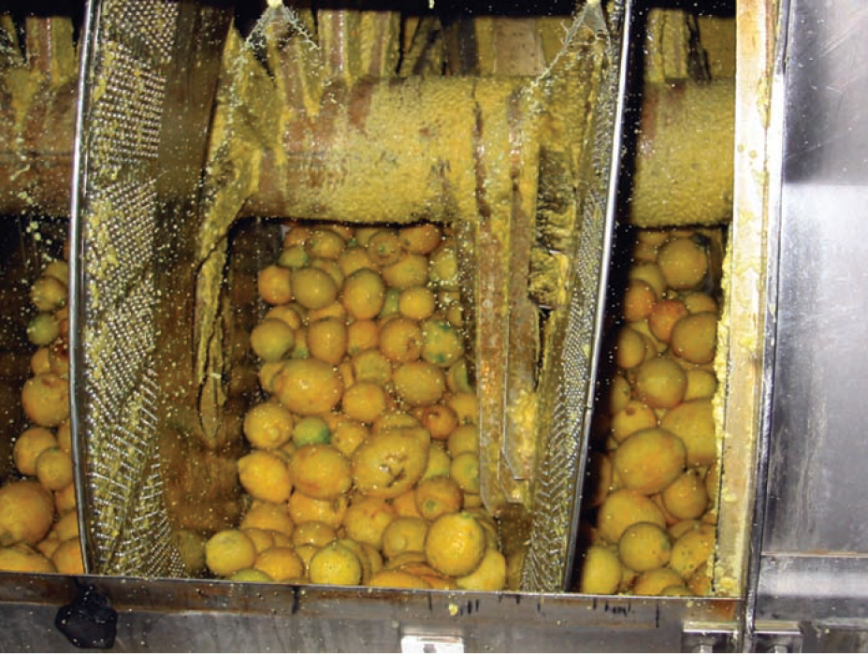
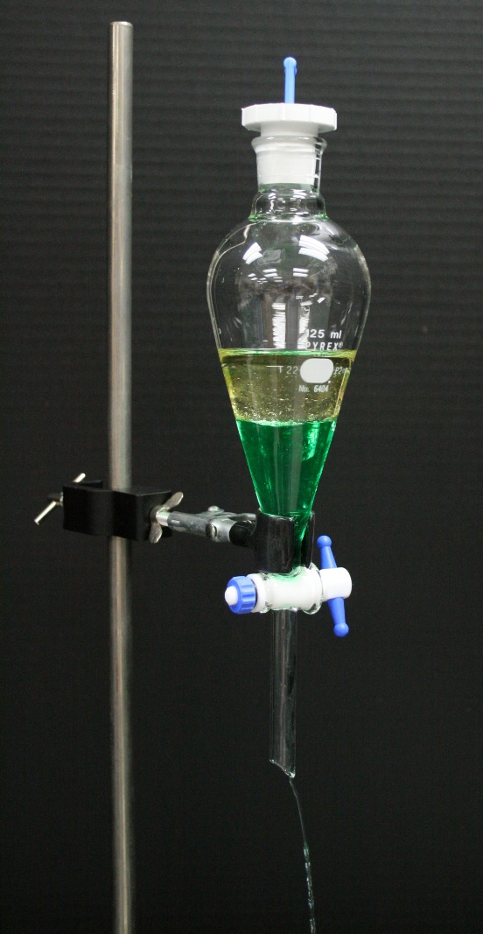
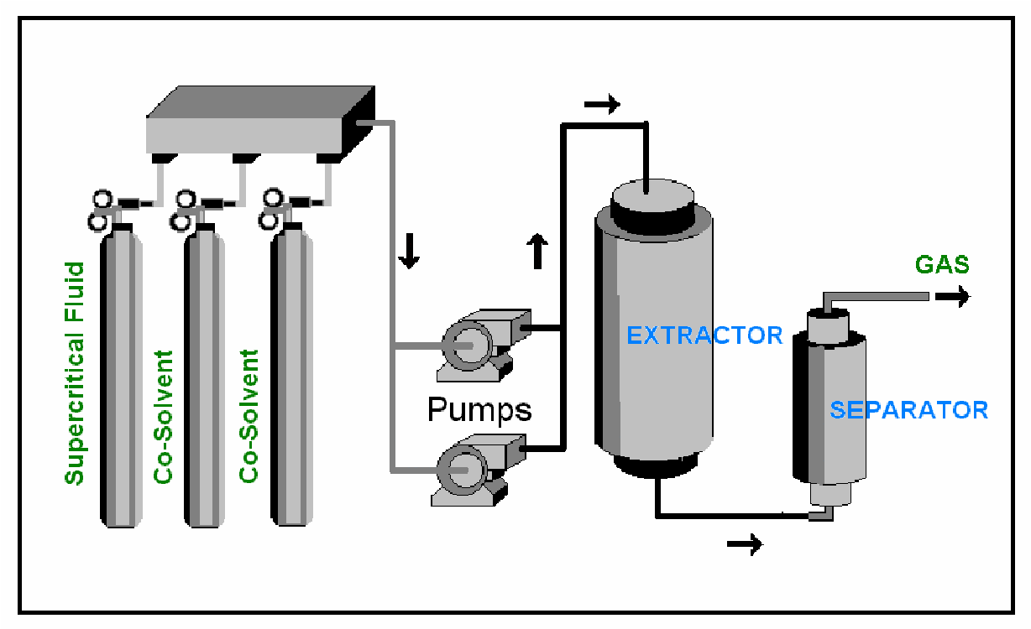
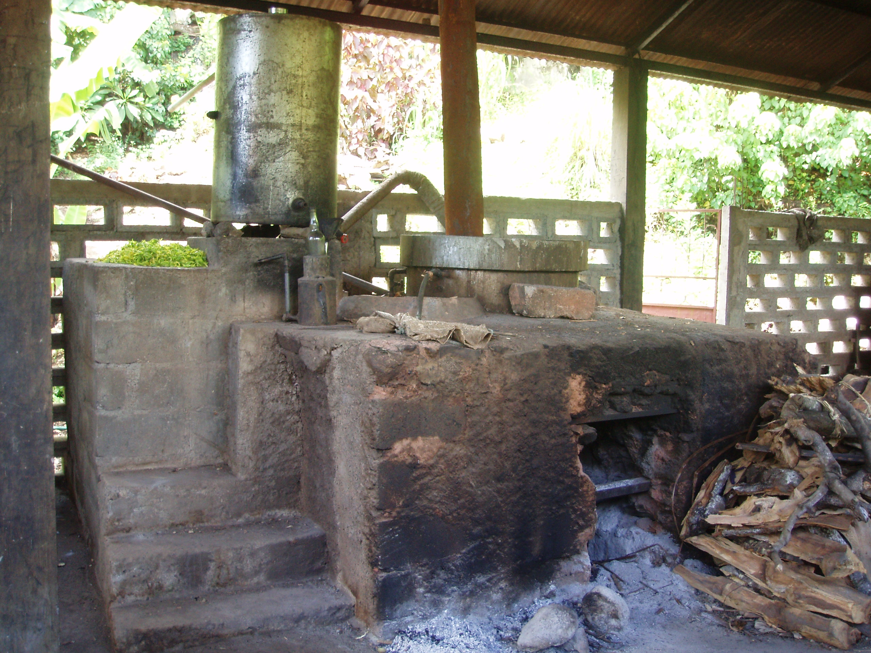
Sustainability
Extraction:
  Cold pressing (neem oil, citrus essential oils)
  Solvents (water, ethanol, methanol but also ethyl acetate, benzene, acetone, chloroform, hexane) (e.g. algae extract)
  Supercritical CO₂ (phenolics, terpenes, fatty acids)
  Hydrodistillation / steam distillation for essential oils (wood, gas, petrol)
Purification: conventional or greener techniques (energy, wastes)
Formulation: co-formulants frequently coming from chemical synthesis
➔ The LCMN is working on sustainable strategies

Slide 9
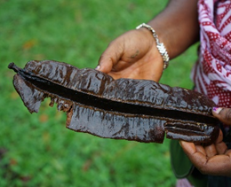
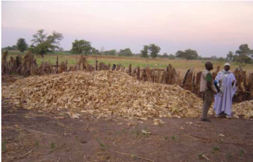
Solutions …
A
1. Using entire plants without extraction step
Boscia senegalensis leaf powder to protect maize against post-harvest insects
See Aminata Diagne and Aissatou Sakoh’s poster
Tetrapleura tetraptera fruit powder to protect maize against post-harvest insects in Congo
See Jérémy Berdy’s poster

Slide 10
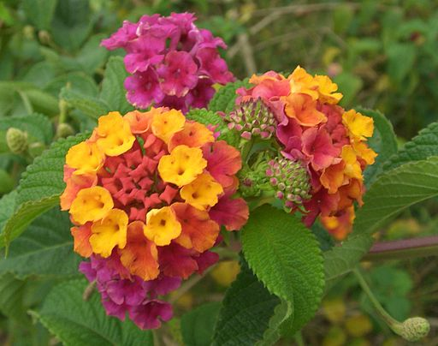
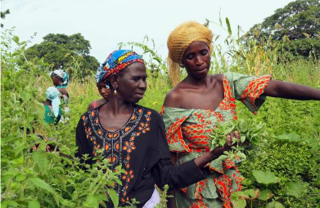
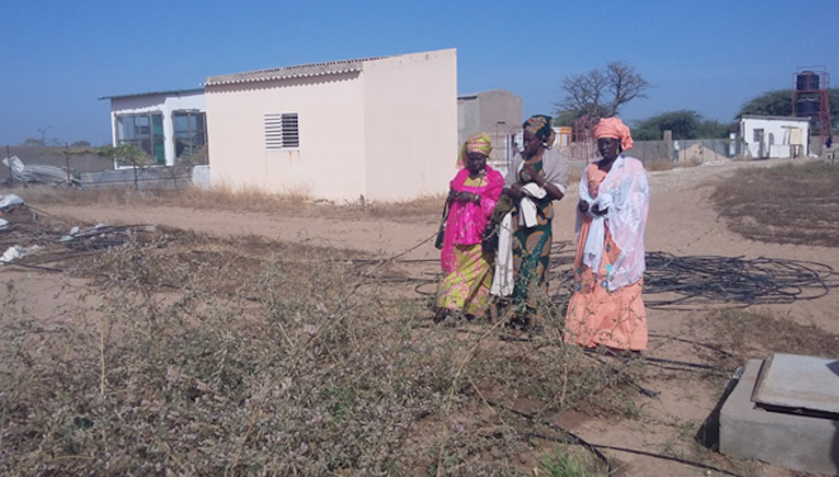
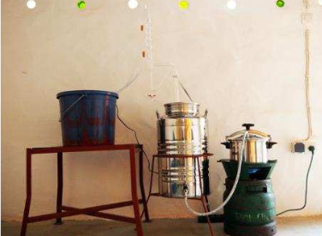
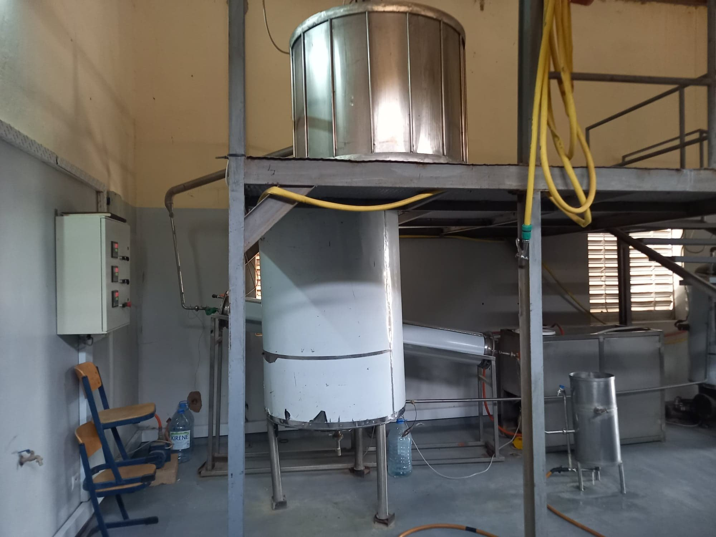
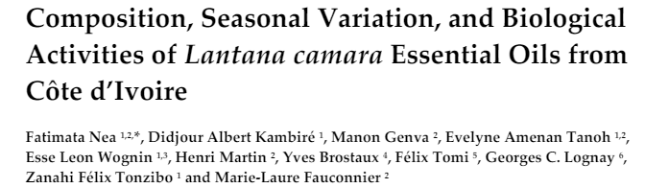
Solutions …
A
2. Using weeds or plants that do not require watering
Lantana camara essential oil to protect stored food against insect in Ivory Coast
Hyptis spicigera or Lippia alba essential oils to protect stored food against insects (South and North Senegal respectivelly)
See Aminata Diagne and Aissatou Sakoh’s poster

Slide 11
Solutions …
A
3. Strip-cultivation, intercropping, crop rotation
Plants containing botanicals can be included
  In crop rotation
  In intercropping
  In strip cropping
  In contour cropping
  In relay cropping
  In valorized intercrop
Can be an advantage for the crop
  Diversification (e.g. Lamiaceae)
  Insect repellent
  Nematicide
  Attractant for beneficial arthropods (i.e. pollinators and pest natural predators)
  Weed control
  Soil structure, …
Caraway (Carum carvi) / cereals

Slide 12
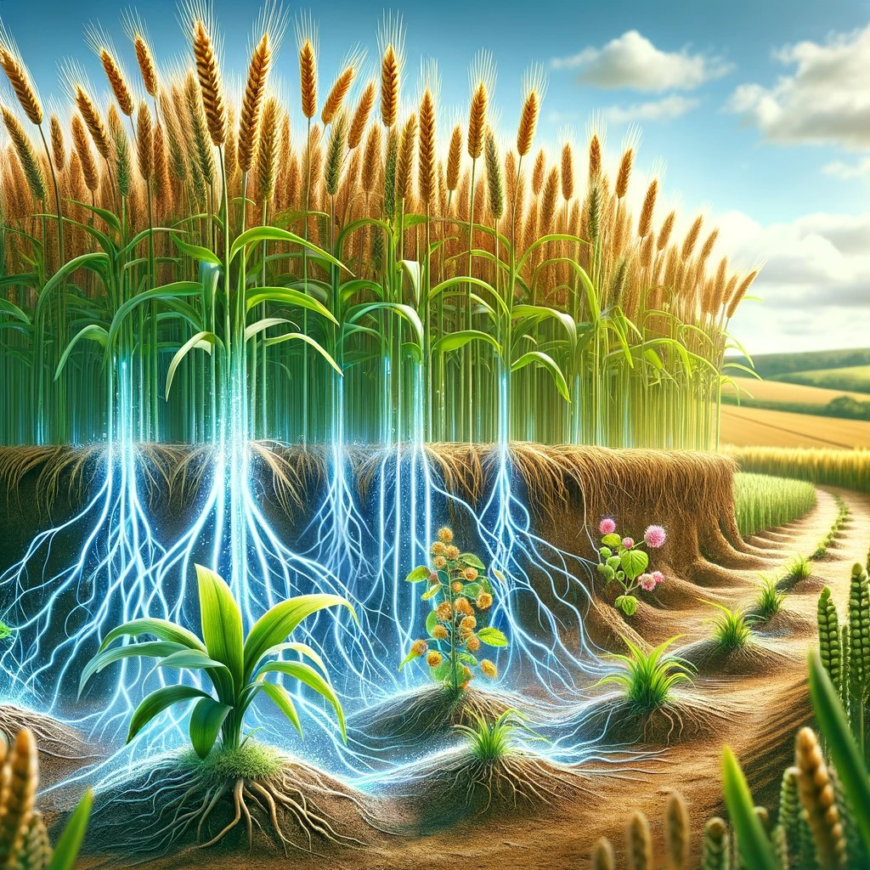
Solutions …
A
4. Allelopathy
Allelopathy is a form of chemical interference in which one organism negatively affects another through the release of chemical compounds
Production of allelochemicals has a cost for the crop
In induced allelopathy, allelochemicals are released by the crops only in presence of weeds
Exploiting induced allelopathy is an interesting strategy
A lot of research to be done …
See Waseem Mushtaq’s talk

Slide 13
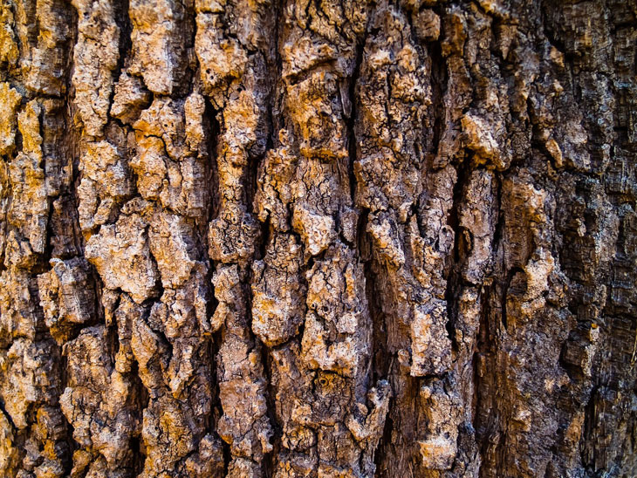
Solutions …
A
5. Using local co-products / green extraction
Barks are co-products that are undervalued in our regions due to their low calorific value (garden)
Bark contains interesting secondary metabolites
Bark essential oils extracted from local trees are tested for applications in crop and wood protection (insecticide, fungicide, herbicide)
Water extraction (maceration and decoction) and bio-ethanol extracts are also tested
See Leonel Taguimjeu Tafokeu’s poster

Slide 14
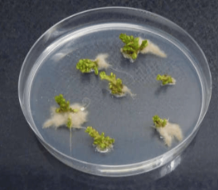
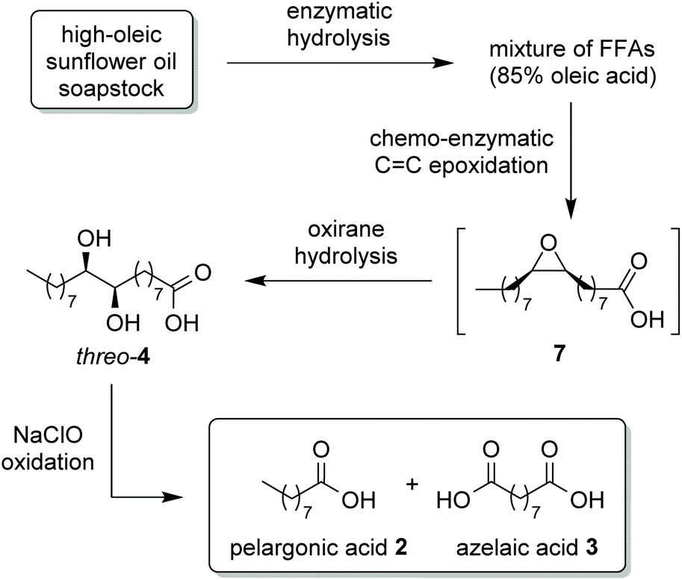
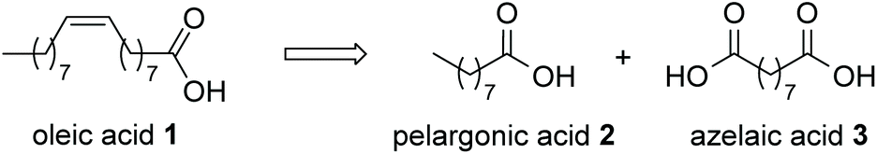
Solutions …
A
6. Biotechnology strategies/ synthesis of bio-based analogues / combination
In vitro culture (hairy roots, shoot culture, cell suspension, callus) ➔ modified secondary metabolism
Using bacteria / yeast for biotransformation / production
Enzymatic biotransformation
Chemical transformation of a bio-based substrate
Combination of several strategies
Capparis spinosa
see Marouan Mohaddab's poster

Slide 15
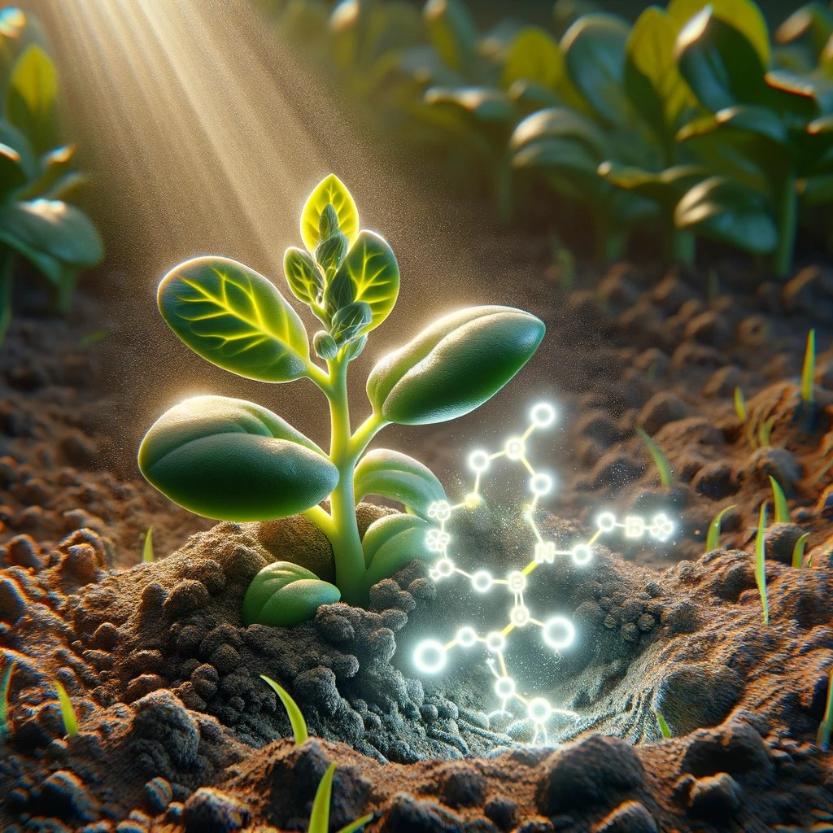
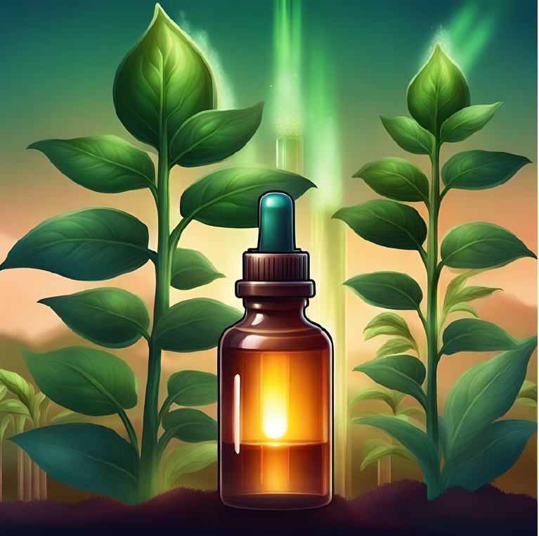
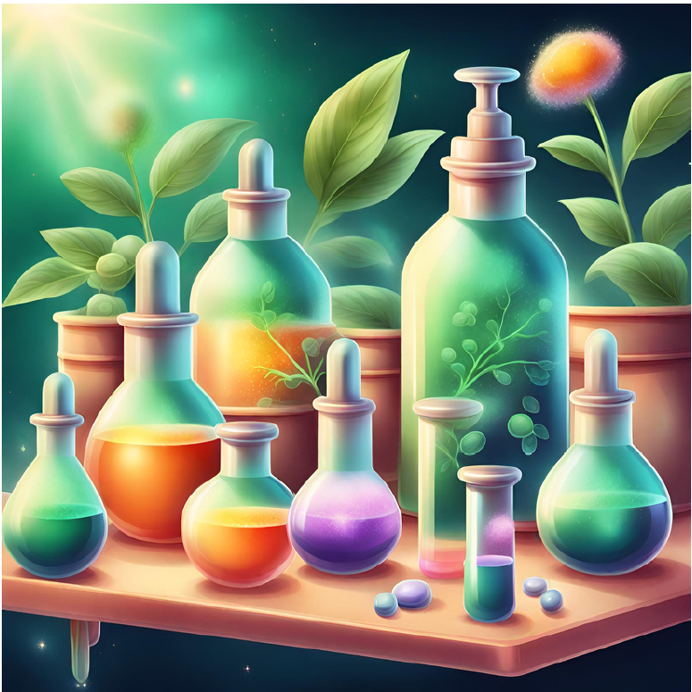
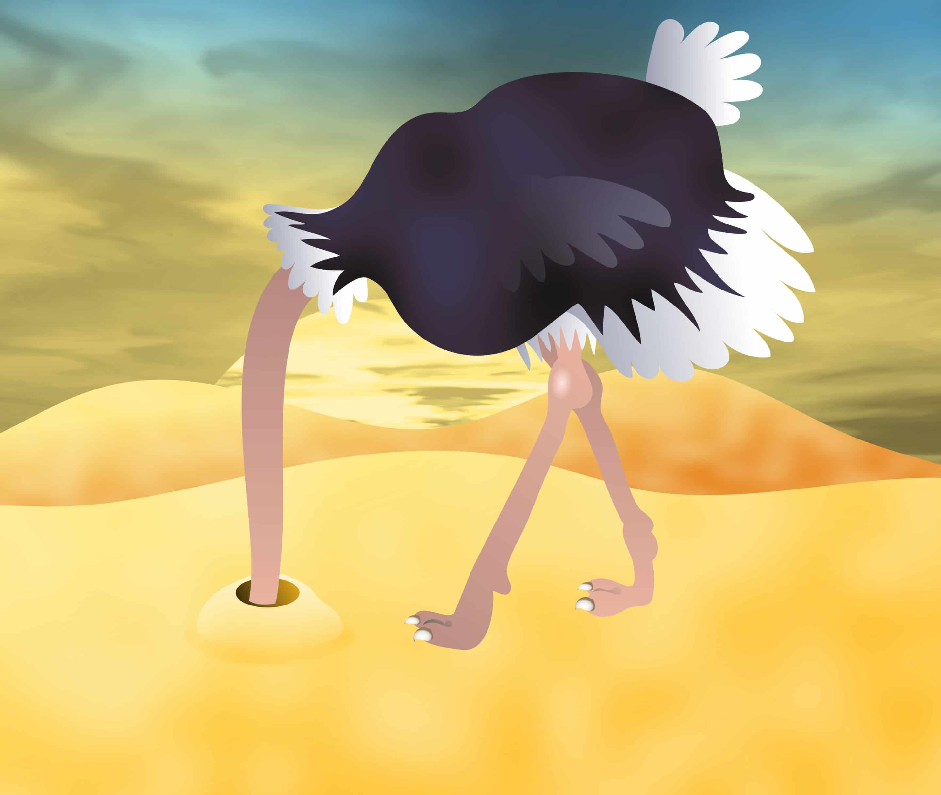
Conclusion
Next time you conduct research with botanicals, don't forget to consider sustainability, especially if these compounds are produced far from where they are used. Stop burying your head in the sand.
Resorting to sustainability labels as well as studying the life cycle are avenues to explore in achieving this
When getting to the formulation step, don't forget to check the origin of the co-formulants, which are mostly derived from petrochemistry.
The use of plants to protect other plants through the valorization of botanicals is a fascinating subject that draws on various disciplines, with potential application and implications in both North and South countries.
However, a substantial journey lies ahead to gain an in-depth understanding of the mechanisms at play and develop sustainable valorization strategies to replace conventional pesticides with bio-based solutions.

Slide 16
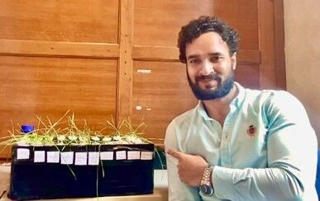


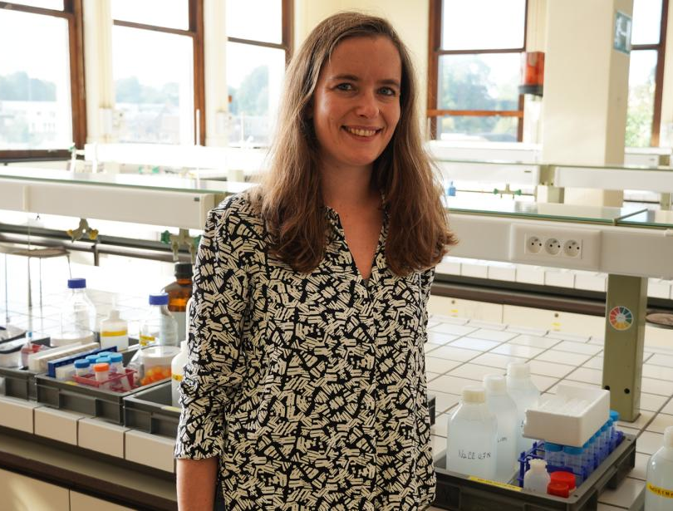










Thank you for your attention!
Clément Burgeon
Manon Genva
Waseem Mushtaq
Leonel Taguimjeu Tafokeu
Aissatou Sakoh
Aminata Diagne
Gaëlle Race
Jérémy Berdy
Marouan Mohaddab
Florian Martini
marie-laure.fauconnier@uliege.be
Adrien Francis
Thomas Bertrand
Maxime Grégoire
Franck Michels
Notes:
PAGE D'INTRODUCTION 2 / Page sans photo permettant l'insertion du titre de la présentation ainsi que d'autres infos (date, lieu, orateur, sous-titre,…)

