Slide 2
AML: new therapies - current and future
Adrien DE VOEGHT
Uliège
Centre Hostpitalier Universitaire de Liège
Laboratory of Hematology, GIGA-I3
Montefiore Institute of Electrical Engineering and computer Science
Adrien.devoeght@chuliege.be

Slide 3
Plan
Introduction
Epidemiology
What are major advances over five decades of research in AML
3.1. Improvement of frontline chemotherapy for fit patient
3.2. Improvement of frontline treatment for unfit patient
3.3. Better risk stratification
3.4. Major advances in Measurable Residual Disease
3.5. Better supportive care
3.6. Better control of HSCT complications
3.7. Potential role of maintenance
4. How we treat fit AML patient in Belgium in 2023?
How we treat unfit AML patient in Belgium in 2023?
Ongoing trial who may (or not) change our way to treat patient in the next future
Conclusion

Slide 4
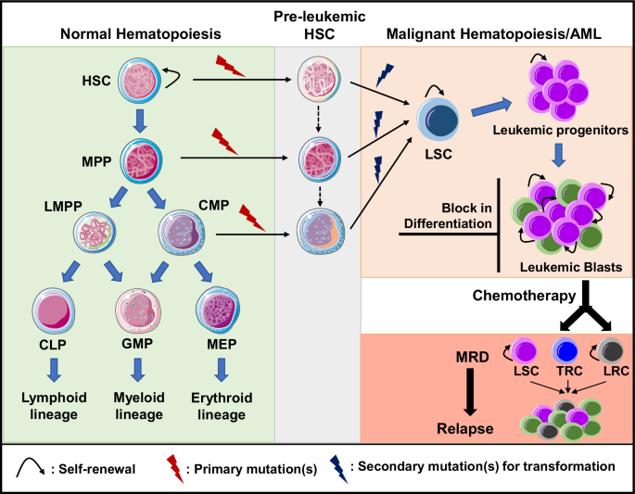
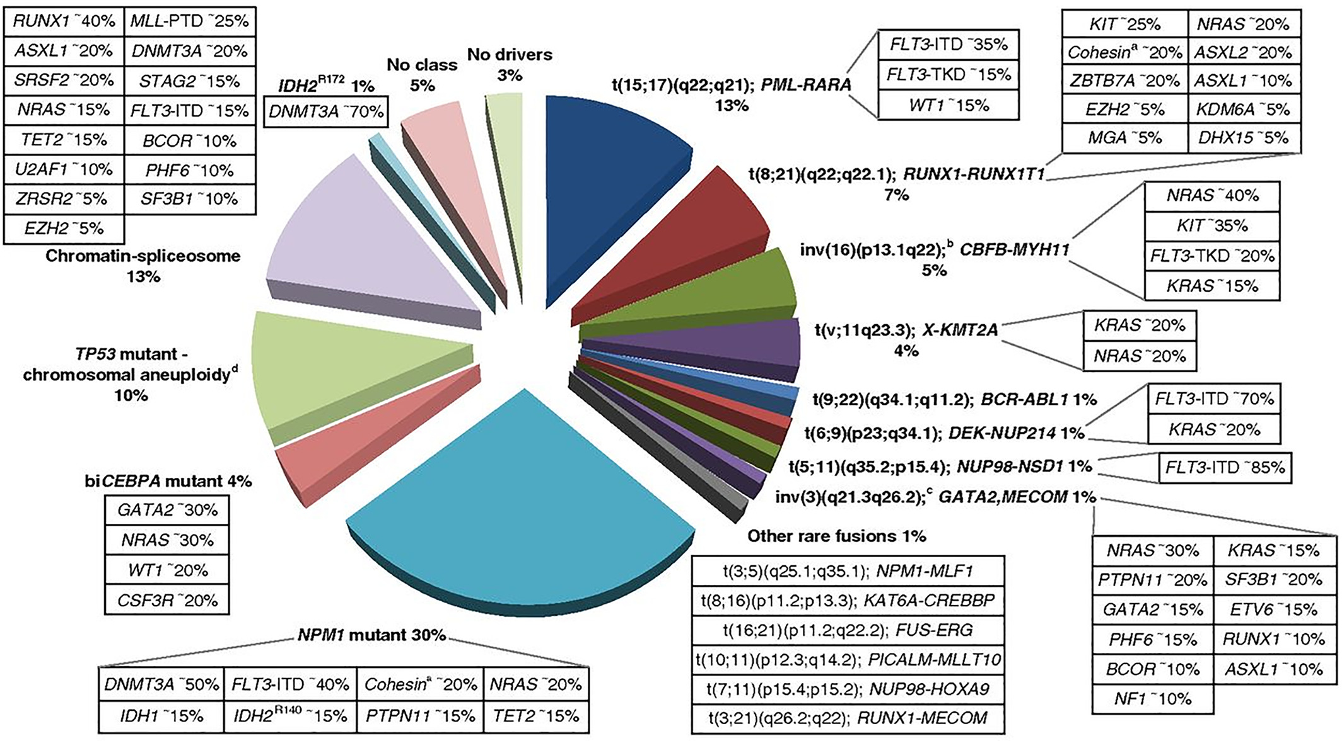
Introduction | Epidemiology | Advances | Fit patient | Unfit patient | Next future | Conclusion
Long N et al. Stem Cell Rev and Rep. 2022
Döhner H. et al. Blood.2017

Slide 5
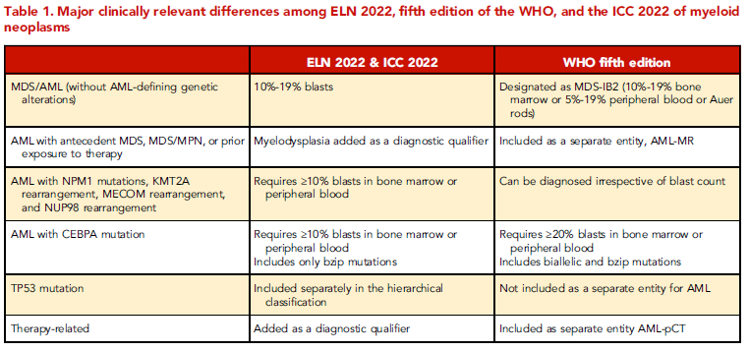
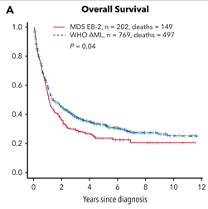
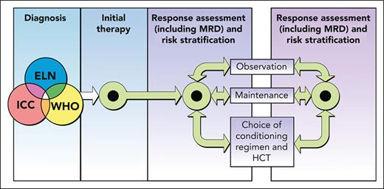
Introduction | Epidemiology | Advances | Fit patient | Unfit patient | Next future | Conclusion
Estey E et al. Blood. 2022
Chaer F. Blood.2023

Slide 6
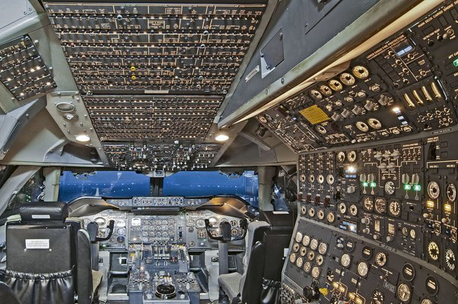
Introduction | Epidemiology | Advances | Fit patient | Unfit patient | Next future | Conclusion
PAST
PRESENT
FUTUR???

Slide 7
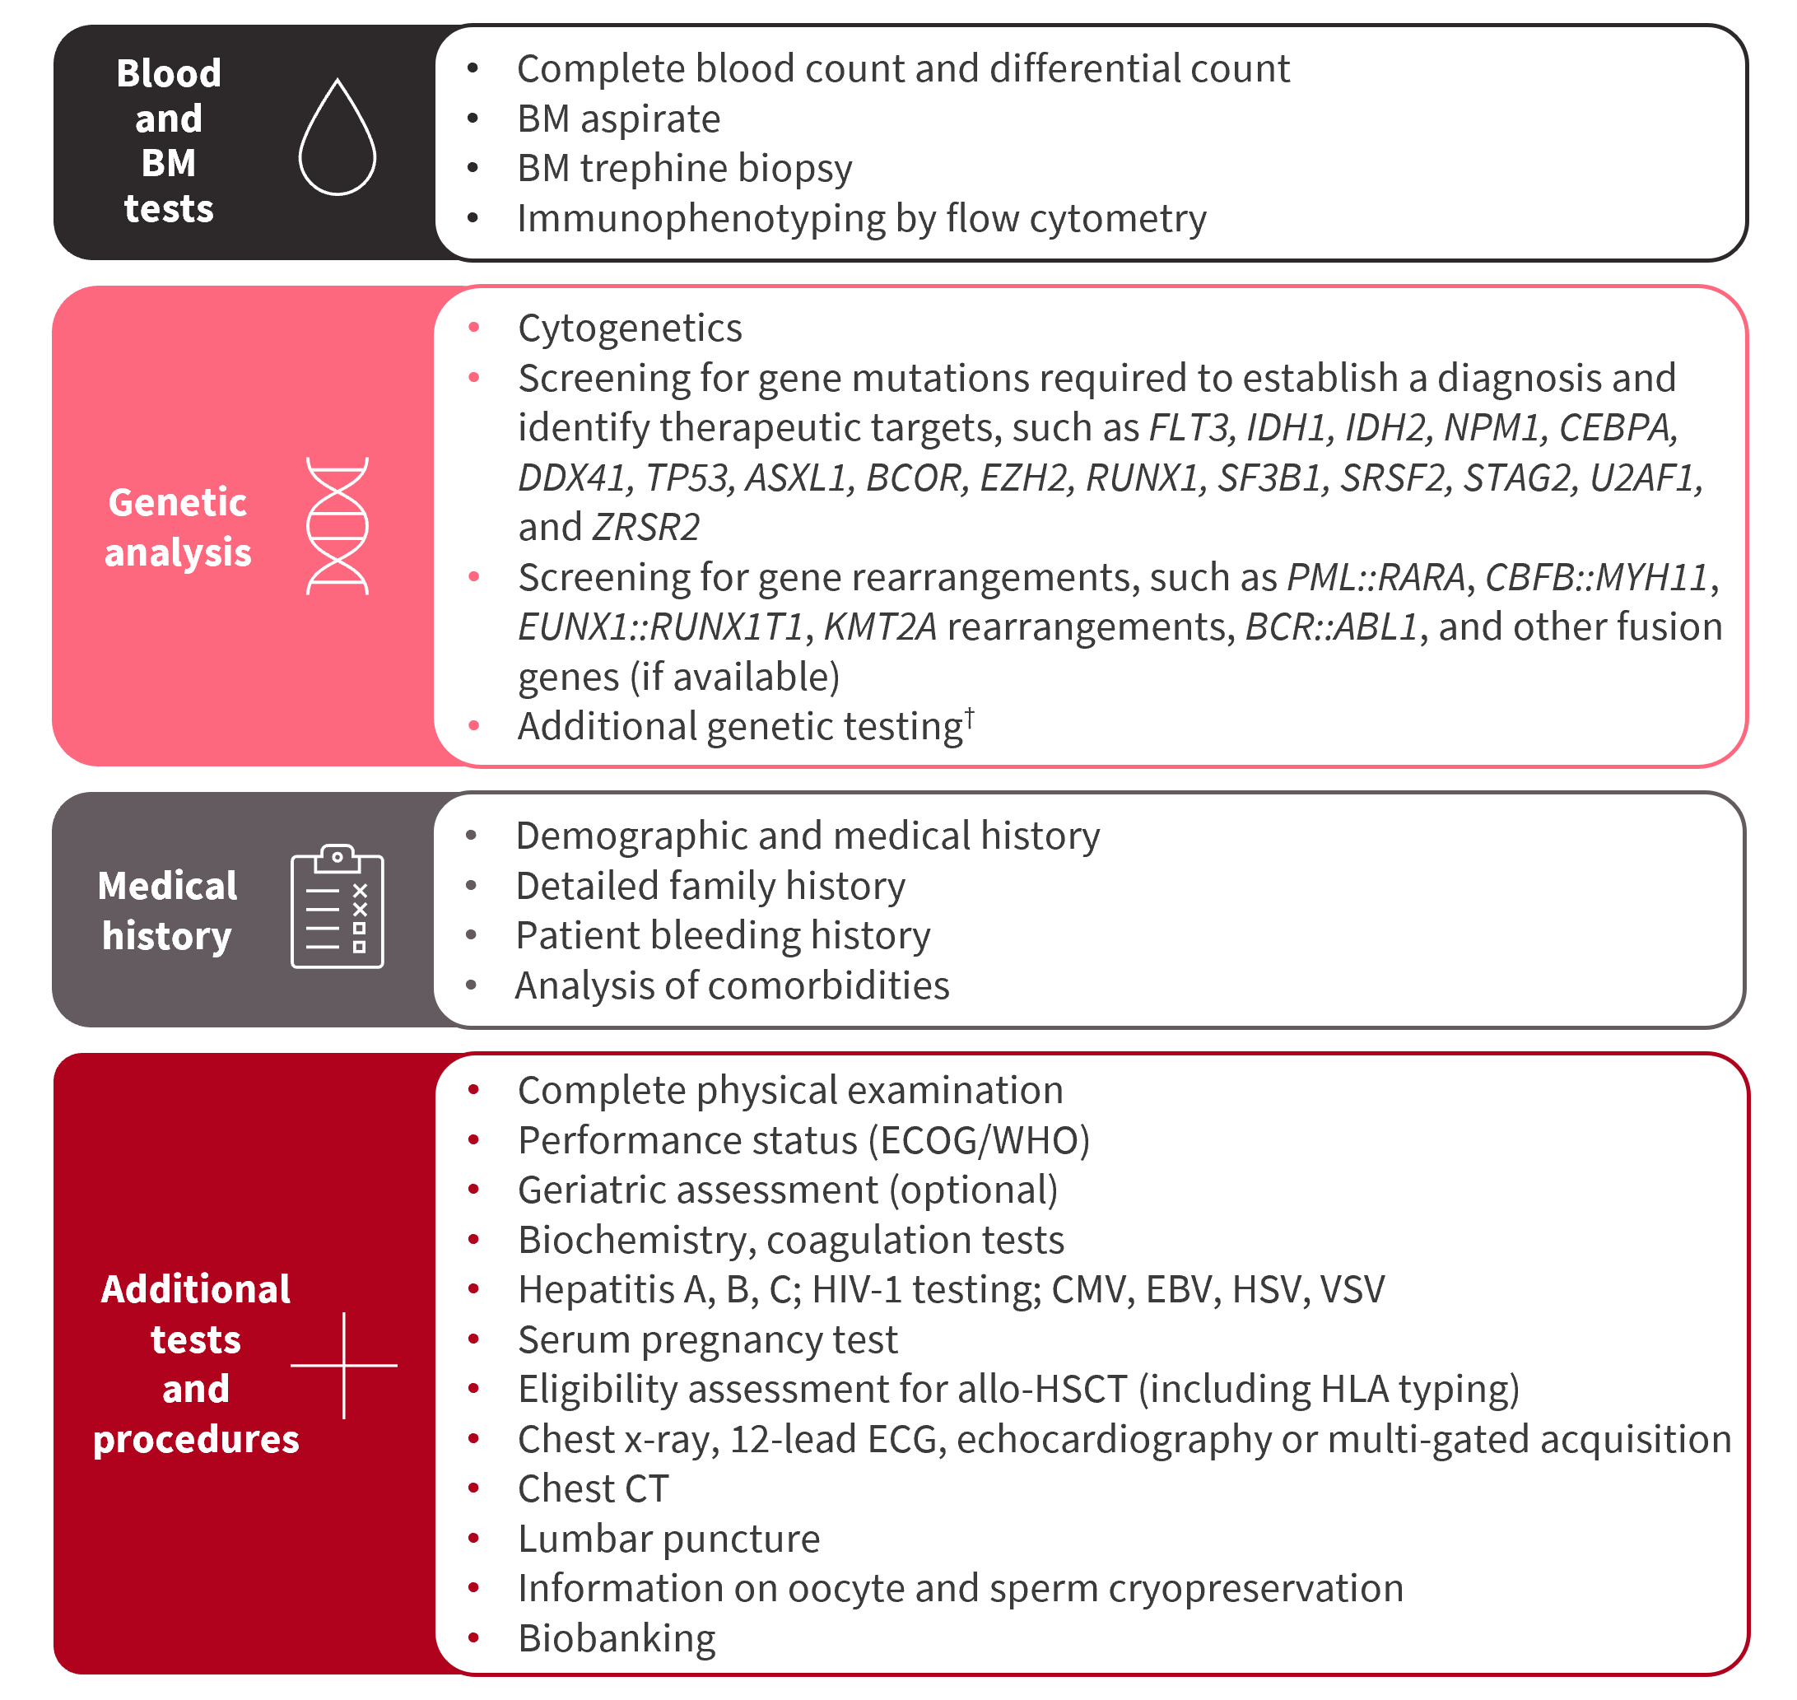
Introduction | Epidemiology | Advances | Fit patient | Unfit patient | Next future | Conclusion
PRESENT
ELN2022

Slide 8
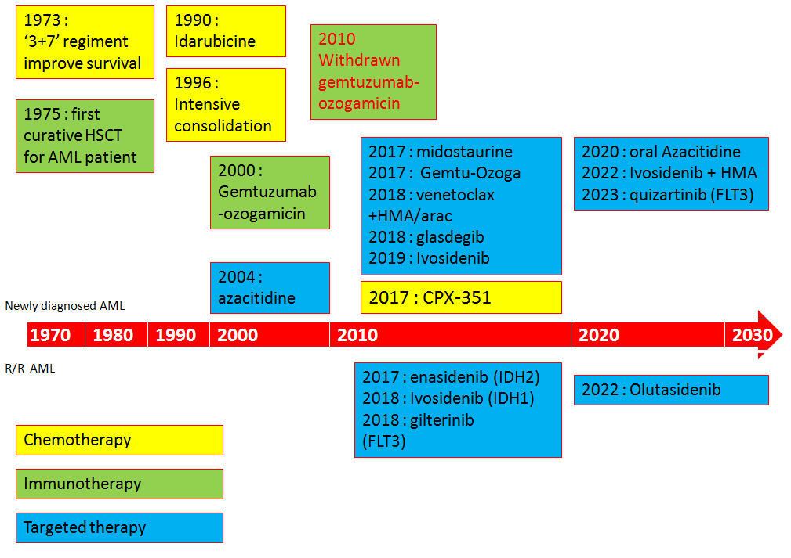
Introduction | Epidemiology | Advances | Fit patient | Unfit patient | Next future | Conclusion

Slide 9
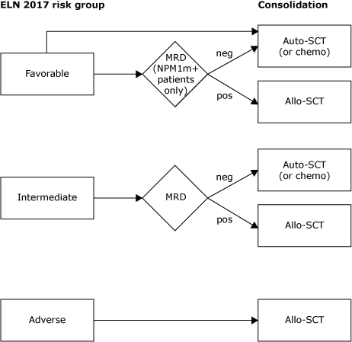
Introduction | Epidemiology | Advances | Fit patient | Unfit patient | Next future | Conclusion
ELN 2022 risk group
CONSOLIDATION
I
N
D
U
C
T
I
O
N
3+7
FLAG-IDA (Young)
ELN2022
HOVON richtlijn

Slide 10
Introduction | Epidemiology | Advances | Fit patient | Unfit patient | Next future | Conclusion
Subjects of interest NOT discussed today
AML predisposition (so-called « germline mutation ») – 5-10 % of MDS/AML diagnosis :
- 3 differents subsets (Inherited bone marrow failure syndromes, Cancer Predisposition Syndromes Familial MDS/AL syndrome);
- Important for slection of donnor, genetic counseling.
Cazzola M. Blood. 2023
Natural history of AML from Clonal Hematopoiesis.
Fabre M. et al. Nature. 2022, Watson C et al. Science.2020
Specific evolution of the comprehension and treatment of Acute Promyelocytic Leukemia (known as M3-Variant).
Sanz M. et al. Blood.2019

Slide 11
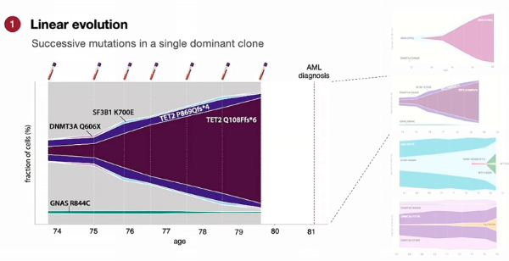
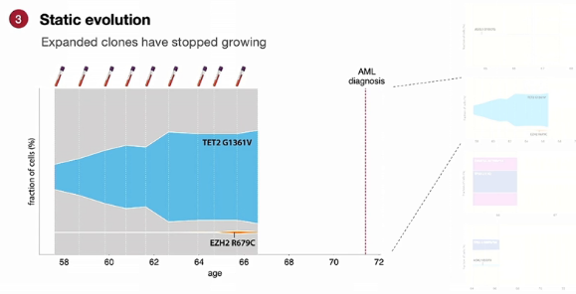
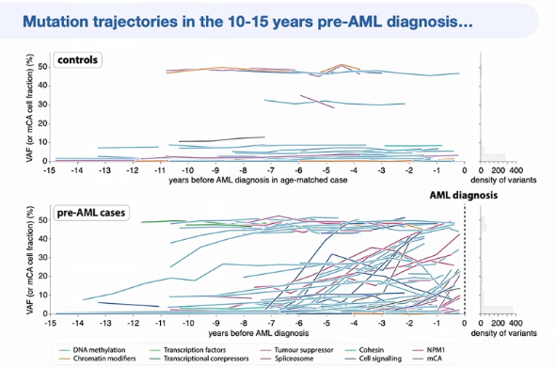
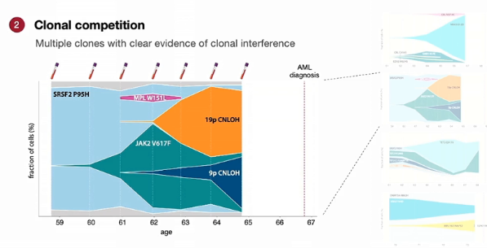
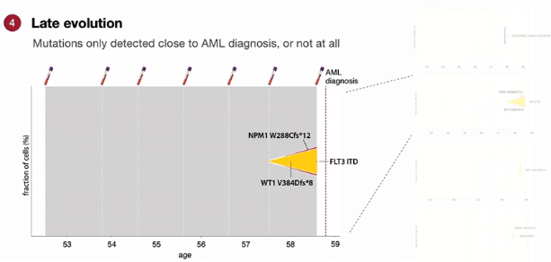
Introduction | Epidemiology | Advances | Fit patient | Unfit patient | Next future | Conclusion
From C Watson, Cambridge
Presented at ESH23-AML

Slide 12
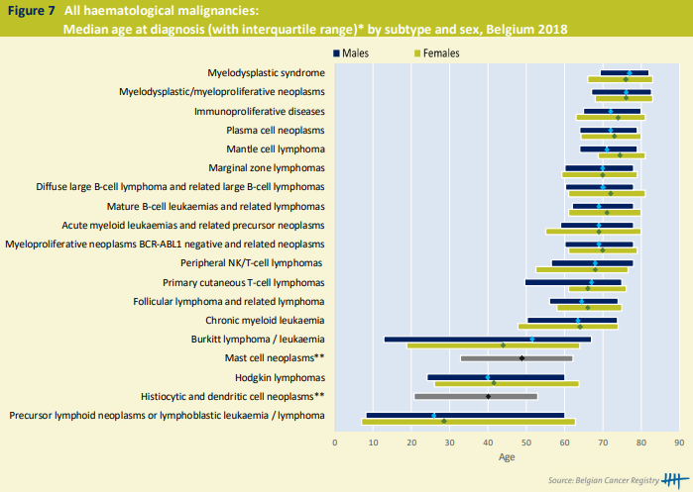
Introduction | Epidemiology | Advances | Fit patient | Unfit patient | Next future | Conclusion
Median age : 69 years old
Male/Female = 1.1
Haematological malignancies in Belgium 2004-2018, Belgian Cancer Registry, Brussels, 2021

Slide 13
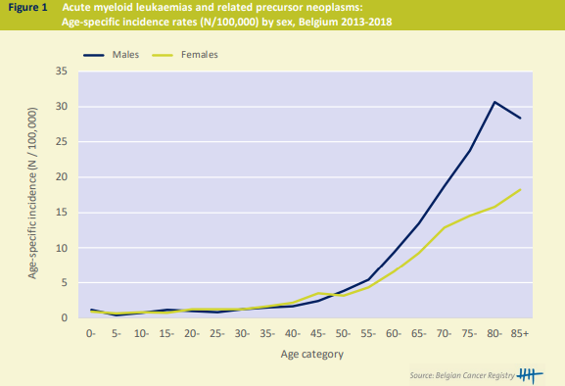
Introduction | Epidemiology | Advances | Fit patient | Unfit patient | Next future | Conclusion
Incidence : 595/y (2018)
Prevalence : 1058 patients (2014-2018)
Haematological malignancies in Belgium 2004-2018, Belgian Cancer Registry, Brussels, 2021

Slide 14
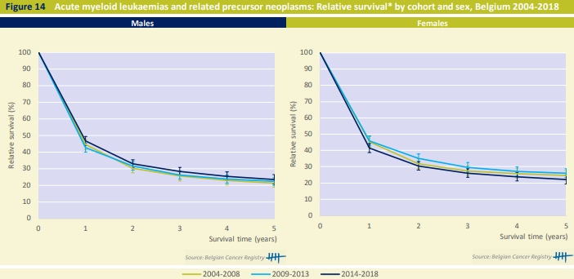
Introduction | Epidemiology | Advances | Fit patient | Unfit patient | Next future | Conclusion
The 10-year relative survival is 20% in males and 22% in females.
The 5-year relative survival varies considerably with age, ranging from approximately 70% in the age group 0-9 years to less than 10% in the age group 70+.
No consistent improvement of the 5-year relative survival is observed in the period 2004- 2018
Haematological malignancies in Belgium 2004-2018, Belgian Cancer Registry, Brussels, 2021

Slide 15
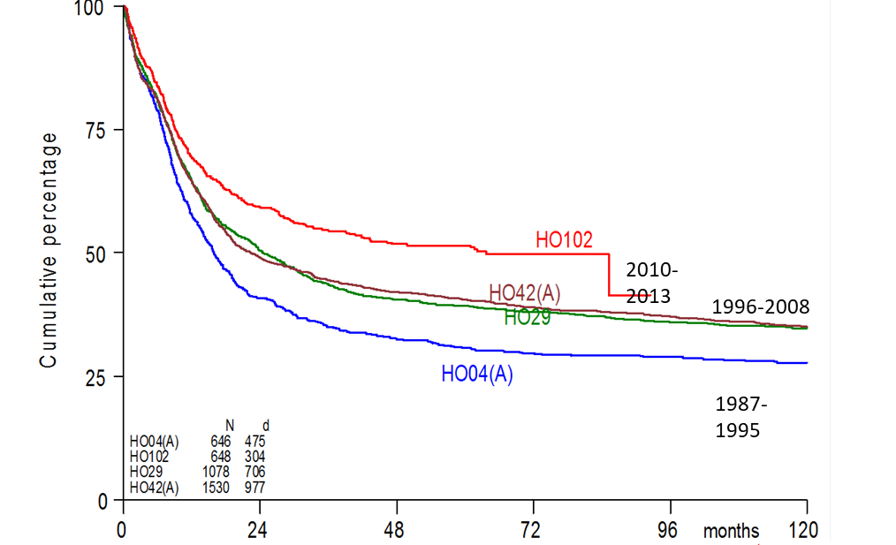
Introduction | Epidemiology | Advances | Fit patient | Unfit patient | Next future | Conclusion
Fit AML | Unfit AML | Stratification | MRD | Supportive care | HSCT | Maintenance
Courtesy of Dr.B WAUTERS from HOVON
Courtesy of Pr.F BARON from EORTC

Slide 16
Introduction | Epidemiology | Advances | Fit patient | Unfit patient | Next future | Conclusion
Fit AML | Unfit AML | Stratification | MRD | Supportive care | HSCT | Maintenance
Courtesy of WW II

Slide 17
Introduction | Epidemiology | Advances | Fit patient | Unfit patient | Next future | Conclusion
Fit AML | Unfit AML | Stratification | MRD | Supportive care | HSCT | Maintenance
Which dose of anthracycline?
Fernadez et al, NEJM. 2009=> 90 mg/m² > 45 mg/m²
MRC AML 17 trial (Burnett et al, Blood. 2015) => 60 = 90 mg/m² (90 > 60 mg/m² if FLT3+)
Lee et al, JCO. 2017 => idarubicin 12 mg/m² = dauno 90 (ida 12 < dauno 90 if FLT3+)
Which dose of cytarabine? (Weigert N. et al, blood reviews. 2021)
1980 : E3483 trial (ECOG) : consolidation is better than no consolidation
1994 : CALGB => consolidation with 4 cycles of AraC increased OS
NO well-established RCT comparing IDAC (1 -2g/m²) vs HiDAC (3g/m²)
NO RCT comparing 2, 3 or 4 cycles of consolidation (except older adult (MRC AML11 trial) => 1=4)
Combining intensive treatment and immunotherapy / targeted therapy?
RATIFY trial (midostaurine) (Stone R. et al. N Engl J Med. 2017)
QuANTUM-First (Quizartinib) (Erba H. et al. Lancet. 2023)
ALFA 0701 trial (Gemtuzumab-ozogamicin) (Lambert J. et al. Haematologica 2019)
Daunorubine 60 mg/m²
Day 1, 2 and 3
AraC 100-200 mg/m² continuous infusion day 1-7
2-4 cycles of AraC 1.5g/m²/3h bid
Day 1 -3

Slide 18
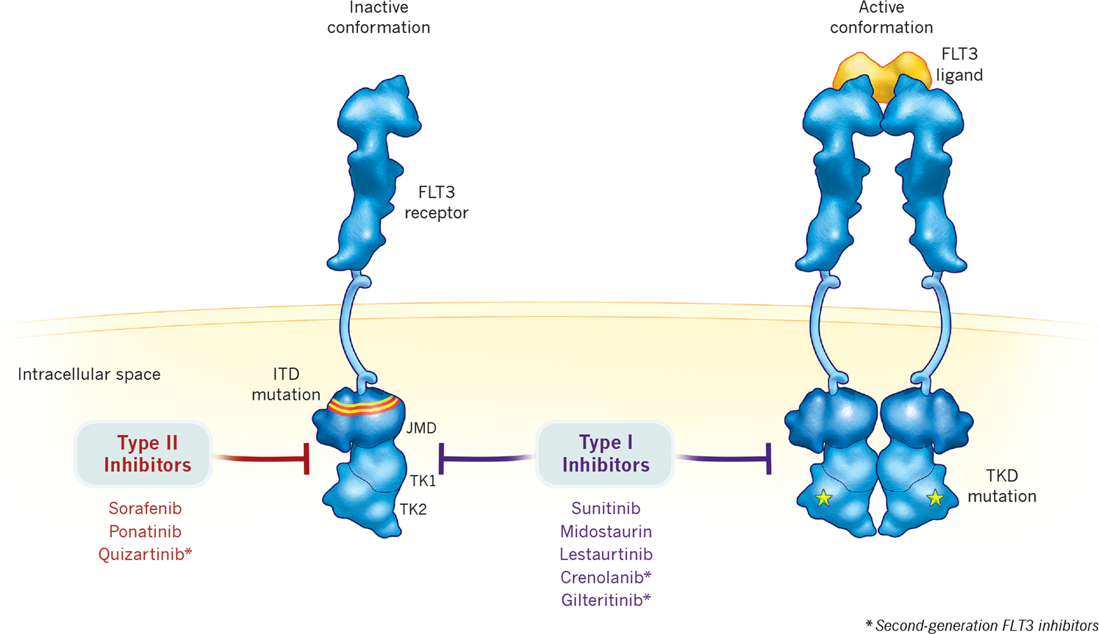
Introduction | Epidemiology | Advances | Fit patient | Unfit patient | Next future | Conclusion
Fit AML | Unfit AML | Stratification | MRD | Supportive care | HSCT | Maintenance
Daver N. et al. Leukemia.2019

Slide 19
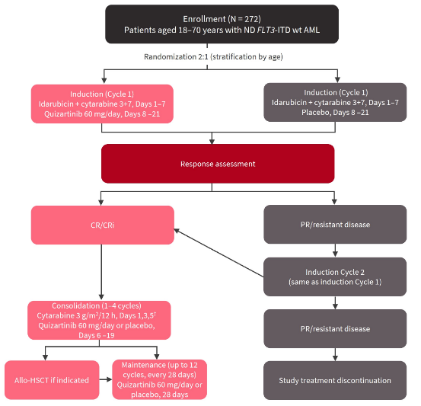
Introduction | Epidemiology | Advances | Fit patient | Unfit patient | Next future | Conclusion
Fit AML | Unfit AML | Stratification | MRD | Supportive care | HSCT | Maintenance
QuANTUM-First
Stone R. et al. N Engl J Med. 2017
Erba H. et al. Lancet. 2023

Slide 20
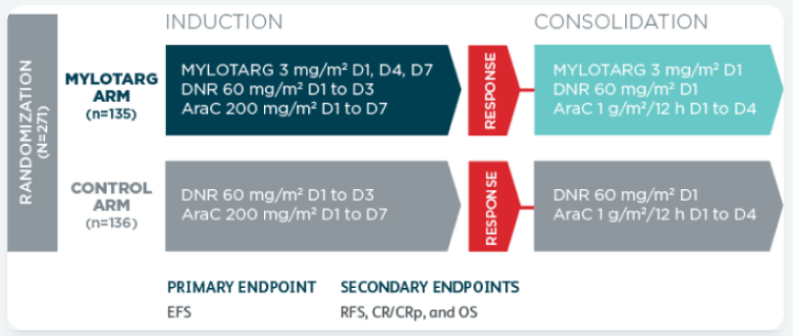
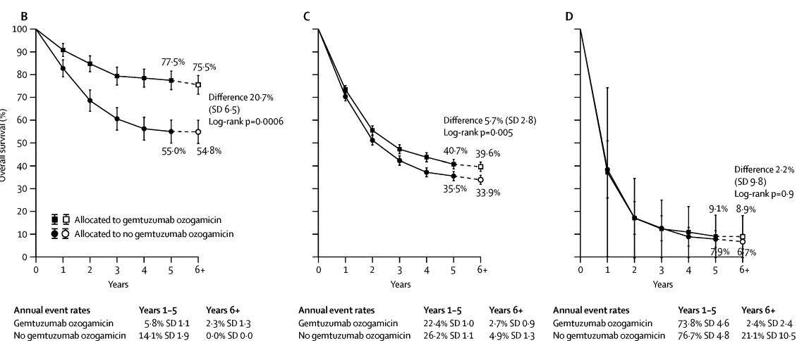
Introduction | Epidemiology | Advances | Fit patient | Unfit patient | Next future | Conclusion
Fit AML | Unfit AML | Stratification | MRD | Supportive care | HSCT | Maintenance
Alfa trial
Favorable
Intermediate
Défavorable
Hills RK et al. the lancet. 2014

Slide 21
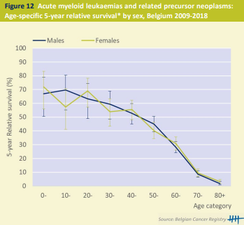
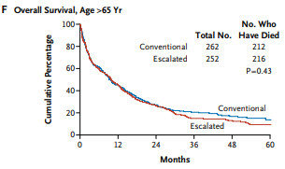
Introduction | Epidemiology | Advances | Fit patient | Unfit patient | Next future | Conclusion
Fit AML | Unfit AML | Stratification | MRD | Supportive care | HSCT | Maintenance
Lowenberg B et al. NEJM. 2009
Haematological malignancies in Belgium 2004-2018, Belgian Cancer Registry, Brussels, 2021

Slide 22
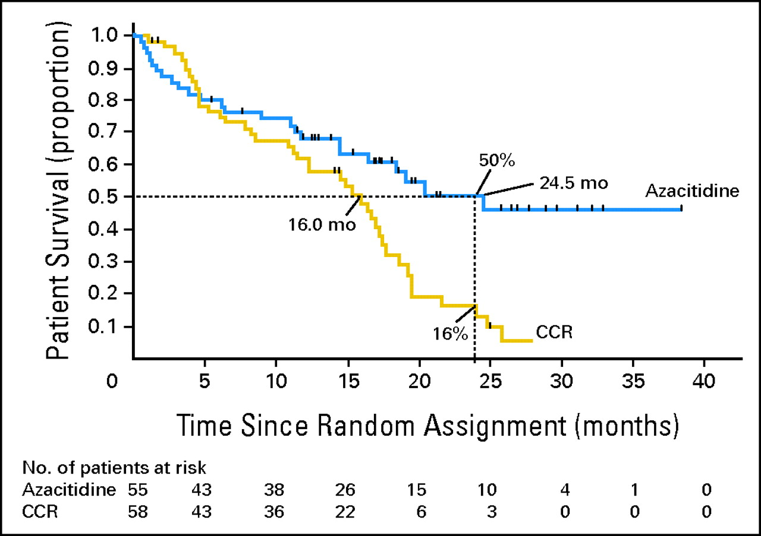
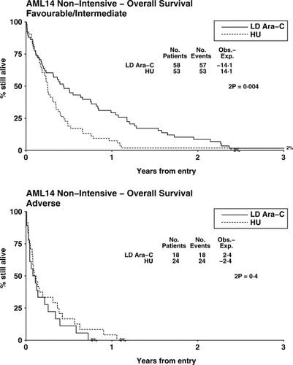
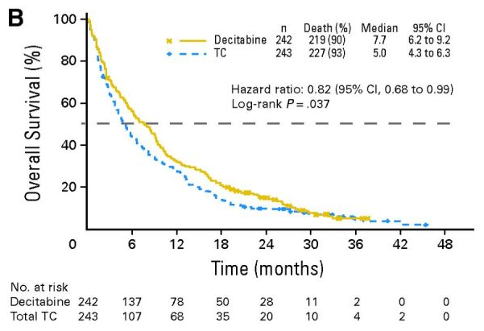
Introduction | Epidemiology | Advances | Fit patient | Unfit patient | Next future | Conclusion
Fit AML | Unfit AML | Stratification | MRD | Supportive care | HSCT | Maintenance
Fenaux P et al. JCO 2010
AraC 20 mg/m² sc, day 1-10
Interval 4-6 wks
Azacitidine 75mg/m²
Sc , Day 1-7
Cycle of 28 days
Decitabine 20mg/m²
IV, day 1-5
Cycle of 28 days
Kantarijian H. JCO. 2012
Burnett A et al. Cancer 2007

Slide 23
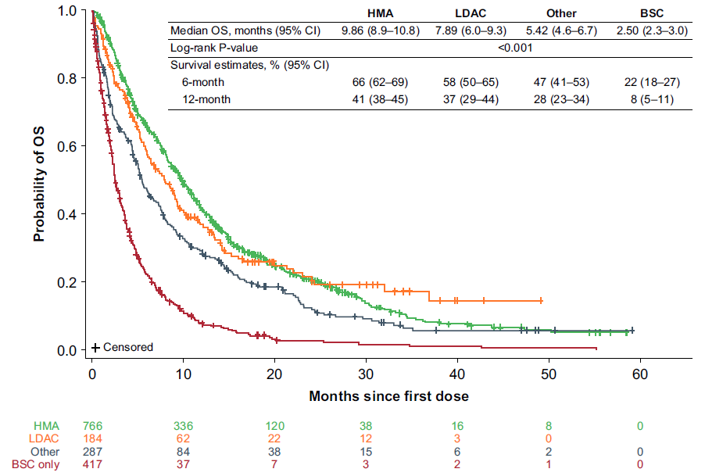
Introduction | Epidemiology | Advances | Fit patient | Unfit patient | Next future | Conclusion
Fit AML | Unfit AML | Stratification | MRD | Supportive care | HSCT | Maintenance
Real world data of 1762 patients coming from 112 community or
hospital medical centers that treated patients with
AML between 2015 and 2018 across 22 countries
Median OS
Miyamoto T et al. LEUKEMIA & LYMPHOMA. 2022
Notes:
Miyamoto T et al. LEUKEMIA & LYMPHOMA. 2022

Slide 24
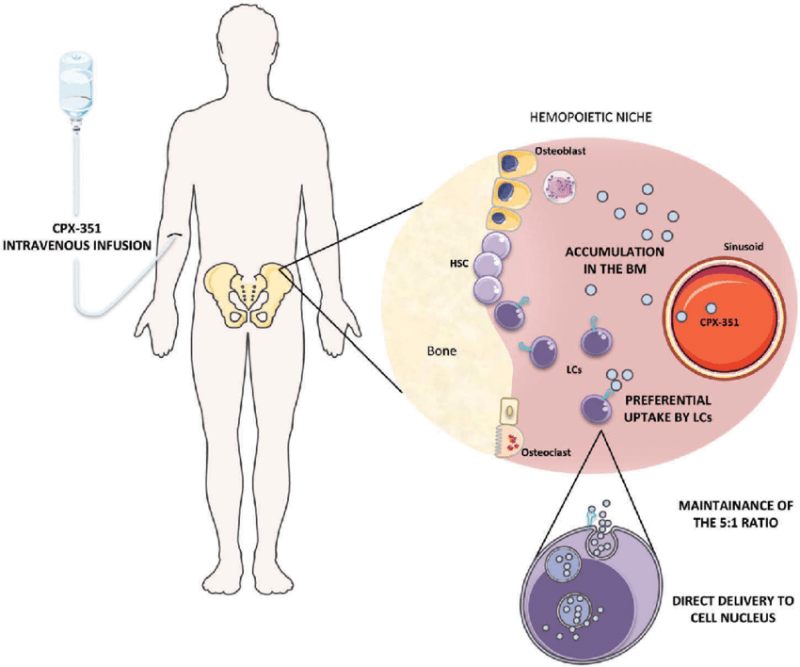
Introduction | Epidemiology | Advances | Fit patient | Unfit patient | Next future | Conclusion
Fit AML | Unfit AML | Stratification | MRD | Supportive care | HSCT | Maintenance
VYXEOS
CPX-351 a 5:1 molar ratio of cytarabine:daunorubicin
Formulation provides synergistic leukemia cell killing in vitro¹
In humans
CPX-351 preserved delivery of 5:1 drug ratio for >24 hr
Drug exposure maintained for 7 days²
Selective uptake of liposomes by bone marrow leukemia cells in xenograft models³
Elderly AML, sAML: more chemoresistent leukemias. CPX can escape drug efflux pumps by entering leukemic cells as intact liposomes. Can also escape early cytarabine deaminase dependent cytarabine-inactivation.
Brunetti C. et al. Expert Review of Hematology.2017
Tardi. Leuk Res. 2009
Feldman. JCO. 2011
Lim. Leuk Res. 2010

Slide 25
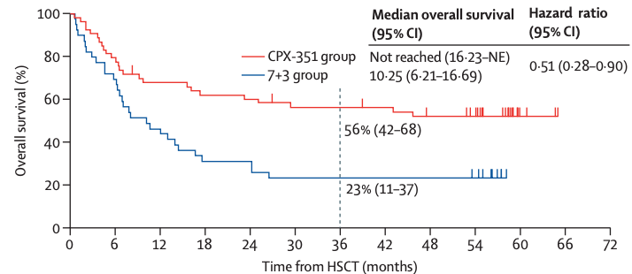
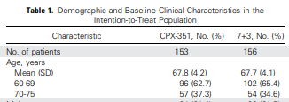
Introduction | Epidemiology | Advances | Fit patient | Unfit patient | Next future | Conclusion
Fit AML | Unfit AML | Stratification | MRD | Supportive care | HSCT | Maintenance
VYXEOS
Lancet. Lancet Haematol. 2021;8:e481

Slide 26
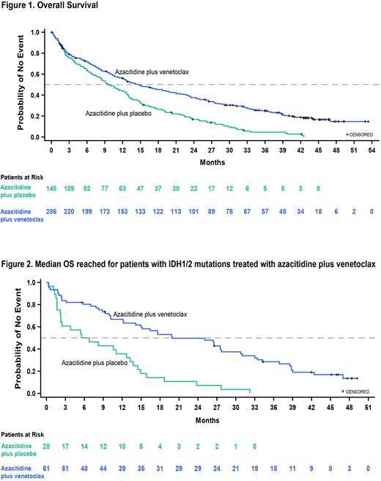
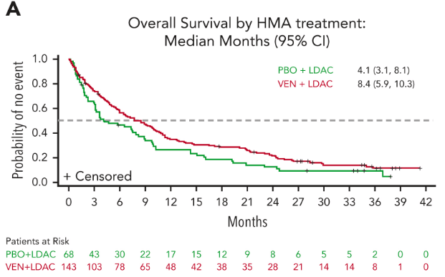
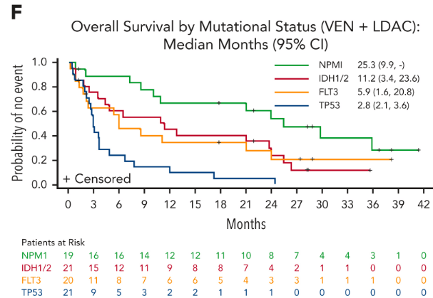
Introduction | Epidemiology | Advances | Fit patient | Unfit patient | Next future | Conclusion
Fit AML | Unfit AML | Stratification | MRD | Supportive care | HSCT | Maintenance
Viale A
Azacitidine sc 75mg/m² (1-7)
Venetoclax 400mg once per day
Cycle of 28 days
Viale C
AraC 20 mg/m² sc (1-10)
Venetoclax 600mg once per day
Cycle of 28 days
VIALE C study
VIALE A study
Pratz K. et al. Blood 2022.
DiNardo C et al. NEJM. 2020
Wei A. et al. Blood. 2022
Notes:
Wei A. et al. Blood. 2022

Slide 27
ALIDHE trial : Unfit IDH1 mutated AML
Introduction | Epidemiology | Advances | Fit patient | Unfit patient | Next future | Conclusion
Fit AML | Unfit AML | Stratification | MRD | Supportive care | HSCT | Maintenance
Ivosidenib,500 mg orally, once daily
Azacitidine 75 mg/m², sc for 7 days in 28-day cycles).
Soon available in Belgium

Slide 28
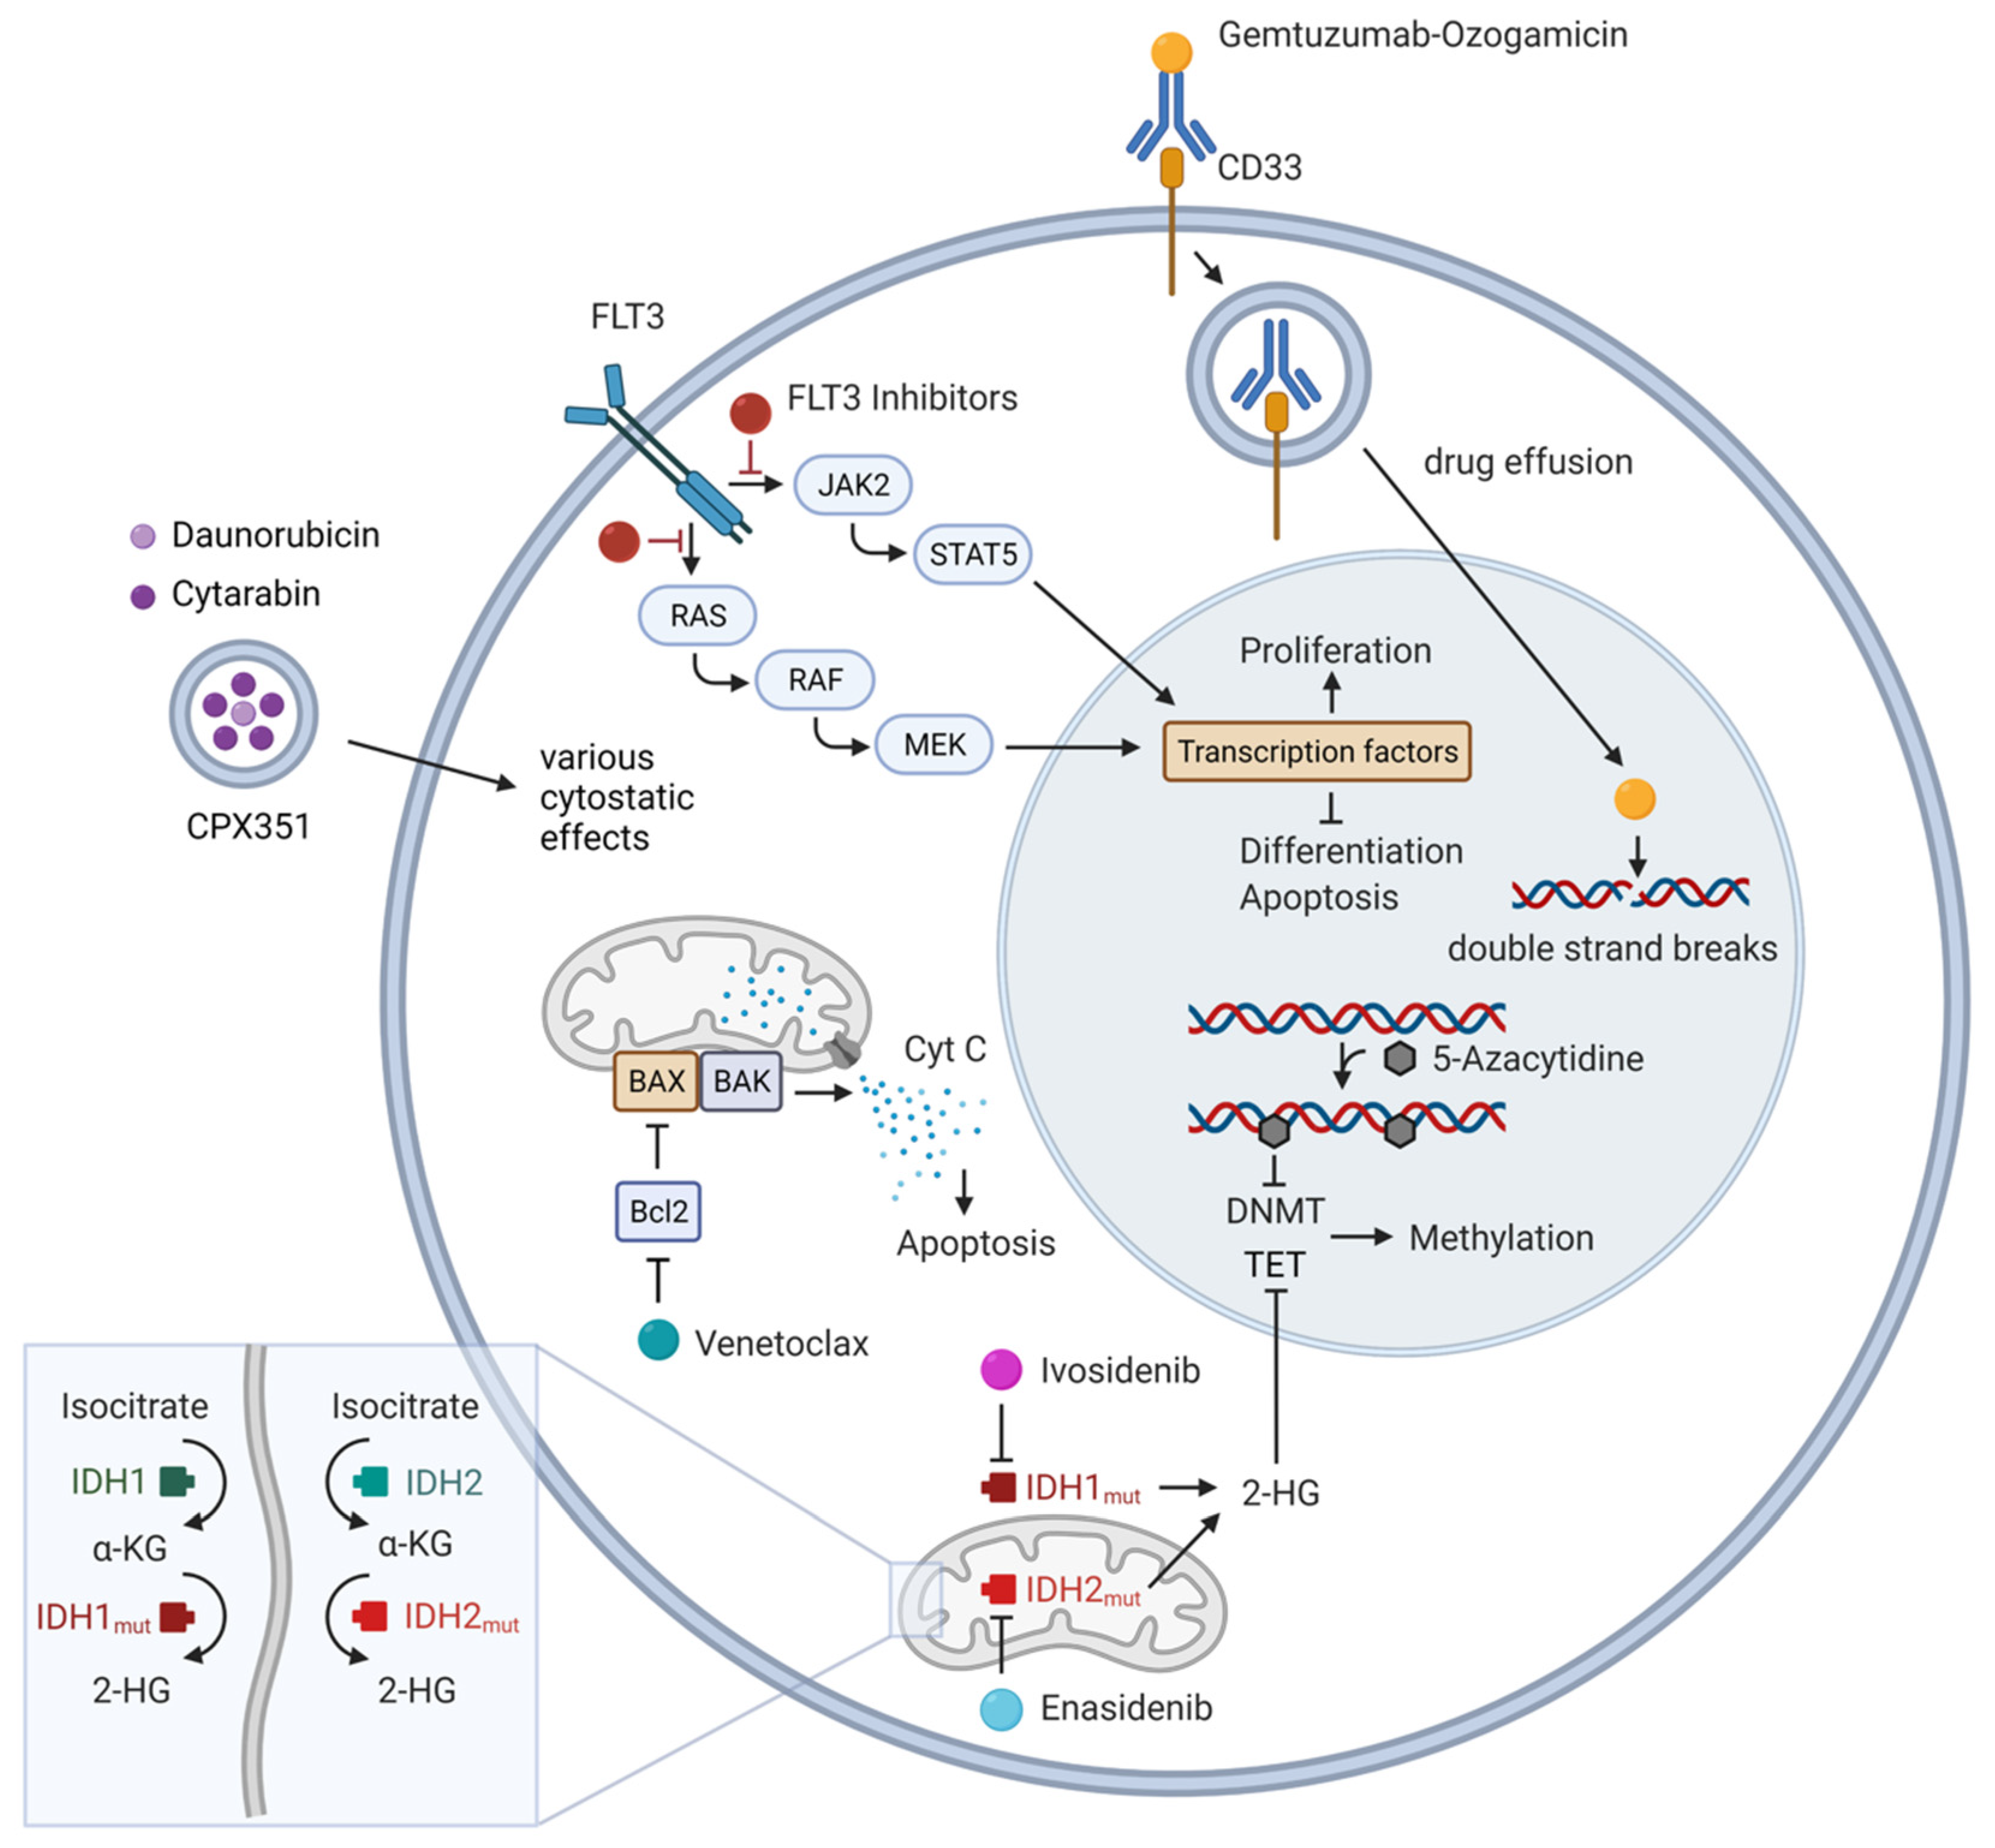
Targeted Therapy
Introduction | Epidemiology | Advances | Fit patient | Unfit patient | Next future | Conclusion
Fit AML | Unfit AML | Stratification | MRD | Supportive care | HSCT | Maintenance
FLT3 up to 30% of newly diagnosed cases, recognized as a proliferative signal
IDH1 up to 8% of AML cases, plays a role in the conversion of isocitrate to alpha-ketoglutarate in the cytoplasm
IDH2 up to 12 of AML cases, plays a role in the conversion of isocitrate to alpha-ketoglutarate in the mitochondria
BCL2 is protective against apoptotic pathway
HMA is a hypomethylating agent that inhibits DNA methyltransferase
Premnath, N. et al. Cancers 2023, 15,3002.
Halik A. Cancers.2022, 14(7), 1689

Slide 29
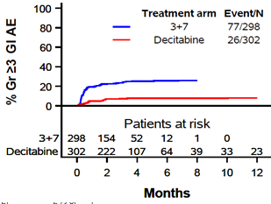
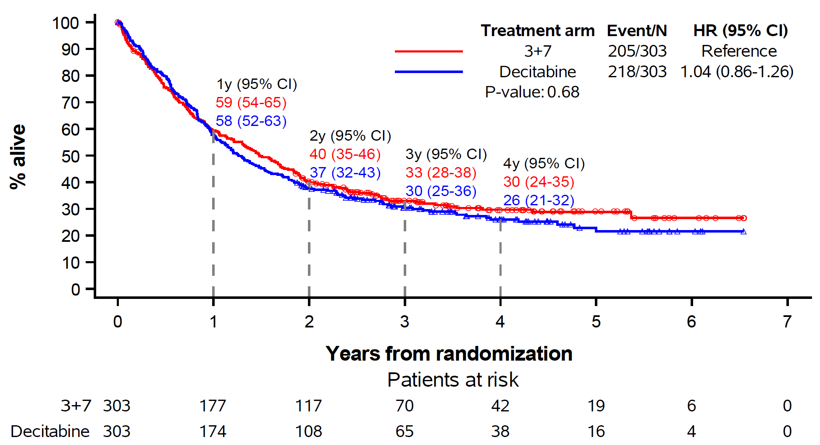
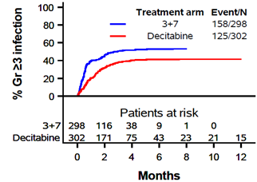
10 days decitabine = 3+7
Introduction | Epidemiology | Advances | Fit patient | Unfit patient | Next future | Conclusion
Fit AML | Unfit AML | Stratification | MRD | Supportive care | HSCT | Maintenance
Lubbert et al. Lancet Hematol. 2023

Slide 30
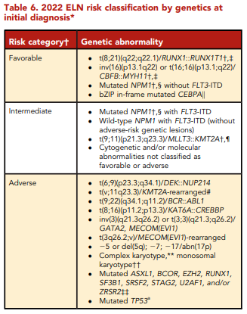
Introduction | Epidemiology | Advances | Fit patient | Unfit patient | Next future | Conclusion
Fit AML | Unfit AML | Stratification | MRD | Supportive care | HSCT | Maintenance
ELN2022
Notes:
https://doi.org/10.1182/bloodadvances.2022009010
https://doi.org/10.1038/s41408-023-00835-5
https://doi.org/10.1038/s41375-023-01884-2
https://doi.org/10.1038/s41408-022-00764-9

Slide 31
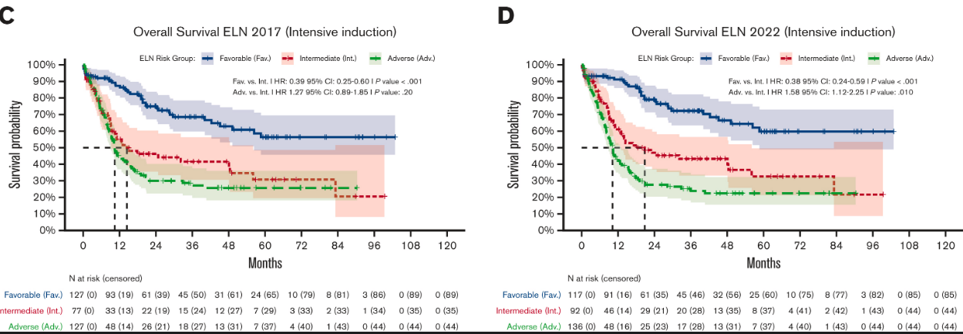
Introduction | Epidemiology | Advances | Fit patient | Unfit patient | Next future | Conclusion
Fit AML | Unfit AML | Stratification | MRD | Supportive care | HSCT | Maintenance
Notes:
https://doi.org/10.1182/bloodadvances.2022009010
https://doi.org/10.1038/s41408-023-00835-5
https://doi.org/10.1038/s41375-023-01884-2
https://doi.org/10.1038/s41408-022-00764-9

Slide 32
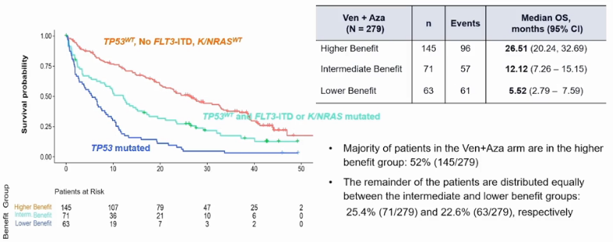
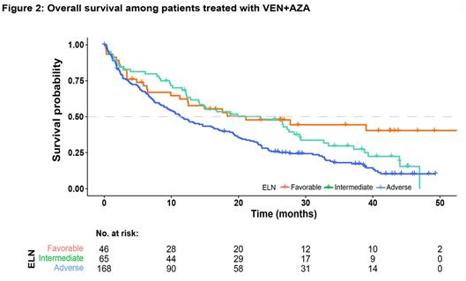
Introduction | Epidemiology | Advances | Fit patient | Unfit patient | Next future | Conclusion
Fit AML | Unfit AML | Stratification | MRD | Supportive care | HSCT | Maintenance
Dorhner et al. ASH. 2022
Notes:
https://doi.org/10.1182/bloodadvances.2022009010
https://doi.org/10.1038/s41408-023-00835-5
https://doi.org/10.1038/s41375-023-01884-2
https://doi.org/10.1038/s41408-022-00764-9

Slide 33
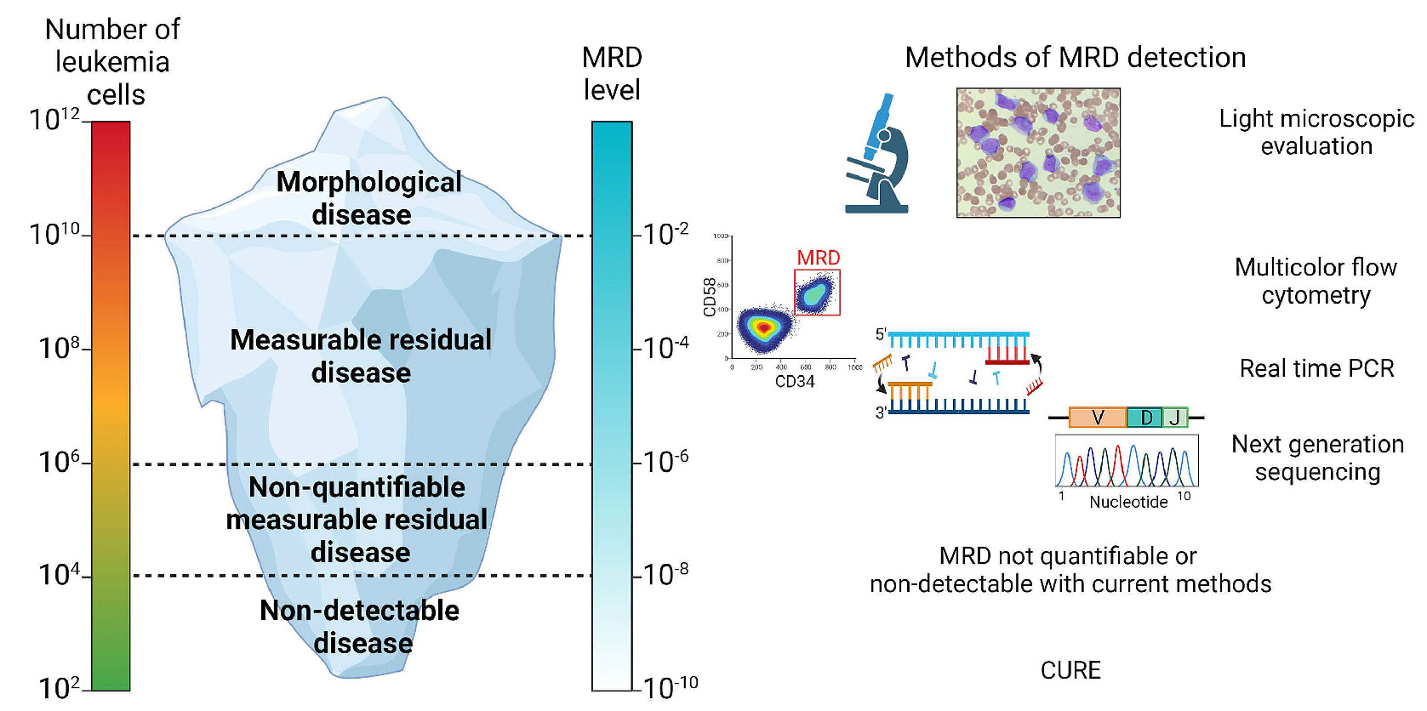
Introduction | Epidemiology | Advances | Fit patient | Unfit patient | Next future | Conclusion
Fit AML | Unfit AML | Stratification | MRD | Supportive care | HSCT | Maintenance
Saygin c. et al. haematology. 2022

Slide 34
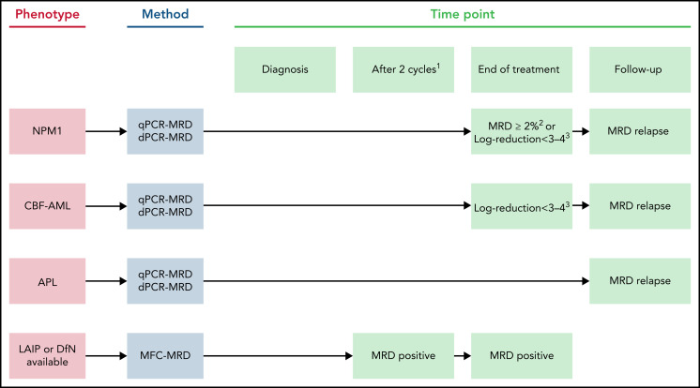
Introduction | Epidemiology | Advances | Fit patient | Unfit patient | Next future | Conclusion
Fit AML | Unfit AML | Stratification | MRD | Supportive care | HSCT | Maintenance
Heuser M. et al. Blood. 2021.

Slide 35
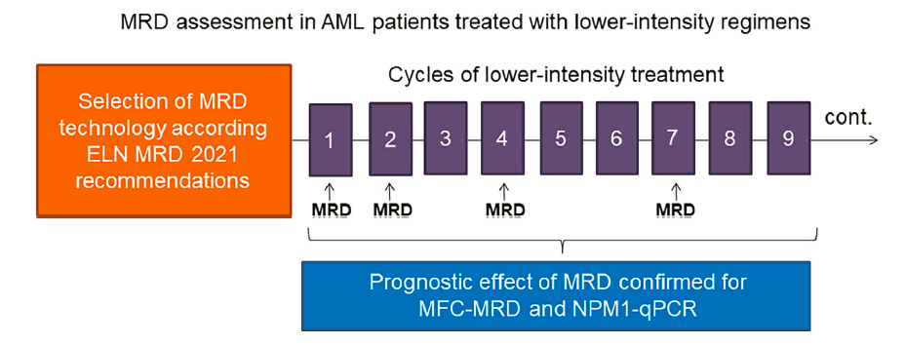
Introduction | Epidemiology | Advances | Fit patient | Unfit patient | Next future | Conclusion
Fit AML | Unfit AML | Stratification | MRD | Supportive care | HSCT | Maintenance
FARANDI R. et al. Am J hematol.2023

Slide 36
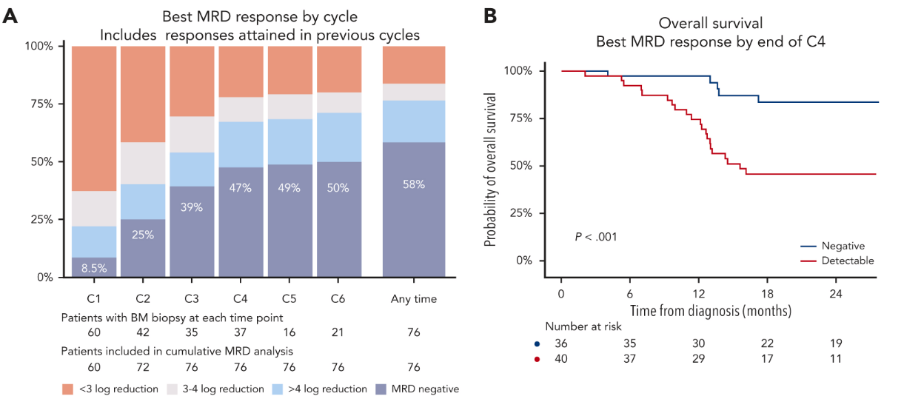
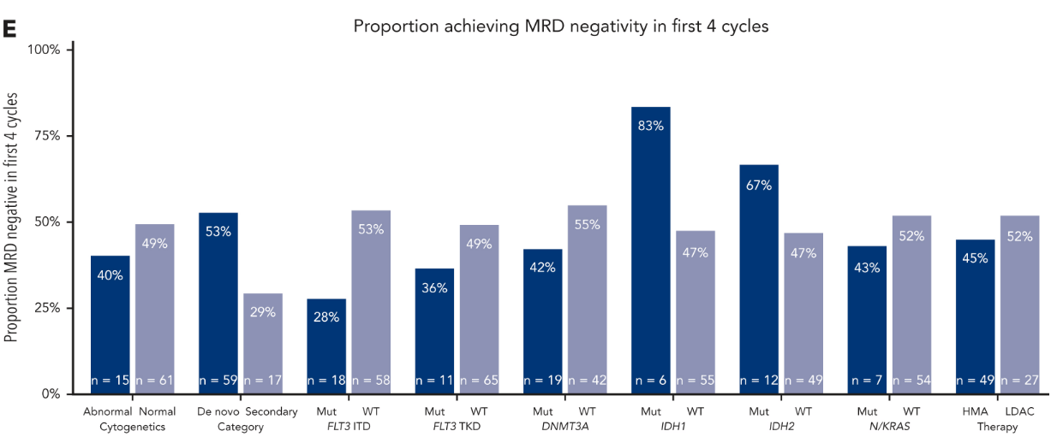
Introduction | Epidemiology | Advances | Fit patient | Unfit patient | Next future | Conclusion
Fit AML | Unfit AML | Stratification | MRD | Supportive care | HSCT | Maintenance
FARANDI R. et al. Am J hematol.2023
Othman et al. Blood.2024

Slide 37
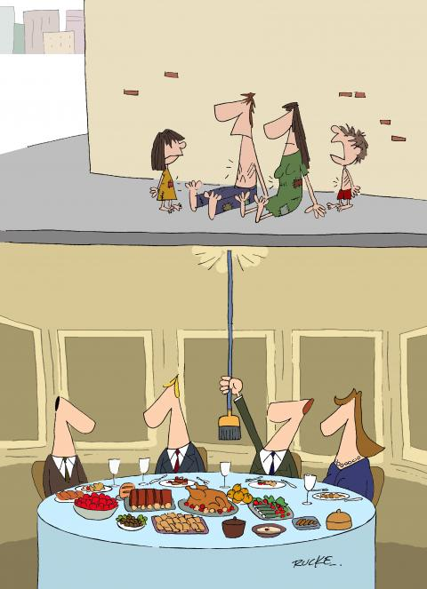
Introduction | Epidemiology | Advances | Fit patient | Unfit patient | Next future | Conclusion
Fit AML | Unfit AML | Stratification | MRD | Supportive care | HSCT | Maintenance
SUPPORTIE CARE trial
Transfusion support
Platelet transfusion
Erythrocyte transfusion
Infectious prophylaxis (, diagnosis) and treatment
Nutrition
PHARMACEUTHICAL trial

Slide 38
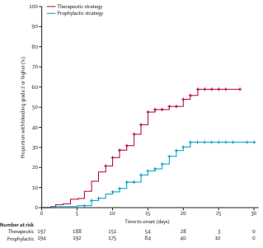
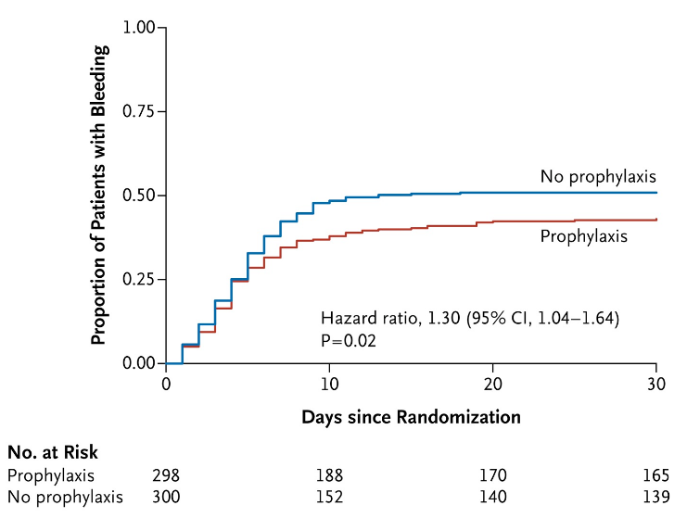
Introduction | Epidemiology | Advances | Fit patient | Unfit patient | Next future | Conclusion
Fit AML | Unfit AML | Stratification | MRD | Supportive care | HSCT | Maintenance
Platelet transfusion
NO death
5 deaths in each group
Stanworth SJ et al. NEJM. 2013
Wandt H et al. Lancet.
Notes:
Wandt H et al. Lancet.

Slide 39
Introduction | Epidemiology | Advances | Fit patient | Unfit patient | Next future | Conclusion
Fit AML | Unfit AML | Stratification | MRD | Supportive care | HSCT | Maintenance
Red Blood Cell Transfusion
NO RCT in AML
Data derivated from other works…
7g/dL = 9 g/dL both for
OS
QoL
Tay et al. JCO. 2020
Notes:
Wandt H et al. Lancet.

Slide 40
Introduction | Epidemiology | Advances | Fit patient | Unfit patient | Next future | Conclusion
Fit AML | Unfit AML | Stratification | MRD | Supportive care | HSCT | Maintenance
Infectious prophylaxis
« hot » topic
FUNGAL prophylaxis
BACTERIAL prophylaxis
Until 2012 : gold standard due to old ph3 studies from ’90.
After 2012, evrything become less clear.
So, depending of the group of study, still performing or not…
BUT ongoing ph3 evaluating short broad spectrum antibiotics during AML induction and they do not recommand to give antibiotic prophylaxis….
Cornely O et al. NEJM.2007
Notes:
Wandt H et al. Lancet.

Slide 41
Introduction | Epidemiology | Advances | Fit patient | Unfit patient | Next future | Conclusion
Fit AML | Unfit AML | Stratification | MRD | Supportive care | HSCT | Maintenance
Neutropenic diet
Is there any evidence for?
153 AML patients during induction
P=0.5
Gardener J et al. JCO.2008
Notes:
Wandt H et al. Lancet.

Slide 42
Introduction | Epidemiology | Advances | Fit patient | Unfit patient | Next future | Conclusion
Fit AML | Unfit AML | Stratification | MRD | Supportive care | HSCT | Maintenance
Neutropenic diet
SEVERE INFECTION?
NO!!!!
MORTALITY?
NO !!!!
Ma Y et al. Front. Oncol. 2022
Notes:
Wandt H et al. Lancet.

Slide 43
Introduction | Epidemiology | Advances | Fit patient | Unfit patient | Next future | Conclusion
Fit AML | Unfit AML | Stratification | MRD | Supportive care | HSCT | Maintenance
Singh A et al. Cancer Res. 2016
Notes:
DOI:10.1158/0008-5472.CAN-16-1311

Slide 44
Introduction | Epidemiology | Advances | Fit patient | Unfit patient | Next future | Conclusion
Fit AML | Unfit AML | Stratification | MRD | Supportive care | HSCT | Maintenance
Better conditionnering
More possibility of donor (MUD, haplo, cordon) due to post-transplant cyclophosphamide
GVH prophylaxis (How I prevent GVHD in high-risk patients: posttransplant cyclophosphamide and beyond)
Treatment of GVH (REACH 1 and 2 RCT with ruxolitinib)
Treatment of CMV
Management of MRD + AML or early relapse
Notes:
DOI:10.1158/0008-5472.CAN-16-1311

Slide 45
Introduction | Epidemiology | Advances | Fit patient | Unfit patient | Next future | Conclusion
Fit AML | Unfit AML | Stratification | MRD | Supportive care | HSCT | Maintenance
Post-chemotherapy | Post-transplant
FLT3 (Ratify Trial) (12 months) | FLT3 (Ratify Trial) (12 months)
Oral Azacitidine (QUAZAR AML-001) (US) (WEI A et al. NEJM. 2020)
ONGOING TRIAL Hovon 150 and 156 DC vaccine … | ONGOING TRIAL AMADEUS trial (oral aza) With BCL 2 (VIALE T) Novel agent (Eprenetapopt …

Slide 46
Introduction | Epidemiology | Advances | Fit patient | Unfit patient | Next future | Conclusion
Courtesy of K Theunissen from BHS lesson 2023-2025

Slide 47
Introduction | Epidemiology | Advances | Fit patient | Unfit patient | Next future | Conclusion
Very very unfit => Best Supportive Care
Very Unfit patient => Azacitidine vs low dose venetoclax with azacitidine
Unfit patient => Azacitidine + venetoclax (Moors I. et al. Belgium guideline. Bel.J. Hemato. 2023)
Not yet reimbursed : Azacitidine + Ivosidenib
Would probably never be reimbursed : low dose AraC + venetoclax
HSCT may be a good option for ‘fit’ unfit patient until 75 years old if HCT-Ci scrore < 2 (EBMT, 2021)
Notes:
Moors, I., Deeren, D., Jaspers, A., Kerre, T., Havelange, V., Selleslag, D., Spilleboudt, C., Straetmans, N., Van Obbergh, F., De Voeght, A., Anguille, S., Schauwvlieghe, A., De Beule, N., De Becker, A., & Breems, D. (2023). Venetoclax-Azacitidine, the new standard of care for AML patients unfit for intensive treatment: A guide for clinical practice. Belg. J. Hematol., 14(2), 59-66.

Slide 48
Introduction | Epidemiology | Advances | Fit patient | Unfit patient | Next future | Conclusion
Notes:
Kapil Saxena;Marina Konopleva; (2021). New Treatment Options for Older Patients with Acute Myeloid Leukemia . Current Treatment Options in Oncology, (), –. doi:10.1007/s11864-021-00841-

Slide 49
Introduction | Epidemiology | Advances | Fit patient | Unfit patient | Next future | Conclusion
HOVON 156 trial
Result awaited
Notes:
Kapil Saxena;Marina Konopleva; (2021). New Treatment Options for Older Patients with Acute Myeloid Leukemia . Current Treatment Options in Oncology, (), –. doi:10.1007/s11864-021-00841-

Slide 50
Introduction | Epidemiology | Advances | Fit patient | Unfit patient | Next future | Conclusion
HOVON 501
In ongoing process, not yet started
Notes:
Kapil Saxena;Marina Konopleva; (2021). New Treatment Options for Older Patients with Acute Myeloid Leukemia . Current Treatment Options in Oncology, (), –. doi:10.1007/s11864-021-00841-

Slide 51
Introduction | Epidemiology | Advances | Fit patient | Unfit patient | Next future | Conclusion
Cherry EM, et al. Blood Adv. 2021

Slide 52
Introduction | Epidemiology | Advances | Fit patient | Unfit patient | Next future | Conclusion
Cherry EM, et al. Blood Adv. 2021

Slide 53
Introduction | Epidemiology | Advances | Fit patient | Unfit patient | Next future | Conclusion
ONGOING PROSPECTIVE STUDY : NCT04801797
Matthews et al. Am J Hemat. 2023

Slide 54
Introduction | Epidemiology | Advances | Fit patient | Unfit patient | Next future | Conclusion
ONGOING PROSPECTIVE STUDY : NCT04801797
3+7 vs HMA + venetoclax
Matthews et al Blood Adv.2022

Slide 55
Introduction | Epidemiology | Advances | Fit patient | Unfit patient | Next future | Conclusion
Notes:
Daver et al. Blood Cancer Journal (2020) 10:107

Slide 56
Introduction | Epidemiology | Advances | Fit patient | Unfit patient | Next future | Conclusion
Grosso D et al. Cancer. 2015
Notes:
https://doi.org/10.1002/cncr.29378

Slide 57
Introduction | Epidemiology | Advances | Fit patient | Unfit patient | Next future | Conclusion
Ongoing ENHANCE-3 (hold-on for safety)
ENHANCE-2 was stopped for futility
De Voeght A. BELG J HEMATOL 2023
Notes:
https://doi.org/10.1002/cncr.29378

Slide 58
Introduction | Epidemiology | Advances | Fit patient | Unfit patient | Next future | Conclusion
Notes:
https://doi.org/10.1002/sctm.20-0147

Slide 59
Introduction | Epidemiology | Advances | Fit patient | Unfit patient | Next future | Conclusion
BEAT AML Master TRIAL
Notes:
https://doi.org/10.1002/sctm.20-0147

Slide 60
Introduction | Epidemiology | Advances | Fit patient | Unfit patient | Next future | Conclusion
Long road since 1973 with major changes !
Better induction (maybe)
Better Supportive care (certainly but poorly studied)
Major modification in diagnosis and monitoring (major advance from MRD)
Better treatment for unfit AML patient
Plenty new drugs challenging the old « 3+7 »
HSCT remains the best curative way for majoroty of patients
Immunotherapy awaited since more than 15 years with poor results but … still promising

Slide 61
Introduction | Epidemiology | Advances | Fit patient | Unfit patient | Next future | Conclusion
BUT …
Financial toxicity !!! ???

Slide 62
Introduction | Epidemiology | Advances | Fit patient | Unfit patient | Next future | Conclusion
ONE size DOES NOT fit ALL

Slide 63
Introduction | Epidemiology | Advances | Fit patient | Unfit patient | Next future | Conclusion
QUESTIONS?

