Slide 1






Neural basis of consciousness
Athena Demertzi, PhD
FNRS Research Associate
Director, Physiology of Cognition Lab
GIGA Institute
CRC-Human Imaging Unit
University of Liège
BELGIUM
Topics in Behavioural Neuroscience
May 16 2024
KULeuven

Slide 2
Consciousness
awareness
Animals
Psychotherapy
NeuroEthics
perception
cognition
thought
imagination
mind
experience
self-awareness
Notes:
Real-life conséquences:
Neuro-ethics
Animal consciousness
Psychotherapy

Slide 3
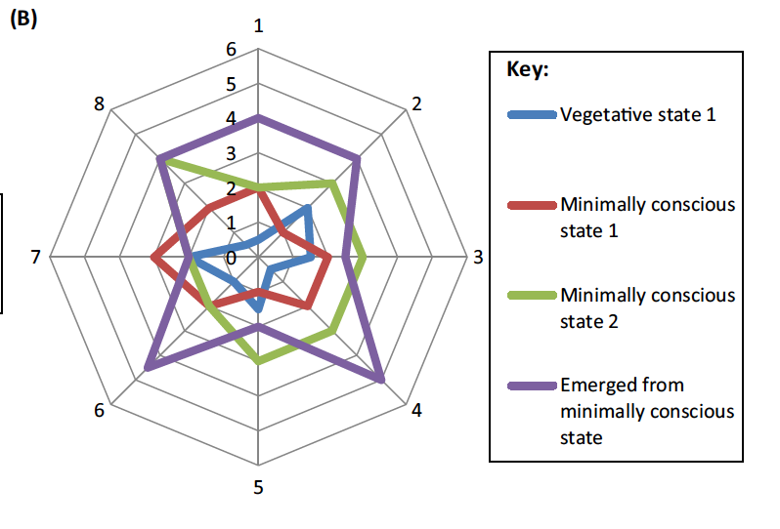
Consciousness is multidimensional
Bayne, Hohwy, Owen. Trends Cogn Sci 2016
Notes:
Metastability refers to the human brain’s ability to integrate several functional parts and to produce neural oscillations in a cooperative and coordinated manner. phase synchronization forms the basis of metastable behavior in neural networks.

Slide 4
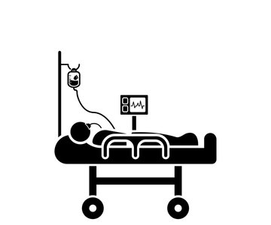
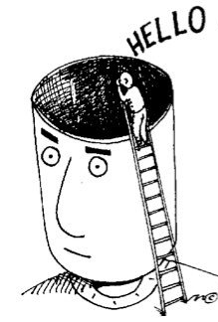

Paradigms to study Consciousness
Clinical conditions Typical wakefuless Embodied reactivity

Slide 5
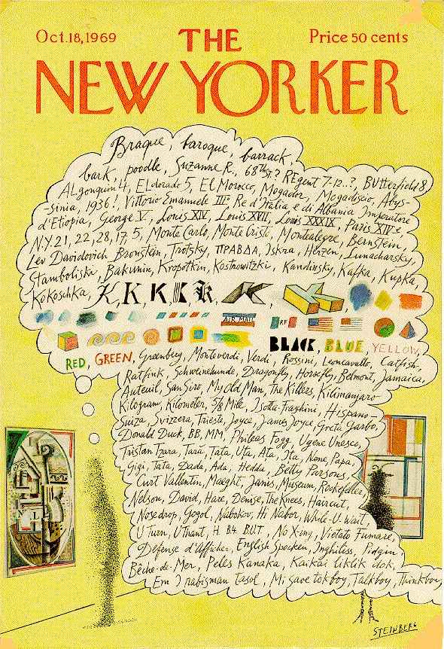
The resting brain
Brain ~2% body’s weight
Evoked changes <5%
80% for neuronal signaling
"While conscious awareness is […] energetically inexpensive, it is dependent upon a very complex, dynamically organized state of the brain that is achieved at great expense”
(Raichle M. Science 2006)
Notes:
Saul Steinberg's marvelous New Yorker cover from October 8, 1969 (see Figure 1), provides the best picture of human consciousness I have encountered. Not just words, but colors and shapessucceed each other in delicious association. Even the genius of Steinberg can't quite render aromas, tickles and sounds on the cover of a magazine, but at least he suggests the likelihood oftheir inclusion. And the whole rendering is made possible by his exploitation of a familiar cartoonists' convention, the thought balloon or thought bubble. Calling this a conventionunderplays its naturalness; I doubt that children ever need to have the convention explained to them--it's quite wonderfully obvious what it depicts, metaphorically: the stream of consciouscontents in the mind of the man looking at the painting in the museum. This powerful and natural metaphor provides a nice setting of the problem of consciousness: If this picture gives us themetaphorical truth, what is the literal truth? How can an account of what happens in the man's brain ever do justice to the familiar--indeed intimate--facts we recognize in this metaphoricalrendering?
W. James (1980): five characters in thought
Every thought tends to be part of a personal consciousness
Within each personal consciousness, thought is always changing
Within each personal consciousness, thought is sensibly continuous
It always appears to deal with objects independent of itself
It is interested in some parts of these objects to the exclusion of others, and welcomes or rejects or chooses from among them, all the while it thinks

Slide 6
Default mode of brain function
Demertzi & Whitfield-Gabrieli: Neurology of Consciousness 2nd ed. 2015
Demertzi, Soddu, Laureys, Curr Opin Neurobiology 2013
Demertzi et al, Front Hum Neurosci 2013 Raichle et al, PNAS 2001
Notes:
Brain areas consistently exhibiting activity decreases during task performance also exhibit coherent spontaneous activity in
the resting state. Performance of a wide variety of tasks has called attention to a group of brain areas (A) that decrease their activity during task performance (data adapted from [4] ). This particular group of brain areas has come to be known as the ‘ default network ’ and serves as an exemplar of all areas of the cerebral cortex which exhibit a systems level organization in the resting (default) state [7] .
If one records the spontaneous fMRI BOLD signal activity in these areas (arrows, A) in the resting state what emerges is a remarkable correlation in the spontaneous fluctuations of the fMRI BOLD signals obtained from the two areas (B). Using these fluctuations to analyse the network as a whole [7] reveals a level of functional organization (C) that parallels that seen in the task-related activity decreases (A).
These data provide a dramatic demonstration of the intrinsic organization of the human brain which likely provides a critical context for all human behaviours including conscious awareness. These data were adapted from our earlier published work [4–6, 24] .

Slide 7
Functional anticorrelations
Fox et al, PNAS 2005

Slide 8
Anticorrelations inform cognitive function?
Vanhaudenhuyse*, Demertzi* et al, J Cogn Neurosci 2011
Demertzi, Soddu, Laureys, Curr Opin Neurobiology 2013
Demertzi & Whitfield-Gabrieli, in: Neurology of Consciousness 2nd ed. 2015
Demertzi et al, Front Hum Neurosci 2013
Demertzi, Kucyi, Ponces-Alvarez, Keliris, Whitfield-Gabrieli, Deco. Netw Neurosci in press

Slide 9
Modified awareness reduces anticorrelations
Demertzi, Soddu, Faymonville et al, Prog Brain Res 2011
Demertzi, Vanhaudenhuyse, Noirhomme, Faymonville, Laureys, J Physiol Paris 2015

Slide 10
Modified arousal reduces anticorrelations
Boveroux et al, Anesthesiology 2010

Slide 11
Mental life is referred from behavior

Slide 12
No anticorrelations in DOC
Di Perri, …, Demertzi*, Laureys*, Soddu*, Lancet Neurol 2016

Slide 13
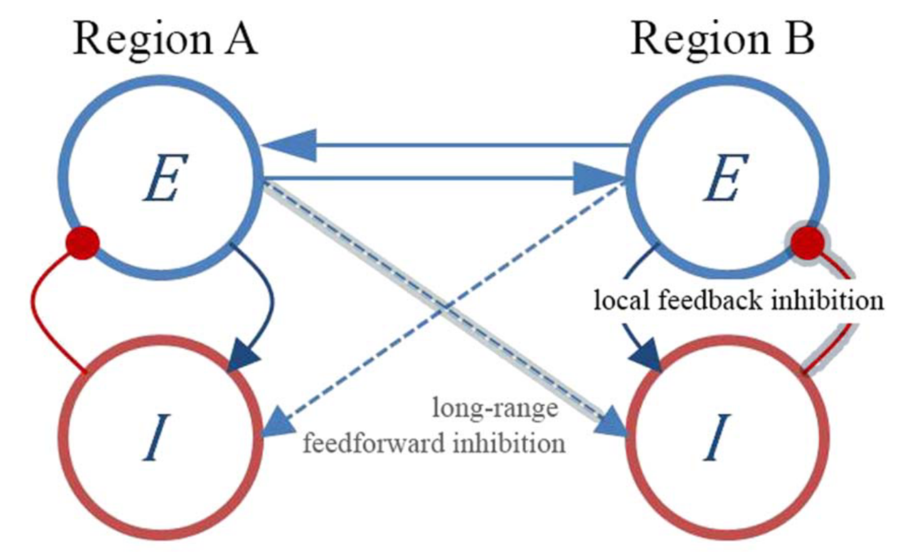
Anticorrelations as a result of neural inhibition
excitatory
inhibitory
Ignition
Deco et al., Sci Adv 2021
Joglekar et al, Neuron 2018
Demertzi, Kucyi, Ponce-Alvarez, Keliris, Whitfield-Gabrieli, Deco. Network Neurosci 2022
Notes:
We do not claim that neural inhibition directly promotes anticorrelated patterns, that is, by having networks straightly inhibiting one another (of note, most interareal connections are glutamatergic/excitatory). Nor do we claim that neural inhibition always leads to anticorrelated profiles. Rather, we suggest that neural inhibition mediates the rise of the anticorrelations indirectly, by breaking the local neural balance which affects network metastability and which eventually permits anticorrelations to appear.
Distant brain regions establish connections between their corresponding excitatory neural populations (Figure 1, E-E blue solid line connectivity). -> The resulting local increase of excitation produces an increase of inhibition through the local E-I loop (feedback inhibition).
Local heterogenous feedback inhibition Studies using heterogeneous and homogeneous whole- brain modeling have mechanistically shown that an increase in ignition was observed (Deco et al., 2021). IGNITION The ability of a given brain area to propagate feed-forward and recurrent neuronal activity to other regions, which are thought to support conscious experience (see next section).
Critically, when feedback projections and randomization of the connectivity weights were removed, dynamic network behavior was abolished, suggesting that feedback connectivity and heterogeneity in connection strength give rise to ignition-like activity (Joglekar et al., 2018).

Slide 14
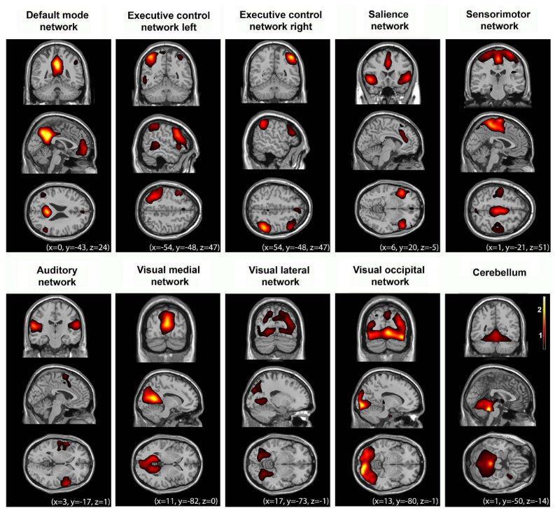
More networks during rest
Biswal et al., Magn Reson. Med 1995
Smith et al, PNAS 2009
Heine et al, Front Psych 2012

Slide 15
DOC separation based on cross-modal interactions
Demertzi & Antonopoulos et al, Brain 2015
Notes:
The patient who was misclassified as being in MCS had a CRS-R total score of 5 on the day of scanning (indicating the VS/UWS; Patient 11 of centre two, Supplementary material) and she evolved to MCS 38 days later (Auditory Function: 1, Visual Function: 3, Motor Function: 2, Oromotor/Verbal Function: 2, Communication: 0, Arousal: 2).
The patient who was misclassified as being in VS/UWS had a CRS-R total score of 9 on the day of scanning (indicating the MCS; Patient 13 of centre two, Supplementary material) based on the presence of localization to noxious stimulation but this behaviour could not be elicited in neither previous (AF: 1, VF: 0, MF: 0, O/VF: 1, COM: 0, AR: 2) or subsequent evaluations (AF: 2, VF: 1, MF: 2, O/VF: 1, COM: 0, AR: 2).

Slide 16
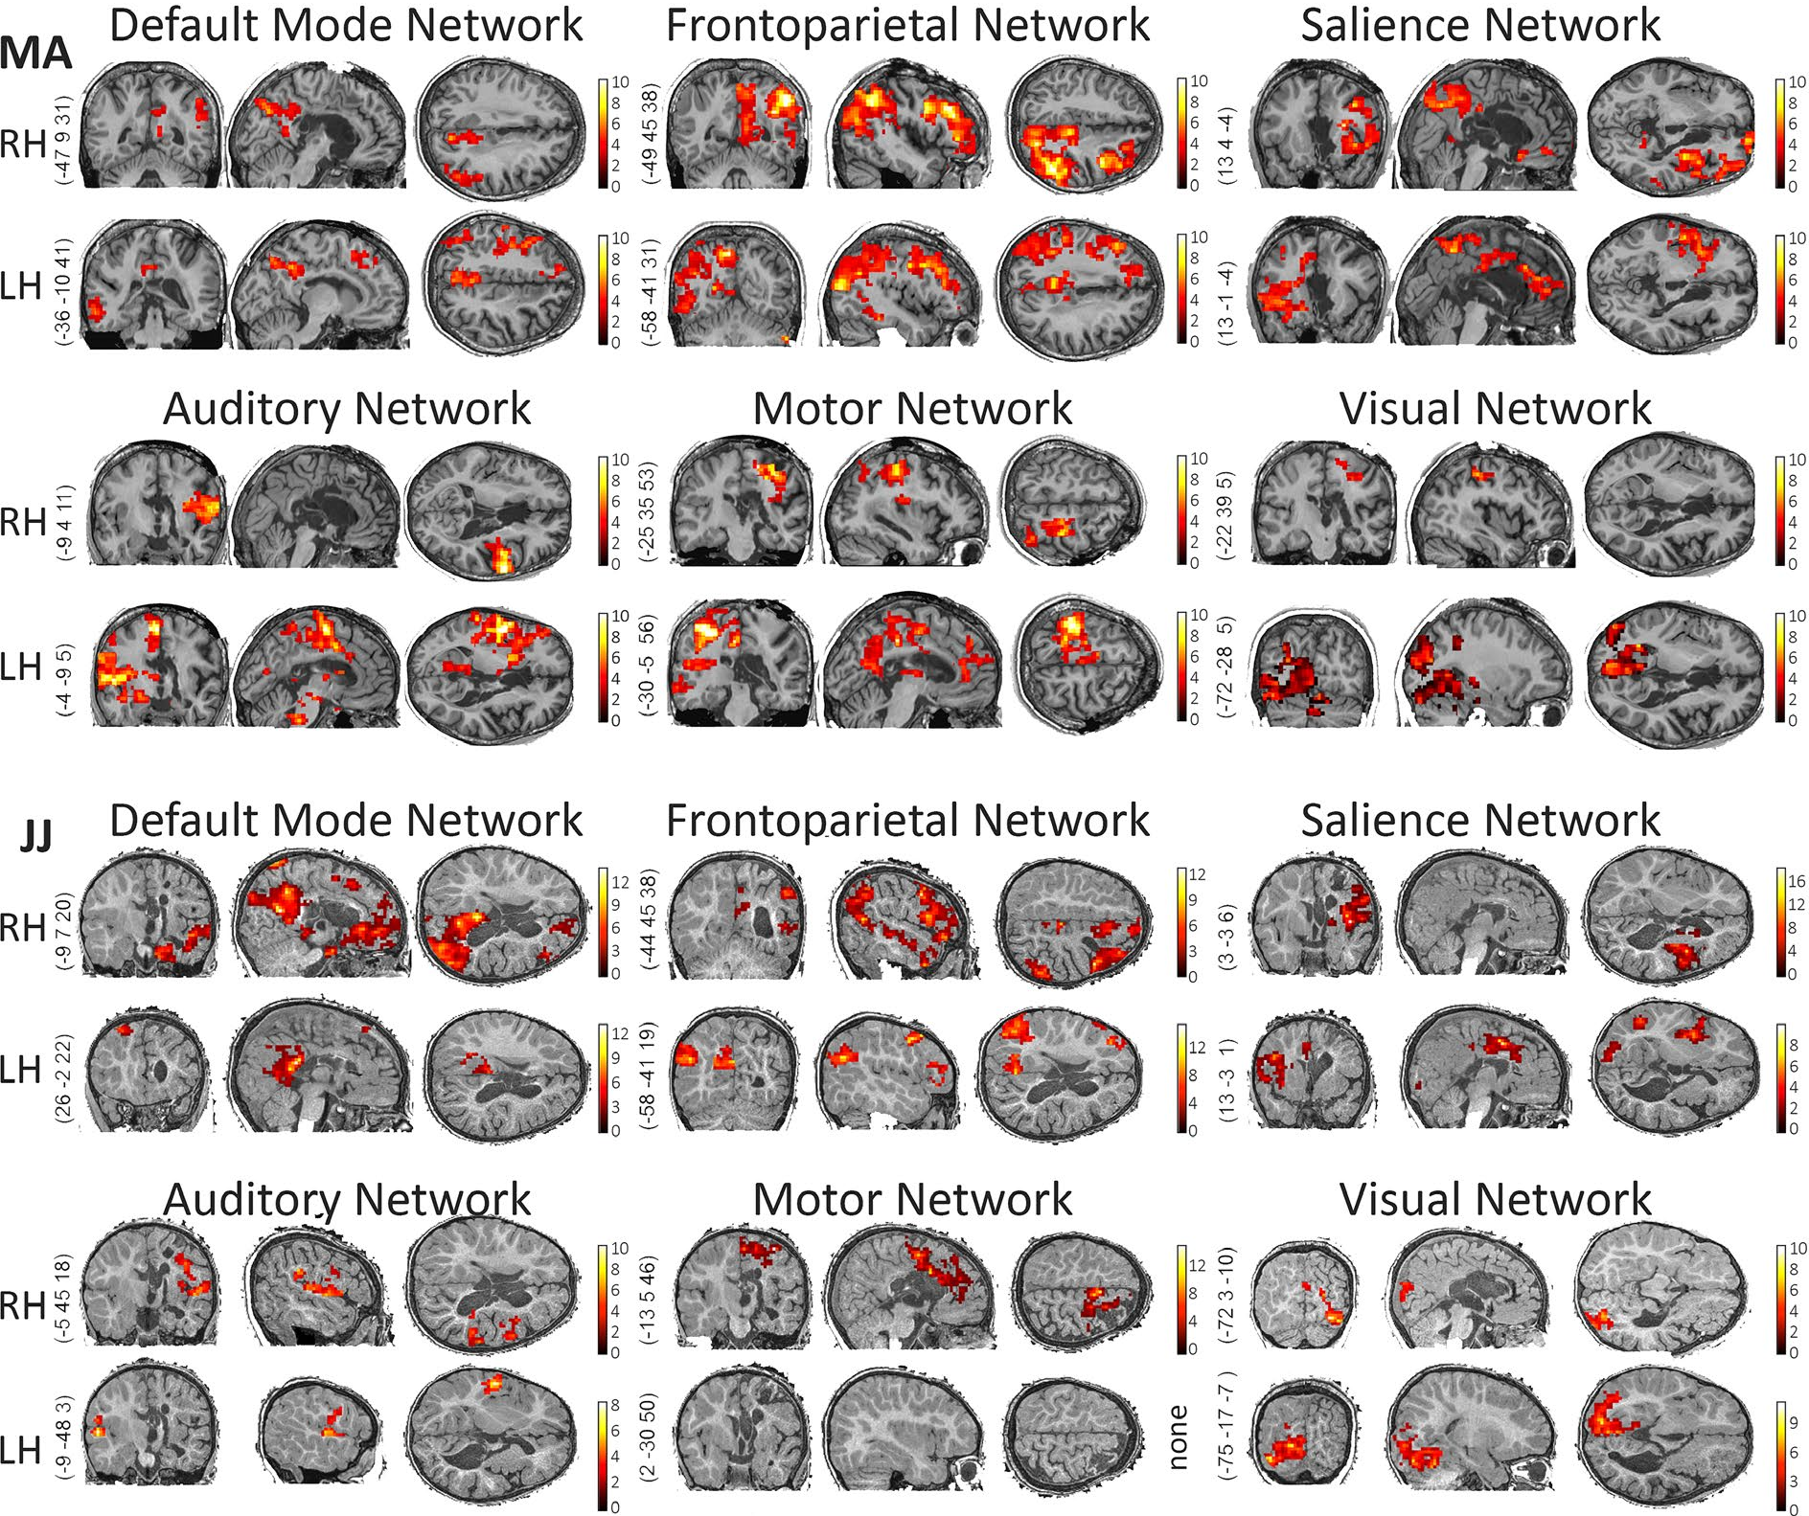
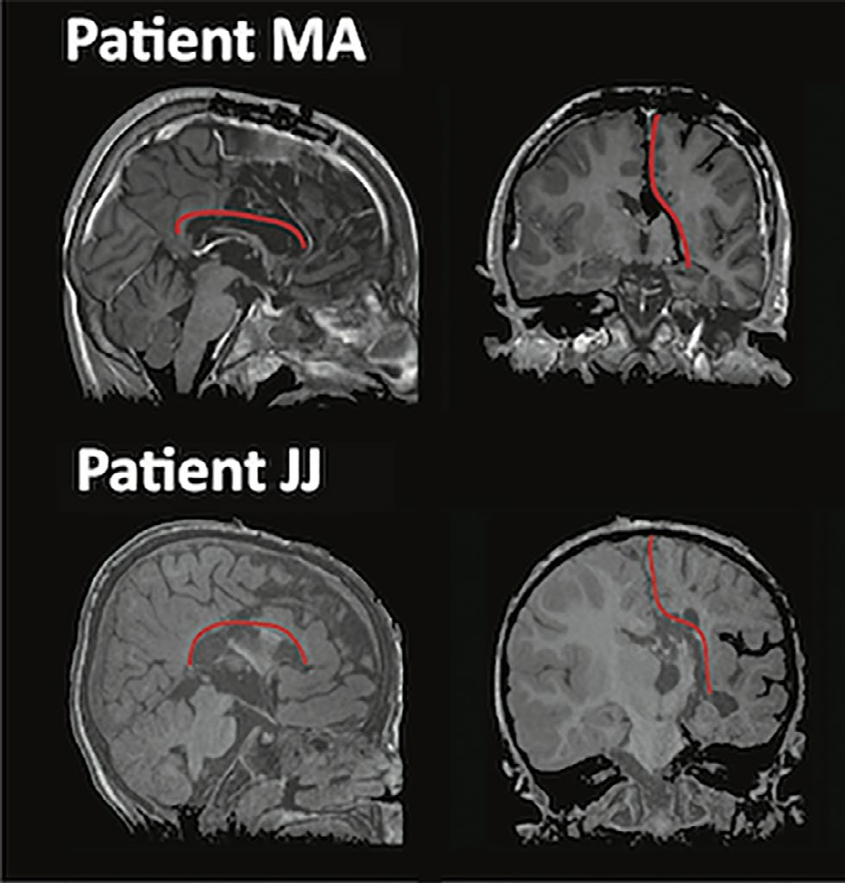
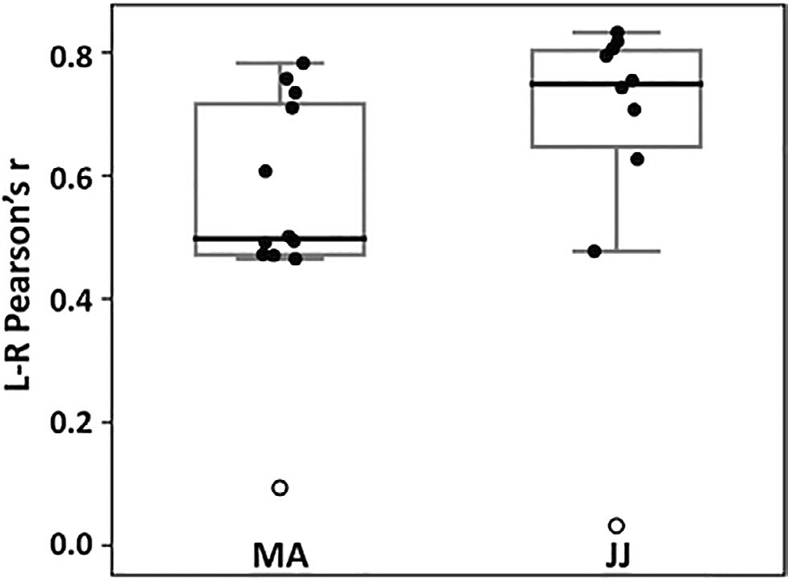

Lower cross-modal interaction in the isolated brain
Inter-hemispheric connectivity
Blauwblomme & Demertzi et al, Epilepsia Open 2020
Notes:
The question as to why intrinsic network functional connectivity is preserved in isolated tissue which does not contribute to behavioral output, remains to be answered. A working hypothesis is that brain activity is driven by the underlying anatomy as we have recently found for noncommunicating states.32 At the same time, it may be that preserved network-level connectivity is critical for the development of synaptic connections and maintenance of synaptic homeostasis at large58 which is reduced, yet preserved, in covert or unconscious conditions.32,5

Slide 17
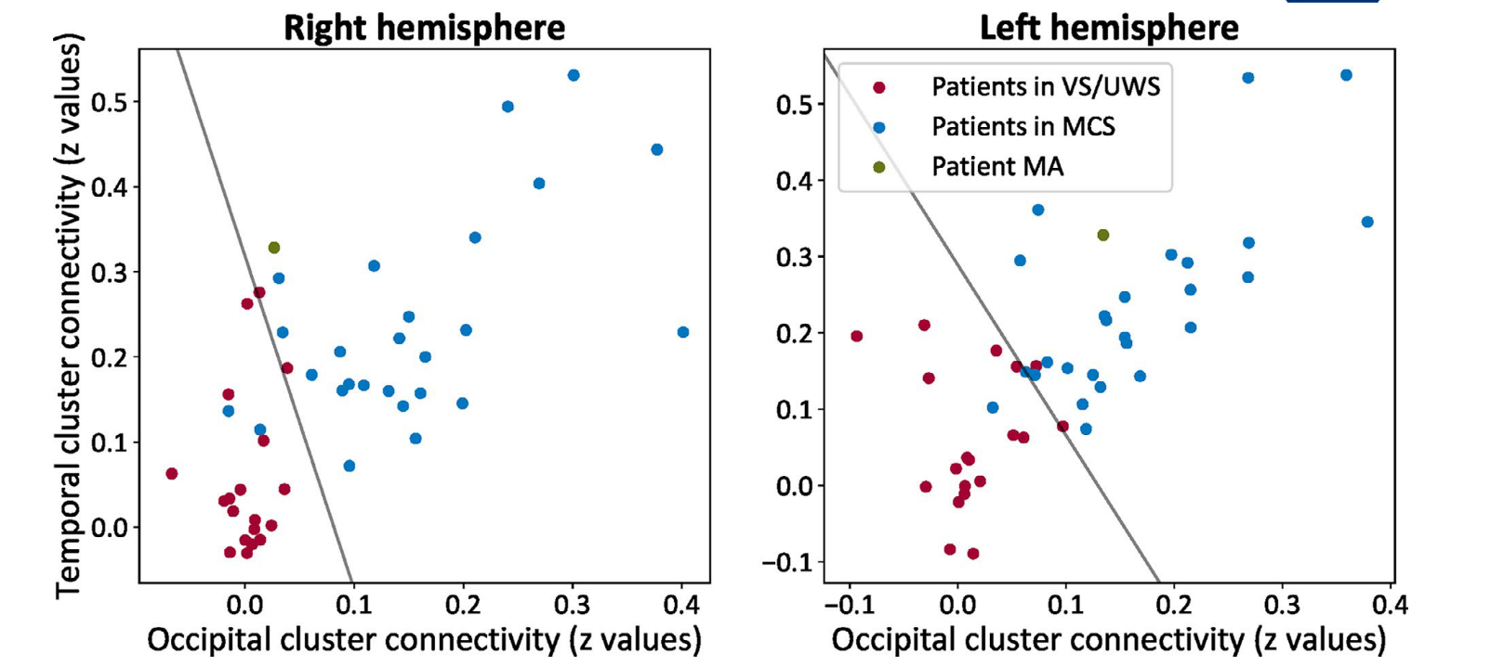
Lower cross-modal interaction in the isolated brain
Blauwblomme & Demertzi et al, Epilepsia Open 2020
Notes:
The question as to why intrinsic network functional connectivity is preserved in isolated tissue which does not contribute to behavioral output, remains to be answered. A working hypothesis is that brain activity is driven by the underlying anatomy as we have recently found for noncommunicating states.32 At the same time, it may be that preserved network-level connectivity is critical for the development of synaptic connections and maintenance of synaptic homeostasis at large58 which is reduced, yet preserved, in covert or unconscious conditions.32,5

Slide 18
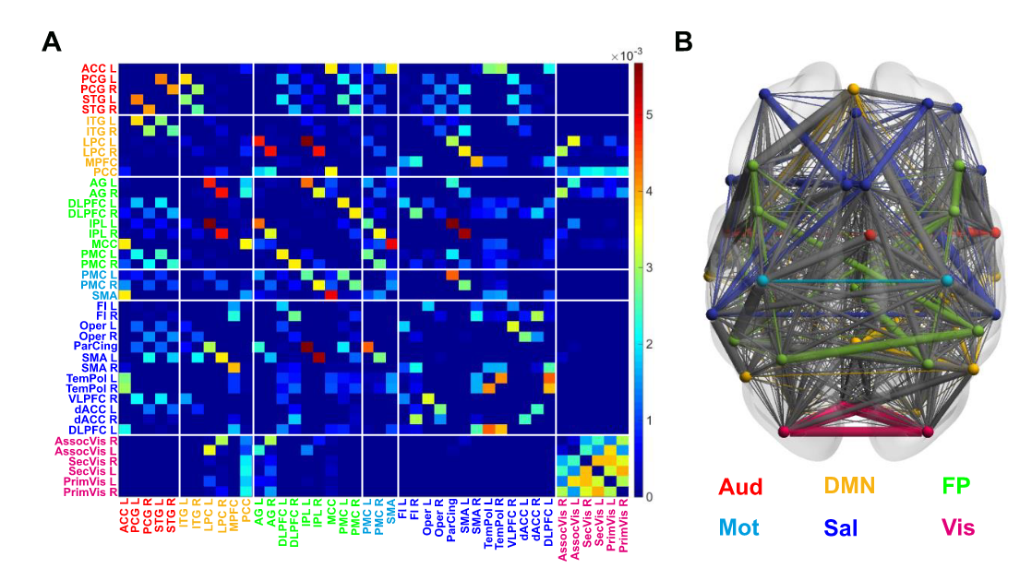
The brain as a network
100 billion neurons, ~100 trillion synaptic connections
The Connectome
A matrix representing all possible
pairwise anatomical connections
between neural elements of the brain
Sporns, Tononi, & Koetter.
PLoS Comput. Biol. 2005
Fornito, Zalesky, Bullmore. Ch 1: An Introduction to Brain Networks. Fundamentals of Brain Network Analysis, Academic Press 2016
Image from: Demertzi & Tagliazucchi, Dehaene, Deco, Barttfeld, Raimondo […] et al, Science Advances 2019
Notes:
This approach emphasises the fundamental roles of the interactions between regions, thereby finding solid grounding in the complex systems approach to the brain – and providing plentiful insights about brain function and dysfunction

Slide 19
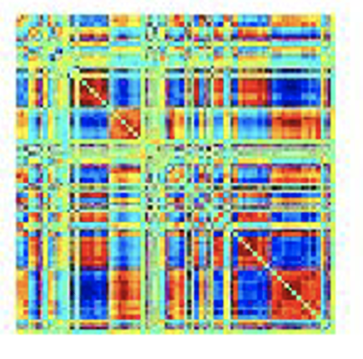
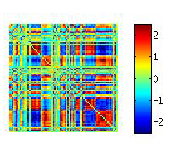
Brain dynamics and cognition
Averaged connectome
Typical wakefulness
Performance, emotion and cognition
Alavash et al, Neuroimage, 2016; Shine et al Neuron, 2016; Friston Neuroimage, 1997; Thompson et al, Hum Brain Mapp, 2013
Unconsciousness
Rigid spatiotemporal organization, less metastable dynamics
sleep (Tagliazucchi et al, PNAS 2013; Wang et al, PNAS 2016; Wilson et al., Neuroimage 2015; Chow et al, PNAS 2013)
anesthesia
humans (Tagliazucchi et al, J. R. Soc. Interface 2016; Kafashan et al, Front Neural Circuits, 2016; Amico et al, PLoS One 2014)
animals (Barttfeld et al, PNAS 2014; Grandjean et al, Neuroimage 2017; Liang et al, Neuroimage 2015)
Time-varying connectome
The brain cannot map the complexity of internal and external world
(Dehaene et al, Trends Cog Sci, 2006; Tononi et al, Nat Rev Neurosci. 2016)
Notes:
Metastability in the brain is a phenomenon studied in computational neuroscience to elucidate how the human brain recognizes patterns. Here, the term metastability is used rather loosely. There is no lower-energy state, but there are semi-transient signals in the brain that persist for a while and are different than the usual equilibrium state.

Slide 20
“Rich” connectivity in communicating states
Demertzi & Tagliazucchi, Dehaene, Deco, Barttfeld, Raimondo, Martial, Fernández-Espejo, Rohaut, Voss, Schiff, Owen, Laureys, Naccache, Sitt. Science Advances 2019

Slide 21
Simple connectivity in “unconsciousness”
Demertzi & Tagliazucchi, Dehaene, Deco, Barttfeld, Raimondo, Martial, Fernández-Espejo, Rohaut, Voss, Schiff, Owen, Laureys, Naccache, Sitt. Science Advances 2019

Slide 22
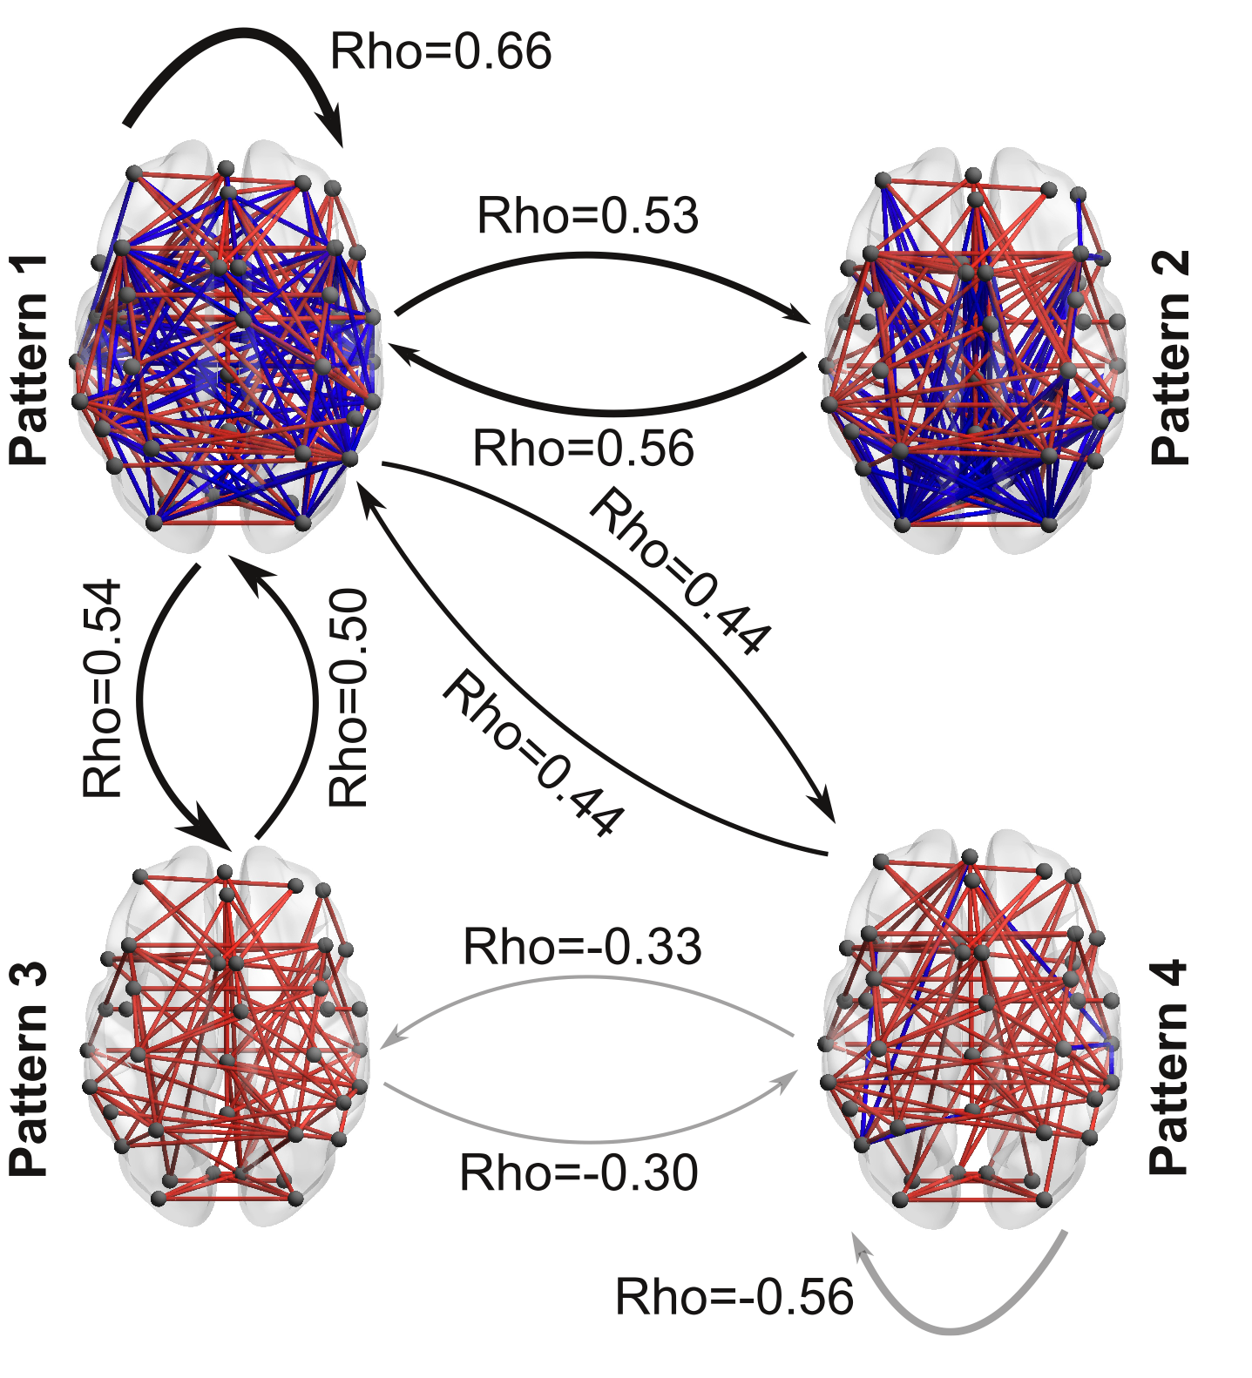
Higher dynamism in conscious states
Healthy > MCS > UWS
UWS > MCS > Healthy
Demertzi & Tagliazucchi, Dehaene, Deco, Barttfeld, Raimondo, Martial, Fernández-Espejo, Rohaut, Voss, Schiff, Owen, Laureys, Naccache, Sitt. Science Advances 2019
Notes:
﻿Black arrows indicate a higher probability to transit between the coordination patterns in healthy controls (HC) as opposed to patients in MCS and patients in UWS (HC > MCS > UWS). Gray arrows indicate the opposite trend (HC < MCS < UWS)
﻿To further describe the dynamic nature of the pattern exploration, we obtained, for each participant, a matrix containing information about the probabilities that any given pattern to transition into another. This matrix contains, in its ith row, the normalized (i.e., sum equal to one) frequency distribution of observing a volume labeled as the ith pattern transitioning into the pattern corresponding to the jth column. The average contiguous amount of time spent in each pattern for each clinical group was corrected for random durations by subtracting the average duration of surrogate shuffled pattern series.
The sequence predictability for each individual was quantified using the entropy rate (Markov entropy) for the corresponding probabilities and the transition probability matrices. The entropy rate for the sequence of brain patterns of each participant was computed as follows:
Astochastic or random process is a mathematical object usually defined as a family of random variables. Many stochastic processes can be represented by time series. However, a stochastic process is by nature continuous while a time series is a set of observations indexed by integers.

Slide 23
Typical wakefulness

Slide 24




Mental states
Christoff et al, Nat Rev Neurosci 2016
Notes:
Mental states =

Slide 25
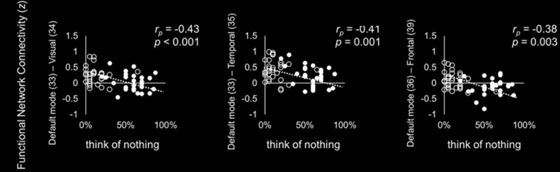
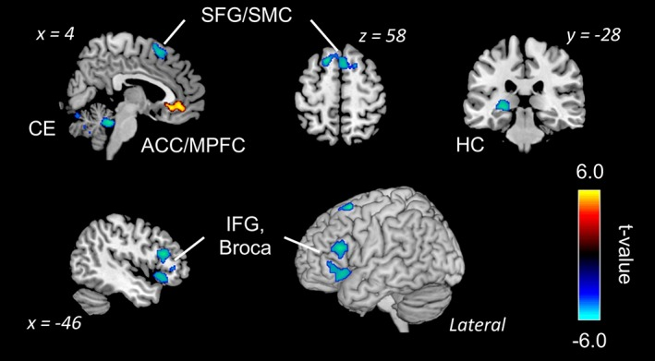
Induced MB: Result of reduced inner speech?
Kawagoe et al , Eur J Neurosci 2018
“When you realize that you are thinking about something, disengage your attention and again try to think of nothing during the scans”
Kawagoe et al, Hum. Brain Mapp 2019
Notes:
Decreased activation:
Broca's area → reduced “inner speech”
Hippocampus → less impressionable “content”
Increased activation:
ACC → stream of consciousness continuity is retained
Decreased connectivity:
DMN - sensory cortices → less available content from sensory avenues to drive internally, self-oriented thought

Slide 26
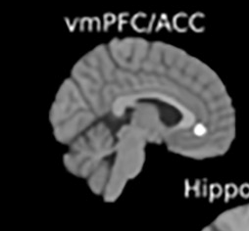
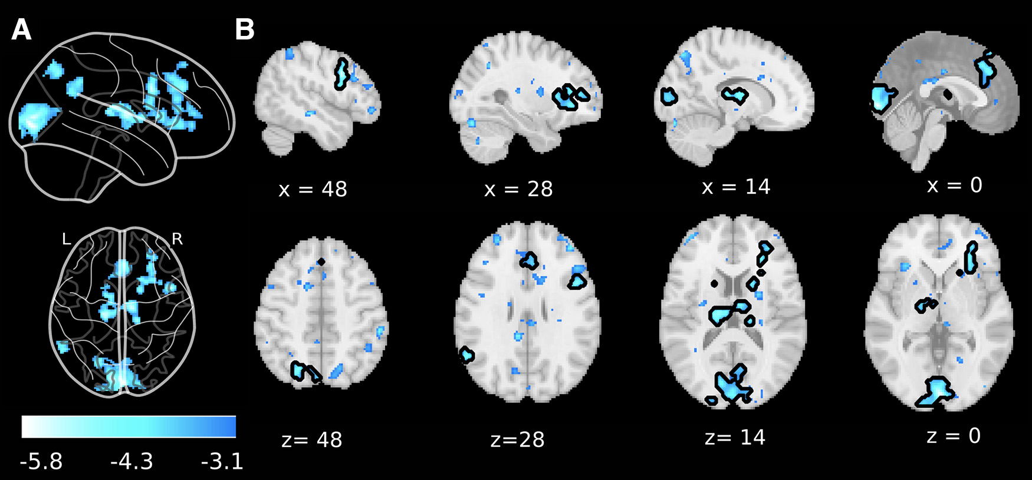
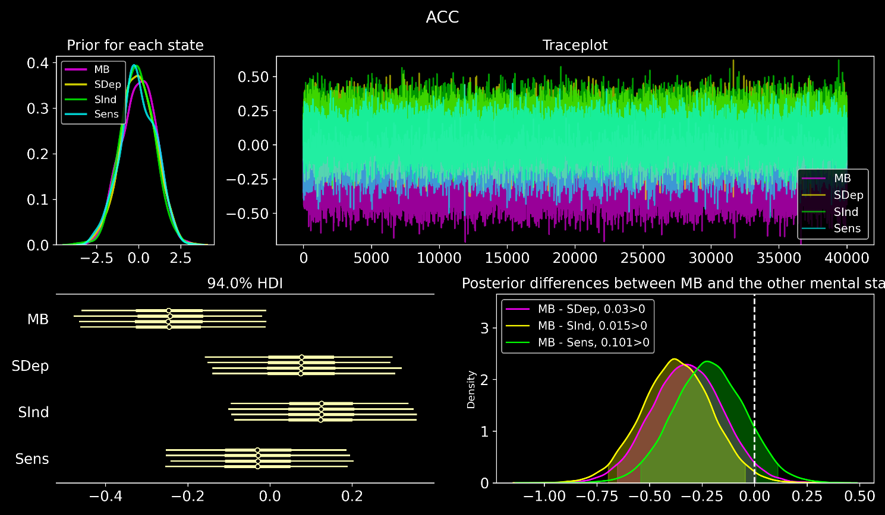
Spontaneous MB
Result of wide regional disengagement?
FMRI univariate analysis of MB reports reveals whole-brain deactivations
Bayesian linear model of the beta parameters in
the ACC cluster (Kawagoe 2019)
Prior expectations Traceplot of model fit (MCMC-NUTS)
Posterior values
The vmPFC/ACC contains
significant evidence for MB deactivations
voxel-level p_{uncorrected} <0.001
cluster level p_{FDR} <0.05
Posterior distribution contrasts
Frontal deactivations differentiated
between MB and SInd
Boulakis, Mortaheb, Van Calster, Majerus, Demertzi. JNeurosci 2023
Notes:
We sampled 5000 samples from the posterior, with 2000 samples as burn-in.
Forest plot of each of the four sampled chains of the posterior distribution indicate that vmPFC/ACC contains significant evidence for MB deactivations, as the b values did not contain 0 in the
94% highest density interval (HDI). The HDI is the interval which contains the required mass such that all points within the interval have a higher probability density than points outside the interval.
Posterior differences between MB and the other mental states. We observed that the contrast MB-SInd did not contain 0 in the 94% HDI (shaded area), providing evidence that frontal deactivations differentiated between MB and SInd.
https://www.linkedin.com/advice/0/how-do-you-visualize-bayesian-models-skills-statistics#:~:text=Trace%20plots%20show%20how%20the,sampling%20from%20the%20posterior%20distribution.

Slide 27
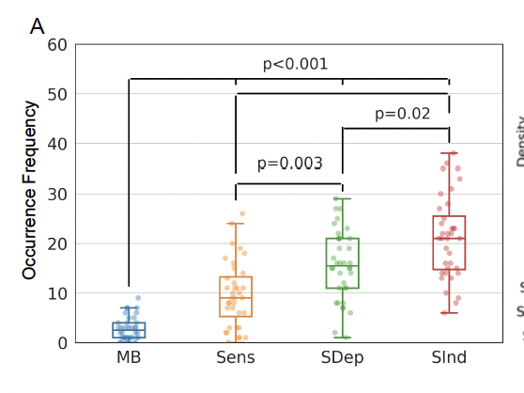
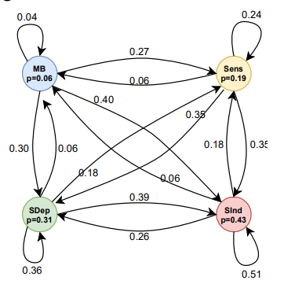
Mind Blanking has a distinct behavioral profile
Less frequent Equally probable across time Transient relay
N participants = 36
Mortaheb, Van Calster, Raimondo, Klados, Boulakis, Georgoulaa, Majerus, Van De Ville*, Demertzi*. PNAS 2022
Van Calster, D’Argembeau, Salmon, Peters, Majerus, J Cogn Neurosci 2017

Slide 28
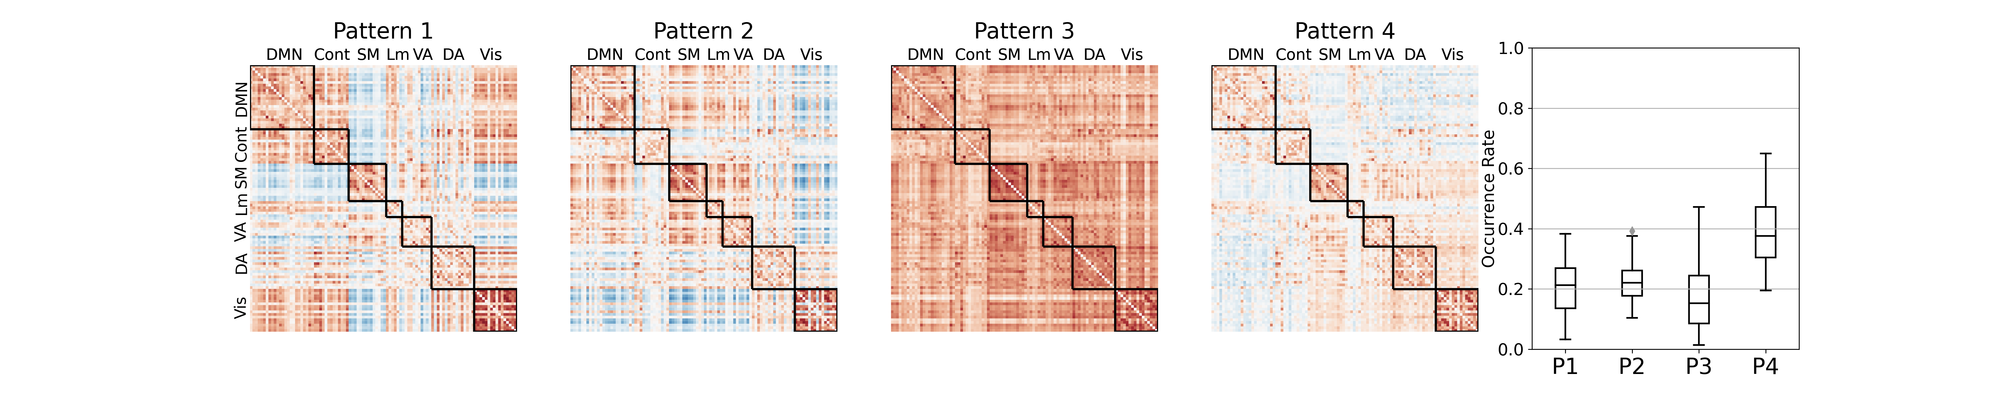
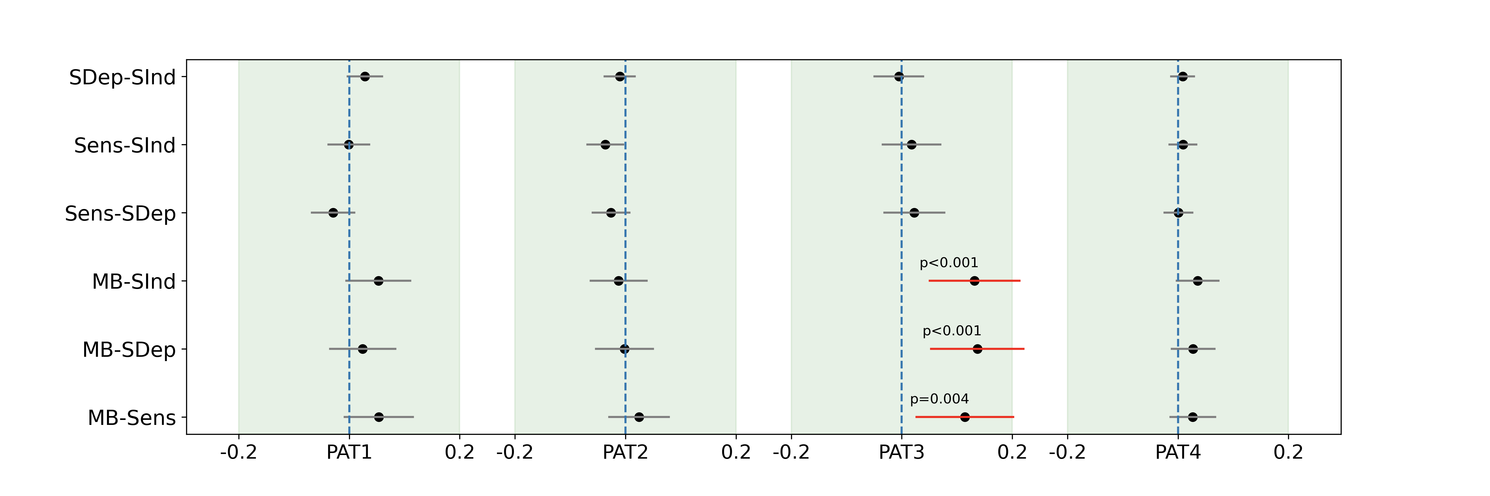
MB is linked to a hyper-connected state
Sparsely reported Reduced perceptions Equiprobable
Mortaheb, Van Calster, Raimondo, Klados, Boulakis, Georgoulaa, Majerus, Van De Ville*, Demertzi*. PNAS 2022
Notes:
Cosine similarity determines how similar two matrices/vectors are irrespective of their norm. It can be considered as the normalized version of the Euclidean distance (i.e., projecting the vectors onto the unit sphere and calculating Euclidean distance, which is then effectively the cosine of the angle between those vectors). Subsequently, for each mental state the distribution of distances to all four centroids was created.
A generalized linear mixed effect model with gamma distribution and log link function was applied to test the relationship between the distances to each pattern and the mental states.
Tukey post hoc test was applied to compare

Slide 29
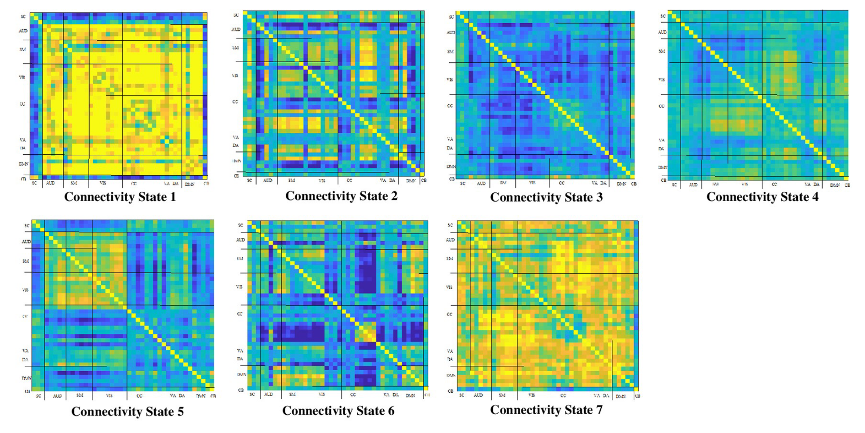
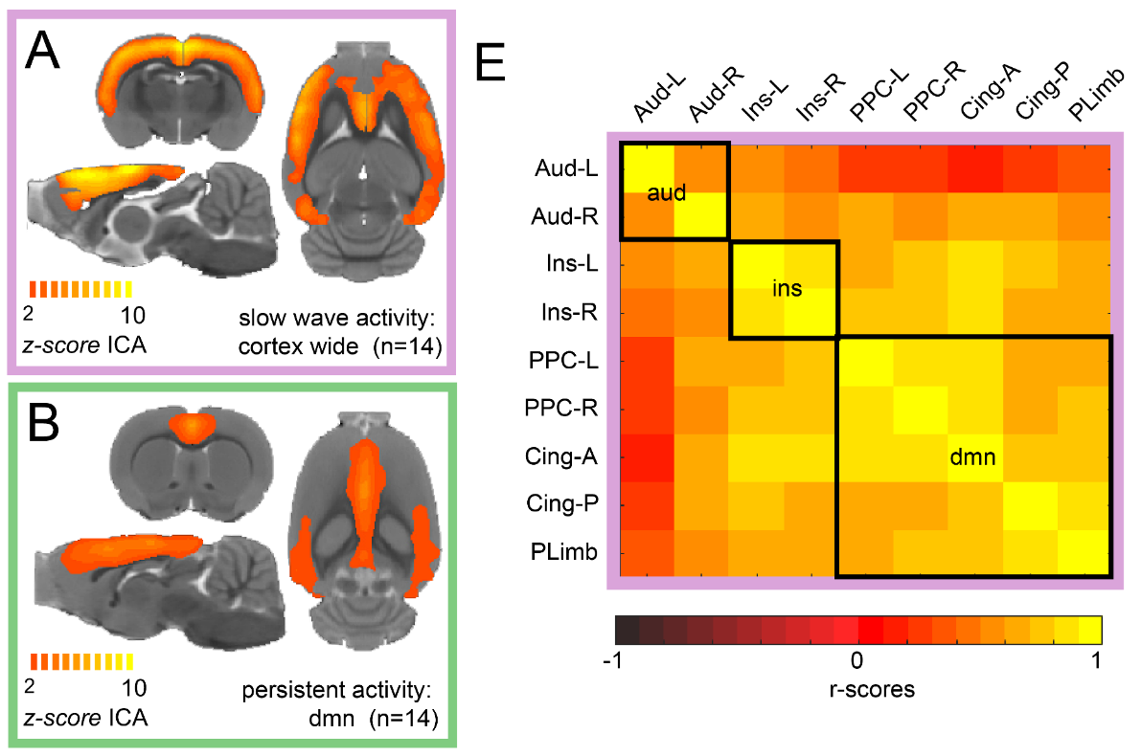
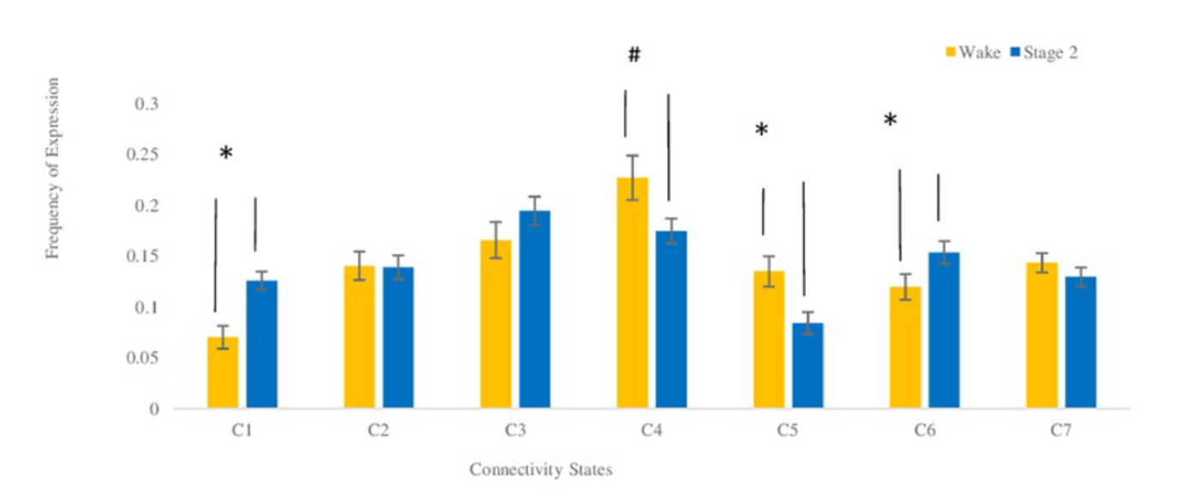
What is this higher connectivity about?
a) Slow wave activity in unconscious states
Sparsely reported Reduced perceptions Equiprobable
NREM sleep
Humans
Isoflurane anesthesia
Rats
Wake
Stage 2
Frequency
El-Baba et al, PLOS One 2019
Aedo-Jury et al, eLife 2019

Slide 30
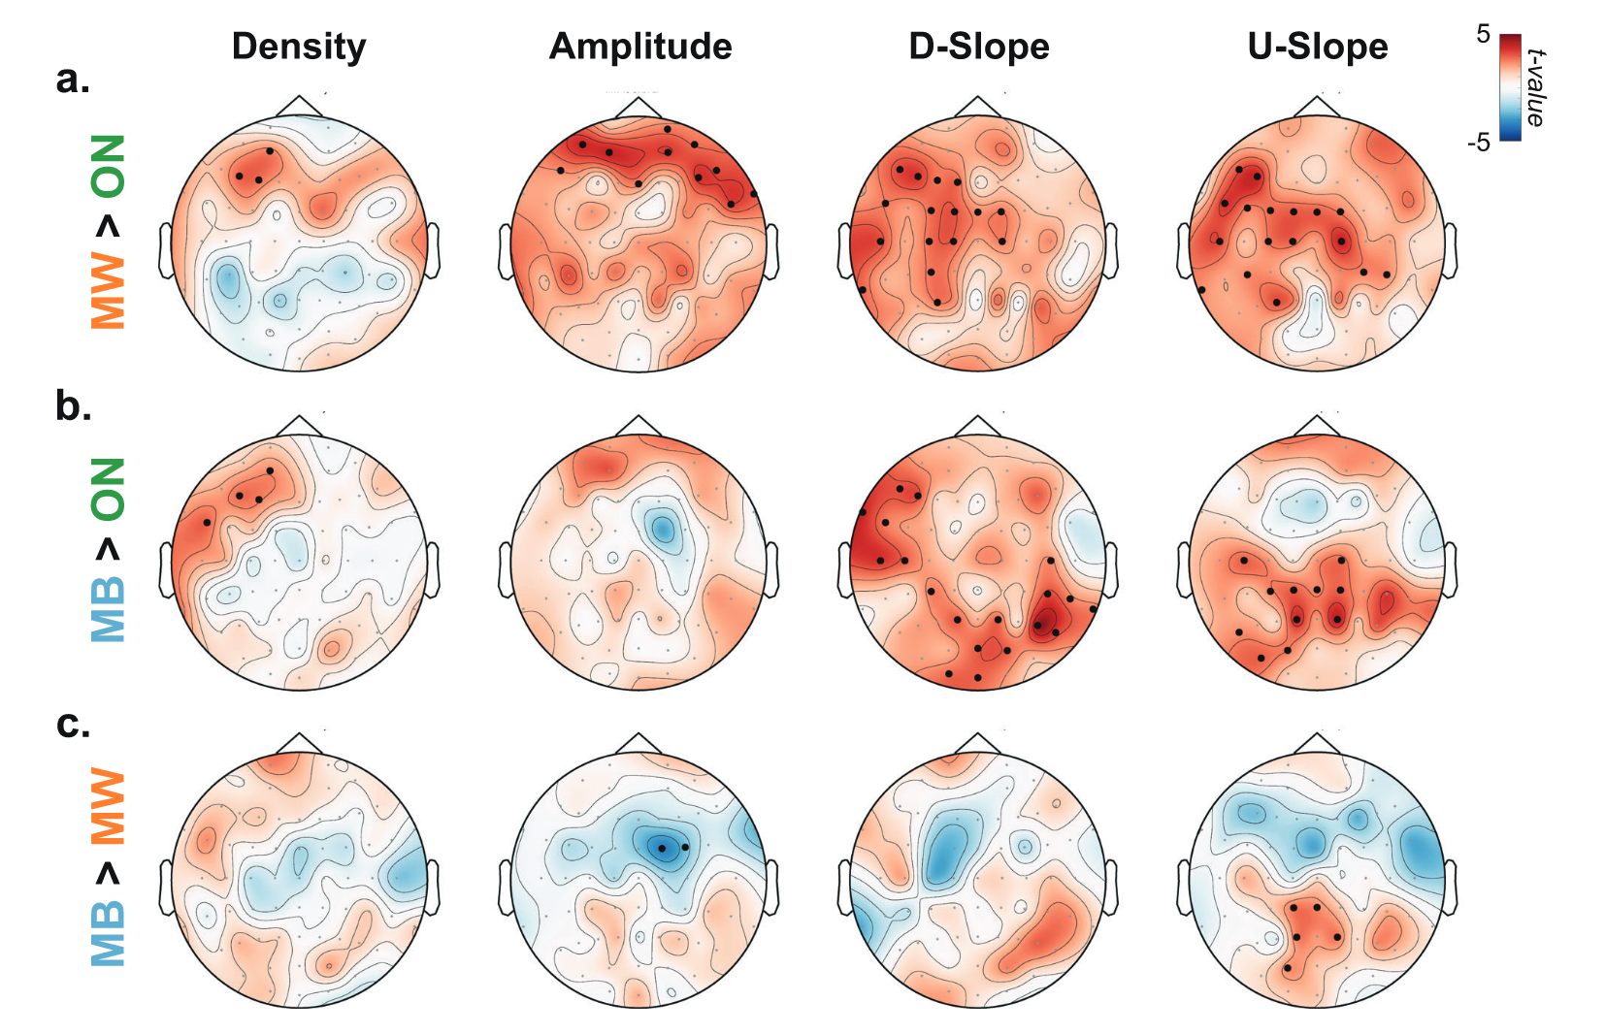
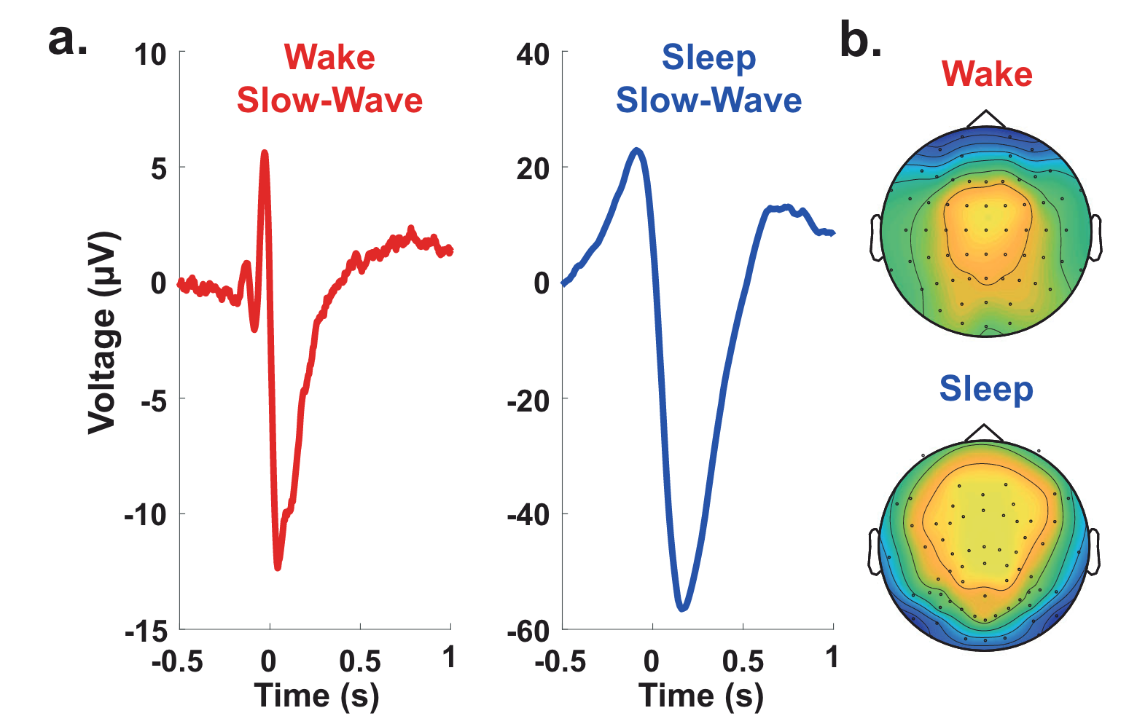
Slow wave activity in wakefulness “local sleeps”
Properties of slow waves
Predictive of mental states
Andrillon et al, Nat Communications 2021
Notes:
Slow waves in the back of the brain were associated with misses (Fig. 5c), which is consistent with the involvement of parietal cortices in sensorimotor integration
MB > MW: reduction of slow-wave amplitude over frontal electrodes but an increase in their upward slope over parietal electrodes were predictive of MB: a perturbation of frontal cortices leads to unconstrained thoughts (MW) rather than the loss of awareness, but that awareness decreases when posterior regions momentarily go offline, a pattern similar to the neural correlates of dreaming during sleep or spontaneous thoughts during wakeful rest57,75.
Slow wave parameters such as
Amplitude
slope and
number of negative peaks
are thought to depend on the number of recruited neurons and the speed of synchronization across neuronal populations (Esser et al., 2007; Riedner et al., 2007; Vyazovskiy et al., 2007). In particular, steep, high-amplitude slow waves with few negative peaks are generated when an efficient neuronal synchronization allows for a fast recruitment of a large number of neurons at the cortical level.
https://www.ncbi.nlm.nih.gov/pmc/articles/PMC3900623/#:~:text=Slow%20wave%20activity%20(SWA%2C%200.5,slope%20of%20sleep%20slow%20waves.:
It has been proposed that the slope of slow waves, measured in the EEG, may represent a marker of this neuronal synchronization.^{16–18} Thus, the faster neuronal populations of a network are able to synchronize their activity, the steeper the slopes of the slow waves are. Consequently, the slope of slow waves at the beginning of the night when sleep pressure is high is much steeper compared to the slope of slow waves with the same amplitude towards the end of the sleep period when sleep pressure has dissipated.¹⁷

Slide 31
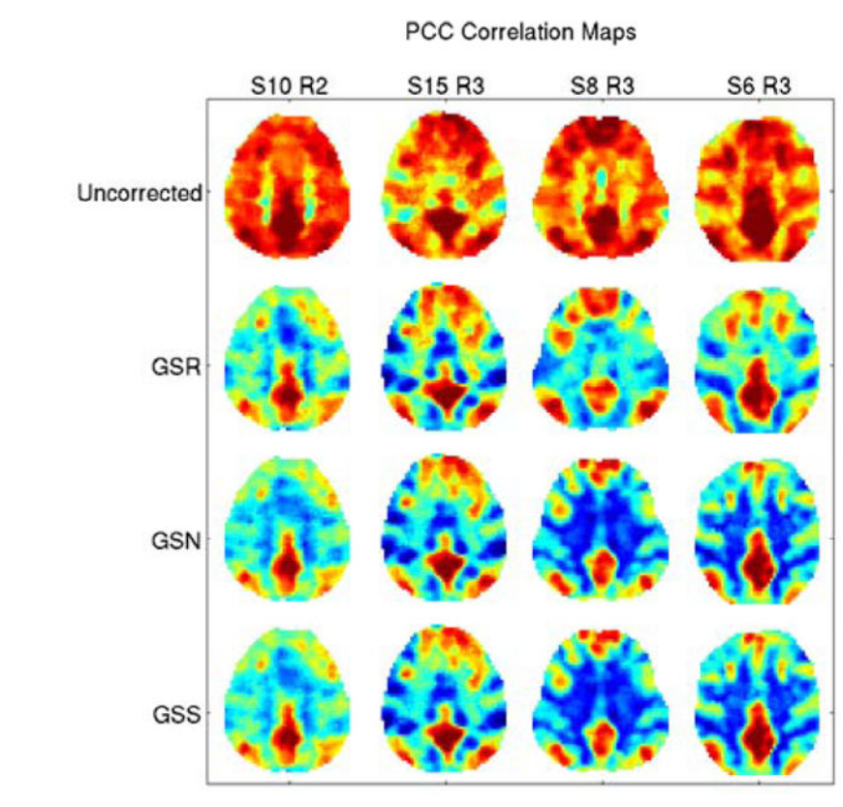
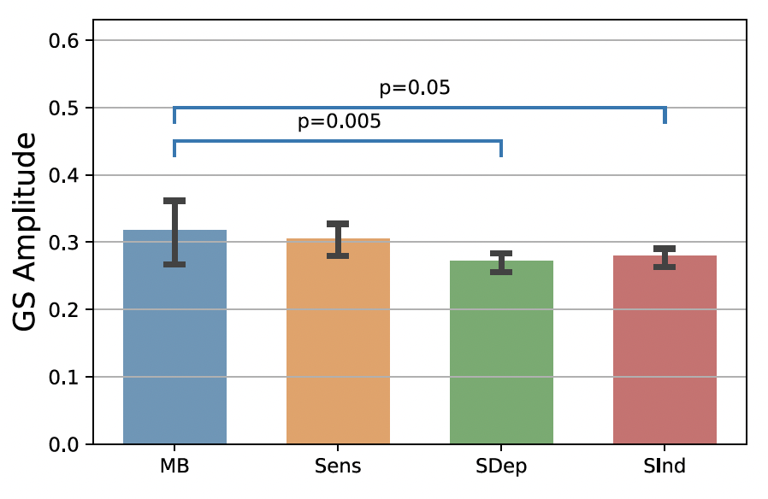
What is this higher connectivity about? b) MB due to lower cortical arousal?
Global signal
Average voxel timeseries
Zarahn, Aguirre, D’Esposito, NeuroImage 1997
(“Global flow’’ in PET, Friston et al., 1990)
Higher Global Signal Amplitude around MB reports
Liu et al, NeuroImage 2017
Mortaheb et al, PNAS 2022
Notes:
‘‘Global flow’’ in PET (Friston et al., 1990), which is the average measured blood flow for the entire volume.
In fMRI there is at least a superficial analogue which we will refer to as the ‘‘global signal’’ and which we define as the average brain voxel time series (the global signal is thus a time signal)
The global signal for each subject was calculated after applying the atlas and time series extraction, by averaging time series of all the ROIs
The global signal amplitude was defined as the sum of the absolute value of the GS time points related to the functional repertoire of each mental state (extracted at the ROI level, after preprocessing)

Slide 32
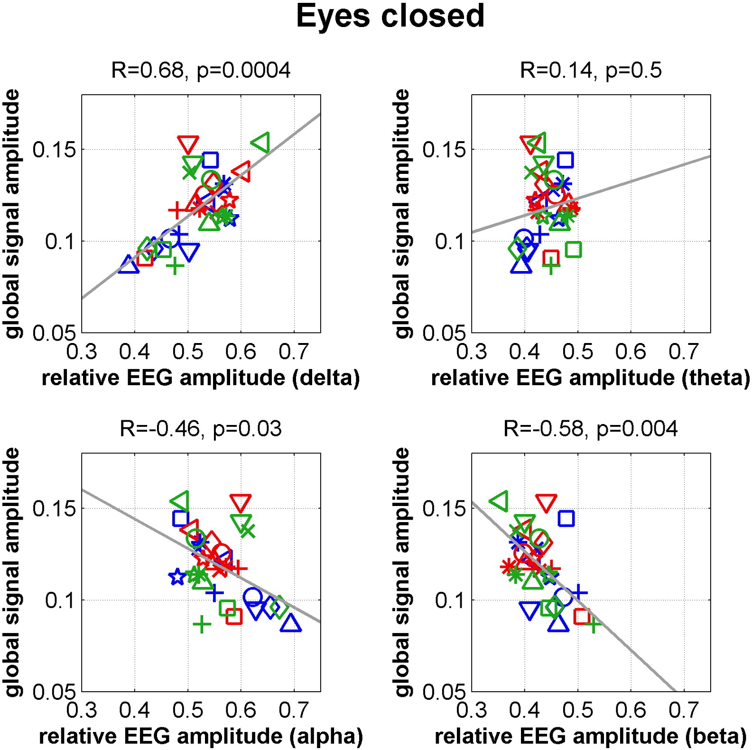
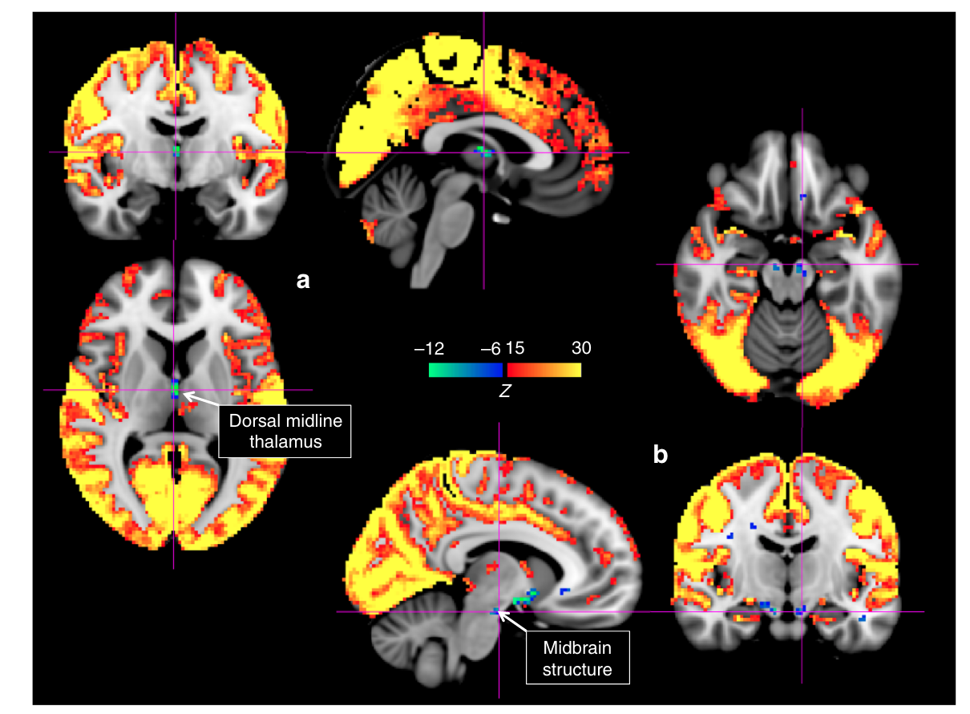
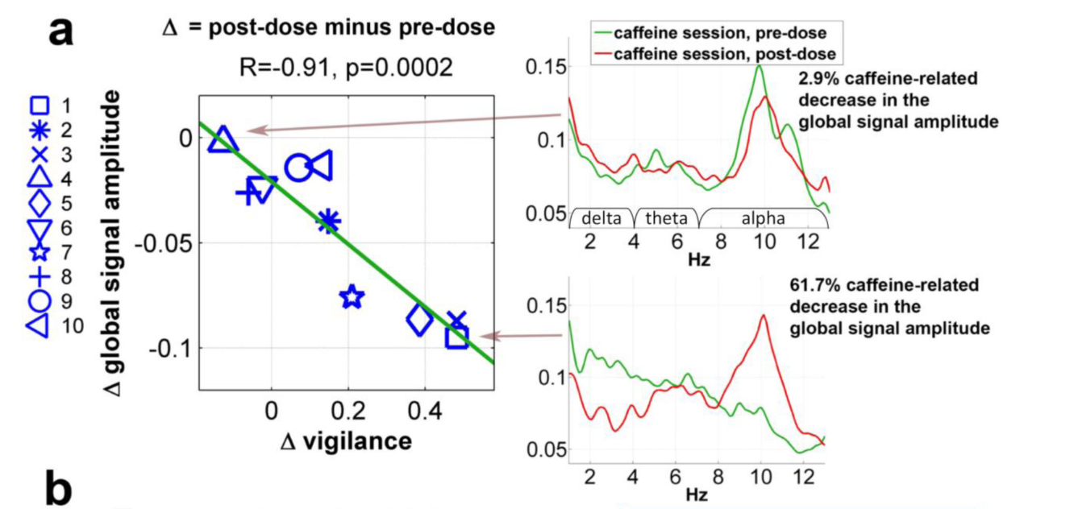
Global Signal amplitude reflects levels of arousal
GS amplitude is linked to low arousal
GS amplitude linked to signal decreases in subcortical structures of arousal
GS amplitude decreases with caffeine intake
Wong et al, Neuroimage 2013
Liu et al, Nat Communications 2018
Notes:
Liu 2018:momentary increases in the global signal are accompanied by signal decreases in subcortical regions with established involvement in promoting arousal and wakefulness.

Slide 33
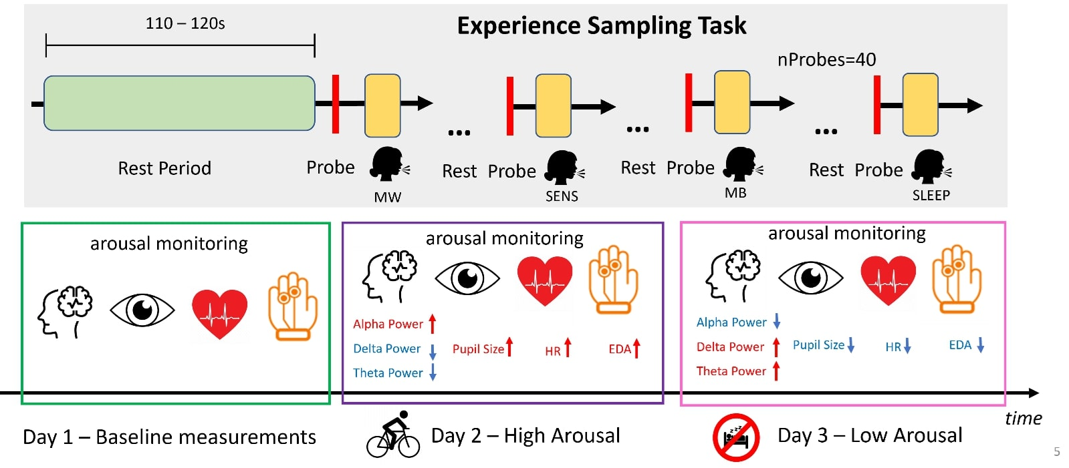
Do arousal variations mediate MB?
Boulakis, Simos, Zoi, Mortaheb, Schmidt, Raimondo, Demertzi. Registered Report Stage2 (results), biorχiv 2024
Notes:
N = 26
Power = .95
3 sessions
Baseline
Post-Exercise
Sleep Deprivation
40 resting blocks (110-120sec) -> probe
Monitored and matched sleep schedule

Slide 34
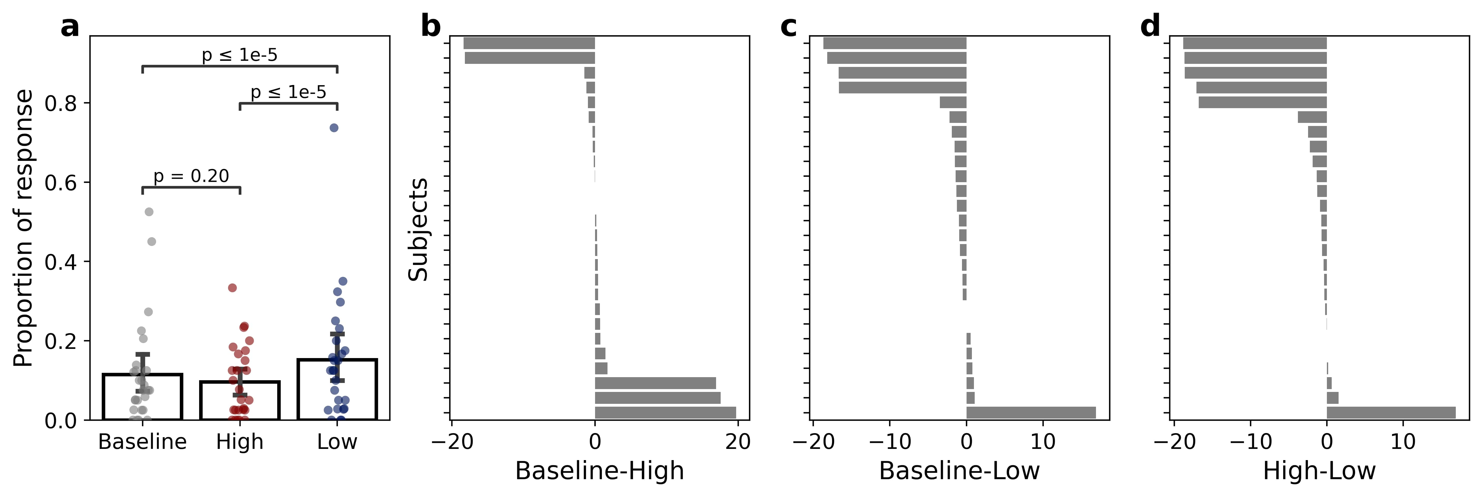
Altered arousal increases MB reports
Sleep depr – Bike exc
Transition Probabilities
-.2
MW
-.23
.01
.07
.09
SENS
MB
.1
.06
Baseline Bike exc Sleep depr
.05
.07
BUT MB was more frequent in first half of post-exercise vs. second half (divergence = 4.08, p = 3.2e-02)
Notes:
After sleep deprivation (Low Arousal), participants were more likely to transition from mind-wandering (MW) to mind-blanking (MB) compared to the condition of physical exercise (High Arousal). Additionally, participants were less likely to transition to MW. Arrows indicate the direction of the mental state transition. Bold font indicates statistical significance (FDR corrected).

Slide 35
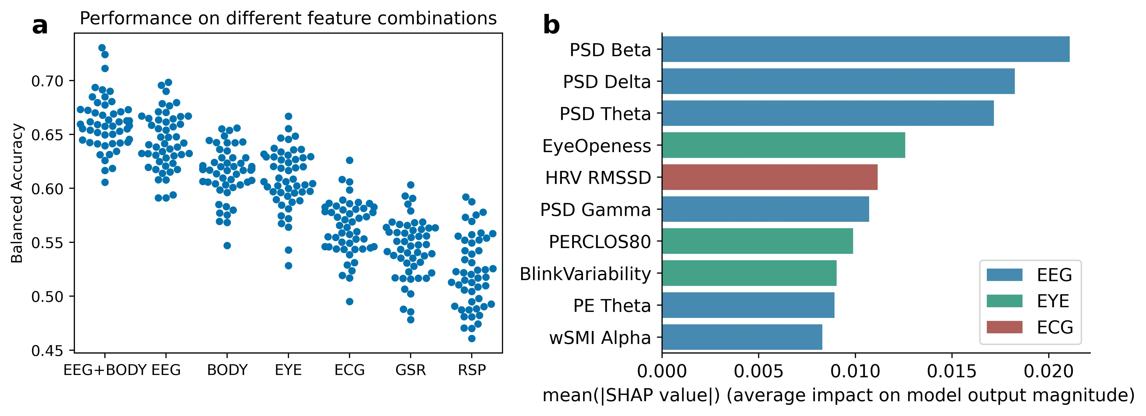
MB has a unique brain-body profile
MB vs. other states
Boulakis, Simos, Zoi, Mortaheb, Schmidt, Raimondo, Demertzi, Registered Report Stage2 Results
Notes:
A balanced random forest classifier trained on a combination of BRAIN and BODY features 626 outperformed classifiers trained solely on BRAIN or BODY features when evaluated with balanced accuracy. Individual points 627 indicate performance on the folds of the repeated cross-validation.
b) Subset of the 10 features with the highest mean of the 628 absolute SHAP values obtained from the balanced random forest classifier.

Slide 36
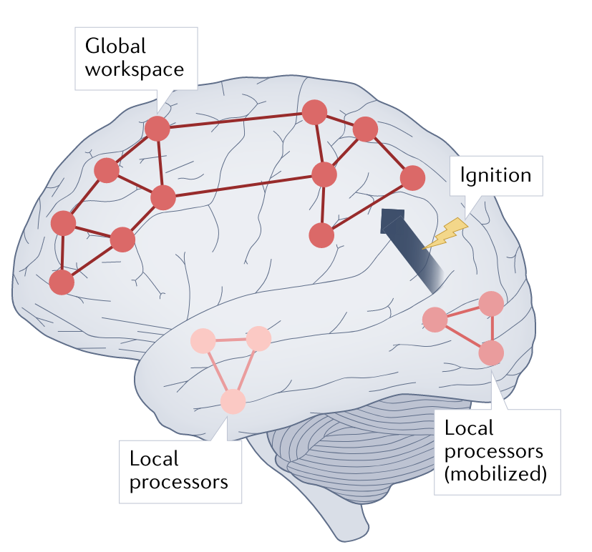
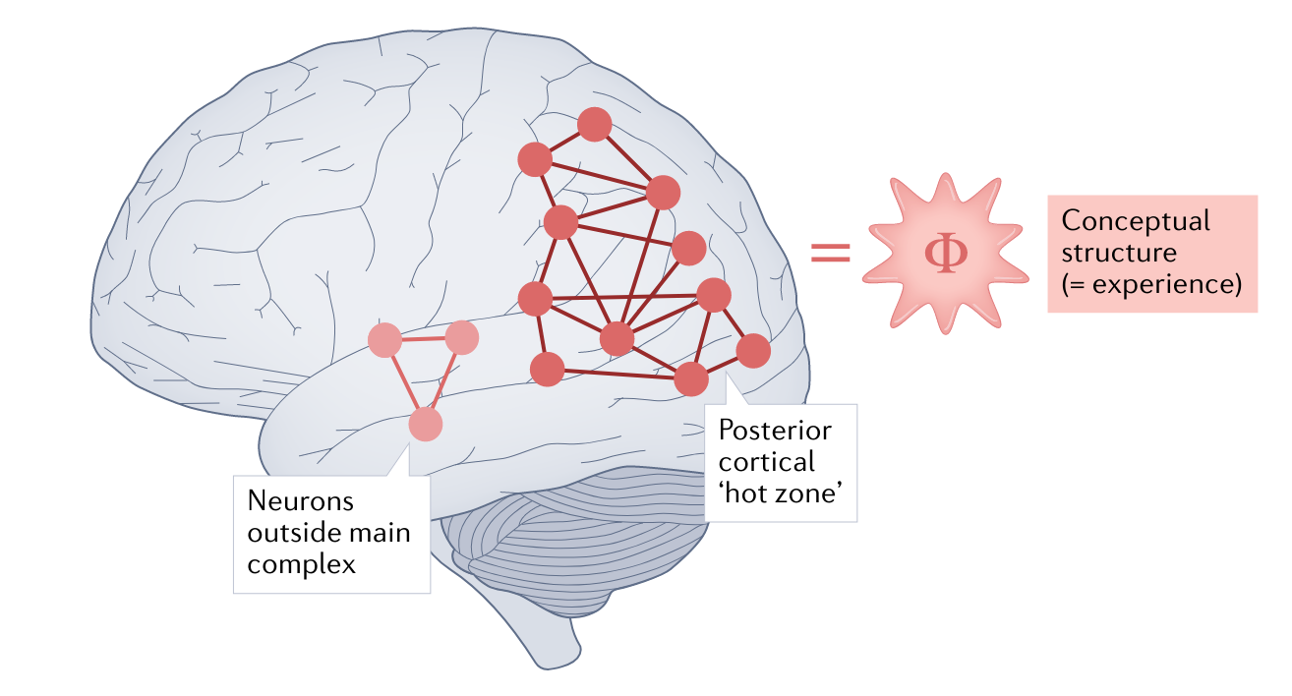
Non-reportable Awareness? Challenges for Theories of Consciousness
Global Neuronal Workspace Theory
Integrated information theory
Seth & Bayne Nat Rev Neurosci 2022
Notes:
Is it possible to decode the experience of MB from brain body interaction? What would such a brain-body profile look like?
Is the experience of MB phenomenologically akin to other cases of inability to report our mental life, like blindsight? What can we draw from there?

Slide 37
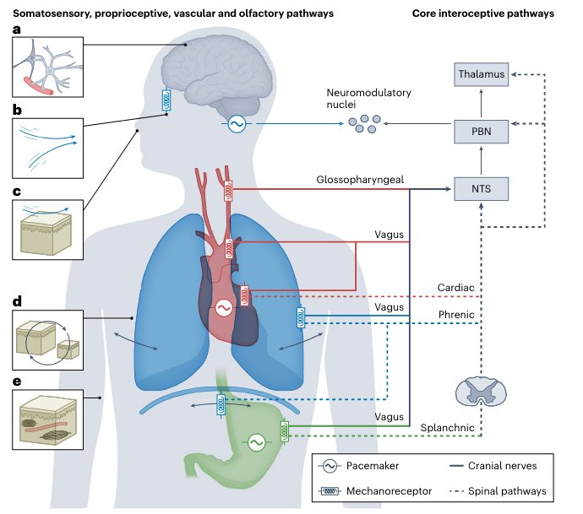
The embodied
perspective
Engelen, Solcà, Tallon-Baudry. Nature Neurosci 2023​
Varela F. Nat Rev Neurosci. 2001​

Slide 38
The mind is embodied and embedded
Seth & Friston. Phil Trans R Soc London B 2016
Notes:
Neuronal activity encodes expectations about the causes of sensory input with the aim to minimize surprise of sensory data

Slide 39

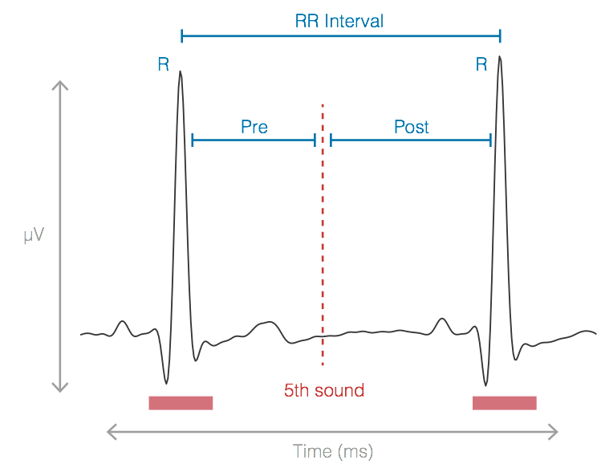
Cardiac reactions to oddballs in MCS
Auditory oddball paradigm
Electrocardiographic markers carry
independent information from EEG
Cardiac cycle-phase acceleration
only in MCS
Bekinschtein et al., PNAS, 2009
Post interval
Raimondo, Rohaut, Demertzi, Valente, Engemann, Salti, Fernandez Slezak, Naccache, Sitt. Annals of Neurology 2017
Bekinschtein et al., PNAS, 2009
Notes:
After the deviant, the foillowing heartbeat is faster in the MCS

Slide 40
Cardiac reactions to oddballs in sleep
Cardiac deceleration for global deviants only in REM
Koroma, Boulakis, Raimondo, Blume, Strauss, Demertzi. In prep
EEG: Strauss, Sitt, King, Elbaz, Azizi, Buiatti, Naccache, van Wassenhove, Dehaene, S, PNAS 2015
EEG: Blume, Niedernhuber, Spitschan, Slawik, Meyer, Bekinschtein, & Cajochen. Sleep 2022

Slide 41

Cardiac responses to word-induced relaxation during sleep
Cardiac decelaration after
relaxing words
Cardiac modulation = SR - RS
S
relax
R
R
relax
vs
xaler
materials
vs
slairetam
Time (ms)
n=50
RS
SR
night
night
Koroma, Beck, Schmidt, Rasch, Demertzi, A. J Sleep Res 2024
Notes:
Cardiac modulation index: the difference between the word's onset (S) and the heartbeat (R) coming after (SR) versus before (RS) the word's presentation. Positive index values indicate cardiac activity deceleration; negative index values indicate cardiac acceleration.

Slide 42
Consciousness is multidimensional
Inter-state dynamism
(metastability)
Cross-modal interactions
(multi-sensory integration)
“Rich” inter-regional
communication
(arousal)
Functional Anticorrelations
(neural inhibition)
Embodied responsiveness
(active inference)
Bayne, Hohwy, Owen Trends Cogn Sci 2016
Notes:
Metastability refers to the human brain’s ability to integrate several functional parts and to produce neural oscillations in a cooperative and coordinated manner. phase synchronization forms the basis of metastable behavior in neural networks.

Slide 43

Papers
a.demertzi@uliege.be
Notes:
Conclusions: I showed how states of unconsciousness raise ethical debates, mostly about whether C . exists. I provided data which point towards the one or the other direction. In the end, it seems there is an Open dialogue in the science of about what C it is. In that respect, Consciousness is a construct of consensus and we'd better be off to define 4 quantify it as accurately as possible. This is why I think

