Slide 1
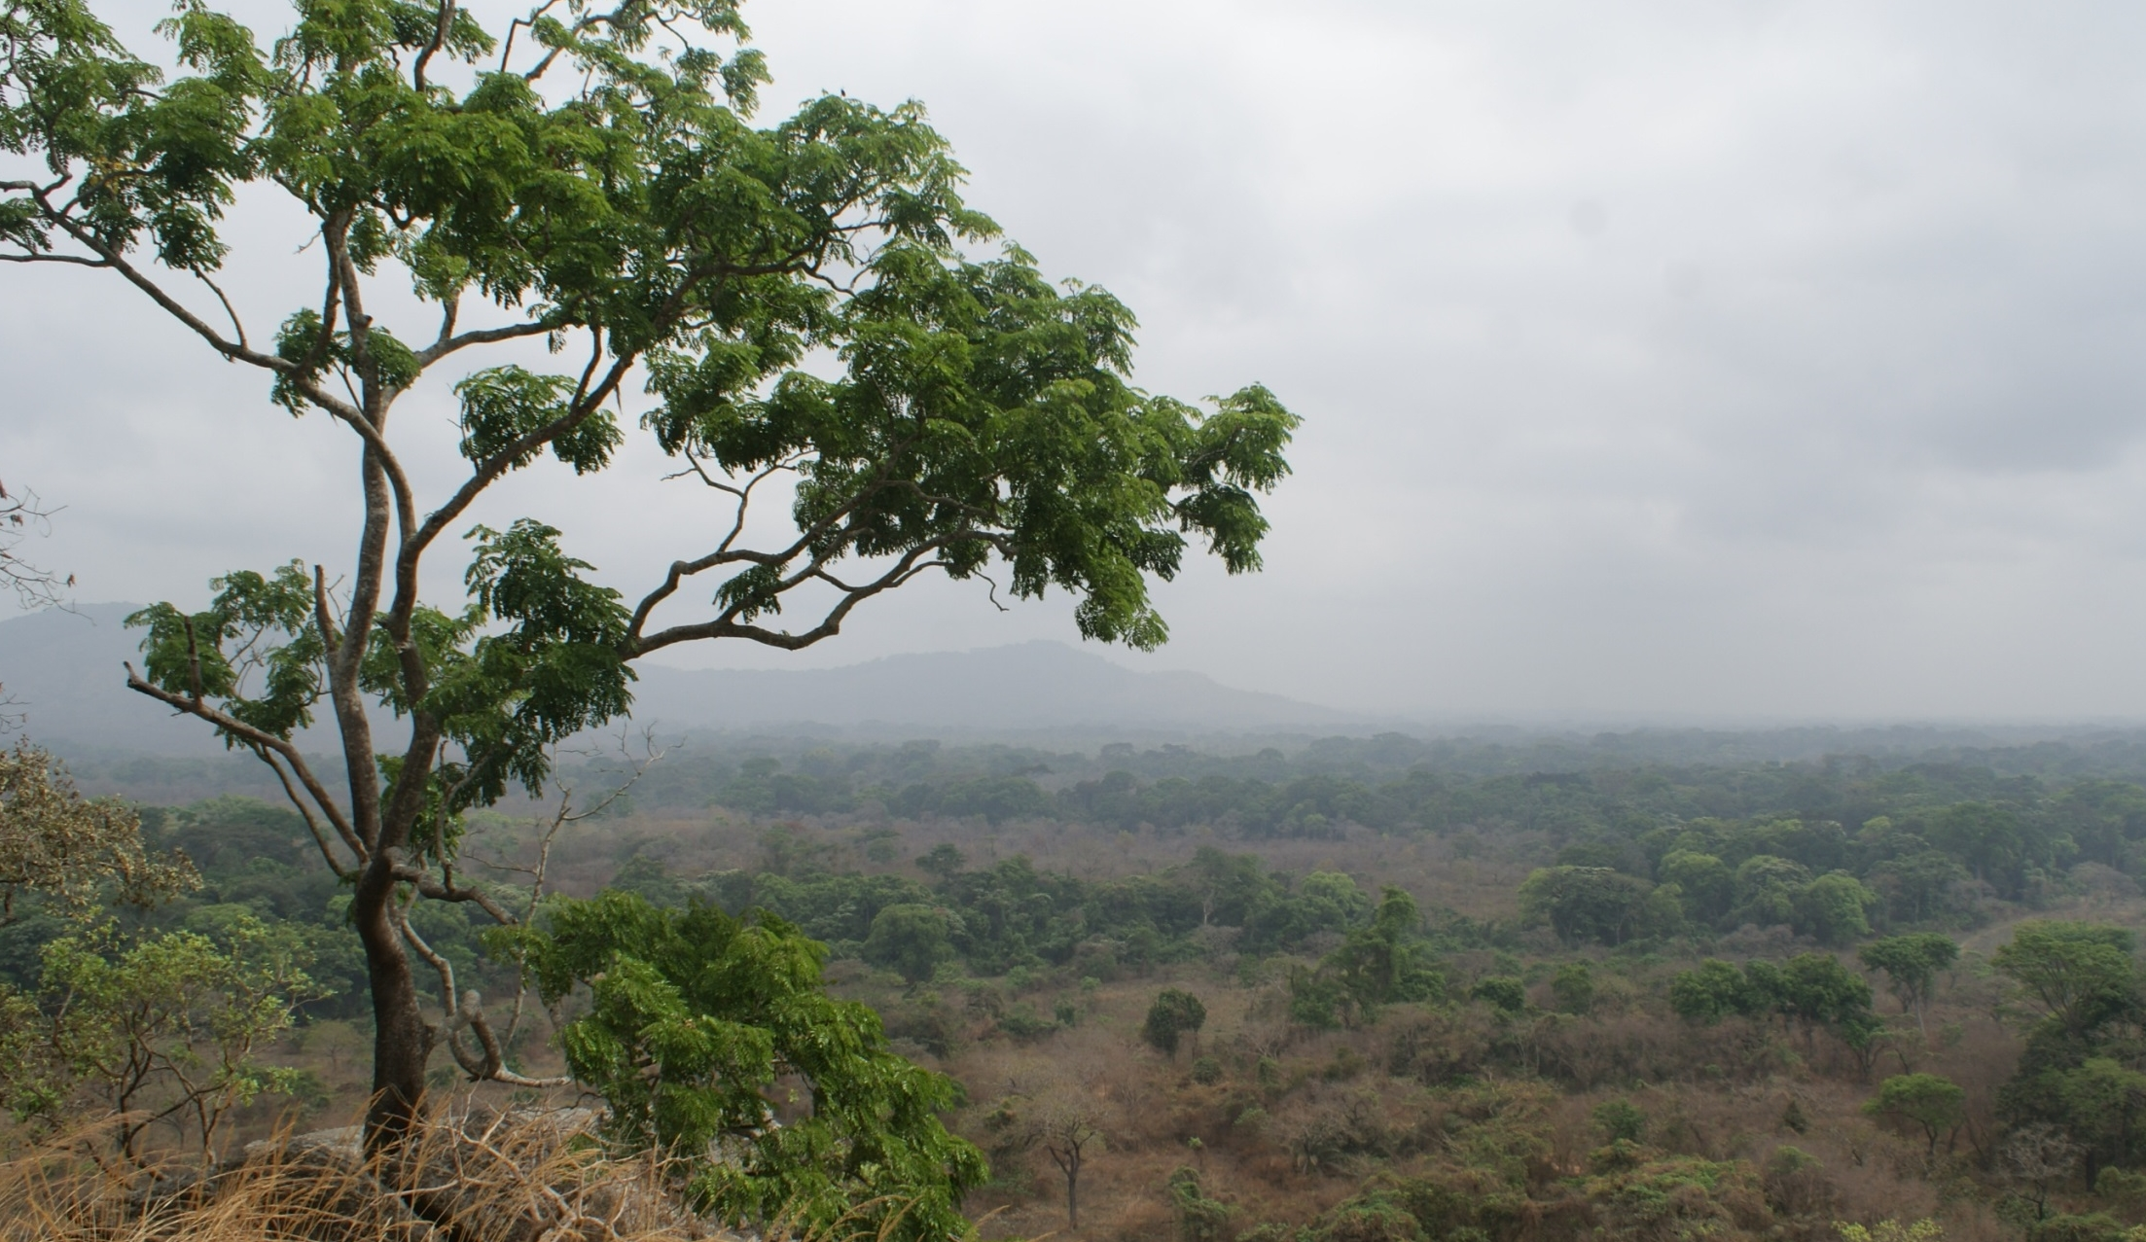


Climatic niche lability of the African woody flora
i.e. the quality of being easily changeable
Anaïs Gorel

Slide 2
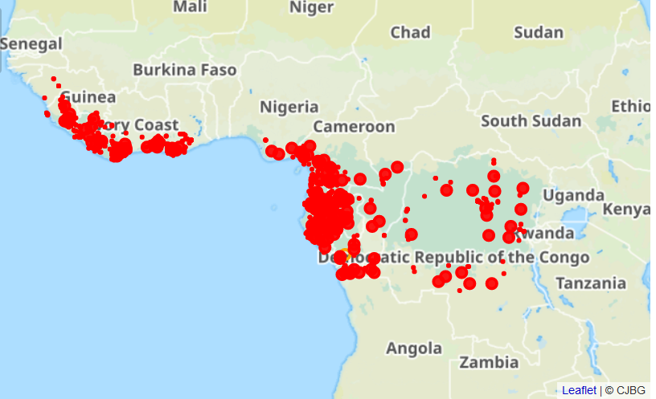
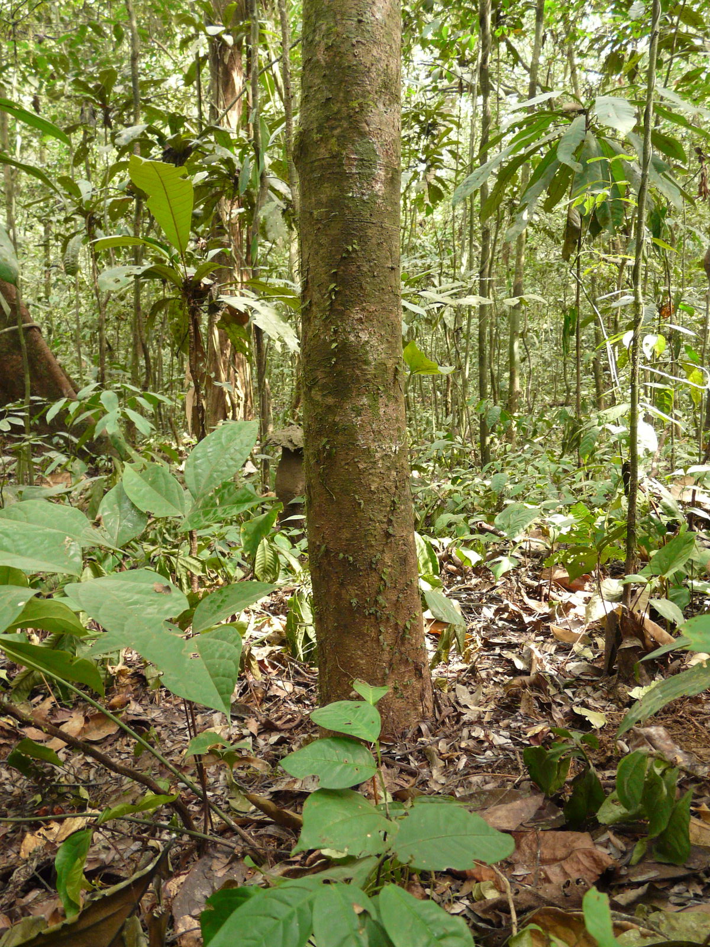
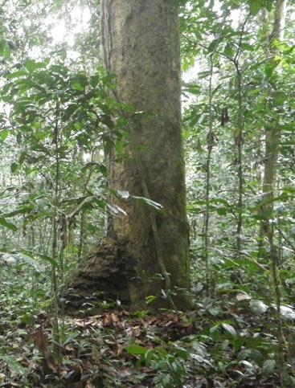
Conserved genus in Africa: Gilbertiodendron
38 species
G. dewevrei
G. newberyi
Base de données des plantes d'Afrique (CJB)
Notes:
25 espèces
All in GC in Africa
G dewevrei limbali

Slide 3
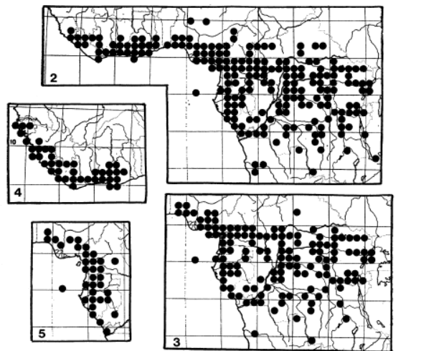
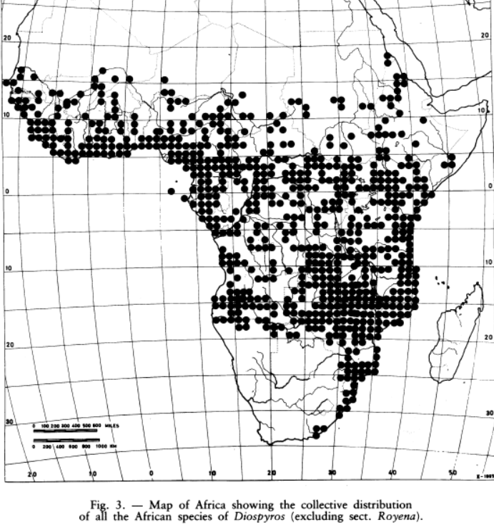
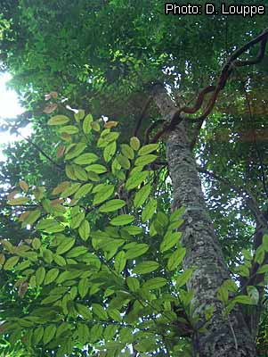
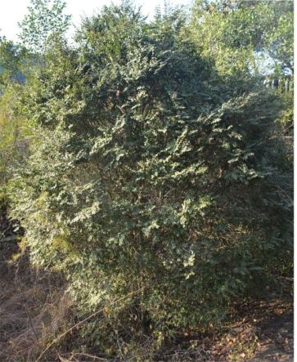
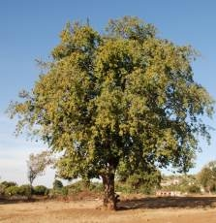
Labile genus in Africa: Diospyros
729 species, 80 in Africa
D. natalensis
D. crassiflora (Ebony)
D. mespiliformis
The Taxonomy, Ecology and Chorology of African Ebenaceae, White (1978, 1988)
Notes:
Sur tous les continents
729 Accepted Species espèces 80 sp in GC and outside
Crassiflora = 5
Mespi= zambezien

Slide 4
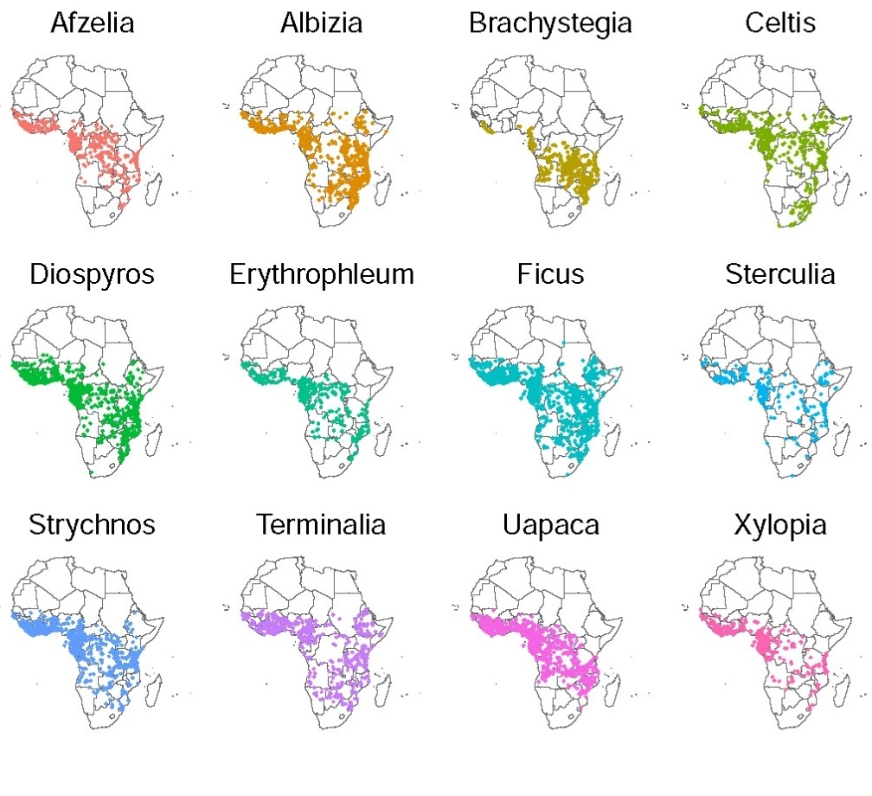
Labile genus in Africa: Diospyros
729 species, 80 in Africa
D. natalensis
D. crassiflora
D. mespiliformis
The Taxonomy, Ecology and Chorology of African Ebenaceae, White (1978, 1988)
Notes:
Sur tous les continents
729 Accepted Species espèces 80 sp in GC and outside
Crassiflora = 5
Mespi= zambezien

Slide 5
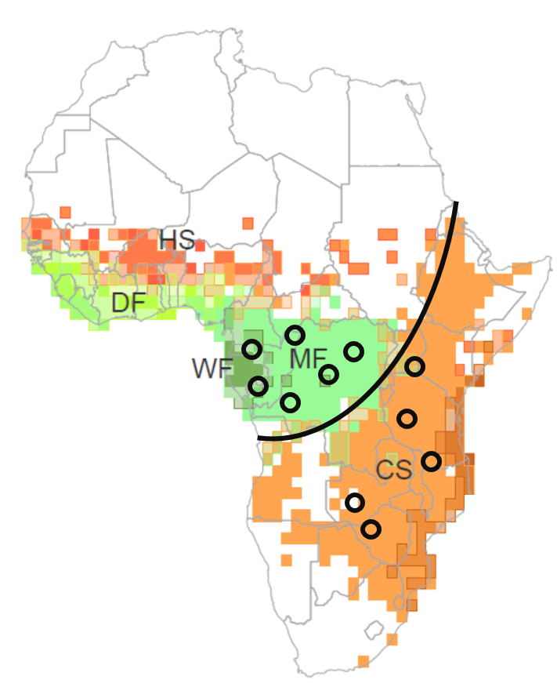
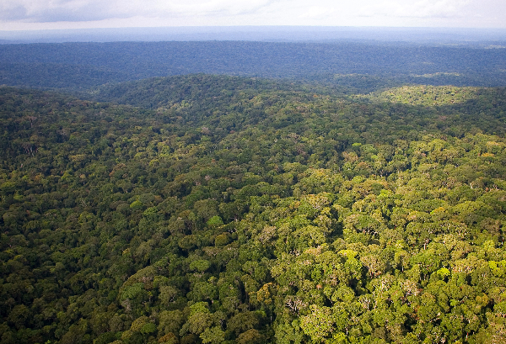
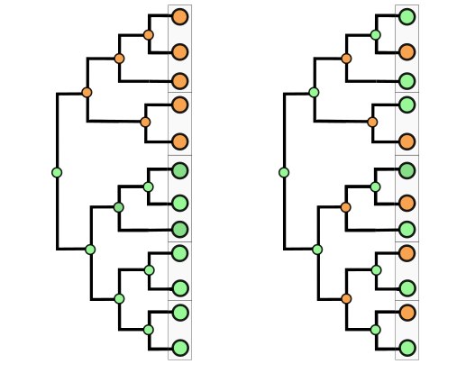
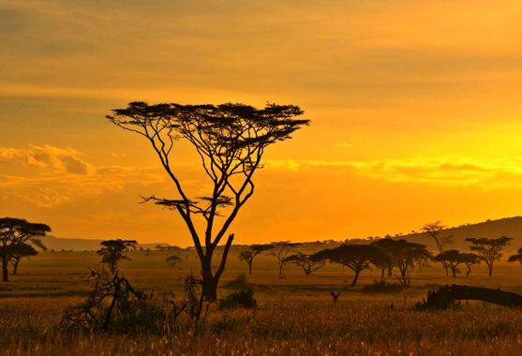
Questions and hypothesis
How labile is climatic niche in the tropical woody flora?
How does niche lability vary across ecological boundaries?
clade?
?
Evidence:
From current distribution
From past reconstruction (genus-level phylogeny; Segovia et al., 2020)

Slide 6
Questions and hypothesis
How labile is climatic niche in the tropical woody flora?
How does niche lability vary across ecological boundaries?
clade?
?
Evidence:
From current species distribution
From past niche reconstruction (genus-level phylogeny; Segovia et al., 2020)

Slide 7

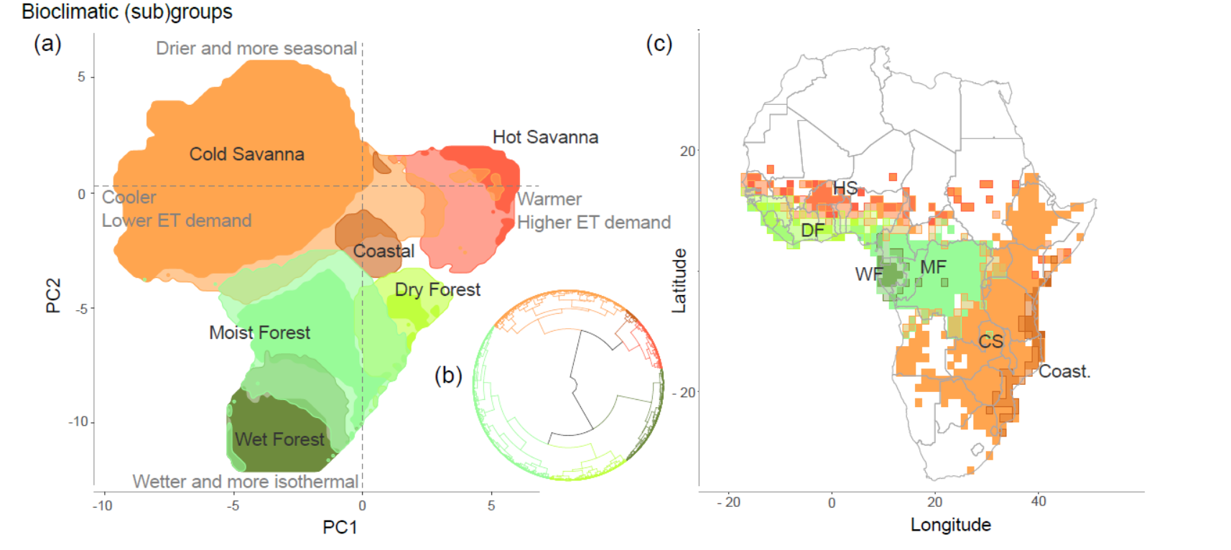
Biomes and bioclimatic groups
Climatic niches 4,142 from 956 woody genera and 138 families
Savanna
Forest

Slide 8
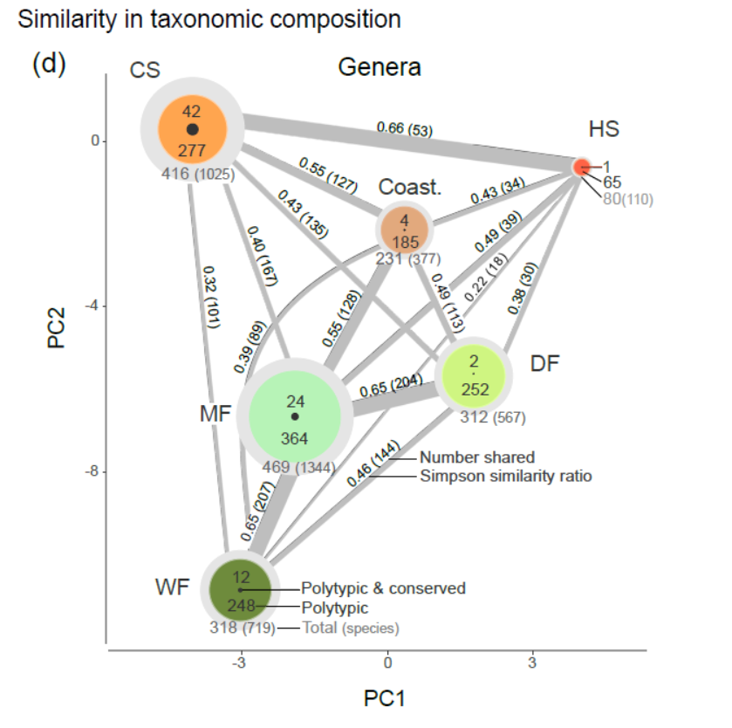
Niche lability: evidence from present
Current forest-savanna partition for 40% of the polytypic woody genera, 80% considering subgroups within biomes
Savanna
Forest

Slide 9
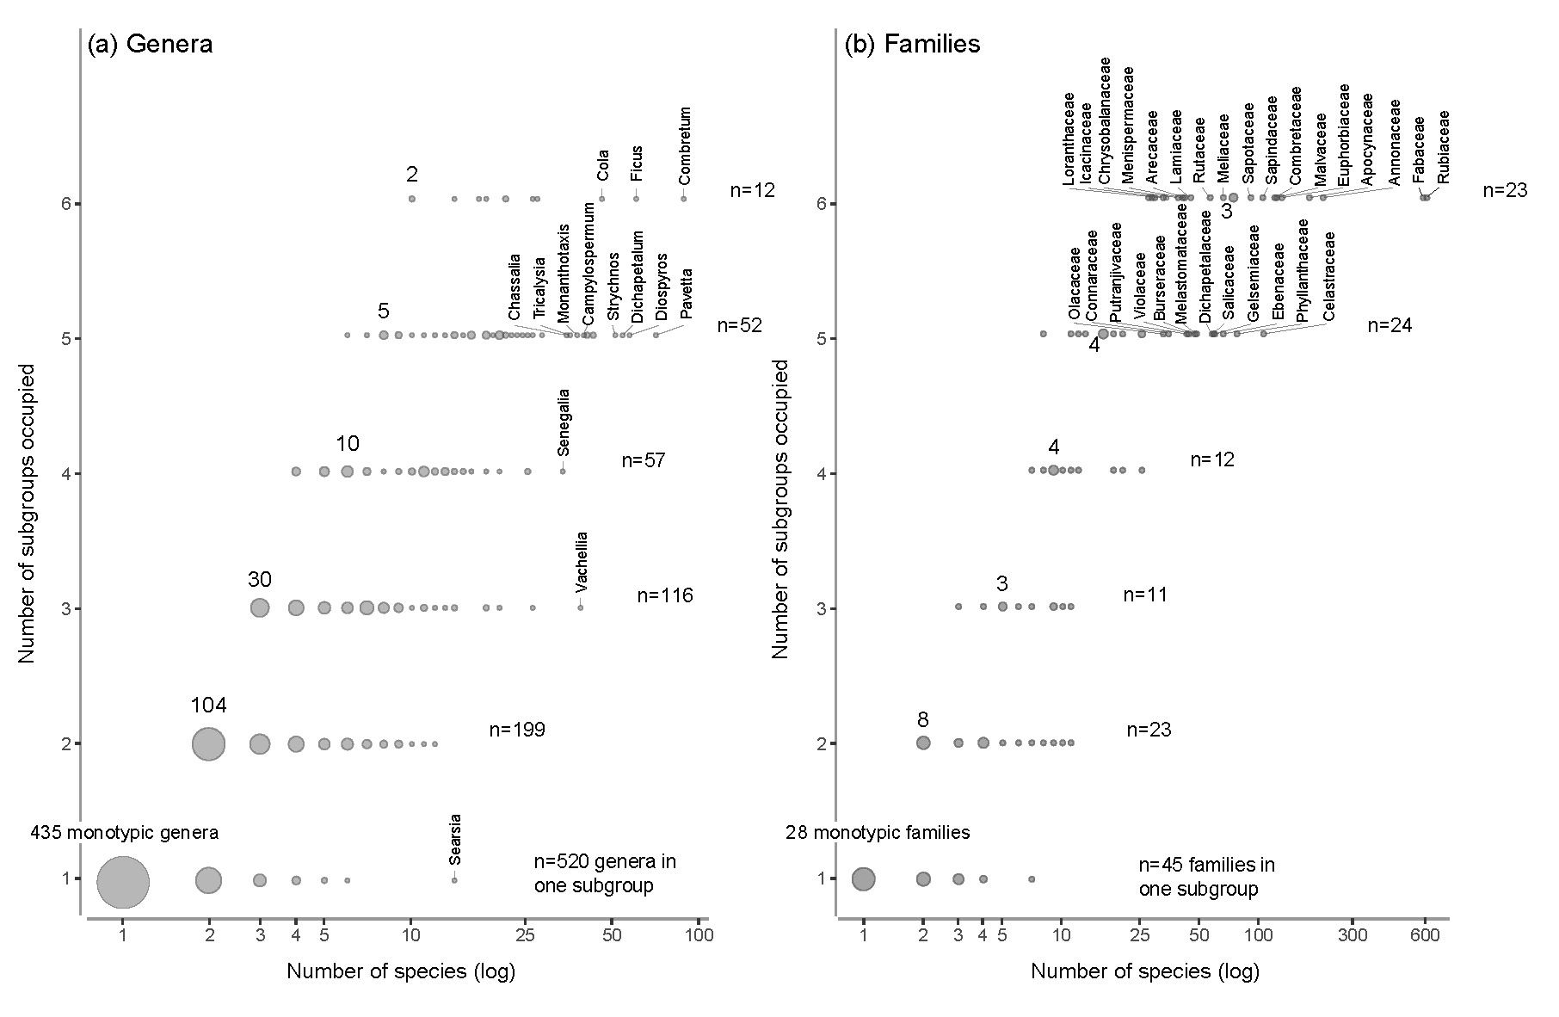
Niche lability: evidence from present
Contrasting abilities to evolve and diversify
≠f(age)

Slide 10
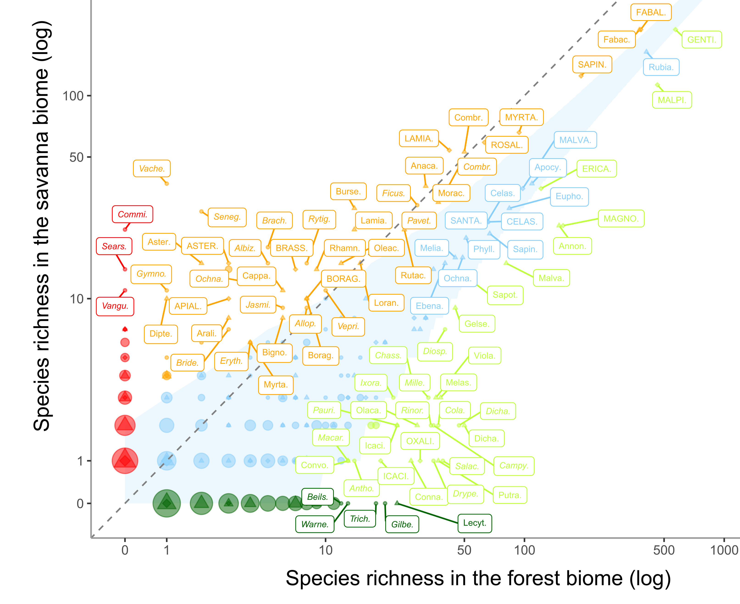
Niche lability: evidence from present
Current distribution
FOREST vs SAVANNA
More diversified in Savanna
than expected by chance
null distribution
More diversified in Forest
than expected by chance

Slide 11
Niche lability: inferring the past
Ancestral biome reconstruction
Current distribution

Slide 12
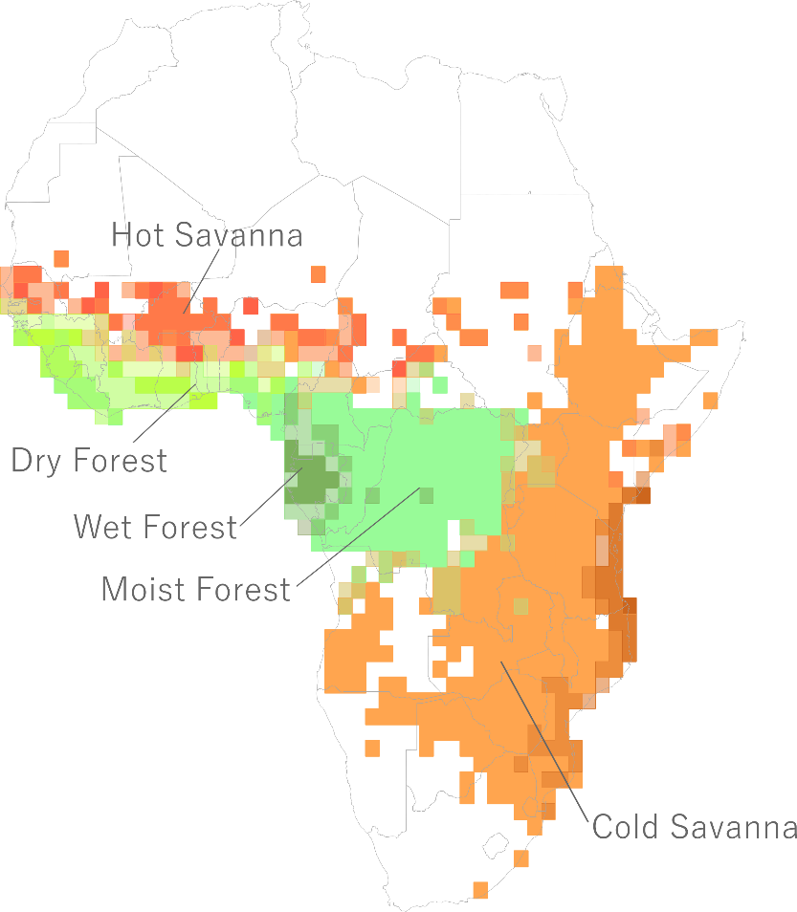
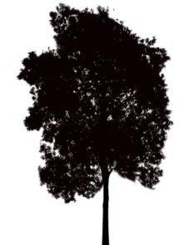
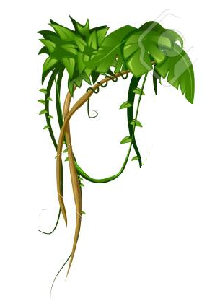
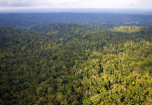

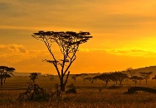

Functional changes and niche shifts
Growth form changes associated with biome shift?
No, clades mostly retaining their ancestral form
Functional traits associated with drought-tolerance/avoidance?
Enabler traits?
To be continued…
Biome shift
Notes:
The study is in progress

Slide 13
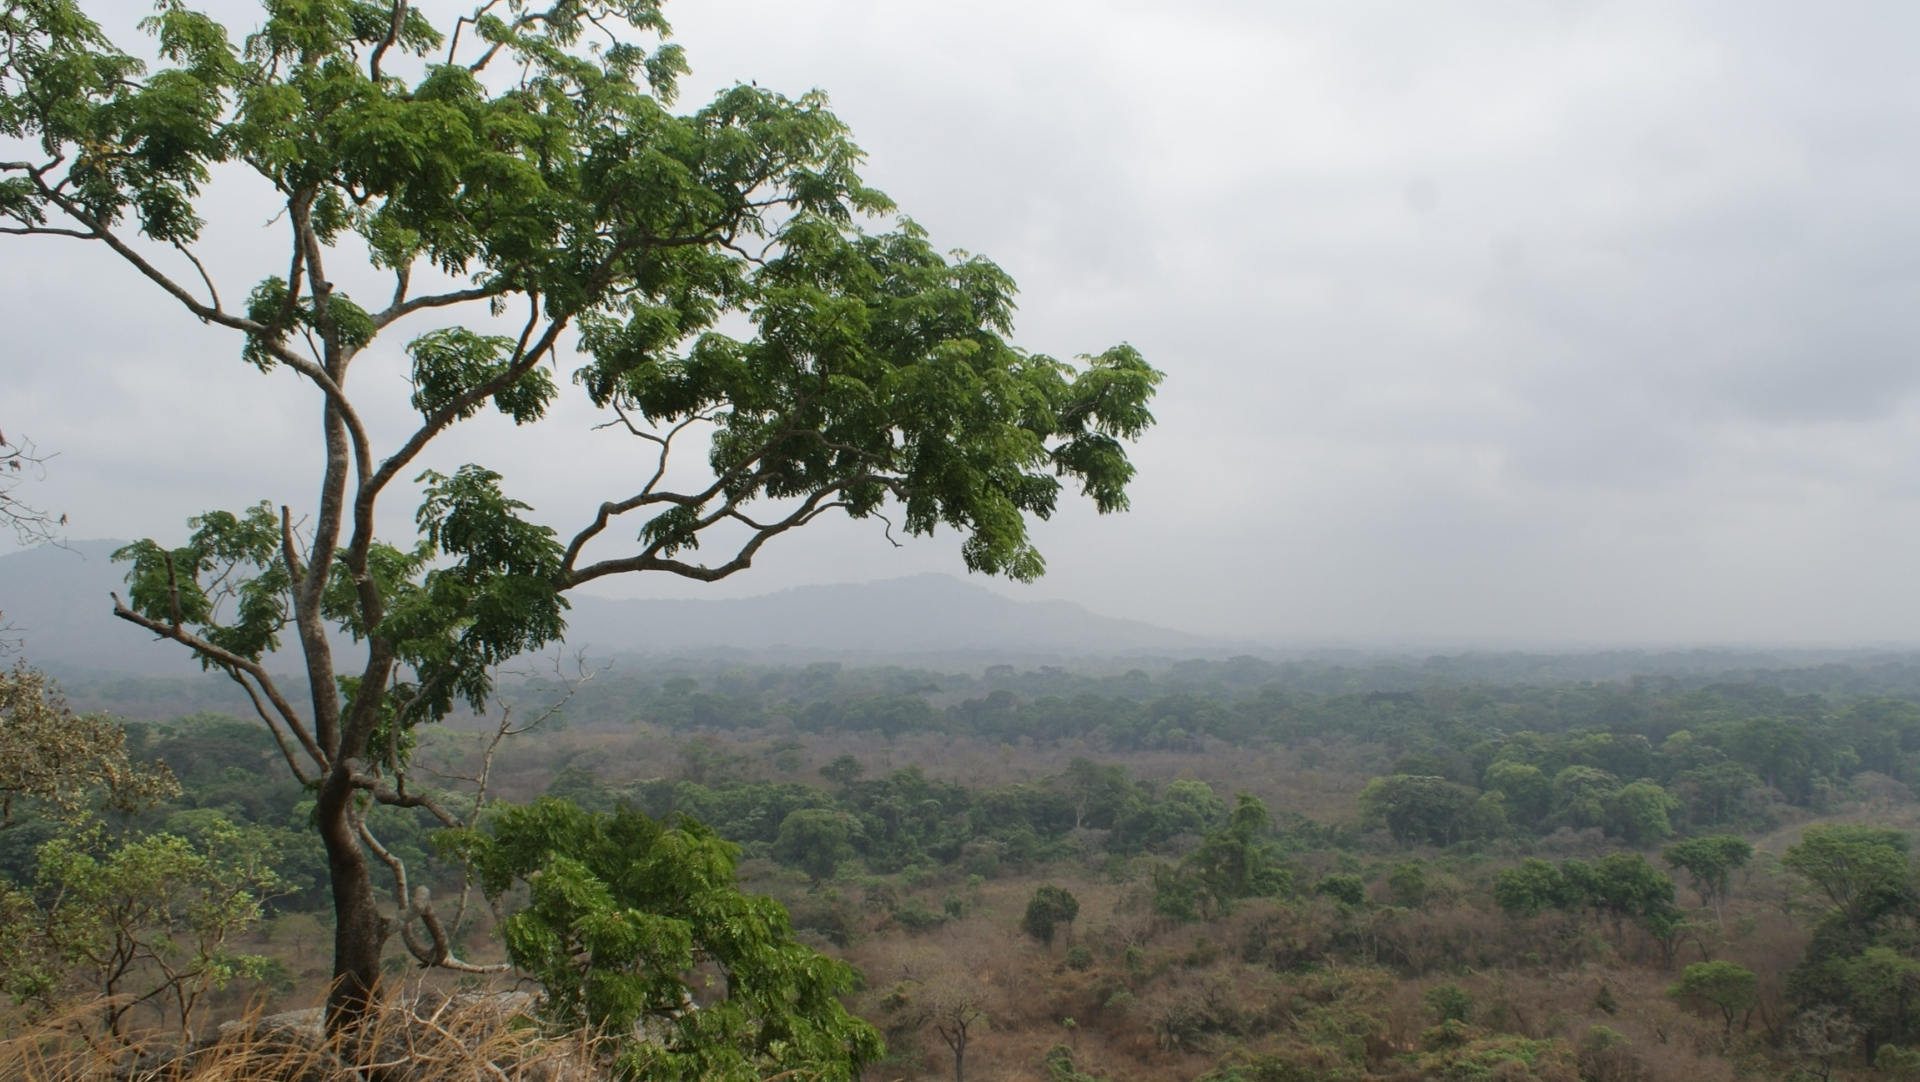
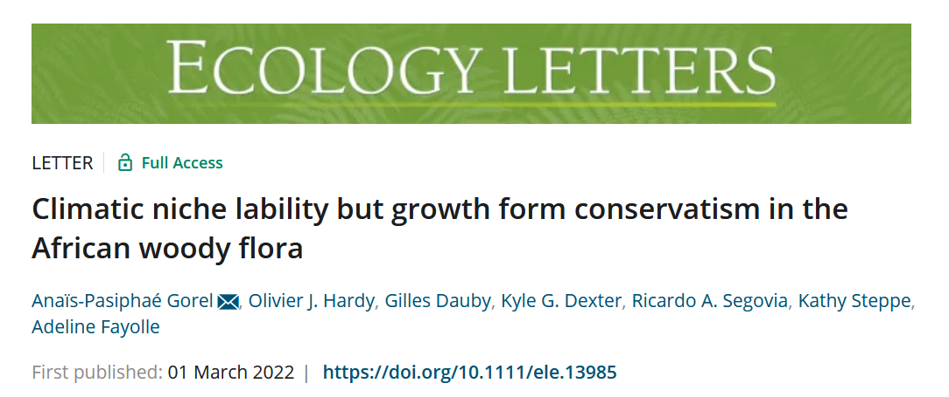
Merci!

