Slide 1
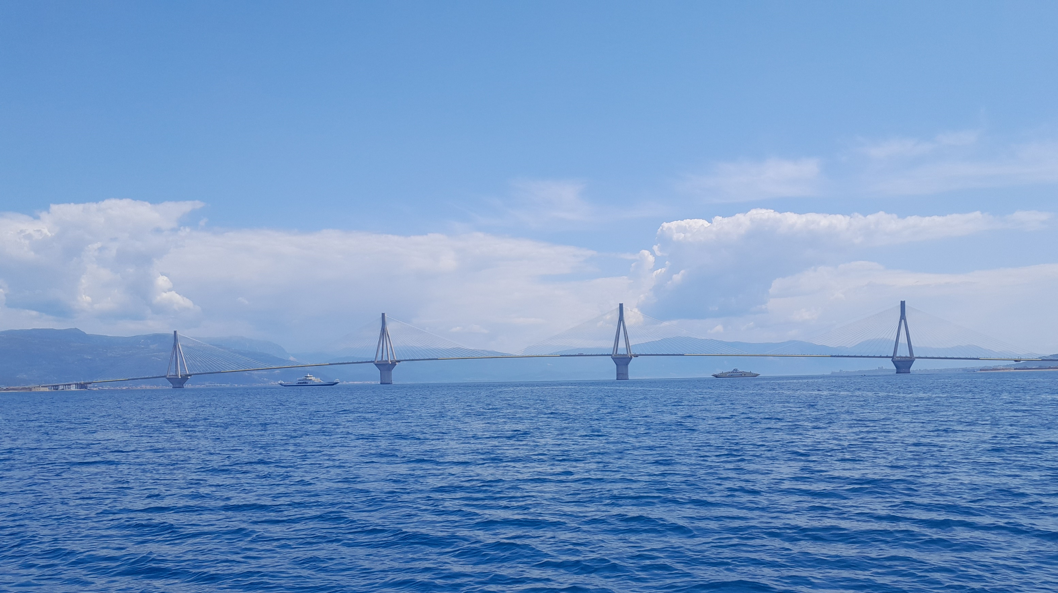
A new fully erosive end-member to the strait depositional model: the importance of strong internal tides and shallow water settings, case of the Rion-Antirion Strait (Greece)
Basile CATERINA
PhD Student – FRIA Grant - FNRS
Dpt of Geography – University of Liège
EGU 2024

Slide 2
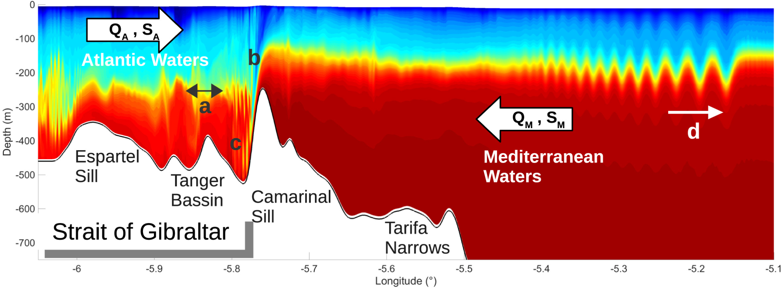
Tidal strait characteristics
Spatial change in dynamics evidenced in depositional model: dunes near the sill and erosion in the sill
Internal tide and internal waves with bathymetric thresholds
Theoretical depositional model in a tidal strait from Longhitano et al., 2013
Internal wave in Gibraltar Strait (Hilt et al., 2022)

Slide 3
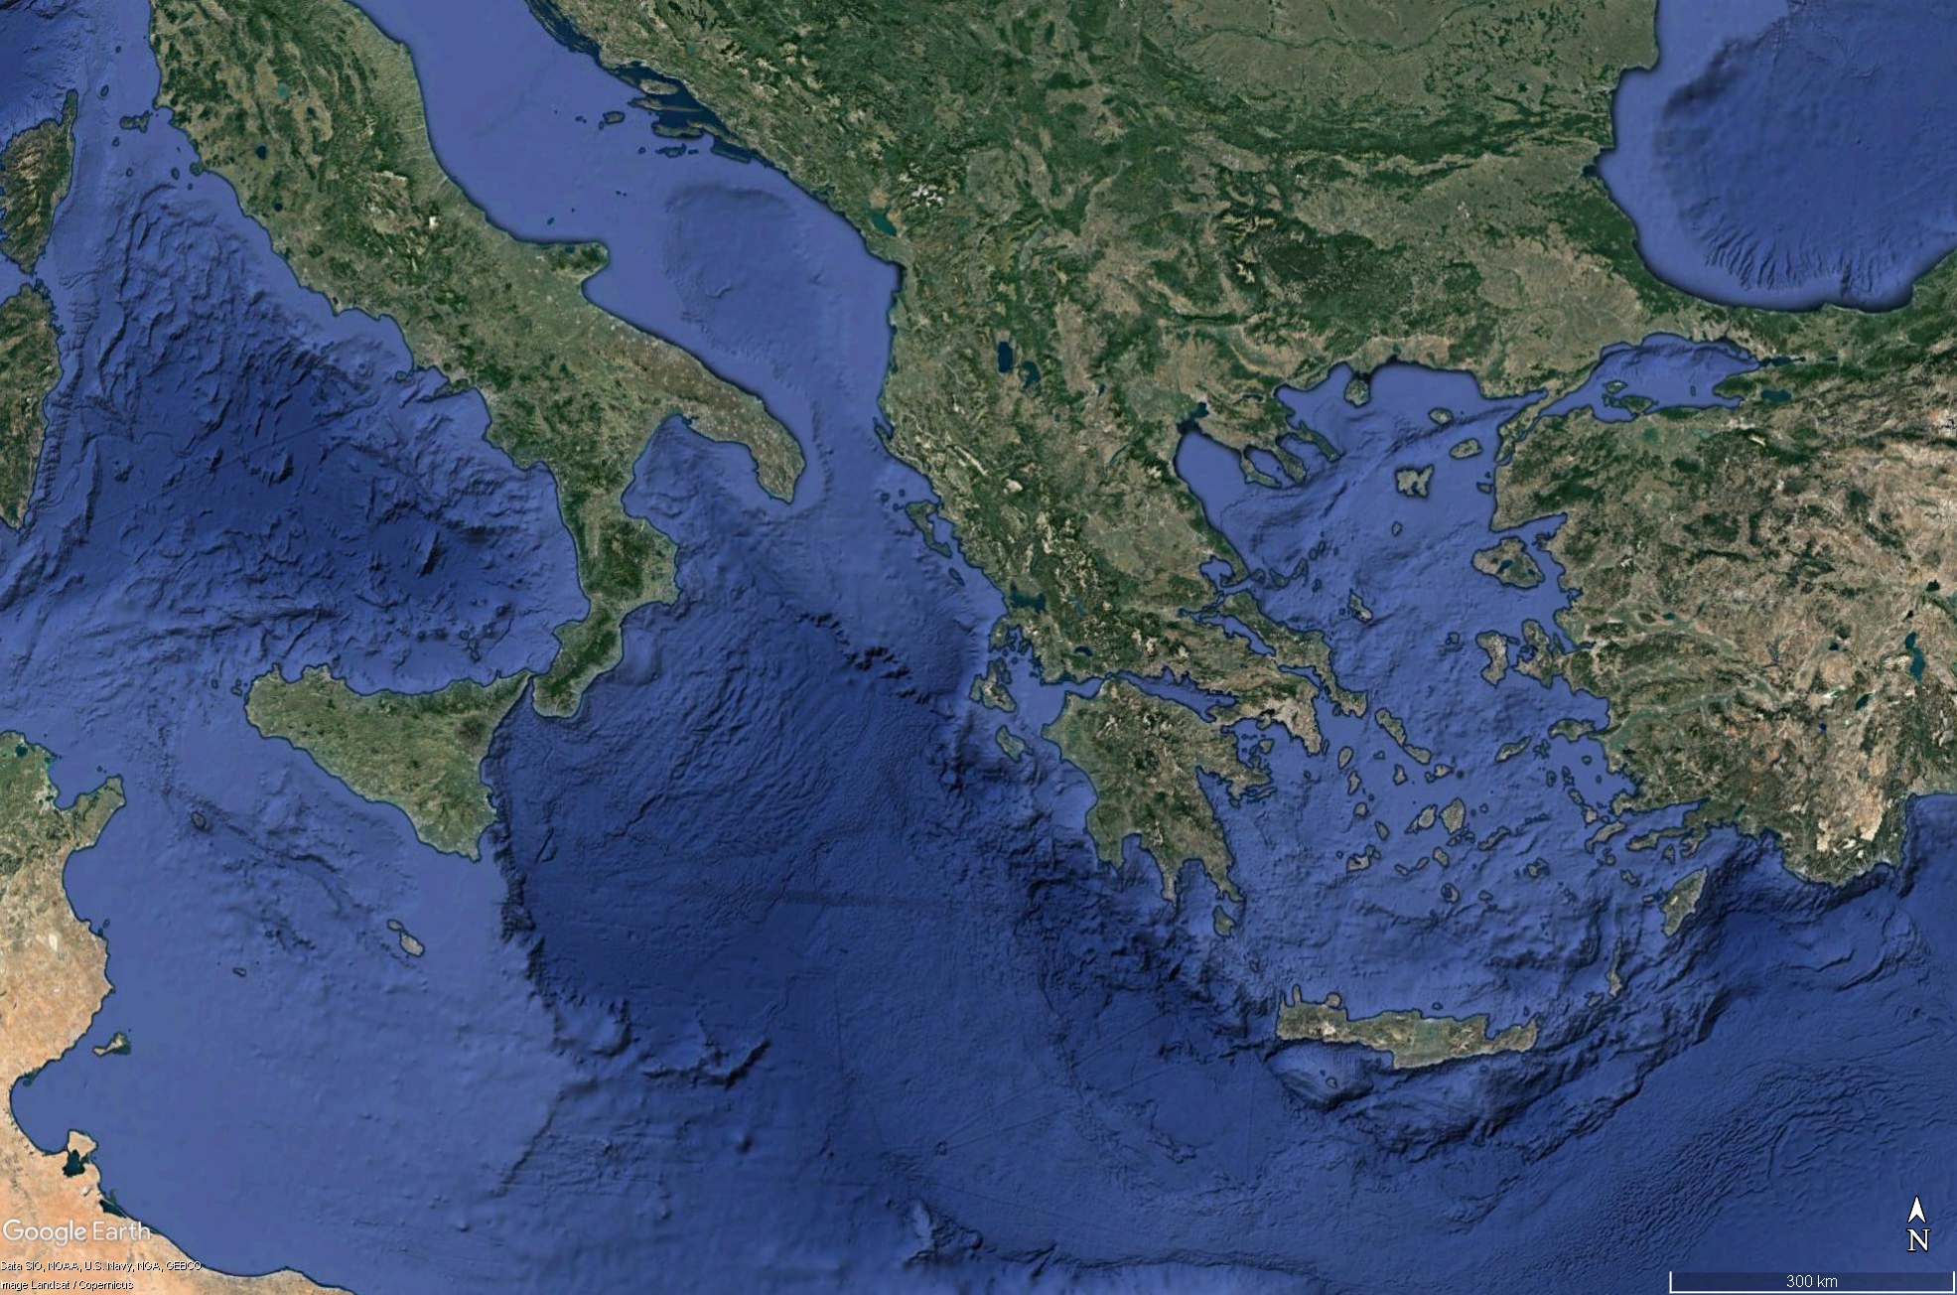
Study: The Rion-Antirion Strait
Greece
Close to Patras city, third-most populous city in Greece
Patras Gulf: “wide” and shallow (~150 m depth)
Corinth Gulf: “narrow” and deep (~900 m depth)
High dynamics in a microtidal context
Ionian Sea
Aegean Sea
Continental Greece
Patras Gulf
Rion-Antirion strait
Corinth Gulf
Peloponnesus
Localization of the study area
Notes:
Rion strait separates 2 distinct basins

Slide 4
Measure currents and link them to morphologies
Currents:
In-situ: CTD, ADCP
Remote sensing: CMEMS database, Landsat
Morphologies:
Seismic profiles (CHIRP and Sparker)
MBES (High resolution bathymetry)
Map of all the transects with seismic and ADCP data. Fault and high-resolution bathymetry map of the Rion-Antirion strait (Rubi et al., 2022)

Slide 5
No dunes… too much erosion
Notes:
We expected dunes but instead, erosion

Slide 6
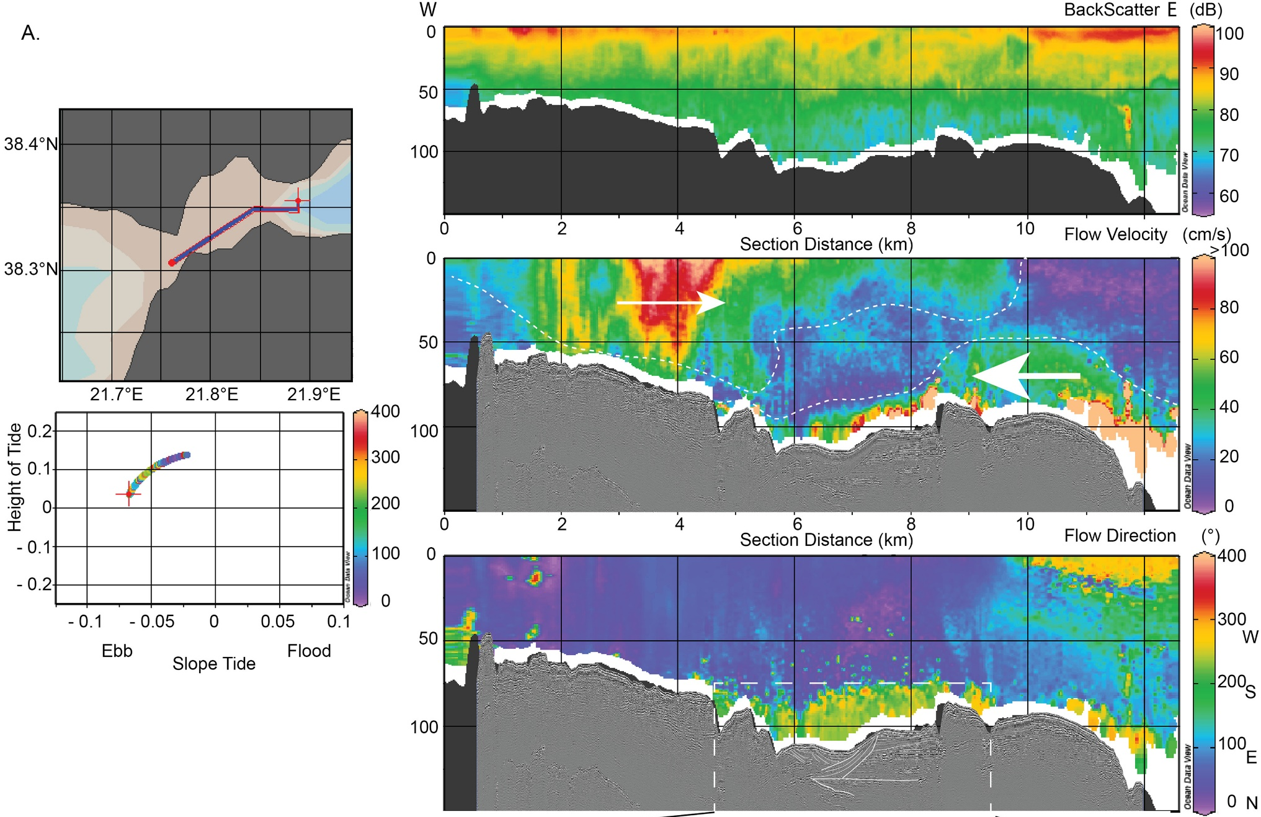
Evidence of an internal tide
Ebb tide
Surface: towards Corinth Gulf
Bottom:
internal tide due to a bathymetric threshold
High-velocity flow (up to 4m/s)
ADCP measurements during ebb tide on a longitudinal section in the Rion-Antirion Strait (Rubi et al., 2022)

Slide 7
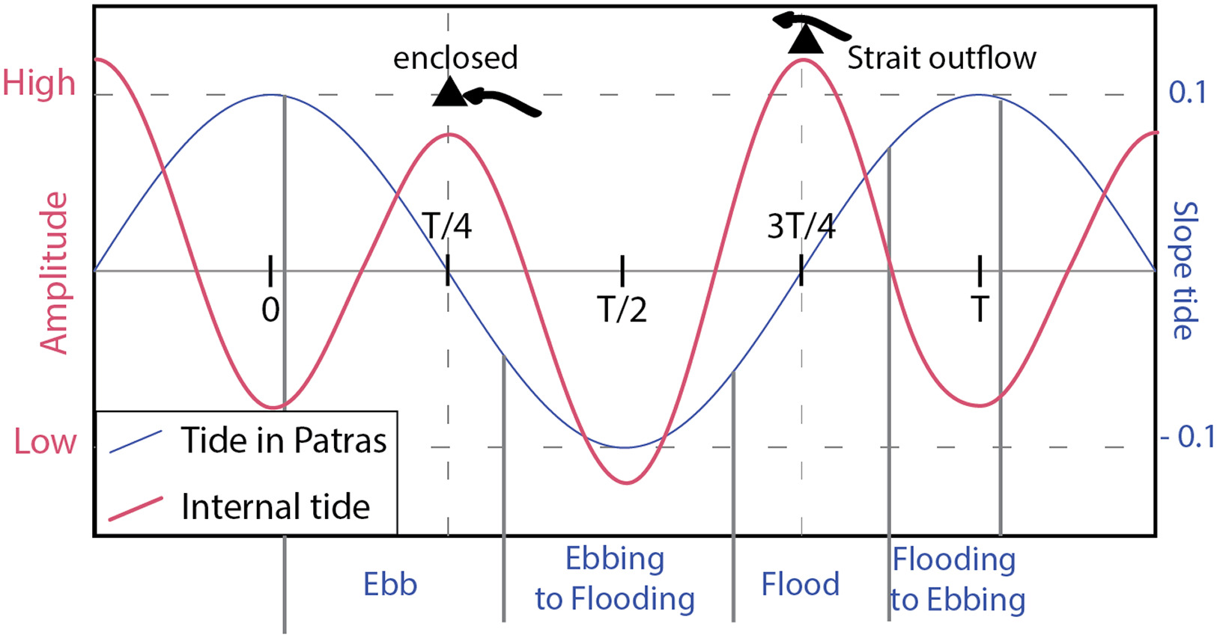
Tidal frequencies and impacts
2 different frequencies in the tides: surface vs bottom
“Crashing” or “Cascading” of the internal waves
Tidal amplitude and direction of the currents (Rubi et al., 2022)

Slide 8
Regional Oceanographic Modelling System
Forcings: Bathymetry (GEBCO), Oceanography (CMEMS), Winds (ECMWF), Tides (TPXO)
Actual conditions verified through satellite data/in-situ measurements
Technical details
High Resolution bathymetry for the strait (1,1) ~450 m
Corrected bathymetry (HR bathymetry)
Forcing at the boundaries; the rest is calculated
Masks : lakes, small bays and Aegean Sea
May 2019 and 1 year (01/01/2019 to 01/01/2020)
Adaptative depth: 32 layers

Slide 9
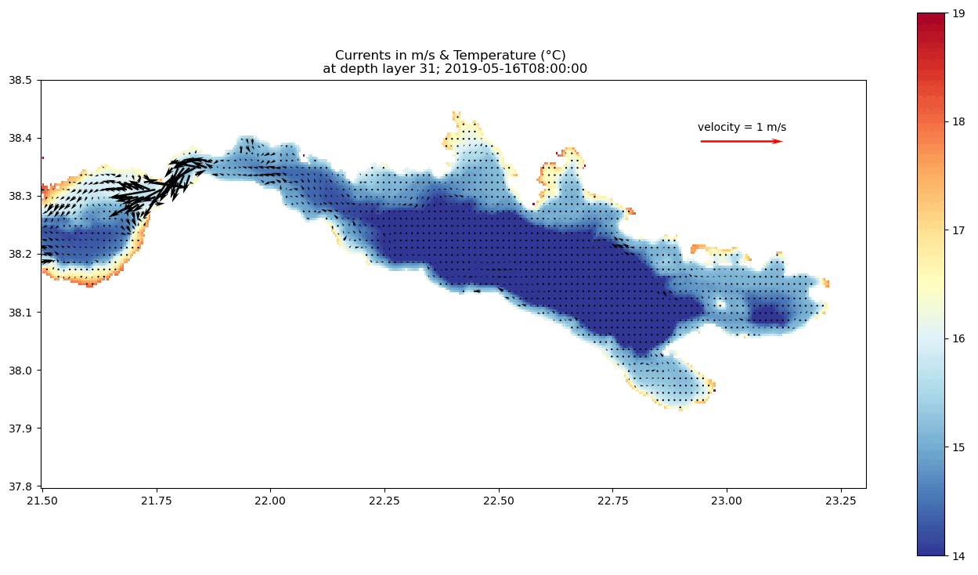
Tidal currents at depth: funnel effect
From bottom to top
Stronger currents appear at the bottom of the strait!
Funnel effect from the shape of the 2 Gulfs

Slide 10
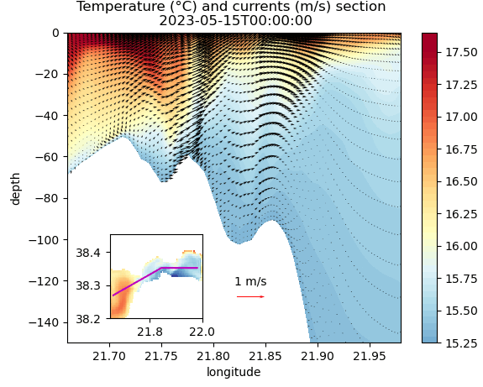
Tidal currents in the strait
“High” resolution bathymetry (~450 m/pixel)
Funnel effect
Strongest currents at the bottom of the Rion-Antirion bridge
Differences in phases between surface and bottom tidal currents
Patras Gulf
Rion bridge
Drepano spit
Notes:
Changer section avec nouvelle échelle verticale

Slide 11
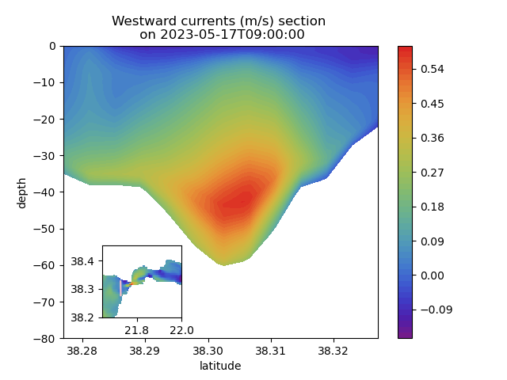
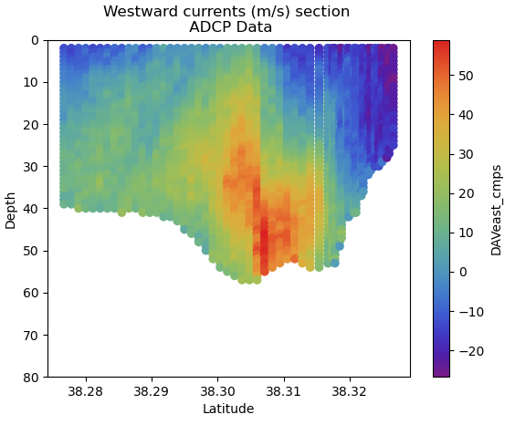
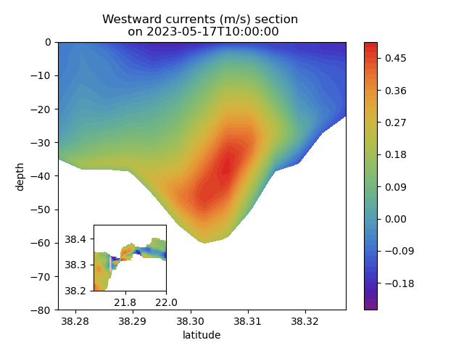
ADCP vs ROMS: Validation
Similar magnitude and position for the bottom currents
Validation: OK

Slide 12
Erosion & internal tides
Conclusions:
No dunes but erosive features
Active hydrodynamism & funnel effect: velocities > 1m/s
Internal tides frequency ≠ tide frequency
Interpreted bathymetry around Rion-Antirion strait & Amplitude of the tide and internal tide in the Strait (Rubi et al., 2022)

Slide 13
Thank you for your attention
Notes:
PAGE DE FIN 1 / Possibilité de personnaliser le texte

