Slide 1
Four variations of the decoding process in a Belgian university
D. Verpoorten, L. Milo, L. Michiels

Slide 2
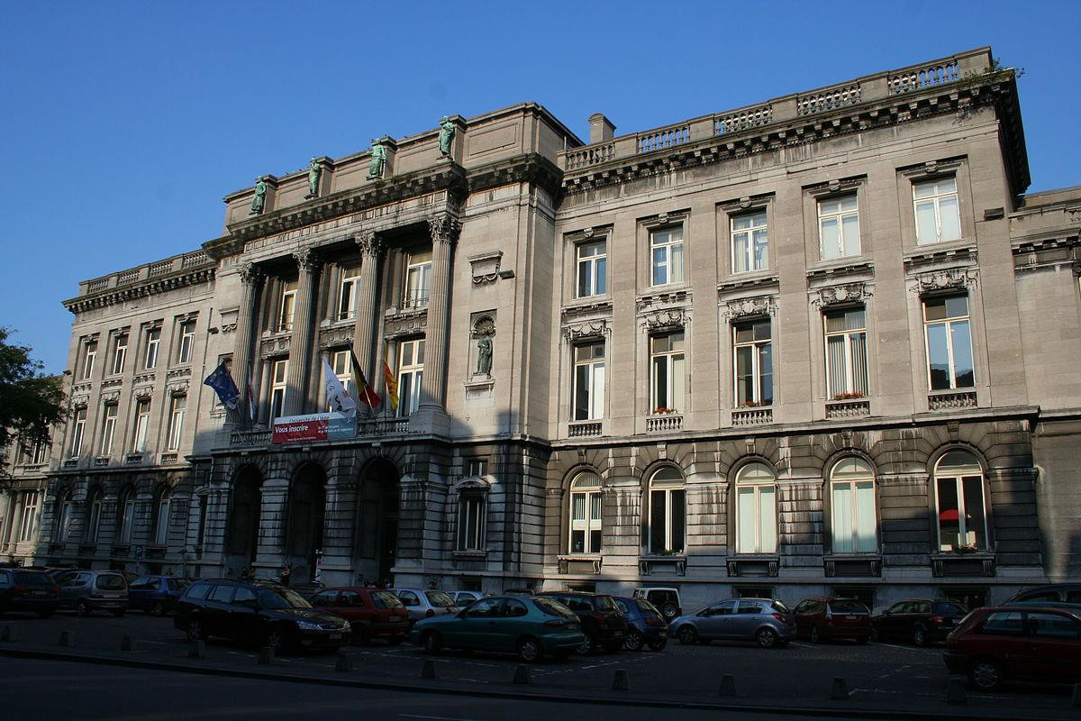
About Liège University
Public university of the French Community of Belgium
Established 1817
Academic staff: 600
Scientific staff: 2900
Students : 27,000
Location : Liège, Wallonia, Belgium

Slide 3
Institute for Training and Research in Higher Education (IFRES).
Promotion of the teaching mission;
Staff development (SoTL);
Support faculty / departments/ institution in using face-to-face and online learning/teaching modalities;
Research into higher education pedagogy.

Slide 4
The story of ULiège with bottlenecks
Pilot study
Adaptation
Implementation worshop
Digital advisors

Slide 5
Variation 1 - Pilot project (June 2016-January 2017)
Student Support Service lists 10 faculty. Invitation sent. 7 will cover the 8 steps
Presentation of the project
Feedback with online survey (perceived value and resistance)
Teachers who agreed read a wrap-up on bottlenecks
Teachers provide 2/3 bottlenecks

Slide 6
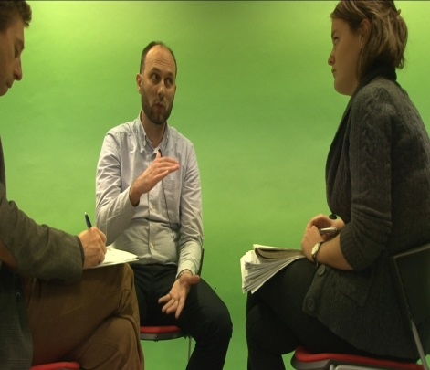
Decoding interview (2 advisors)

Slide 7
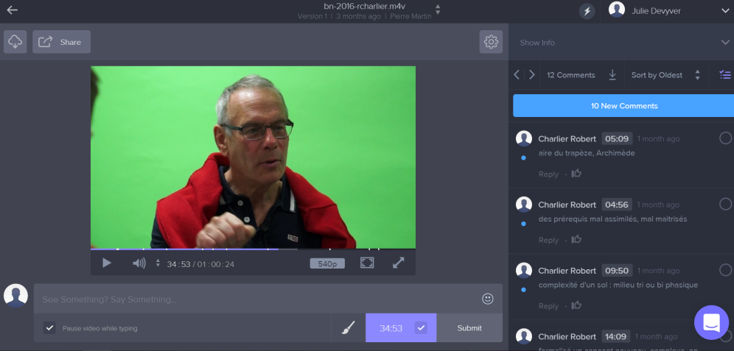
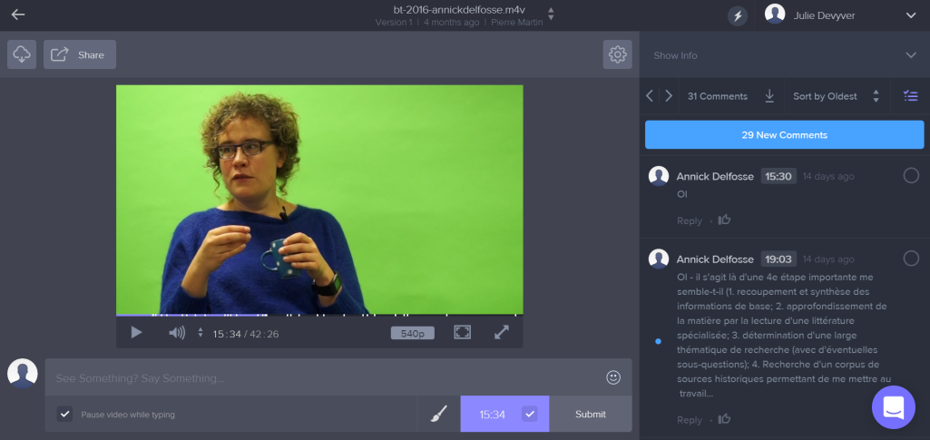
Dual analysis

Slide 8
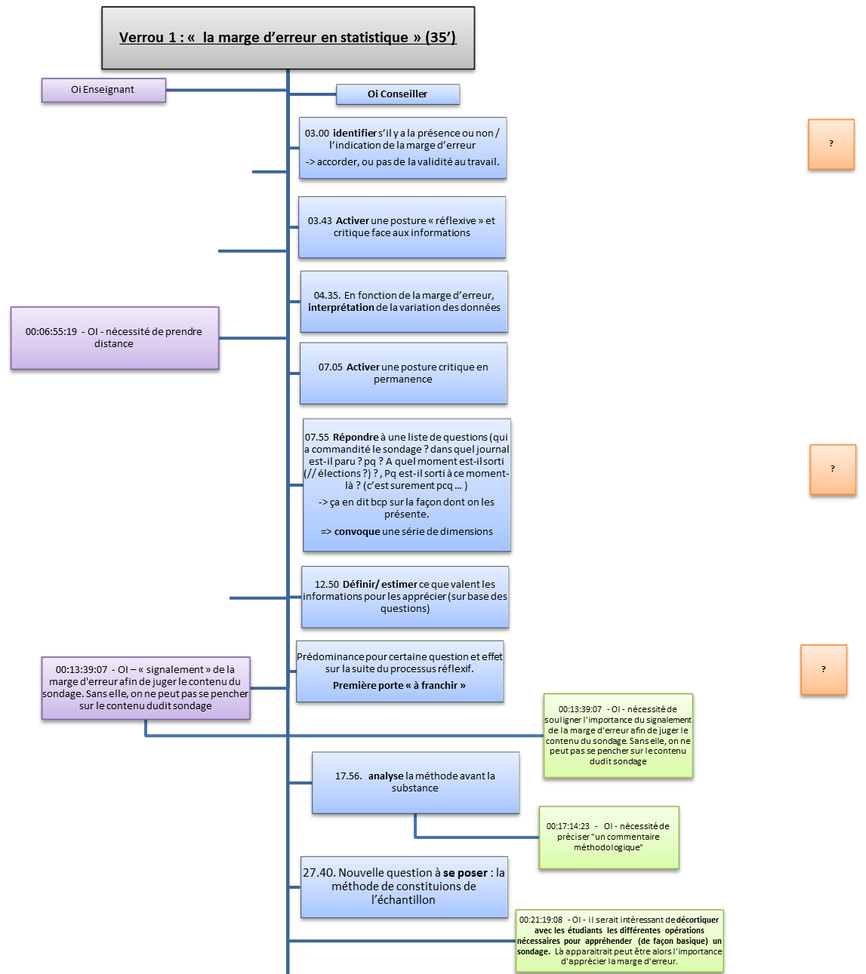
Cued debriefing (bottlenecks + feedback on the process)
16/28 bottlenecks were examined in the decoding interviews during a time period running between 4’ and 42’ (M = 19’, SD = 10). On Frame.io professors related a total of 62 mental moves to the bottlenecks while the pedagogical adviser identified 119 thereof.
Légende : Oi enseignant OI Conseiller Remarque/commentaire Piste de régulation

Slide 9
Lesson 1 - Ratio cost / benefit
First contact (15’)
Presentation (30’)
Online questionnaire (30’)
Readikng of the wrap-up (15’)
Bottlenecks identifiction (30)
Decoding interview (1H)
Dual analysis (2H)
Debriefing (1H)
=> 6 heures de travail
Positive (R. 2,3,4,5,6)

Slide 10
Lesson 2
First contact (15’)
Presentation (30’)
Online questionnaire (30’)
Readikng of the wrap-up (15’)
Bottlenecks identifiction (30)
Decoding interview (1H)
Dual analysis (2H)
Debriefing (1H)
Not a big deal to spot bottlenecks (except R.2)

Slide 11
Lesson 3
First contact (15’)
Presentation (30’)
Online questionnaire (30’)
Readikng of the wrap-up (15’)
Bottlenecks identifiction (30)
Decoding interview (1H)
Dual analysis (2H)
Debriefing (1H)
Stress from the interview (R.5) (« squash syndrom », also in SI-PASS)
Fear to reveal weaknesses as expert (R.5)
Two teachers convinced that they spontaneoulsly decode

Slide 12
Lesson 4
Time consuming
Difference between steps in a process and mental moves (R.5)
Discomfort watching oneself (R.2,3,4,5,6)
First contact (15’)
Presentation (30’)
Online questionnaire (30’)
Readikng of the wrap-up (15’)
Bottlenecks identifiction (30)
Decoding interview (1H)
Dual analysis (2H)
Debriefing (1H)

Slide 13
Lesson 4
No wish< for more
First contact (15’)
Presentation (30’)
Online questionnaire (30’)
Readikng of the wrap-up (15’)
Bottlenecks identifiction (30)
Decoding interview (1H)
Dual analysis (2H)
Debriefing (1H)

Slide 14
The story of uliege with bottlenecks
Pilot study
Adaptation (shortened, one-advisor version, stop discomfort)
Implementation worshop
Digital advisors

Slide 15
Version 2 (end 2017)
First contact (6/6 first year teachers will cover the 7 steps)
Presentation of the project
Feedback with online survey (perceived benefits and resistance)
Teachers who agreed read a wrap-up on bottleneck
Teachers provide 3/4 bottlenecks
Decoding interview one advisor
(Paired analysis replaced by a Decoding leaflet )
7. Cued debriefing (based on the Decoding leaflet)

Slide 16
The Decoding leaflet

Slide 17
Effects of adjustments
Perception : better overall satisfaction regarding time investment (also on advisors’ side)
Leaflet appreciated (written)
No teacher willing to go further (they are very polite)

Slide 18
Some text analysis on the first and second cohort
« Vous m’avez obligé, en tout amitié, à regarder avec d’autres lunettes, c’est une nouvelle source de réflexion » (R.2)
« le fait de passer par l’écrit (identification) permet de mettre en lumière des choses plus enfuies … Ça permet de rendre conscient ce que je faisais naturellement » (R.3)
« Je n’avais jamais pensé aux verrous, jamais de chez jamais, je savais qu’il y avait des choses plus compliquées mais je ne me suis jamais questionné sur ce qui pouvait être devenu un automatisme … c’est un autre angle, c’est nouveau pour moi» (R.4)
« c’était très intéressant car j’ai pris conscience que je ne prépare jamais mes cours en fonction de moi mais en fonction de ce que j’imagine … de ce que j’imagine que mes étudiants ont besoin » (R.5)
« C’est intéressant de changer de regard, et de revenir non pas sur ce que les étudiants ne savent pas faire mais sur ce que moi je fais, et parfois ce qui est difficile pour moi… et que je n’explicite pas clairement» (R.5)
« Ca me permet de mettre en perspective ces choses, de remettre en question ce que je fais » (R.6)
« on a beaucoup de discussions entre collègues, on a l’impression que le niveau baisse mais maintenant, je réalise que beaucoup de chose nous semble si simple alors qu’en fait pas du tout !» (R.6)
« Je me suis rendu compte pendant l’interview qu’en fait ce n’est peut-être pas aussi claire que ce que tu ne penses que ca l’est … et sans votre aide je n’y serais pas parvenu» (R.6)
« ça peut être différent en fonction de l’enseignant, moi dans mon cas j’essaye de faire en cours comme je ferais pour moi-même, donc ça n’a pas changer grand-chose… je leur dis déjà, moi je fais ceci…» (d’après elle, dû au fait qu’elle a quitté l’unif pendant quelques années et qu’elle y est revenue. Pour cela elle a du se remettre dans la peau d’un étudiant et se reposer ts ces questions… pour elle s’était intuitif et elle l’a décortiqué pour réussir à leur expliquer) (R.3)
« C’est le seul moment où je peux nourrir mon enseignement, pour prendre des avis extérieurs, on parle de choses auxquelles que je n’aurais pas pensé… vous avez des connaissances pédagogiques que je n’ai absolument pas… donc consacré un certain temps à cela ca m’intéresse ! Comme je vous ai dit, ca fait 10 ans que je donne le cours, et je suis encore loin de la pension donc je n’ai pas envie de donner pendant 30 ans de la même manière, donc si je peux changer des choses…» (R.4)

Slide 19
Feedback of the two committed pedagogical advisors
Both convinced by the value of the approach
Some frustration (reflection ok but effects? / to be explicit OK but action? / the unfolding of expertise OK but what about the ability to teach to novices)
(too) time-consuming
Being ignorant is a problem for one, a strenght for the other
Cost/benefit difficult to ascertain as we do not know whether changes occur
Concern about going further than step 2 of the cycle

Slide 20
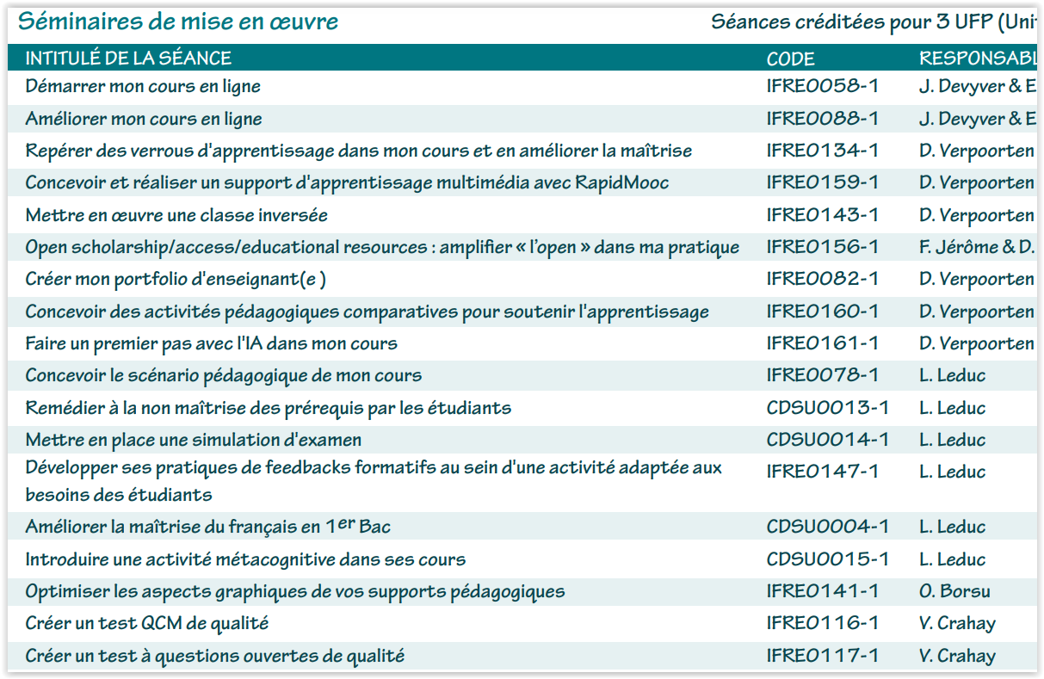
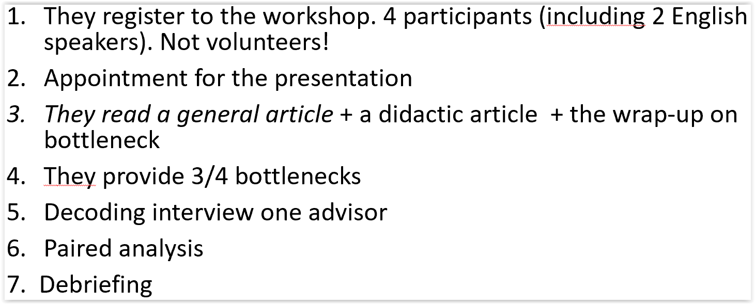
Variation 3 - Implementation workshops (6H / 2018 – 2022)
10 Compulsory Training modules about higher education pedagogy for new Teachers and T.A.s

Slide 22
Good surprises (2018 – 2022)

Slide 23
Variation 4 – Digital learning advisors
The decoding process is presented to 7 newly hired advisors (my concern here are not the teachers, not the students)
Two are interested in trying it (Faculty of philosophy & humanities / Faculty of Veterinary sciences) What is success?
After a 2 hour training session and some readings, they conduct a decoding interview
They produce a written debriefing with an emphasis on the pros and cons of the approach for their job

Slide 24
Results
+ Decoding is plugged into a major concern of teachers
+ Unusual opportunity for pedagogical depth
+ Unusual opportunity for a personnal trust relationship
+ Teacher can afford the initial request which is precise, circumscribed and not time-consuming
+ It is simple => it is complex (it breaks down into steps)
+ Teacher increases awareness of problems that might be generic (prerequisite, need to slow down…)
+ Opportunity for the teacher to verbalize solutions that may be semi-conscious or intuitive
° Several conditions for success (not so easy to gather)
- Difficult for the teacher not to think as a teacher (« risk: to invent bottlenecks »)
- Difficult for the teacher to « disagregate » own reasoning
- Challenging for the advisor not to influence/guide the reasoning

Slide 25
An extra string to advisors’ bow

Slide 26
Decoding in a larger pedagogical landscape
Treshold concepts. Done
Rich french-speaking literature on « obstacles to learning ». Where does decoding locate?
Cognitive load theory (« intrinsic load »)
Worked examples (« students overwhelmed » => Worked examples are step-by-step illustrations of the process required to complete a task or solve a problem.
Theories of (desirable?) difficulty (A desirable difficulty is a learning task that requires a considerable but desirable amount of effort, thereby improving long-term performance. Bjork & Bjork, 2020).
Productive failure theory (« learning design that intentionally designs for and uses failure in preparatory problem-solving for learning” (Kapur, 2016). To what extent should bottlenecks be eliminated?)

