Slide 1
A Multi-Scale Model to Investigate Gas Transport Processes in Clay Materials
15 April 2024 • EGU General Assembly – Session ERE5.4 • Vienna (Austria)
Gilles Corman¹ & Frédéric Collin¹
¹ University of Liège

Slide 2
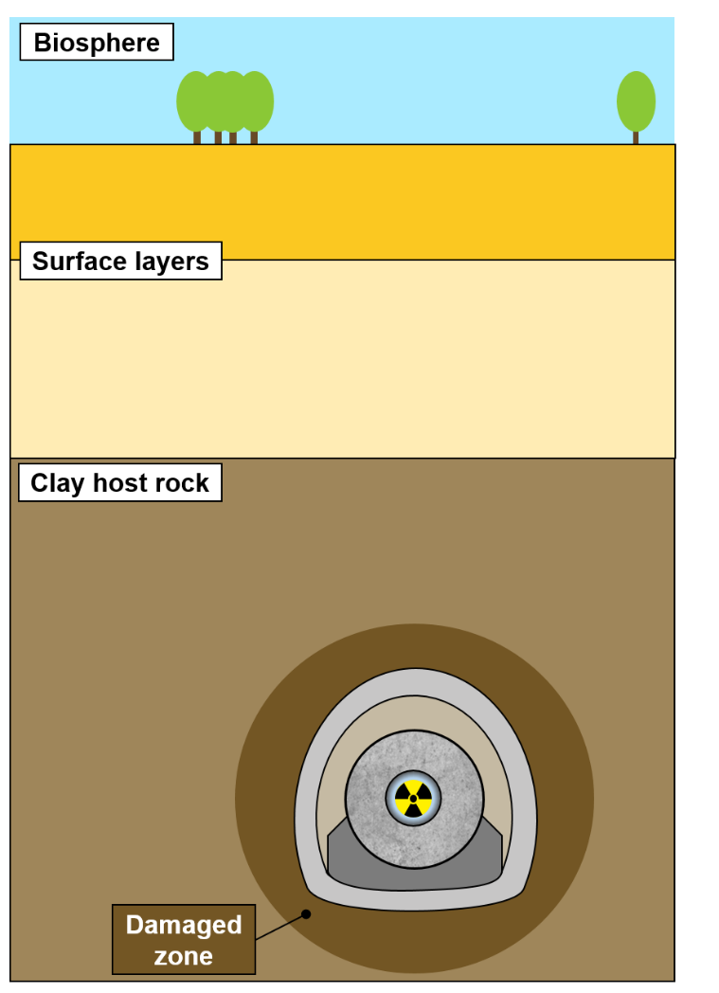
Context
Conceptual scheme of a deep geological repository.
1/10

Slide 3
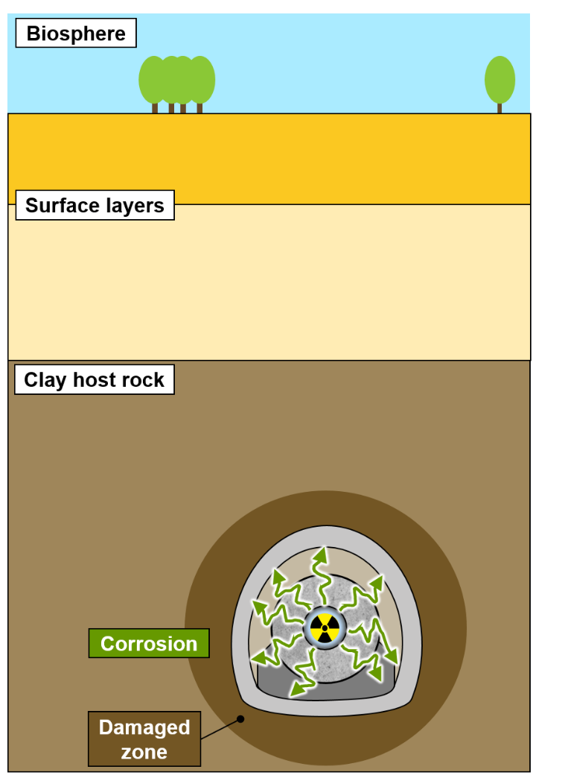
Context
Conceptual scheme of a deep geological repository.
1/10

Slide 4
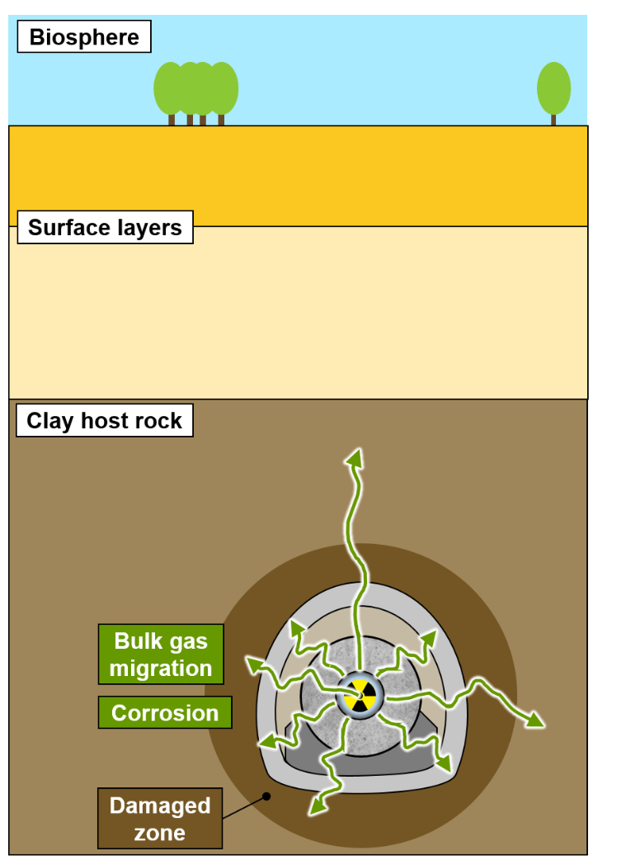
Context
Conceptual scheme of a deep geological repository.
1/10

Slide 5
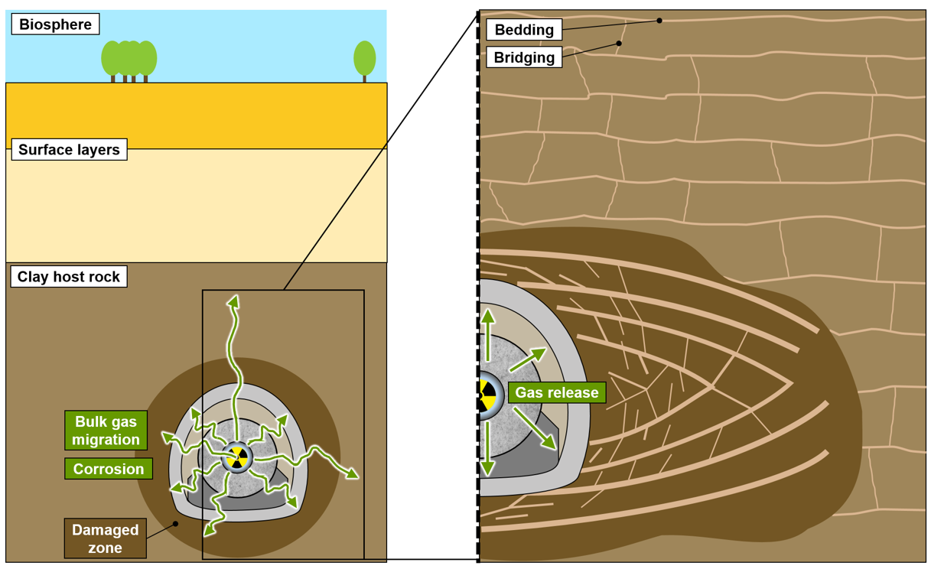
Context
Conceptual scheme of a deep geological repository.
Expected gas transport modes in the EDZ and the sound rock, inspired from Levasseur et al. (2024).
1/10

Slide 6
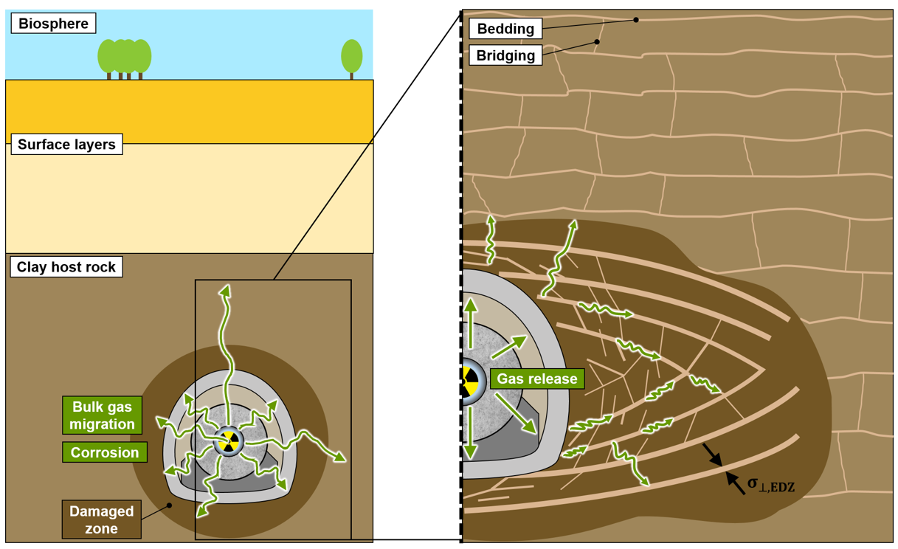
Context
Excavation Damaged Zone (EDZ)
Experimental Observation:
Modifications of the hydraulic properties induced by fracturation.
Numerical implementation:
2nd gradient H²M model.
Corman et al. (2022)
Conceptual scheme of a deep geological repository.
Expected gas transport modes in the EDZ and the sound rock, inspired from Levasseur et al. (2024).
1/10

Slide 7
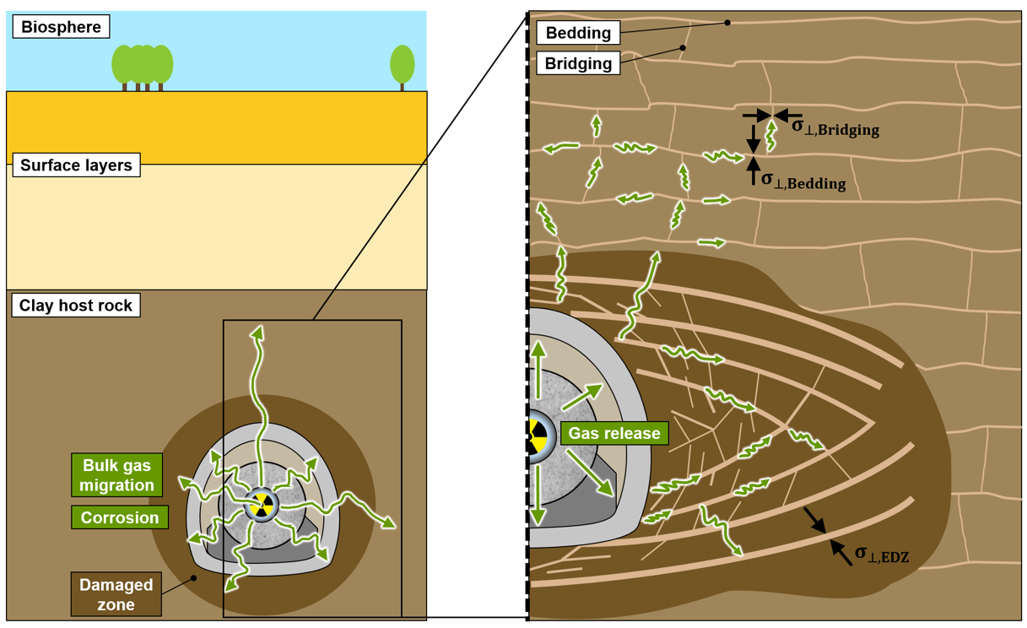
Context
Sound rock
Experimental Observation:
Microstructure-induced process.
Numerical implementation:
Hydro-Mechanical (HM) multi-scale model
Corman et al. (2024, under review)
Excavation Damaged Zone (EDZ)
Experimental Observation:
Modifications of the hydraulic properties induced by fracturation.
Numerical implementation:
2nd gradient H²M model.
Corman et al. (2022)
Conceptual scheme of a deep geological repository.
Expected gas transport modes in the EDZ and the sound rock, inspired from Levasseur et al. (2024).
1/10

Slide 8
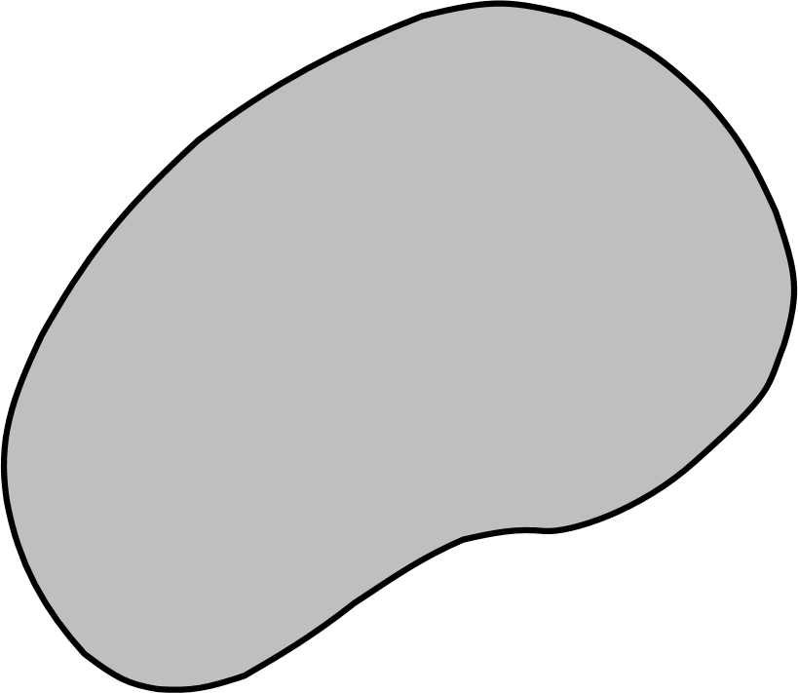
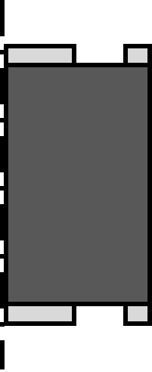
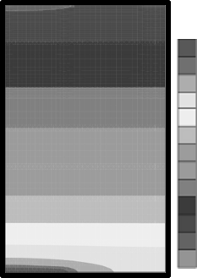
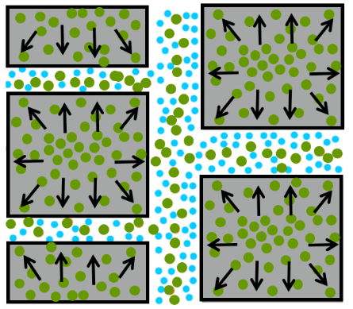
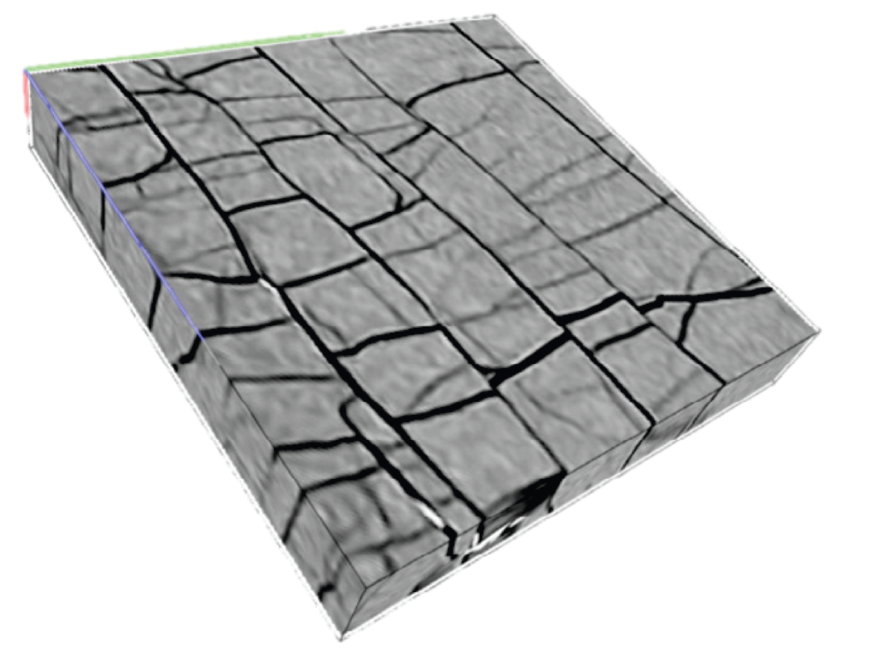


Motivation
km
m
cm
mm
$μ$m
nm
Large-scale models
Small-scale models
Repository scale
Laboratory scale
Process scale
No direct representation of local phenomena
Direct modelling of the whole microstructure
Useful for modelling at the process scale
$$Ω$$
COx sample
Sr [-]
0.998
High computational costs for upscaling
Gas
0.966
Water
Gerard et al. (2014)
From Jing et al. (2016) & Bertrand et al. (2019)
2/10

Slide 9
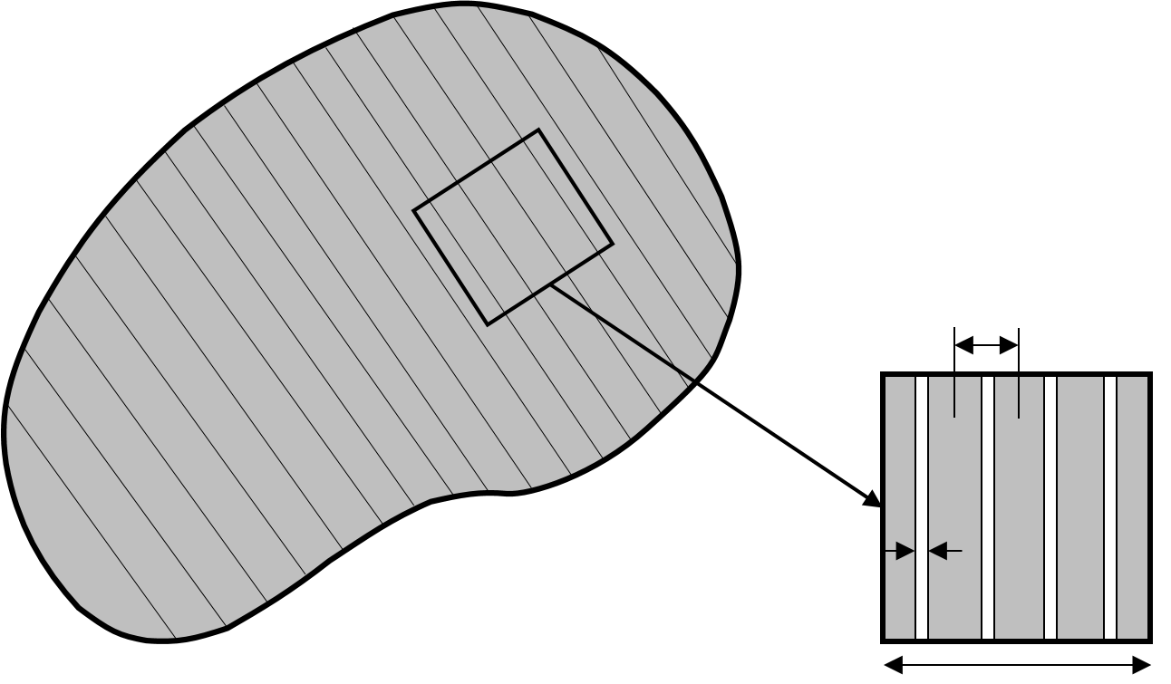
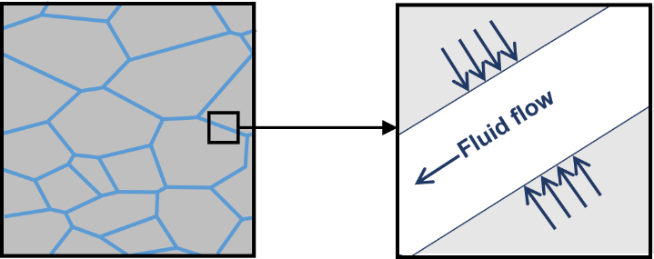
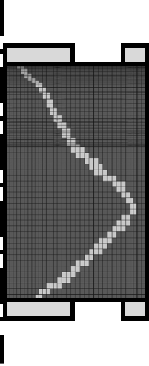
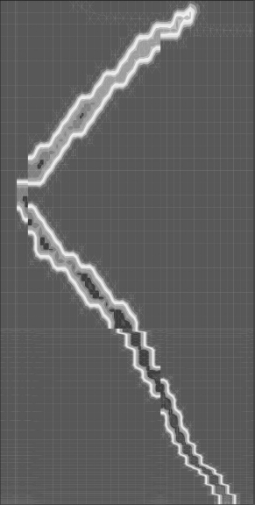


Motivation
km
m
cm
mm
$μ$m
nm
Large-scale models
Intermediate-level multi-scale models
Small-scale models
Repository scale
Laboratory scale
Process scale
No direct representation of local phenomena
Combination of the benefits from both scales
Direct modelling of the whole microstructure
Enriched with micro-mechanical effects,
e.g. embedded fracture model
Explicit description of the constituents on their specific length scale through a REV definition
Useful for modelling at the process scale
w
$$Ω$$
b
$$Ω$$
s
van den Eijnden et al. (2016)
COx sample
Sr [-]
0.998
Initial fracture in sample
High computational costs for upscaling
Very limited exploitation of the microstructure potential
Gas
0.645
Water
Gerard et al. (2014)
From Jing et al. (2016) & Bertrand et al. (2019)
2/10

Slide 10
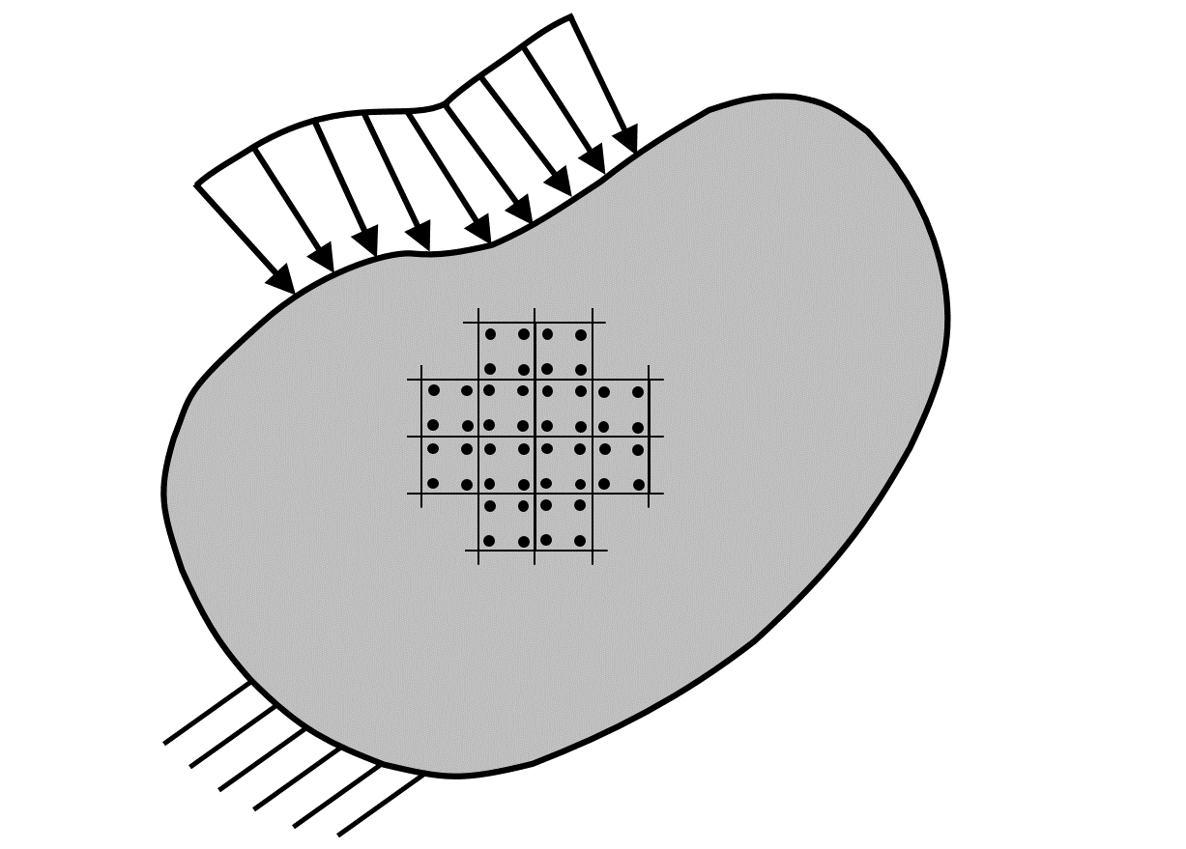
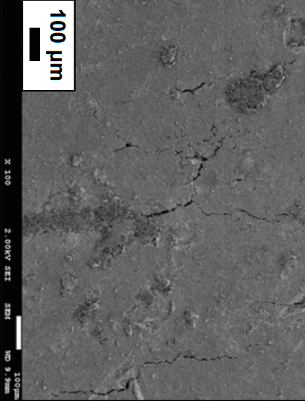

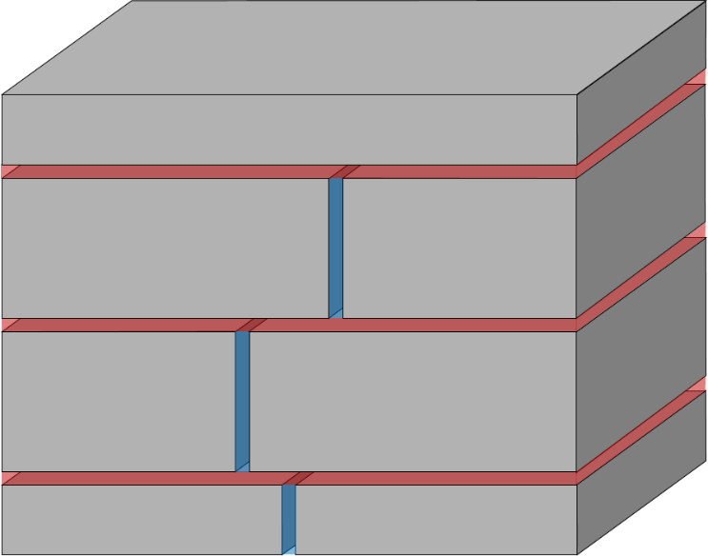
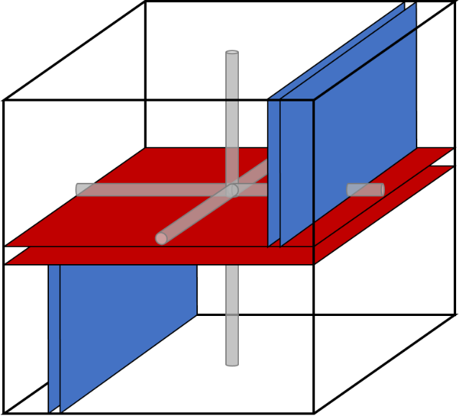

Data-supported model
FE computation
Homogenisation
FESEM
100 $μ$m
Boom clay matrix block
Bridging
Schematic representation of the macroscopic scale.
Equivalent (bundle of) tubes
Bedding
REV
w
w
w
w
REV
Localisation
w
Hydraulic system resolution
w
Internal visualisation of a Boom Clay sample using FESEM, from Gonzalez-Blanco (2017).
Physical idealisation of the microstructure.
Definition of the representative element volume (REV).
3/10

Slide 11
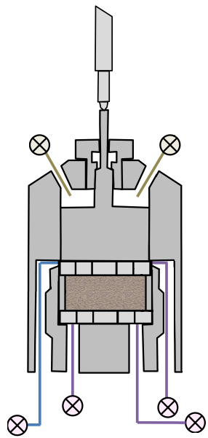
Modelling gas injection tests
Problem statement
Downstream reservoir
0.017m
Boom Clay Sample
0.020m
Upstream reservoir
0.034m
0.025m
Gonzalez-Blanco (2017)
4/10

Slide 12









Modelling gas injection tests
Problem statement
$$p_{w}=0.6MPa$$
$$p_{g}=0.1MPa$$
$$σ_{y}=6.1MPa$$
Downstream reservoir
$$p_{l}=0.6MPa$$
$$p_{l}=0.6MPa$$
$$p_{l}=0.6MPa$$
$$p_{l}=1.6 MPa$$
0.017m
$$p_{l}=1.0 MPa$$
Boom Clay Sample
0.020m
Air dissipation
Air dissipation
Upstream reservoir
0.034m
Water replaced by air
Air injection
$$p_{g}=0.6MPa$$
$$p_{g}=4.1 MPa$$
Impermeable
Impermeable
$$p_{w}=0.6MPa$$
$$p_{g}=0.1MPa$$
0.025m
Gonzalez-Blanco (2017)
4/10

Slide 13
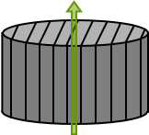
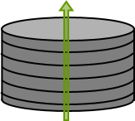
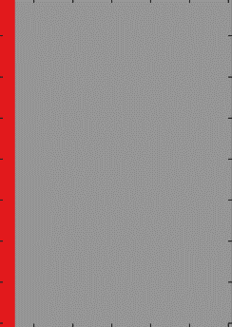
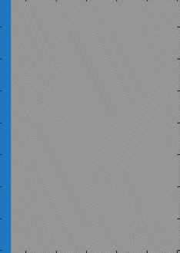
Modelling gas injection tests
Problem statement
REV
ZFD
REV
ZFD
$$σ_{y}=6.1MPa$$
$$p_{w}=0.6MPa$$
$$p_{g}=0.1MPa$$
Downstream reservoir
0.017m
Bundle of tubes
Undisturbed Boom Clay
Bundle of tubes
Undisturbed Boom Clay
Bedding plane
Bedding plane
Bridging plane
Bridging plane
ZFD
Boom Clay Sample
0.020m
Undisturbed
ZFD
Undisturbed
ZFD
2 MPa
Upstream reservoir
Range of effective stress
0.034m
6 MPa
$$p_{w}=0.6MPa$$
$$p_{g}=0.1MPa$$
0.025m
5/10

Slide 14
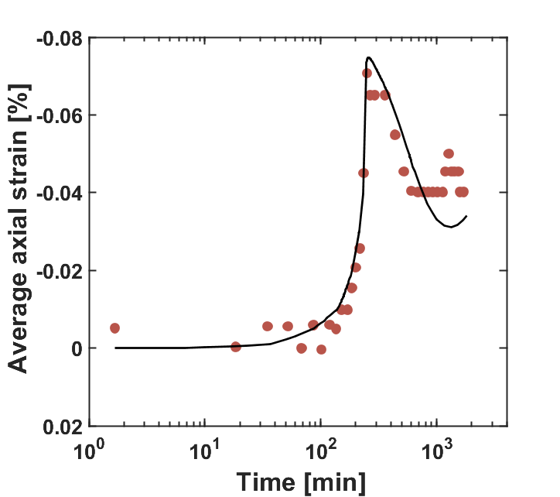
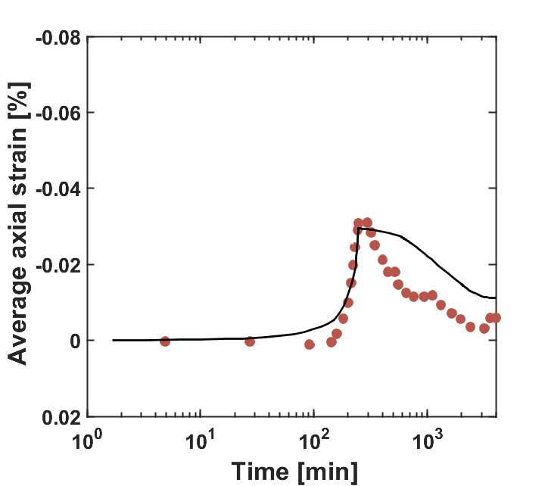
Modelling gas injection tests
Results
Downstream reservoir
Gonzalez-Blanco (2017)
Numerical fitting
Gonzalez-Blanco (2017)
Numerical fitting
ZFD
Upstream reservoir
Injection
Dissipation
Injection
Dissipation
6/10

Slide 15
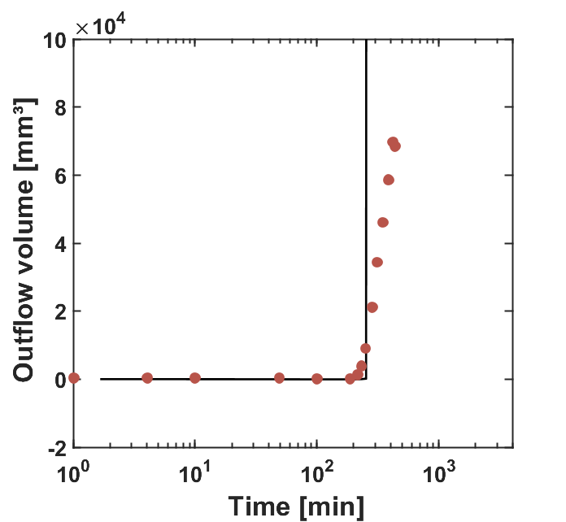
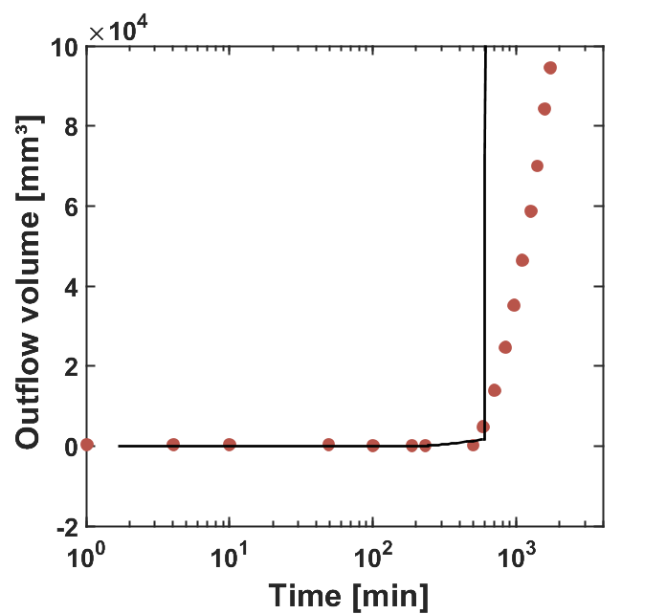
Modelling gas injection tests
Results
Downstream reservoir
Gonzalez-Blanco (2017)
Numerical fitting
Gonzalez-Blanco (2017)
Numerical fitting
ZFD
Boom Clay Sample
Upstream reservoir
Injection
Dissipation
Injection
Dissipation
6/10

Slide 16
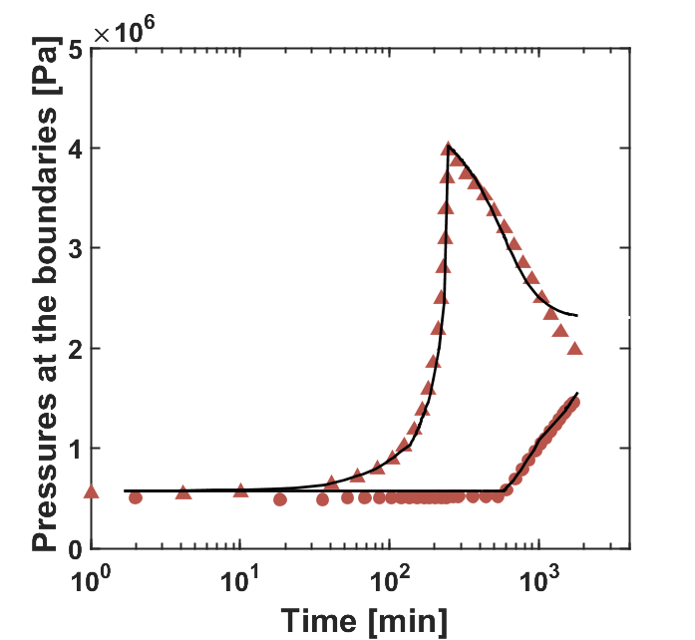
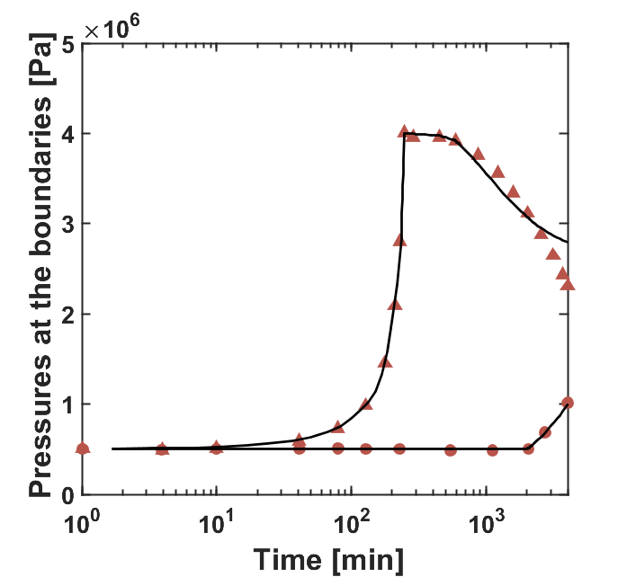
Modelling gas injection tests
Results
Downstream reservoir
Injection
Dissipation
Injection
Dissipation
Gonzalez-Blanco (2017)
Numerical fitting
Gonzalez-Blanco (2017)
Numerical fitting
ZFD
Boom Clay Sample
Upstream reservoir
6/10

Slide 17
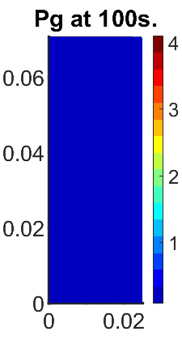
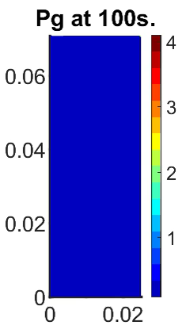
Modelling gas injection tests
Results
[MPa]
[MPa]
Downstream reservoir
ZFD
Boom Clay Sample
Upstream reservoir
7/10

Slide 18
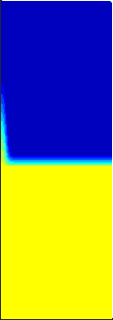
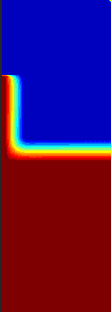
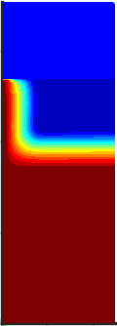
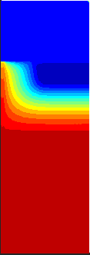
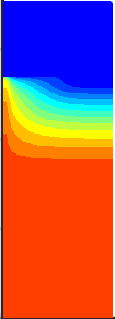
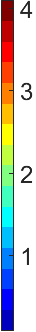
Modelling gas injection tests
Results
Pg
[MPa]
Downstream reservoir
ZFD
Boom Clay Sample
Upstream reservoir
Start injection
Breakthrough
Around 55000s
Air dissipation
7/10

Slide 19
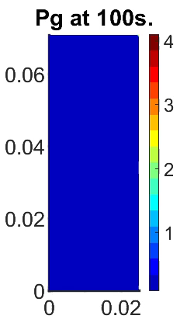
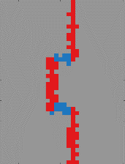
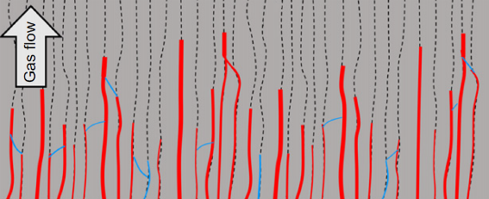
Modelling gas-filled pathways
Plane strain configuration
ZFD
[MPa]
Downstream reservoir
ZFD
Conceptualisation
Upstream reservoir
Undisturbed Boom Clay
Disturbed bridging planes
Disturbed bridging planes
Undamaged planes
Gas flow conceptualisation, from Gonzalez-Blanco (2017).
8/10

Slide 20
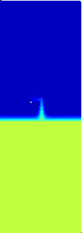
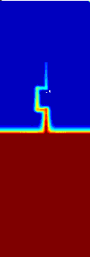
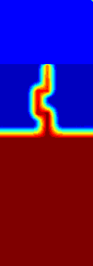
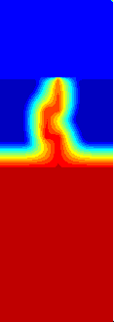
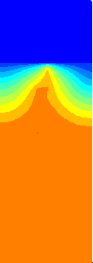
Modelling gas-filled pathways
Plane strain configuration
Pg
[MPa]
Downstream reservoir
ZFD
Upstream reservoir
Start injection
Breakthrough
Around 50000s
Air dissipation
8/10

Slide 21
Modelling gas-filled pathways
Up-scaled configuration
Downstream reservoir
Boom Clay
Matrix
Upstream reservoir
9/10

Slide 22
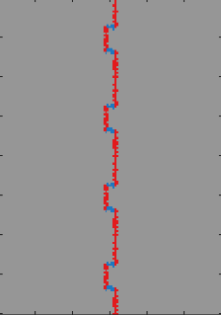
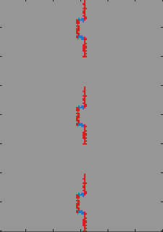
Modelling gas-filled pathways
Up-scaled configuration
Downstream reservoir
ZFD
Boom Clay
Matrix
ZFD
Upstream reservoir
Undisturbed Boom Clay
Disturbed bridging planes
Disturbed bridging planes
9/10

Slide 23
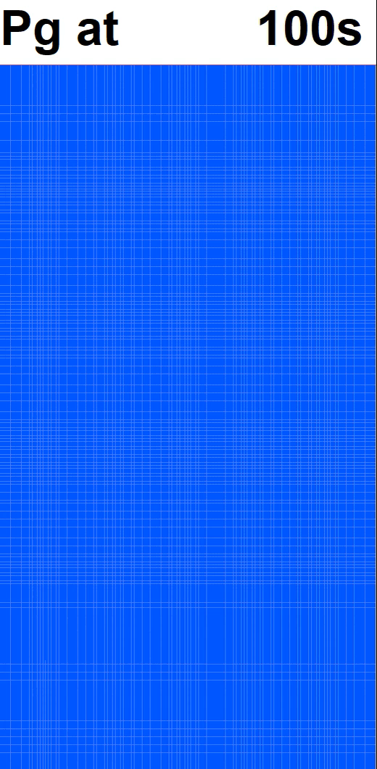
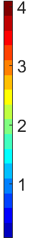
Modelling gas-filled pathways
Up-scaled configuration
[MPa]
Downstream reservoir
ZFD
Boom Clay
Matrix
ZFD
Upstream reservoir
Undisturbed Boom Clay
Disturbed bridging planes
Disturbed bridging planes
9/10

Slide 24




Modelling gas-filled pathways
Up-scaled configuration
[MPa]
Downstream reservoir
ZFD
Boom Clay
Matrix
Start injection
Breakthrough
Around 100000s
Air dissipation
ZFD
Upstream reservoir
Undisturbed Boom Clay
Disturbed bridging planes
Disturbed bridging planes
9/10

Slide 25

Modelling gas-filled pathways
Up-scaled configuration
[MPa]
Downstream reservoir
ZFD
Boom Clay
Matrix
Start injection
Breakthrough
Around 100000s
Air dissipation
[MPa]
ZFD
Upstream reservoir
Undisturbed Boom Clay
Disturbed bridging planes
Disturbed bridging planes
9/10

Slide 26




Modelling gas-filled pathways
Up-scaled configuration
[MPa]
Downstream reservoir
ZFD
Boom Clay
Matrix
Start injection
Breakthrough
Around 100000s
Air dissipation
[MPa]
ZFD
Upstream reservoir
Undisturbed Boom Clay
Disturbed bridging planes
Disturbed bridging planes
Start injection
9/10

Slide 27


Conclusions
The multi-scale HM coupled model is able to…
Simply idealise the microstructure of a clayey rock with fractures and tubes
Disturbed planes
Clay sample
10/10

Slide 28







Conclusions
The multi-scale HM coupled model is able to…
Simply idealise the microstructure of a clayey rock with fractures and tubes
Reproduce the mechanisms inherent to gas migrations in sound rocks by taking into account advanced HM couplings
Advection and diffusion of dissolved gas
Gas flow in preferential pathways
Disturbed planes
Clay sample
Low gas pressure
High gas pressure
10/10

Slide 29
Thank you for your attention
15 April 2024 • EGU General Assembly – Session ERE5.4 • Vienna (Austria)
Gilles Corman¹ & Frédéric Collin¹
¹ University of Liège

Slide 30
References
Levasseur et al. (2024), State of the Art on Gas Transport in Clayey Materials. Deliverable D6.2 of the HORIZON 2020 project EURAD, WP GAS.
P. Gerard et al (2014), Modelling of localised gas preferential pathways in claystone, International Journal of Rock Mechanics and Mining Sciences, 67:104-114.
S. Olivella, EE. Alonso (2008), Gas flow through clay barriers. Géotechnique, 58:157-68.
L. Gonzalez-Blanco (2017), Gas migration in Deep Argillaceous Formations: Boom Clay and Indurated Clays, Doctoral thesis, Universitat Politècnica de Catalunya.
H. Yu, Y. Zhu, X. Jin, H. Liu, H. Wu (2019), Multiscale simulations of shale gas transport in micro/nano-porous shale matrix considering pore structure influence, Journal of Natural Gas Science and Engineering, Volume 64, Pages 28-40.
F. Bertrand (2019), Hydro-mechanical modelling of multiphase flow in naturally fractured coalbeds applied to CBM recovery or CO2 storage, Doctoral thesis, University of Liège.
P. Bésuelle, G. Viggiani, JJM. Desrues, C. Pascal (2014), A Laboratory Experimental Study of the Hydromechanical Behavior of Boom Clay, Rock Mechanics and Rock Engineering.
G. Volckaert, L. Ortiz, P. De Canniere, M. Put, S.T. Horseman, J.F. Harrington, V. Fioravante, M. Impey (1995), MEGAS Modelling and experiments on gas migration in repository host rocks. EUR 16235 MEGAS Final Report Phase 1, p.464.
S. Yuster et al. (1951), Theoretical considerations of multiphase flow in idealized capillary systems, In Proceedings of the 3rd World Petroleum Congress, Section II, The Hague, Volume 2, Pages 437-445.
R.E. Goodman (1976), Methods of geological engineering in discontinuous rocks.
M. T. Van Genuchten (1980), A closed-form equation for predicting the hydraulic conductivity of unsaturated soils. Soil science society of America journal, 44(5):892–898.

Slide 31
Appendices
15 April 2024 • EGU General Assembly – Session ERE5.4 • Vienna (Austria)
Gilles Corman¹ & Frédéric Collin¹
¹ University of Liège

Slide 32



Experimental evidences
Changes in Boom Clay pore size distribution after air injection, and corresponding FESEM images with zooms on the detected fissures, modified after Gonzalez-Blanco et al. (2022)
Fissured material

Slide 33

Multi-scale modelling approach
Overview
Macro-to-micro scale transition: Localisation of the macro-scale deformations to the micro-scale
Resolution of the boundary value problem at the micro-scale
Micro-to-macro scale transition: Homogenisation of the micro-scale stresses to compute the macroscopic quantities
Resolution of the boundary value problem at the macro-scale
Conceptual scheme of the iterative process for the multiscale model
Hybrid developed tool
Complete hydraulic system implemented and solved at the micro-scale
Mechanical effects addressed at the macro-scale and implicitly integrated at the lower scale through HM couplings

Slide 34






Multi-scale modelling approach
Model formulation at the macroscopic scale
Clay material treated as a porous medium
Balance equations
Momentum
Water
Gas
Constitutive equations
Total stress definition
Variation of solid density
Unsaturated triphasic porous medium and definition of phases and species

Slide 35





Multi-scale modelling approach
Macro-to-micro scale transition: Localisation
Decomposition of the micro-kinematics:
Macro-pressure fields ($□^{M}$) of water and gas must be identical to the micro-quantities ($□^{m}$) for any point of the material
For any point $P$ close to $\hat{P},$
at the macroscopic scale:
at the microscopic scale:
Separation of scales
Approach restricted to situations where the variations of the macroscopic fields is large compared to the variations of micro-scale fields
Higher-order terms neglected
Fluctuation fields to replace higher-order terms

Slide 36

Multi-scale modelling approach
Micro-scale boundary value problem
Balance equations at the micro-scale
Water
Mechanical effects: computed at the macro-scale and transferred to the micro-scale through HM couplings
Balance equations at the micro-scale
Gas
Variations of fluid contents
Mass flows

Slide 37








Multi-scale modelling approach
Micro-scale boundary value problem
Constitutive equations: Hydraulic problem considering a channel flow model (Navier-Stokes equations)
Advective component:
Diffusive component
Laminar fluid flow profiles between two parallel plates
Laminar fluid flow profiles in a circular pipe
Gas flow in between of water flows in a circular pipe
Gas flow in between of water flows in a fracture space

Slide 38





Multi-scale modelling approach
Micro-scale boundary value problem
Constitutive equations: Hydro-mechanical couplings
Stress-dependent evolution of micro-elements aperture
Stress-dependent formulation of the transmissivity and the entry pressure of micro-elements
Constitutive law describing the normal behaviour of a rough rock joint, Cerfontaine (2015)
Definitions of the hydraulic and the mechanical aperture in reality (left) and in the modelling (right), Marinelli (2016)

Slide 39

Multi-scale modelling approach
Micro-scale boundary value problem
General principles for numerical resolution of the hydraulic system
Hydraulic network respecting these conditions:
  Anti-symmetric boundary fluxes
  Macroscopic pressure gradient between the boundaries
Hydraulic problem established through mass balance on each node (j)
Hydraulic problem solved
  For a given configuration
  Under steady-state conditions
  By applying the macro-pressure to one node
Example of a channel network with the mass balance on node j

Slide 40



Multi-scale modelling approach
Micro-to-macro scale transition: Homogenisation
Fluid fluxes
Fluid masses: total amount of fluids inside the fractures and tubes

Slide 41

Multi-scale modelling approach
Macro-scale boundary value problem
Under matrix form:
Summarized as:

Slide 42














Modelling gas injection tests
$$k_{y}={1∙10}^{−19}m^{2}$$
Characterisation of the microstructure parameters
Experimental estimations of bedding plane separation, from Gonzalez-Blanco (2017)
$$y$$
$$h$$
FESEM | $μ$-CT
150 – 270 $μm$ | 410 – 560 $μm$
$$w$$
Tubes
$$k_{x}={2∙10}^{−19}m^{2}$$
1. Size of the REV
Bedding plane separation
$$w=300 μm$$
$$x$$
Bedding
2. Macroporosity
Fitting of the pore size distribution
Effect of small-size pores
(Tortuosity = Calibration factor)
Fracture aperture
Macropores
3. Intrinsic permeability
Effect of large-size pores
$$k_{x,frac,0}={10}^{−19}m^{2}$$
$$k_{x}=\frac{π}{8} {\left(\frac{D}{2}\right)}^{4}\left(\frac{1}{w}\right)+\overset{k_{x,frac}}{\overbrace{\frac{h^{2}(·w)}{12 }\left(\frac{h}{w}\right)}}$$
$$k_{y}=\frac{π}{8} {\left(\frac{D}{2}\right)}^{4}\left(\frac{1}{w}\right)$$
$$→h_{0}=\sqrt[3]{12 w k}$$

Slide 43





Multi-scale modelling approach
Characterisation of the microstructure parameters
4. Relative permeability curves
5. Retention curve
6. Normal stiffness of the fracture
Yuster et al. (1951)
Van Genuchten (1980)
Goodman (1976)
Num. Tubes
0.6
$$S_{r}={S_{res}+(S_{max}−S_{res})\left(1+{\left(\frac{s}{P_{e}}\right)}^{\frac{1}{1−λ}}\right)}^{−λ}$$
$$Δσ^{′}=K_{n}Δh with K_{n}=\frac{K_{n}^{0}}{{\left(1+\frac{Δh}{h_{0}}\right)}^{2}}$$

Slide 44







Multi-scale modelling approach
Geometry and boundary conditions
Parameters
Reservoirs
Stiff elements:
Highly conductive:
Flat retention curve:
$$E=10000MPa$$
$$ν=0.3$$
$$n=0.5$$
$$k={10}^{−10}m^{2}$$
$$P_{entry}=0.01MPa$$
Boom Clay matrix
Mechanical:
Hydraulic:
  Initial aperture: $0.80−1.27∙{10}^{−7}m$
  Initial permeability: $2.0−4.0∙{10}^{−19}m^{2}$
  Initial porosity: $0.363$
$$E=200−400MPa$$
$$ν=0.33$$
Boom Clay Zone of Fracture Development (ZFD)
Bedding
Bridging
Damaged
Undamaged

Slide 45






Multi-scale modelling approach
Fracture aperture
Experimental observations: Opened fractures after injection
h₀ = 8.51E-08 [m]
h₀ = 5.78E-08 [m]
Gonzalez-Blanco & Romero (2022)
h₀ = 1.36E-06 [m]
h₀ = 1.10E-06 [m]
Injection
Dissipation
Injection
Dissipation

