Slide 1
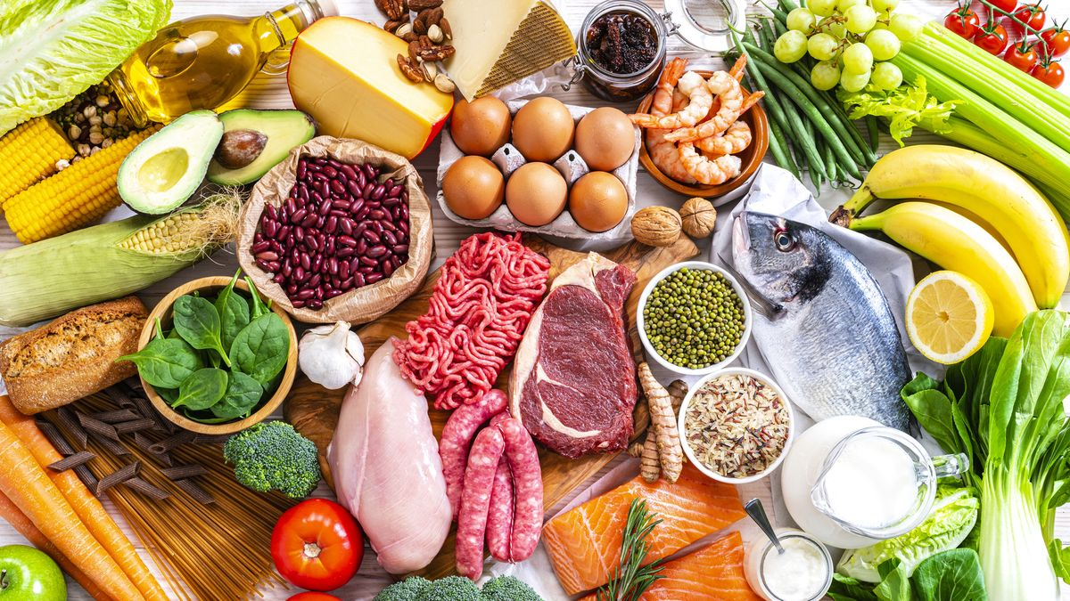


Microwave-assisted process for Fatty Acids Methyl Esters analysis in food matrix:
A comparative study
Donatella Ferrara ^{1,2}, Giorgia Purcaro ^{2*}
1 University of Liege, Gembloux Agro-BioTech, Belgium.
2 University of Turin, Dipartimento di Scienza e Tecnologia del Farmaco, Italy.
Notes:
Thanks to the chair for the kind presentation. As already has been said i will present a comparative study of different Microwave-assisted process for the analysis of Faty Acids Methyl Esters in food matrix.

Slide 2
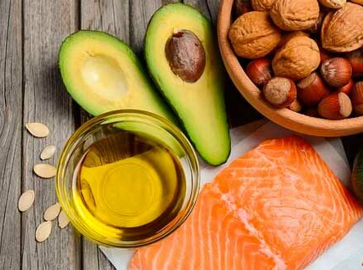
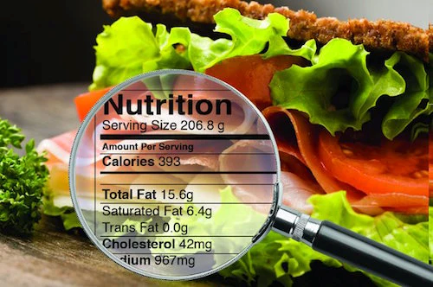

Why fatty acid analysis is important?
CHARACTERIZATION AND DETERMINATION OF TOTAL FAT CONTENT IN FOODS
FOR NUTRITIONAL LABELING AND TO UNDERSTAND THE AVAILABILITY OF FAT
HEALTH IMPACT AND CORRELATION WITH SOME DISEASES
FATTY
ACIDS
MICROWAVE
Notes:
First of all i would like to spend few seconds to explain why the analysis of Fatty Acids is important.

Slide 3
Why fatty acid analysis is important?
CHARACTERIZATION AND DETERMINATION OF TOTAL FAT CONTENT IN FOODS
FOR NUTRITIONAL LABELING AND TO UNDERSTAND THE AVAILABILITY OF FAT
HEALTH IMPACT AND CORRELATION WITH SOME DISEASES
FATTY
ACIDS
MICROWAVE
Notes:
FAs are the basic unit of fats and oil and their analysis can be helpful for the charactwrization and determination of total fat content in foods.

Slide 4
Why fatty acid analysis is important?
CHARACTERIZATION AND DETERMINATION OF TOTAL FAT CONTENT IN FOODS
FOR NUTRITIONAL LABELING AND TO UNDERSTAND THE AVAILABILITY OF FAT
HEALTH IMPACT AND CORRELATION WITH SOME DISEASES
FATTY
ACIDS
MICROWAVE
Notes:
For nutritional labeling and to understand the availability of fat

Slide 5
Why fatty acid analysis is important?
CHARACTERIZATION AND DETERMINATION OF TOTAL FAT CONTENT IN FOODS
FOR NUTRITIONAL LABELING AND TO UNDERSTAND THE AVAILABILITY OF FAT
HEALTH IMPACT AND CORRELATION WITH SOME DISEASES
FATTY
ACIDS
MICROWAVE
Notes:
And in the end, interest in this area has been showed for the potential negative effect of some SFA and trans isomers od UFA on human health, but also on the positive correlation with other classes of fatty acids.

Slide 6

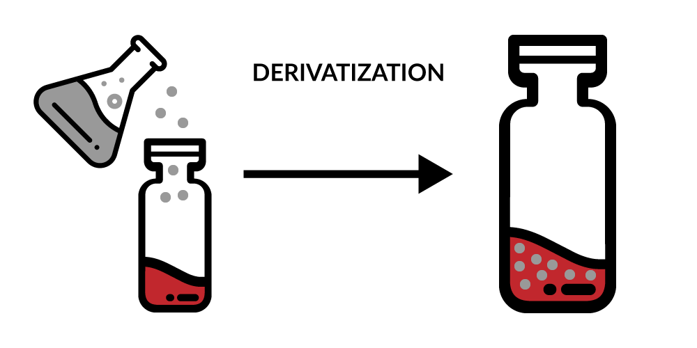
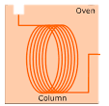

GENERAL PROCEDURE FOR FATTY ACIDS ANALYSIS
STEP 1
STEP 2
STEP 3
EXTRACTION
DERIVATIZATION
GC-FID ANALYSIS
GC
FID
FATTY
ACIDS
MICROWAVE
Notes:
For the analysis of Fatty acids composition, Sample preparation is a significant task and involves different steps. The common methodology to analyse fatty acids is based on three main steps: The extraction of the lipid fraction, then the derivatization to obtain the corresponding methyl esters derivatives and the final analysis by gas chromatography.

Slide 7
GENERAL PROCEDURE FOR FATTY ACIDS ANALYSIS
STEP 1
STEP 2
STEP 3
ONE STEP
EXTRACTION
DERIVATIZATION
GC-FID ANALYSIS
EXTRACTION + DERIVATIZATION
OR
+
GC
FID
FATTY
ACIDS
MICROWAVE
Notes:
But recently we developed a new method for FAMEs analysis that is a easier and faster consisting in a single step.

Slide 8

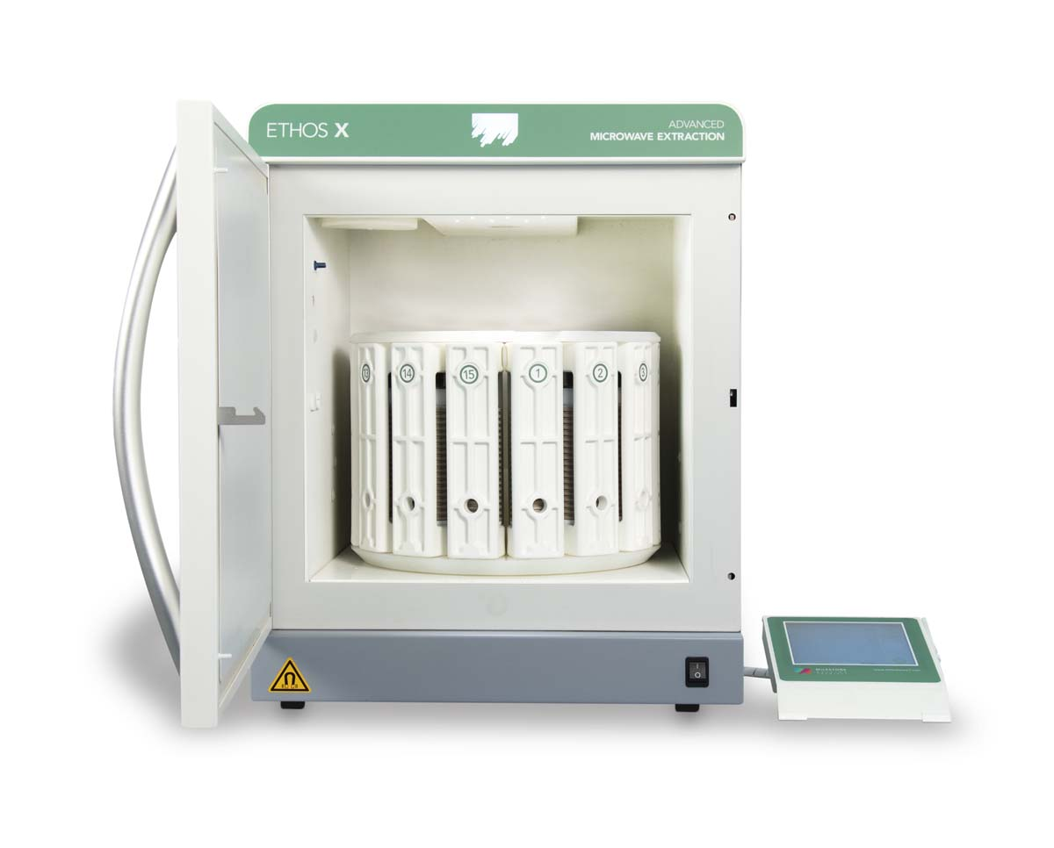

0.5 g + 10 mL AcMeOH +25 mL Cyclohexane
15 minutes at 120 °C
ONE STEP MICROWAVE-ASSISTED EXTRACTION AND DERIVATIZATION
CONVENTIONAL
HEATING
MICROWAVE
HEATING
MICROWAVE
FATTY
ACIDS
Notes:
This method is based on microwave heaiìting, basically 0,5 g of sample, 10 ml od AcMeoh and 25 ml of cyclohexane are heated in a microwave system for 15 min and the the organic part containing fames is directly injected. Brifely i willl show you why the use microwave to heat brings some advantages by just comparing it to the conventional heating.

Slide 9
0.5 g + 10 mL AcMeOH +25 mL Cyclohexane
15 minutes at 120 °C
ONE STEP MICROWAVE-ASSISTED EXTRACTION AND DERIVATIZATION
CONVENTIONAL
HEATING
MICROWAVE
HEATING
MICROWAVE
FATTY
ACIDS
Notes:
in the conventional heating, the heat is generated by a hotplate and then trasferred to the vessel. As a result, the interal temperature is lower than the external one and it may take significant amount of time to reach the targeted temperature.

Slide 10
0.5 g + 10 mL AcMeOH +25 mL Cyclohexane
15 minutes at 120 °C
ONE STEP MICROWAVE-ASSISTED EXTRACTION AND DERIVATIZATION
CONVENTIONAL
HEATING
MICROWAVE
HEATING
Direct Heating
High Time Efficiency
Low Energy Consumption
Short Processing Times
Less Heating Exposure
Green Process
MICROWAVE
FATTY
ACIDS
Notes:
On the other hand, in MW heating the reaction vessel is trasparent to the MW allowing for direct heating of the sample. So in this case the targeted temperature is reached more efficiently and in a significant shorter time. And this is only the most immediate advantages of MW, but it’s not the only one. We also have high efficiency, low energy consumption, short processing time, less heating exposure and it’a s greener process.

Slide 11
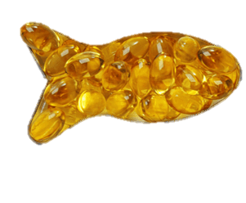

DEVELOPMENT OF A GC×GC-FID METHOD FOR FAMEs ANALYSIS
1D limitations:
Difficult and/or time-consuming to resolve all isomers
  High polarity columns:
    Polyunsaturated FAMEs coelute with higher-chain-length saturated FAMEs
    Stability of columns
  Use long columns (up to 200 m in some cases)
    Expensive, with longer run times
  Multiple analyses
    Decreased productivity
COMPLEX MATRIX
GC×GC
FATTY
ACIDS
MICROWAVE
Notes:
In addiction to the sample preparation step, we also developed a GCXGC-FID method to increase the throughput of the analysis. Indeed, from a chromatographic point of view, FAMEs profiling can be challenging if we deal with complex matrix and using monodimentional chromatography we may face some limitations. 1D may require long capillary columns or even two GC runs with different stationary face, but both alternatives are ruther time-consuming.

Slide 12
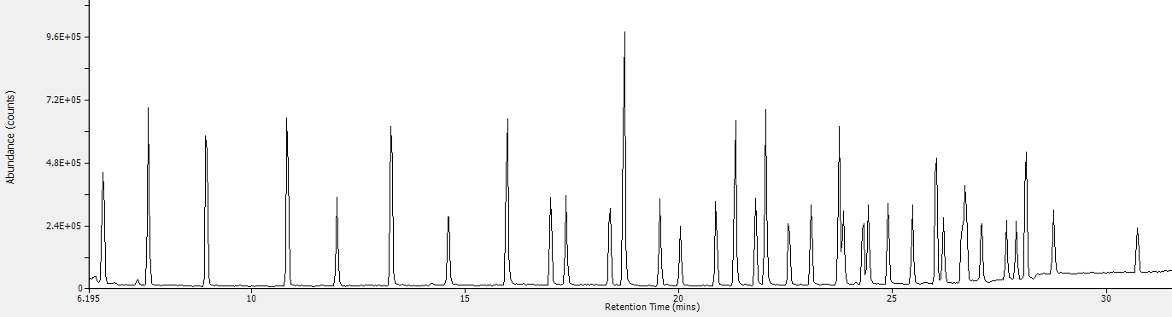
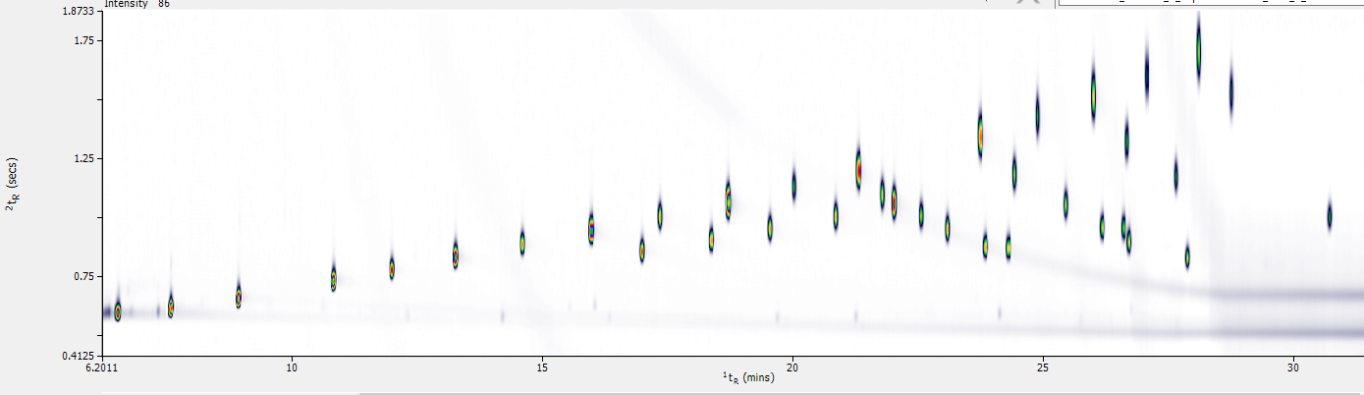
ENHAUNCED SEPARATION
REDUCED
CO-ELUTION
ADVANTAGES OF GC×GC
1D GC–FID
~30 min
run time
GC×GC–FID
C22:1n9
C20:3n3
C20:4n6
Notes:
Instead, with bidimentional chromatography we can go behind this limitation. Infact, with the enhaunced separation of gcxgc, we could have better resolution of complex mixture, making it easier to distinguish and identify individual compounds. Then, gcxgc can significantly reduce the occurrance of co-eluition, which is a real challenge in 1D As you can see in the same running time we can not separate the c 22:1n9 and c20:3n3 4N6 in 1D but we can in 2D.

Slide 13
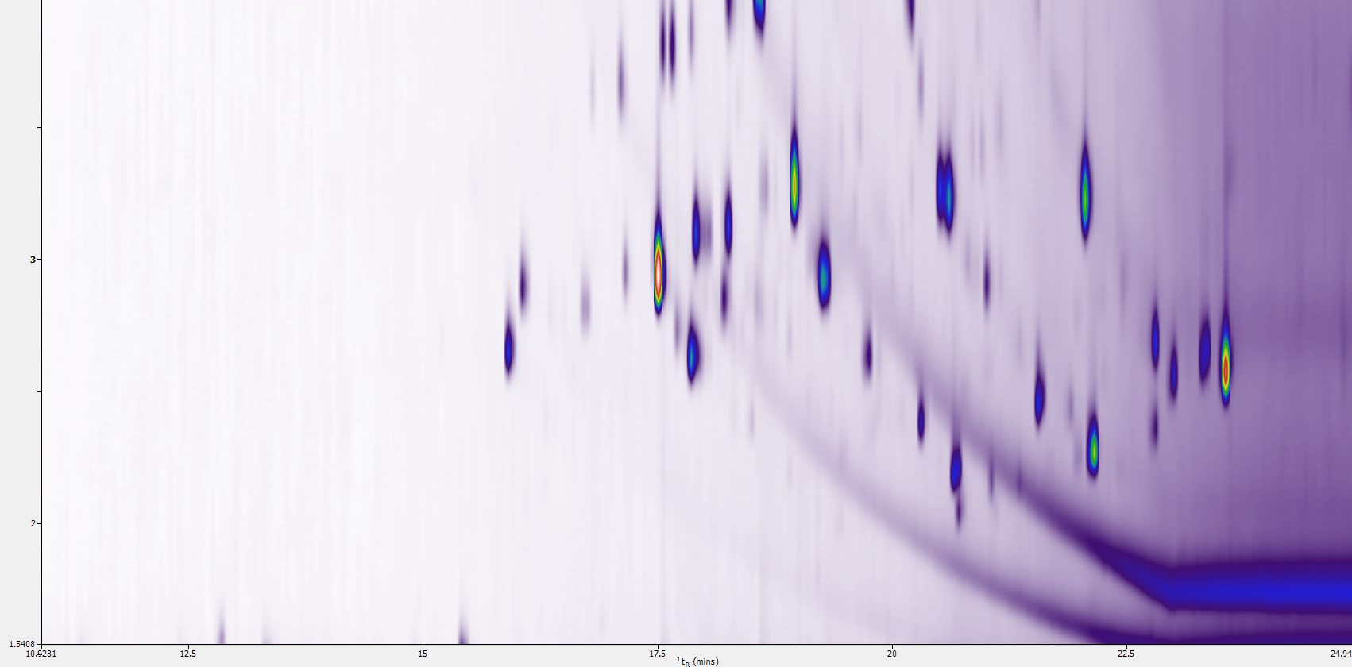
REDUCED
CO-ELUTION
! NO FAMEs
Notes:
Always regarding the co-eluition, you can see here compounds that are not fames, that we don’t need to integrate, and that in 1D would be coeluted.

Slide 14
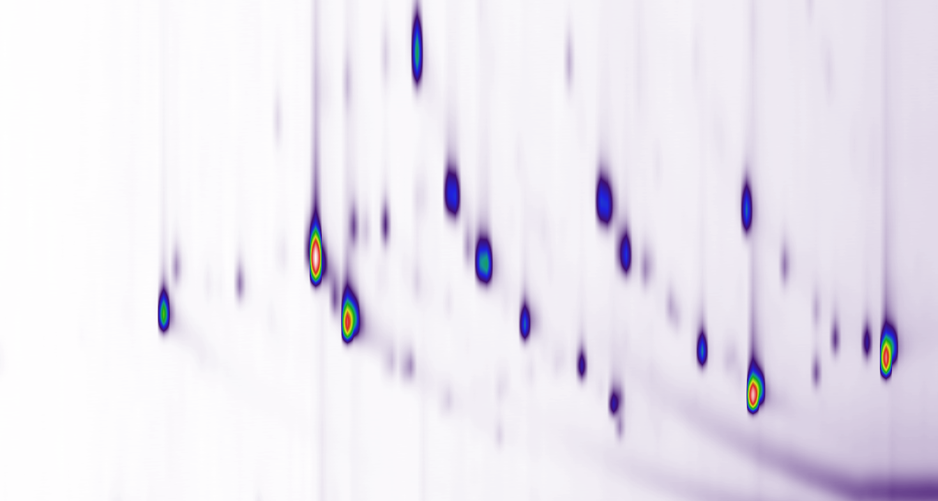
COMPREHENSIVE ANALYSIS
4
2D tr
3
2
15
16.25
17.5
18.75
20
21.25
22.5
23.75
1D tr
Notes:
Moreover in gcxgc we have a compehensive analysis. By using a second dimention separation we obtain more structured chromatograms. In the specific case of FAMEs we have an easy pattern where we can easily identify the structure of isomers. Saturated and then the undaturated.

Slide 15
COMPREHENSIVE ANALYSIS
4
2D tr
3
SATURATED
1 DB
2
2 DB
3 DB
4 DB
5 DB
6 DB
15
16.25
17.5
18.75
20
21.25
22.5
23.75
1D tr
Notes:
where we can easily identify the structure of isomers. Saturated and then the undaturated.

Slide 16
INCREASED SENSITIVITY
Trace compounds
Notes:
Last but not least, thanks to gcxgc we have an increased sensitivity that allowed us to detect also trace compounds.

Slide 17
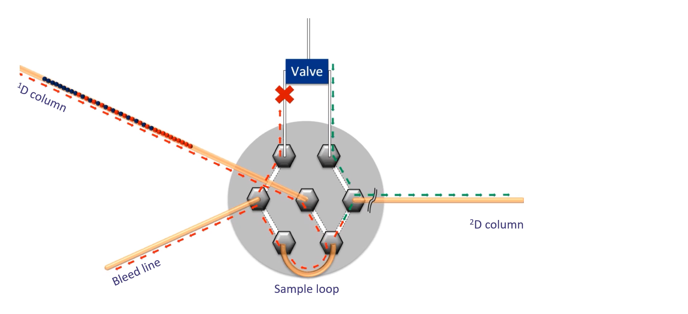
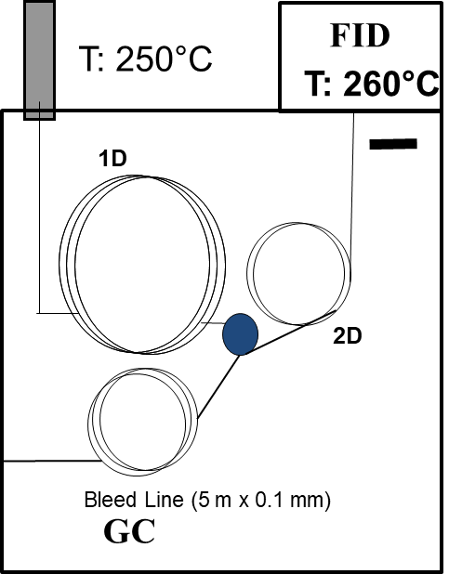
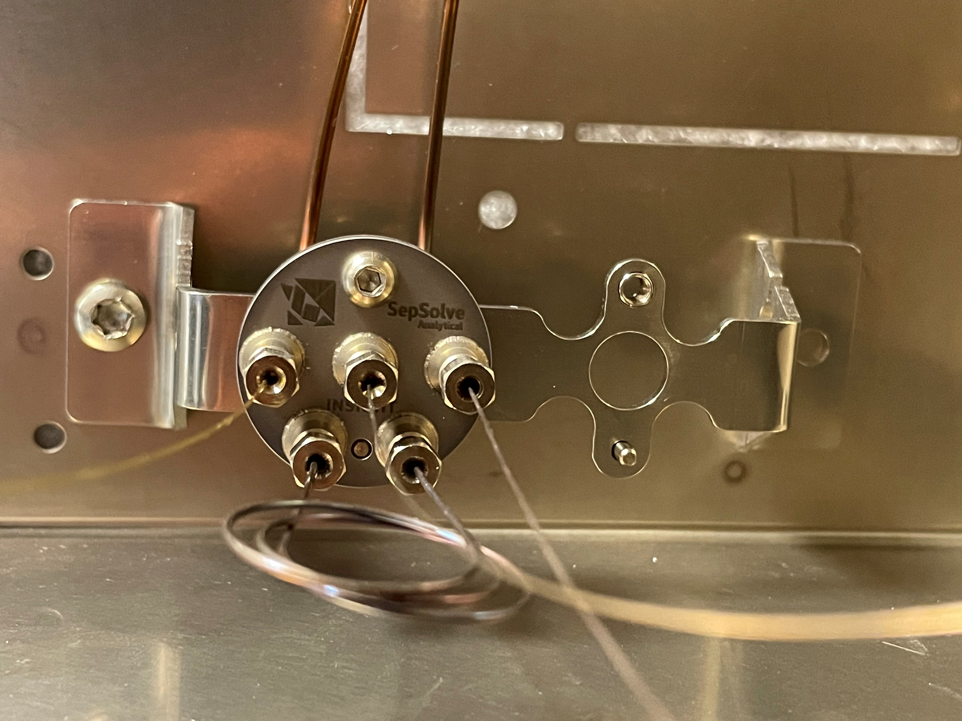
GC×GC –FID CONDITIONS
Reversed fill/flush Flow modulation
1D Mid-polar (SepSolve 1D-FAMEs 20 m x 0.18 mm x 0.1 µm)
Constant flow 0.5 mL/min
2D Apolar (SepSolve 2D-FAMEs 5 m x 0.25 mm x 0.1 µm)
Constant flow 20 mL/min
Griffith et al, J. Chromatogr. A, 1226 (2012) 116– 123
Notes:
We used a GCXGC System with a column set specific for FAMEs property of Sepsolve connected by a flow modulator. Brifly for who is not familiar with the technique, in the animation you can see how it works. The effluent coming from the first dimension come into the central port of the modulator and begin to fill a sample loop. The modulation valve then switches position to flush the contents of the loop onto the second column for further separation.
This happens in the reverse direction to which it was filled – thus the name reverse fill/flush
The process happens alternately throughout the run to provide modulation of all components in the sample.
Some of the key benefits of flow modulation are that it is consumable free so allowed us to reduce the running cost because we don’t have a cryogenic fluic , no volatility restrictions, so very volatile species can be modulated as efficiently as semi-volatiles

Slide 18
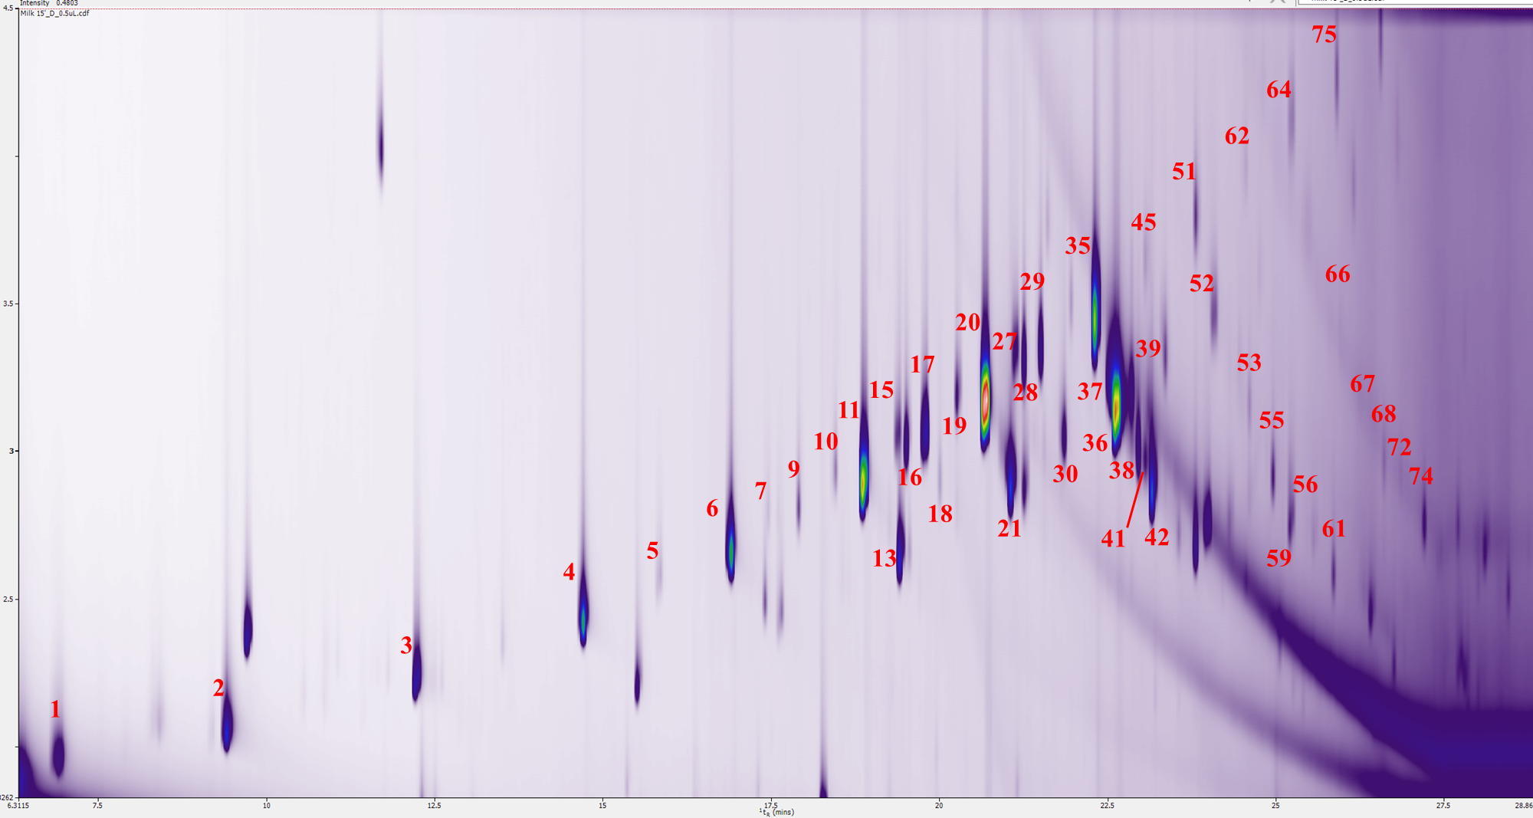
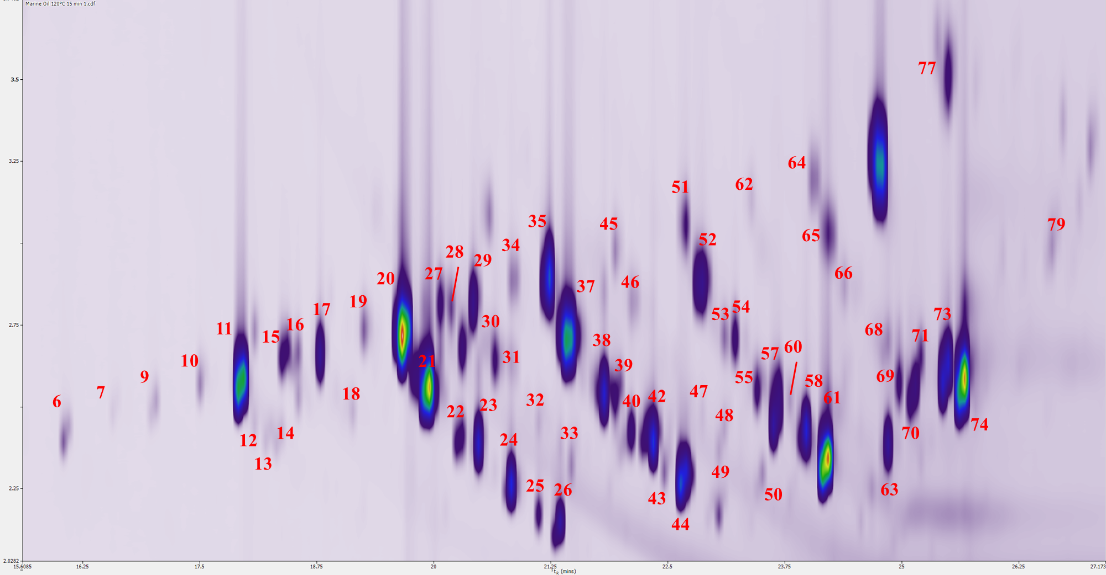
DEVELOPMENT OF A GC×GC-FID METHOD FOR FAMEs ANALYSIS
~30 min
run time
COMPLEX MATRIX
GC×GC
FATTY
ACIDS
MICROWAVE
Notes:
to increase the number of analyte that we can separate in SHORTER TIME. As the case of milk and fish oil that are very complex matrix with more than 80 componds

Slide 19

Instrumental performances
INTRA-DAY
INTER-DAY
Average C37 FAMEs standard (n=6)
Average C37 FAMEs standard (n=16 consecutive days)
RSD% tr₁< 0.02%
RSD% tr₂< 1.2%
RSD% Area< 1.15%
RSD% tr₁< 0.12%
RSD% tr₂< 3.1%
RSD% Area <8%
Notes:
having excellent repeatability of the instrumental analysis as you can see from the reported relative standard deviations of the first and second dimention reterntion time and the area of the standard mixure.

Slide 20

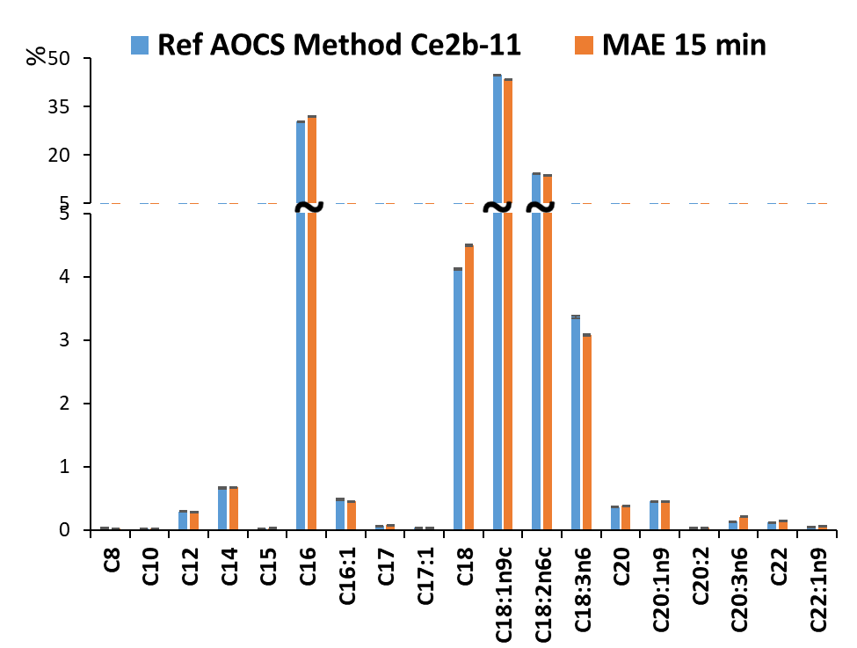
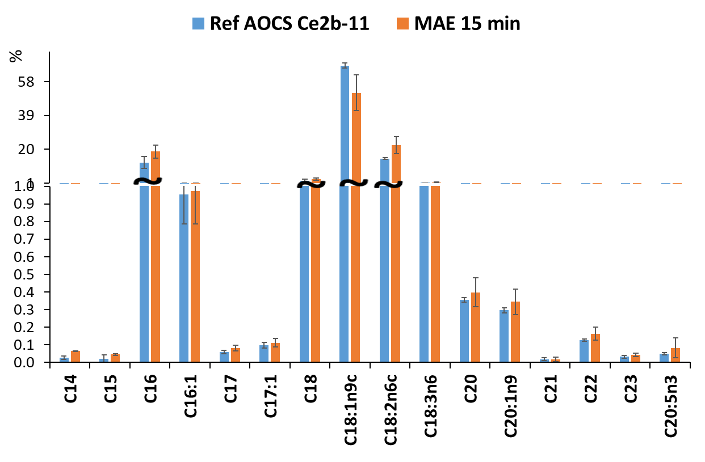
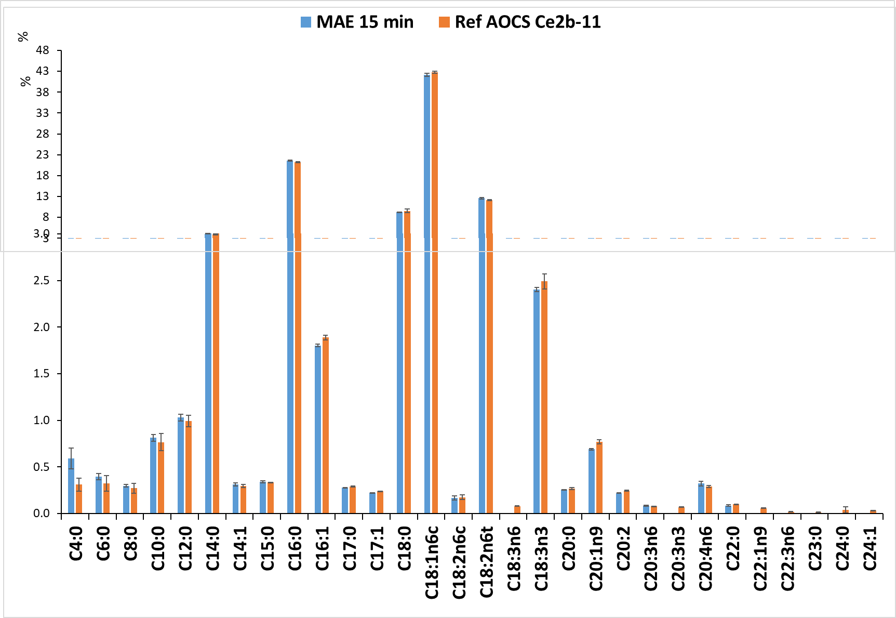



COMPARISON WITH AOCS OFFICIAL METHODS Ce 2b-11
different food sample
Notes:
So we applied the MAED-GCXGC-FID Method on different matrices and the results that we obtained were comparable to the one obtained with the reference method AOCS

Slide 21
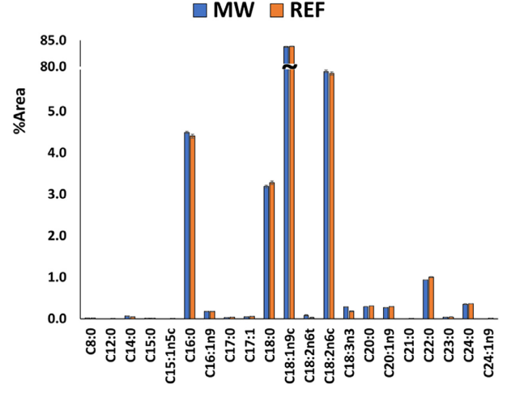
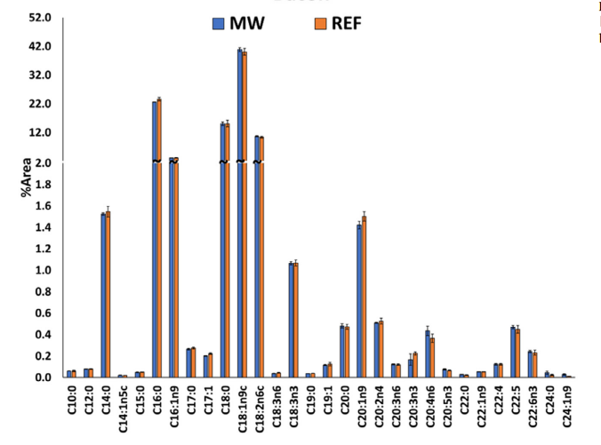
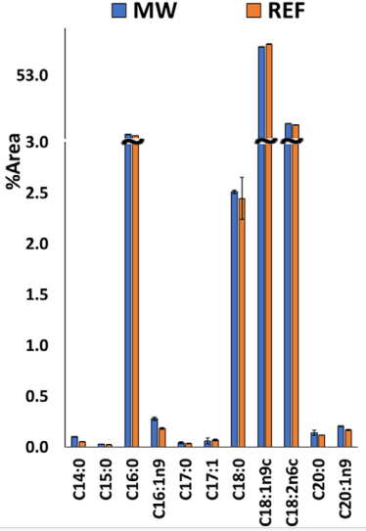



COMPARISON WITH AOCS OFFICIAL METHODS Ce 2b-11
different food sample
Notes:
Other matrices

Slide 22
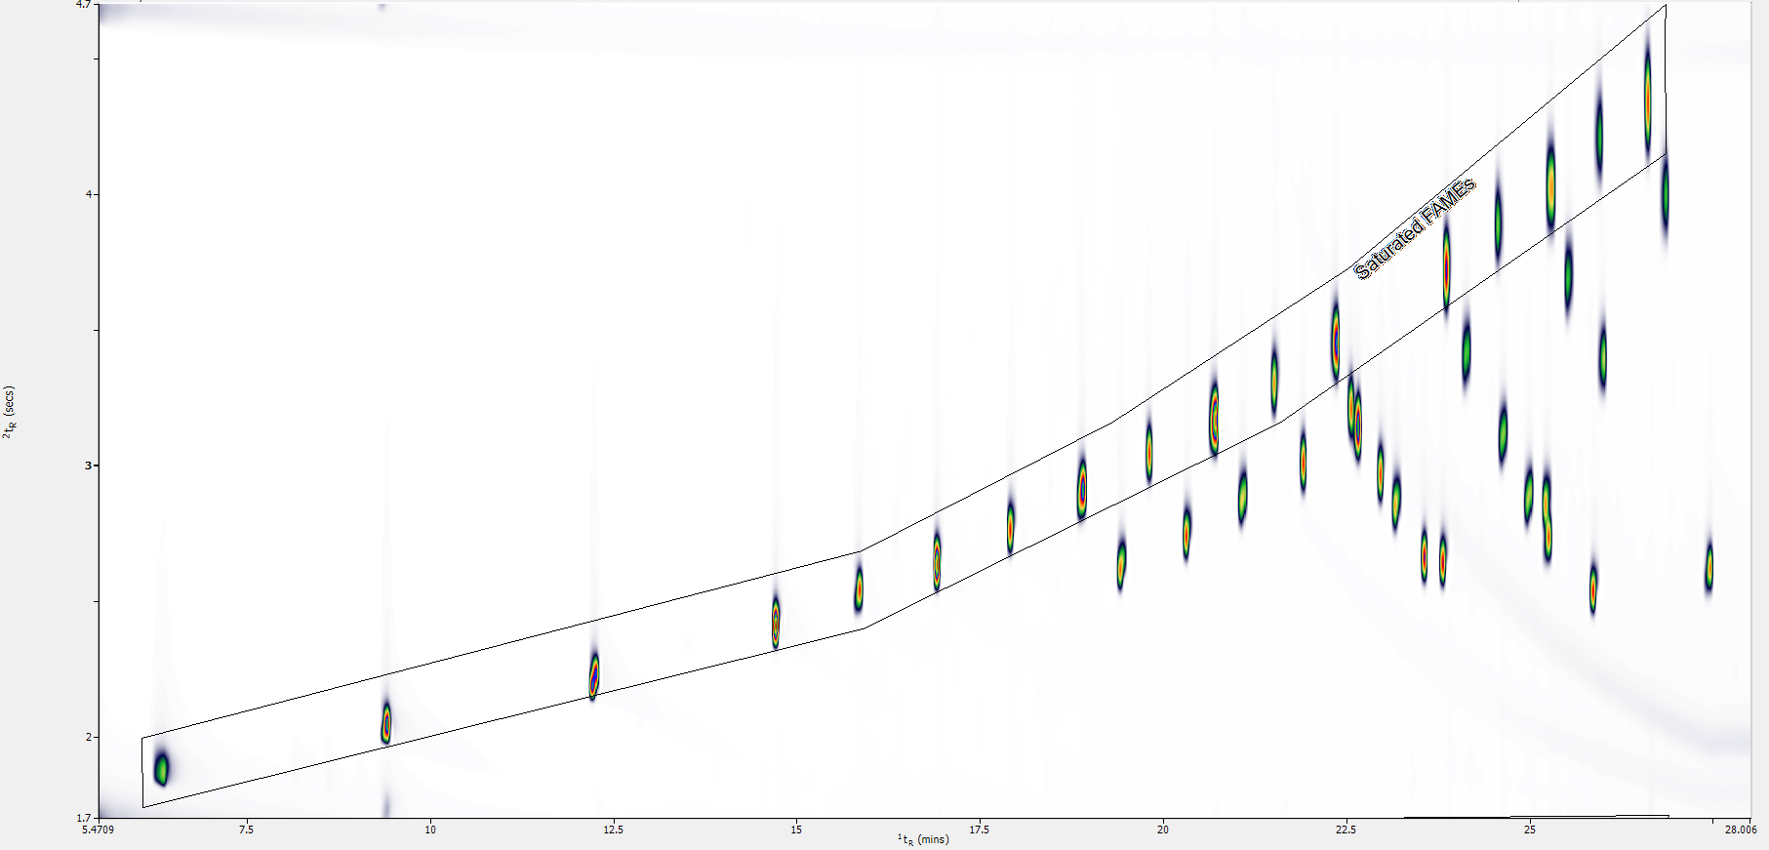
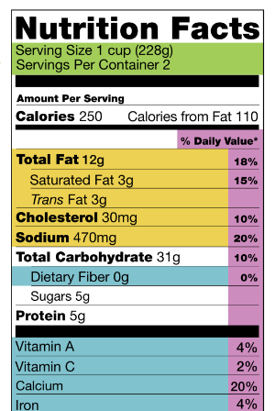


LABELING by MAED-GC×GC-FID
Notes:
This developed method was also used to calculate the Saturated FA and trans content as many Control Laboratory does to put this value on the lable of foods. And thanks to the gcxgc we can identify at the first glance the saturated, here underlined

Slide 23
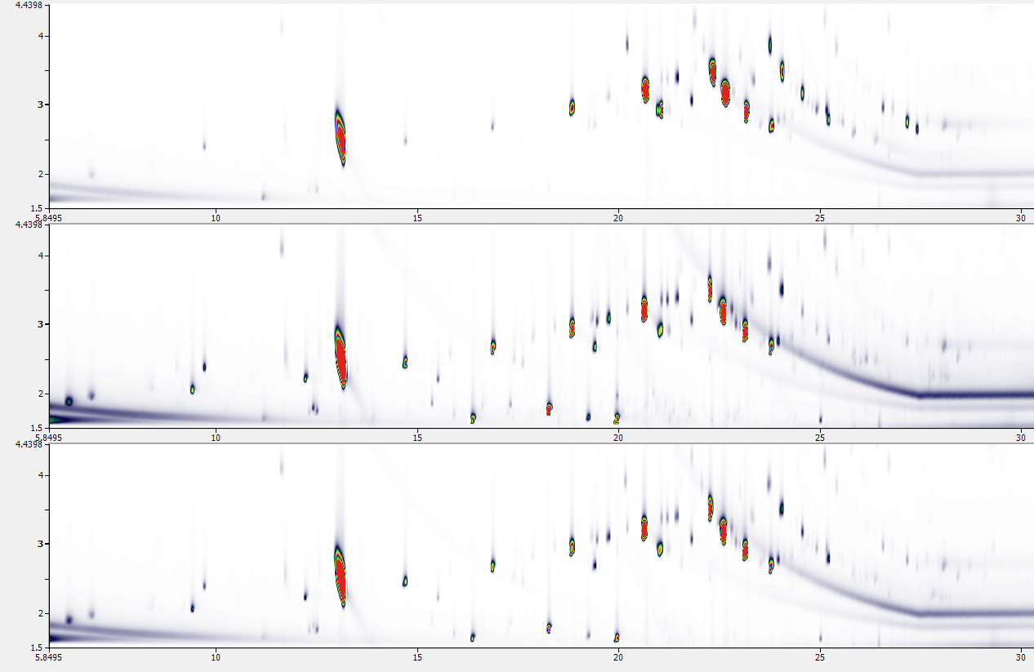
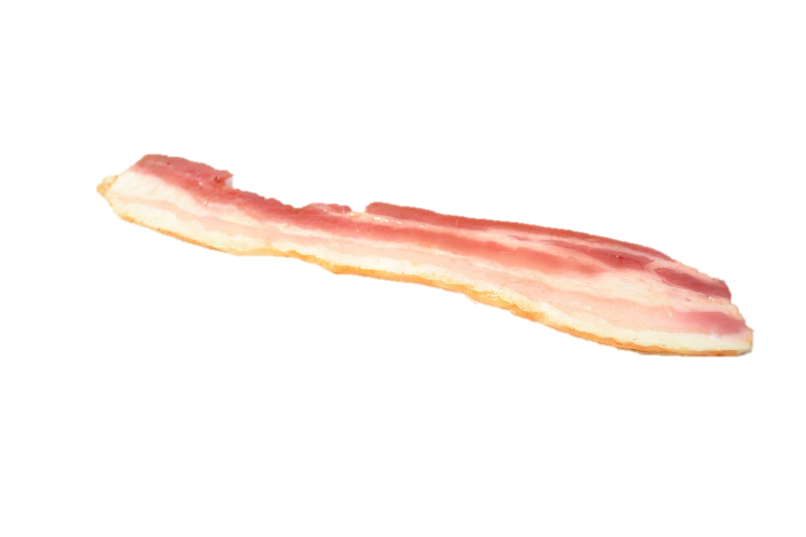
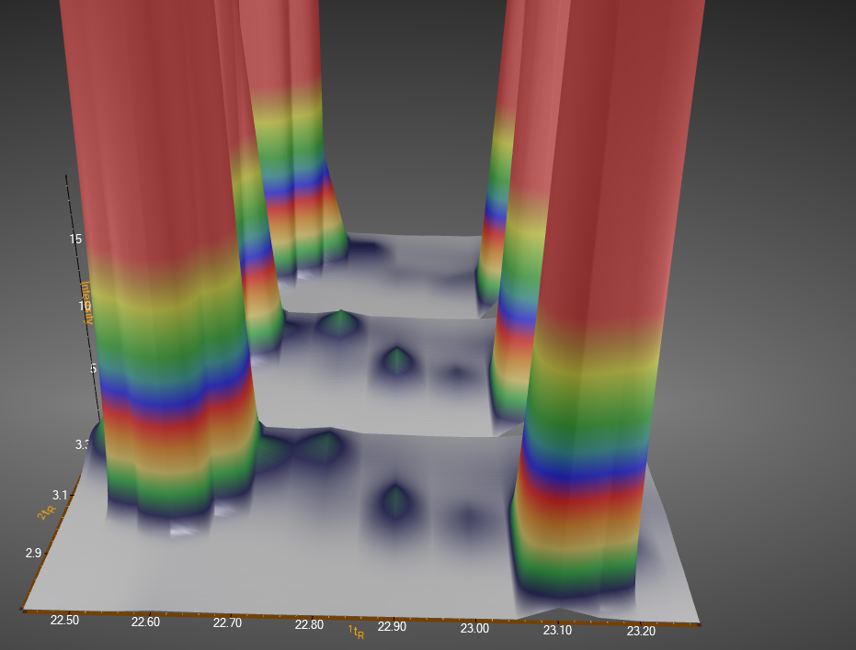

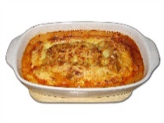
²t_{R} (s)
Bacon
(0%)
Pizza (0.23 %)
Lasagne
(0.17 %)
Linolelaidic acid (C18:2n6t)
¹t_{R} (min)
Notes:
And also the trans isomers. And also this time we found a good correlation between the results of our method, the refence method and the lable of the analyzed matrix.

Slide 24
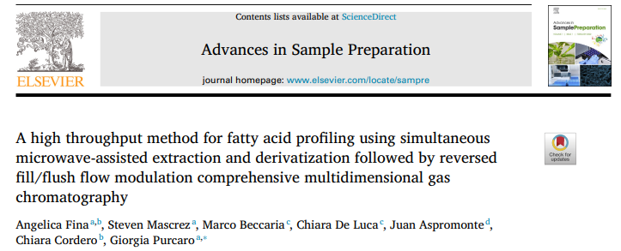

LET’S GO FURTHER
Notes:
We were satisfied of the results so we decided to go further

Slide 25


LAB
2
LAB
1
LAB
3
LAB
4
LAB
5
LAB
6
LAB
7
LAB
8
Notes:
From a brainstorming with other lab we realized

Slide 26
LAB
2
LAB
1
LAB
3
MICROWAVE-ASSISTED EXTRACTION
SPREADLY USED FOR
TOTAL FAT
LAB
4
LAB
5
LAB
6
LAB
7
LAB
8
Notes:
That the microwave is very used , mainly for the analysis of total fat and

Slide 27
LAB
2
MICROWAVE-ASSISTED EXTRACTION
SPREADLY USED FOR
TOTAL FAT
LAB
1
LAB
3
LAB
4
LAB
5
DERIVATIZATION WITH BF₃
LAB
6
LAB
7
LAB
8
Notes:
After the add the step of Derivatization using Boron Trifluoride for the label part of saturated and trans.

Slide 28

LAB
2
01
02
LAB
1
LAB
3
COMPARISON OF MAED AND OFFICIAL METHODS
AOCS Ce 2b-11
AOCS Ce 2c-11
LAB
4
LAB
5
EXPLORE THE USE OF MICROWAVE TO PERFORM THE DERIVATIZATION
LAB
6
LAB
7
LAB
8
Notes:
From here the idea: why not to use the microwave also to performe the derivatization? Using the same derivatization method that we used for the one step MAED?

Slide 29
LAB
2
01
02
LAB
1
LAB
3
COMPARISON OF MAED AND OFFICIAL METHODS
AOCS Ce 2b-11
AOCS Ce 2c-11
LAB
4
LAB
5
EXPLORE THE USE OF MICROWAVE TO PERFORM THE DERIVATIZATION
LAB
6
LAB
7
LAB
8
Notes:
But also to extend the evaluation of our developed method with another official method

Slide 30
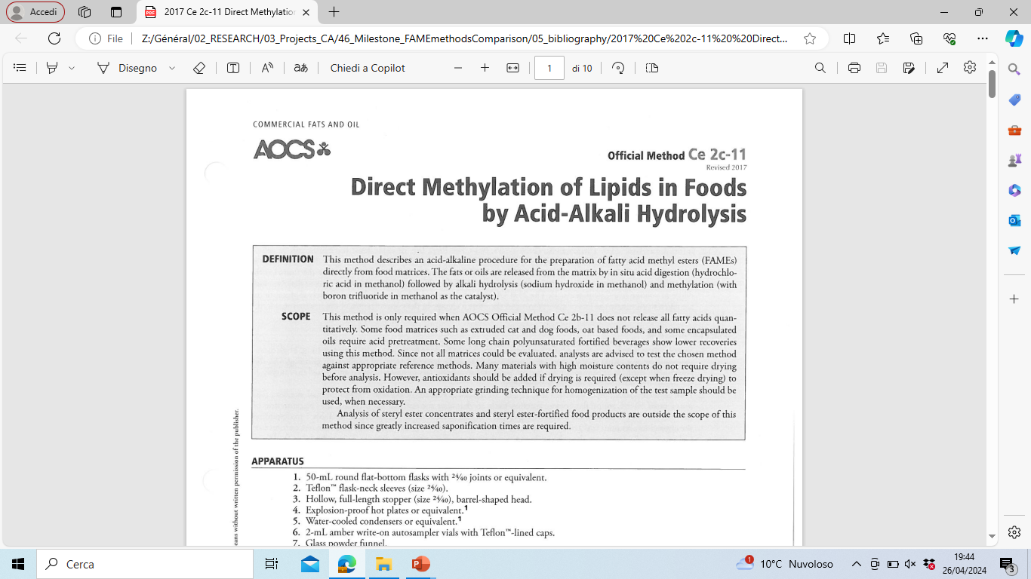











PREVIOUS STUDY
01
COMPARISON OF MAED AND OFFICIAL METHODS
AOCS Ce 2b-11
AOCS Ce 2c-11
CURRENT STUDY
Notes:
In particular, for this first step we choose different matrix from the previous work including a particular case study, that is the oat for with the AOCS Ce 2c-11 suggest to use an Acid hydrolysis

Slide 31


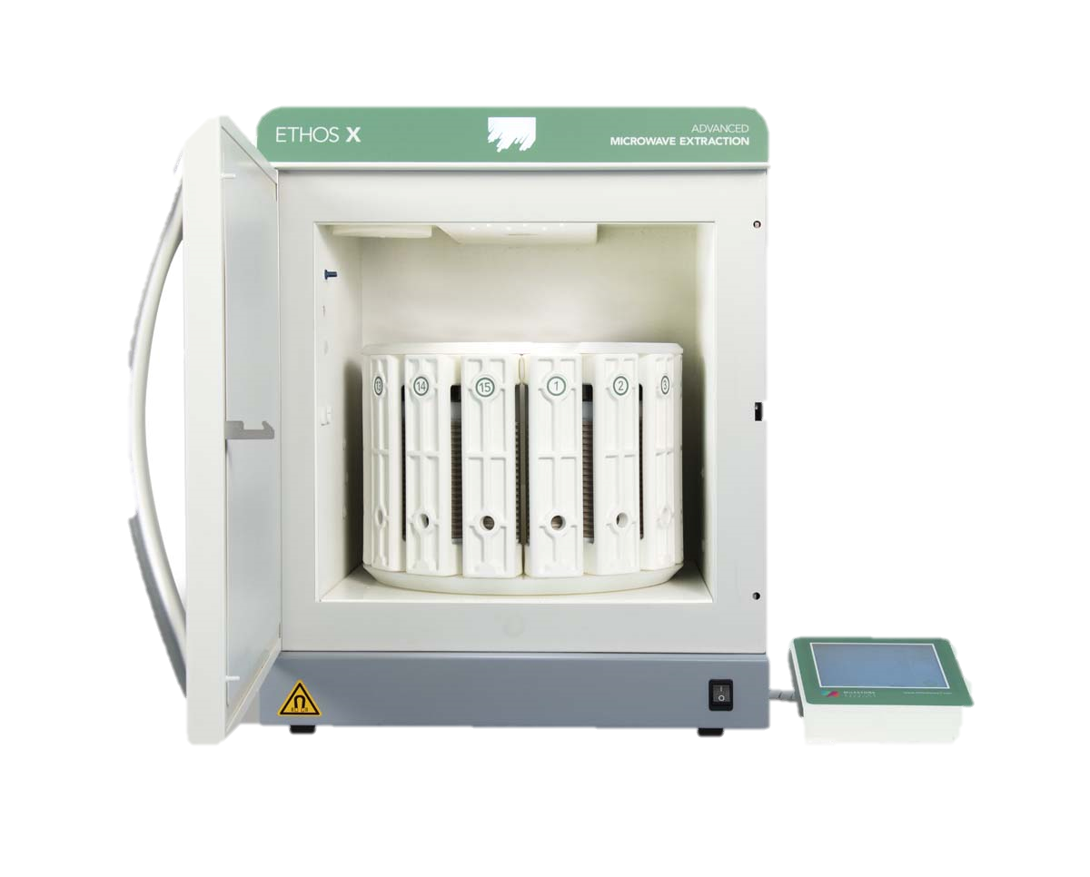


DERIVATIZATION WITH BF₃
02
EXPLORE THE USE OF MICROWAVE TO PERFORM THE DERIVATIZATION
Waiting for boiling
MICROWAVE ASSISTED DERIVATIZATION
Waiting
10 mL AcMeOH +25 mL Cyclohexane
15 minutes at 120 °C
Sample
+
NaOH/MeOH
Add BF₃
Add Hexane
Notes:
For the second objective. We know that the use of BF3 is the most used for the derivatization, but is a hazardous reagents, not green and is not possible to traslate this kind of derivatization in the microwave because of the multiple step. We need to add a first regent waiting for boiling and then add the bf3, we need to wait and then add the hexane. That’s why we proposed the Derivatization with a single step assisted by MW whith the same condition of the one step method we developed.

Slide 32

AOCS Ce2c-11
Microwave-assisted Extraction
Direct Methylation by Acid- Alkaly hydrolysis
AcMeOH + NaOH + BF₃ + Hexane
EXTRACTION + HYDROLYSIS
H₂SO₄ + Cyclohexane
01
HEXANE EXTRACTION
AOCS Ce2b-11
COMPARISON OF MAED AND OFFICIAL METHODS
AOCS Ce 2b-11
AOCS Ce 2c-11
Direct Methylation by Alkaly hydrolysis
NaOH + BF₃ + Hexane
TOTAL
FAT
MAED
One-Step Microwave-assisted extraction and derivatization
AcMeOH + Cyclohexane
Derivatization with BF₃
Derivatization with AcMeOH
Notes:
To get into the experimental part, this is the summery of all the performed methods. For the first objective, we are going to compare all the method that we call one step because there is no calculation of total fat in the middle.

Slide 33

AOCS Acid-Alk-BF₃
AOCS Alk-BF₃
MAED
AOCS Ce2c-11
Direct Methylation by Acid- Alkaly hydrolysis
AcMeOH + NaOH + BF₃ + Hexane
%
%
%
AOCS Ce2b-11
Direct Methylation by Alkaly hydrolysis
NaOH + BF₃ + Hexane
%
%
%
MAED
One-Step Microwave-assisted extraction and derivatization
AcMeOH + Cyclohexane
Notes:
Here are reported the persentage profile of saturated, mono and poli unsaturated, the results are comparable for all the matricies and all the methods except for the oat as suggested by AOCS.

Slide 34
AOCS Ce2c-11
Direct Methylation by Acid- Alkaly hydrolysis
AcMeOH + NaOH + BF₃ + Hexane
AOCS Ce2b-11
Direct Methylation by Alkaly hydrolysis
NaOH + BF₃ + Hexane
MAED
One-Step Microwave-assisted extraction and derivatization
AcMeOH + Cyclohexane
AOCS Acid-Alk-BF₃
AOCS Alk-BF₃
MAED
Notes:
The same if we consider the percentage profile of all the single FA. So Except for the Avena, we can confirm that the MAED-developed method is still a reliable alternative to the official method.

Slide 35
AOCS Ce2c-11
Microwave-assisted Extraction
Direct Methylation by Acid- Alkaly hydrolysis
AcMeOH + NaOH + BF₃ + Hexane
EXTRACTION + HYDROLYSIS
H₂SO₄ + Cyclohexane
HEXANE EXTRACTION
02
AOCS Ce2b-11
Direct Methylation by Alkaly hydrolysis
NaOH + BF₃ + Hexane
TOTAL
FAT
EXPLORE THE USE OF MICROWAVE TO PERFORM THE DERIVATIZATION
MAED
One-Step Microwave-assisted extraction and derivatization
AcMeOH + Cyclohexane
Derivatization with BF₃
Notes:
For the second objective, we want to use the microwave for the derivatization. We know that the common proceddure is to extarct the lipid with one of the reported extraction, hydrolysis or solvent in yellow and orange , calculate the total fat and then to derivatize with bf3.

Slide 36
AOCS Ce2c-11
Microwave-assisted Extraction
Direct Methylation by Acid- Alkaly hydrolysis
AcMeOH + NaOH + BF₃ + Hexane
EXTRACTION + HYDROLYSIS
H₂SO₄ + Cyclohexane
HEXANE EXTRACTION
02
AOCS Ce2b-11
Direct Methylation by Alkaly hydrolysis
NaOH + BF₃ + Hexane
TOTAL
FAT
EXPLORE THE USE OF MICROWAVE TO PERFORM THE DERIVATIZATION
MAED
One-Step Microwave-assisted extraction and derivatization
AcMeOH + Cyclohexane
Derivatization with BF₃
Derivatization with AcMeOH
Notes:
we are going to compare to the microwave assisted derivatization with the acidic solution of methanol

Slide 37
AOCS Ce2c-11
Microwave-assisted Extraction
Direct Methylation by Acid- Alkaly hydrolysis
AcMeOH + NaOH + BF₃ + Hexane
EXTRACTION + HYDROLYSIS
H₂SO₄ + Cyclohexane
HEXANE EXTRACTION
02
AOCS Ce2b-11
Direct Methylation by Alkaly hydrolysis
NaOH + BF₃ + Hexane
TOTAL
FAT
EXPLORE THE USE OF MICROWAVE TO PERFORM THE DERIVATIZATION
MAED
One-Step Microwave-assisted extraction and derivatization
AcMeOH + Cyclohexane
Derivatization with BF₃
Derivatization with AcMeOH
Notes:
To do it , we consider the two derivatization performed on the same extract obtained with extraction with acidc hydrolys

Slide 38
Microwave-assisted Extraction
MAEH-AcMeOH
MAEH-BF₃
MAED
%
%
%
EXTRACTION + HYDROLYSIS
H₂SO₄ + Cyclohexane
HEXANE EXTRACTION
TOTAL
FAT
%
%
%
Derivatization with BF₃
Derivatization with AcMeOH
One-Step Microwave-assisted extraction and derivatization
AcMeOH + Cyclohexane
Notes:
From the general profile the two derivatization method performed on the same extract gives the same results and they both are comparable with MAED.

Slide 39
MAEH-AcMeOH
MAEH-BF₃
MAED
Microwave-assisted Extraction
EXTRACTION + HYDROLYSIS
H₂SO₄ + Cyclohexane
HEXANE EXTRACTION
TOTAL
FAT
Derivatization with BF₃
Derivatization with AcMeOH
One-Step Microwave-assisted extraction and derivatization
AcMeOH + Cyclohexane
Notes:
And it’s the same for all the fatty acids

Slide 40
MAE-AcMeOH
MAE-BF₃
MAED
Microwave-assisted Extraction
%
%
%
EXTRACTION + HYDROLYSIS
H₂SO₄ + Cyclohexane
HEXANE EXTRACTION
TOTAL
FAT
%
%
Derivatization with BF₃
Derivatization with AcMeOH
One-Step Microwave-assisted extraction and derivatization
AcMeOH + Cyclohexane
Notes:
Even if we compare the extract obtained with solvent extraction the derivatization are comparable

Slide 41
MAE-AcMeOH
MAE-BF₃
MAED
Microwave-assisted Extraction
EXTRACTION + HYDROLYSIS
H₂SO₄ + Cyclohexane
HEXANE EXTRACTION
TOTAL
FAT
Derivatization with BF₃
Derivatization with AcMeOH
One-Step Microwave-assisted extraction and derivatization
AcMeOH + Cyclohexane
Notes:
Per il formaggio è diverso dal maed la le derivatizzazioni tra di loro sono uguali! Ma come si giustifica il MAED diverso?

Slide 42
Microwave-assisted Extraction
MAEH-AcMeOH
MAE-AcMeOH
MAED
EXTRACTION + HYDROLYSIS
H₂SO₄ + Cyclohexane
HEXANE EXTRACTION
TOTAL
FAT
Derivatization with BF₃
Derivatization with AcMeOH
One-Step Microwave-assisted extraction and derivatization
AcMeOH + Cyclohexane
Notes:
Now that i know that i can derivitize with AcMeOH i want to understand the effect of the different extraction. That as you can see are different only for the oat

Slide 43
AOCS Acid-Alk-BF₃
AOCS Alk-BF₃
MAEH-AcMeOH
MAE-AcMeOH
MAED
Microwave-assisted Extraction
%
EXTRACTION + HYDROLYSIS
H₂SO₄ + Cyclohexane
HEXANE EXTRACTION
TOTAL
FAT
Derivatization with BF₃
Derivatization with AcMeOH
%
Direct Methylation by Acid- Alkaly hydrolysis
AcMeOH + NaOH + BF₃ + Hexane
Direct Methylation by Alkaly hydrolysis
NaOH + BF₃ + Hexane
One-Step Microwave-assisted extraction and derivatization
AcMeOH + Cyclohexane
Notes:
Effectly the avena is the only matrix that showed differente results for the different methods, for the moment we suggest to continue using the AOCS 2c-11 and we need to investigate more.

Slide 44
AOCS Acid-Alk-BF₃
MAEH-AcMeOH
MAED
Microwave-assisted Extraction
%
EXTRACTION + HYDROLYSIS
H₂SO₄ + Cyclohexane
HEXANE EXTRACTION
TOTAL
FAT
Derivatization with BF₃
Derivatization with AcMeOH
%
Direct Methylation by Acid- Alkaly hydrolysis
AcMeOH + NaOH + BF₃ + Hexane
Direct Methylation by Alkaly hydrolysis
NaOH + BF₃ + Hexane
One-Step Microwave-assisted extraction and derivatization
AcMeOH + Cyclohexane
Notes:
Effectly the avena is the only matrix that showed differente results for the different methods, for the moment we suggest to continue using the AOCS 2c-11 and we need to investigate more.

Slide 45

EVALUATION OF THE GREENNESS OF THE METHODS
AGREEprep-Analytical greenness metric for sample preparation
Favor in situ sample preparation
Use safer solvents and reagents
Target sustainable, reusable, and renewable materials
Minimize waste
Minimize sample, chemical, and material amounts
Maximize sample throughput
Integrate steps and promote automation
Minimize energy consumption
Choose the greenest possible post-sample preparation configuration for analysis
Ensure safe procedures for the operator
Notes:
In the end we also evaluates the greennees of the methods that we performed. We based the evaluation on the recently published criteria Agree-Prep. Where the 10 principle here listed are used to give a score that represents how green is the method.

Slide 46
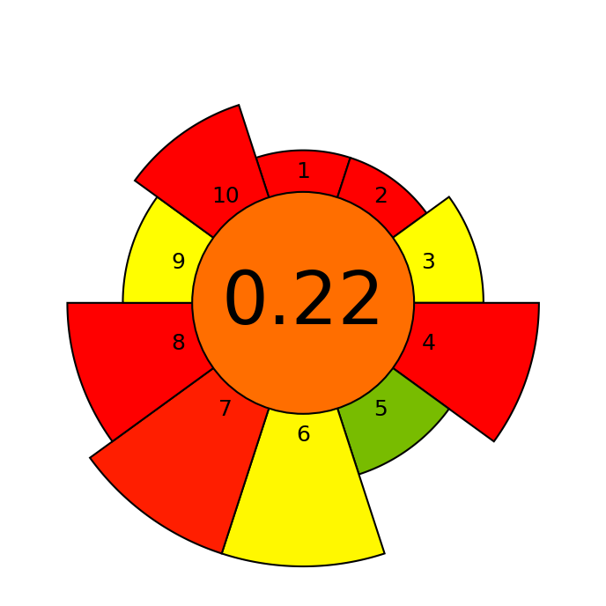
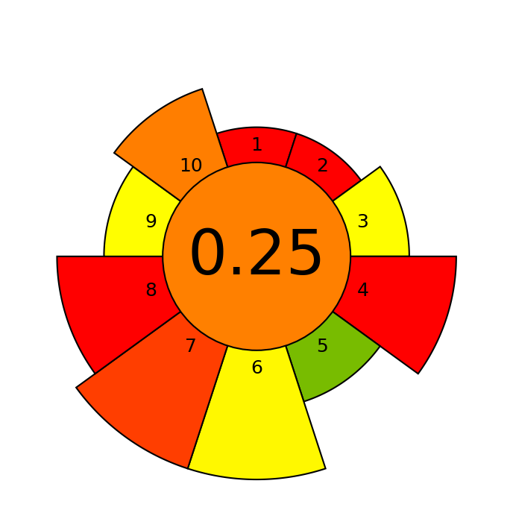
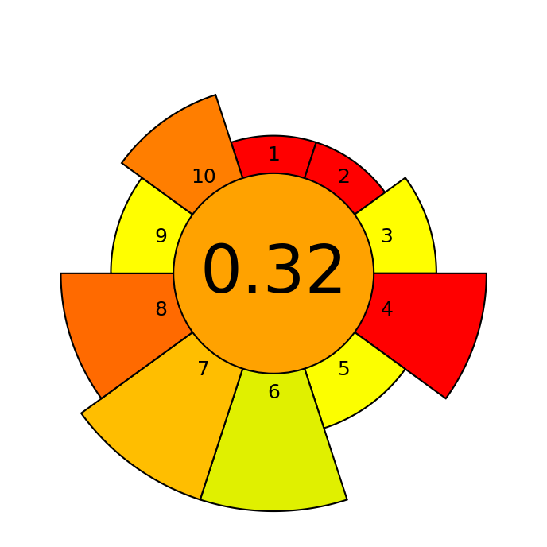
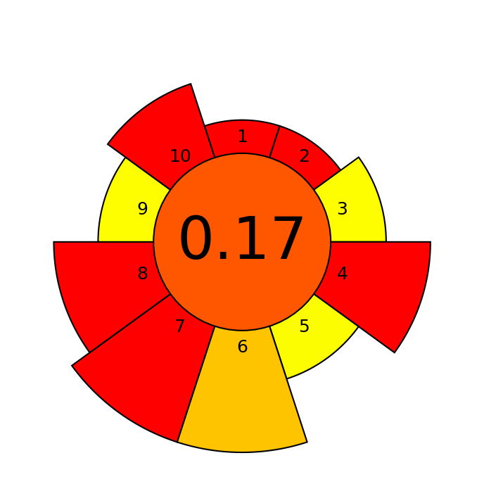
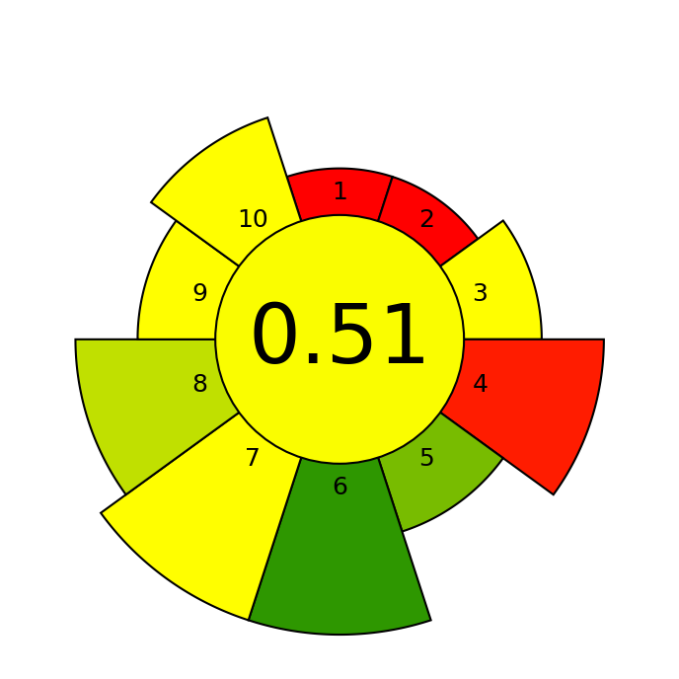

EVALUATION OF THE GREENNESS OF THE METHODS
AOCS Acid-Alk-BF₃
AOCS Alk-BF₃
MAEH-AcMeOH
MAEH-BF₃
MAED
MAE-AcMeOH
MAE-BF₃
IMPROVEMENT OF THE GRENNESS OF THE SAMPLE PREPARATION METHOD
Notes:
we can see that the lower score are given to the methods that used BF3, and the higher to the One Step Microwave assisted extraction and derivatization.

Slide 47
GREEN CONSIDERATIONS OF MAED-GC×GC-FID
HIGHER THROUGHPUT: 12 samples every 15 min so 48 per h (or even more if the rotor with 44 position is used)
SUITABLE FOR A WIDE RANG OF SAMPLES
AUTOMATION, minimizing energy consumption, less toxic solvents
The use of a flow modulator which is more energetically sustainable than the cryogenic modulator
The use of FID rather than MS, thanks to the structured chromatogram obtained in GC×GC
Notes:
The strenght point of MAED method coupled with the GC×GC-FID is 1 and is suitable for a lot of samples. Allowed the promotion of automation, minimizing energy consumption, using less toxic solvents. Just a consideration Unfortunately, in this metric the important role of GC×GC to increase the throughput by reducing the number of analyses required to obtain result cannot be included. As well as the enhance interpretation capability provided by this technique and the higher level of information

Slide 48
CONCLUSION
THE ONE STEP MICROWAVE-ASSISTED EXTRACTION AND DERIVATIZATION IS COMPARABLE TO OFFICIAL METHODS AND MORE GREENER
THE DERIVATIZATION STEP ASSISTED BY MICROWAVE CAN REPLACE THE USE OF BF₃

Slide 49

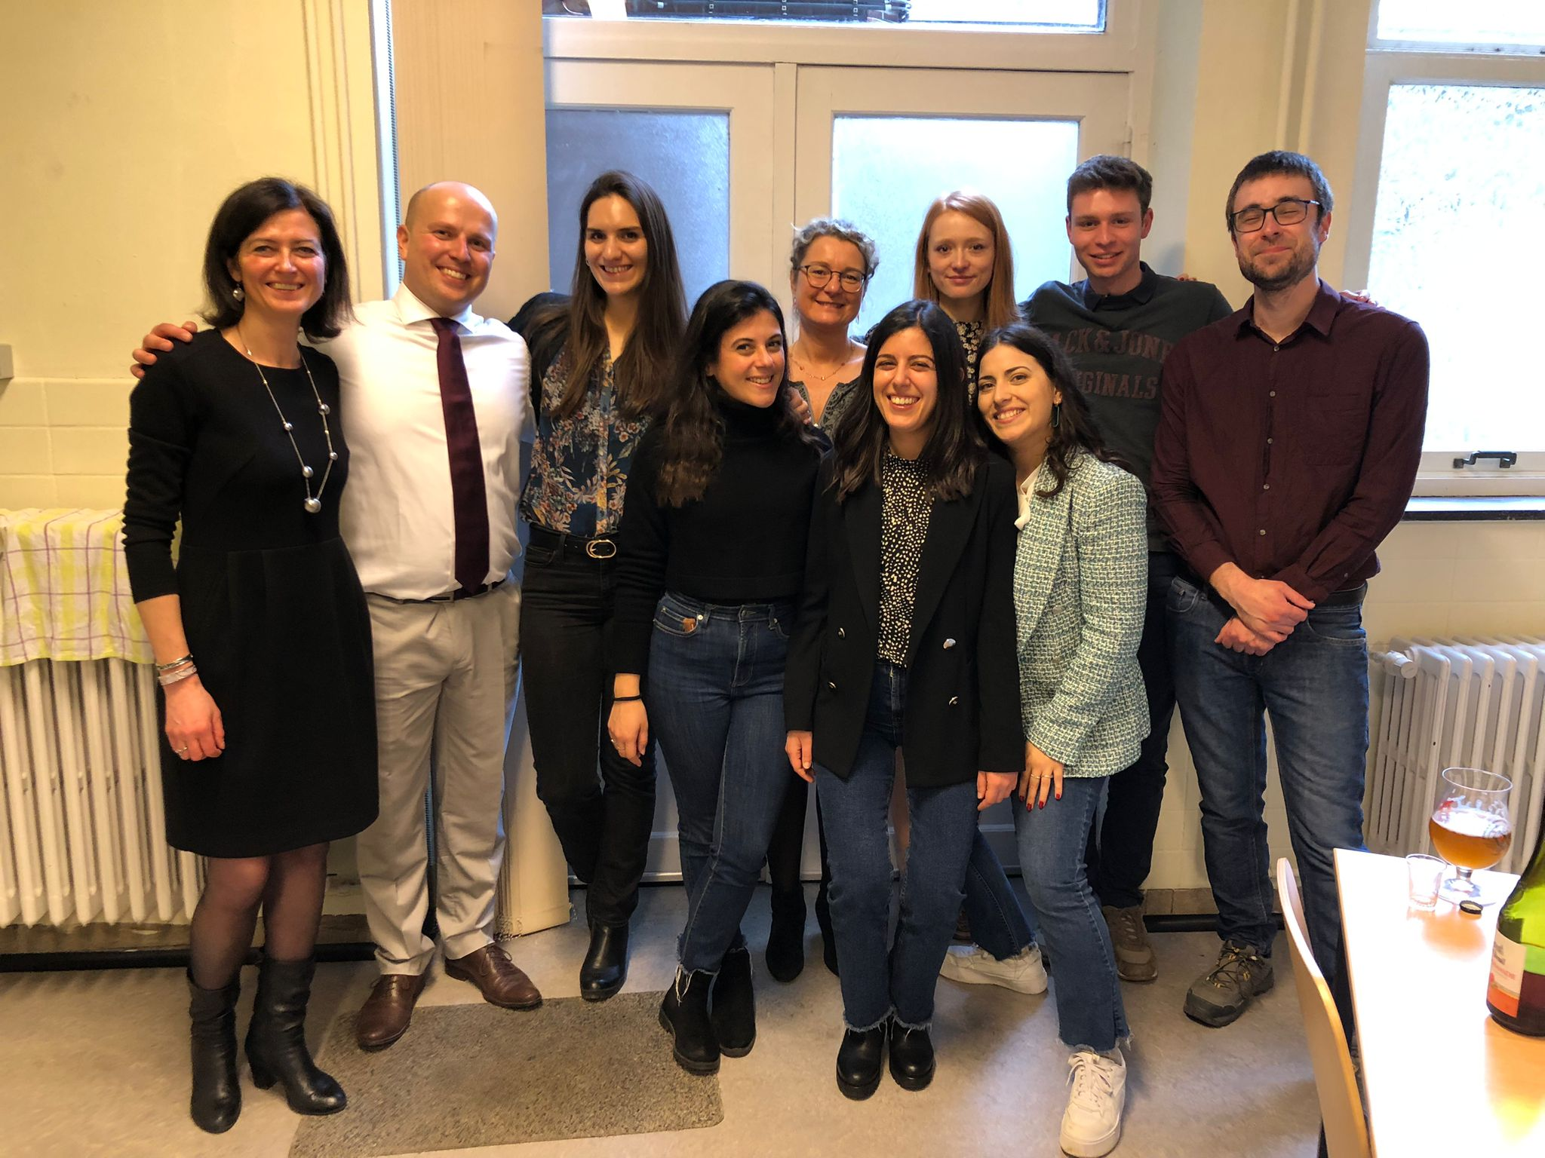

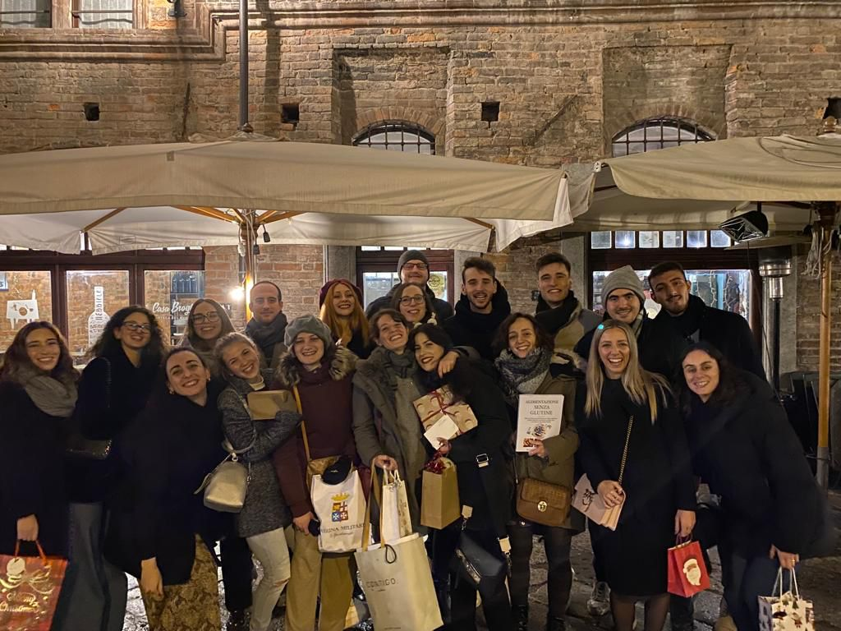

A SPECIAL THANKS TO MY RESEARCH GROUP
Giorgia Purcaro
Sophie Vancraenenbroeck
Steven Mascrez
Paula Albendea
Damian Eggermont
Aleksandra Gorska
Damien Pierret
Andrea Schincaglia
Chiara Emilia Cordero
Andrea Caratti
Angelica Fina
Fulvia Trapani

