Slide 1
Facing vulnerabilities: lessons from the social model of disability, and beyond
Dr. Florence CAEYMAEX
Professor or Ethics and Medical Humanities
University of Liège, Belgium
Belgian Advisory Committee on Bioethics

Slide 2
The Belgian Advisory Committee on Bioethics
Legislation
Cooperation agreement of 15 January 1993 : Federal State, Communities (French-, Dutch- and German-speaking) & Joint Community Commission (Brussels).
The Committee (set up in 1996) is however independent of these authorities
35 effective members, 35 deputies, 8 advisory members
Values & missions
Independence - Pluralism - Interdisciplinarity
Advisory role: to issue opinions (art.1.1) not necessarily consensus-based
Scope : problems raised by research and its applications in the fields of biology, medicine and health & examined from an ethical, social and legal point of view, with particular reference to respect for human rights
Information role (art. 1.2.c) for society and the public, Government & Parliament
Notes:
To date, we have published 86 opinions, 16 notices by letter (short opinions), 26 annual reports and books and conference proceedings

Slide 3
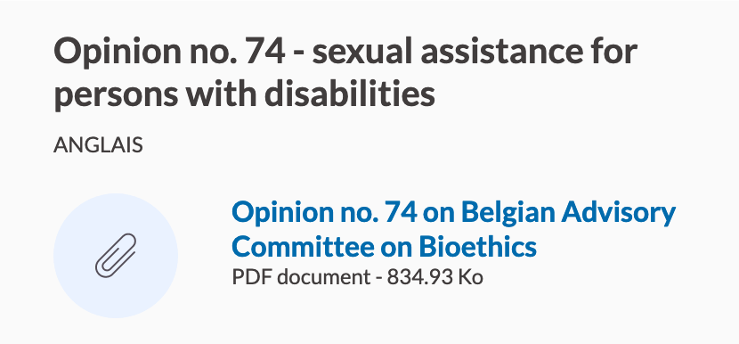
Ethical issues linked to vulnerable persons & groups
people suffering from dementia (opinion n. 73, 2017)
people with a disability (opinion n. 74, 2017)
people suffering from chronic illnesses in the context of the Covid-19 pandemic (opinion n. 75, 2020)
people living, working or passing through collective structures such as psychiatric hospitals, prisons and asylums for migrants (opinion n. 75, 2020, opinion n. 81, 2022)
Elderly people living in nursing homes (opinion n. 75, 2020; opinion n. 78, 2021; opinion n. 84, 2023)
Notes:
The Belgian Advisory Committee on Bioethics has dealt with ethical issues involving consideration of the specific challenges linked to the vulnerability of certain people:

Slide 4
Opinion no. 74 : request & opinion
Can sexual assistance be a valid and legitimate means of contributing to the quality of the emotional and sexual life of persons with a disability?
Can this assistance be considered to be conducive to the health (as defined by the WHO) of persons with a disability?
Is it ethically acceptable for public authorities to support accessibility to socially organized sexual assistance for persons with disabilities and under what conditions ?
Insofar as « Health is a state of complete physical, mental and social well-being and not merely the absence of disease or infirmity' (WHO, 1948) »
Considering emotional, relational and sexual life is an integral part of health
Considering many persons with a disability face major social and relational obstacles
professional and well-conducted SA is legitimate, among other policies

Slide 5
What did we learn from the disability issue ?
Ethical issue relating to persons with a disability requires a specific framework
1. An ethically relevant treatment of the issue must be driven by a fundamental rights-based approach
2. A fundamental rights-based approach must combine a social model of disability with « anthropological » considerations
➔ the fundamental rights : an ethical response to vulnerabilities
an ethic that makes the principle of justice the condition for autonomy, beneficence and non-maleficence
Notes:
The Belgian Advisory Committee on Bioethics has dealt with ethical issues involving consideration of the specific challenges linked to the vulnerability of certain people:

Slide 6
Extending the notion of disability ?
WHO - International Classification of Functioning, Disability and Health (ICF)
Two key concepts
Impairment: Any loss or abnormality of psychological, physiological, or body structure or function, for example, paralysis or blindness.
Disability: Any restriction or lack (resulting from an impairment) of ability to perform an activity in the manner or within the range considered normal for a human being. Functional limitation with regard to a particular activity.
Does not see disability only as a "medical" or "biological" dysfunction.
Takes into account the social/functional aspects of disability.
Notes:
Bisiani, Swaffer, Greenwood, Alderman & Power, 2018

Slide 7
Extending the notion of disability ?
The UN Convention on the Rights of Persons with Disabilities (2006), states that
Art. 1 Persons with disabilities include those who have long-term physical, mental, intellectual or sensory impairments which in interaction with various barriers may hinder their full and effective participation in society on an equal basis with others.
Impairments differ from short-term illnesses/diseases that can be cured
Impairments do not necessarily mean “unhealthy”
Are nevertheless in need of care (medical, paramedical, social, everyday life-care)
Notes:
The Belgian Advisory Committee on Bioethics has dealt with ethical issues involving consideration of the specific challenges linked to the vulnerability of certain people:

Slide 8
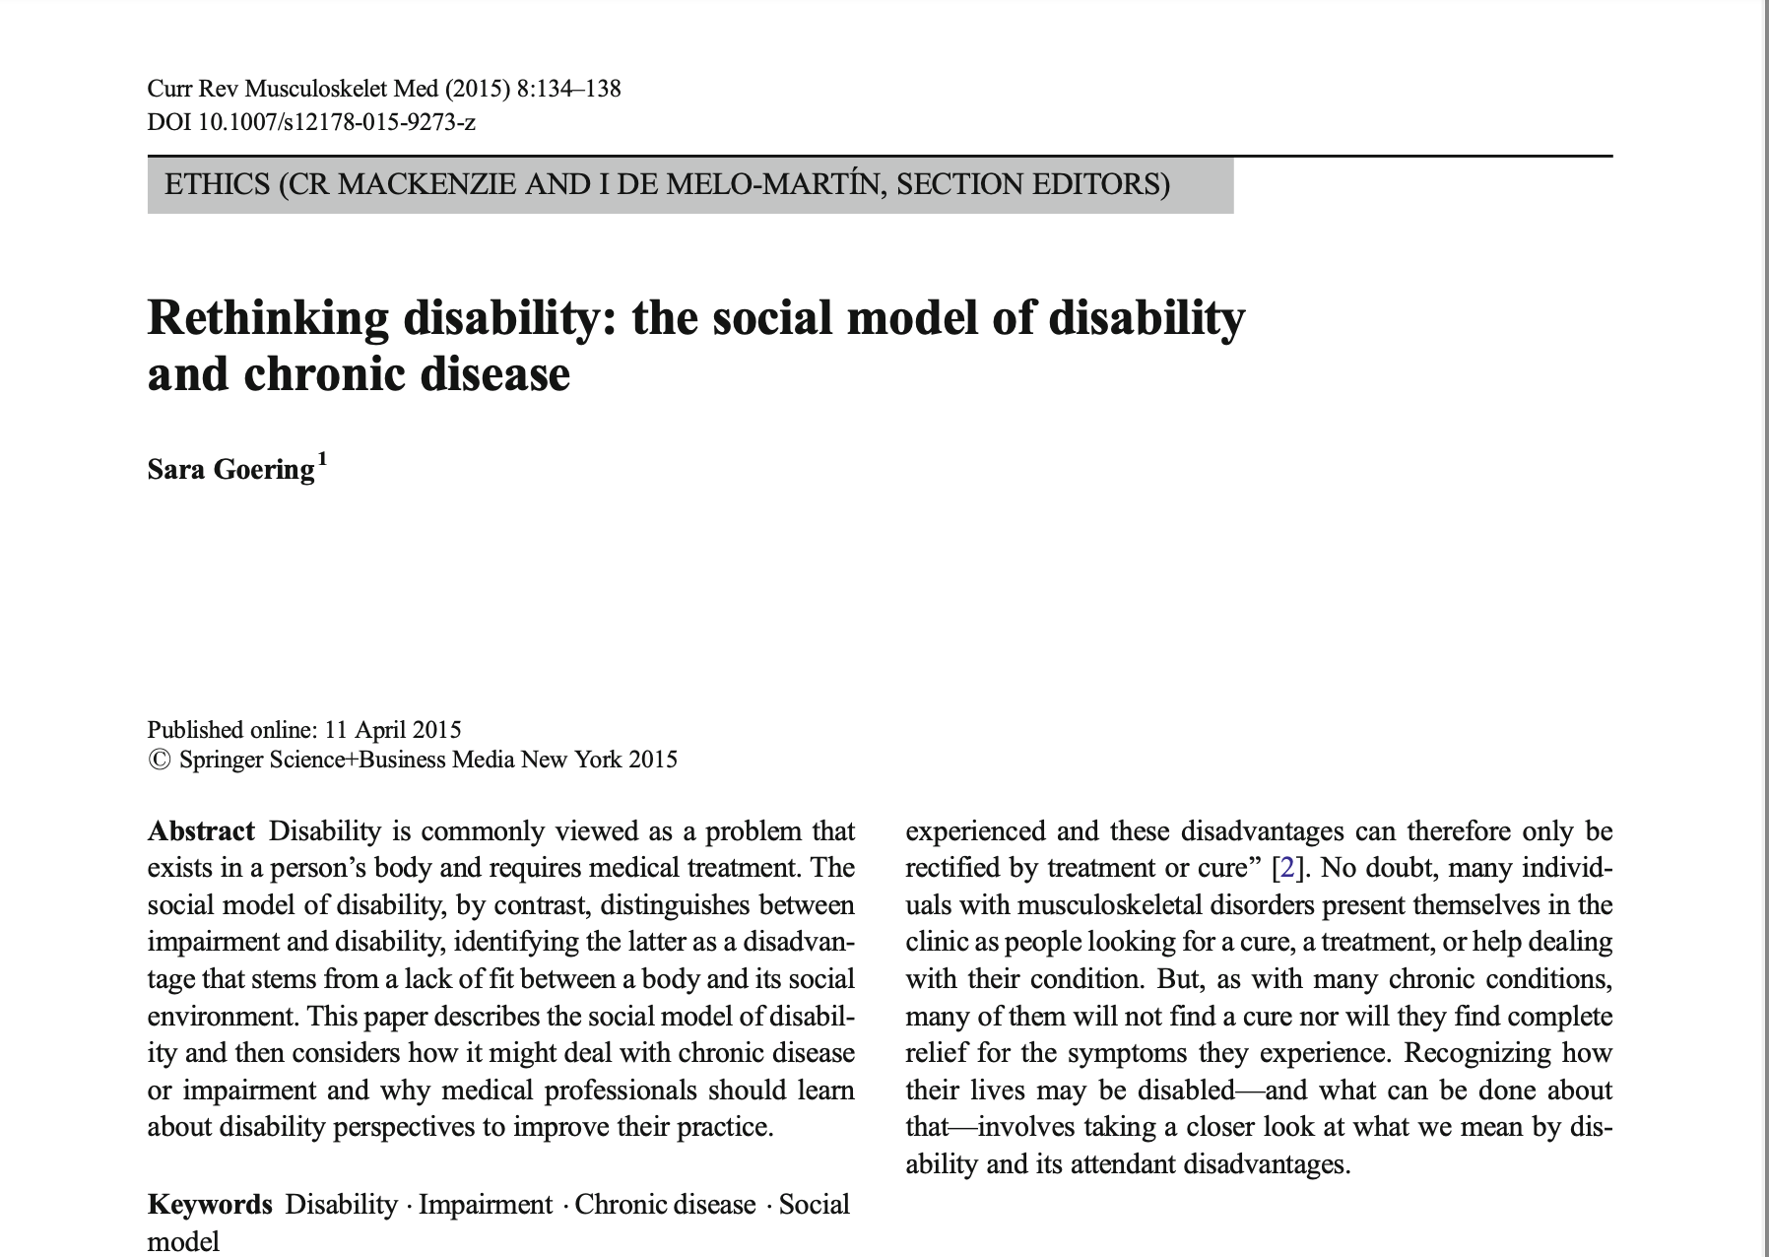
Extending the notion of disability ?
WHO - International Classification of Functioning, Disability and Health (ICF)
& The UN Convention on the Rights of Persons with Disabilities (2006)
Chronic diseases
Chronic pain
Neuro-evolutive diseases such as Alzheimer’s
Parkinson’s & Huntington’s disease
Changes due to advanced age
➔ Long-term mental health issues
As coined by Dementia Alliance International
“Dementia isn’t a mental health condition, it is a cognitive disability”
Notes:
Bisiani, Swaffer, Greenwood, Alderman & Power, 2018

Slide 9
A fundamental rights approach to disability
The UN Convention on the Rights of Persons with Disabilities from 13 December 2006
Art. 1
The purpose of the present Convention is to promote, protect and ensure the full and equal enjoyment of all human rights and fundamental freedoms by all persons with disabilities, and to promote respect for their inherent dignity
Preamble
(y) Convinced that a comprehensive and integral international convention to promote and protect the rights and dignity of persons with disabilities will make a significant contribution to redressing the profound social disadvantage of persons with disabilities and promote their participation in the civil, political, economic, social and cultural spheres with equal opportunities, in both developing and developed countries,

Slide 10
A fundamental rights approach
Art. 3 : General Principles
Respect for inherent dignity, individual autonomy including the freedom to make one’s own choices, and independence of persons
Non-discrimination
Full and effective participation and inclusion in society
Respect for difference and acceptance of persons with disabilities as part of human
diversity and humanity
Equality of opportunity ; Accessibility ; Equality between men and women
Respect for the evolving capacities of children with disabilities and respect for the right of
children with disabilities to preserve their identities

Slide 11
Two challenging articles
Article 12: Equal recognition before the law
12.2 : States Parties shall recognize that persons with disabilities enjoy legal capacity on an equal basis with others in all aspects of life.
12.4 : States Parties shall ensure that all measures that relate to the exercise of legal capacity provide for appropriate and effective safeguards to prevent abuse in accordance with international human rights law. Such safeguards shall ensure that measures relating to the exercise of legal capacity respect the rights, will and preferences of the person, are free of conflict of interest and undue influence, are proportional and tailored to the person’s circumstances, apply for the shortest time possible and are subject to regular review by a competent, independent and impartial authority or judicial body.
Article 19: Living independently and being included in the community
Persons with disabilities have the opportunity to choose their place of residence and where and with whom they live on an equal basis with others and are not obliged to live in a particular living arrangement

Slide 12
Two challenging articles
Concerns ? A too restrictive, individualistic interpretation of « autonomy » :
Art. 12
- To limit measures that relate to the exercise of legal capacity could possibly result in a weakening of protection that mentally impaired persons need
Art. 19
- The « right to live independently, outside institutions, run the risk of weakening collective/social solidarity and justifying cuts in State social spending?
Such concerns show the need to return to the roots of the UN CRPD
To the « social model of disability » underlying the Convention

Slide 13
The roots of the UN – CRPD (i)
https://www.coe.int/sr/web/compass/disability-and-disablism
Disability movements since the 1960’s
« The independent living movement »
Crip Theory, Disability Studies
A paradigm shift
« Nothing about us without us »
Deconstructing the medical model of disability

Slide 14
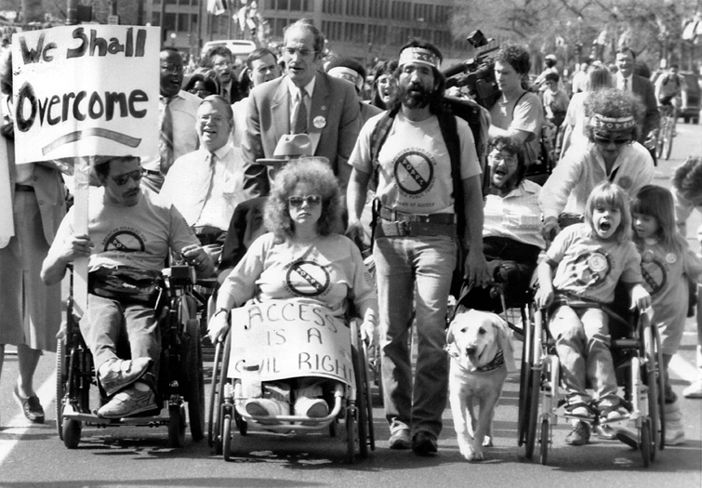
The roots of the UN – CRPD (ii)
https://www.coe.int/sr/web/compass/disability-and-disablism
A paradigm shift
Disability is not a personal tragedy but a human/civil rights issue
From the "patient" to the citizen
Fighting against ableism / disabilism

Slide 15
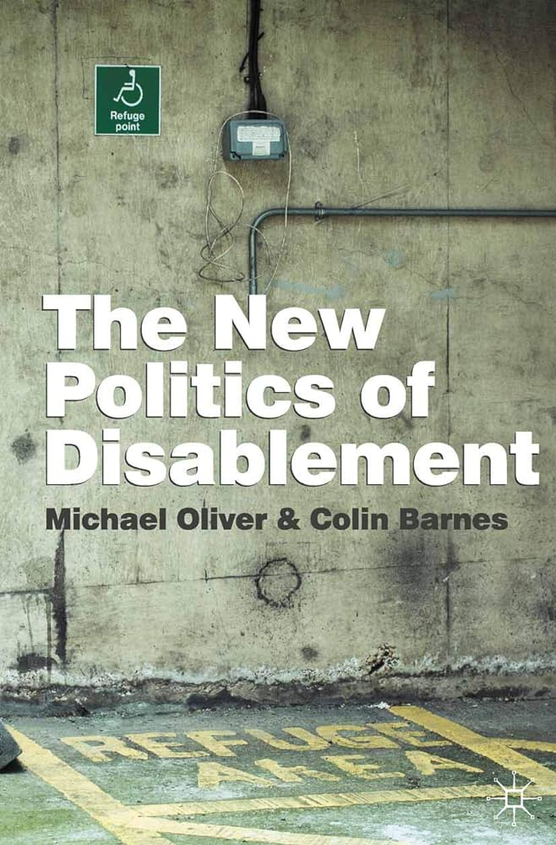
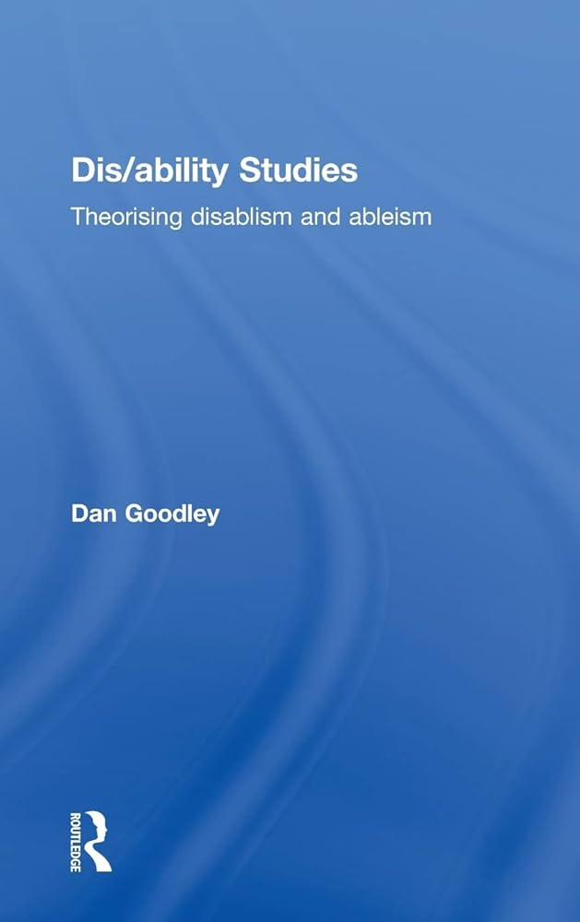
The roots of the UN - CRPD (iii)
Disablism / Ableism (Dan Goodley, 2014)
Discriminatory, oppressive, abusive behaviour arising from the belief that disabled people are inferior to others.
Refers to prejudice, stereotyping, or "institutional discrimination" against disabled people. Structural feature of society
Conscious discriminatory behaviour and unconscious ways to relate to people with disabilities.
Parallel with sexism or racism : a justice issue

Slide 16
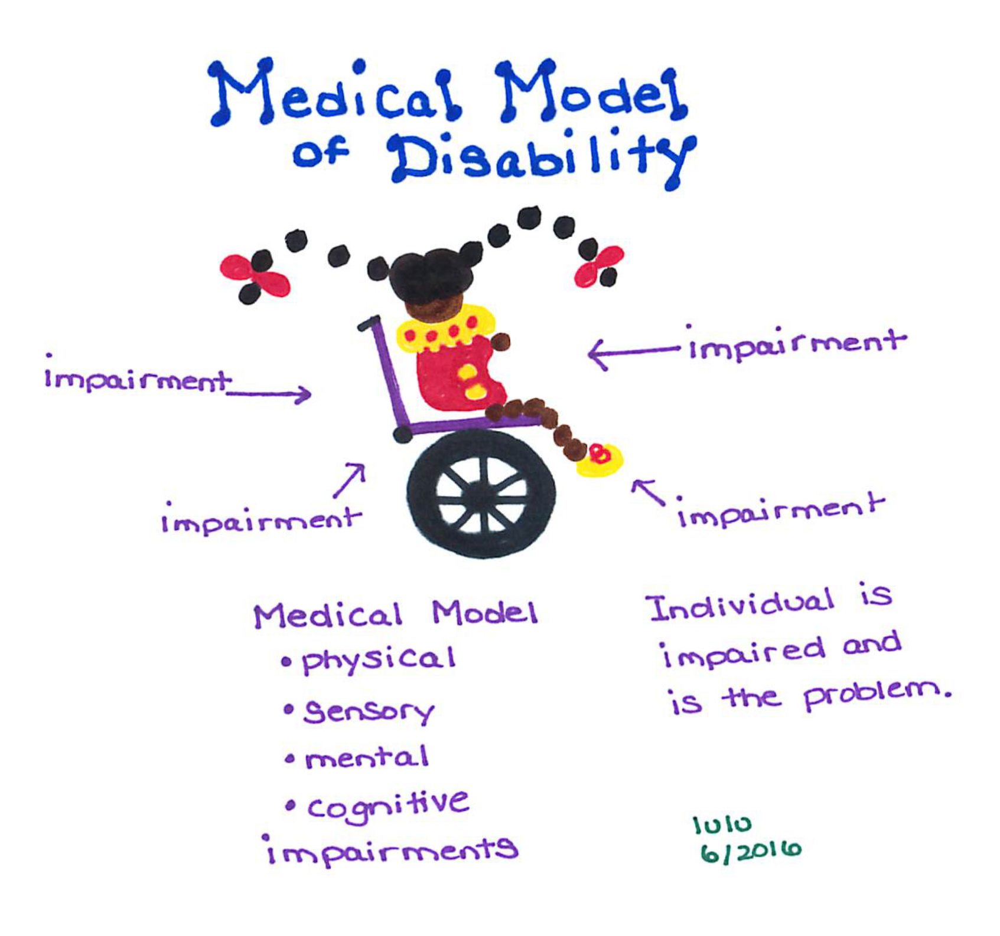
The medical model of disability
Person with disability
- medical failures ; victims of circumstances
- a patient in need of specific care and institutions apart from the « valid »
communities and society
Disability
- negative individual characteristic, deviating from the norm
- limitations of capacities due to the person’s defects ➔ a dis-adaptation
Care
restoration of what is considered to be « normal »
rehabilitation provisions and practices
Responding to basic needs (to the detriment of complex, human needs)
The carer is the only agent of change
The patient
Notes:
– where the norm not only refers to the existence of a fact, but also to the 'value' attributed to this point of reference

Slide 17
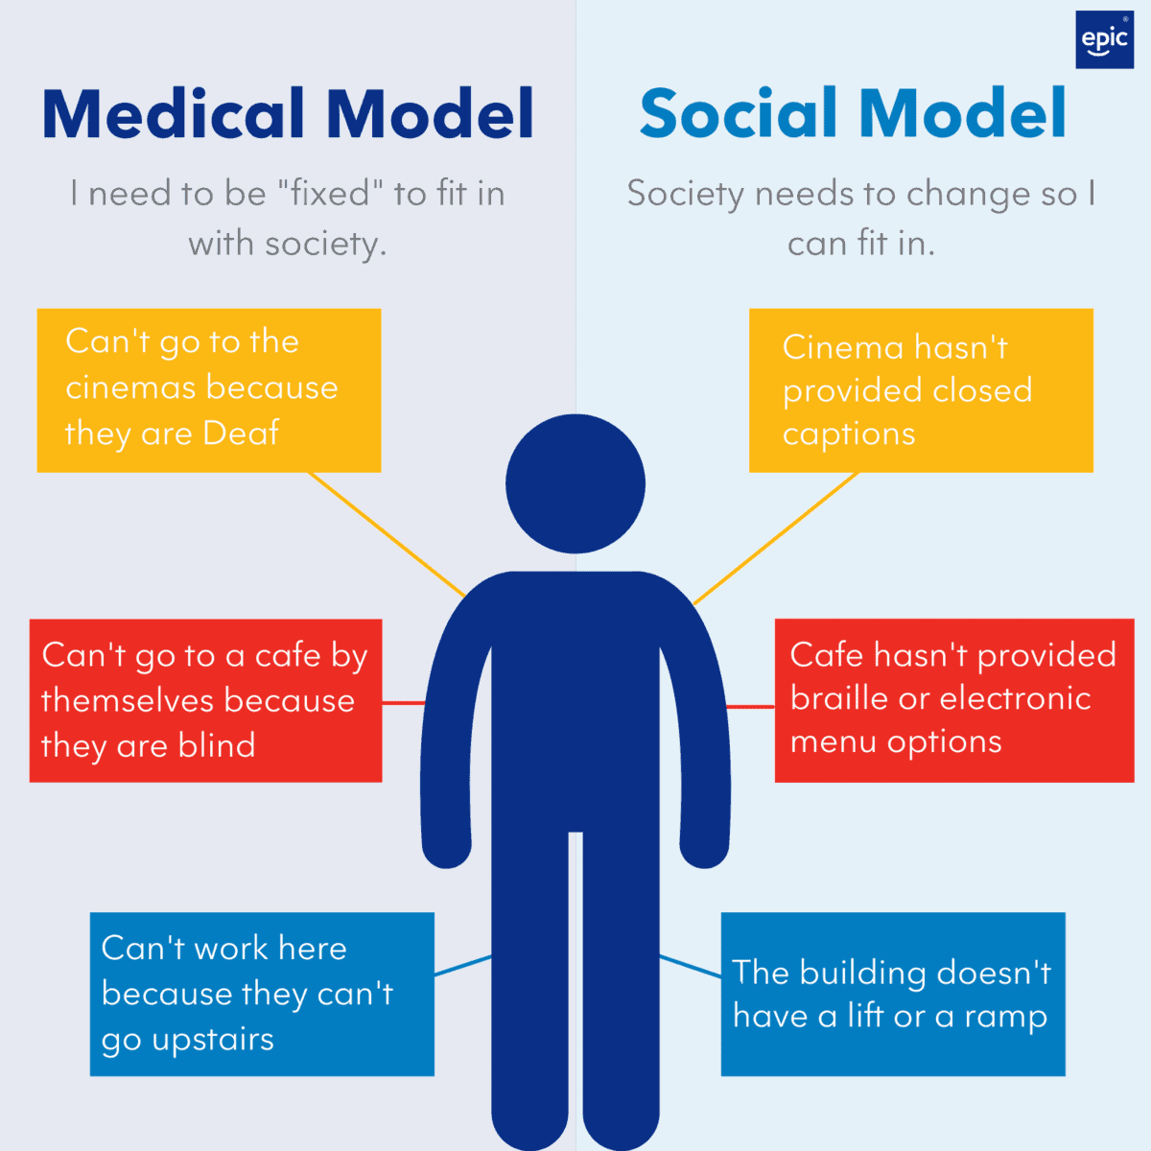
Towards the social model of disability
The citizen
A justice issue
The patient
Notes:
– where the norm not only refers to the existence of a fact, but also to the 'value' attributed to this point of reference

Slide 18
The social model of disability
Person with disability
someone who experiences disadvantages and difficulties related to the
Inherent limitations of the social environment (material, relational,
ideological limitations)
Disability
consequence of a dynamic interaction between a person's health and
other personal factors (such as age, sex, personality or level of education)
and the social and physical environment
« Disability is a result of how society is organised […] disability is about
discrimination and social exclusion »
Notes:
– where the norm not only refers to the existence of a fact, but also to the 'value' attributed to this point of reference

Slide 19
The social model of disability
Care
- the response to disability is a change in this interaction, by acting on the
environment
- the response is collective / social
- the person with a disability, together with others, can grow into a full
participant in this transformation
- does not exclude the medical care when this is useful and necessary
- should help fighting against discrimination
Notes:
– where the norm not only refers to the existence of a fact, but also to the 'value' attributed to this point of reference

Slide 20
The social model : limits
Gzil, F.(2024) ; Charras, K. & al. (2022) ; Weil-Dubuc, P. (2021)
Compensatory logic centered on the environment
- too visible and unsightly environmental design
- perspective aligned with functional and technical standards defined by able-bodied people
a standardized ideal of independent living and autonomy
favours the functional (physical or mental) autonomy
disempowerment of the person
favours those with the least impairment
risk of ableism - disablism
« the compensatory perspective anchors difference, cements stigma and reinforces discrimination » (Charras & al.)
Notes:
Gzil, F.(2024), Research on Medical ethics, the Alzheimer Phenomenon and Autonomy, ENS, Paris
Charras, K. & al. (2022) , S’affranchir du concept de handicap
Weil-Dubuc, P. (2021), « La pensée inclusive à l’épreuve du polyhandicap », in Camberlein, Ph. (ed.),Dunod

Slide 21
Strenghtening the social model : anthropological perspective*
What we all have in common as human beings (with disability or not)
We all are fundamentally vulnerable : every human project always collide in one way or
another with its own boundaries
We all are relational, interdependant beings ; mutual care is a precondition of human
life, we have secondary needs (Kitwood)
We all are unique, thus different from each other
Notes:
* For lack of anything better

Slide 22
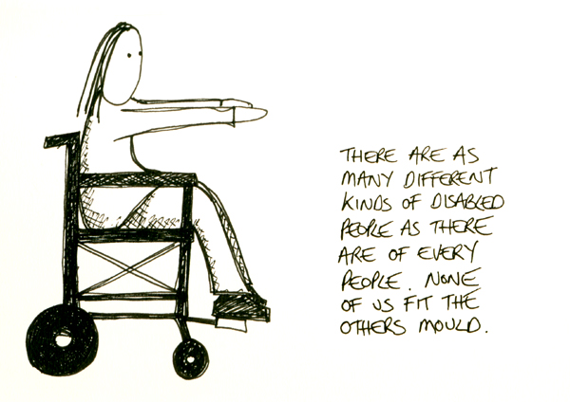
Strenghtening the social model: anthropological perspective
A logic of positive difference instead of « negative otherness » to :
- lower the boundaries between « us » and « them »
pay attention to the person’s lived experience
to account for moral and civil autonomy (not only functional) : one’s values, representations, desires, & capacities as a citizen
consider secondary needs (Kitwood, Rogers)

Slide 23
Take home message to finish
➔ Major care and ethics challenges at a global scale chronic diseases, neuro-evolutive diseases, changes due to advanced age, long-term mental health issues
➔ Challenges that might usefully be considered from the point of view developed by the disability movements & studies
➔ To « de-medicalise » ? Fundamental rights + social model + « anthropological » considerations
➔ Towards an ethic of care (Joan Tronto, 1993, Molinier, 2020), for which social justice and solidarity is a condition of a genuine autonomy

Slide 24
Thank you for your attention
Notes:
* For lack of anything better

