Slide 1
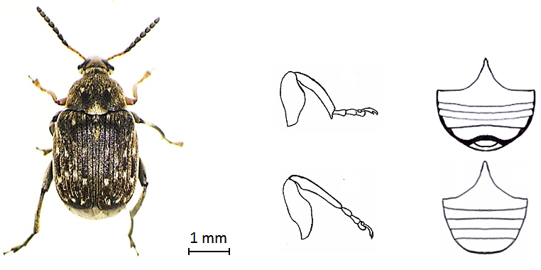
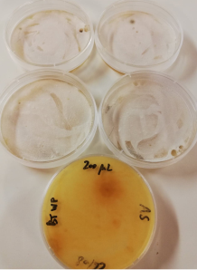
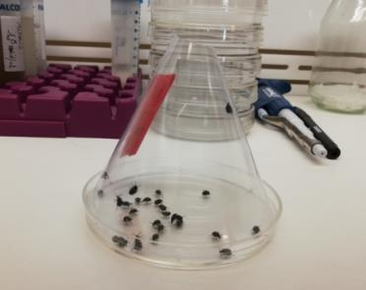
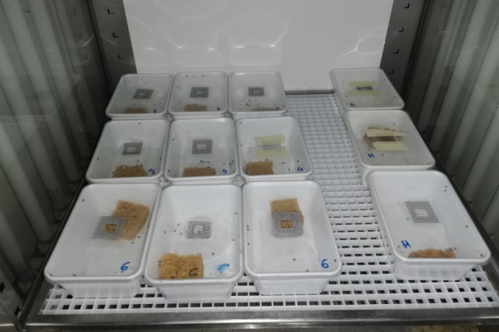
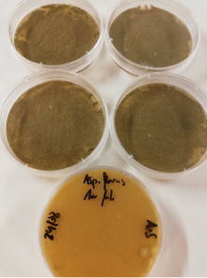
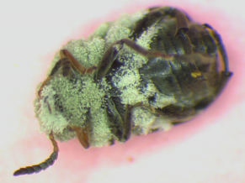
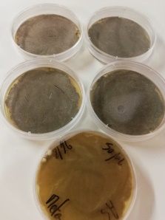
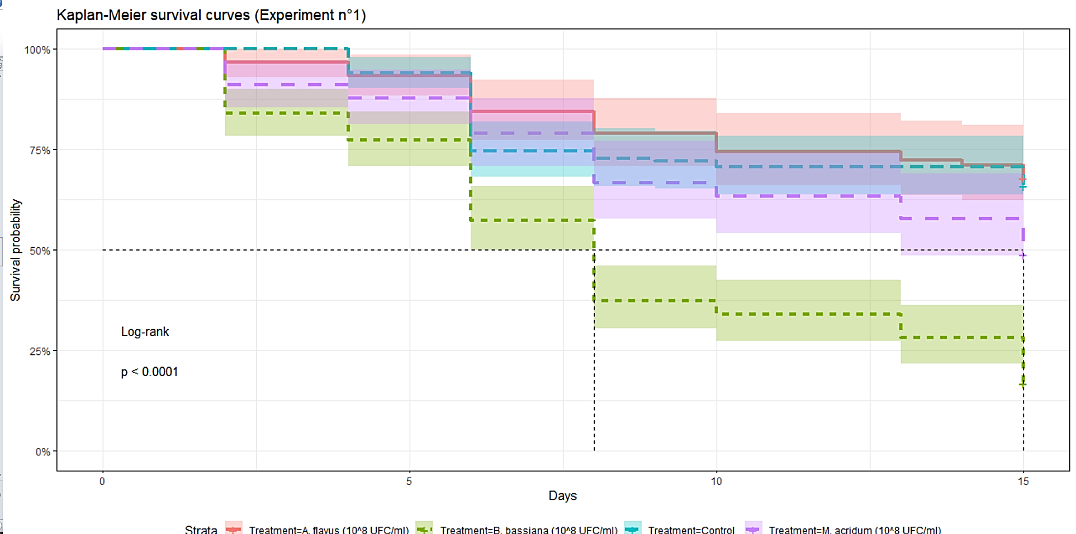
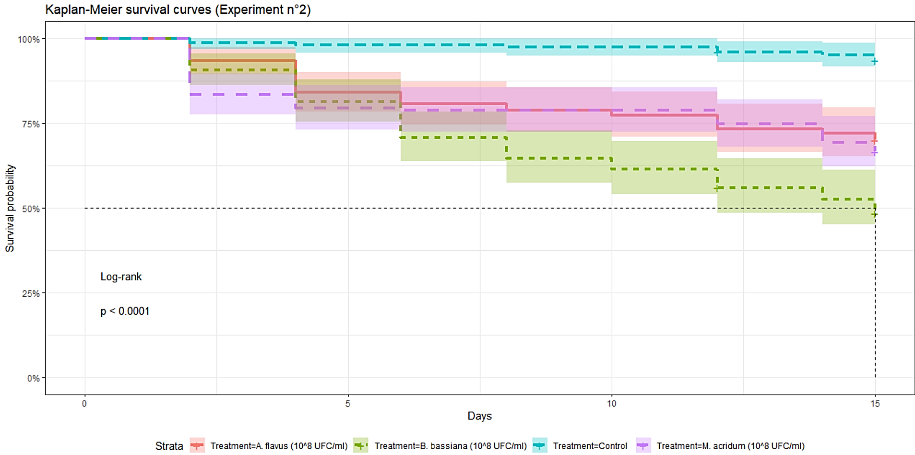
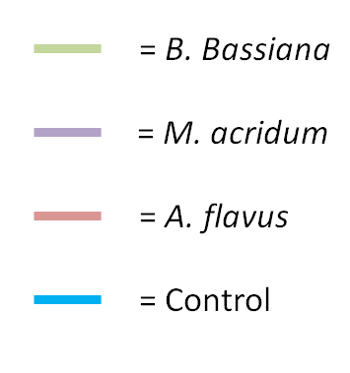
Susceptibility of Bruchus rufimanus Boheman 1833 (Coleoptera: Chrysomelidae) to three entomopathogenic fungi: Limits of conidial suspensions sprayings and potential alternatives in integrated pest management strategy
Arnaud Segers*¹ ; Rudy Caparros Megido¹ ; Caroline De Clerck² ; Frédéric Francis¹
¹ Functional and Evolutionary Entomology–Gembloux Agro-Bio Tech (University of Liège), Gembloux, Belgique, Belgium.
² Agriculture Is Life - Gembloux Agro-Bio Tech (University of Liege), Gembloux, Belgique, Belgium
Introduction
B. rufimanus is a serious pest of Vicia faba preventing the valorization of seeds because of damage caused by seminovorous endophytic larvae ;
Conventional control methods (i.e. field spraying of pyrethroids against adults) became inefficient and restricted so that alternatives are needed ;
Three entomopathogenic fungi were tested in laboratory to develop potential microbial biocontrol agents (MBCAs).
B. rufimanus
(COLEOPTERA : Chrysomelidae)
Material and method
2 Bioassays were led to determine LT 50 of three fungal strains:
Hand spraying
1 ml of 10^8 CFU/ml of conidial suspensions
1 ml of water + 0.05% Tween 80 ®
T° = 25 ± 2°C
HR = 75%
Photoperiod = 16L:8D
Conidial suspension diluted in water + 0.05% Tween 80 ®
10^8 CFU/ml
Beauveria bassiana (Bals.-Criv.) Vuill. 1912 (strain GHA)
20-25 days
T° = 25°C
Batches of 30 insects aged of 1 month per treatment
Medium = PDA + 0.005% of chloramphenicol
Aspergillus flavus Link 1809
 | Treatments | Repetition (Batches) | n insects | CO₂ anesthesia | Estimated conidial amount per insect
Bioassay n°1 | Control | 5 | 150 | No | > 2.56 10⁵ conidia/insects
 | B. bassiana (10^8 CFU/ml) | 5 | 150
 | M. acridum (10^8 CFU/ml) | 3 | 90
 | A. flavus (10^8 CFU/ml) | 3 | 90
Bioassay n°2 | Control | 5 | 150 | Yes | = 2.56 10⁵ conidia/insects
 | B. bassiana (10^8 CFU/ml) | 5 | 150
 | M. acridum (10^8 CFU/ml) | 5 | 150
 | A. flavus (10^8 CFU/ml) | 5 | 150
Counting dead infected insects (2 days)
Metarhizium acridum (Driver & Milner) J. F. Bisch., S. A. Rehner & Humber 2009
Statistical analyses for estimations of LT50: Kaplan-Meier log-rank test
Results and discussion
 |  | Kaplan-Meier survival estimates |  |  |  |  |  | Log-rank test with control
 | Treatments | n | Events | Median | 0.95LCL | 0.95UCL |  | Chisq | Df | P
Bioassay n°1 | Control | 150 | 51 | >15 | >15 | >15
 | B. bassiana (10^8 CFU/ml) | 150 | 125 | 8 | 6 | 8 |  | 72.4 | 1 | <0.001
 | M. acridum (10^8 CFU/ml) | 90 | 46 | 15 | 13 | >15 |  | 6.3 | 1 | 0.01
 | A. flavus (10^8 CFU/ml) | 90 | 29 | >15 | >15 | >15 |  | 0.1 | 1 | 0.8
Bioassay n°2 | Control | 150 | 9 | >15 | >15 | >15
 | B. bassiana (10^8 CFU/ml) | 150 | 77 | 15 | 12 | >15 |  | 74.7 | 1 | <0.01
 | M. acridum (10^8 CFU/ml) | 150 | 50 | >15 | >15 | >15 |  | 33.3 | 1 | <0.01
 | A. flavus (10^8 CFU/ml) | 150 | 45 | >15 | >15 | >15 |  | 28.4 | 1 | <0.01
Kaplan-Meier survival curves of bioassay n°1
Kaplan-Meier survival curves of bioassay n°1
B. bassiana : LT50 = 8 days (χ²₍₀.₉₅ ̦ ₁₎ =72.4; p<0.001)
M. acridum : LT50 = 15 days (χ²₍₀.₉₅ ̦ ₁₎ = 6.3; p=0.01)
A. flavus : LT50 > 15 days
B. bassiana : LT50 = 15 days (χ²₍₀.₉₅ ̦ ₁₎ = 74.7; p<0.001)
M. acridum and A. flavus : LT50 > 15 days
LT 50 are too long when adults are in contact with conidial suspensions to avoid any oviposition ;
Innundative delivery methods of MBCAs on the canopy of V. faba (as it could be performed with conventionnal sprayers) seems complicated for implementation of successful control pethods against adults of B. rufimanus before oviposition on forming pods ;
Moreover, additionnal field factors would decrease conidia viabilities and application on V. faba such as UV light, dessiccation, unfavorable temperature ranges, or the dense canopy of V. faba preventing the conidial suspensions spray to reach the target parts of the plants.
Further studies should be performed on other strains of entomopathogenic agents and/or other modes of application to adults such as « attract and infect » strategies
Projet FEVERPRO - référence dossier: D31-1395, WP 1/5
*Contact: arnaud.segers@uliege.be

