Slide 1
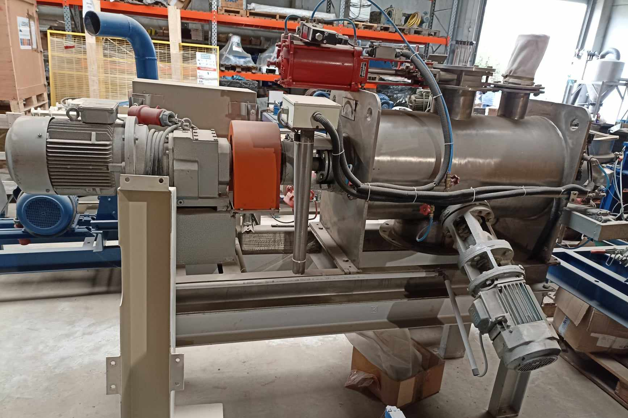
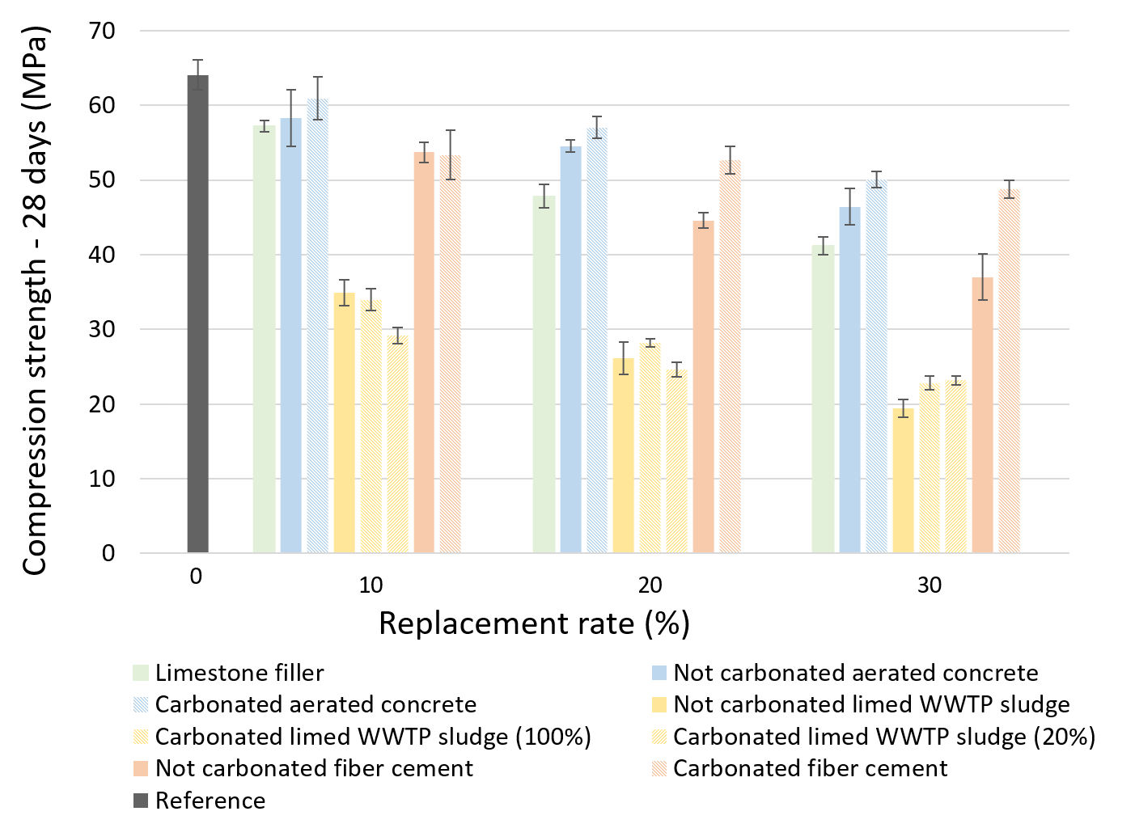
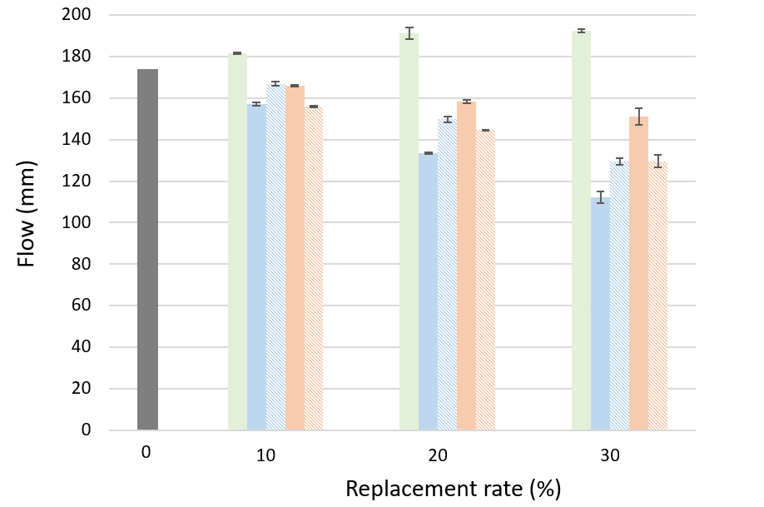
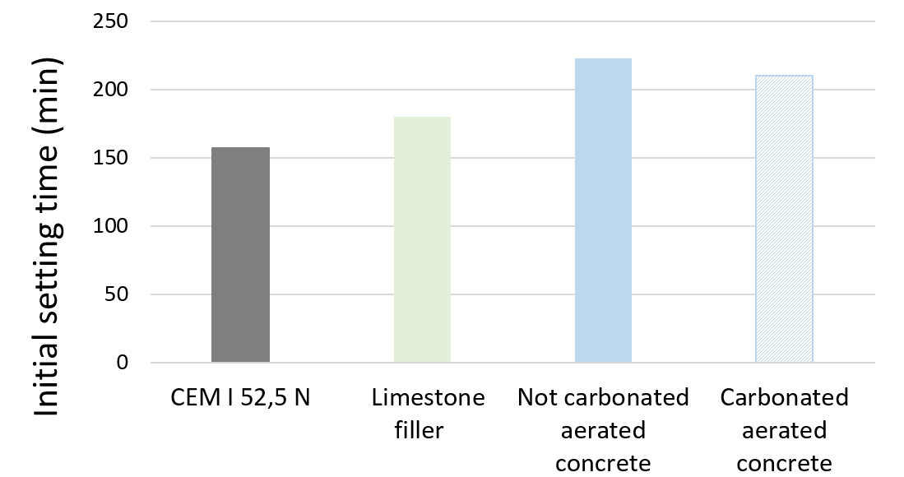
Valorization of mineral waste through accelerated carbonation
S. Grigoletto¹, A.F. Kameni Wontcheu¹, E. Aubry², S. Marquis³, L. Courard¹
¹ Urban and Environmental Engineering, University of Liège, Belgium
^{2.} Carmeuse Europe S.A., Belgium
³ Centre Terre et Pierre, Belgium
sophie.grigoletto@uliege.be +32 4 366 92 24
PARTNERS
1. CONTEXT
Mineral waste is by far the largest waste stream in Europe. Unlike other waste streams, it is rarely recycled and predominantly stored of in landfills. Carbonation is a way to transform industrial by-products of an alkaline nature into new products which have technical characteristics compatible with their most general use as construction materials. The aim of this study, which is a part of the Mineral Loop project, is to bring added value to some carbonated mineral waste by valorizing them as a partial substitute for cement in mortar composition.
Mineral waste
Accelerated carbonation
Industrial CO₂
Fillers
2. MATERIALS
Fines from three different material flows are studied:
fiber cement
aerated concrete
limed sludge from waste water treatment plant (WWTP).
They are all passing through a 100 μm sieve. A limestone with a high content of finely ground pure calcium carbonate is used as a reference filler.
Part of the resulting fine particles undergoes a dynamic carbonation process in an industrial mixer, composed of:
a 120 L tank, hermetically closed
2 valves installed in its upper part allowing gas supply and evacuation
a main axial rotor equipped with 6 lifting blades, ensuring mixing of the materials.
3. METHODS
Fines are used as fillers, substituting Portland cement (CEM I 52,5 N) at 10, 20 and 30% rates (by mass). Mortars compositions complies with the requirements of NBN EN 196-1 standard.
Tests are conducted according to NBN EN 1015-11 standard on hardened mortar specimens to determine their compressive strength at 7 and 28 days.
The consistency of freshly mixed mortars is estimated by means of the flow value, according to NBN EN 1015-3 standard.
The setting time of cement paste is determined by measuring the penetration of a needle of well-defined weight and diameter into a paste of standard consistency until it reaches a specified value, according to NBN EN 196–3. The water content of the cement paste of standard consistency must be determined from several different mixtures. Replacement rate is set at 30% for this test.
coming from demolition wastes
Material | Reference | 10% | 20% | 30%
Normalized sand | 1350 | 1350 | 1350 | 1350
Cement | 450 | 405 | 360 | 315
Fillers | 0 | 45 | 90 | 135
Water | 225 | 225 | 225 | 225
Materials | Test conditions
 | W/P | % CO₂ | Flow (L/min) | Time (min)
Limed WWTP sludge | 0,3 | 100 | 8 | 120
 | 0,3 | 20 | 8 | 120
Fiber cement | 0,2 | 100 | 8 | 120
Aerated concrete | 0,3 | 100 | 8 | 180
4. RESULTS
When substituted to Portland cement, all tested fines lead to a loss of mechanical properties. For fiber cement and aerated concrete fines, this loss is comparable to the one of limestone filler. However, with a reduction of nearly 50% of the compressive strength at only 10% of replacement, limed WWTP sludge is rejected and not tested further. In any case, carbonation treatment of fines seems to contribute to improve the mechanical performances of mortar specimens compared to specimens made of raw fines.
Unlike limestone filler, workability of mortars decreases when replacement rate is increased. At a fixed substitution rate, carbonation of aerated concrete fines improves the workability of the mortars. It is not the case for fiber cement fines, probably because carbonated and not carbonated fines come from different batches.
CONCLUSIONS
1
Cement can be partially replaced by carbonated fiber cement and aerated concrete fines to 30% replacement rate without losing more than 30% of 28 days compressive strength.
Due to its high organic matter content, limed WWTP sludge fines cannot be used as cement substitute, even when carbonated.
Carbonation of aerated concrete fines improve mortars workability and initial setting time.
The use of 30% of aerated concrete fines tends to increase significantly the initial setting time of the cement paste, more than the use of limestone filler at the same rate. However, carbonatation of these fines reduces slightly this increase.
Results on fiber cement fines not yet available.
2
3

