Slide 1
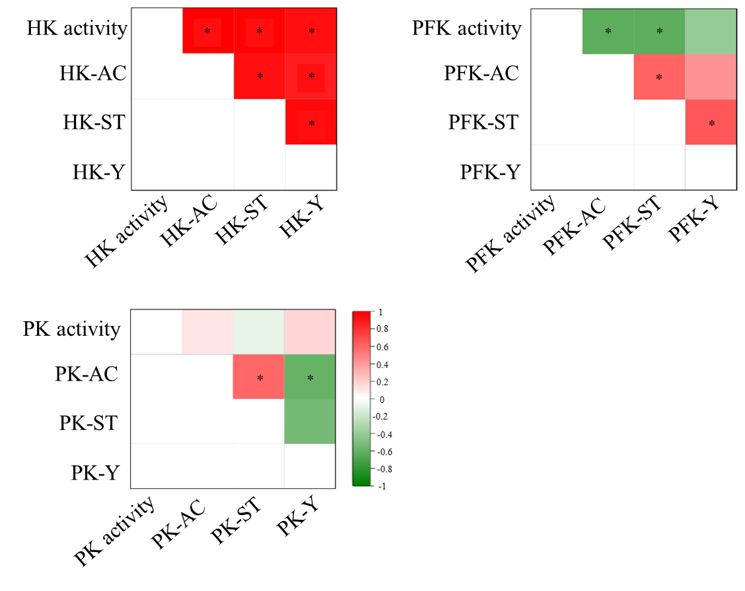
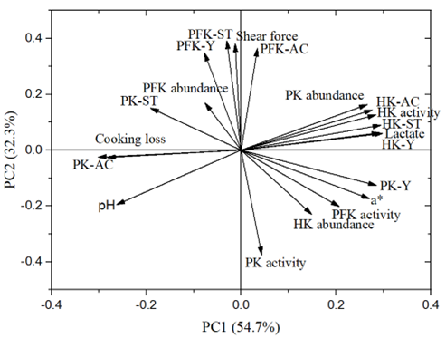
Phosphorylation and acetylation of glycolytic enzymes cooperatively regulate their activity and meat quality
Chi Ren, Xin Li, Chengli Hou, Li Chen, Xiaochun Zheng, Zhenyu Wang and Dequan Zhang*
Institute of Food Science and Technology, Chinese Academy of Agricultural Sciences/ Key Laboratory of Agro-products Quality & Safety in Harvest, Storage, Transportation, Management and Control, Ministry of Agriculture and Rural Affairs, Beijing 100193, P. R. China
*Corresponding author email: dequan_zhang0118@126.com
I. Introduction
Glycolysis is the main pathway of energy metabolism in the postmortem muscle, which greatly determines meat quality. Hexokinase (HK), phosphofructokinase (PFK) and pyruvate kinase (PK) are the three rate-limiting enzymes of glycolysis. The activity of glycolytic enzymes is of great concern for meat quality development due to their effects on the glycolysis rate. Previous studies have showed that the activities of glycolytic enzymes are vital to regulate meat quality through a single PTM of protein phosphorylation or acetylation. However, the role of phosphorylation and acetylation crosstalk on the activities of glycolytic enzymes in postmortem muscle is still unknown. The objectives of present study were to investigate the coregulation pattern of phosphorylation and acetylation of HK, PFK and PK in muscle samples with different glycolysis rates, and the consequent influence on meat quality.
affect the biological characteristics of meat. First, the phosphorylation and acetylation of glycolytic enzymes influence meat quality through the effect of enzymes activity on glycolysis. Second, the phosphorylation and acetylation of glycolytic enzymes regulate the interaction of them with other proteins such as those located in mitochondria and the cytoskeleton.
II. Material and Methods
The pH changes from 1 h to 1 d at 4°C of lamb longissimus thoracis lumborum (LTL) muscle were measured. LTL muscle of fast and slow pH decline were selected respectively (n = 9). Meat quality traits including colour, shear force and cooking loss were measured. The activity, abundance, phosphorylation and acetylation level of HK, PFK and PK were evaluated, respectively. The data of three replications were recorded as means ± standard deviation and analyzed by a general linear model with different glycolysis rate groups and postmortem times in SPSS Statistic 19.0. P < 0.05 represented the significant difference.
Figure 1. Correlation analysis between phosphorylation level, acetylation level and activity of HK (A), PFK (B) and PK (C). “AC” means protein acetylation level, “ST” means protein Ser/Thr phosphorylation level, “Y” means protein Tyr phosphorylation level. Red color represents positive correlation, green color represents negative correlation. * P < 0.05.
III. Results
HK activity was positively correlated with its acetylation and phosphorylation (P < 0.05, Fig.1). The acetylation and Ser/Thr phosphorylation of PFK showed a negative correlation with its activity (P < 0.05, Fig.1). Although there was positive correlation between PK acetylation level and Ser/Thr phosphorylation level, it was negatively correlated with Tyr phosphorylation level (P < 0.05, Fig.1). The results of principal component analysis (PCA) showed that a total of 87% was assigned to PC1 (54.7%) and PC2 (32.3%) (Fig.2). The features of HK including its activity, acetylation level, Ser/Thr and Tyr phosphorylation levels were closely related with the lactate content. The protein acetylation of PK was linked with cooking loss. The shear force was mostly related with the properties of PFK and they were strongly affected by PC2. PFK is the most attracting one for actin and presents higher catalytic activity compared to other binding proteins, which might be the reason of the close relationship between PFK and tenderness. Thus, there are two possible pathways of how phosphorylation and acetylation
Figure 2. The first two principal components for 20 variables. PC1 and PC2 accounted for 54.7% and 32.3%, respectively.
Ⅳ. Conclusions
The phosphorylation and acetylation of HK, PFK and PK coregulate glycolysis through different crosstalk patterns on their activity and this might affect meat quality.
69th International Congress of Meat Science and Technology, 20-25 August 2023, Padova, Italy

