Slide 1
Inconsistent administrative enforcement of EU law at Member State level: the Lisbon Treaty’s hidden constitutional challenge?
Katarzyna A. Jancewicz, Prof. Dr. Pieter Van Cleynenbreugel, LL.M., Dr. Julien Bois
Université de Liège
This project has received funding from the European Research Council (ERC) under the European Union's Horizon 2020 research and innovation programme (grant agreement n° 948473).

Slide 2
Art. 291(1) TFEU: EU law implemented and a fortiori enforced by the Member States
EU secondary legislation: conditioning the design, decision-making powers and judicial review options left for Member States
?
ERC Project mapping: 18 fields
National laws
27 Member States: competent to designate administrative authorities and provide for the enforcement powers
?
?
?
?
FR
PL
PT
RO

Slide 3
Increasingly fragmented landscape = different resources are allocated in different Member States to the enforcement of different EU legal norms
At times, choices made by the EU legislator even appear somewhat contradictory in nature. In the realm of consumer protection law, no independent authority has to be established but competent authorities need to have a minimum amount of investigative and enforcement powers. By contrast, in the realm of platform regulation, which is directly inspired by existing more general consumer protection obligations, Member States have to provide for independent competent authorities entrusted with enhanced investigative and sanctioning powers (Compare Art. 5 of Regulation 2017/2394 with Articles 49-51 of Regulation 2022/2065)
openart.ai (no copyrights)

Slide 4
Contradictory?
Art. 291(1) TFEU: EU law implemented and a fortiori enforced by the Member States
EU secondary legislation: conditioning the design, decision-making powers and judicial review options left for Member States
Sector-specific?
Fragmentation?
Independent data protection authorities to be set up
Member States shall identify competent authority or authorities
Competent authorities or criminal prosecution authorities
Q: How does the EU constitutional law framework affect this increasingly fragmented landscape ???
National laws
27 Member States: competent to designate administrative authorities and provide for the enforcement powers

Slide 5
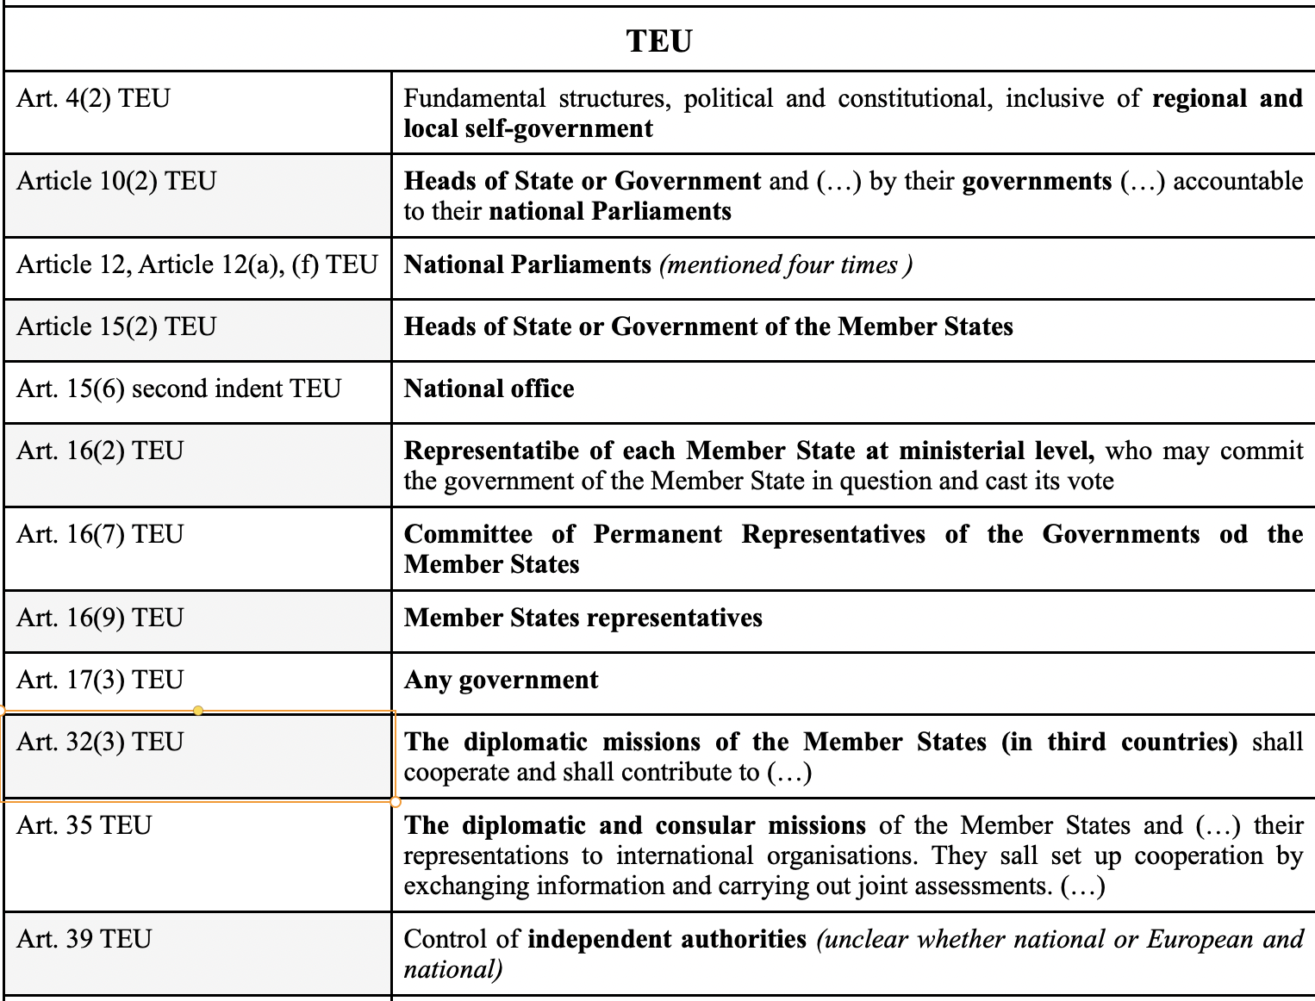
Q: How does the EU constitutional law framework affect this increasingly fragmented landscape ???
1) mapping of disparate references to coordinated enforcement of EU law that can be found in the EU’s founding Treaties
Methodology: mapping all references to public authorities of Member States (incl. ambiguous ones) and to cooperation/coordination

Slide 6
Q: How does the EU constitutional law framework affect this increasingly fragmented landscape ???
Article 197 TFEU implicitly legitimises this situation:
the provision only refers to ‘effective’ implementation rather than ‘consistent’ implementation -> tailored enforcement approaches to administrative design based on sector-specific needs -> Constitutionally enshrined diversity and, therefore, potentially inconsistent enforcement;
Article 197(2) TFEU: no measures harmonising Member States’ administrative structures even if those are different across Member States and policy fields.
1) mapping of disparate references to coordinated enforcement of EU law that can be found in the EU’s founding Treaties
Lack of consistency in practice
Contribution to the emergence of patchwork of sector-specific EU-influenced national institutional arrangements
Little coherence
Conceptual confusion

Slide 7
Lack of consistency in practice
Article 197 TFEU
Article 4(3) TEU: Member States shall refrain from any measure which could jeopardise the attainment of the EU’s objectives = requiring the Member States to design their administrative enforcement structures in compliance with a coherent EU-structured template ???
-> In practice, neither the EU legislator nor the CJEU have interpreted the principle in that manner
The rights to good administrative protection and effective judicial protection can be found respectively in Articles 41 and 47 CFR = to be interpreted as design standards against which Member States’ administrative enforcement structures can be held ???
-> In practice, the EU legislator has not fundamentally relied on them in that manner
Q: 2) Could other EU constitutional principles be relied on to coordinate administrative enforcement across different sectors?
?
Principle of sincere cooperation (Article 4(3) TEU)
Fundamental good administration and judicial protection rights (CFR)

Slide 8
Fragmentation -> Lack of consistency in practice
Article 4(3) TEU (-)
Articles 41 and 47 CFR (-)
Q: 3) To what extent the existing fragmentation identified before is at odds with Article 7 TFEU?
The notion of consistency?
Its potential relevance as a means to overcome the constitutional challenges raised by the Lisbon Treaty in terms of consistent administrative enforcement?
?
?
Article 7 TFEU: call for consistency among policy areas and activities
-> Introduced by the Lisbon Treaty

Slide 9
Article 7 TFEU
The role currently played by Article 7 TFEU remains limited, although not entirely insignificant; Consistent policies = those adopted in accordance with a correct legal basis (CJEU)
The focus on consistency between activities may nevertheless impose a higher burden on the EU legislator than currently relied on; No EU Treaties’s provision to impose a narrow interpretation of Article 7 TFEU;
Conclusion:
CONCLUSION:
EU legislator to face a higher consistency burden when designing or adopting administrative enforcement structures

