Slide 1
An adaptive controller of reliable neuromodulation for biological rhythm switches
43rd Benelux Meeting on Systems and Control
A. Fyon, G. Drion

Slide 2
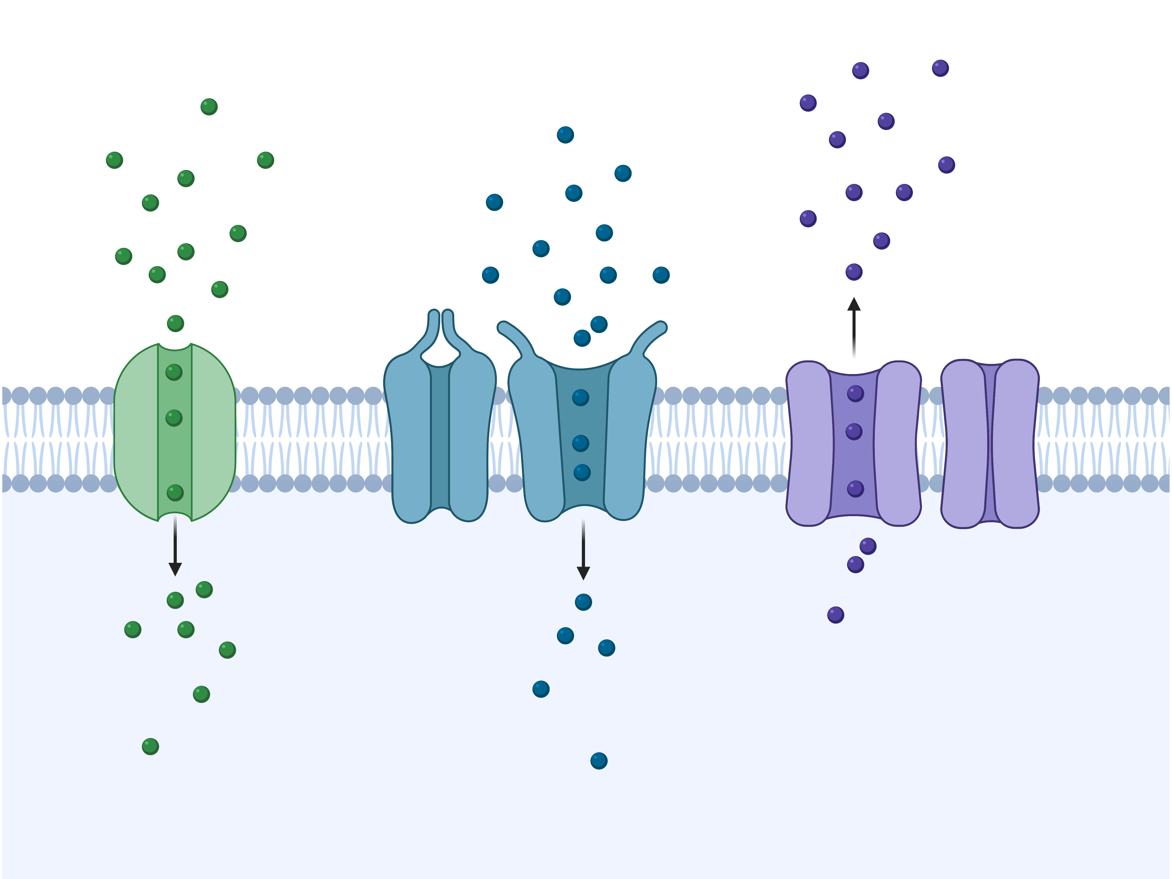
Neurons use spikes to communicate
$$Na^{+}$$
$$Ca^{++}$$
$$K^{+}$$
Jefferys et al., 1996
1
Notes:
Neurons are event-based processor

Slide 3
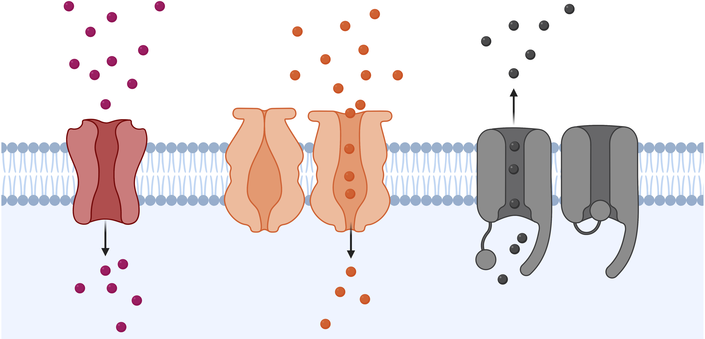
Ion channels determine spiking activity
$$Na^{+}$$
Drion et al., 2011
$$Ca^{++}$$
$$K^{+}$$
Zagha et al., 2014
2
Notes:
Spiking activity is determined by ion channels, in quantity and in type. For instance, switch from tonic to burst

Slide 4
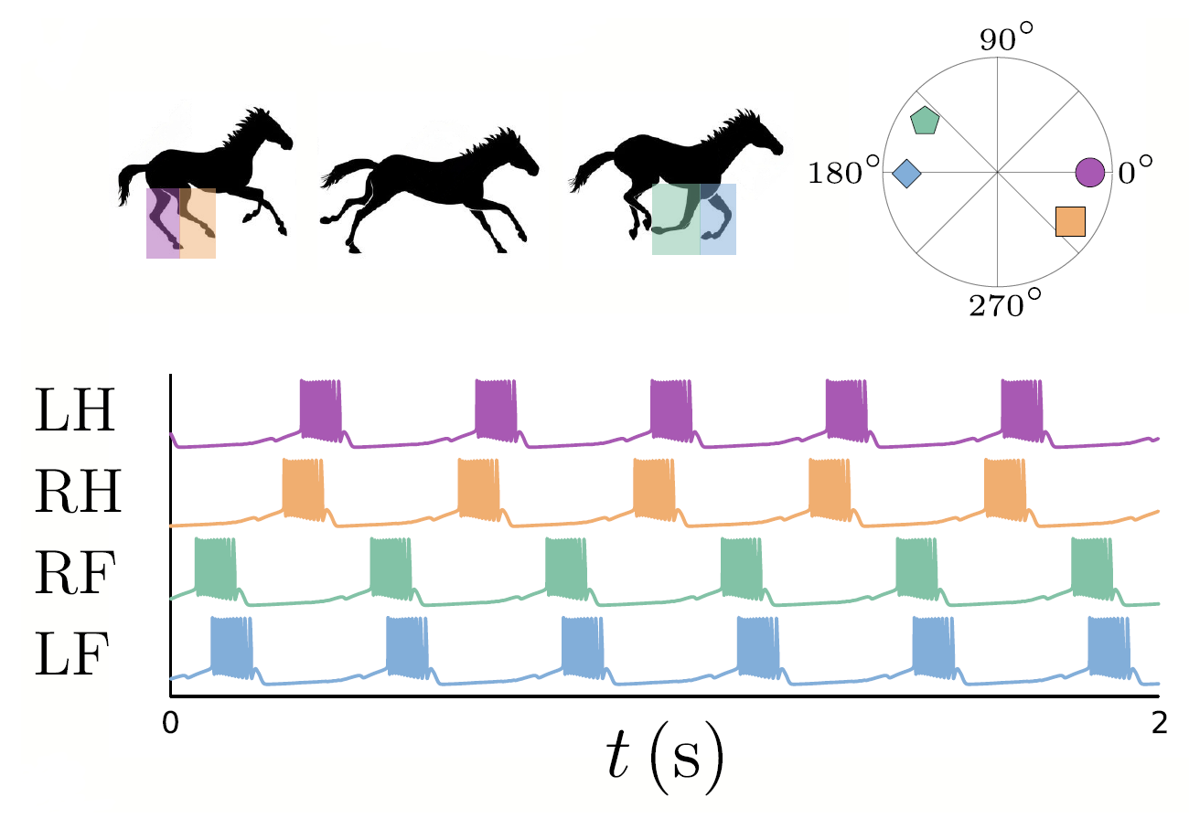
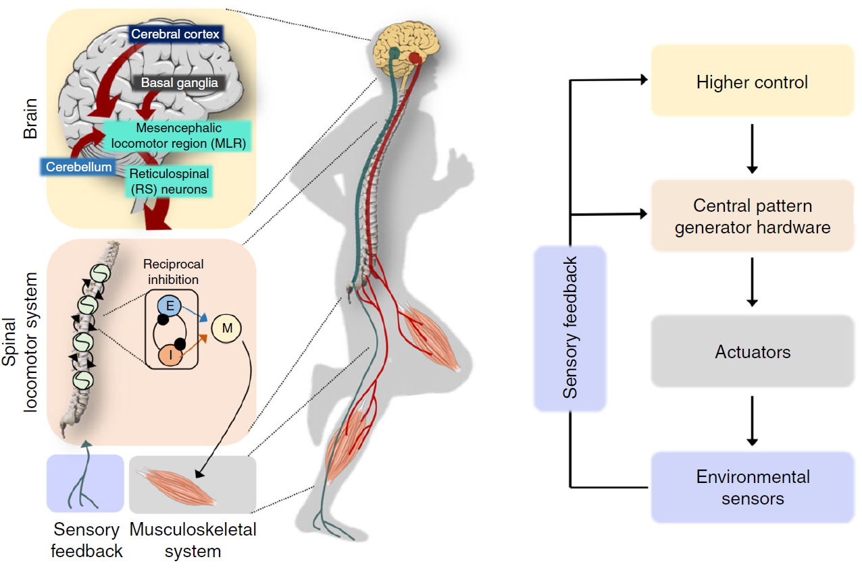
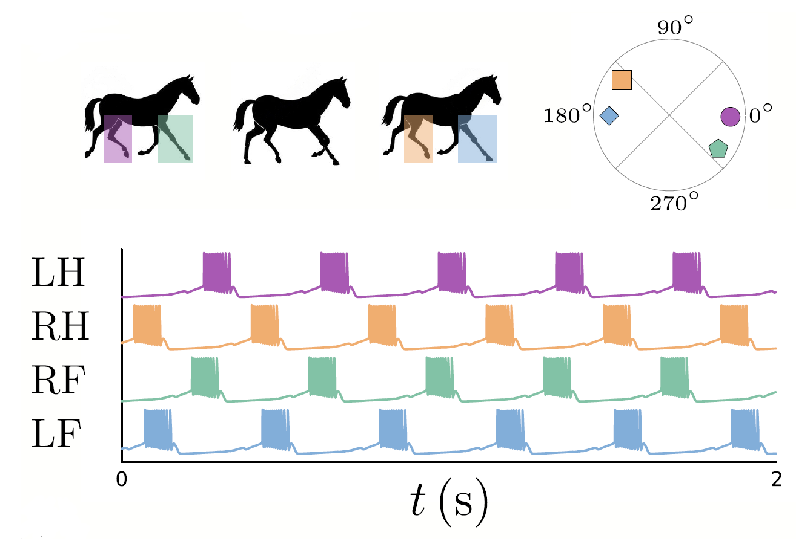
Biological rhythms from central pattern generators
Gallop
Trot
Dutta et al., 2019
3
Notes:
Bursting is an essential behavior in CPGs. Explain what CPGs are and show that for the trot/gallop, there are two different rhythms.

Slide 5
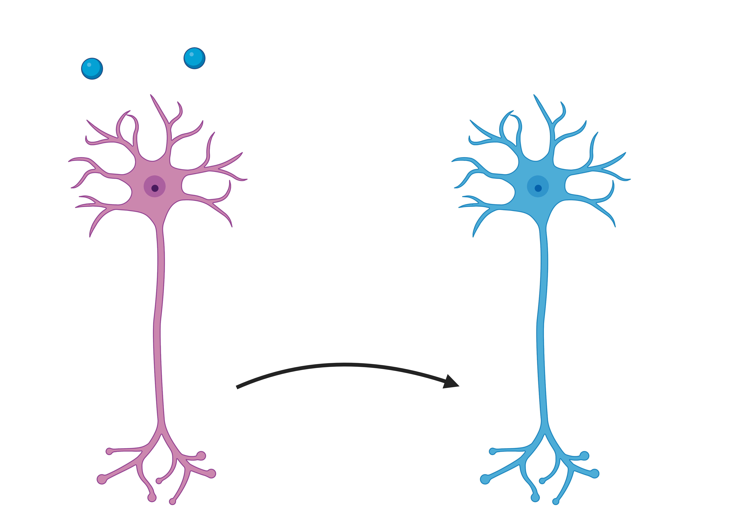
Neuronal activity is highly modulated
Control activity
Neuromodulator A
Neuromodulator B
Neuromodulation
Neuromodulator C
Marder, 2012
4
Notes:
To modulate activity, neurons rely on neuromodulation

Slide 6
Neuromodulation targets ion channels
Such neuromodulator triggers complex signaling cascade inside the cell.
The end targets are a set of ion channels.
Nadim and Bucher, 2014
5
Notes:
Neuromodulation targets ion channels, so that it switches the neuronal activity.

Slide 7
Only conductance-based models are capable of modeling ion channels
6
Notes:
Neuronal modelling consists in conductance based modelling.

Slide 8
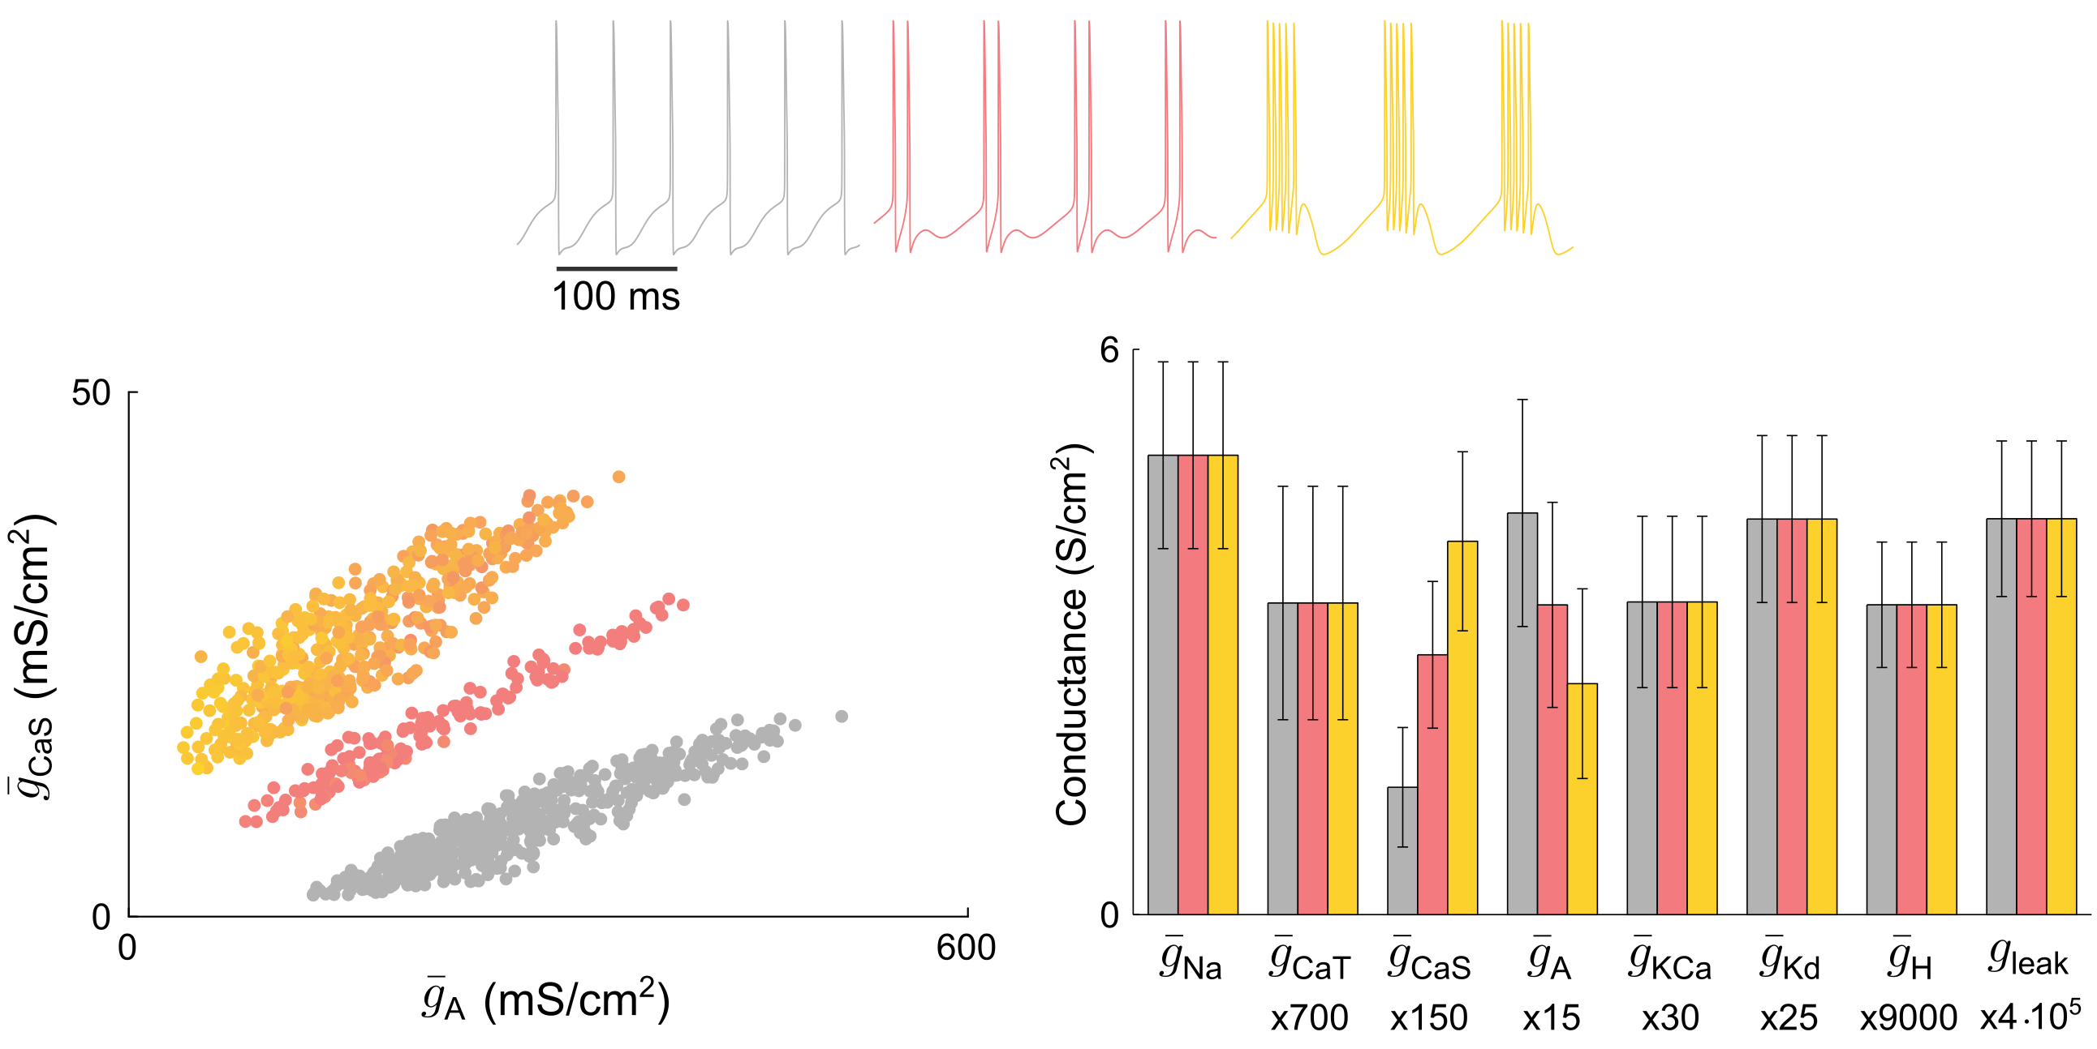
Similar activity emerge from different parameter sets
7
Notes:
However, there are a high dimensionality and degeneracy, as different values of parameters lead to the same firing pattern.

Slide 9
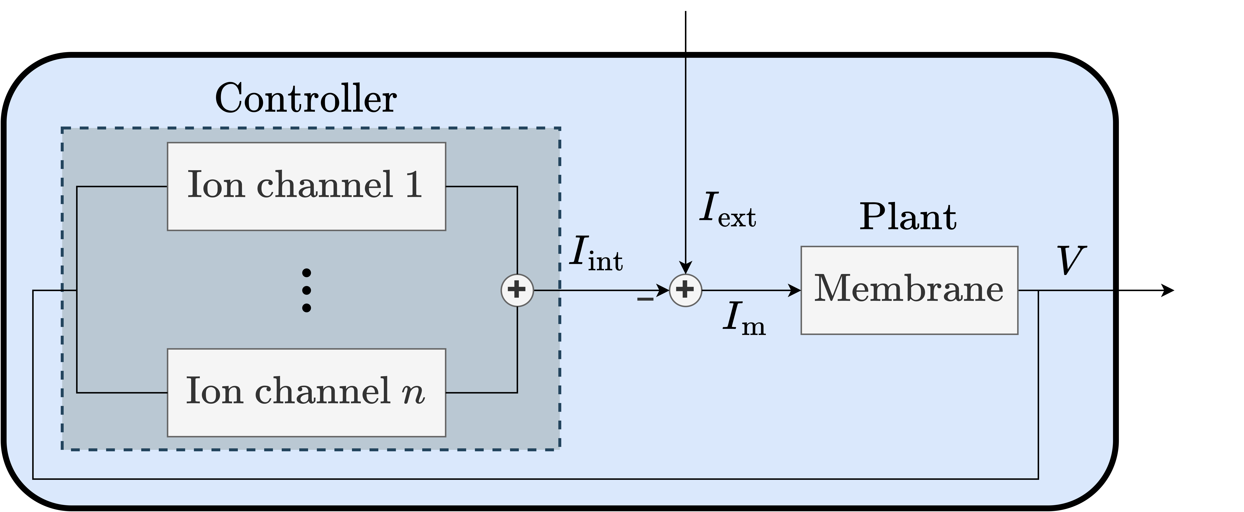
Neurons as feedback models
8
Notes:
To tackle that, we need to switch to the feedback representation.

Slide 10
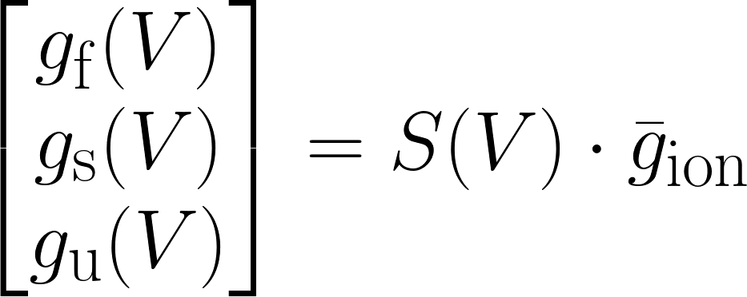
The control action of ion channels can be aggregated in 3 feedback gains
These can be aggregated into 3 neuronal feedback gains = 3 voltage dependent conductances: Dynamic Input Conductances (DICs)
Fast
Slow
Ultraslow
Drion et al., 2015
9
Notes:
This is helpful thanks to the neuronal feedback gains, this become tractable.

Slide 11
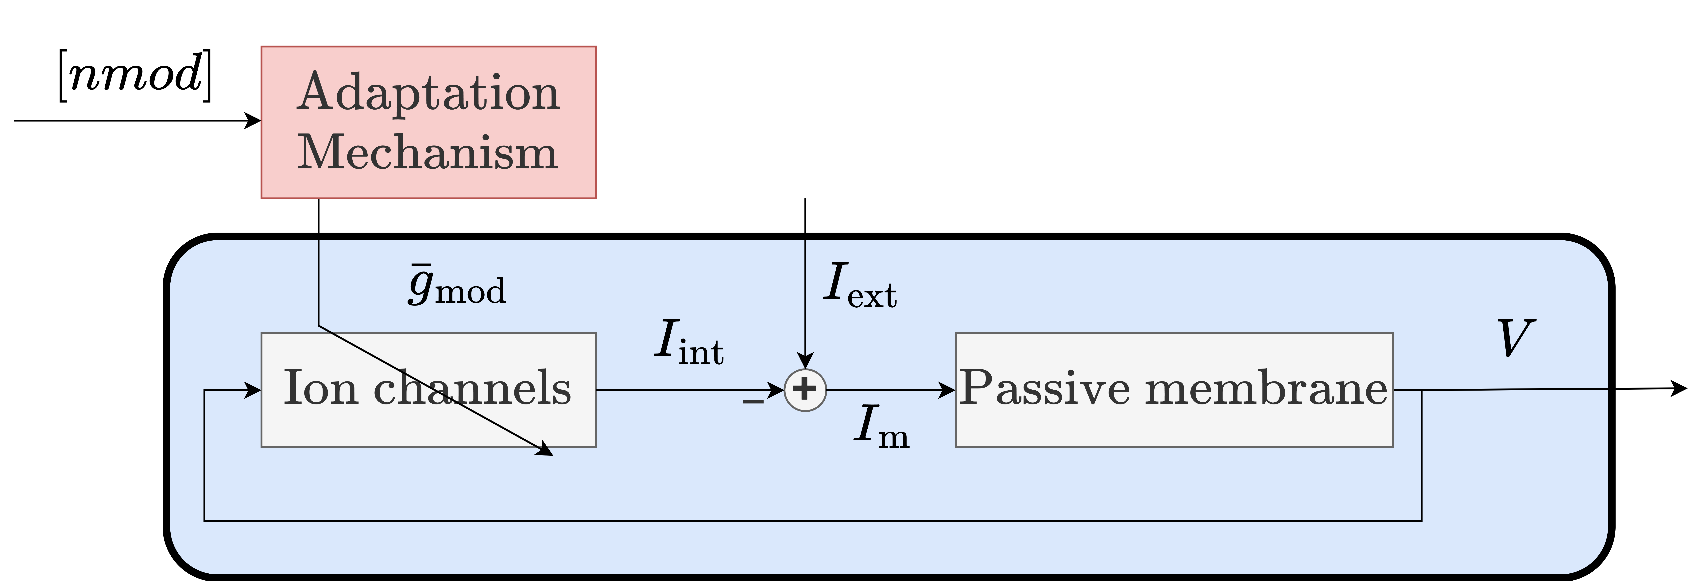
Neuromodulation can be seen as an adaptive control problem
Fyon et al., 2023
10
Notes:
Neuromodulation become tractable thanks to these neuronal feedback gains.

Slide 12
Adaptive control model enables reliable neuromodulation in variable neurons
Protocol:
Random population of 200 conductance based models with disparate parameters is generated
Tonic spiking to bursting transition is simulated with the adaptive control of neuromodulation
Variable parameters
Fyon et al., 2023
11
Notes:
Basically, the adaptive controller works.

Slide 13
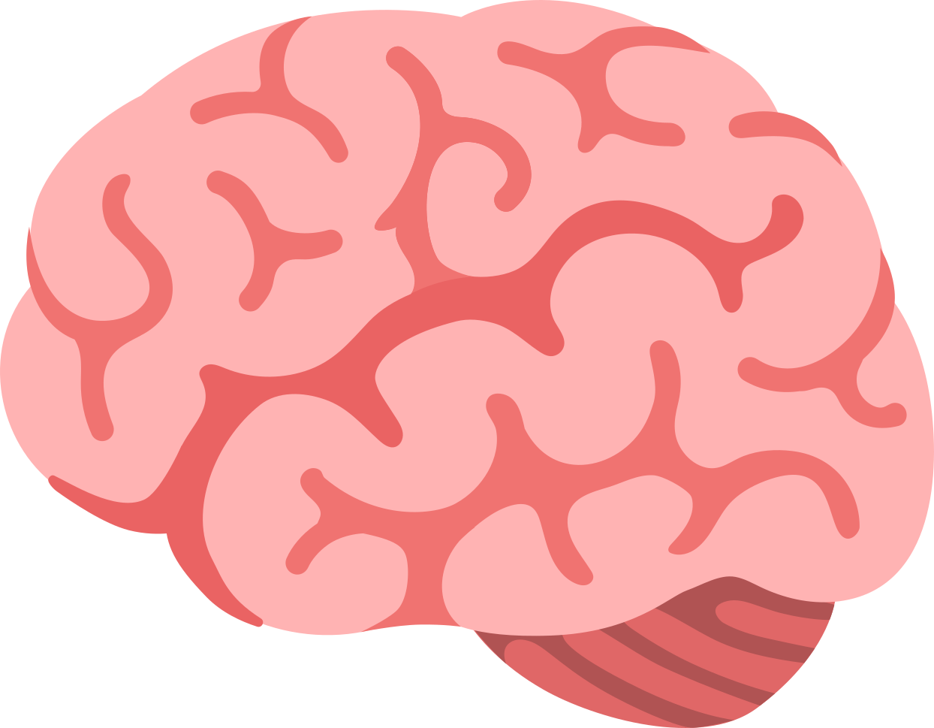
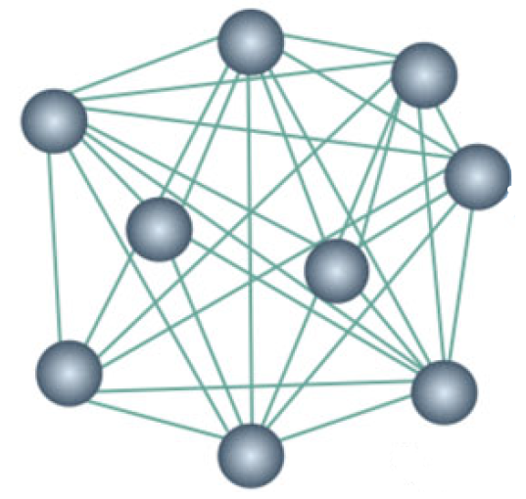
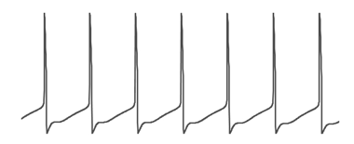
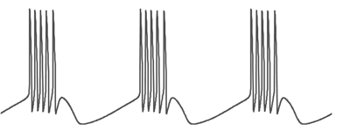
Central pattern generators as neuromodulatory structures
Neuromodulatory input
Neuromodulated network
OFF
ON
Dutta et al., 2019
Motor neurons
12
Notes:
Describe the neuromodulatory CPG architecture, that allows to switch from one rhythm to another robustly with a fixed connectome.

Slide 14
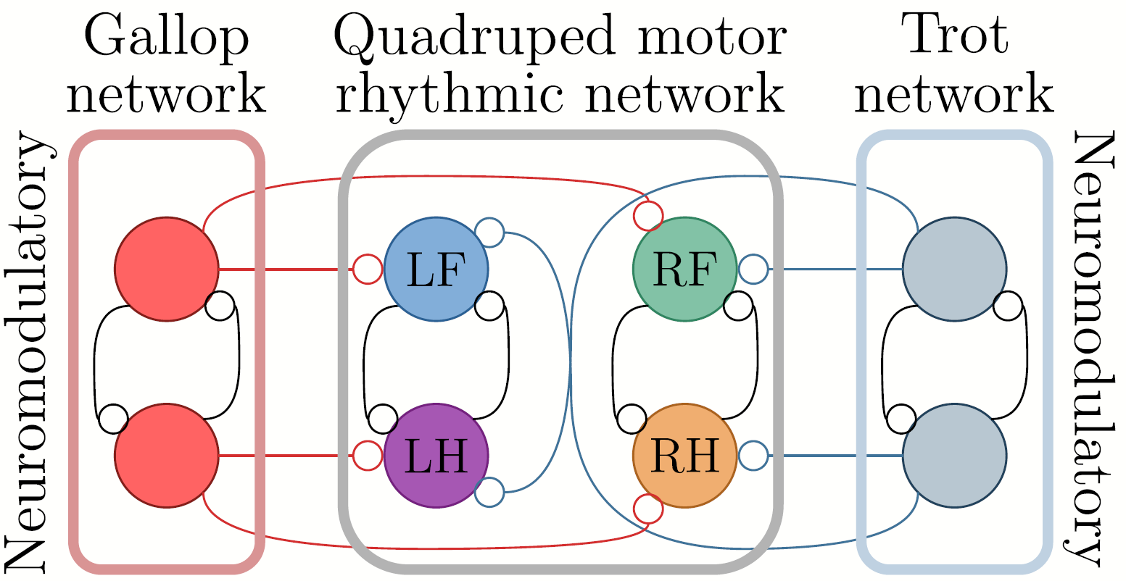
Gait control using neuromodulation
Gallop
Trot
13
Notes:
Describe the gallop/trot circuit.

Slide 15
Gait control using neuromodulation
Gallop
Trot
13
Notes:
Boite noire disparaitre, et avoir une slide plus dynamique, avec statique en backup

Slide 16
Gait control using neuromodulation
Gallop
Trot
13
Notes:
Boite noire disparaitre, et avoir une slide plus dynamique, avec statique en backup

Slide 17
Gait control using neuromodulation
Gallop
Trot
13
Notes:
Boite noire disparaitre, et avoir une slide plus dynamique, avec statique en backup

Slide 18
Gait control using neuromodulation
Gallop
Trot
13
Notes:
Boite noire disparaitre, et avoir une slide plus dynamique, avec statique en backup

Slide 19
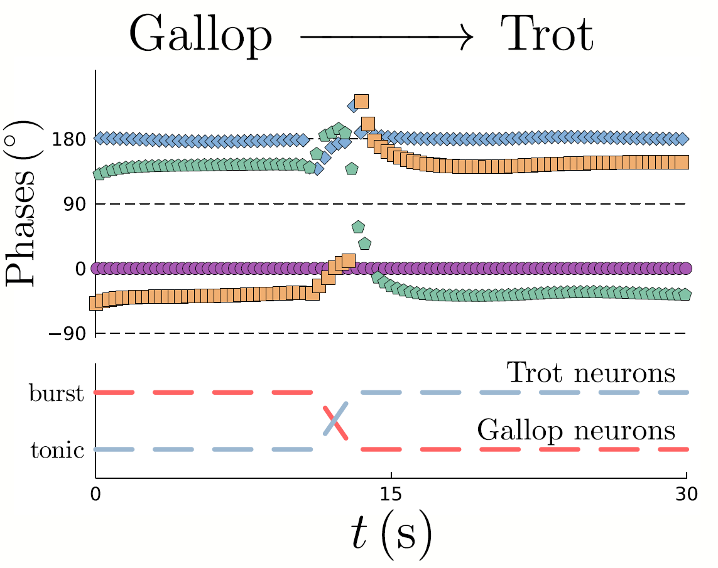
Gait control using neuromodulation
14
Notes:
Show results and insist on the fact that this is neuronal parameter robust.

Slide 20
1. The study of robust neuromodulation presents a challenging task due to the high dimensionality of conductance-based models. 2. By conceptualizing single neurons as feedback models, high dimensionality can be tackled. 3. Using this feedback representation, robust neuromodulation can be achieved using adaptive control. 4. This robust neuromodulation can be applied to various application, including robust gait control in locomotion.
Take-home messages
15

Slide 21
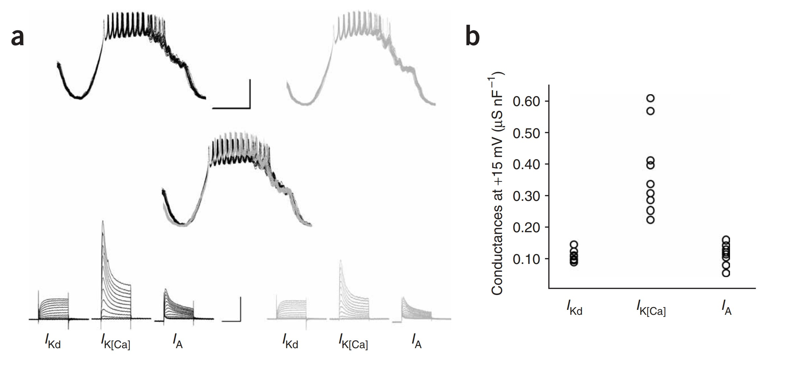
Similar activity emerge from different parameter sets
Schulz et al., 2006
S1

Slide 22
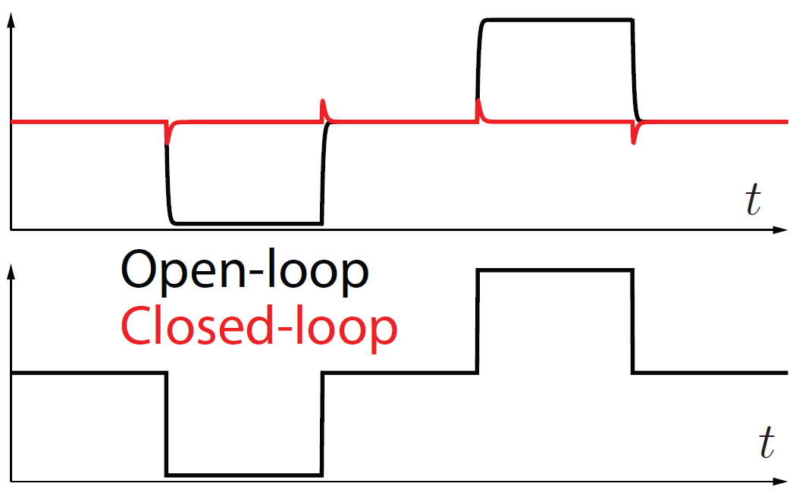
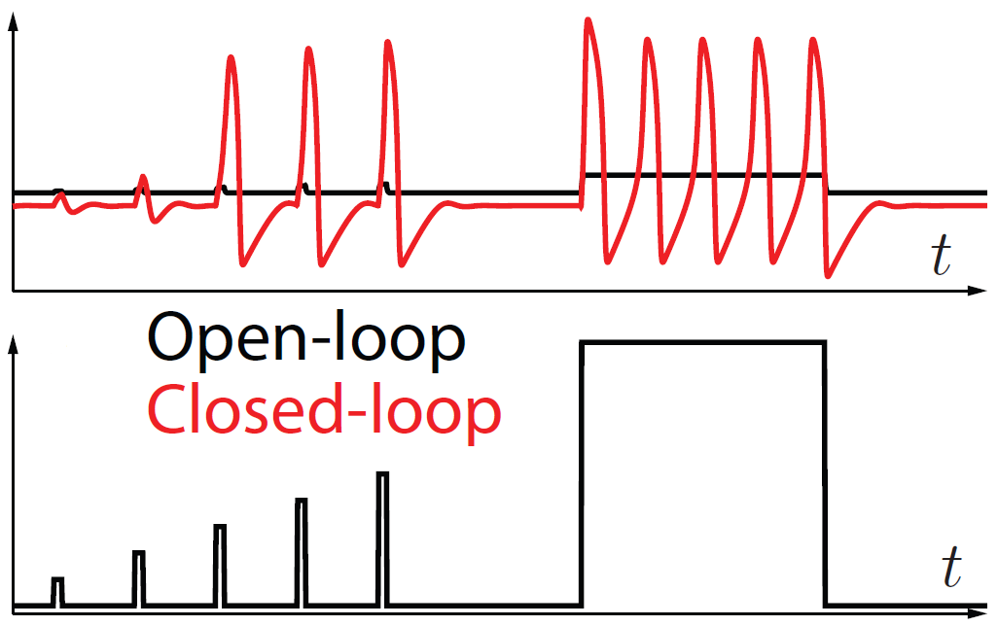
Neurons are mixed feedback systems
Classical negative feedback systems
Mixed feedback systems
S2

Slide 23
Local feedbacks are important
Tonic spiking
Bursting
Global slow negative feedback
Global slow negative feedback
Local slow positive feedback
S3

Slide 24
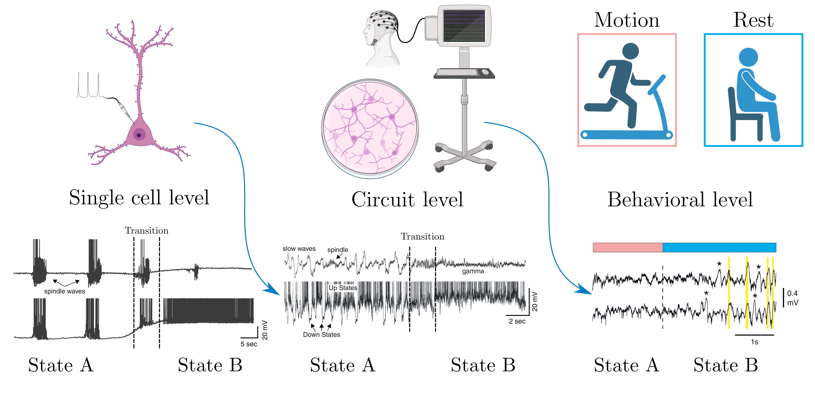
Neuromodulation across scales
S4
Notes:
Neuromodulation can be observed across scales, from single cells, to circuits, and to behavioral, such as locomotion rhythms.

