Slide 1
Using H₂ for CO₂ activation on the way towards synthetic fuels
European PhD Hydrogen Conference
(EPHyC 2024)
Antoine ROUXHET
Supervisor: Grégoire Léonard

Slide 2
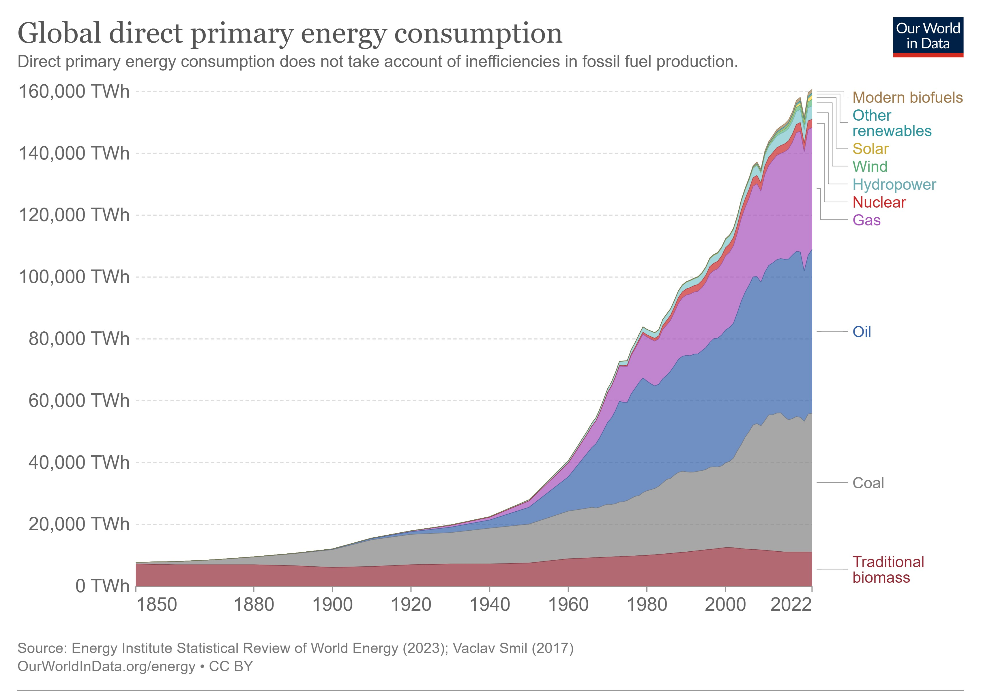
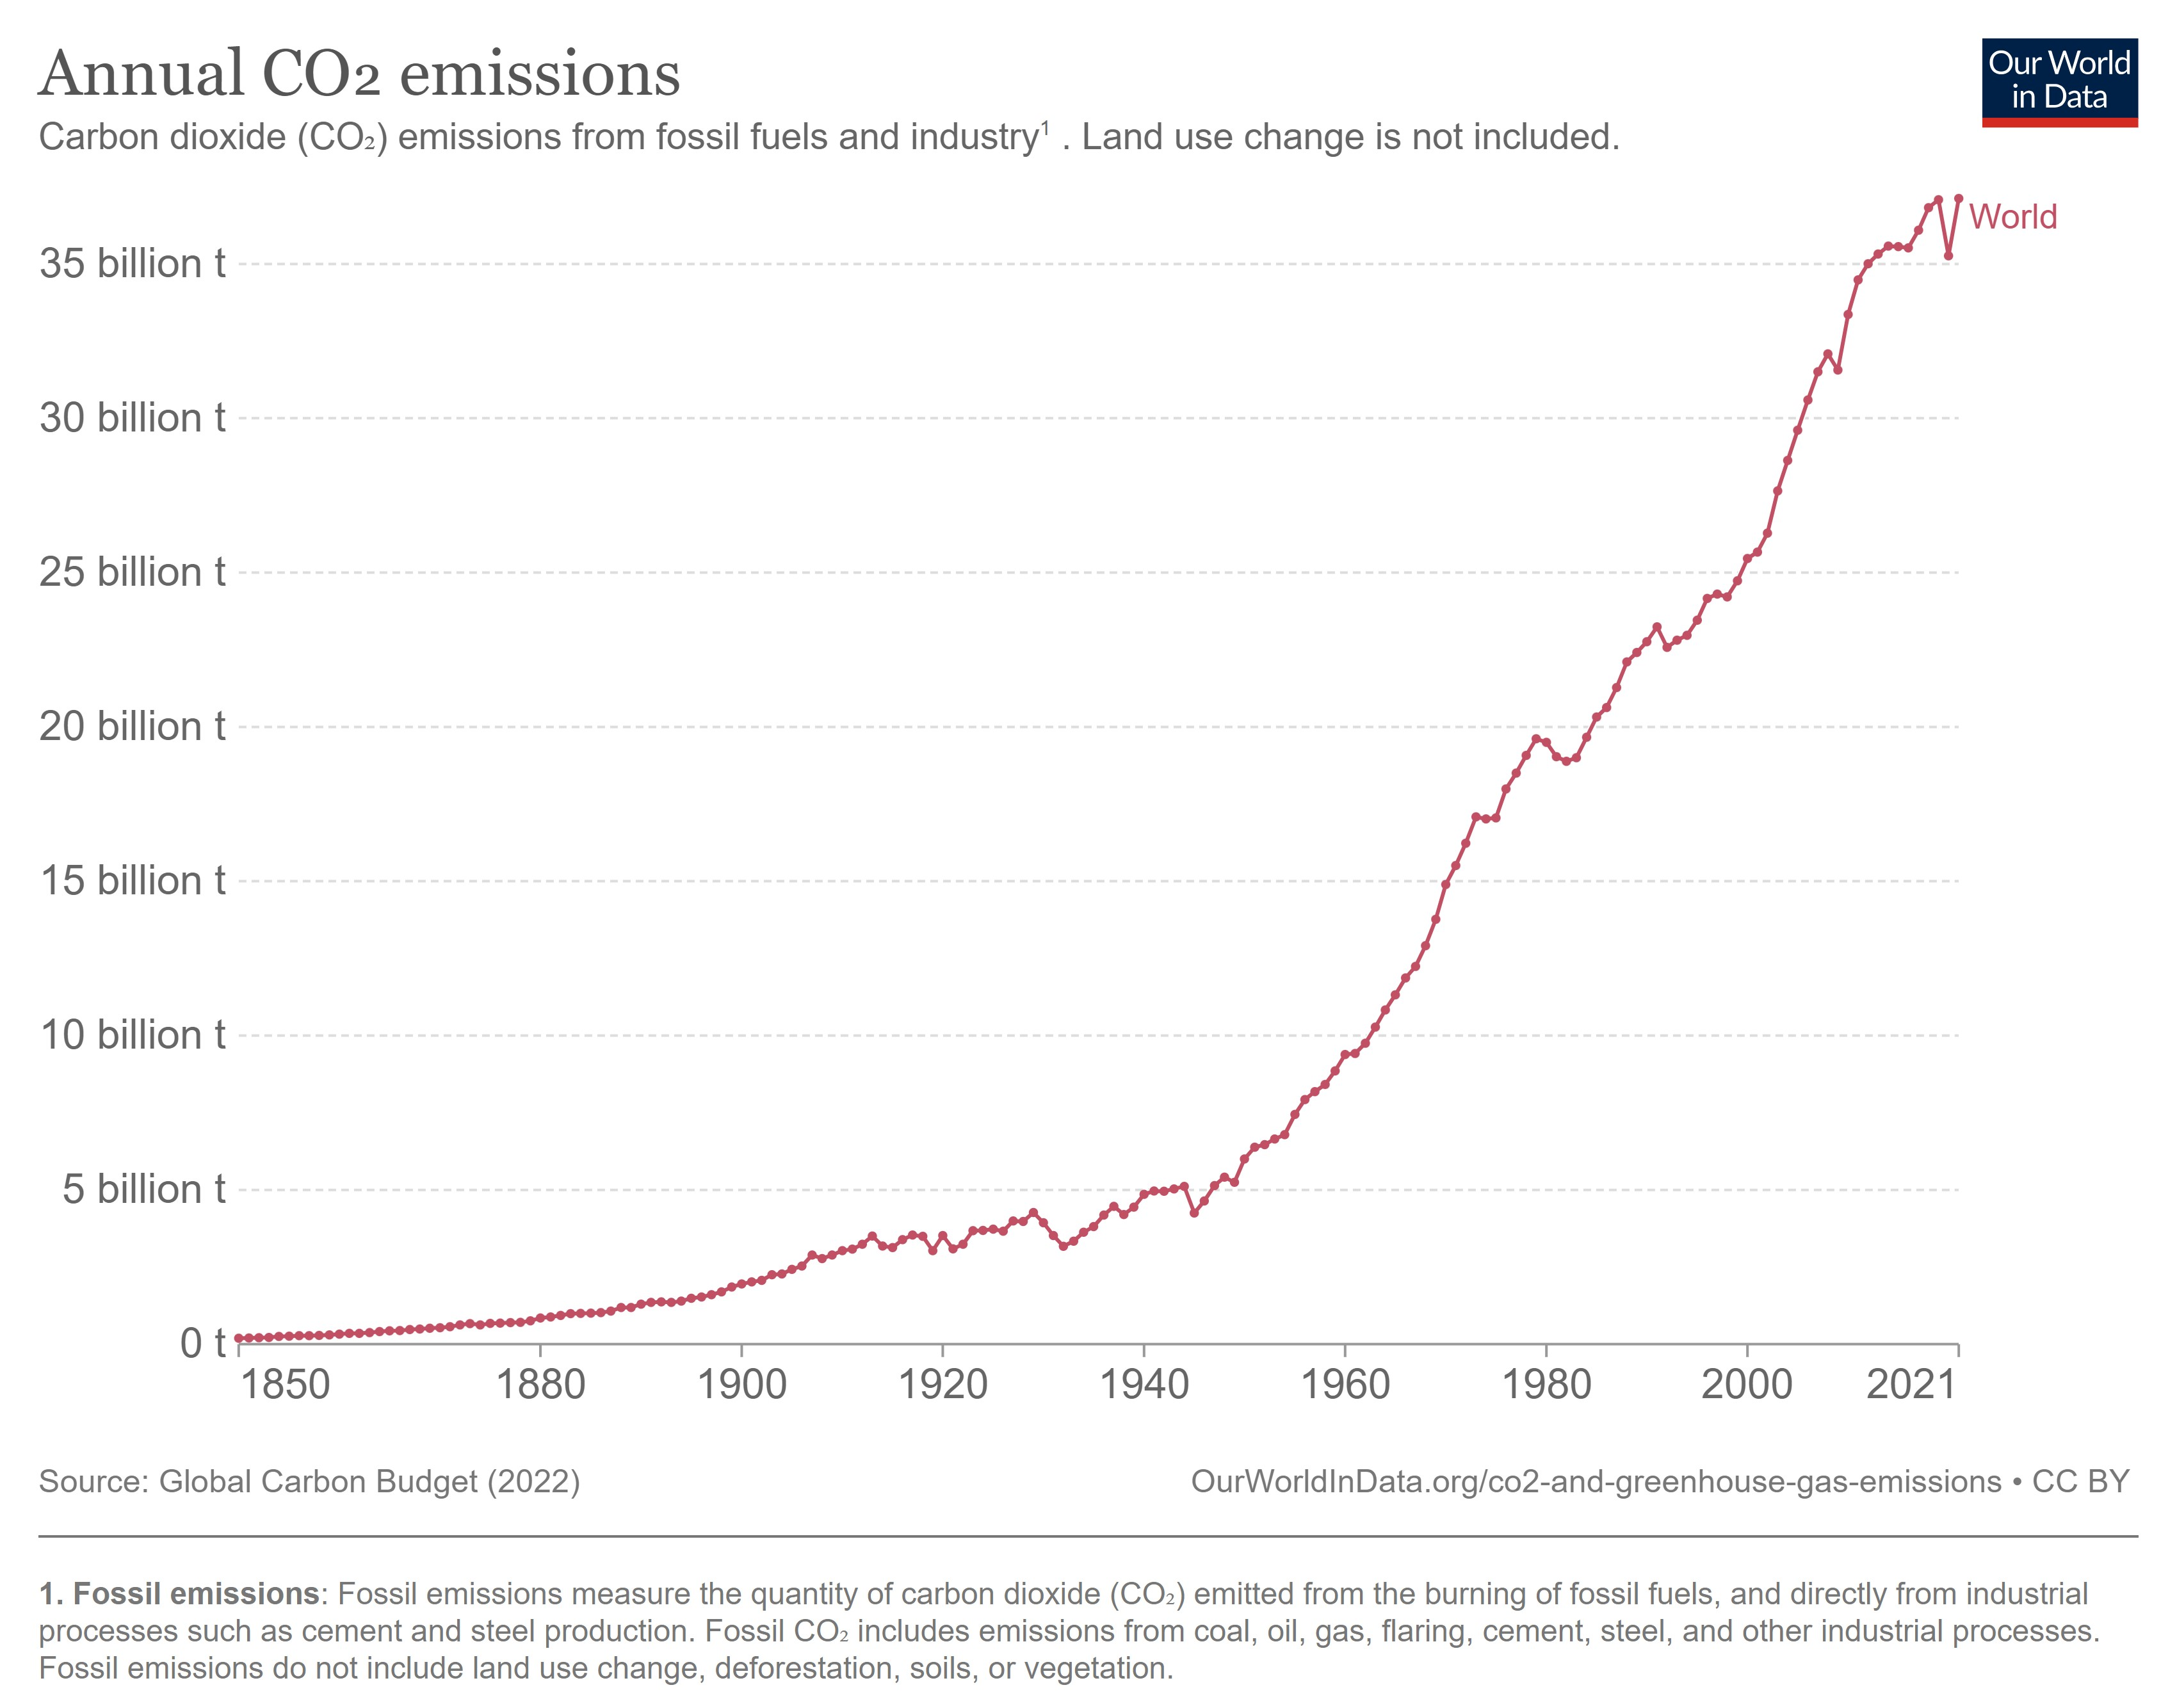
The Energy Crisis: a dilemma
Meet the increasing
energy demand
><
Limit GHG emissions
https://ourworldindata.org/grapher/global-primary-energy
Hannah Ritchie, Max Roser and Pablo Rosado (2020) - "CO₂ and Greenhouse Gas Emissions". Published online at OurWorldInData.org. Retrieved from: 'https://ourworldindata.org/co2-and-greenhouse-gas-emissions' [Online Resource]

Slide 3
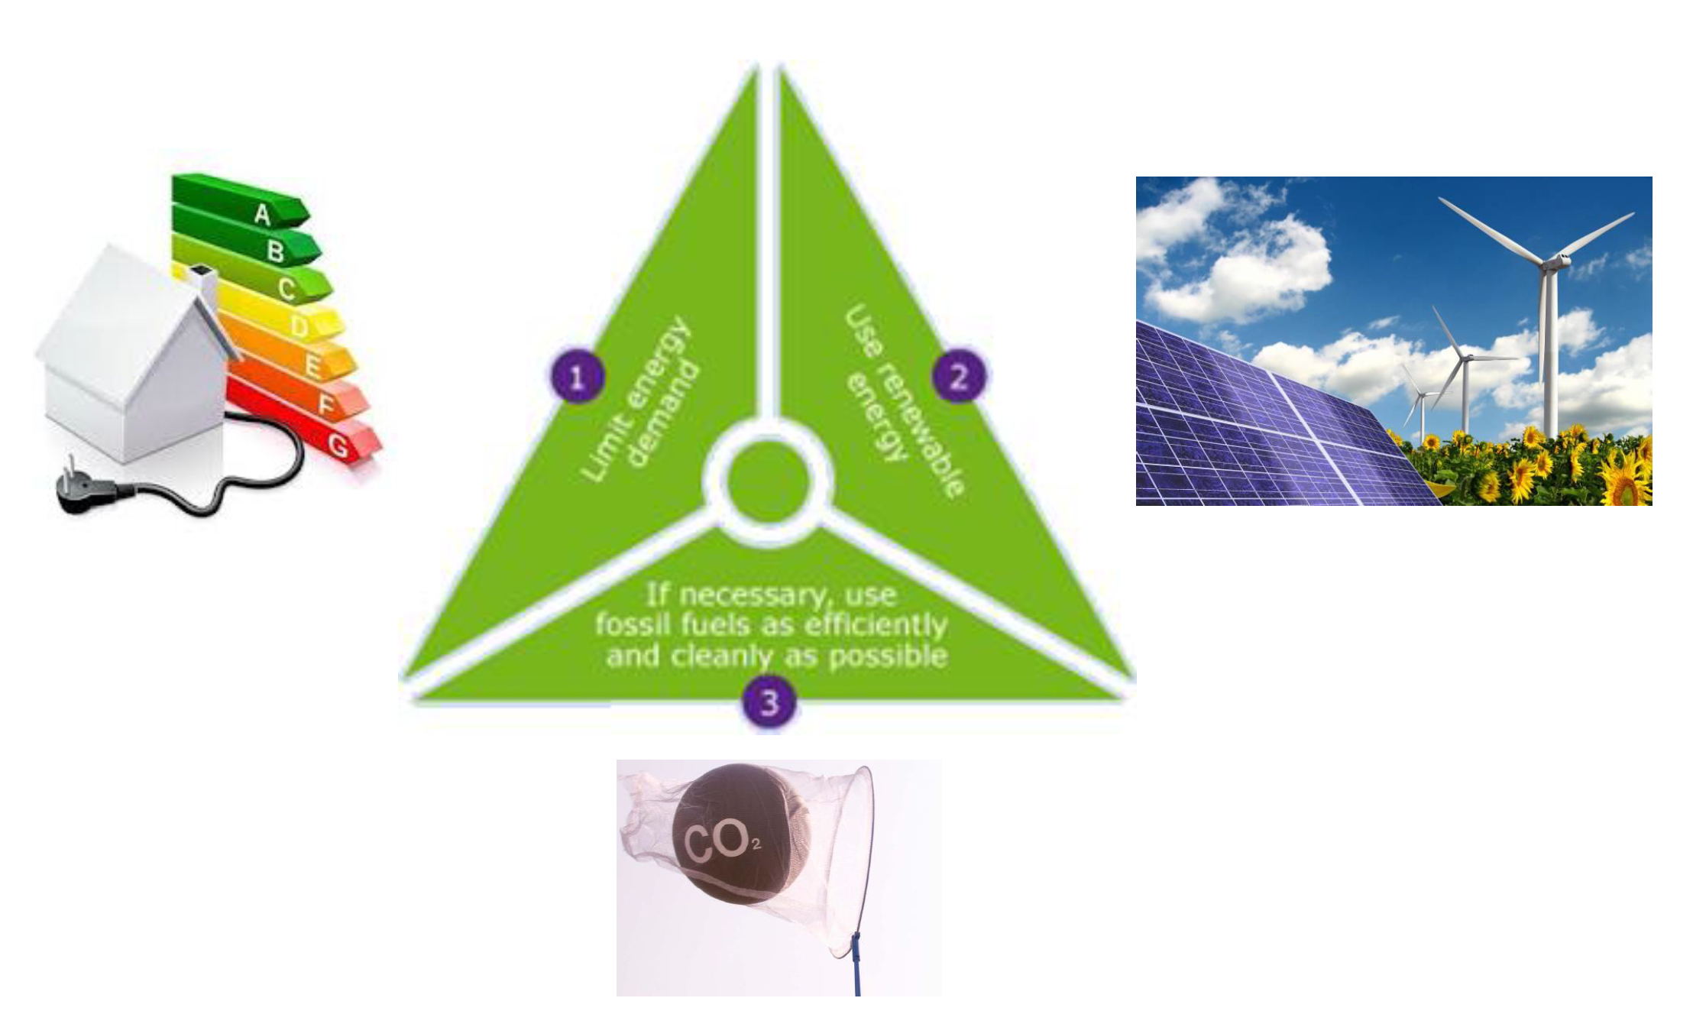
A possible solution: the Trias Energetica
Lysen, E H. The Trias Energica: Solar energy strategies for developing countries. Germany: N. p., 1996. Web.

Slide 4
Implications of the Trias Energetica concept
Variable (time)
storage required
Variable (location)
transport required
Large amount of CO₂ available

Slide 5
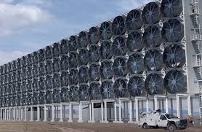
The power-to-fuel concept
4. Carbon circularity
2. CO₂ capture
Air capture
CO₂
Fuels for mobility & industry
Petrochemistry
Industries
CO₂
H₂
CO₂
Energy storage
H₂O
H₂
Residual heat
Renewables
1. Water electrolysis
3. Synthesis of hydrocarbons

Slide 6
The power-to-fuel concept
4. Carbon circularity
2. CO₂ capture
Air capture
CO₂
Fuels for mobility & industry
Petrochemistry
Industries
CO₂
H₂
CO₂
Energy storage
H₂O
H₂
Residual heat
Renewables
1. Water electrolysis
3. Synthesis of hydrocarbons

Slide 7
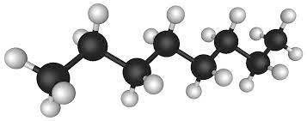
From the CO₂ molecule to the synthetic fuel…
CO₂
H₂
Synthetic fuels
C
H
H
n CO₂ + (3n+1) H₂ ↔ C_{n}H_{2n+2} + 2n H₂O
Reaction difficult to achieve in a single step
CO₂ molecule highly stable
C-C bonds hard to form
Indirect synthesis of synthetic fuels

Slide 8
From the CO₂ molecule to the synthetic fuel…
CO₂ + H₂ ↔ CO + H₂O
reverse water-gas shift reaction (rWGS)
CO₂
H₂
C
O
C
H
H
n CO + (2n+1) H₂ ↔ C_{n}H_{2n+2} + n H₂O
Fischer-Tropsch reaction

Slide 9
Objectives of our work
rWGS reaction
Standardisation
Design and optimisation
Dynamic study
CO₂
Methanol, ethanol…
Hydrocarbons mixture
rWGS reactor
Fischer-Tropsch reactor
Separation steps
CO
Methanol reactor, ethanol reactor,…
H₂
H₂
Kerosene
Gasoline, diesel…

Slide 10
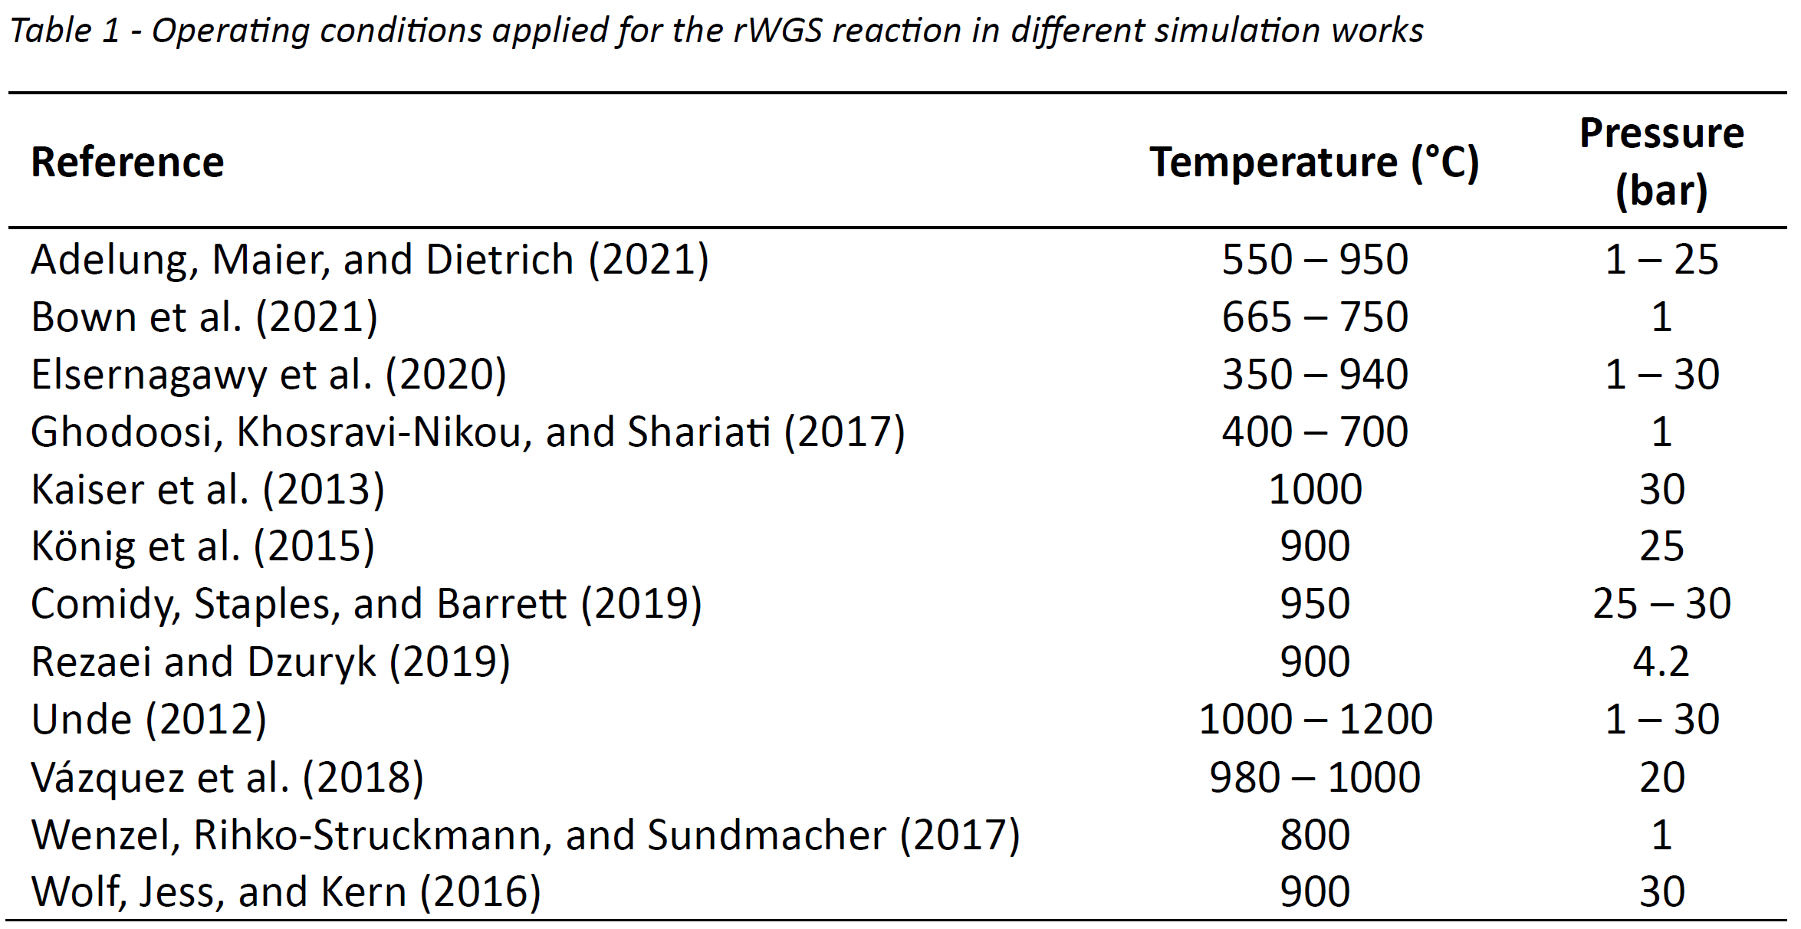
rWGS reaction operating conditions
CO₂ + H₂ ⇔ CO + H₂O ΔH° = +41 kJ/mol
CO₂ + 4 H₂ ⇔ CH₄ + 2 H₂O ΔH° = -165 kJ/mol
CO + 3 H₂ ⇔ CH₄ + H₂O ΔH° = -206 kJ/mol
+ exothermic solid carbon formation
T° ≈ 800 – 900°C
P ≈ 1 – 30 bar
A. Rouxhet, M. E. A. Berchiche, and G. Léonard, “A Review of the Reverse Water-Gas Shift Reaction as an Intermediate Step in Power-to-Fuels Processes.” unpublished.

Slide 11
rWGS reactor at equilibrium – conditions influence
P = 1 bar --- Inlet H₂/CO₂ = 2
CH₄ production limited above 700°C at 1 bar

Slide 12
rWGS reactor at equilibrium – conditions influence
P = 30 bar --- Inlet H₂/CO₂ = 2
H₂
H₂O
CO
CO₂
CH₄

Slide 13
rWGS reactor at equilibrium – conditions influence
Constant inlet H₂/CO₂ = 2
P = 1 bar
P = 1 bar
P = 30 bar
P = 30 bar
CO₂ conversion and CO selectivity favoured at low pressure

Slide 14
rWGS reactor at equilibrium – conditions influence
Constant inlet H₂/CO₂ = 2
P = 1 bar
P = 1 bar
P = 30 bar
P = 30 bar
Coking reaction only impacts CO₂ conversion at low temperature

Slide 15
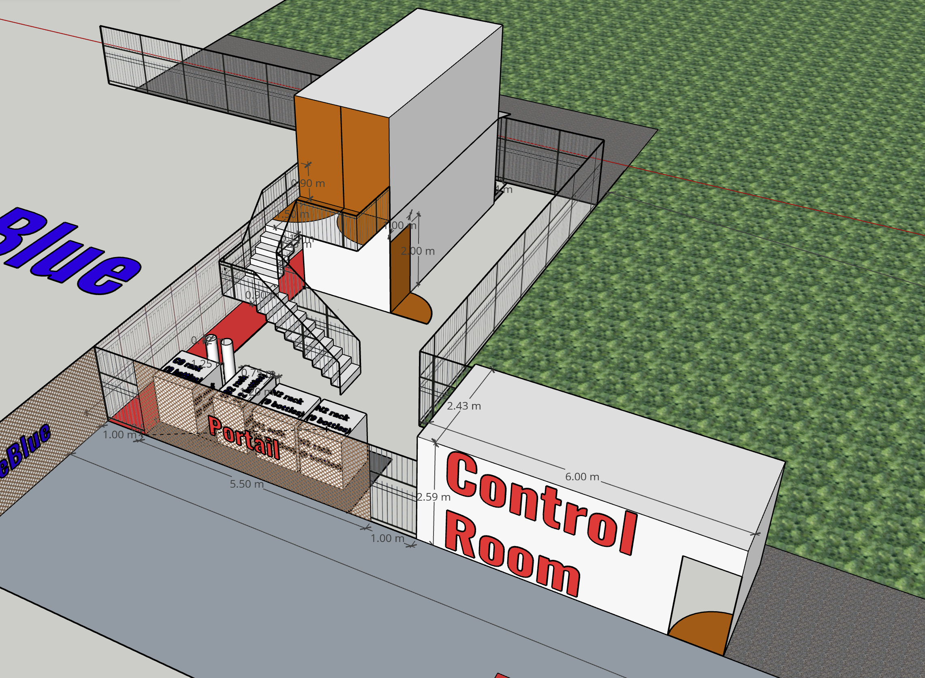
Major perspective: a pilot-scale installation

Slide 16
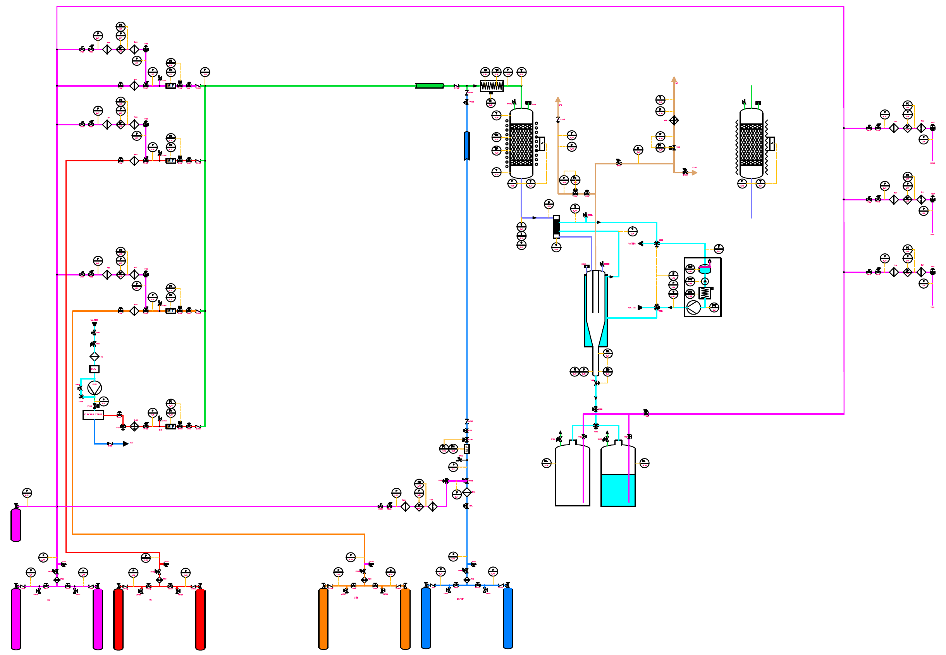
Major perspective: a pilot-scale installation
H₂ source = water electrolysis max. 1.5 Nm³/h

Slide 17
Take-home messages
In the future, increasing need to store and transport energy
Power-to-fuel concept offers a solution
Fuels present high energy density per unit volume
Indirect synthesis from captured CO₂ and H₂
rWGS pathway = CO₂ activation by transformation into CO
High temperature required to limit CH₄ production
Optimal pressure not as straightforward
Pilot installation converting CO₂ to kerosene soon at ULiège

Slide 18
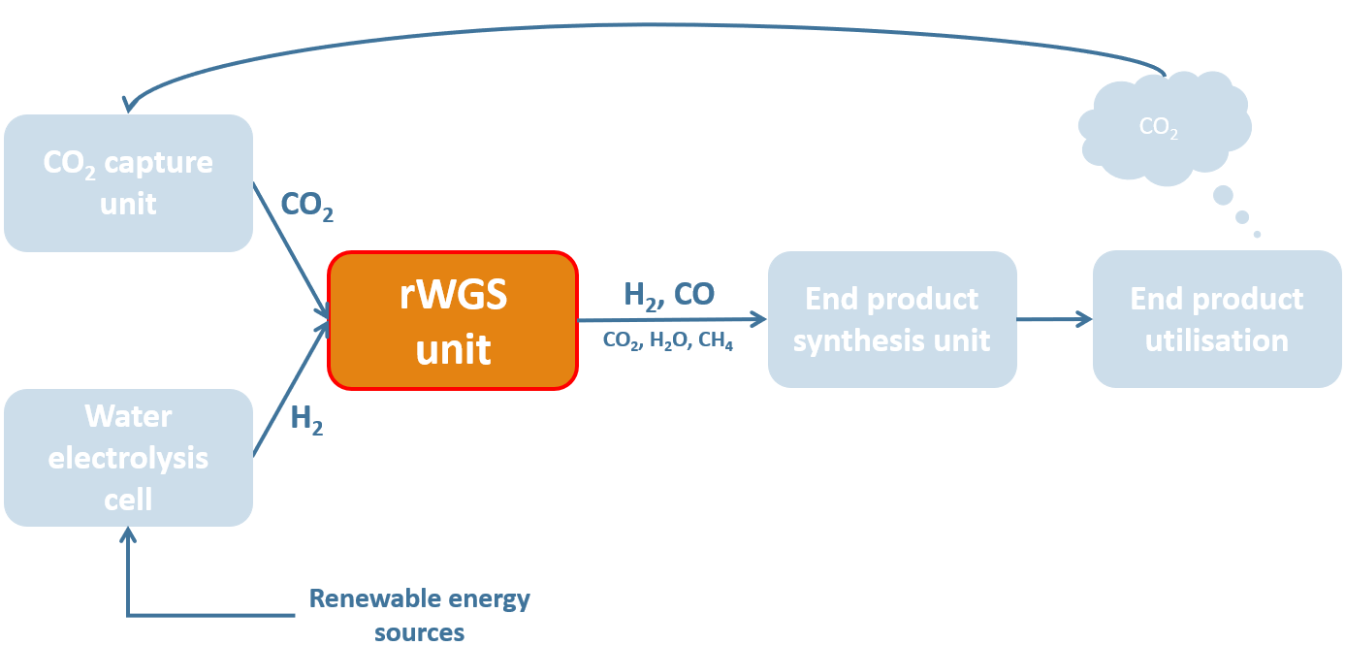
Thank you for your attention!
Antoine ROUXHET
This papper is supported by the Walloon Region as part of a FRIA grant (F.R.S.-FNRS).

