Slide 1
Modern aviation:
Taking off towards a new carbon-neutral technological era
Prof. Damien Ernst
Boeing 777X, currently under development
Orizio event: A Century of Belgian Aviation
March 28, 2024

Slide 2
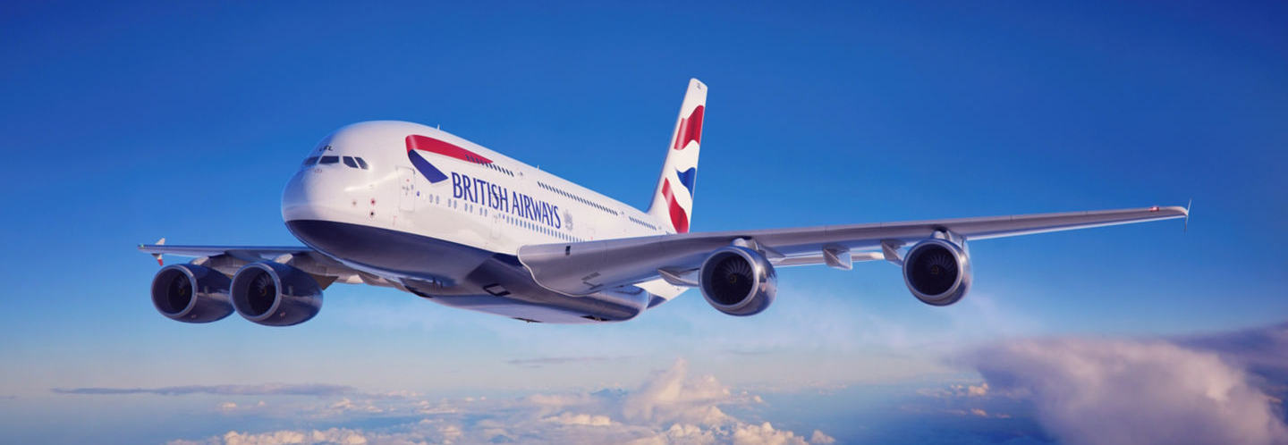
The airplane: a fascinating object…
Bringing people together
An engineering marvel
Essential lifeline for business and tourism
A380-800

Slide 3
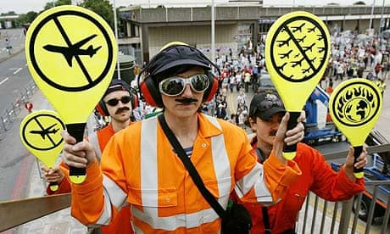
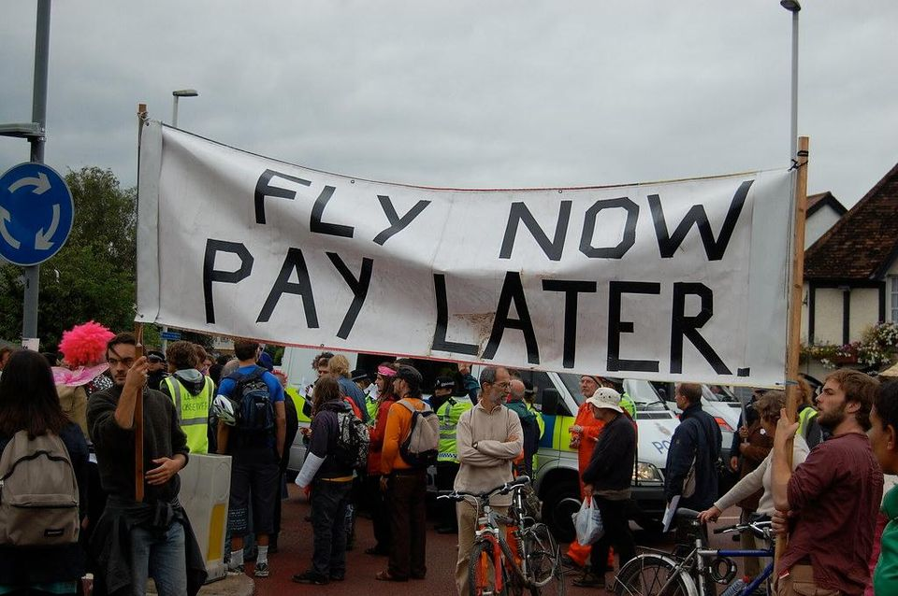
…yet questioned and criticized
« Flygskam »: flight shame in Swedish
Frequently associated with global warming
First target for degrowth ecologists

Slide 4
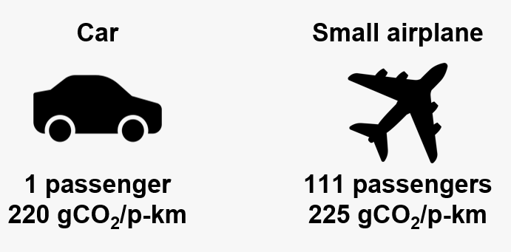
Are such fears rational?
An airplane actually emits about the same amount of CO₂ per passenger-kilometer as a car with internal combustion engine, yet it also provides superior comfort and opportunities (needs?) for longer distance travel.

Slide 5
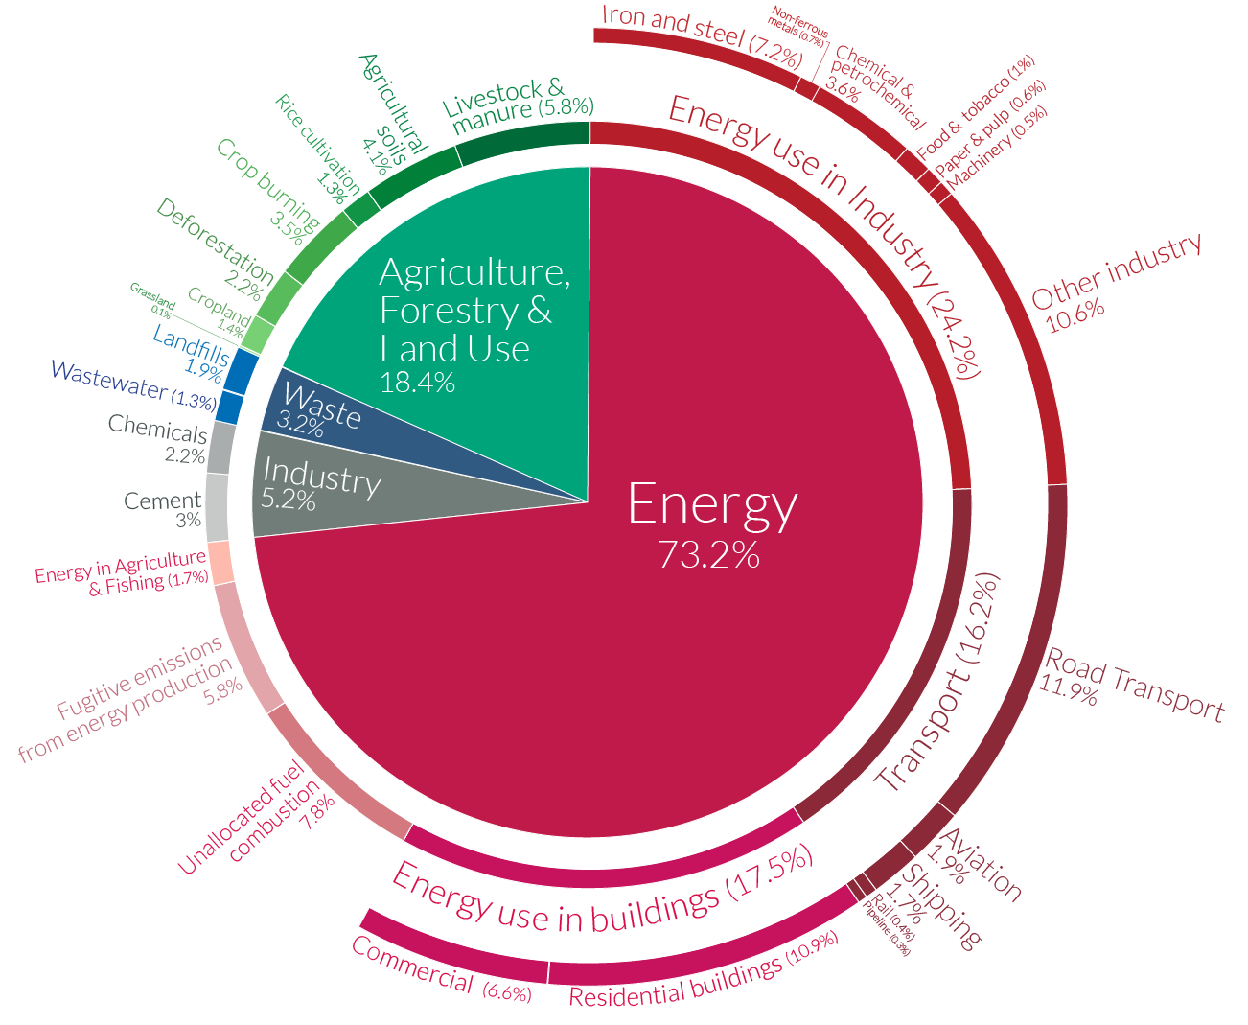
Overall CO₂ emissions from airplanes
In 2022, aviation accounted for 2% of global energy-related CO₂ emissions.

Slide 6
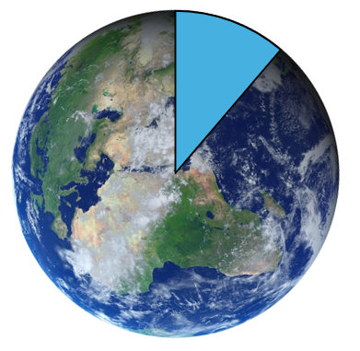
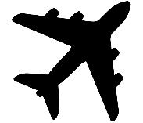
Decarbonizing: a social purpose
Even if aviation is only responsible for 2% of CO₂ emissions, it is very important to decarbonize the aviation sector, especially since we want everyone to be able to travel by airplane while respecting the environment.
« Only » 4.5 billion scheduled passengers boarded by the global airline industry in 2019. It is assumed that this corresponds to 866 million individuals.

Slide 7
Can we have planes emitting less or no CO₂?
There are four ongoing strategies to reduce CO₂ emissions:
1) Technical optimizations of airplanes;
2) Carbon-neutral kerosene-powered airplanes;
3) Hydrogen-powered airplanes;
4) Electric airplanes.

Slide 8
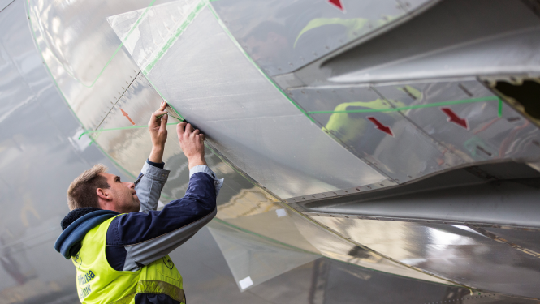
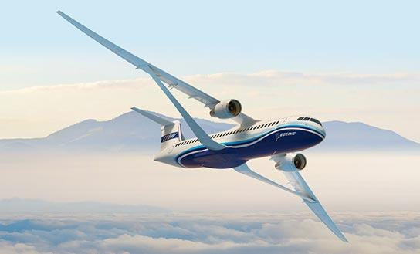
1) Technical optimization of airplanes
The biomimetic coating AeroSHARK by Lufthansa Technik (2023, already operationnal).
Swiss International Air Lines
Boeing 777-300ER with AeroSHARK
Transonic Truss Braced Wing developed by Boeing (on-going).
X-66A concept by Boeing and NASA

Slide 9
2) Carbon-neutral kerosene-powered airplanes
Two methods are considered to produce carbon-neutral kerosene:
1. Biofuels:
Involving the cultivation of plants rich in oils/sugars.
The CO₂ emitted when burning the biofuels is “cancelled out”
by the absorption of CO₂ by plants during growth.
2. Fischer-Tropsch synthesis:
Chemical process used to convert a mixture of carbon dioxide (CO₂)
and hydrogen (H₂) into carbon-neutral kerosene.

Slide 10
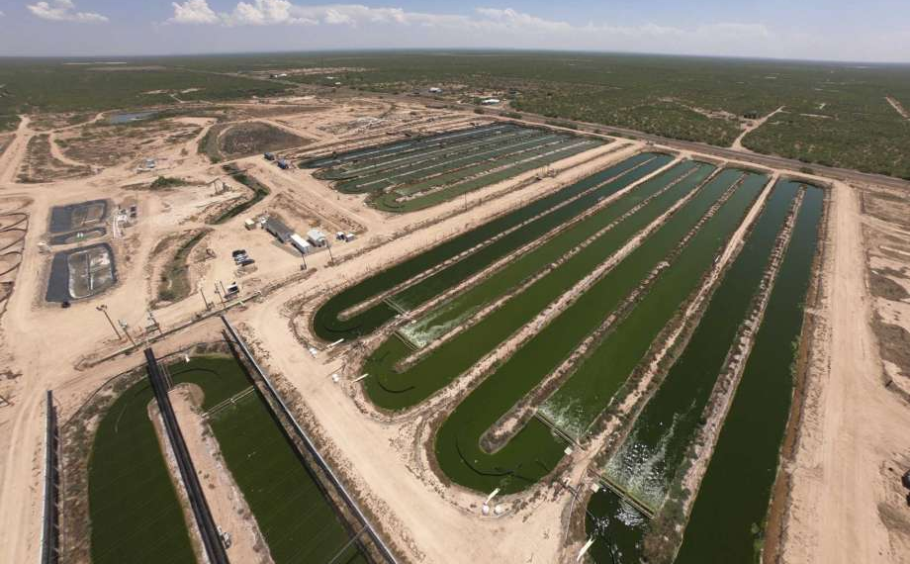
2.1) Production of kerosene from biofuels
Algae are the most efficient biomass producers. In water, they can generate up to 4 W/m².
Note: Photovoltaic panels in Texas produce around 50 W/m².
Qualitas Health algae cultivation, Texas
Stacked tubular algae reactors, Algae PARC Wageningen University

Slide 11
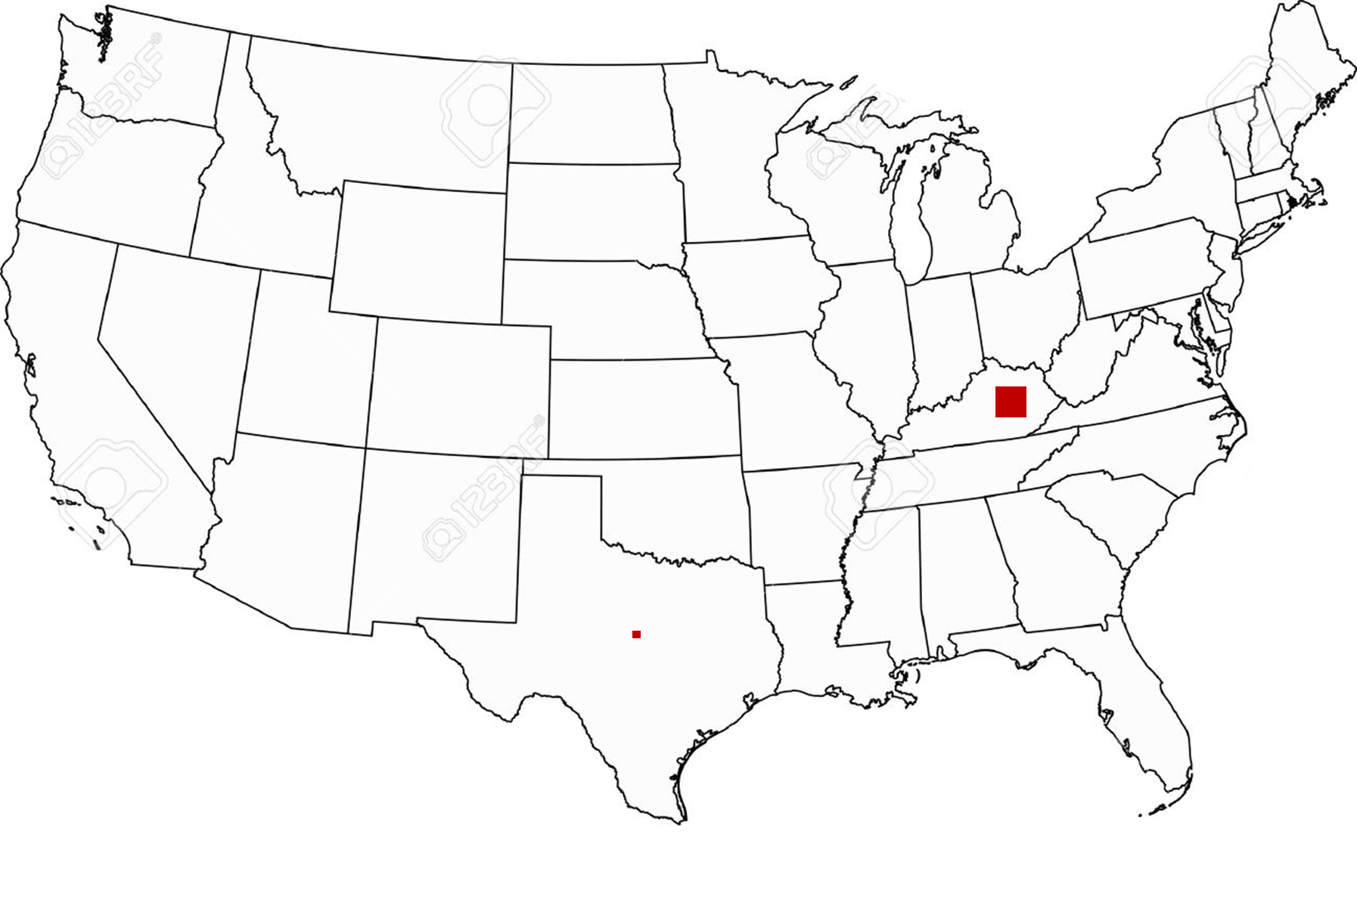
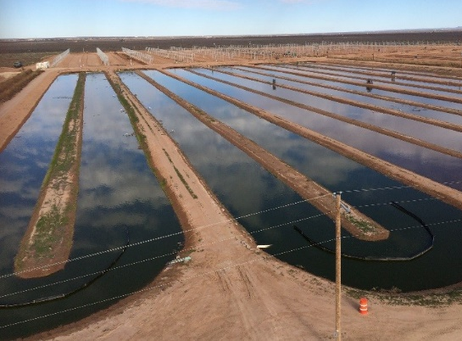
How large would the exploitable area be?
In 2022, the demand for jet fuel in the US was 1.6 million barrels per day, the highest in the world. Considering that there are 1.6 MWh of energy in one barrel of oil and that the efficiency of algae-to-kerosene conversion is 50%, it would require a cultivation area of 53,370 km² for algae, which is equivalent to 7.7% of the size of the state of Texas (695,662 km²).
An area of 53,370 km² of algea cultivation.

Slide 12
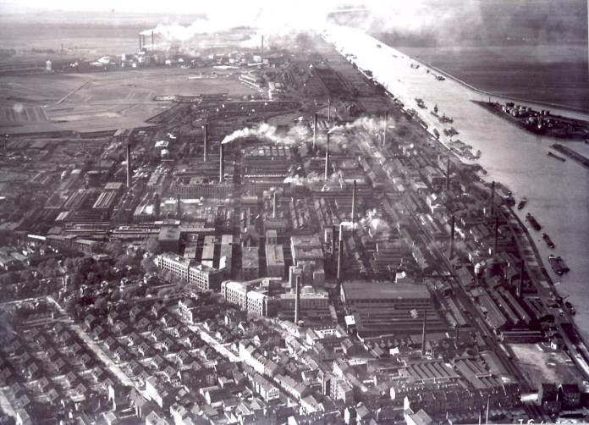
2.2) Production of carbon-neural kerosene from Fischer-Tropsch synthesis
1st step: Produce H₂ from water using water electrolysis with carbon-neutral electricity.
2nd step: Directly capture CO₂ from the air (Direct Air Capture).
3rd step: Use the Fischer-Tropsch reaction to transform H₂ and CO₂ into carbon-neutral kerosene.
Water electrolysis since 1890
Direct Air Capture since the 2010s
Fischer-Tropsch since WW2
In 1944, half of the fuel used by the Wehrmacht was produced from coal using the Fischer-Tropsch reaction.

Slide 13
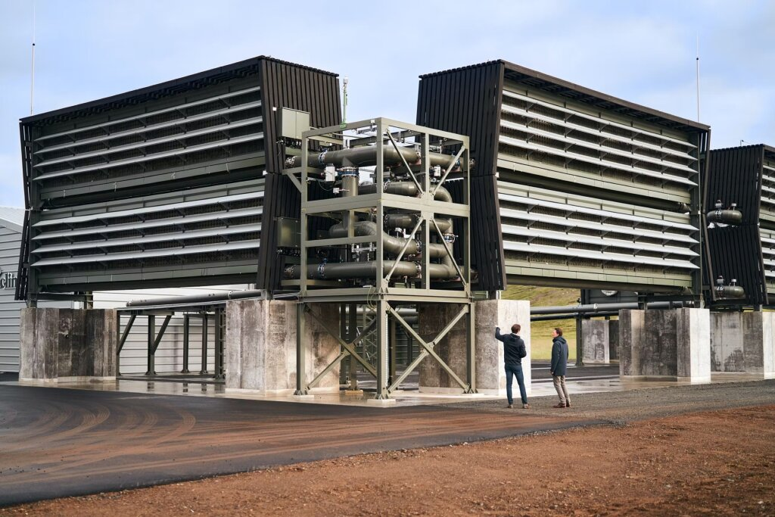
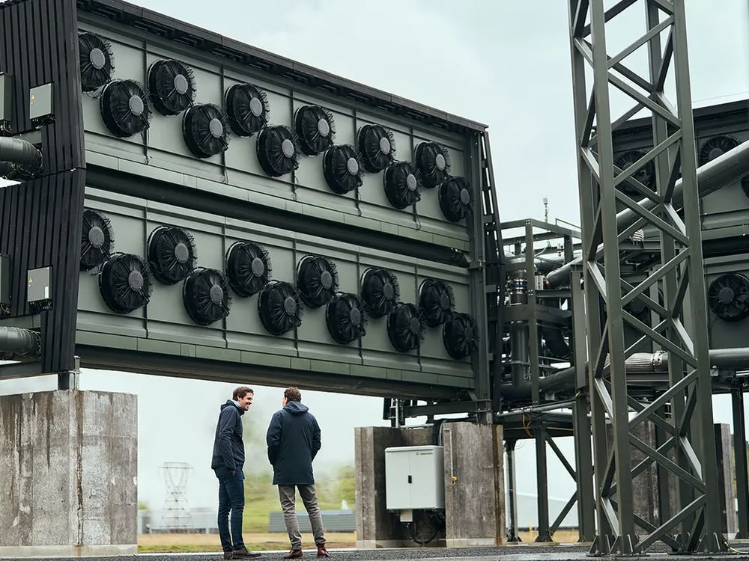
The world's first large-scale Direct Air Capture unit was launched in Iceland in 2021. Capture capacity: up to 4,000 tons of CO₂ per year.
CO₂ removal plant – a reality
First direct air capture and storage plants by the Swiss company Climeworks, Iceland

Slide 14
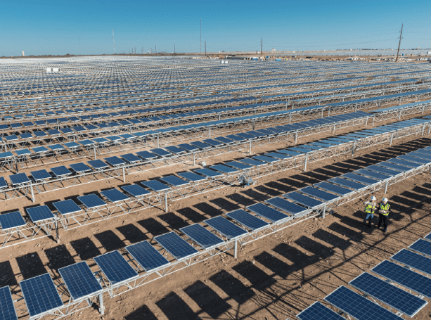
How large would the exploitable area be?
By utilizing renewable electricity from photovoltaic panels and considering a Fischer-Tropsch synthesis conversion efficiency of 50%, it would require an area of approximately 4,250 km² of panels in Texas to power the entire US airplane fleet with carbon-neutral kerosene.
An extra area of 4,250 km² of solar panels.

Slide 15
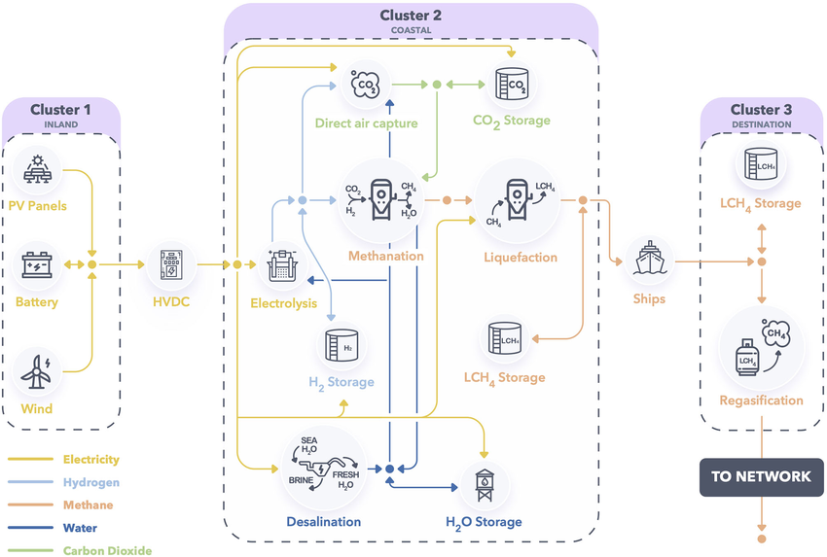
What about conflicts in land use?
To avoid problems with land use (conflicts with agriculture, deforestation, etc.), we can undertake the production of carbon-neutral kerosene in regions abundant in wind and solar resources, using the concept of remote renewable energy hubs for carbon-neutral fuel production.

Slide 16
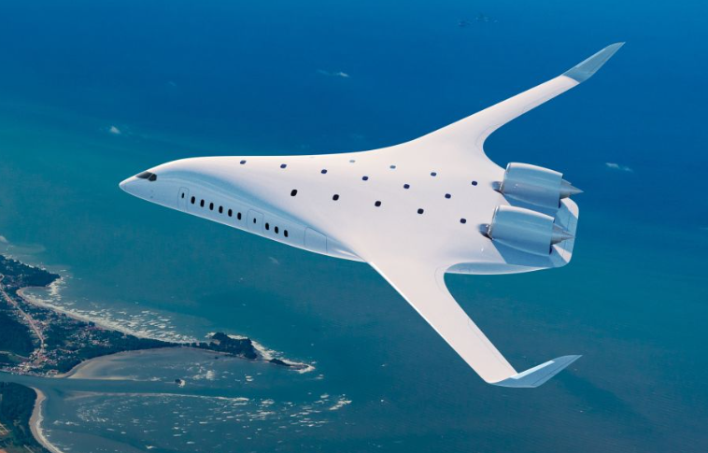
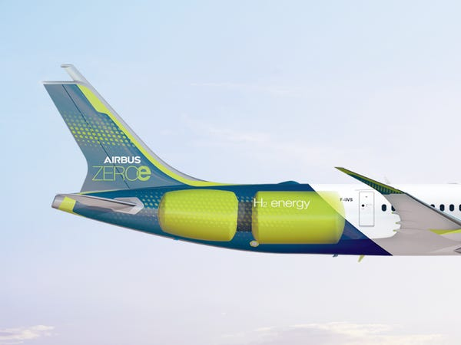
3) Hydrogen-powered airplanes
Airbus' ZEROe project aims to develop the world's first commercial hydrogen-powered aircraft by 2035.
H₂ can be generated from carbon-neutral electricity.
JetZero design concept by Airbus
Airbus ZEROe hydrogen tanks

Slide 17
Comparison with a kerosene-fueled airplane
The amount of kerosene needed for a New York to Brussels trip (7,838 km) aboard a Boeing 747 is equal to 76,860 liters.
If this chemical energy was stored using H₂, much bigger tanks would be needed due to the low volumetric energy density of H₂.
Kerosene-powered
H₂-powered
76,860 liters of kerosene
(10.3 kWh/liter)
282,735 liters of liquid hydrogen
(2.8 kWh/liter)

Slide 18
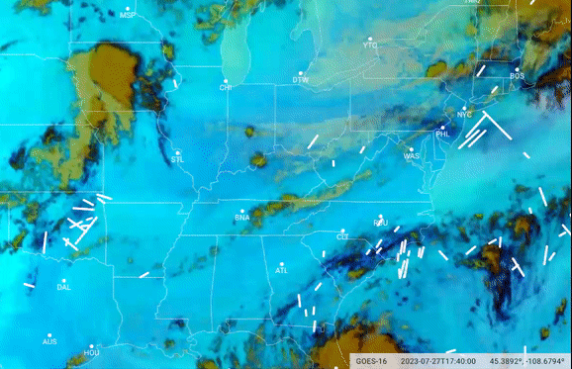
Emission of other GHG – radiative forcing
Even if you burn carbon-neutral fuels, degrowth ecologists will say that the contrails left by airplanes contribute to the greenhouse effect.
However, this problem can be addressed, for example using AI that generates predictions on the time and location of contrails formation to avoid them.
Contrails
Google AI detecting contrails over the US based on satellite imagery

Slide 19
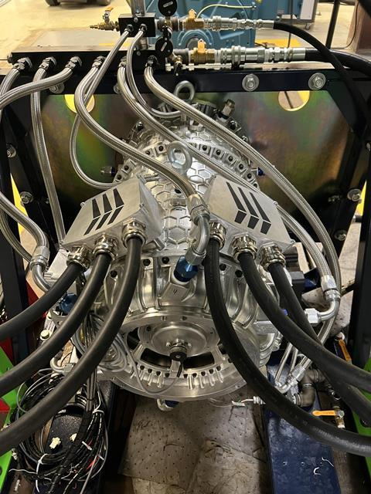
4) The electric airplane
Standard approach:
A battery powers an electro-mechanical motor.
Main weakness:
The energy density of commercial battery is around 270 Wh/kg.
This is relatively small with respect to the energy density of kerosene which is 12,000 Wh/kg.
That limits the range of electric airplanes to around 500 - 1,000 km.
Electric motor with 1 MW of power, Wright Electric

Slide 20
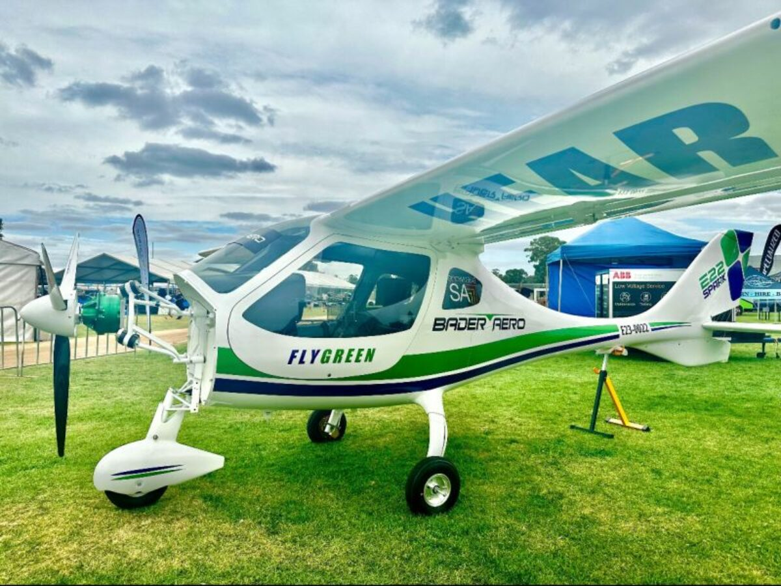
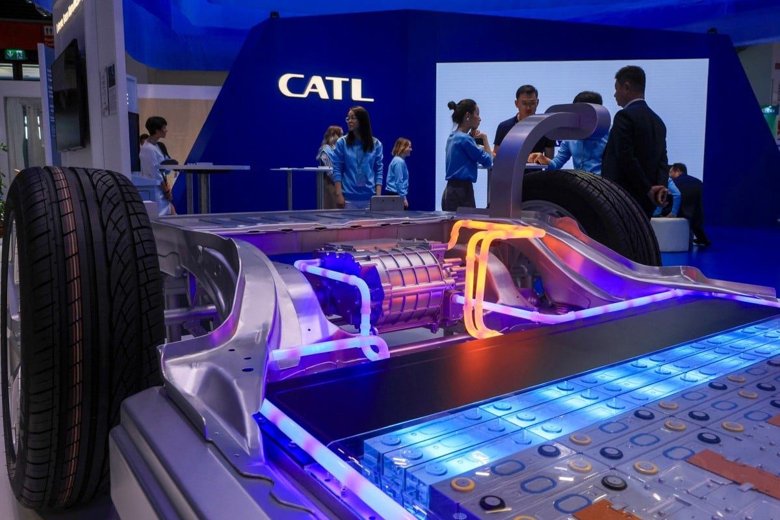
Batteries with much higher energy densities are on the way. Some cutting-edge battery developers such as CATL and Amprius have already hit the 500 Wh/kg threshold. We have insight into new battery chemistries that could reach 1,000 Wh/kg. With such batteries, one could think about having electric airplanes with 3,000 km of range soon.
Progress in batteries
Infinitus Aero revealed E22 Spark electric aircraft
CATL battery-powered car at the Munich Motor Show

Slide 21
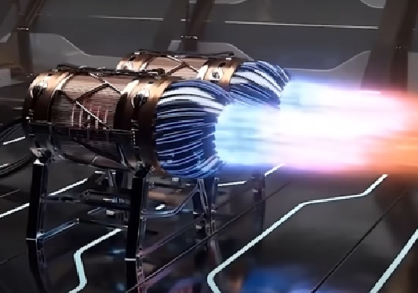
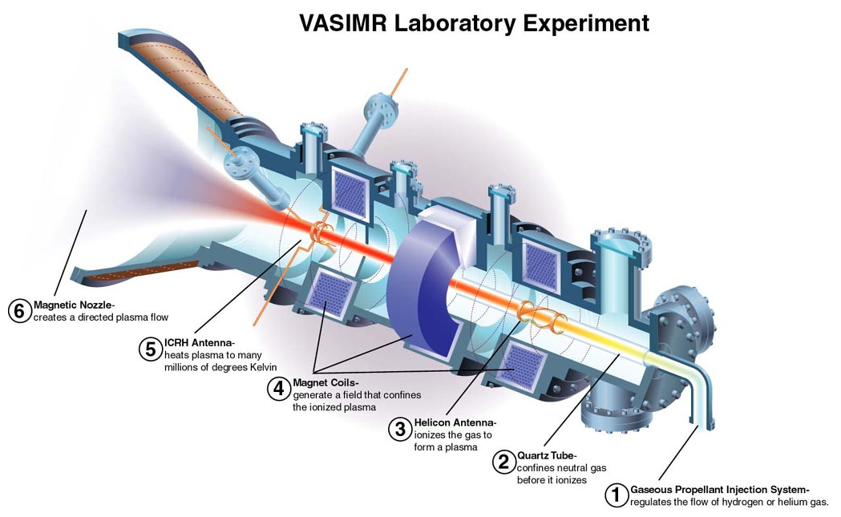
Toward faster electric airplanes
Limited distance range of electric airplanes may be solved with battery developments, but electromechanical motors may lead to electric airplanes that travel too slowly (fastest one travels 670 km/h).
New technological development with electric plasma motors could lead to much faster electric airplanes!
VASIMR laboratory Experiment
Electric plasma motor concept on Blender

