Slide 1
CERAB for ISR
Arnaud Kerzmann, MD
CHU Liège, Belgium

Slide 2
Disclosures
Consultant
Boston Scientific, BD
Grant/research support
Medicor, iVascular, Medtronic, Artivion, Biotronik, DMB Medical

Slide 3
Case introduction – Patient history (1)
59 years old woman
Past history:
- smoking habit
- arterial hypertension
- dyslipidemia
- emphysema
- left adrenalectomy
- varicoces veins treatment on both lower limbs
- right common iliac artery stenting 14 months earlier

Slide 4
Case introduction – Patient history (2)
medications: - calcium antagonist
- aspirin
- statin and ezetimibe
both calfs Rutherford stage 3 peripheral arterial disease (PAD)
imprecise walking distance but short, worse uphill
palpable pulses, ABI = 1 on the right and 1,1 on the left side

Slide 5
Case introduction – CT angiography

Slide 6
Case introduction - CT angiography
stent into the distal aorta thin stented right common iliac artery

Slide 7
Treatment approach
CERAB
strategy:
- spinal anesthesia
- 6 F and 7 F sheaths into the common femoral arteries
- heparin 5000 IU
- iCover™ 10 mm into the distal abdominal aorta, post- dilation with Oceanus™ 12 mm
- iCover™ 6 or 7 mm into the both common iliac arteries
- closure devices

Slide 8
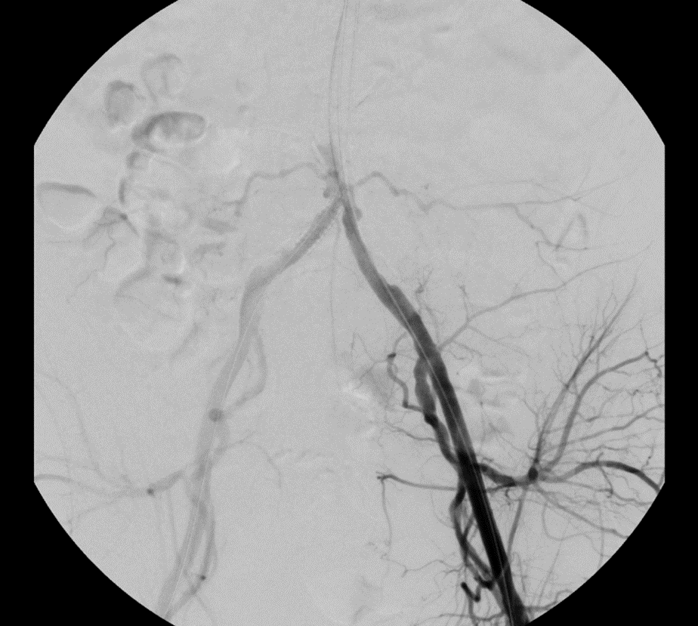
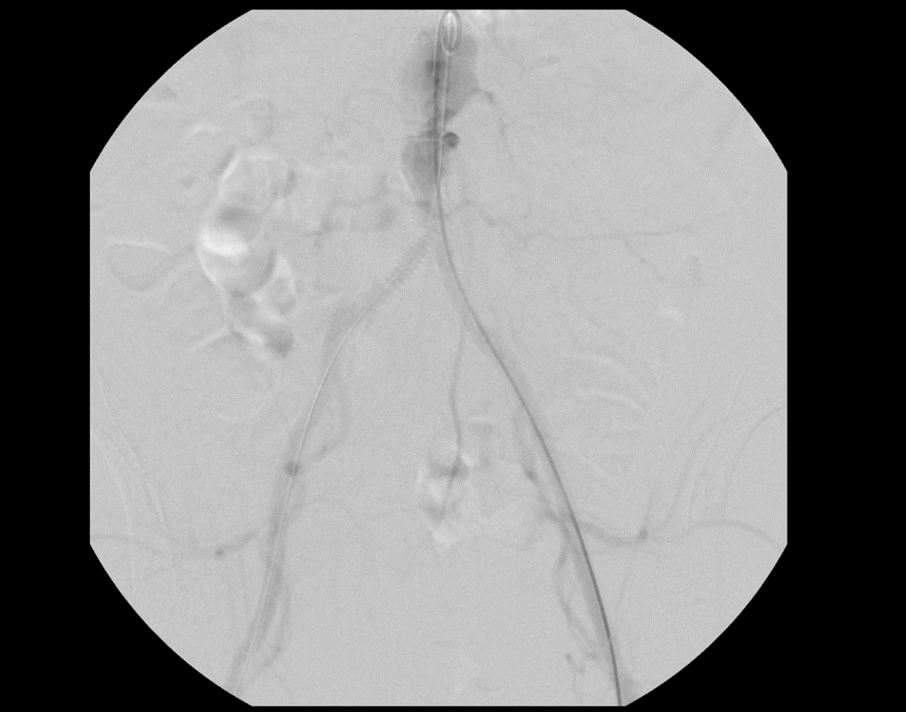
Treatment images and explanation
6 F sheath on the right side and 7 F sheath on the left side
pre-treatment angiographies

Slide 9
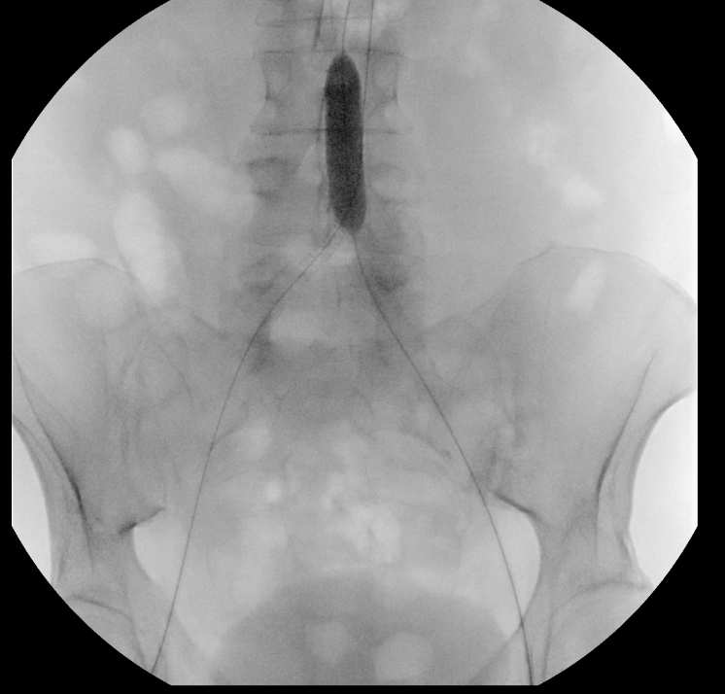
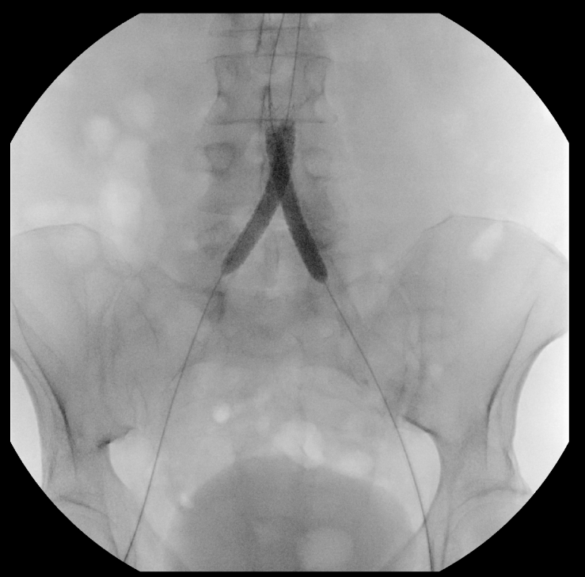
Treatment images and explanation
The Oceanus™12-40 mm balloon pushed the iCover™ 10-27 mm upper into the dilated aorta
iCover™ 7-57 mm into both common iliac arteries

Slide 10
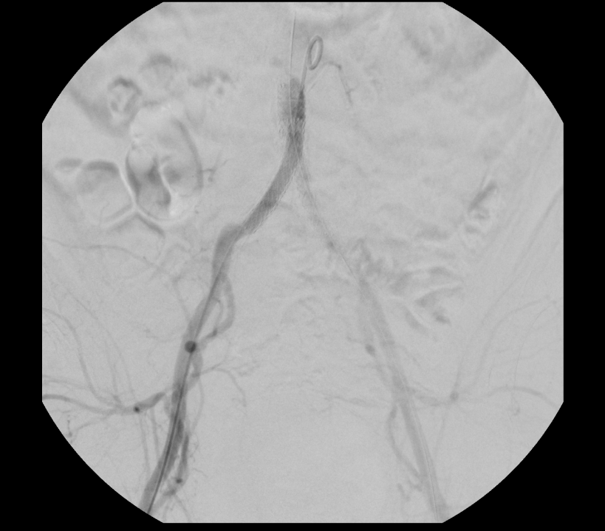
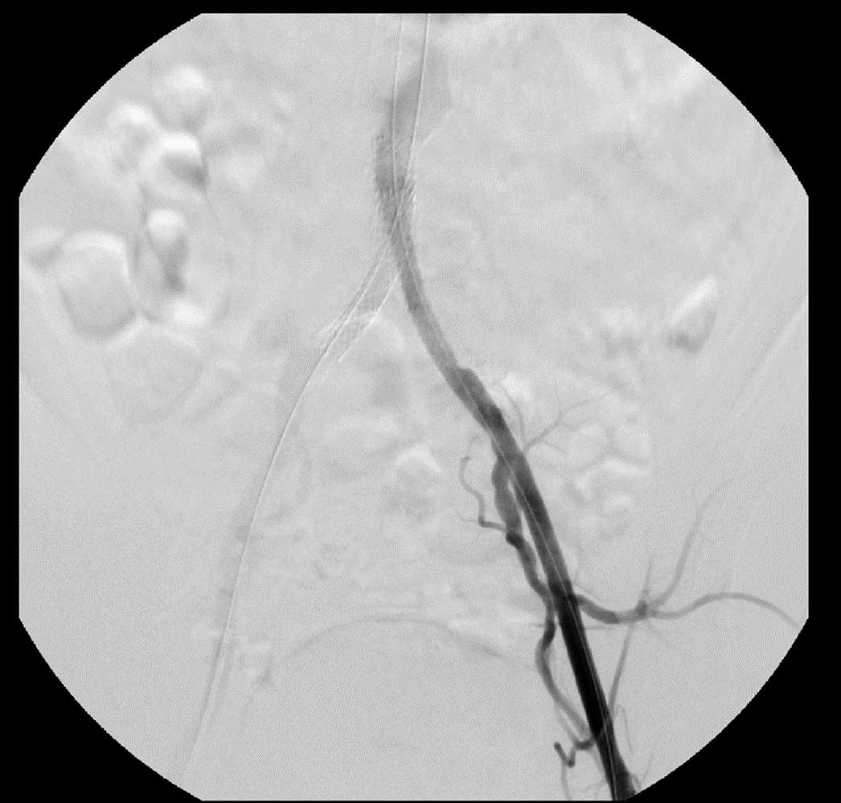
Treatment images and explanation
post-treatment angiog- raphies

Slide 11
Treatment images and explanation
no operative complication
discharge on the first post-operative day
improved walking ability, Rutherford stage 1
palpable pulses, ABI = 1 on both sides
after 7 months of follow-up, no recurrence, patient happy

Slide 12
Final images – after 7 months of follow-up

Slide 13
Conclusions
normal clinical examination doesn’t exclude PAD
A new generation covered stent may be deployed into the distal aorta, for example for CERAB, with safety and efficacy

