Slide 1





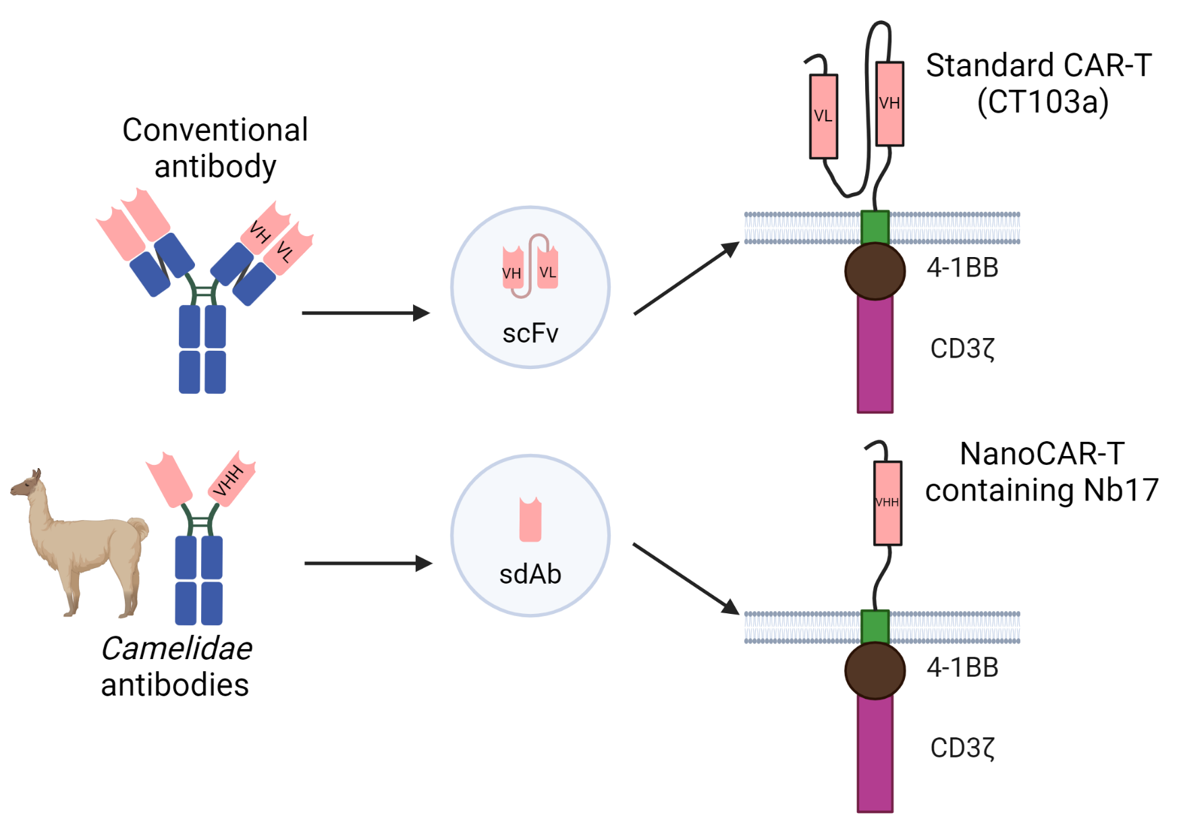
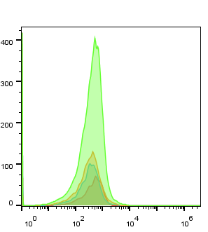
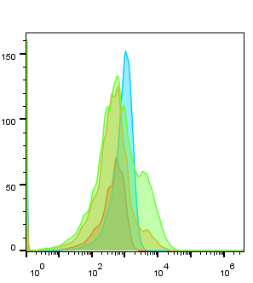
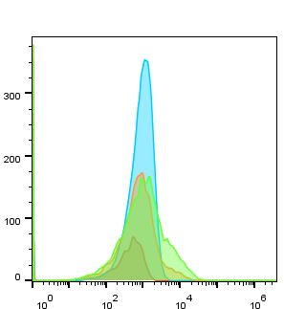
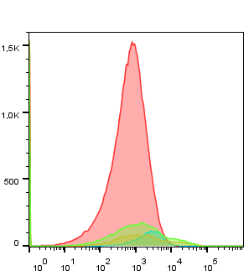
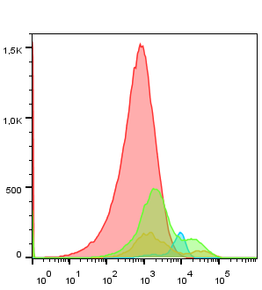

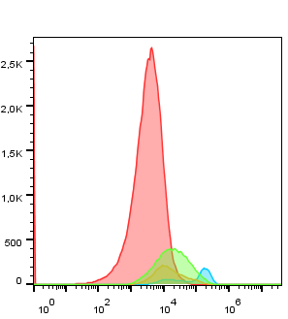
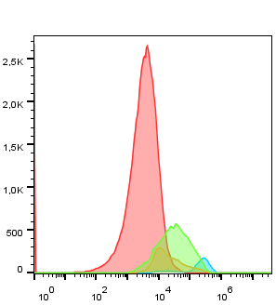
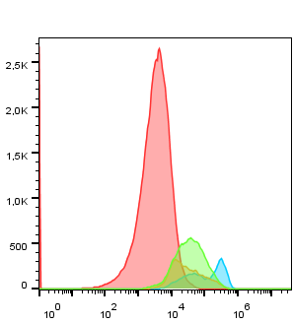
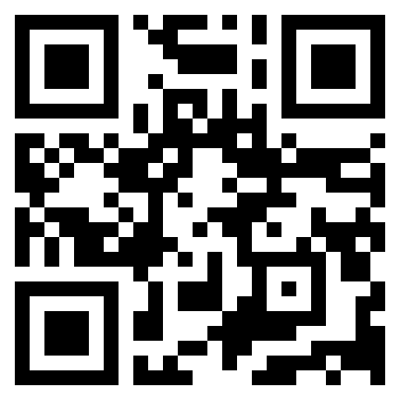
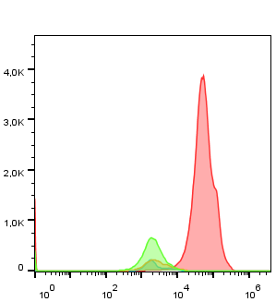
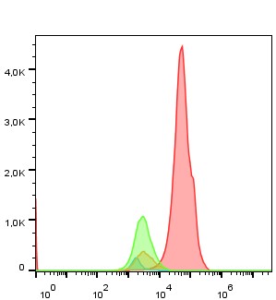

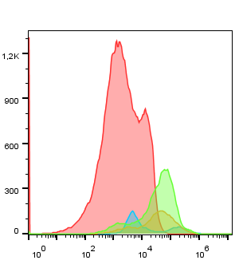
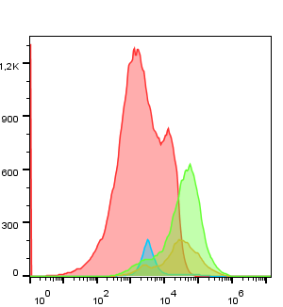
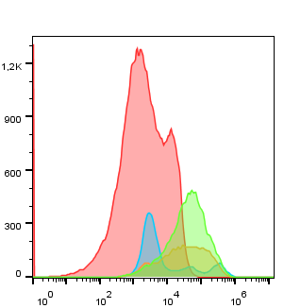
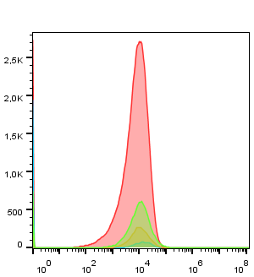


CAR-T and nanoCAR-T for multiple myeloma: Does smaller mean smarter ?
Mégane Jassin¹, Chloé Onkelinx¹, Bianca E Silva¹, Valentina Bocuzzi¹, Guillaume Marcion¹, Grégory Ehx¹, Frédéric Baron^{1,2}, Emmanuel Di Valentin³, Jo Caers^{1,2} and Nguyen Tham¹
1 Laboratory of Hematology, GIGA-I3, University of Liège, Liège, Belgium
2 Department of Hematology, CHU de Liège, Liège, Belgium
3 Viral Vectors, GIGA, University of Liège, Liège, Belgium
INTRODUCTION & OBJECTIVE
Multiple myeloma (MM) is an incurable hematologic malignancy of plasma cells. Chimeric antigen receptor T lymphocyte (CAR-T) immunotherapy has shown remarkable results in relapse patients. Single-domain antibody (sdAb) offers an excellent alternative to scFv due to the advantage of having a small and stable folding structure, therefore avoiding tonic signaling. Despite the development of numerous nanoCAR-Ts, there is limited data demonstrating the direct differences and their mechanisms of action.
This project aims to characterize the activity of a nanoCAR-T (containing sdAb, called Nb17) to a standard CAR-T (called CT103a) and elucidate the underlying mechanisms driving these differences. These findings may reveal new potential targets for novel CAR-T design strategies.
METHODS & RESULTS
1) Cell surface BCMA was quantified in seven MM cell lines using the BD QuantibriteTMBeads-PE kit, using OPM-2 as a negative control (a). Then, the binding capacity of the sdAb (Nb17) to BCMA cell surface was analyzed on each MM cell lines (b).
(a)
(b)
3) Flow cytometry was performed on co-cultures of MM1.S with UNT, CT103a or NanoCAR-T. Several markers were analyzed after 24h, 48h, or rechallening (addition of MM1.S for 2 days with co-cultures that had been ongoing for 48h). We followed exhaustion markers, LAG-3, PD-1 and TIM-3, which are expressed more over the course of the co-cultures. However, levels are not higher for CAR-Ts than UNT (h), (i), (j).
CD45RA is expressed less for each co-culture condition than naive T cells (k).
CD62L memory marker is epxressed more by CAR-Ts (l). CCR7 has the same expression for each condition (m).
24h
48h
Rechallenging
Naive T
UNT
CT103a
NanoCAR
(h)
LAG-3
Mann-Whitney tests: Comparison of each MM cell line with OPM-2
(i)
(c)
(d)
PD-1
(g)
(j)
TIM-3
(e)
(f)
(k)
CD45RA
Mann-Whitney tests:
2) Co-cultures of MM (MM1.S, RPMI-8226, LP-1), expressing BCMA or lymphoma (K562) cell lines with untransduced T cells (UNT) or CAR-T were followed for 96h using the IncuCyte S3. Cell lines expressed GFP. CT103a and NanoCAR-T seem to specifically kill cell lines expressing BCMA (c), (d), (e), (f). Scan the QR code to watch videos of these co-cultures (g).
(l)
MM1.S
MM - UNT: ****
NanoCAR-T – CT103a: ****
MM – CT103a: ****
MM – NanoCAR-T: ****
UNT – CT103a: ****
UNT – NanoCAR-T: ****
RPMI-8226
MM - UNT: **
NanoCAR-T – CT103a: ****
MM – CT103a: ****
MM – NanoCAR-T: ****
UNT – CT103a: ****
UNT – NanoCAR-T: ****
CD62L
LP-1
MM - UNT: p = 0,6674
NanoCAR-T – CT103a: ****
MM – CT103a: ****
MM – NanoCAR-T: ****
UNT – CT103a: ****
UNT – NanoCAR-T: ****
K562
K562 - UNT: ****
NanoCAR-T – CT103a: p = 0,9811
K562 – CT103a: ****
K562 – NanoCAR-T: ****
UNT – CT103a: ****
UNT – NanoCAR-T: ****
(m)
CCR7
(n)
5) ELISAs were performed for different donors after 24h of co-cultures with MM1.S cells. NanoCAR-T produces less IL-2 (less proliferation), equal amounts of IFNγ, but more TNFα (more cytotoxicity) than CT103a (o), (p), (q).
(o)
(p)
(q)
4) Luciferase assays were performed for different donors after 48h of co-cultures with MM1.S-GFP-luciferase cells. These assays show that the NanoCAR-T appears to kill better than the standard CAR-T CT103a (n).
Mann-Whitney tests: Comparison beetween UNT/CT103a/NanoCAR-T one by one
Unpaired T tests: Comparison beetween UNT/CT103a/NanoCAR-T one by one
CONCLUSION
The nanoCAR-T generated in our lab demonstrates excellent anti-cancer efficacy equivalent to the standard CAR-T CT103a. Further investigation of activation and degranulation markers and transcriptomic levels may reveal mechanistic differences and potential improvements to CAR-T therapy.
Megane.Jassin@uliege.be

