Slide 1
EU’s water management and climate change: Towards a European Union Water Agency?
Are further agencification and simplification of networks an alternative to the international-law-based model of transboundary cooperation?
Katarzyna Aleksandra JANCEWICZ
Université de Liège (Belgium)
EU Legal Studies
This project has received funding from the European Research Council (ERC) under the European Union's Horizon 2020 research and innovation programme (grant agreement n° 948473).

Slide 2
EC/EU Treaties on environment and water
Article 130s (1) EEC -> 175 (1) TEC -> Article 192 (1) TFEU = ordinary legislative procedure
Provisions dedicated to environment joined the (Communities) primary law firstly under SEA
Legal basis: Article 130s EEC (unanimity)
Article 130s (2) EEC -> 175 (2) TEC -> Article 192 (2) TFEU = ordinary legislative procedure = NEVER USED
…quantitative management of water resources or affecting, directly or indirectly, the availability of those resources…
’…Management of water resources’
Overall environmental objectives
Article 100/235 EEC
Part Three - Title ‘Environment’
Title XX TFEU ‘’Environment’
Title VII EEC
Title XVI TEC
Title XIX TEC
Single European Act
Maastricht Treaty
Amsterdam Treaty
Nice Treaty
Lisbon Treaty

Slide 3
EU secondary legislation on water in force (overview, non-exclusive)
Directive 2000/60/EC - Water Framework Directive
Directive 2007/60/EC - Floods Directive
‘Daughter Directives’ of Water Framework Directive
Directive 2006/118/EC - Groundwater Directive
Directive 2008/105/EC - Environmental Quality Standards Directive
Directive 2006/7/EC - Bathing Water Directive
Directive 91/271/EEC - Urban Waste Water Treatment Directive
Directive 91/676/EEC - Nitrates Directive
Regulation (EU) 2020/741 - Water Reuse
Directive 2008/56/EC - Marine Strategy Framework Directive
SEA
Maastricht Treaty
Amsterdam Treaty
Nice Treaty
Lisbon Treaty

Slide 4
What is a river basin district?
River basin district: optimal unit for water management
‘Hybrid form of territoriality’ (Johnson, 2012)
Ecosystem approach (Integrated Water Resources Management)
Below: local communities - traditional role in water management, subsidiarity principle
Discrepancy: administrative borders and river basin districts
Competent authorities under WFD ≠ international river commissions

Slide 5
EASA
EFCA
EMA
ECHA
…
⚠️
EEA gathers, validates and processes environmental data; it shall provide the EU and the EU MS with information at the European level & necessary technical/scientific support
⚠️
COMM Proposes, shapes, implements and manages the EU environmental law and policy framework
⚠️
⚠️
⚠️
⚠️
European Environment Information and Observation Network (Eionet) - ‘partner network’/‘knowledge network’ with a ‘complex’ internal structure
32 EEA member countries, incl. 27 EU MS
DG CLIMA
DG MARE
DG JRC
DG ENV
⚠️
⚠️
National Focal Points
Informal networks related to Common Implementation Strategies
WISE-Marine
WISE-Freshwater
⚠️
⚠️
river basin districts
⚠️
‘Water Directors’
Copernicus Programme
CMS
EDO + EDO Partner Network
EFAS
Water Framework Directive
‘Marine Directors’
⚠️
⚠️
marine (sub)regions
European Marine Observation and Data Network (EMODnet)
Marine Strategy Framework Directive

Slide 6
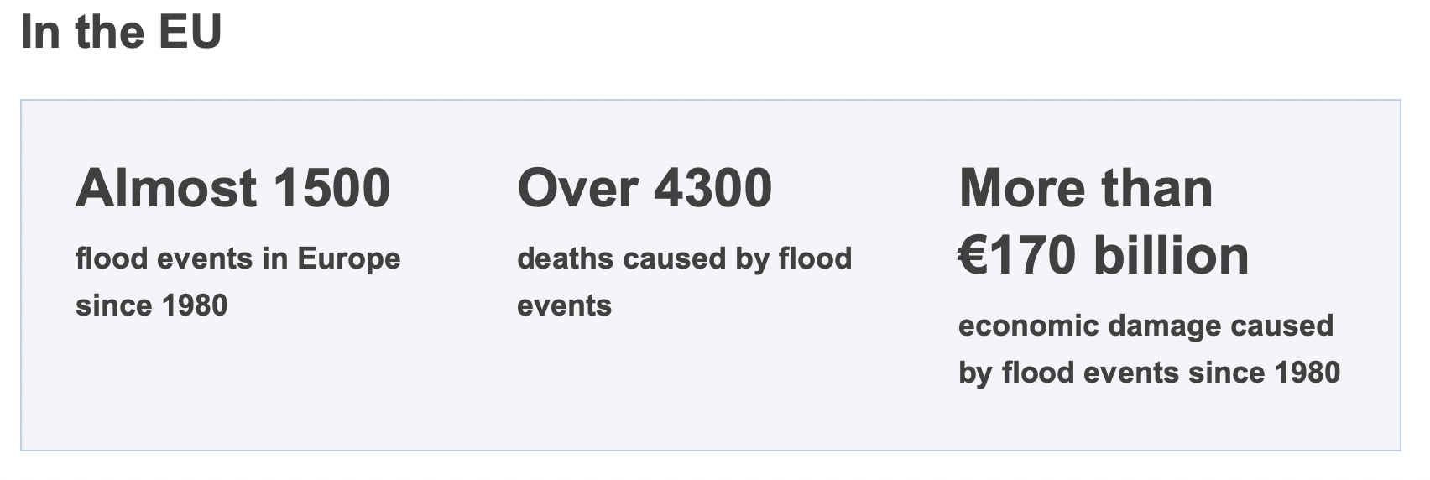
Pre-warning : droughts, floods & water scarcity….

Slide 7
Recent change proposals made by scientists & policy-makers
EU secondary legislation: adopting a new instrument a ‘Drought Directive’ (Blauhut et al., 2019), and amendment of the Water Framework Directive…
Even more databases and networks (TEN-W [Lekaviciute and Liselotte, 2023], Green Data for All)…
European Parliament recommends drafting guidances on transboundary drought management - but they were drafted by the ‘Water Directors’…
Save the date: a high-level conference of the EESC ‘Call for an EU Blue Deal’, 26.10. 2023

Slide 8
Reform ideas: testing the limits of Lisbon Treaty
? …nd package(s)?
? 2nd package?
⚠️
empower EEA & Eionet: EEA as a ‘regulatory agency’ AND/OR
create a distinct ‘European Union Water Agency’ or two distinct agencies dealing with freshwater and marine waters = with marine (sub)regions and river basin districts as field offices (under enhanced cooperation if needed)
? 1st package?
Meroni and Short - Selling judgements doctrines!
Reform: Eionet = simplification;
EEA = again as a central environmental data hub
Clear role ascribed to
river basin districts &
marine regions under EU secondary
legal framework
⚠️
Article 192 (2) TFEU: quantitative management of water resources?
Reform by EU secondary legislation amendments

Slide 9
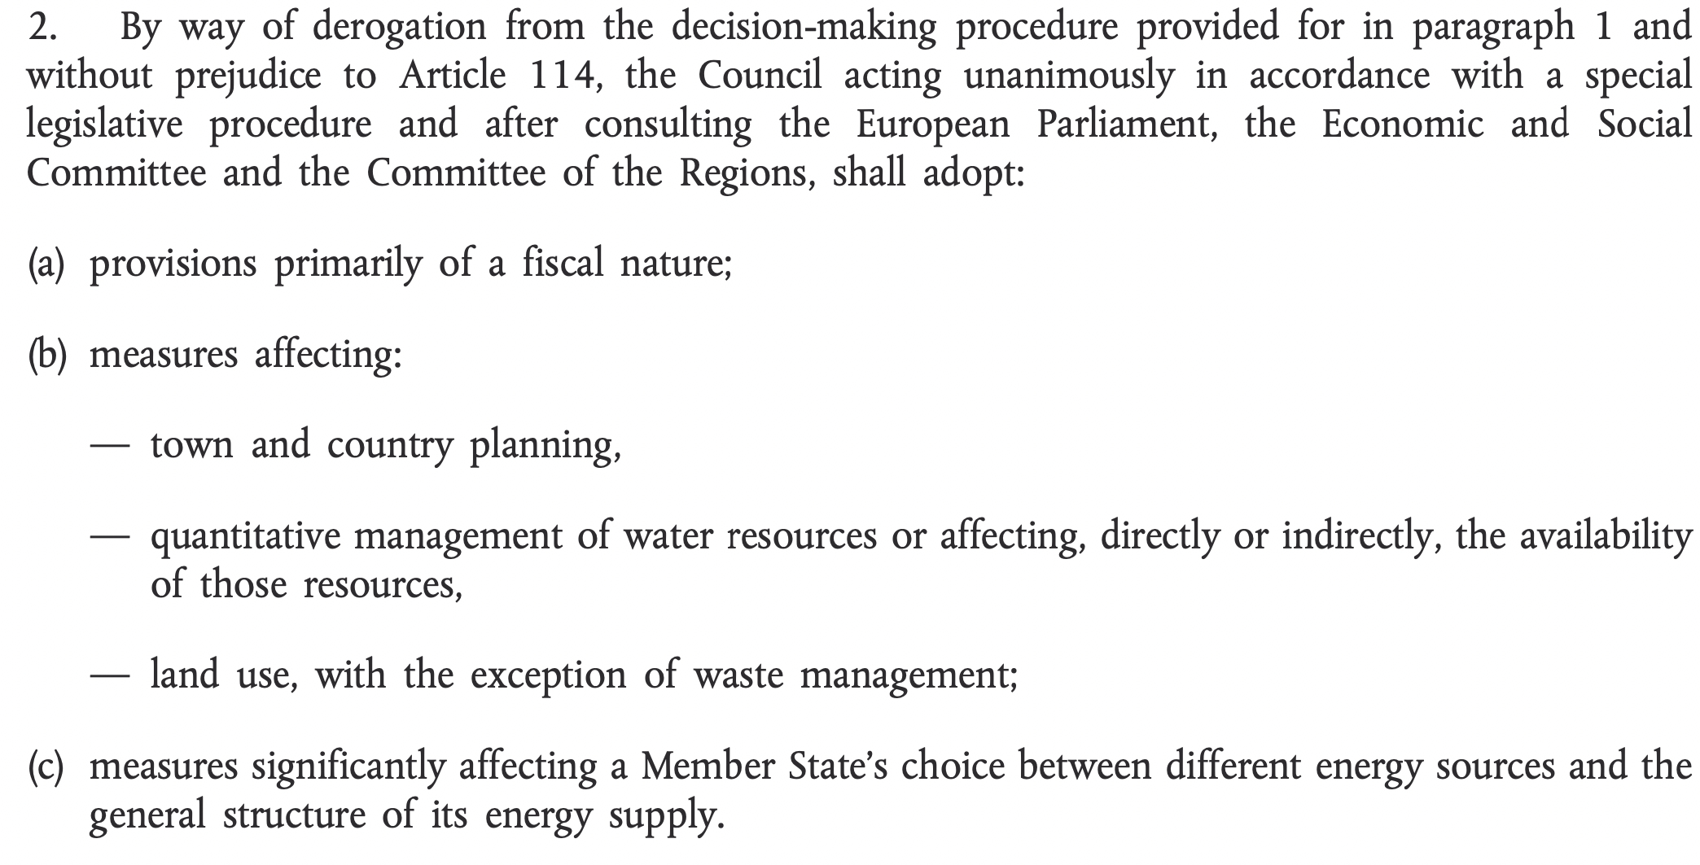
So let’s talk about Article 192 (2) subpara 1 TFEU…
Article 191 (1) TFEU:
water quality
limitation of discharges

