Slide 1

A benchmark of the large-scale in-situ PRACLAY Heater test
17 Sep. 2023 • UNSAT-WASTE, Shanghai (China)
Hangbiao Song¹, Arnaud Dizier², Séverine Levasseur³, Frédéric Collin¹
¹ University of Liège, ² EIG EURIDICE, ³ ONDRAF/NIRAS

Slide 2
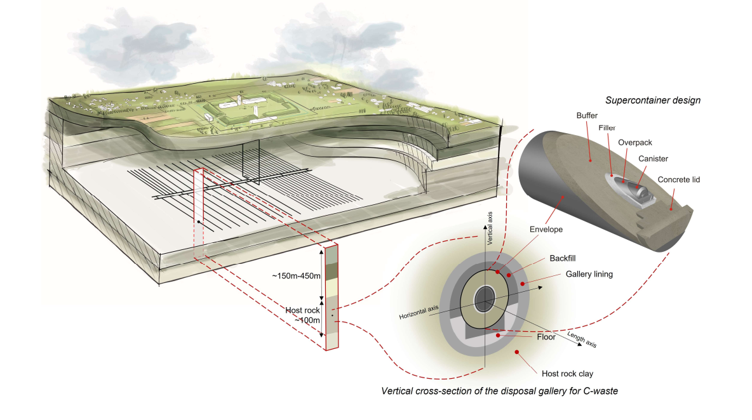
Context
Geological disposal of radioactive wastes
Multi-barrier confinement
Long-term management
THMC coupling process
Excavation, open drift, waste emplacement, backfilling, self-sealing, repository closure
Schematic view of the current design of geological disposal facility in Belgium, (NIRAS/ONDRAF)
02/13

Slide 3
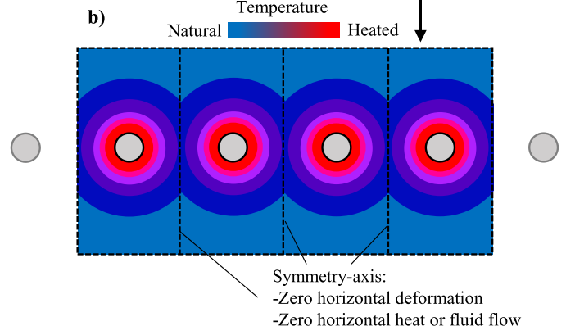
Context
Near field:
Excess pore pressure
Fracture re-opening/propagation
Alter permeability
Far field:
Tensile failure
Shear failure
Reactivate old fractures/faults
Temperature
Rock layers
Natural
Heated
Thermal conduction
Thermal pressurization
T
P_{w}
Disposal gallery
α_{w} > α_{s}
Symmetric axes: No horizontal deformation
No horizontal heat/water flow, modified from Braun P., (2019)
Objective:
Reproduce the in-situ observations induced by thermal effects.
03/13

Slide 4
Table of content
Context
Description of the in-situ PRACLAY Heater test
Numerical prediction
Conclusions
04/13

Slide 5
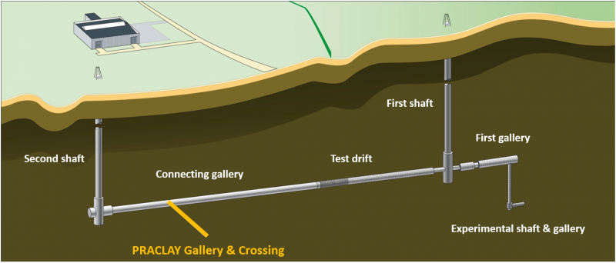
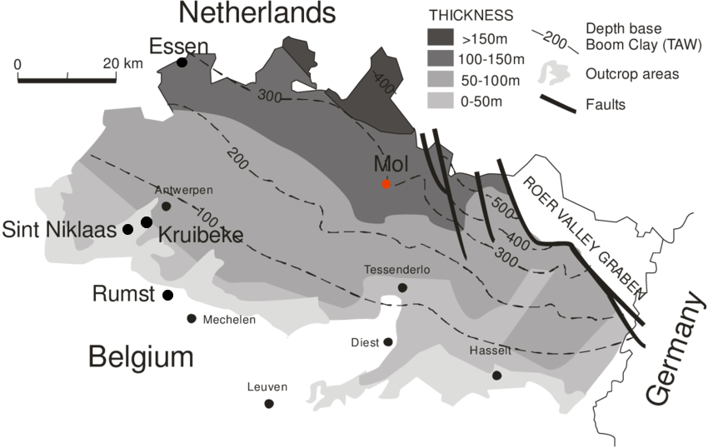
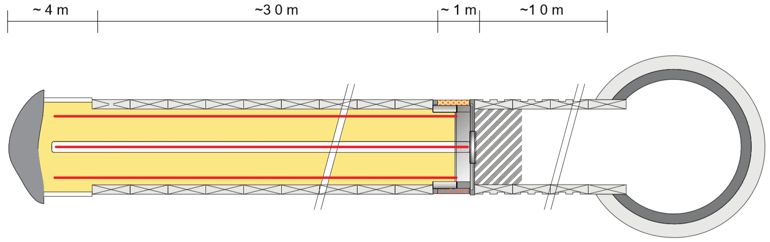
Experimental set-up
PRACLAY Heater test
Location of Boom Clay layer in Belgium (NIRAS/ONDRAF)
Layout of the underground laboratory at Mol, Belgium
EURIDICE website (2018)
Layout PRACLAY gallery
Concrete lining
Heater cables
Backfill material: sand
End Plug
Bentonite annular ring
Division longitudinal zones
→ Focus on Ring 50 (central position)
Ring 50
D = 2.5 m
Steel reinforcement
General layout of the test setup in the PRACLAY gallery EURIDICE website (2018)
Zone 3
Zone 2
Zone 1
05/13

Slide 6
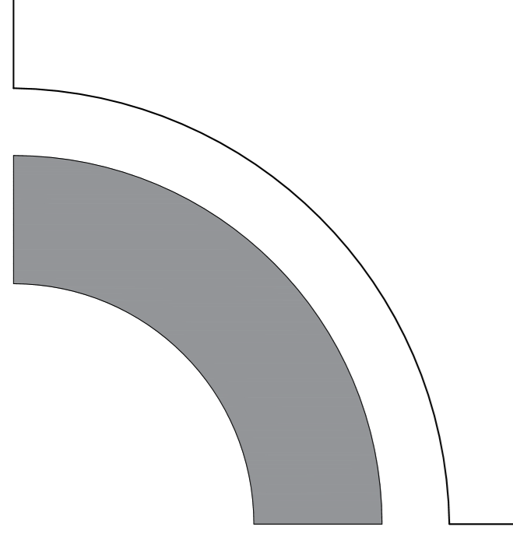
PRACLAY Heater test
Construction PRACLAY gallery
Excavation and waiting phase until start pressurization (1597 days)
σ_{V0} = 4.5 MPa
σ_{H0} = 3.825 MPa
G
H
p_{w0} = 2.25 MPa
I
A
B
C
Artificial pressurization: p_{w} intrados lining
Applied pore water pressure from experimental observation: p_{w} intrados lining
1 day
4.4 years
21/10/2007
22/10/2007
5/03/2012
3/11/2014
17/08/2015
17/08/2025
Excavation of the PRACLAY gallery
Start-up heating phase: T at lining extrados
Stationary heating phase: 80°C at lining extrados
06/13

Slide 7
PRACLAY Heater test
Pressurrization
Pressurization phase (973 days)
G
H
I
A
B
C
Artificial pressurization: p_{w} intrados lining
Applied pore water pressure from experimental observation: p_{w} intrados lining
1 day
21/10/2007
22/10/2007
5/03/2012
3/11/2014
17/08/2015
17/08/2025
Excavation of the PRACLAY gallery
Start-up heating phase: T at lining extrados
Stationary heating phase: 80°C at lining extrados
07/13

Slide 8
PRACLAY Heater Test
Heating phase
Heating phase (3940 days)
G
H
I
A
B
C
Artificial pressurization: p_{w} intrados lining
Applied pore water pressure from experimental observation: p_{w} intrados lining
1 day
21/10/2007
22/10/2007
5/03/2012
3/11/2014
17/08/2015
17/08/2025
Excavation of the PRACLAY gallery
Start-up heating phase: T at lining extrados
Stationary heating phase: 80°C at lining extrados
08/13

Slide 9
Table of content
Context
Description of the in-situ PRACLAY Heater test
Numerical prediction
Conclusions
04/13

Slide 10


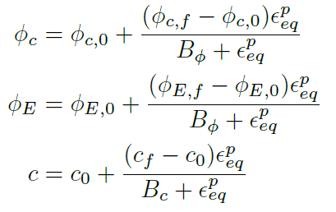
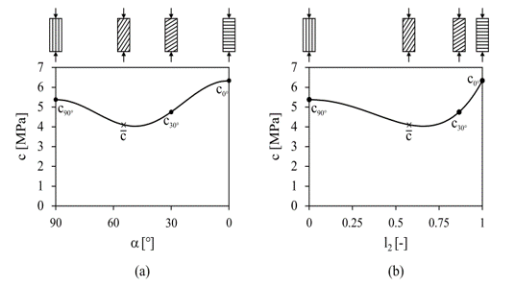
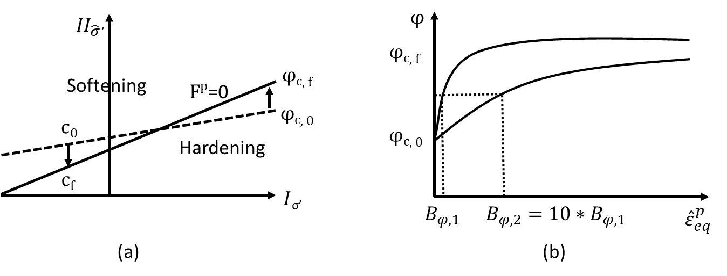

Numerical prediction
EURAD-HITEC Subtask 2.3 – THM modelling of effect of temperature in near field: selection of benchmark exercises
Main characteristics
2D plane strain
LAGAMINE developed in ULiege
Thermo-hydro-mechanical coupling
Refinement around gallery
Constitutive law: Drücker Prager
$$\left(∅_{c}=∅_{E}\right)$$
Variation of cohesion for cross-anisotropic rock (fabric tensor):
Niandou et al., (1997); Valès et al., (2004)
Drücker Prager yield surface with hardening/softening
hyperbolic relation for two values of coefficient Bϕ
(a) as a function of the angle between the normal to the bedding planes and the direction of loading and (b) as a function of the loading vector.
09/13

Slide 11
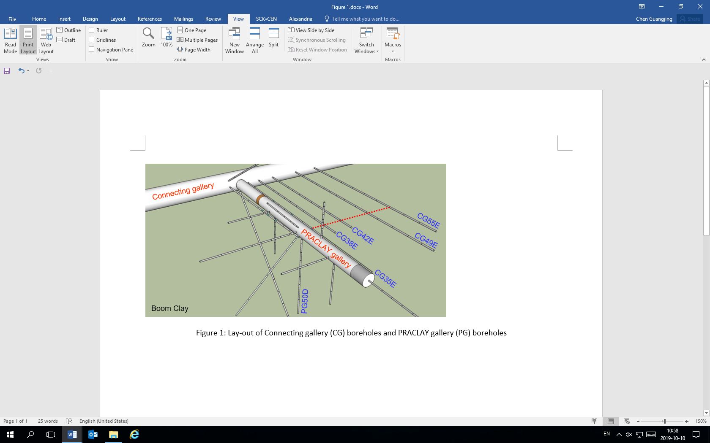
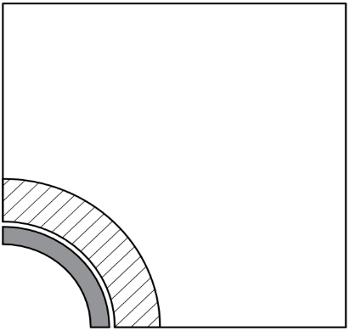

Numerical prediction
Monitoring boreholes around the PRACLAY gallery
Evolution of temperature and pore pressure
Artificial EDZ + Sound layers
Sound layers
Initial value of permeability:
Vertical: 2E⁻¹⁹ m²
Horizontal: 4E⁻¹⁹ m²
Initial value of Young’s modulus:
Parallel: 400 MPa
Normal: 200 MPa
5.14 m $≈$ 2D
EDZ
Vertical intrinsic permeability [m²] | 3E⁻¹⁹
Horizontal intrinsic permeability [m²] | 6E⁻¹⁹
EDZ:
Sound layers :
Young’s modulus parallel to bedding [MPa] | 1400
Young’s modulus normal to bedding [MPa] | 700
Shear modulus parallel to bedding [MPa] | 560
Shear modulus normal to bedding [MPa] | 280
10/13

Slide 12

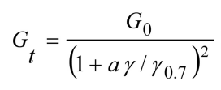
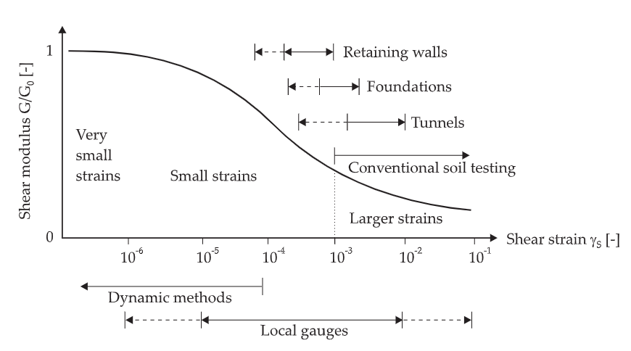
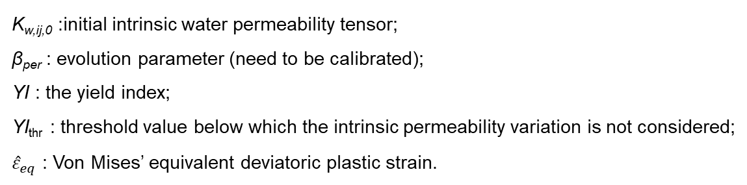
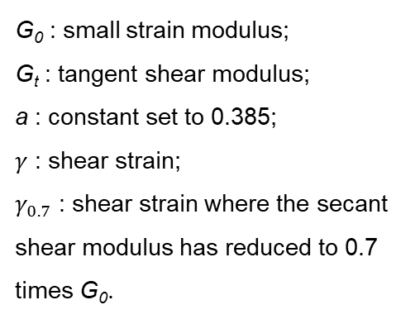
Numerical prediction
Evolution of the intrinsic hydraulic permeability
Pardoen B. (2015)
Artificial EDZ + Sound layers
Evolution of the pore pressure
K_{w,ij,0} :initial intrinsic water permeability tensor;
β_{per} : evolution parameter (need to be calibrated);
YI : the yield index;
YI_{thr} : threshold value below which the intrinsic permeability variation is not considered;
${\hat{ε}}_{eq}$ : Von Mises’ equivalent deviatoric plastic strain.
Evolution of the shear modulus
Atkinson, J.H. (1991)
Chen, (2023)
G₀ : small strain modulus;
G_{t} : tangent shear modulus;
a : constant set to 0.385;
$γ$ : shear strain;
$γ_{0.7}$ : shear strain where the secant shear modulus has reduced to 0.7 times G₀.
11/13

Slide 13
Table of content
Context
Description of the in-situ PRACLAY Heater test
Numerical prediction
Conclusions
04/13

Slide 14
Conclusions
We introduced first an artificial EDZ + sound layers able to
  Reproduce the pore pressure evolution before the heating.
  Highly pronounced thermal pressurization due to T-H-M coupling.
We improved the model by
  The dependency of stiffness and permeability on the deformation.
  The evolution of pore pressure is better captured.
We plan to further investigate
  The evolution of stiffness and permeability with the deformation.
12/13

Slide 15
Thank you for your attention
17 Sep. 2023 • UNSAT-WASTE, Shanghai (China)
Hangbiao Song¹, Arnaud Dizier², Suresh Seetharam³, Séverine Levasseur⁴, Frédéric Collin¹
¹ University of Liège, ² EIG EURIDICE, ³ SCK CEN, ⁴ ONDRAF/NIRAS

Slide 16
References
Ensi (2013), Geologische Tiefenlager, Radioaktive abfälle sicher entsorgen Rapport.
Andra (2005), Dossier 2005: Argile Synthesis. Evaluation of the Feasibility of a Geological Repository in an argillaceous Formation Meuse/Haute-Marne Site. National Agency for Radioactive Waste Management, Paris.
P. Braun(2019), Thermo-hydro-mechanical behavior of the Callovo-Oxfordian. PhD thesis. Université Paris-Est.
M. S. Diederichs (2003), Rock Fracture and Collapse Under Low Confinement Conditions, Rock Mech Rock Eng, 36(5):339–381.
W. Bastiaens, F. Bernier, M. Buyens, M. Demarche, X. L. Li, J.-M. Linotte, J. Verstricht (December 2003), The extension of the HADES underground research facility at Mol, Belgium, The construction of the connecting gallery, EURIDICE report 03-294.
H. Niandou, J. F. Shao, J. P. Henry, and D. Fourmaintraux (1997), Laboratory investigation of the mechanical behaviour of tournemire shale. Int J Rock Mech Min Sci, 34(1):3–16.
F. Valès, D. N. Minh, H. Gharbi, and A. Rejeb (2004), Experimental study of the influence of the degree of saturation on physical and mechanical properties in tournemire shale (france). Appl Clay Sci, 26(1-4):197–207.
B. Pardoen (2015), Hydro-mechanical analysis of the fracturing induced by the excavation of nuclear waste repository galleries using shear banding, PhD Thesis, University of Liège, Faculty of Applied Sciences.
EURAD WP HITEC - Milestone report 49 – Selection of benchmark exercises for task 2.3.
Atkinson, J.H., Sallfors, G.: Experimental determination ofsoil properties, Proc. 10thECSMFE, Florence, Vol. 3, 1991,915–956.
Chen, G., Li, X., Dizier, A., Verstricht, J., Sillen, X., & Levasseur, S. (2023). Characterization of Boom Clay anisotropic THM behaviour based on two heating tests at different scales in the HADES URL. Geological Society, London, Special Publications, 536(1), SP536-2022.
Dizier, A., Chen, G.J., Li, X.L., Leysen, J., Verstricht, J., Troullinos, I., Rypens, J. 2016. The Start-up Phase of the PRACLAY Heater Test. EUR_PH_16_025. Mol, Belgium.
Dizier, A., Chen, G.J., Li, X.L., Rypens, J. 2017. The PRACLAY Heater test after two years of the stationary phase. EUR_PH_17_043. Mol, Belgium

