Slide 1
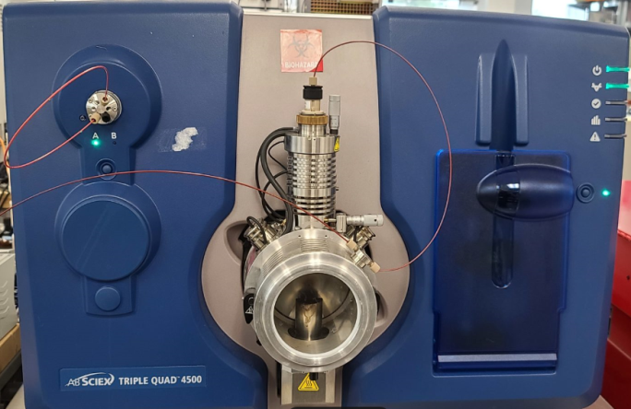
Gastrins
Loreen Huyghebaert
Department of Clinical Chemistry
CHU de Liège

Slide 2
Introduction
Overview
Gastrointestinal hormone
Produced in the G cells (pyloric antral part of the stomach)
Regulates by pH
Roles:
  Stimulates gastric acid and pepsinogen secretion
  Release of humoral mediators
  Regulates growth of gastrointesinal mucosa

Slide 3
Pathologies
Gastric cancer: most common – leading cause of cancer-related deaths
Chronic atrophic gastritis: premalignant gastric condition → Early diagnostic is ESSENTIAL
Zollinger-Ellison syndrome (ZES): tumor producing gastrin
Peptic ulcer, duodenal ulcer
Gastrinoma: neuroendocrine tumor
For a better understanding
Studying the synthesis
bioactive gastrins circulate in different molecular forms

Slide 4
Synthesis
Tryptic-like cleavage converted the progastrine (80 AA) into a number of bioactive peptides released into the circulation
PROGASTRINE
Ser
Arg-Arg
Lys-Lys
Arg-Arg
Asn
22
57
58
74
75
94
95
101
GASTRINES
α-AMIDATED
(Biologically active)
5 Gastrines:
G71, G52, G34, G17, G14, G6
Active site: Trp-Met-Asp-Phe-NH₂

Slide 5
Synthesis
Tryptic-like cleavage converted the progastrine (80 AA) into a number of bioactive peptides released into the circulation
PROGASTRINE
Ser
Arg-Arg
Lys-Lys
Arg-Arg
Asn
22
57
58
74
75
94
95
101
GASTRINES
α-AMIDATED
α-amidated gastrin-17 and -34 = Predominant forms existing in non-sulfated and sulfated forms
Influences neither gastric acid secretion nor metabolic clearance rate
Differences according to the pathologies
(ex: healthy = 37.7 ± 1.9% >< ZES = 44.8 ± 5.5%)
(Biologically active)
5 Gastrines:
G71, G52, G34, G17, G14, G6
Active site: Trp-Met-Asp-Phe-NH₂
Development en LC-MS/MS: gastrin-17 and -34 sulfated and non-sulfated (G17/G34 S-NS)

Slide 6
Synthesis
Tryptic-like cleavage converted the precursor (101 AA) into a number of bioactive peptides released into the circulation
PROGASTRINE
Ser
Arg-Arg
Lys-Lys
Arg-Arg
Asn
22
57
58
74
75
94
95
101
GASTRINES
α-AMIDEES
BIOSYNTHETIQUES PRECURSORS
FRAGMENTS
(No know biological activity)
(Biologically active)
(No know biological activity)
Gastrins glycine-extended = direct precursors α-gastrins
5 Gastrines:
G71, G52, G34, G17, G14, G6
N-terminal (ex: 1-35/6-35/20-35)
C-terminal (ex: 75-80)
Others (ex: 38-52/55-64)
Active site: Trp-Met-Asp-Phe-NH₂
Discovery en HRMS

Slide 7
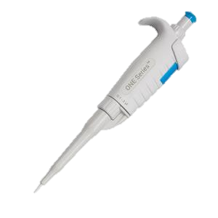
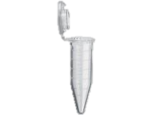
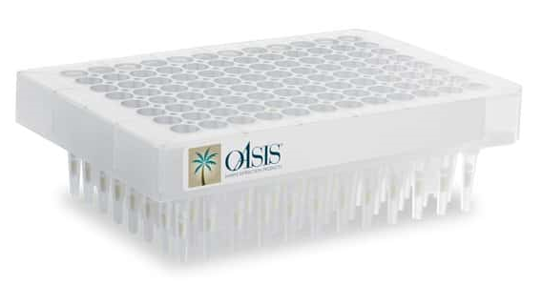
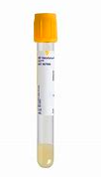
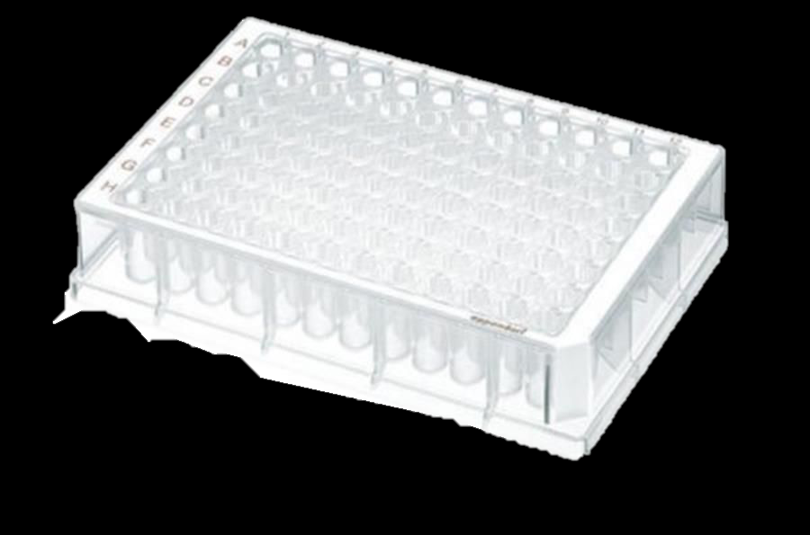
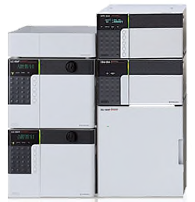
Results
+ 50 µL NH₄OH 5%
 | m/z Q1 | m/z Q3
G17-NS
G17-S
G34-NS
G34-S
Different successive steps:
- LC-MS development
Elution
- Sample treatment development
Evaporate

Slide 8
Conclusion
LC, MS and SPE were optimized for 4 angiotensins
Values of 5pg/ml can be detected.
Method has successfully completed the preverification steps
Perspectives
Complete validation of the method >< CLSI
Dosage of patients
Establishment of peptides profil depending on pathologies

Slide 9
Conclusion
LC, MS and SPE were optimized for 4 gastrins
Values of 20 pg/ml can be detected
Perspectives
Complete validation of the method >< CLSI
Discovery
What others forms are present in blood
Biological activity
Pathology-dependent profile
Early detection of pathologies >< Others forms

Slide 10





CIRM ULiège

