Slide 1
Ministry of Higher Education and Scientific Research Higher National Veterinary School
The Food Hygiene and Quality Assurance Research Laboratory HASAQ 5th International Scientific Day
BRUCELLA and BRUCELLOSIS: A PERPETUAL CHALLENGE
10th February 2024, ENSV
Mathematical modeling of small ruminant brucellosis: Simulation of control strategies in El Oued province
Nacira Ramdani ¹, Sabrina Boussena ², Nassim Moula ³
1 Regional Veterinary Laboratory of El Oued, National Institute of Veterinary Medicine, Algiers, Algeria.
2 Management of Animal Health and Productions Laboratory, Institute of Veterinary Sciences, University of Frères Mentouri Constantine 1, Constantine, Algeria.
3 Department of Veterinary Management of Animal Resources, Faculty of Veterinary Medicine, Liège, Belgium.

Slide 2
Problem
Extensive and detrimental effects of brucellosis on both human and animals in endemic areas (Franc et al., 2018)
Ineffective programs of brucellosis control in Algeria
Endemic disease in Algeria causing more than 10 000 human cases (INSP, 2017)
Algeria is one of the Mediterranean countries with the highest incidence of brucellosis (OIE, 2022).
DSP El Oued (2018): More then one hundred of cases are reported every year in El Oued.
Notes:
It’s a common knowledge that brucellosis causes extensive and detrimental effects on both human and animals specifically in endemic areas.
On the other hand, programs of control of the disease were ineffective in Algeria resulting in more than 10 thousand of human cases

Slide 3
Objective
Design a control/eradication policy adjusted to epidemiological and socioeconomic conditions of El Oued district
Notes:
Therefore, designing a control policy adjusted to epidemiological and socioeconomic conditions of El Oued seemed indispensable.

Slide 4
Plan
Deterministic mathematical model of the dynamic spread of brucellosis
Deterministic simulation agent-based-model (ABM) of control strategies over 20 years
Notes:
To reach that objective, the plan was to develop a Deterministic mathematical model of the dynamic spread of brucellosis using compartmental model to represent the various categories of the animal population related to the studied disease
, and to develop a deterministic simulation agent-based-model (ABM) of control strategies including fixed set of inputs, essential components of the proposed control strategies in order to simulate the various outcomes over twenty (20) years.

Slide 5
1
Deterministic mathematical model of the dynamic of spread of brucellosis
Materials and Methods
Data
1
Animal population
The slaughtered animals (C)
Birth rate (b)
Death rate (µ) = 1/ Life expectancy
2
Epidemiological data
3
Brucella melitensis and brucellosis in small ruminant
Notes:
In order to develop a deterministic model of the dynamic transmission of brucellosis. Certain data should be collected. Data related to animal population like:
The slaughtered animals , Birth rate and Death rate in sheep and goats of the study area.

Slide 6
1
Deterministic mathematical model of the dynamic of spread of brucellosis
Materials and Methods
Data
1
Animal population
TP:3.98% (Ramdani et al., 2022)
Vaccination : 2010 to 2017
2
Epidemiological data
3
Brucella melitensis and brucellosis in small ruminant
Notes:
Epidemiological data like the true prevalence to calculate the proportion of infected and susceptible animals and the vaccination status in the studied population

Slide 7
1
Deterministic mathematical model of the dynamic of spread of brucellosis
Materials and Methods
Data
1
Animal population
Infection in utero is neglected➔ C ∈ (susceptible)
Continuity of infectiousness of infected animals ➔
No immunity
Neglect of environmental transmission
2
Epidemiological data
3
Brucella melitensis and brucellosis in small ruminant
Notes:
Also, data related to brucella melitensis and brucellosis in small ruminant is also relevant. For instance, kids of infected mothers were considered undiseased because infection in utero is less frequent in sheep and goats.
Similarly, the infectiousness is continuous meaning that there is no immunity after infection
To avoid complexity of the model, environmental transmission was neglected

Slide 8
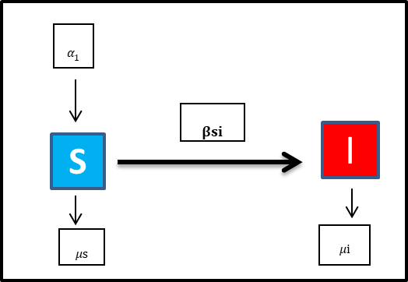
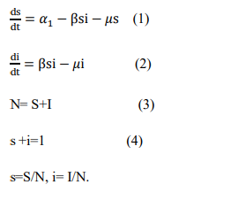
1
Deterministic mathematical model of the dynamic of spread of brucellosis
Materials and Methods
SI model formulation
The model (ODE) for each time t :
Notes:
This flow chart illustrates the formulation of the deterministic SI model of the dynamic spread of brucellosis.
The population of small ruminants is composed of two compartments which are the susceptible (S) and infected (I)animals.
Young animals of replacement rate (α 1) is added to the susceptible subpopulation per year. Susceptible animals become infected at the transmission rate ß after an effective and direct contact with infectious individuals. Infected animals are assumed to be infectious after contracting the infection. The infectiousness is assumed to last during the lifespan of the animal. The death rate (µ) is assumed to be natural death. So we have a rate of death in susceptible and infected compartments.
The model is represented mathematically with ordinary differential equations as illustrated here

Slide 9
1
Deterministic mathematical model of the dynamic of spread of brucellosis
Materials and Methods
SI model formulation
Disease free equilibrium ➔ The model
➔ NGM: R0
Endemic equilibrium state ➔
Notes:
We formulated the basic reproduction number at the disease free equilibrium. The state where there is no new infections.
And then, we formulated the effective reproduction number at the endemic equilirium state which represents the current state of the disease.
So that we could calculate the transmission rate because it’s the only missing value in our model

Slide 10
1
Deterministic mathematical model of the dynamic of spread of brucellosis
Materials and Methods
Matlab
Time step (dt)=1 day
Tmax =20 years
Euler's method
Origin (Pro)
Microsoft Excel
Model running and data analysis
Notes:
After having all the necessary data and numerical values. We have run the model using Matlab. The model was coded using Euler's method. The time step was 1 day and Tmax was for the upcoming 20 years. Afterwards, The line and bar graphs were created with Origin and Excel

Slide 11
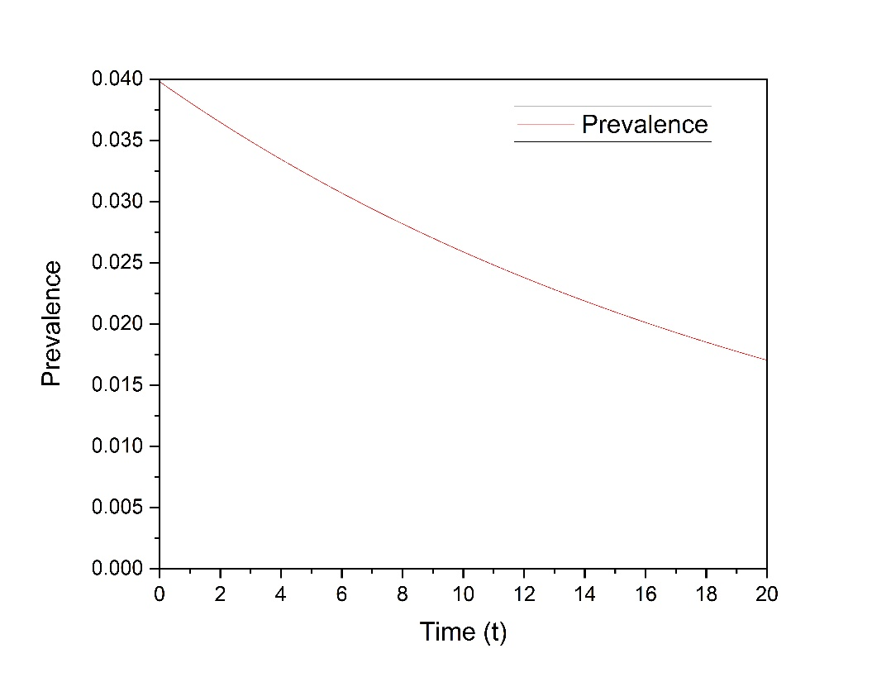
1
Deterministic mathematical model of the dynamic of spread of brucellosis
Results and discussion
Notes:
Forecasting the course of dynamic of transmission of brucellosis in small ruminant over the next 20 years revealed a slight and steady decrease of the prevalence from 3.98% to 3.20%, 2.59% and 1.70% after 5 years, 10 years and 20 years.

Slide 12
2
Deterministic simulation agent-based model of control/eradication strategies
Materials and Methods
Data
Brucellosis vaccines
Brucella melitensis Rev1
Vaccination efficacy : 100%
Waning immunity: 1/2.5 yrs
Serological tests performance
Fixed input data
Notes:
To simulate control strategies, certain data were indispensable. Related to brucellosis vaccines: we have chosen Rev 1 vaccine that has perfect efficacy and waning immunity of 2.5 years

Slide 13
2
Deterministic simulation agent-based model of control/eradication strategies
Materials and Methods
Data
Brucellosis vaccines
RBT and CFT used in series
Sp :99.99%
Se:61.09%
Serological tests performance
Fixed input data
Notes:
And serological tests: we picked RBT and CFT that would be used in series meaning RBT for screening and CFT for confirmation
Also we have calculated their specificity and sensitivity so that we take into consideration the false positive that would be eliminated from susceptible compartment

Slide 14
2
Deterministic simulation agent-based model of control/eradication strategies
Materials and Methods
Data
Brucellosis vaccines
Proportion of animals to be sampled per year: K
Proportion of animals to be vaccinated per year :ɣ
Serological tests performance
Fixed input data
Notes:
We added other inputs such as proportion of animals that would be sampled per year and Proportion of animals that would to be vaccinated per year depending on the control or eradication policy

Slide 15
2
Deterministic simulation agent-based model of control/eradication strategies
Materials and Methods
V
TS-V
TS
Models’ formulation
Three-vaccination deterministic simulation models :
Mass vaccination (MV)
Young animals only (YV)
Adult animals only (AV)
Notes:
3 control / eradication strategies were simulated. The first one was based on vaccination only. We designed three-vaccination deterministic simulation models : Mass vaccination meaning vaccination of age categories of animals. Vaccination of young animals only. The third model was based on vaccination of adult animals only

Slide 16
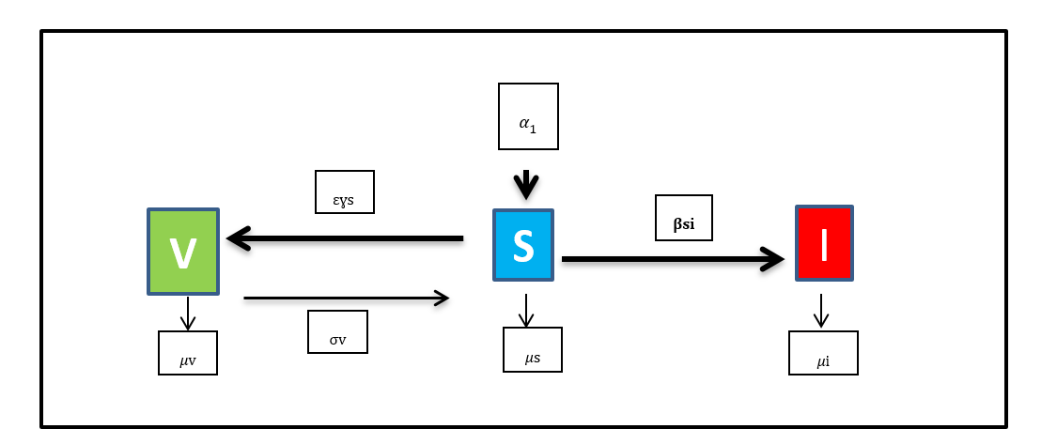
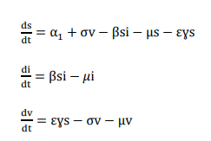
2
Deterministic simulation agent-based model of control/eradication strategies
Materials and Methods
Models’ formulation
V
TS-V
TS
Mass vaccination
Notes:
Starting with mass vaccination model:
A new compartment of subpopulation of vaccinated animals (V) is added to the SI model.
Every year a proportion of vaccinated animals would leave the susceptible compartment. The same proportion would be added to vaccinated compartment. However, a proportion of animals that they would lose their immunity post-vaccination and become susceptible again

Slide 17
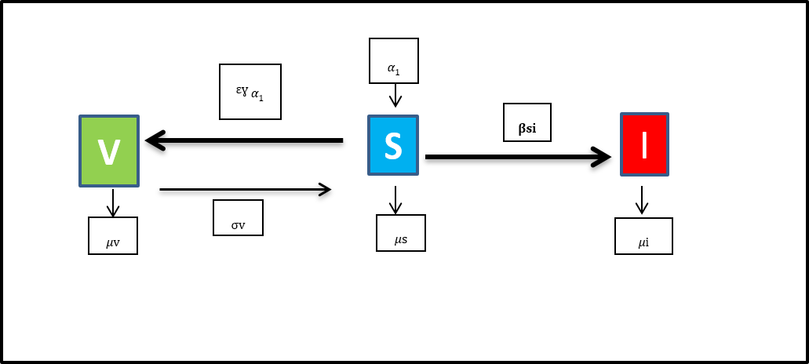
2
Deterministic simulation agent-based model of control/eradication strategies
Materials and Methods
Models’ formulation
Young animals
V
TS-V
TS
Notes:
In this model, only the young animals would be vaccinated every yar

Slide 18
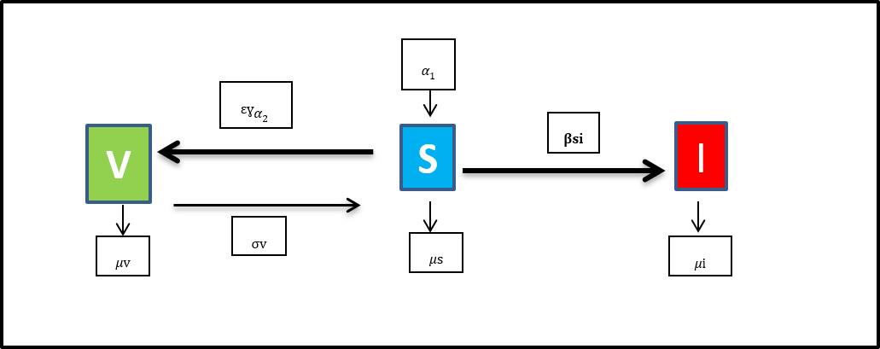
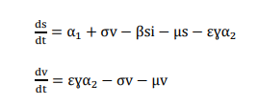
2
Deterministic simulation agent-based model of control/eradication strategies
Materials and Methods
Models’ formulation
Adults animals
V
TS-V
TS
Notes:
And in this model only adult animals would be vaccinated

Slide 19
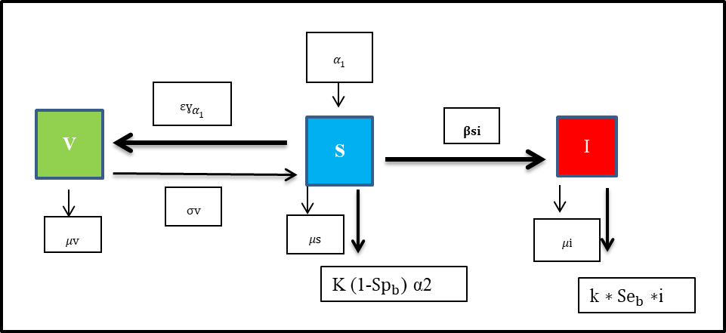
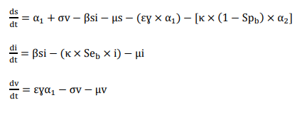
2
Deterministic simulation agent-based model of control/eradication strategies
Materials and Methods
Models’ formulation
V
TS-V
TS
Notes:
The second policy was based on test and slaughter of adults and vaccination of young animals
So there is a proportion of animals to be sampled every year from adults to be tested in the laboratory whether they are infected or susceptible. And a proportion of young animals to be vaccinated.
There would be SIV model. In the susceptible compartment, a proportion of vaccinated young animals would leave to be added to vaccinated compartment. Also, there is a proportion of false positive adult animals that would be slaughtered falsely. In infected compartment, there would be new infections as usual but with test-slaughter policy a proportion of sampled animals would be slaughtered and leave the infected compartment.
In vaccinated compartment, a proportion of animals that they would lose their immunity post-vaccination and become susceptible again

Slide 20
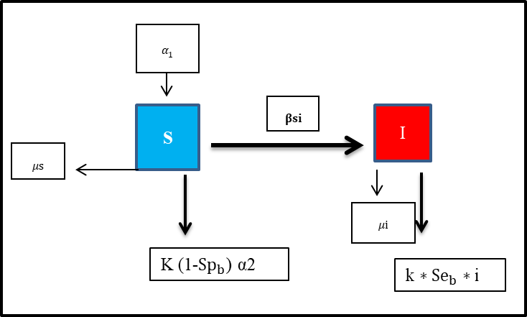
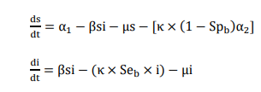
2
Deterministic simulation agent-based model of control/eradication strategies
Materials and Methods
Models’ formulation
V
TS-V
TS
Notes:
The third simulation model concerns test-and –slaughter policy only. There is SI model. It’s is the same as the previous model except that there is no vaccination compartment.

Slide 21
2
Deterministic simulation agent-based model of control/eradication strategies
Materials and Methods
Matlab
Time step (dt)=1 day
Tmax =20 years
Euler's method
31 models of simulation
Origin (Pro)
Microsoft Excel
Model running and data analysis
Notes:
We have run the models using Matlab. 31 models of simulation were coded using Euler's method. The time step was 1 day and Tmax was for the upcoming 20 years. Afterwards, The line and bar graphs were created with Origin and Excel

Slide 22
2
Deterministic simulation agent-based model of control/eradication strategies
After 5 years
Results
Notes:
- Generally, after 5 years of implementing various control strategies, there is a reduction in prevalvence
-Hiwever, a significant decrease in prevalence can be observed after 5 years of vaccination of 20%, 50% and 75% of young animals combined with testing and elimination of 50% of adults which would be resulted in prevalences of : 0.66%, 0. 64% and 0.63%, respectively
- Similarly, a considerable decrease was observed in policies related to test and slaughter of 50% and 75% of adults for 5 years which would be resulted in 0.67% and 0.31%, respectively

Slide 23
2
Deterministic simulation agent-based model of control/eradication strategies
After 10 years
Results
Notes:
-After 10 years, the same strategies revealed similar decline in prevalence of brucellosis. Furthermore, policies related to 30 % of test and slaughter of adults showed a remarkable drop of infected individual rates.

Slide 24
2
Deterministic simulation agent-based model of control/eradication strategies
After 20 years
Results
Notes:
-A notable retreat of infected animals can be seen through the bar chart after 20 years of adopting control measures based on 10% of test-and-slaughter combined with vaccination, 15% and 20% of only test-and-slaughter of adults.
-Brucellosis may be eradicated by implementing 50 % or 75 % of TS alone or combined with vaccination.

Slide 25
2
Deterministic simulation agent-based model of control/eradication strategies
Discussion
Comparison between policies
Test-and- slaughter is the most effective strategy in order to eradicate the disease
Control of brucellosis at short/intermediate term (5-10 yrs): TS of 50% or more either combined with vaccination or alone
Notes:
By comparing the different simulated strategies, we found that :
-Test-and- slaughter is the most effective strategy in order to eradicate the disease
-To control brucellosis at a short or intermdiate term: Tes and slaugher of 50 of adults or more either combined with vaccination or alone would be the optimum strategy

Slide 26
2
Deterministic simulation agent-based model of control/eradication strategies
Discussion
Comparison between policies
Eradication of the disease:
75% TS in 13 yrs
50% TS in 18-19 yrs
Combination of vaccination to TS might accelerate slightly the decrease of the prevalence
Notes:
The disease can be eradicated implenting 75% of test-and slaughter policy for 13 years
Or implimenting 50% of test and sluaghter for 18 to 19 years
The combination of vaccination to TS might accelerate slightly the decrease of the prevalence

Slide 27
2
Deterministic simulation agent-based model of control/eradication strategies
Discussion
Comparison between policies
The impact of vaccination strategies on the prevalence of the disease is negligible in comparison to other policies.
Marginal difference between all vaccination policies at various proportions
Notes:
The impact of vaccination strategies on the prevalence of the disease is negligible in comparison to other policies
The difference is marginal between all vaccination policies at various proportions

Slide 28
2
Deterministic simulation agent-based model of control/eradication strategies
Discussion
Comparison to standard theories
Accordance
Disagreement
Minas (2006) and Smits (2013)
Benkirane (2006) and Blasco (2010)
Notes:
Our results are in accordance with the recommendations of Minas (2006) and Smits (2013): their theories indicated that when individual prevalence is between 1% and 5 %=> Combination of TS and vaccination of YA is recommended. The same opinion described by Benkirane (2006) and Blasco (2010). However, it’s applied to herd prevalence.
Slight disagreement with these thories, is that Use of immunization is of minor effect when combined to TS

Slide 29
Conclusion and recommendation
Sampling of 50% of adults and elimination of positive reactors to both tests RBT and CFT used in series would be the optimum policy to eradicate the disease in El Oued.
Different models of the dynamic spread of brucellosis should be developed depending on the epidemiological conditions and animal population in each area.
Application of mathematical modeling and simulation to implement control strategies of animal diseases.

Slide 30
Thank you for your attention
Merci de votre attention
شكرا على حسن إنتباهكم

