Slide 1
Intergenerational transmission of memory within families
Shared Memories: From Family to Collective and Past to Future
ICPS2023
10/03/2023
David Baudet
Ph.D. Candidate 2022-2026
Principal Investigators: Christine Bastin & Aline Cordonnier
Notes:
PAGE DE SOUS-SECTION / Page avec possibilité d'insertion d'un titre de sous-chapitre et d'un petit texte

Slide 2
What is transmitted?
Why ?
What is remembered?
Why ?
Stone et al. (2014), Cordonnier et al. (2021), Fivush et al. (2019), Svob et al. (2012; 2016)
Notes:
What do you know about your parents ? Grand-parents ?
Little information about grand-parents’ personal life from WWII is recalled by grand-kids (Cordonnier et al., 2021; Stone et al., 2014)

Slide 3
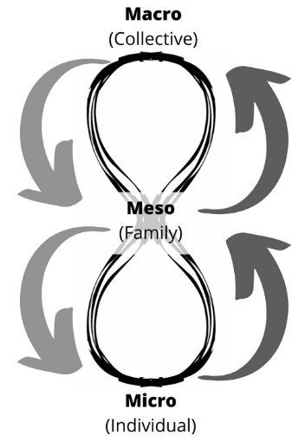
Filter between collective and invididual memory
“family narratives are a window into how families construct a shared sense of history, understand and validate each others’ emotions and create a sense of who they are as a family, and as individuals, in the present” (Fivush et al., 2010)
From Cordonnier et al., (2022)
Notes:
Meso level through the role of families and how the family values and representations act as a memory and information filter

Slide 4
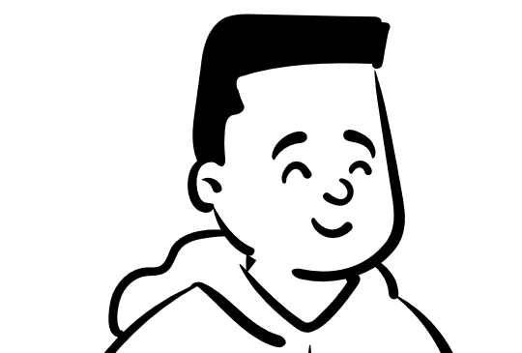
Family and transmission
Conversation roles¹, from very young age²
Shared history ², origin of autobiographical memory^{3,4}
Identity, well-being, finding meaning^{6,7,8}
Sense of belonging⁵ and individuality²
van der Haegen et al. (2022)¹, Fivush et al., (2009)², Farrant & Reese (2000)³, Reese (2002)⁴, Fivush et al. (2019)⁵, Fivush et al., (2010), Chen et al. (2021)⁷ , Merril et al. (2018)
Notes:
Narratives are both the process by which identity is created and a reflection of that identity.

Slide 5
« Study 0 »
Important variables affecting transmission ?
Online questionnaire (Qualtrics©, 2022)
380 respondents
Top-down perception of transmission
Transmission
Transmission
G1
G2
G3
Bottom-up perception of transmission
Notes:
Exploratory
Which variables are to be taken in account

Slide 6
Method
Transmission
« How frequently do you talk about personal events with your child? » (top-down)
« How frequently does this parent talk to you about public events? » (bottom-up)
Importance of transmission
Interpersonal closeness: Inclusion of Other in the Self Scale (Aron et al., 1992)
For family and transmitter/receiver
Frequency of interaction
For :
Both perspective (bottom-up and top-down)
Two-generation gap vs. One-generation gap
Public and personal events
Events that occurred before / after receiver’s birth and recent events

Slide 7
G1 reports transmitting more to G2 than G2 reports receiving from G1
G2 reports transmitting more to G3 than G3 reports receiving from G2
Perception top-down of perception
No difference between bottom-up vs. top-down between G1 and G3
Transmission
Transmission
G1
G2
G3
Perception bottom-up of perception

Slide 8
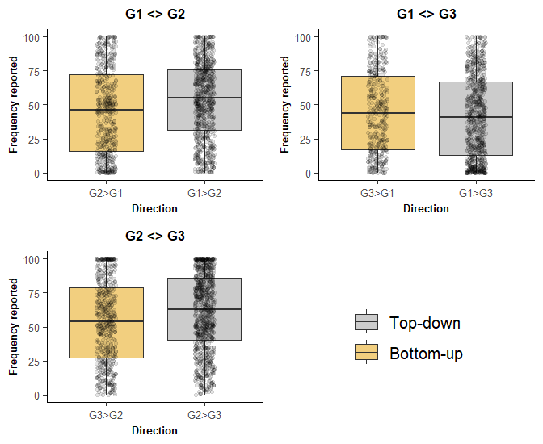
Model | Estimate | 95% Cl | p | ε²_{p}
G1G2 vs. G2G1 | -8.19 | [-13.44, -2.95] | .002 | 0.04 [0.00, 0.10]
G2G3 vs. G3G2 | -6.78 | [-11.48, -2.08] | .005 | 0.03 [0.00, 0.08]
G1G3 vs. G3G1 | 3.16 | [-3.44, 9.76] | 0.349 | 0.00 [0.00, 0.00]
Note. First generation in a duo (e.g. G1G2) is the one rating the transmission to the other generation. Underlined combinations are top-down transmissions.

Slide 9
Cohort effect ?
G1G2
G2G3
top-down perception
vs.
Transmission
Transmission
G1
G2
G3
Notes:
These sociologists generally focused on the concept of ‘social generations’(also called cohorts), which included groups people born around the same time on the premise that because of their common historical–biographical past, they would have a shared world view and a generational consciousness

Slide 10
Cohort effect ?
G1G2
G2G3
top-down perception
vs.
Transmission
Transmission
G1
G2
G3
G2 report transmitting more to G3 than G1 report transmitting to G2
Effect of age ?
Social generation ?
Notes:
These sociologists generally focused on the concept of ‘social generations’(also called cohorts), which included groups people born around the same time on the premise that because of their common historical–biographical past, they would have a shared world view and a generational consciousness

Slide 11
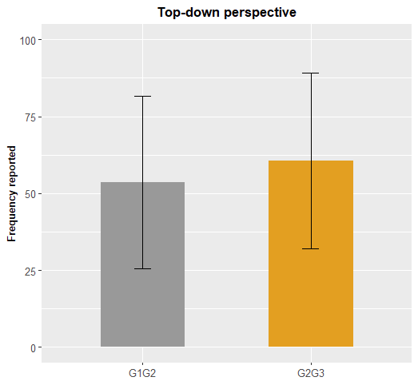
Contrast | Estimate | 95% Cl | p | ε²_{p}
G2G3 vs. G1G2 | -7.04 | [-11.65, -2.43] | .003 | 0.02 [0.00, 0.07]
Note. First generation in a duo (e.g. G1G2) is the one rating the transmission to the other generation. Underlined combinations are top-down transmissions.

Slide 12
Effect of generation gap?
top-down perception
2 generations
vs.
1 generation
Transmission
Transmission
G1
G2
G3
Notes:
These sociologists generally focused on the concept of ‘social generations’(also called cohorts), which included groups people born around the same time on the premise that because of their common historical–biographical past, they would have a shared world view and a generational consciousness

Slide 13
Effect of generation gap
2 generations
top-down perception
vs.
1 generation
Transmission
Transmission
G1
G2
G3
Greater reports of transmitted memory when only one generation gap, compared to two generations (Cordonnier et al., 2021)
Notes:
These sociologists generally focused on the concept of ‘social generations’(also called cohorts), which included groups people born around the same time on the premise that because of their common historical–biographical past, they would have a shared world view and a generational consciousness

Slide 14
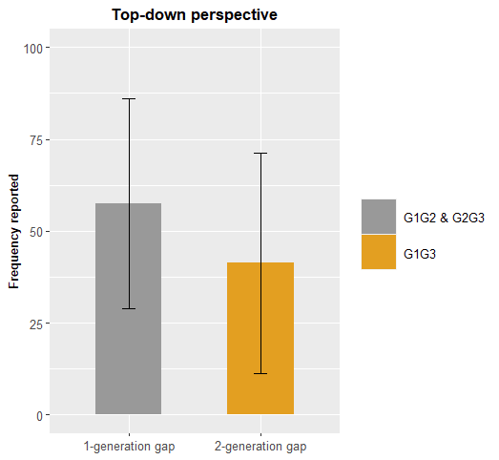
Contrast | Estimate | 95% Cl | p | ε²_{p}
G1G3 vs. G1G2 & G2G3 | 15.90 | [13.08, 18.72] | < .001 | 0.15 [0.11, 0.20]
Note. First generation in a duo (e.g. G1G2) is the one rating the transmission to the other generation. Underlined combinations are top-down transmissions.

Slide 15
Cohort effect
Transmission
Transmission
G1
G2
G3
G2G1
vs.
G3G2
G3 report receiving more from G2 than G2 report receiving from G1
Bottom-up transmission
Notes:
These sociologists generally focused on the concept of ‘social generations’(also called cohorts), which included groups people born around the same time on the premise that because of their common historical–biographical past, they would have a shared world view and a generational consciousness

Slide 16
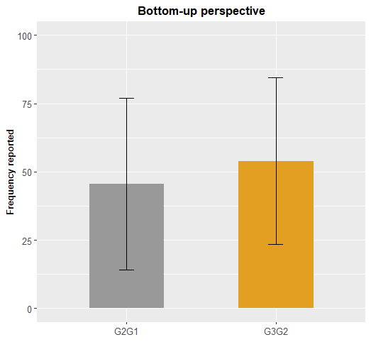
Contrast | Estimate | 95% Cl | p | ε²_{p}
G3G2 vs. G2G1 | -8.46 | [-13.93, -2.99] | .003 | 0.04 [0.00, 0.10]
Note. First generation in a duo (e.g. G1G2) is the one rating the transmission to the other generation.

Slide 17
Effect of generation gap
Transmission
Transmission
G1
G2
G3
1 generation
vs.
2 generations
Greater reports of received memory when only one generation gap, compared to two generations
Bottom-up transmission
Notes:
These sociologists generally focused on the concept of ‘social generations’(also called cohorts), which included groups people born around the same time on the premise that because of their common historical–biographical past, they would have a shared world view and a generational consciousness

Slide 18
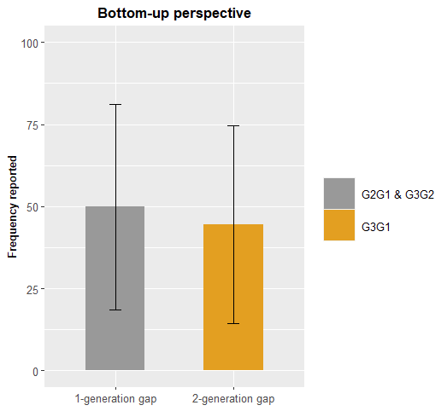
Contrast | Estimate | 95% Cl | p | ε²_{p}
G1G3 vs. G1G2 & G2G3 | 4.84 | [0.87, 8.82] | < .017 | 0.007 [0.00, 0.02]

Slide 19
Variable 1 | Variable 2 |  | Correlation (Pearson) |  | Correlation (Pearson)
IOS | Frequency de communication | G2G1 | 0.33 [0.132, 0.508] | G1G2 | 0.44 [0.292, 0.572]
IOS | Importance of transmission |  | 0.29 [0.088, 0.474] |  | 0.23 [0.056, 0.84]
Importance of transmission | Frequency de communication |  | 0.08 [-0.135, 0.284] |  | 0.16 [-0.008, 0.328]
Transmission | Frequency de communication |  | 0.53 [0.364, 0.669] |  | 0.42 [0.270, 0.556]
Transmission | Importance of transmission |  | 0.20 [-0.12, 0.393] |  | 0.23 [0.063, 0.390]
Transmission | IOS |  | 0.27 [0.060, 0.452] |  | 0.43 [0.273, 0.558]
IOS | Frequency de communication | G3G1 | 0.75 [0.617, 0.837] | G1G3 | 0.63 [0.510, 0.722]
IOS | Importance of transmission |  | 0.33 [0.142, 0.500] |  | 0.17 [-0.0005, 0.335]
Importance of transmission | Frequency de communication |  | 0.57 [0.380, 0.712] |  | 0.08 [-0.095, 0.248]
Transmission | Frequency de communication |  | 0.59 [0.409, 0.728] |  | 0.58 [0.450, 0.683]
Transmission | Importance of transmission |  | 0.35 [0.122, 0.546] |  | 0.33 [0.166, 0.476]
Transmission | IOS |  | 0.57 [0.376, 0.709] |  | 0.67 [0.563, 0.756]
IOS | Frequency de communication | G3G2 | 0.6 [0.455, 0.715] | G2G3 | 0.52 [0.393, 0.625]
IOS | Importance of transmission |  | 0.27 [0.723, 0.455] |  | 0.12 [-0.036, 0.275]
Importance of transmission | Frequency de communication |  | 0.25 [0.055, 0.431] |  | 0.16 [-0.0003, 0.307]
Transmission | Frequency de communication |  | 0.53 [0.365, 0.658] |  | 0.35 [0.199, 0.478]
Transmission | Importance of transmission |  | 0.24 [0.039, 0.418] |  | 0.24 [0.080, 0.379]
Transmission | IOS |  | 0.32 [0.128, 0.490] |  | 0.33 [0.182, 0.463]

Slide 20
Lots of data…
Correlations between different measures :
transmission and feeling of proximity (IOS, Aron et al., 1992)
transmission and frequency of communication
different types of event (public vs. personal)
….
Variable1 | Variable2 | Combination | Spearman ρ
Transmission | Feeling of closeness | G1G2 | 0.43 [0.273, 0.558]
 |  | G1G3 | 0.67 [0.563, 0.756]
 |  | G2G3 | 0.33 [0.182, 0.463]
 |  | G2G1 | 0.27 [0.060, 0.452]
 |  | G3G2 | 0.32 [0.128, 0.490]
 |  | G3G1 | 0.57 [0.376, 0.709]
Note. First generation in a duo (e.g. G1G2) is the one rating the transmission to the other generation. Underlined combinations are top-down transmissions.

Slide 21
Lots of data…
Correlations between different measures :
transmission and feeling of proximity (IOS, Aron et al., 1992)
transmission and frequency of communication
different types of event (public vs. personal)
….
Many variables to take in account
Continue to explore

Slide 22
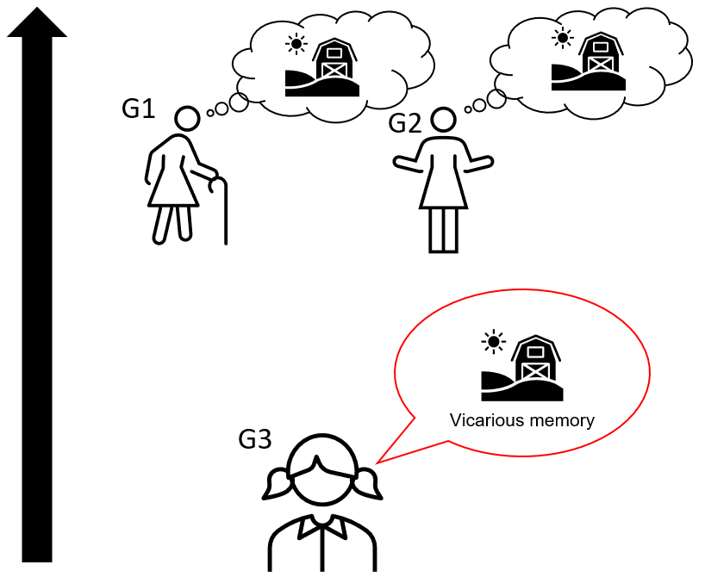
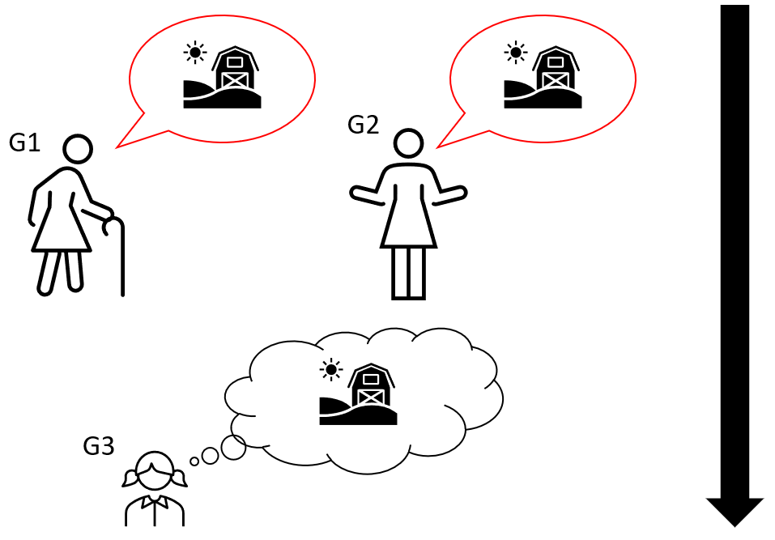
4 main studies
Top-down (transmission)
Bottom-up (vicarious memory)
In progress…
Important event
Emotional events
Important event
Emotional events
(1)
(2)
(3)
(4)

Slide 23
What we are trying to do
Put back memory in its social context
Create a bridge between collective and individual memory
What is transmitted ?
Why ?

Slide 24
Thanks for your attention !
Thanks for your attention !
david.baudet@uliege.be
Notes:
PAGE DE FIN 2 / Possibilité de personnaliser le texte et d'insérer un contact

Slide 25
Demographics
Gen | Count | Age_M | Women | Alive_parent | Dead_Gp | FreqGen | FreqWomen
1 | 129 | 71.11 (6.11) | 71 | 0 | 0 | 0.34 | 0.55
2 | 155 | 56.4 (10.84) | 106 | 87 | 0 | 0.41 | 0.68
3 | 96 | 26.885 (5.66) | 68 | 0 | 29 | 0.25 | 0.71
General tranmission
Comb | Total transmission (SD) | Relation (IOS) | Frequency of interaction
G1G2 | 53.66 (27.99) | 7.16 (2.29) | 72.80 (21.17)
G1G3 | 41.28 (30.05) | 5.73 (2.84) | 58.72 (26.65)
G2G1 | 45.46 (31.45) | 5.94 (2.77) | 64.10 (27.00)
G2G3 | 60.70 (28.53 | 8.36 (2.02) | 85.55 (19.50)
G3G1 | 44.44 (30.07) | 5.11 (3.37) | 57.69 (23.54)
G3G2 | 53.92 (30.57) | 7.63 (2.62) | 80.51 (22.61)
Note. First generation in a duo (e.g. G1G2) is the one rating the transmission to the other generation. Underlined combinations are top-down transmissions.

Slide 26
Comb | Public (SD) | Personal (SD) | Before Birth | After Birth | Recent | Public 1 | Public 2 | Public 3 | Personal 1 | Personal 2 | Personal 3
G1G2 | 48.53 (29.09) | 58.78 (25.88) | 39.98 (29.97) | 53.09 (24.62) | 67.90 (25.12) | 31.37 (25.75) | 46.58 (25.06) | 67.64 (24.35) | 48.59 (25.45) | 59.60 (22.44) | 68.15 (25.97)
G1G3 | 37.85 (30.07) | 44.70 (29.67) | 33.27 (28.58) | 39.66 (28.56) | 50.90 (30.38) | 29.40 (27.60) | 35.99 (28.71) | 48.16 (30.94) | 37.14 (29.13) | 43.33 (28.04) | 53.64 (29.67)
G2G1 | 39.66 (31.45) | 51.26 (30.43) | 37.53 (29.08) | 40.51 (27.81) | 58.34 (33.24) | 30.66 (27.97) | 32.43 (27.01) | 55.91 (32.80) | 44.40 (28.70) | 48.60 (26.34) | 60.78 (33.68)
G2G3 | 54.94 (29.86) | 66.45 (25.91) | 47.59 (27.65) | 60.60 (25.69) | 73.90 (25.97) | 41.27 (27.69) | 52.23 (27.90) | 71.34 (25.99) | 53.90 (26.21) | 68.98 (20.13) | 76.46 (25.78)
G3G1 | 37.12 (29.25) | 51.76 (29.16) | 45.28 (30.67) | 33.62 (22.57) | 54.42 (32.53) | 35.51 (28.10) | 25.90 (19.10) | 49.96 (33.76) | 55.06 (30.20) | 41.34 (23.25) | 58.88 (30.85)
G3G2 | 45.60 (30.79) | 62.24 (28.02) | 39.90 (27.80) | 49.35 (26.42) | 72.52 (27.84) | 29.84 (25.54) | 39.47 (26.18) | 67.50 (27.44) | 49.95 (26.42) | 59.23 (22.81) | 77.53 (27.48)
Note. First generation in a duo (e.g. G1G2) is the one rating the transmission to the other generation. Underlined combinations are top-down transmissions.

