Slide 1
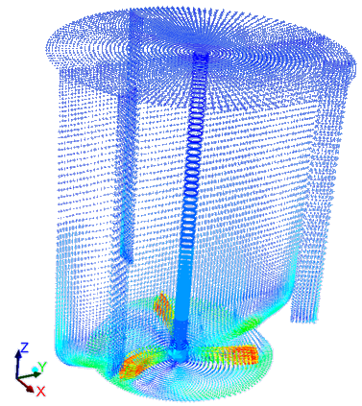
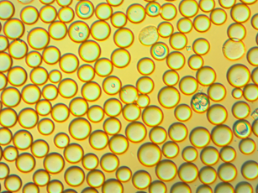
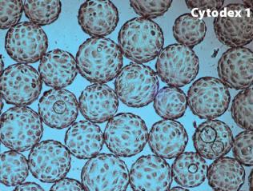
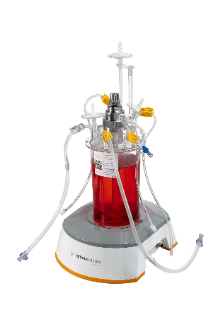
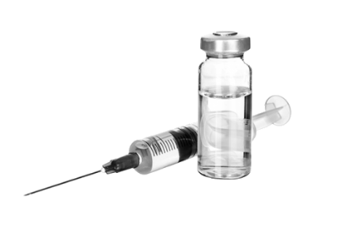

Use of numerical tools to improve solid-liquid reactor involved in pharmaceutical processes
S. Calvo* , A. Delafosse et D. Toye
Department of Chemical Engineering – PEPs, University of Liege, Belgium

Slide 2
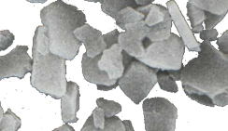
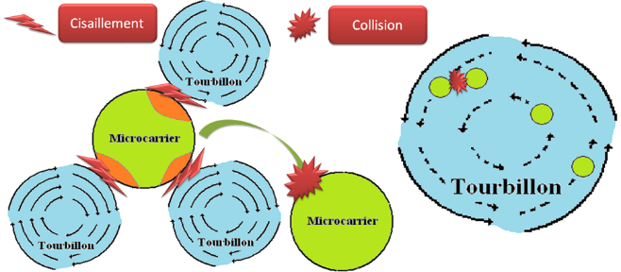
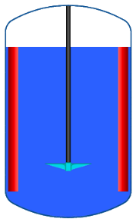
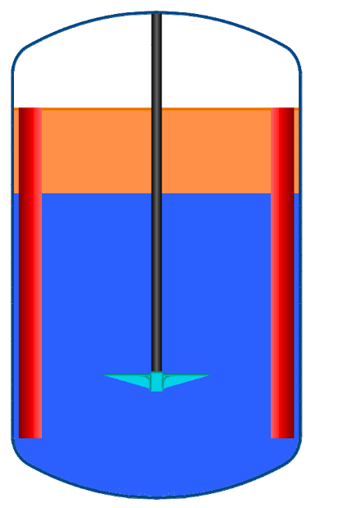

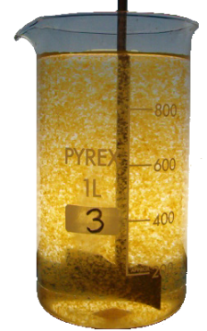
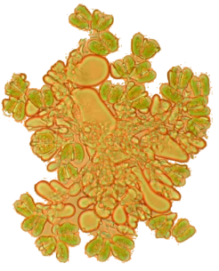
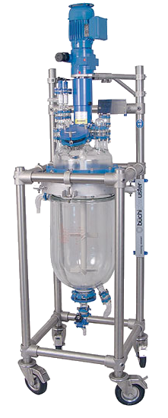
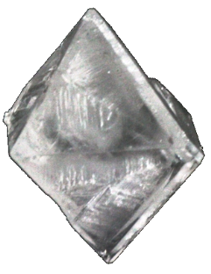

Difficulties in solid-liquid system involve in pharmaceutical processes
Difficulties
  Inhomogeneity
  Cristallization on walls
  Mass Transfert
  Constrains
    Shear stress
    Interface liquid-gas
    Over concentration du to additive addition
  Scaling up / Scaling-down
Mechanical stresses
Vaccine formulation
Cell / algae / Microbial
culture
Scaling-up
Flocculation
Cristallization
Dissolution

Slide 3
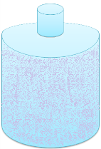
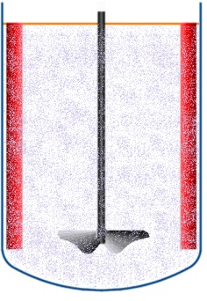
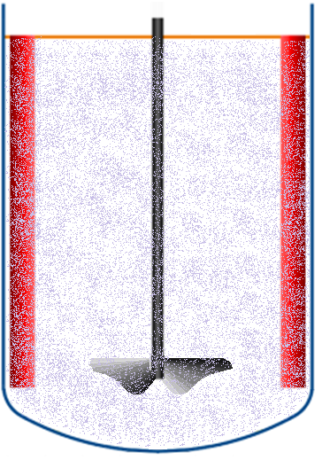
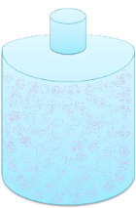
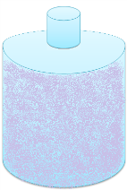




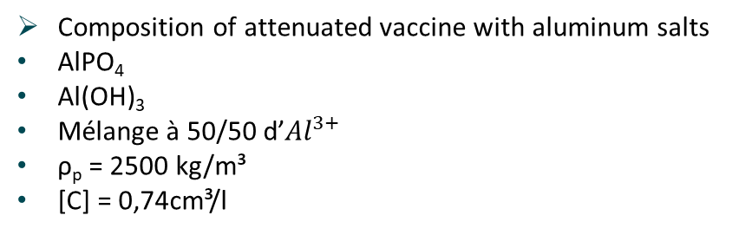



1. Ensuring product homogeneity from lab scale to industrial scale
Composition of attenuated vaccine with aluminum salts
AlPO₄
Al(OH)₃
Mélange à 50/50 d’${Al}^{3+}$
ρ_{p} = 2500 kg/m³
[C] = 0,74cm³/l
Process scale-up
Lab Scale
Production
Dose of vaccine
$$\left[C\right]=[\overline{C}]$$
?
$$\left[C\right]<[\overline{C}]$$
$$\left[C\right]<[\overline{C}]$$
$$\left[C\right]>[\overline{C}]$$
$$\left[C\right]=[\overline{C}]$$
$$\left[C\right]=[\overline{C}]$$
Inefficiency /
Dangerous
Homogeneous operating conditions at different scales
$$\left[C\right]>[\overline{C}]$$
3

Slide 4
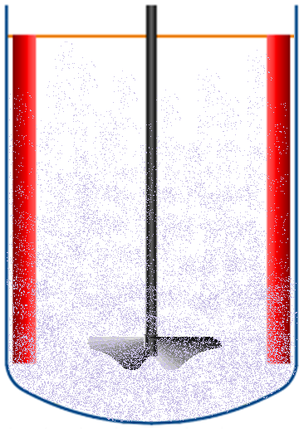
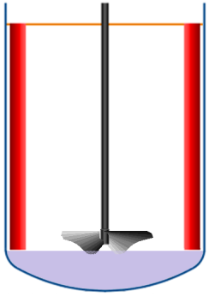

1. What is the main consideration for homogeneous suspension
Full Suspension
Njs
Njs prediction (Just supended speed)
Correlation of Zwietering
Full Suspension
Sedimentation
N ↗
extrapolation
Homogeneous suspension
N ↗
Tip speed
Volumic power input
Nhs
Nhs prediction
N correlation
Analogy
extrapolation
4

Slide 5
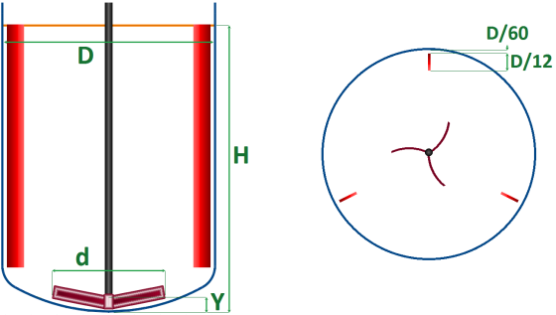
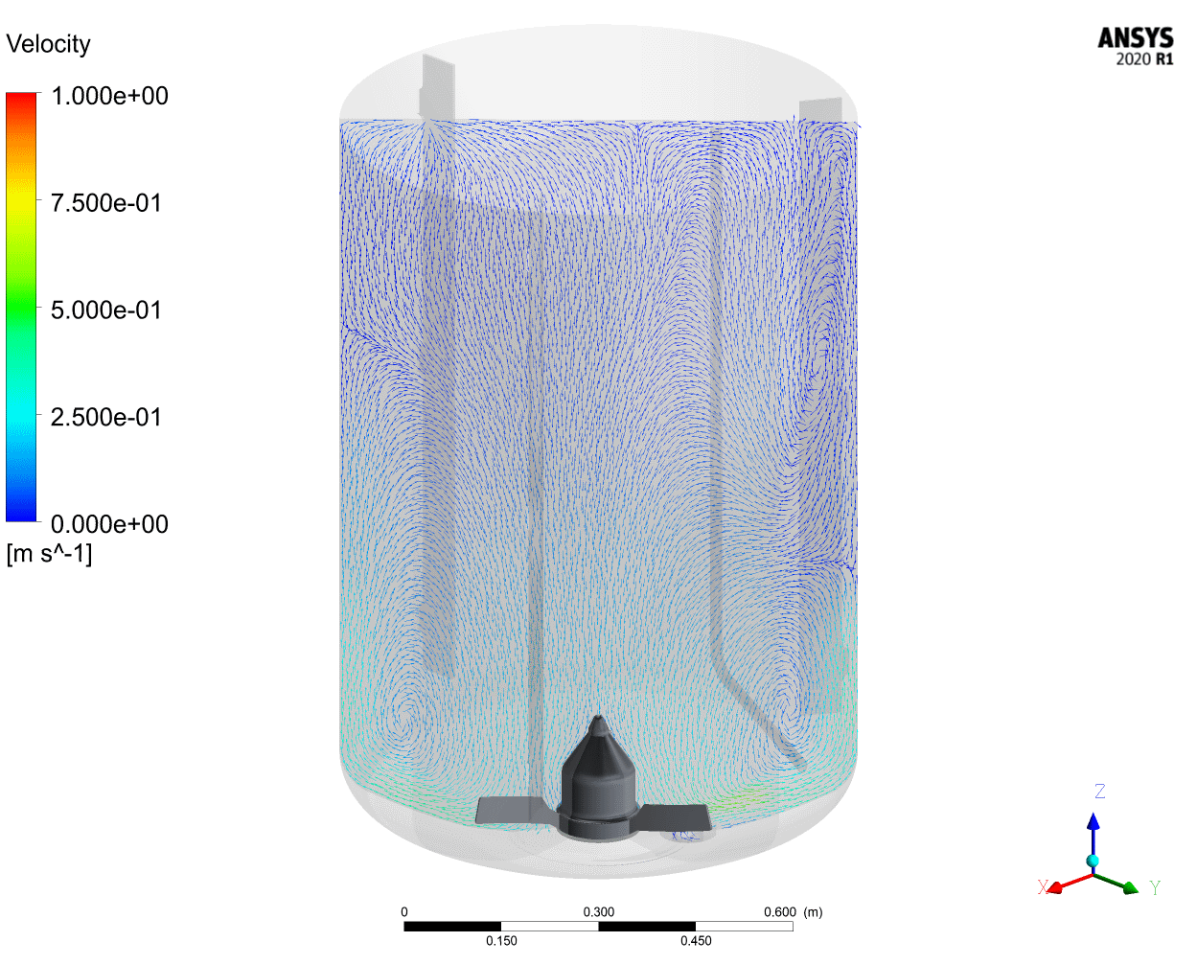
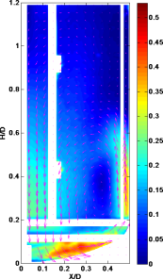
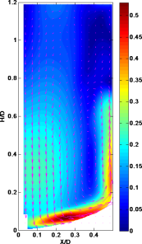
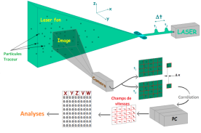
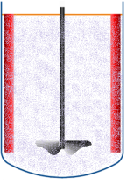
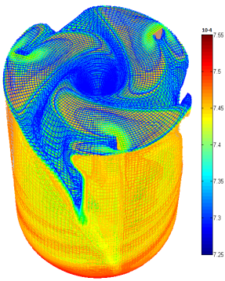
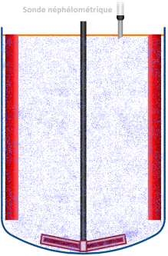

1. How to perform robust analysis with CFD for scaling-up
Rule for Scale-Up
CFD Modelization
Caractérisation des particules
PIV Measure
Fluid flow validation
Suspension behaviour validation
Nhs
Measure
5

Slide 6
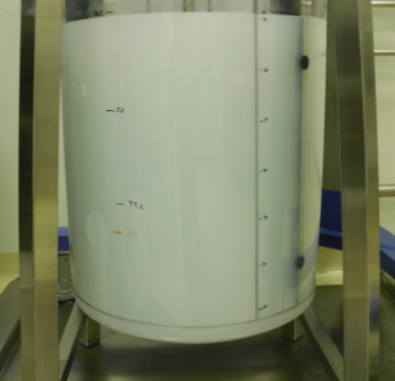
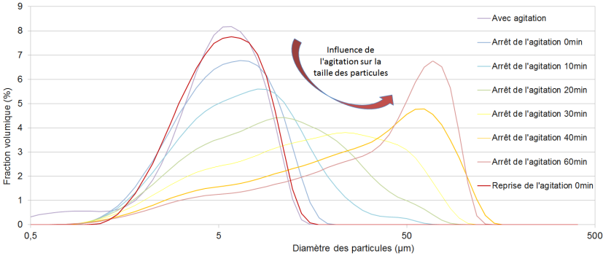
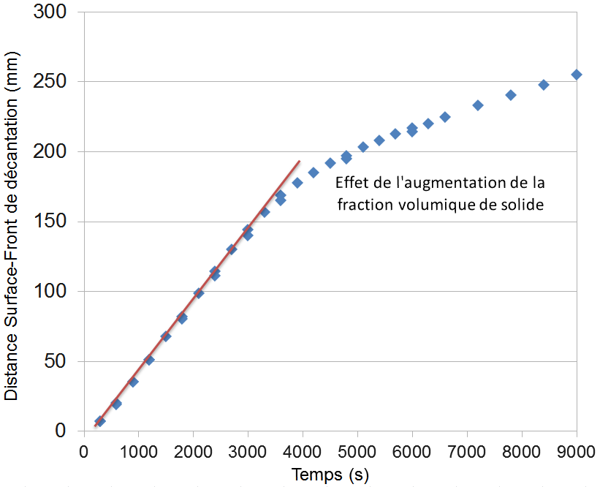
1. Solid Particles characterization
Particles of aluminum salts
AlPO₄
Al(OH)₃
Mélange 50/50 Al
ρ_{p} = 2500 kg/m³
[C] = 0,74cm³/l
Laser granulometry
Sedimentation speed
Particule size evolution due to hydratation with no mixing
6

Slide 7
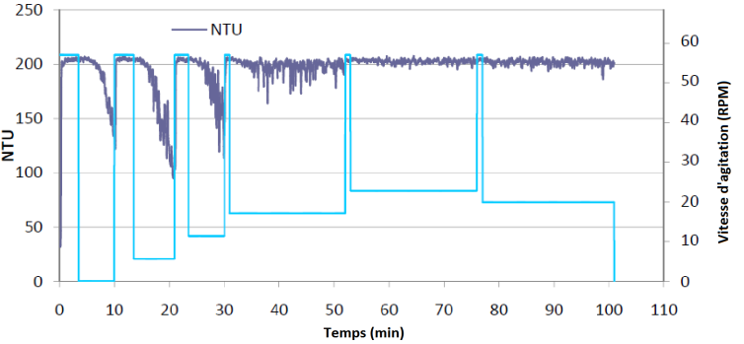

1. Simulation adaptation
CFD
Modelization
Nhs condition Simulation
Nhs Measure
Validation of suspension behaviour
+
Particle size validation
Numerical particle size adjustment
7

Slide 8
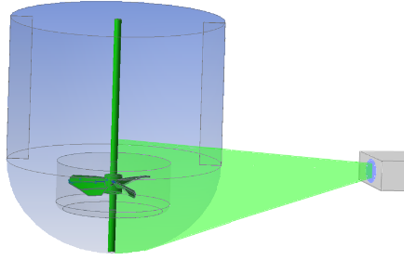
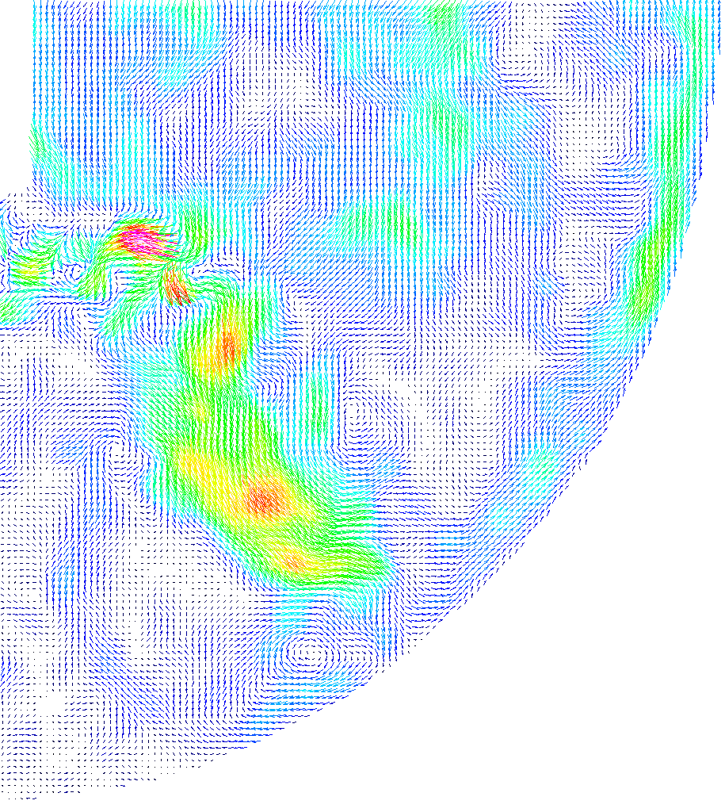
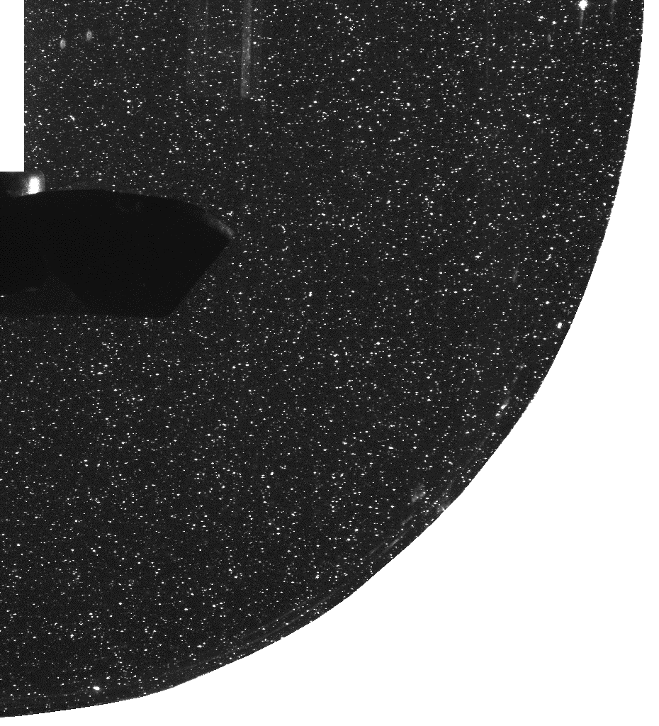

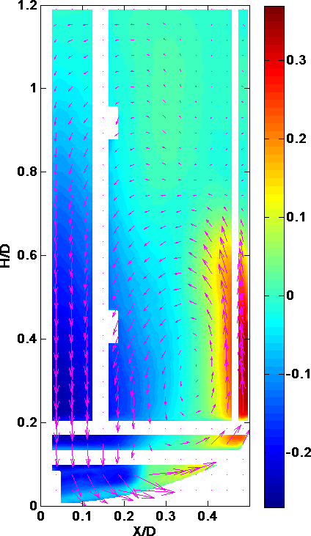
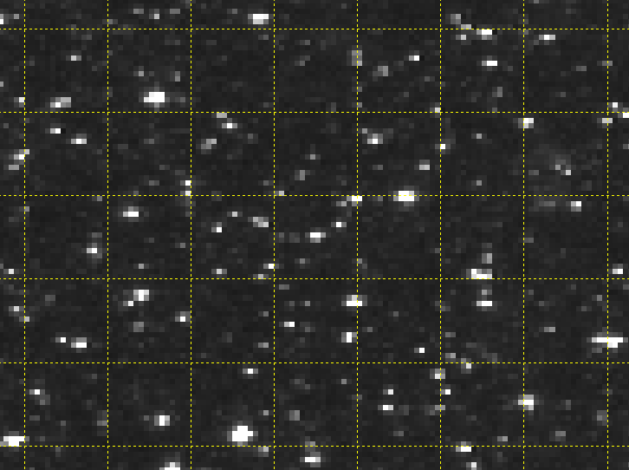
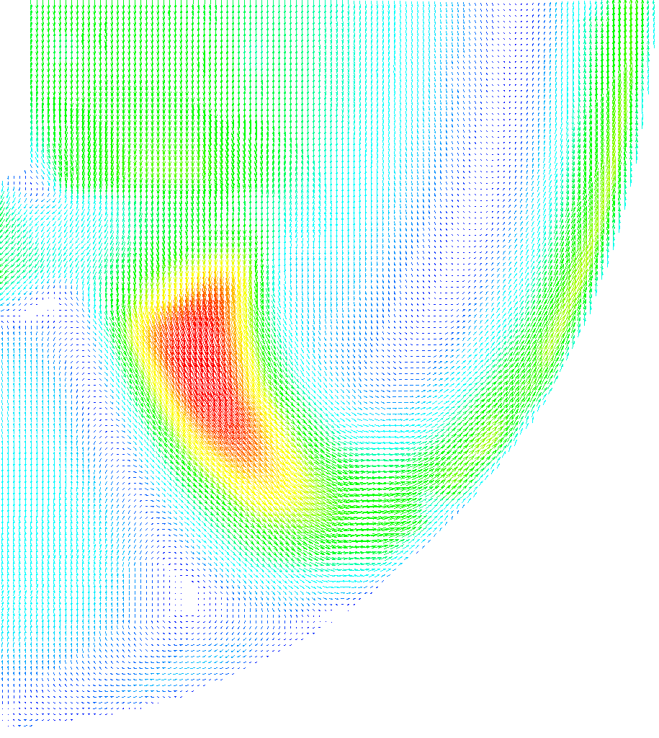
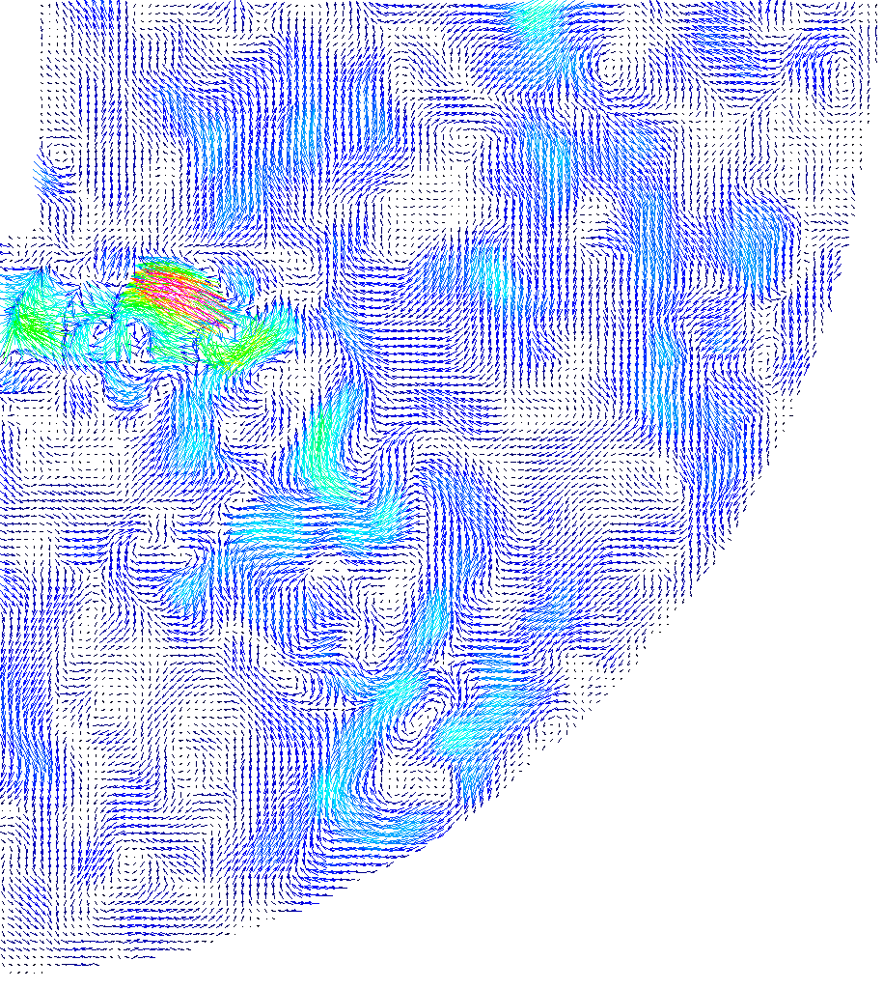
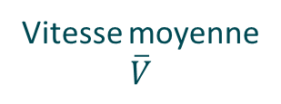
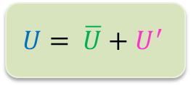
1. Exp. flow characterization by Particle Image Velocimetry (PIV)
Particules:
Dp = 5-10µm
Dp = 20-50µm
Instantaneous velocities
Correlation
Vitesse moyenne
$\overline{V}$
Composante axiale
16 x 16 pixels
Mean local velocities
Instantaneous velocities
Velocity fluctuation
$$U= \overline{U}+U^{′}$$
8

Slide 9
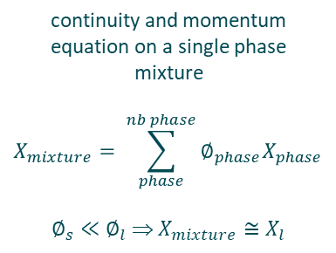
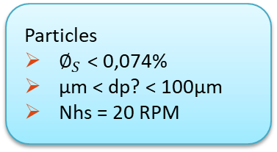
1. CFD Model
« Eulerian Mixture »
« Eulerian Multiphase »
Particles
$∅_{S}$ < 0,074%
µm < dp? < 100µm
Nhs = 20 RPM
continuity and momentum equation on a single phase mixture
$$X_{mixture}= \sum_{phase}^{nb phase}{∅_{phase}X_{phase}}$$
$∅_{s}≪∅_{l}$ ⇒ $X_{mixture}≅X_{l}$
continuity and momentum equation on both phase
Hypothèses
No particle-particle interaction
No particle effect on fluid flow
Coupling of the different phases by the application of interfacial terms:
drag, added mass, lift force, slip velocity
0,2 < Vol. Fraction < 16% + dp > 100µm
k-ε
Multiphase ≥ Mixture
« Eulerian Mixture »
9

Slide 10
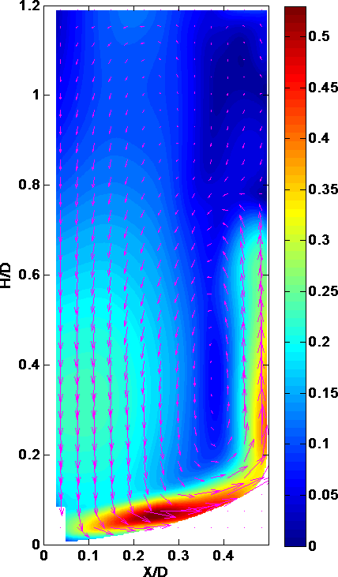
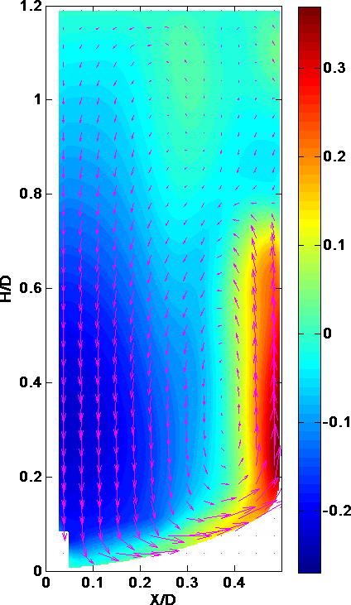
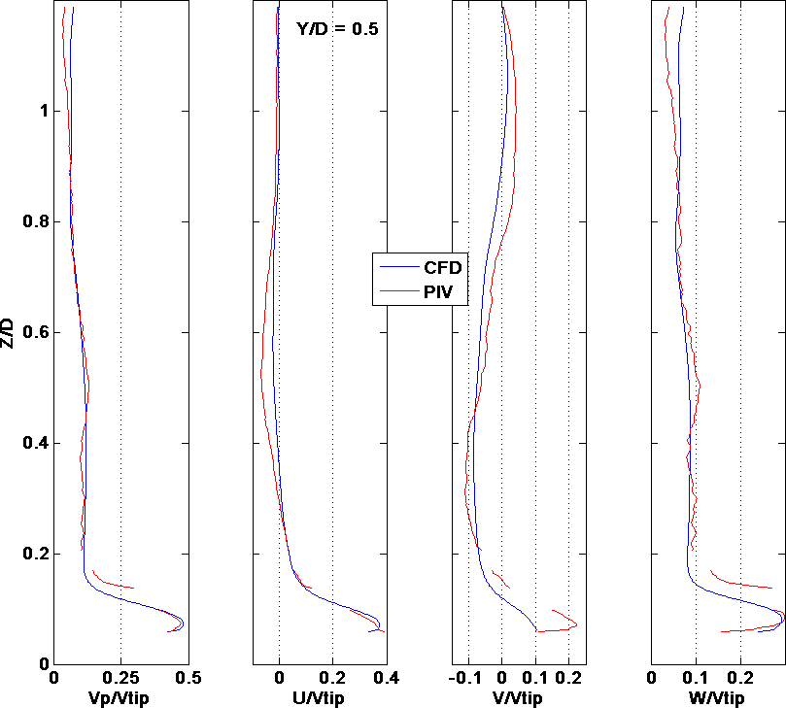
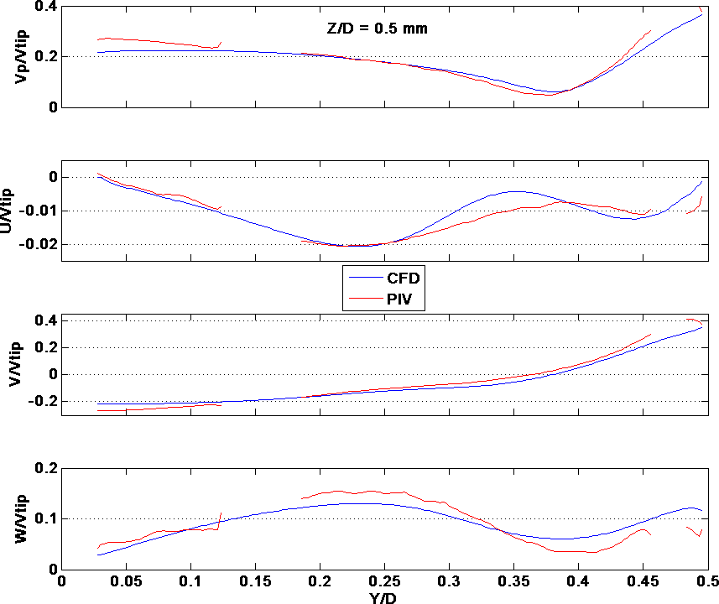



1. CFD one phase liquid validation
Mean velocity $\overline{V}$
Axial velocity
Mean velocity $\overline{V}$
Axial velocity
Validation lines
PIV
CFD
10

Slide 11




1. Validation of particle size in CFD
$${\overline{d}}_{p}=7µm$$
$$Obtention d^{′}une suspension homogène à 95\%$$
+/- 2% [$\overline{C}$]
≥ 95% of Volume
Evolution of solid spacial distribution depending on the particle diameter
(color scale +/- 2% [$\overline{C}$])
$$Experimetnal characterization shows a mean particle diameter$$
${\overline{d}}_{p}=5−7µm$ under agitation condition
→ Validation of particle diameter
11

Slide 12



1. Model validation at different scales
Extrapolation du modèle à 12,5L et 375L
  Ajustement de la vitesse d’agitation
  +/- 2% $∅_{S}$≥95% Volume -> Nhs +/- 2,5RPM
Validation expérimentale
  Np = Cste => Transitoire / Turbulent
  Extrapolation de Nhs => Pv = Cste
12,5L
70L
375L
12

Slide 13




1. Applications on other geometry / liquid-solid system
Defining placebo to mimic worst solid-liquid vaccines
Same System on different geometries
13

Slide 14



2. Simulation of microcarrier suspension for stem cell cultures
Context: Improving expansion of stem cells on microcarriers in stirred tank reactors
?
2D static culture
3D dynamic culture
CSMs attached on the bottom surface of T=flasks
- Low ratio S/V
- No automation/control
- High operational costs
MSCs attached on microcarriers in suspension in STR
+ High ratio S/V
+ Automation/control possible => How ?
- Quality/Detachment issue (Cell = Product)
- Mechanical stress => Damage to cells ?
14

Slide 15

2. Simulation of microcarrier suspension for stem cell cultures
Context: Improving expansion of stem cells on microcarriers in stirred tank reactors
Constraints on agitation rate:
No motionless microcarrier at the tank bottom
Low agitation to avoid hydromechanical stresses
⇨ Compromise: N = N_{js} (complete suspension)
Challenges
Prediction of N_{js} ?
Zwietering correlation does not predict well N_{js} for microcarrier suspension
Visual estimation of N_{js} = Subjective
Spatial distribution of microcarriers ?
Complete suspension
Extensive literature data on glass/sand particles (ρ_{S} / ρ_{L} = 2.5) but none on microcarriers (ρ_{S} / ρ_{L} ≅ 1)

Slide 16


2. Simulation of microcarrier suspension for stem cell cultures
Context: Improving expansion of stem cells on microcarriers in stirred tank reactors
Constraints on agitation rate:
No motionless microcarrier at the tank bottom
Low agitation to avoid hydromechanical stresses
⇨ Compromise: N = N_{js} (complete suspension)
Challenges
?
Multiphase CFD ?
V ≈ 10-100 mL
V ≈ 1-10 L

Slide 17


2. Simulation of microcarrier suspension for stem cell cultures
Numerical method: Choice of the multiphase CFD approach

Slide 18




2. Simulation of microcarrier suspension for stem cell cultures
Numerical method: Multiphase CFD approach
CFD code: ANSYS Fluent R19.2
Volume fraction $\left\langle α\right\rangle$ (%) |  | 1 | 2,5 |  | 5 |  | 10
Mesh size (10⁶ cells) |  | 1,5 | 2,1 |  | 3,5
Impeller rotation |  | Moving Reference Frame |  |  | Moving Mesh
Multiphase model |  | Mixture-(Granular) |  |  | Euler-(Granular)
Turbulence model | Liquid Phase | k-epsilon standard |  |  | other RANS models
 | Solid Phase | Mixture |  | Dispersed |  | Per Phase
Drag function |  | Schiller-Naumann |  |  | Huilin-Gidaspow
Turbulence interaction models |  | none |  |  | Simonin et al.
Turbulent dispersion force |  | none |  |  | Simonin et al.
HTPG impeller
N = 50 - 200 rpm
V ≈ 1 L
Solid phase:
d_{P} = 170 µm
ρ_{S} = 1015 kg.m⁻³
a_{max}= 63 %
Liquid phase:
$ρ_{L}$ = 997.5 kg.m⁻³
$μ_{L}$ = 0.911 mPa.s
(Water at 23°C)

Slide 19


2. Simulation of microcarrier suspension for stem cell cultures
Experimental method: Light attenuation technique
Material
Hemispherical-bottom tank
H = T = 0.12 m (V = 1.12 L)
Probes + Baffles
Liquid: Phosphate Buffer Saline (PBS) 0.01 M
Solid:
Cytodex-1 microcarrier
Diameter depends on the salt concentration
Translucent
Backlight LED
Axial impeller HTPG
C/T = D/T = 0.5
Aquarium filled with water
ρ_{S} = 1015 kg/m³
Camera CMOS 4 Mpixels
d_{P} = 170 µm

Slide 20







2. Simulation of microcarrier suspension for stem cell cultures
Experimental method: Light attenuation technique
Increasing solid volume fraction α
Increasing impeller speed N (α = 10 %)
Suspended solid fraction as a function of N
Averaged volume fraction –
Measured vs expected

Slide 21










2. Simulation of microcarrier suspension for stem cell cultures
Results: Solid spatial distribution – Exp. vs CFD
Exp.
CFD
N = 50 rpm
N = 60 rpm
N = 70 rpm
N = 80 rpm
N = 90 rpm

Slide 22
2. Simulation of microcarrier suspension for stem cell cultures
Conclusions:
Overestimation of Njs with the CFD approach
Best CFD modeling approach : Euler-Granular approach with Huilin-Gidaspow drag force model
No influence of the solid phase turbulence model (liquid and solid share the same k and ε whatever the model)
No influence of the turbulence interaction model (the solid has no influence on the liquid)
Dramatic influence of the turbulence dispersion force (overprediction of the solid dispersion when used)
Strong influence of the mesh refinement at the bottom wall
Potential issues:
Turbulence closure model ?
Small volume and low N_{js}
Low Reynolds number Re = 3000 – 6000
Low wall-y+
Liquid-solid interaction models ?
Influence of the solid on the liquid ? And vice versa ?
Multiphase turbulence model ?
Liquid solid interaction model ?
Turbulent dispersion force ?
Single-phase PIV
Two-phase PIV

Slide 23

Conclusions
Thanks !
Any questions ?
23

