Slide 1
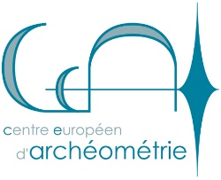
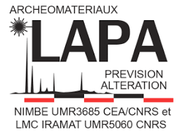
Acies Ferri
Archaeometallurgical study of Merovingian seaxes and swords from Alsace
Tobias Heal, Thomas Fischbach, Alexandre Disser
Notes:
Quick warning, you may notice I have a cold, in fact you’ve probably heard my coughing at the back of the room for the past couple of days. Rest assured, I’m not dead yet, just that if I start coughing, I apologise in advance
Acies Ferri: Archaeological and Archaeometric study of 5th to 9th century weapons between the Seine and Rhine Rivers

Slide 2
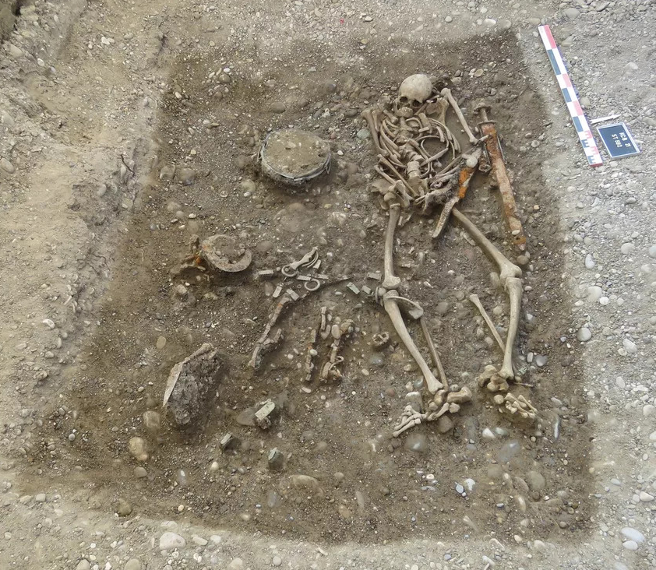
Typology and metallurgy
Merovingian swords and seaxes found in funerary contexts
Most studies focus on typology
Many studies focus on individual weapons
Elite Burial at Kembs (Haut-Rhin) ©ANTEA - Archéologie
Notes:
- Given that Merovingian is a bit of a vague term, I’ll specify that I’m using it to refer to Frankish cultures from between the mid 5th to early 8th centuries.
- Weapons mostly found in funerary contexts though very rare in other contexts. However, it is generally accepted that the merovingians did not bury their dead with object specifically designed for burial. It is very likely that these weapons were actually used.
- Extensive typological study with many well established and well dated categories
- few metallurgical studies that exist focus on individual weapons

Slide 3
Evolution of seaxes
Single edged blades
Precise use often unclear:
Tools?
Weapons?
Notes:
- what is a seax?
- Single edged bladed weapon, typical of germanic cultures of the age of migrations. Fround across Europe from Scandinavia in the North to Italy in the South, and from Britain in the west to Hungary in the east.
- Prcecise used is generally unclear
- Broad range of typological features, I’m focusing on continental seaxes
- early seaxes tend to be short and light

Slide 4
Evolution of seaxes
Single edged blades
Precise use often unclear:
Tools?
Weapons?
Notes:
- transition in the early 7th century, gradually heavier and longer seaxes

Slide 5
Acies Ferri
Which forge techniques?
Correlation with typology or social status?
What sources of iron?
What does this reveal about the trade of iron?
What does this reveal about the centralisation of weapons?

Slide 6
Acies Ferri
Which forge techniques?
Correlation with typology or social status?
What sources of iron?
What does this reveal about the trade of iron?
What does this reveal about the centralisation of weapons?

Slide 7
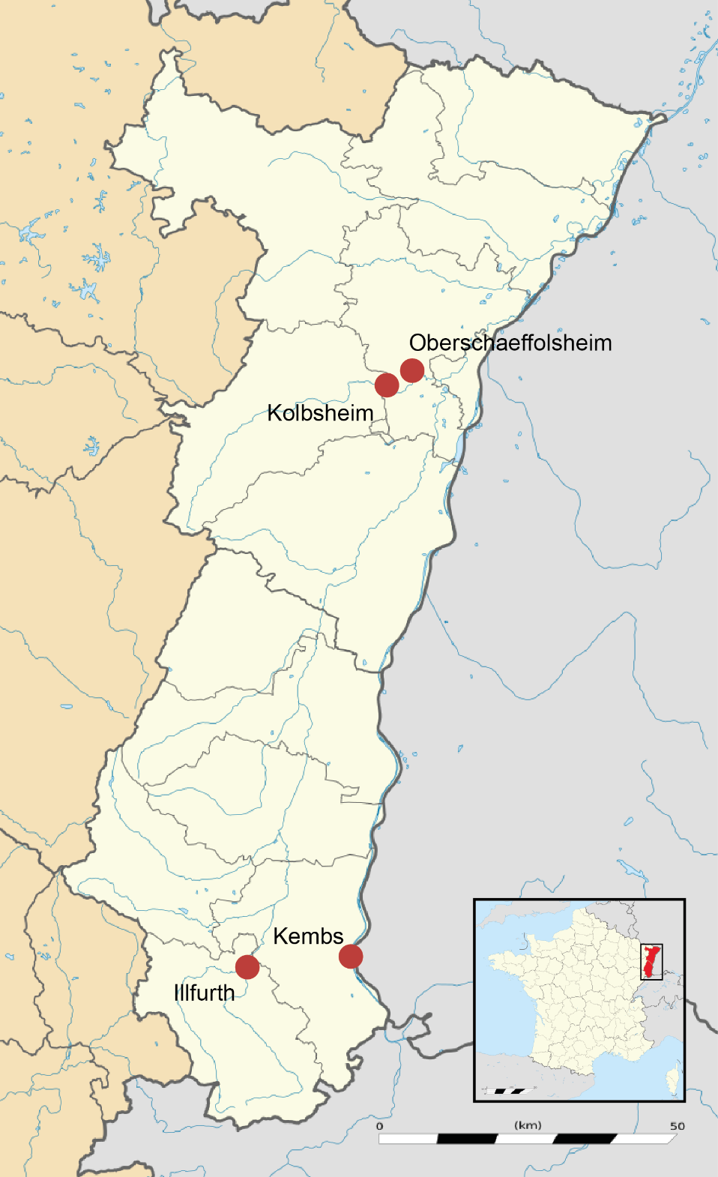
Alsace: studied sites
Bas-Rhin
Oberschaeffolsheim
Kolsbsheim
Erstein
Haut-Rhin
Kembs
Illfurth
1
Notes:
- 4 sites in this study
- hope to look at Erstein soon

Slide 8
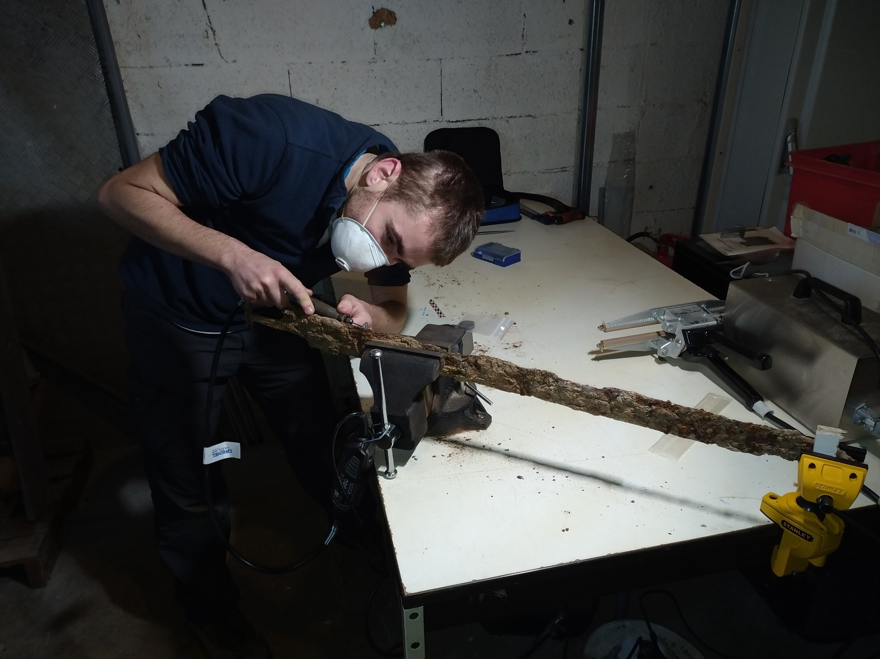
Method: sampling
Two triangular samples
Two goals
Obtain full cross section
Maintain structural integrity
0.6 mm thick cutting disk
Notes:
- two triangular samples
- Full cross section to obtain proper view of weapon construction, many studies only take one sample
- maintain structural integrity
- developed a methodology over time, starting with small cutting disks before moving to a full sized angle grinder equipped with 0.6mm disks

Slide 9
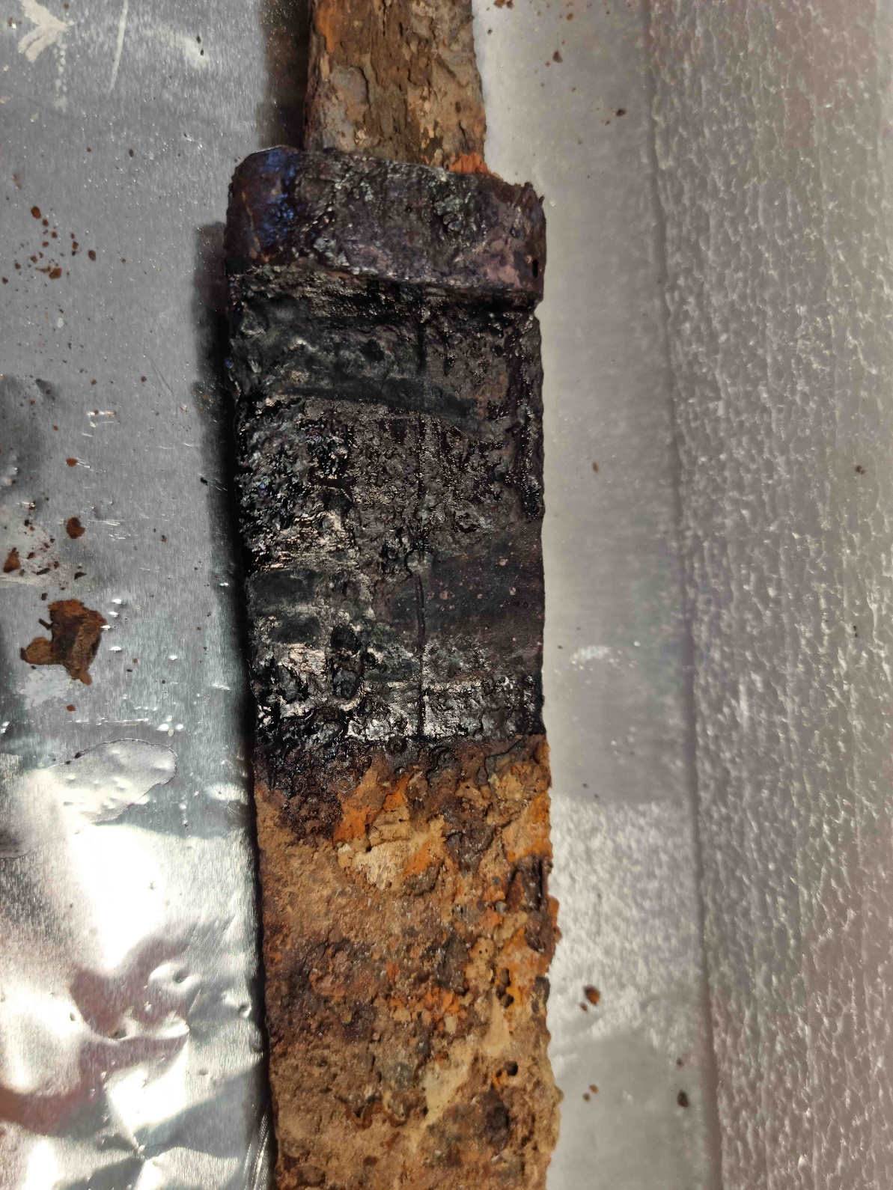
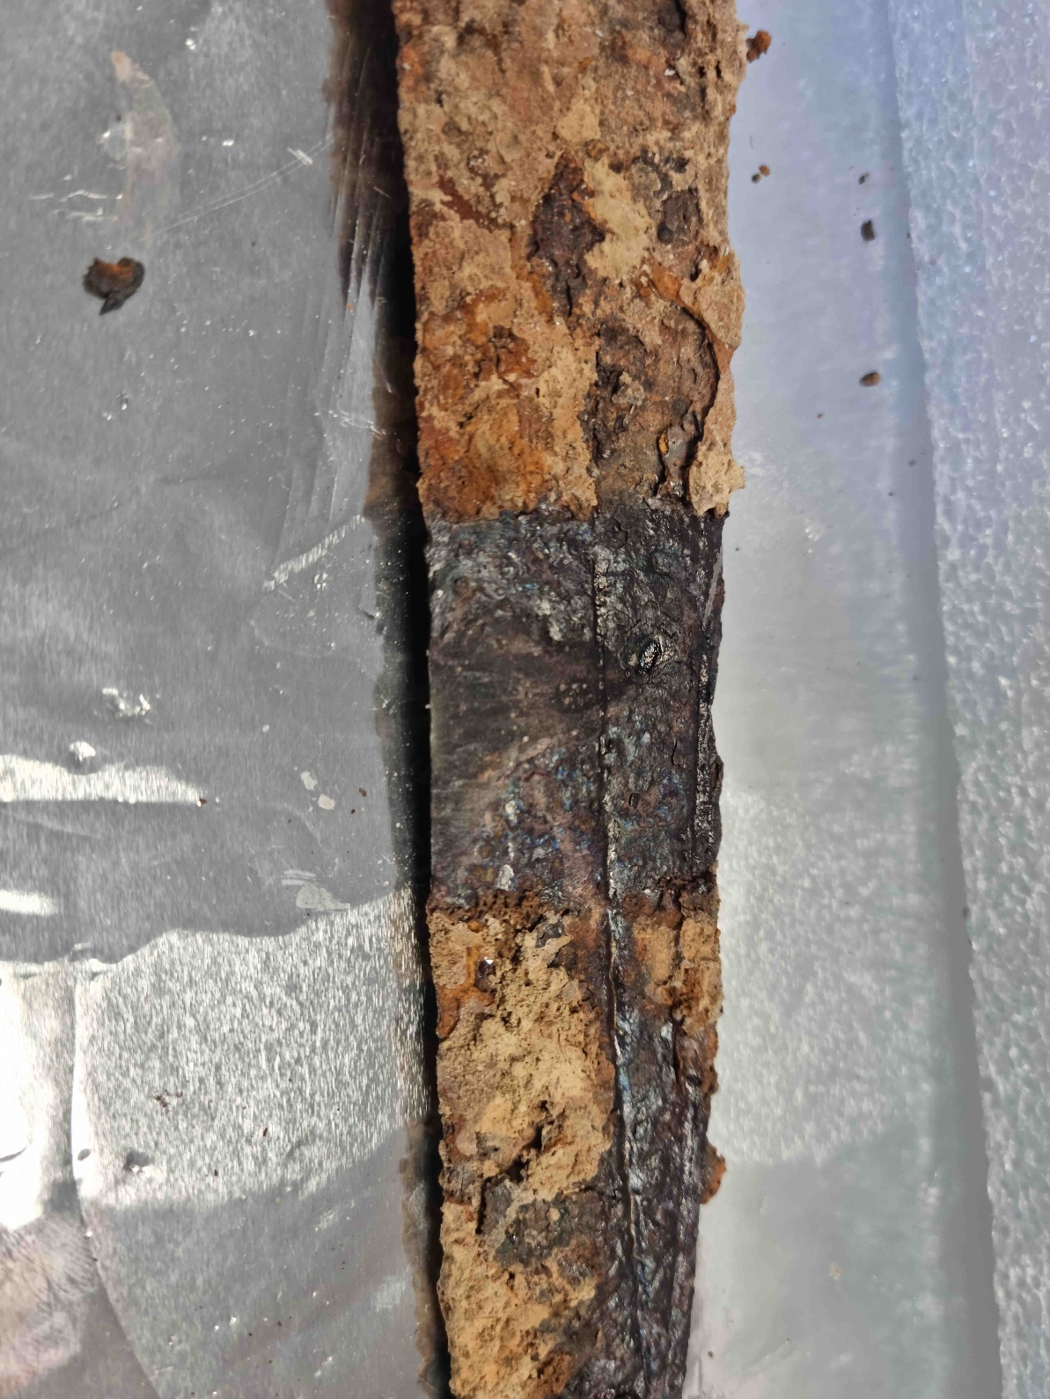
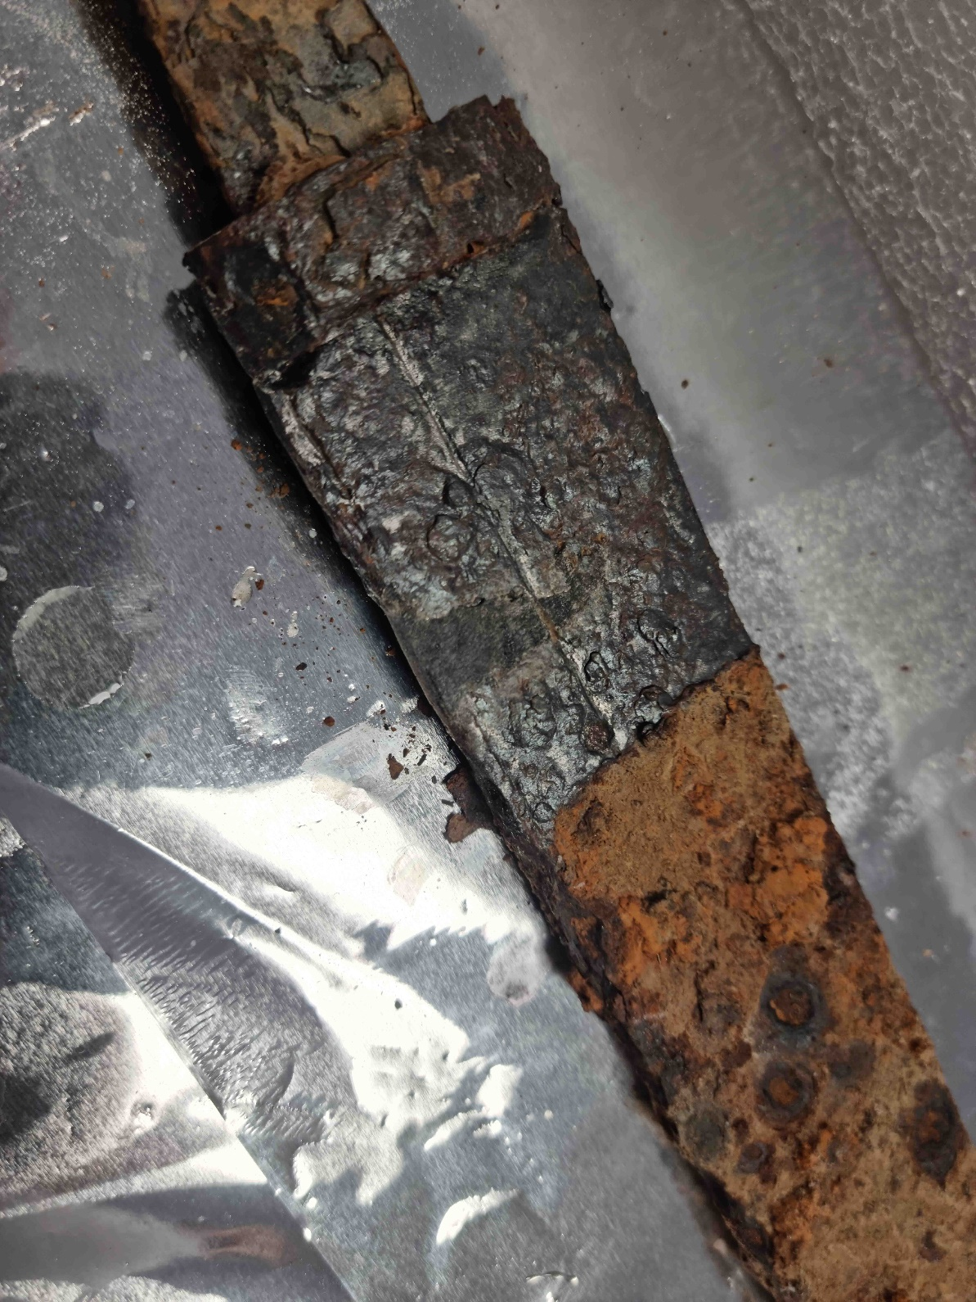
Method: sampling
Resulting gaps filled with resin
Notes:
- resulting gaps plugged with resin
- limits risk of future corrosion in the centre of the piece
- completes the profile, not the death of the object from a museulogical perspective
- keeps conservators happy

Slide 10
Method: analysis
Etching:
Nital
Oberhoffer
Metallographic study:
Optical Microscopy
Major elements in slag inclusions
SEM-EDX
Notes:
- hot mounting
- Polishing to miror finish
- full overview of sample surface with mosaic of micrographs taken using optical microscope
- combined with etching compounds to identify features of sample microstructure
- study complimented by SEM-EDX analysis of slag inclusions

Slide 11
Seax construction
Two types of Seax construction
ORM22-SP31-M7 (Oberschaeffolsheim)
Welded seaxes
ORM22-SP240-M3 (Oberschaeffolsheim)
Non-welded seaxes
Notes:
- Two types of seaxes
- welded seaxes have weld between spine and working edge
- non welded seaxes don’t
- well established techniques in blade making but interesting to note that both are present

Slide 12
Seax construction
Notes:
- stats: no clear preference for one method of fabrication across sites
- slight preference for non welded in illfurth and welded in kembs but possible sample size bias
- each construction can be split into sub constructions

Slide 13
Non-welded
Two types of non-welded seax construction
ORM22-SP240-M3 (Oberschaeffolsheim)
Bulk forged
ICV22-27-M2 (Illfurth)
Folding/piling
Notes:
- bulk forged
made from a single piece of iron worked into shape
Folding/piling
a single pice of iron folded over, or possible multiple pieces of iron welded and folded together
- Again, both well established techniques in blade creation and are found in everything from modern knives to ancient swords but interesting to note that both are present in Alsace.

Slide 14
Non-welded
Notes:
- again, no clear preference for one type of construction over the other across the sites that I’ve been looking at

Slide 15
Welded: spine
KKB-COS2.1-MFE-0064-0001 (Kolbsheim)
Bulk forged
ORM22-SP127-M3 (Oberschaeffolsheim)
Folding/piling
Notes:
- welded samples, spine is identical to non welded samples

Slide 16
Welded: edge and spine
Notes:
- silght preference for folding and piling in spine of welded seaxes. This could again be a bias caused by sample size so this will require comparison with a larger number of samples to confirm or refute.

Slide 17
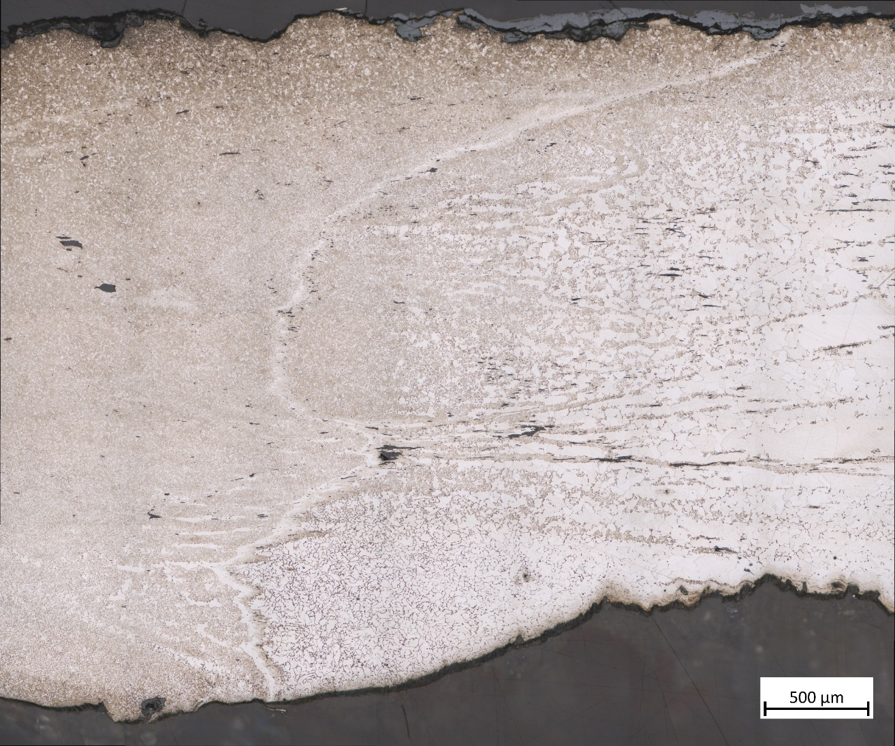
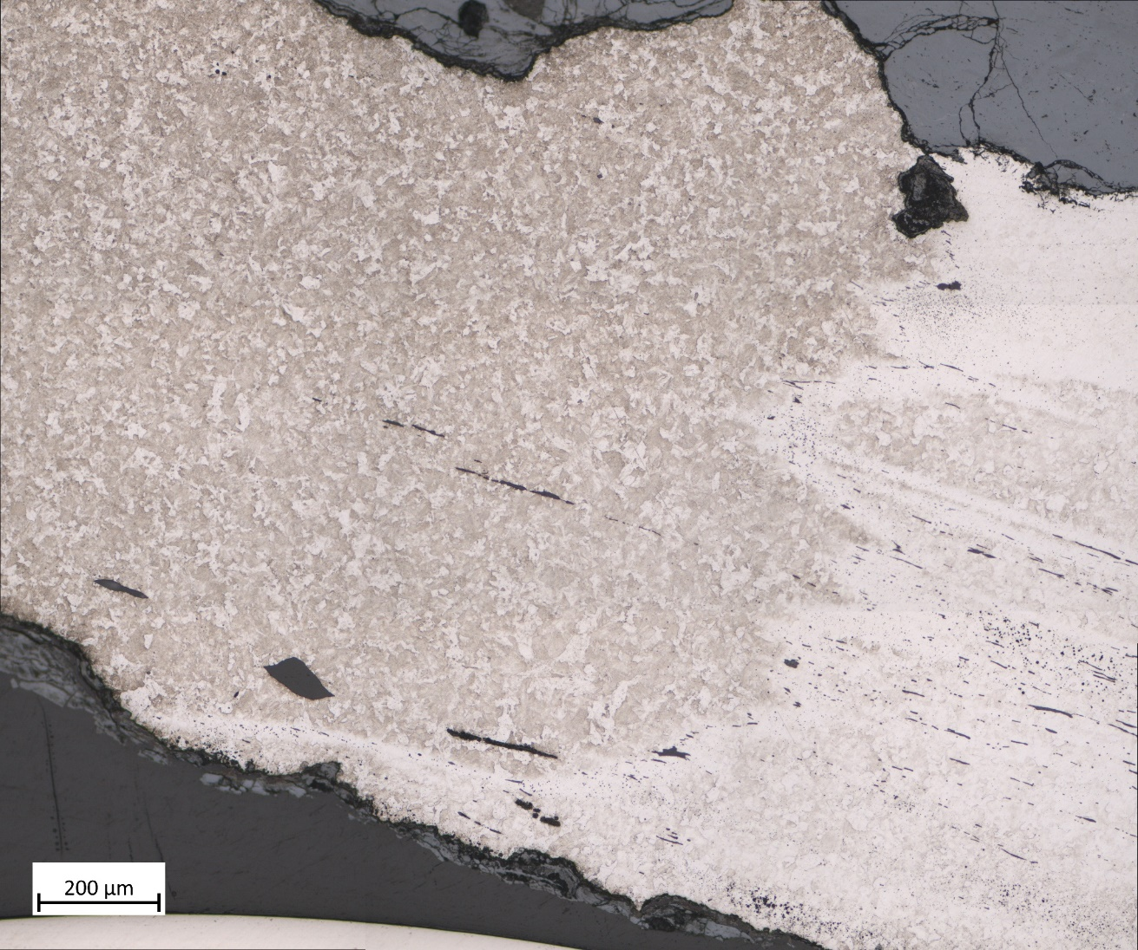
Welded: edge and spine
Consistently well executed
No oxydation
No cracks
Few inclusions
Double weld: visible in some seaxes
ORM22-SP77-M1
ORM22-SP57-M10
Notes:
- Weld between spine and edge well executed
expected, poorly executed weld could easily have impacted the integrity of the blade over time, especially if it was being used to repeatedly hit solid objects, which early medieval weapons were pretty much designed to do.
- double weld, strange, parallel with 9th century swords from the Carpathian basin, Kunadoga and Kiskundorozsma
- no explanation there, talked with blacksmith friend who suggested folding working edge before welding

Slide 18
Welded: edge and spine
ORM22-SP271-M6 (Oberschaeffolsheim)
ORM22-SP20-M1 (Oberschaeffolsheim)
Notes:
- curious dichotomy between spine and working edge observed in many seaxes, both welded and non welded
- a quick calculation found on average 1.5 times as many slag inclusions in the rear sample as opposed to the front sample

Slide 19
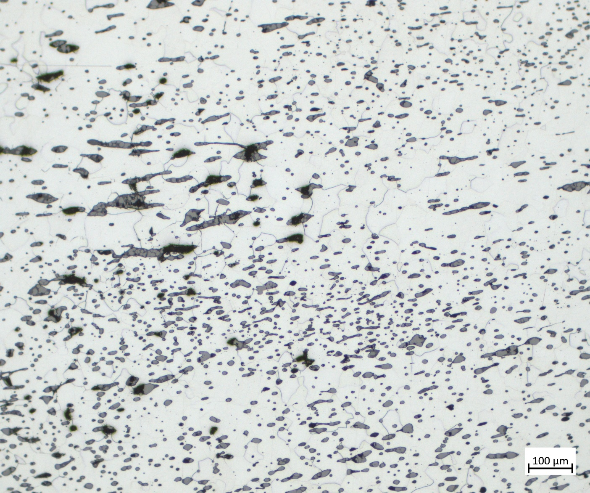
Welded: edge and spine
ORM22-SP271-M6 (Oberschaeffolsheim)
ORM22-SP20-M1 (Oberschaeffolsheim)
Notes:
- difference is quite striking, this particular sample is an extreme example but contains so many slag inclusions, many which don’t appear to have been flattened that it appears to be made from recycled iron

Slide 20
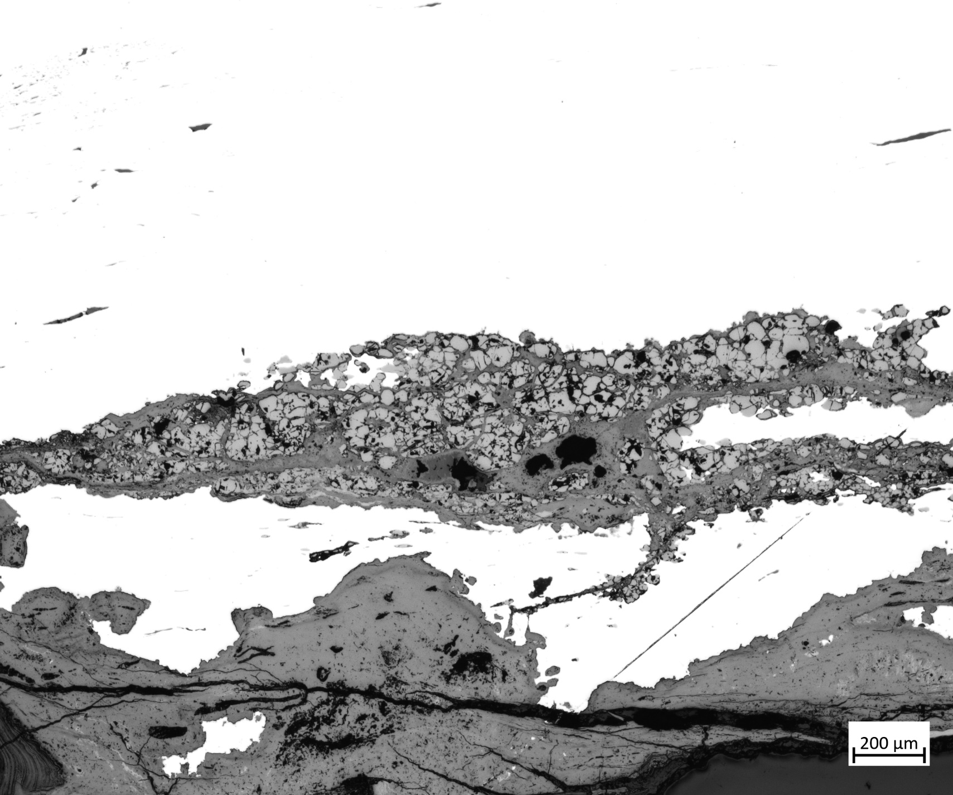
Welded: edge and spine
ORM22-SP271-M6 (Oberschaeffolsheim)
ORM22-SP20-M1 (Oberschaeffolsheim)
Notes:
This sample seems to still contain non vitrified silica particles, suggesting that the temperature was insufficient to vitrify the flux.
Would definitely have impacted the integrity of the weapon, and can see that it has become a conduit for corrosion product.

Slide 21
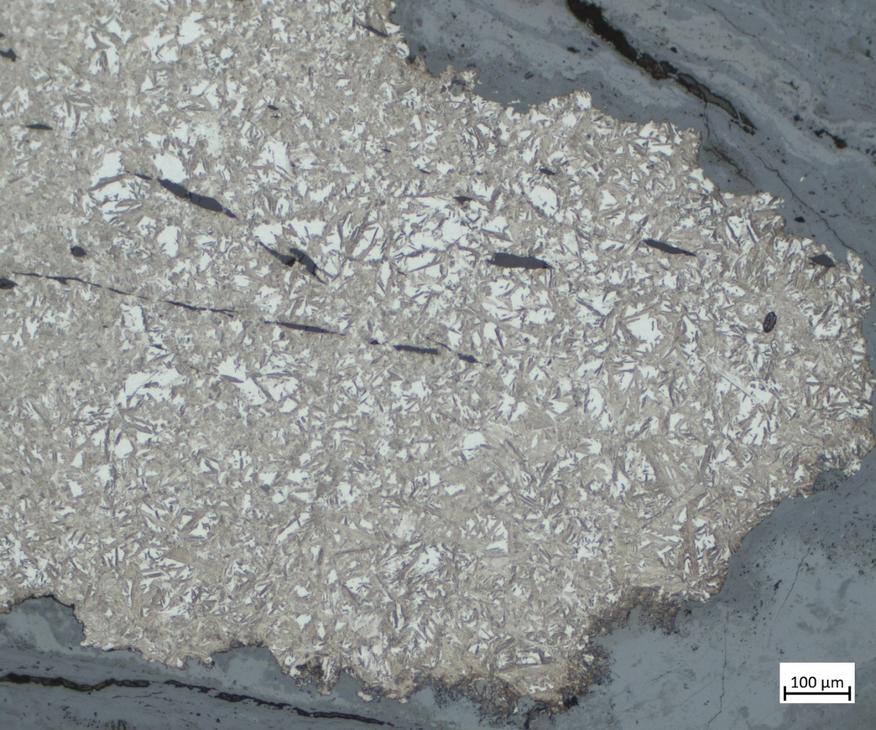
Welded: edge and spine
ORM22-SP271-M6 (Oberschaeffolsheim)
ORM22-SP20-M1 (Oberschaeffolsheim)
Notes:
- direct contrast with working edge of same samples
- this sample showed the use of eutectoid steel, verging on hyper eutectoid near the weld with the tip showing a martensitic structure indicating that it had been quenched. Combined with the well executed weld between the spine and the working edge
- talked with knife smith, he argued that the quality of the spine is of minimal importance relative to the working edge so it doesn’t matter.
- bouncing off what was mentioned yesterday about how the best quality metal is the one which does the job best, this seems to be a good example of this.

Slide 22
Construction and typology
Possible preference for welded in heavier seaxes but trend remains uncertain
Notes:
- comparison between construction and typology, welded seaxes in blue and non welded in orange, with samples unable to be attributed in grey.
- Apparent preference for welded seaxes amongst heavier and longer seaxes, like Heavy Breitsax and Langsax but very slight, could again be the result of sample size.
- at this stage, there is no clear correlation between seax construction and typology

Slide 23
Swords
All swords pattern welded
Absent from Seaxes
Additional welds:
Well executed but reason unclear
Notes:
Wrapping up with swords
- Pattern welded, well established technique found across western and central europe in the early middle ages
- all 7 of the swords from alsace were pattern welded
- completely absent from seaxes, documented in the literatture but interesting to note and also that Alsace sticks to this trend.
- pattern welded steel always located in the centre of the sample and example visible at bottom
- additional welds noted in blade edges. Very strange, always well executed but would again risk the integrity of the blade for seemingly no gain, no clear different in carbon content on different sides of these edges. Possible parallel with the double welds seen in seaxes

Slide 24
Swords
SEM-EDX clearly distinguishes lamellae of pattern welding
Unexpected but welcome result
Notes:
Wrap up with results of inclusion study, same methdology presented by Valentina yesterday.
- SEM-EDX analysis was able to clearly distinguish between the inclusions of the different lamallae of the pattern welding.
- this was an unexpected result but is highly welcome as it suggests that the chemistry of the lamellae is sufficiently internally consistant and different between lamellae to be attributed to different chemical groups based on major éléments alone.
Bodes well for identifying pattern welding in future samples where it may not be so clear post etching and the results were able to inform sample choice for trace element analysis by LA-ICP-MS
- counter example to what was being said later about complexity of swords making it impossible to do this kind of inclusion and provenance study

Slide 25
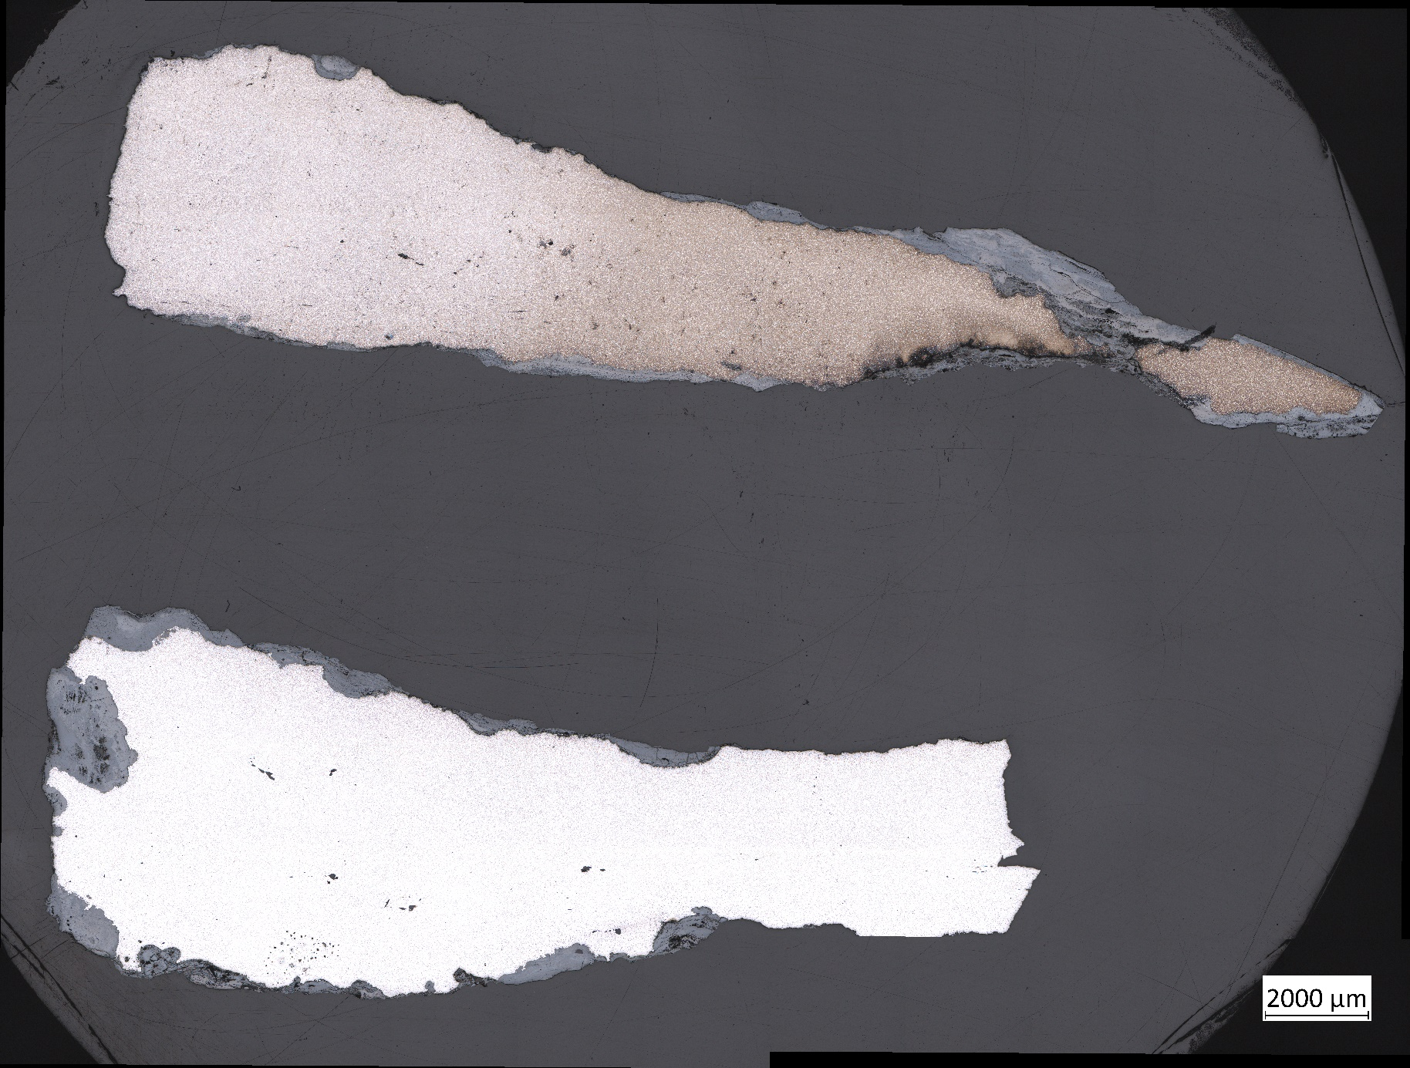
Synthesis
Two methods of construction
Welded
Non welded
No clear link between construction and typology
Clear dichotomy between spine and working edge
All studied swords pattern welded
Notes:
- read the slide

Slide 26
Future study
Deep understanding of weapon creation
Use trace element analysis to establish networks of production and exchange
Multiple sources in a single site?
The same source at different sites?
Comparison with other regions
Notes:
- this study was able to shed light into many aspects of seax and sword creation but was unable to cover many topics here.
Notably heat treatment, clear evidence that many, if not most of the blades recieved at least some kind of heat treatment, presence of martensite the most obvious but also globular cementite and seeming increase in carbon content around welds, maybe indication of carburisation? Unclear at present
- future study will involve trace element analysisand compare with analyses of ore and slag of known origin to establish networks of production and exchange
- particularly interesting: multiple sources of iron at a single site? The same source at different sites? Specific source can be associated with method of construction?
- will benefit over the course of my PhD from comparison with other weapons from Alsace but also from Lorraine, the Netherlands and also Belgium, where I was able to start by studying the weapons from the site of Ciply just last month.

Slide 27
Thanks for listening

