Slide 1
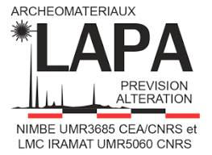


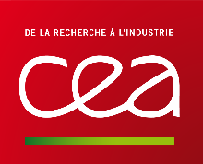


Hidden Riches in the Early Medieval Rhine Delta
Iron working at Merovingian Oegstgeest

Slide 2
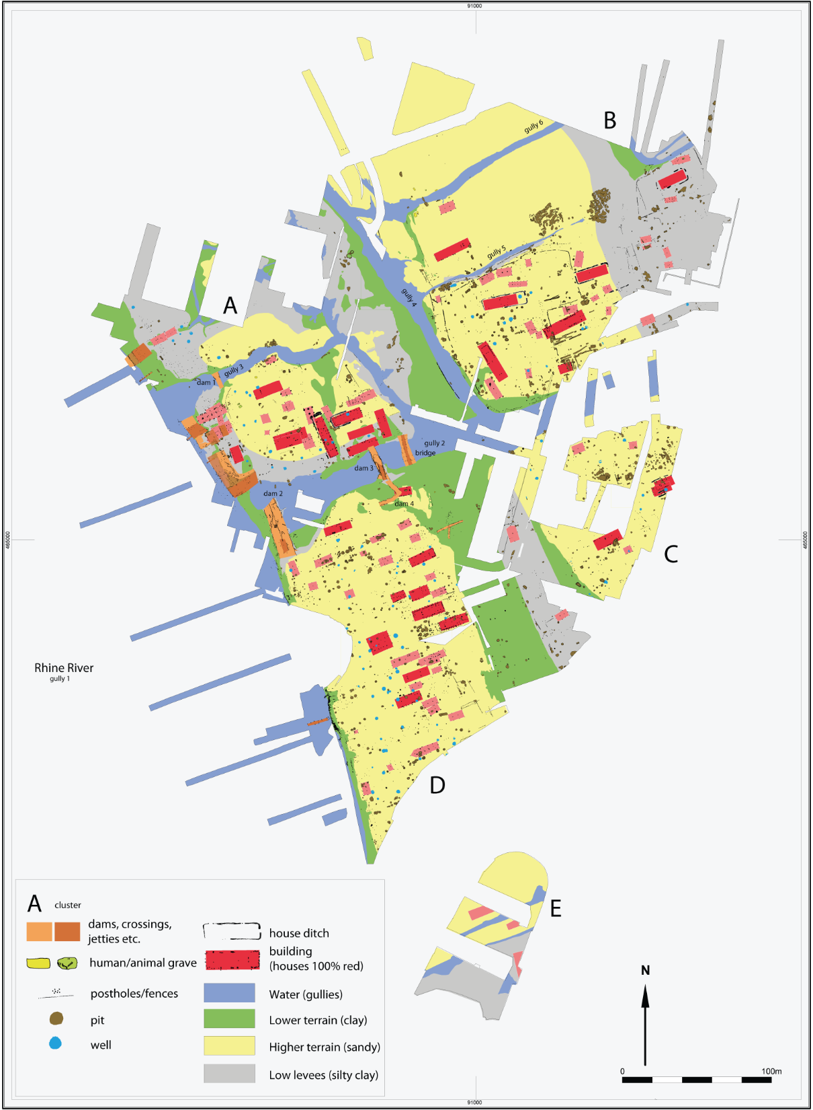
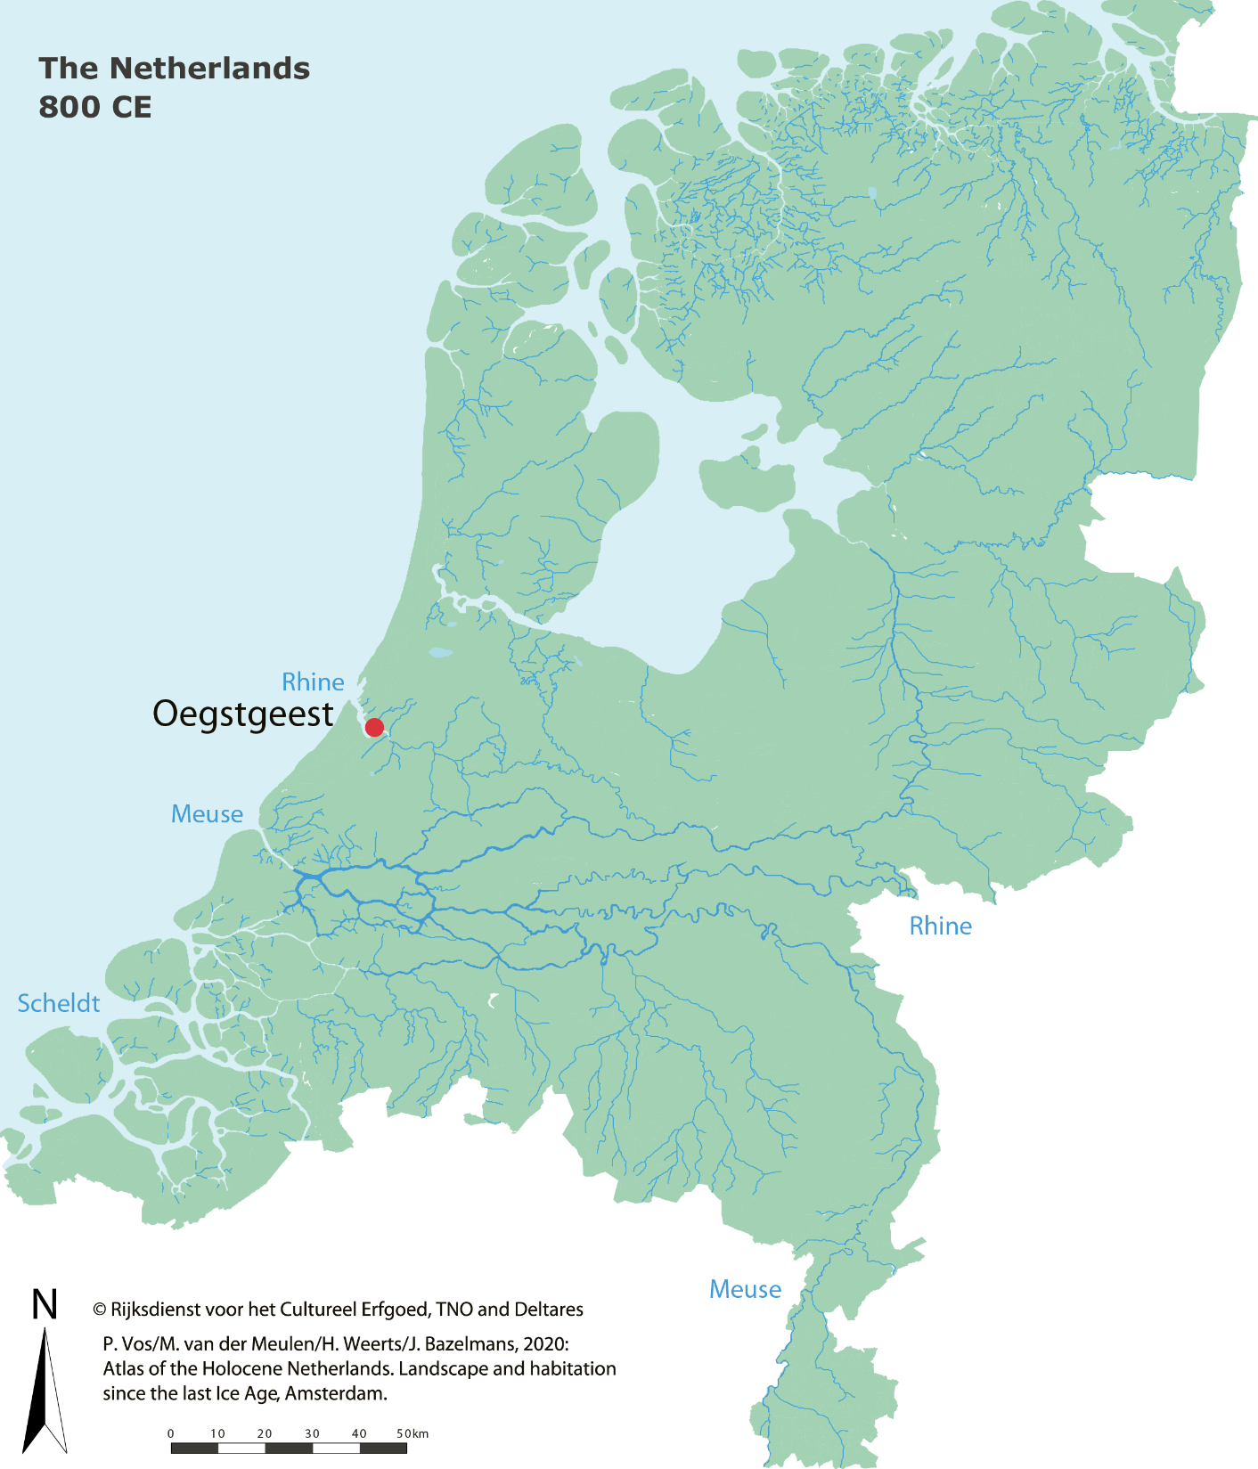
Merovingian Oegstgeest
Images adapted from Theuws et al. 2021a
1

Slide 3
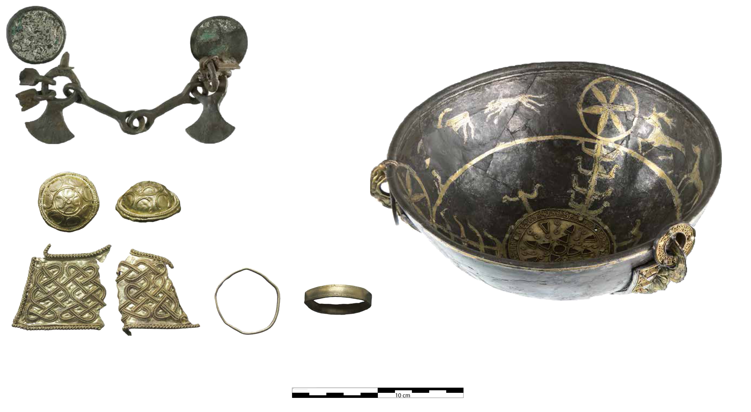
Merovingian Oegstgeest
Images adapted from Theuws et al. 2021a
1

Slide 4
Merovingian Oegstgeest
v
Images adapted from Theuws et al. 2021a
1

Slide 5
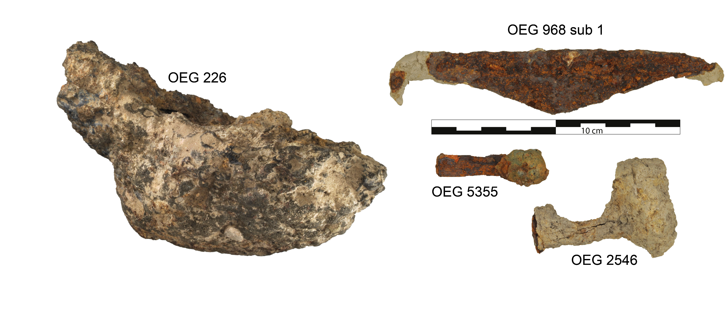
Merovingian Oegstgeest
Images adapted from Theuws et al. 2021a
1

Slide 6
Research Questions
What forge techniques were used at Oegstgeest?
What do these reveal about the skills of the artisans?
Where did this iron come from?
What do the answers to these questions reveal about the socio-economic role of Oegstgeest?
2

Slide 7
Methodology
Samples cut, mounted in resin and polished
Acid etching and optical microscopy: metallurgy
SEM-EDX: major element content and metallurgy
LA-ICP-MS: trace element content and provenance by HCPC
3

Slide 8
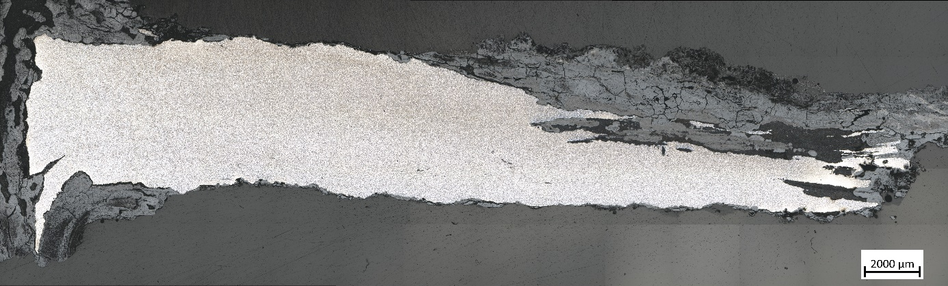
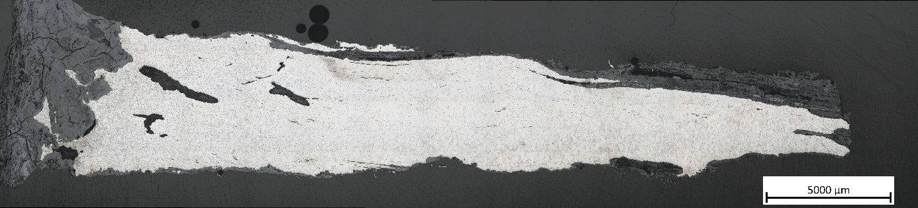
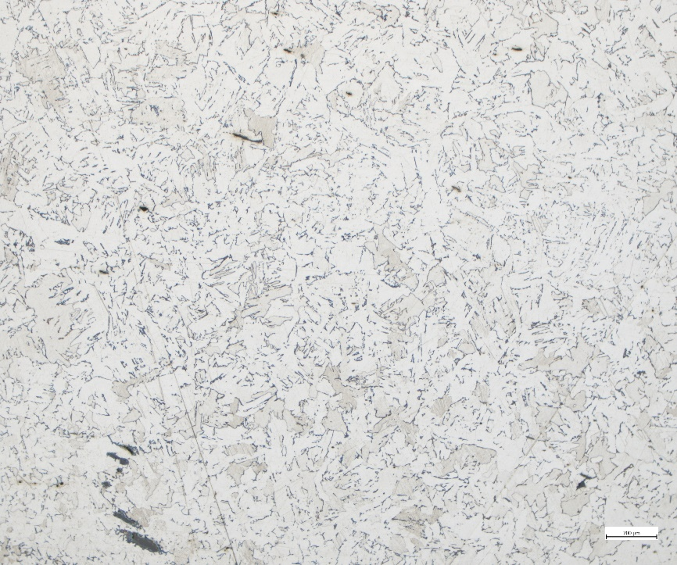
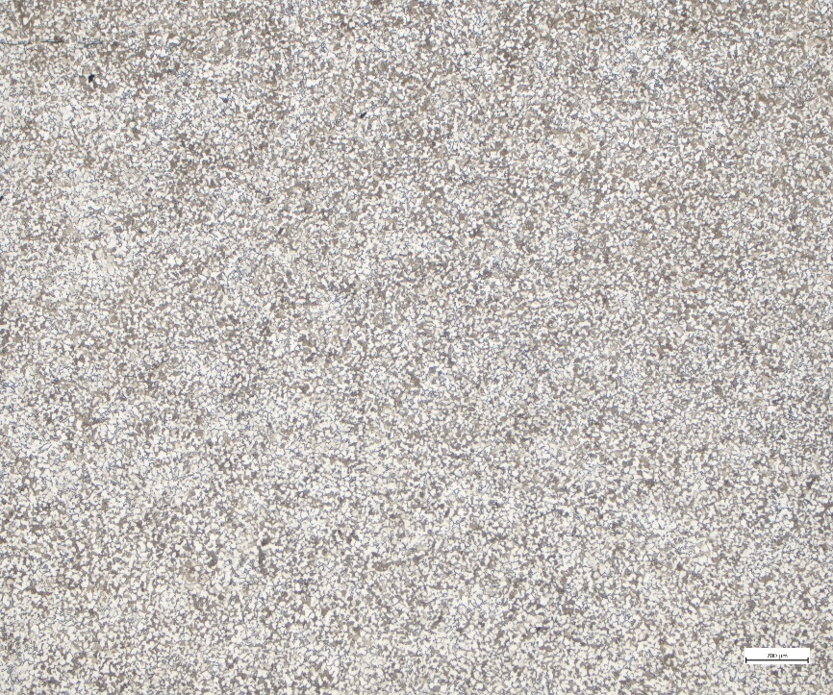
Results: Nails
Homogeneous
microstructure across
each piece
Even carbon distribution
Quality metal
OEG 968 sub 3
OEG 2540
4

Slide 9
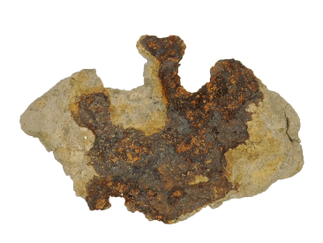
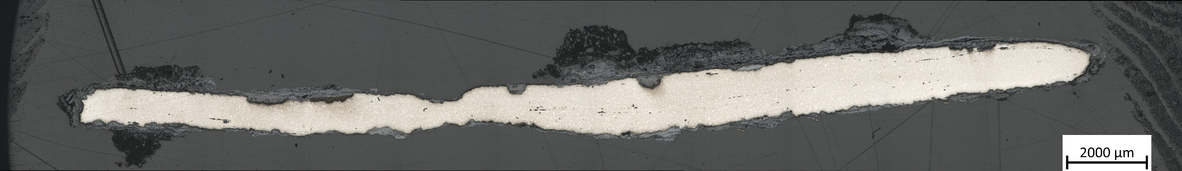
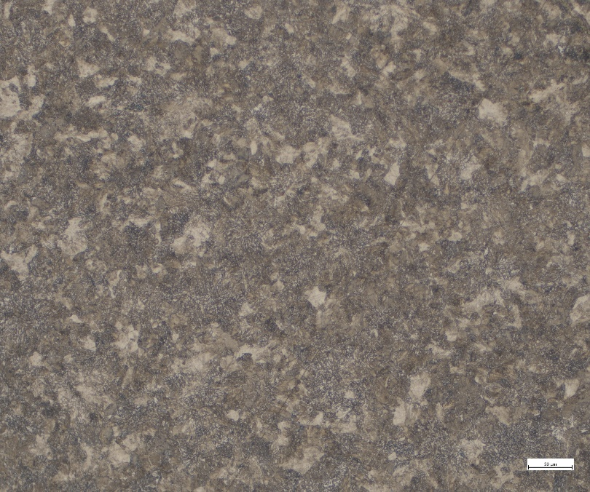
Results: complex objects
OEG 968 sub 2
5

Slide 10
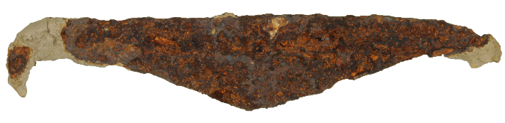
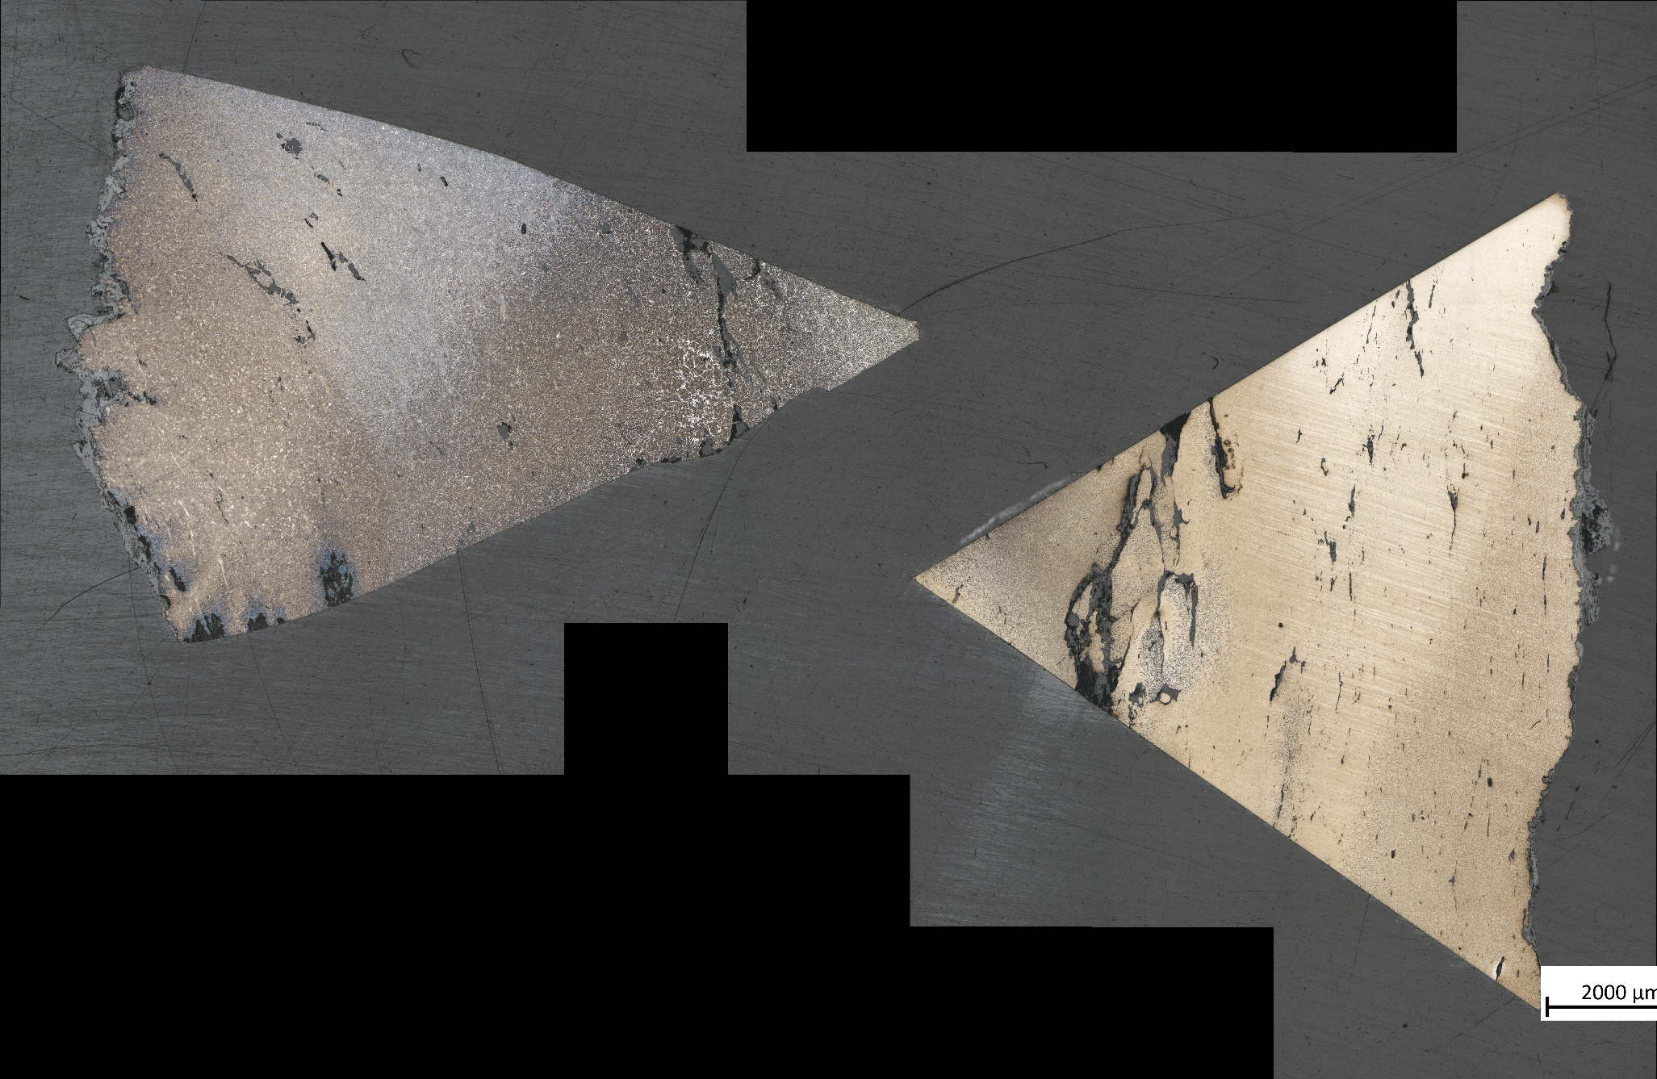
Results: complex objects
OEG 968 sub 1
5

Slide 11
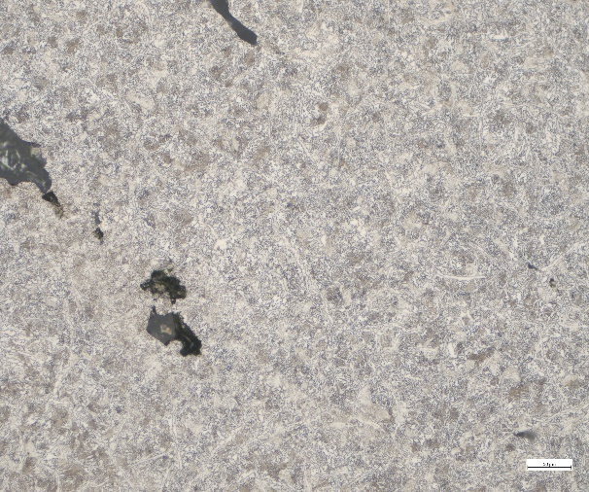
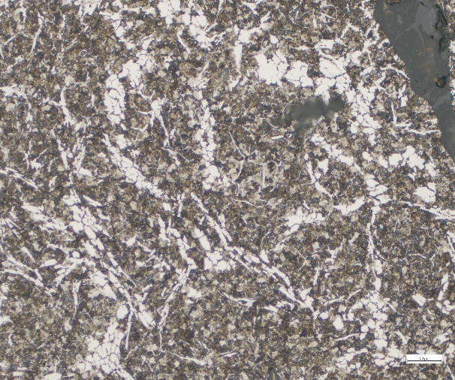
Results: complex objects
OEG 968 sub 1
5

Slide 12
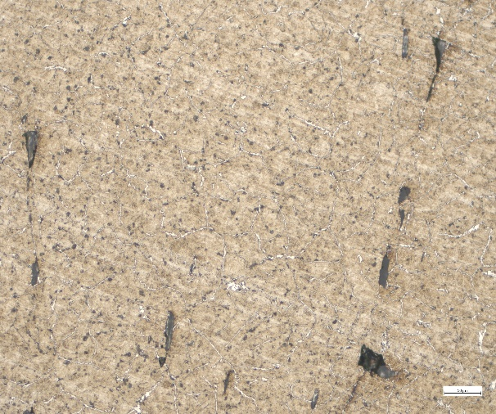
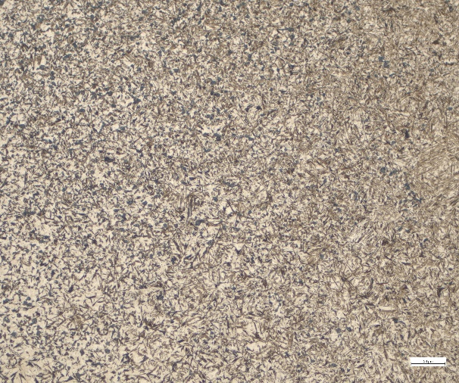
Results: complex objects
OEG 968 sub 1
5

Slide 13
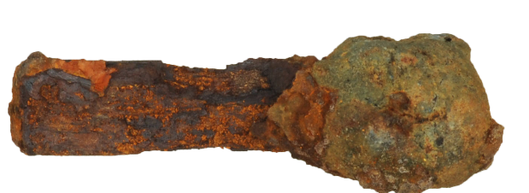
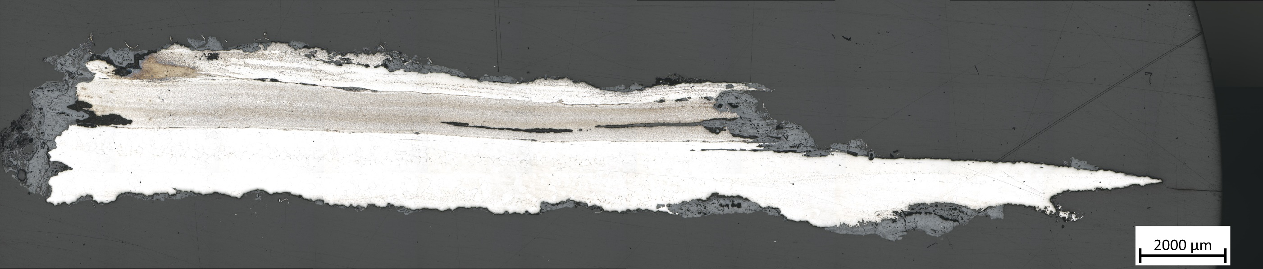
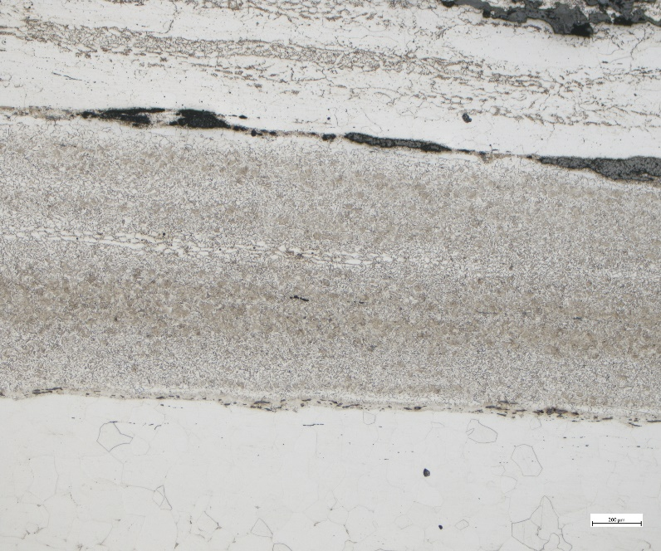
Results: forge scrap
OEG 5355
Offcut: likely produced at Oegstgeest
Direct weld between iron and steel
Likely at least one experienced smith at Oegstgeest
6

Slide 14
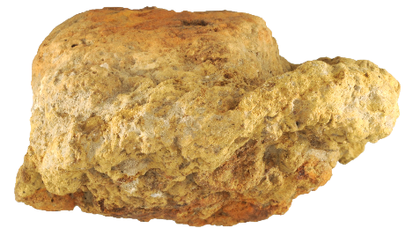
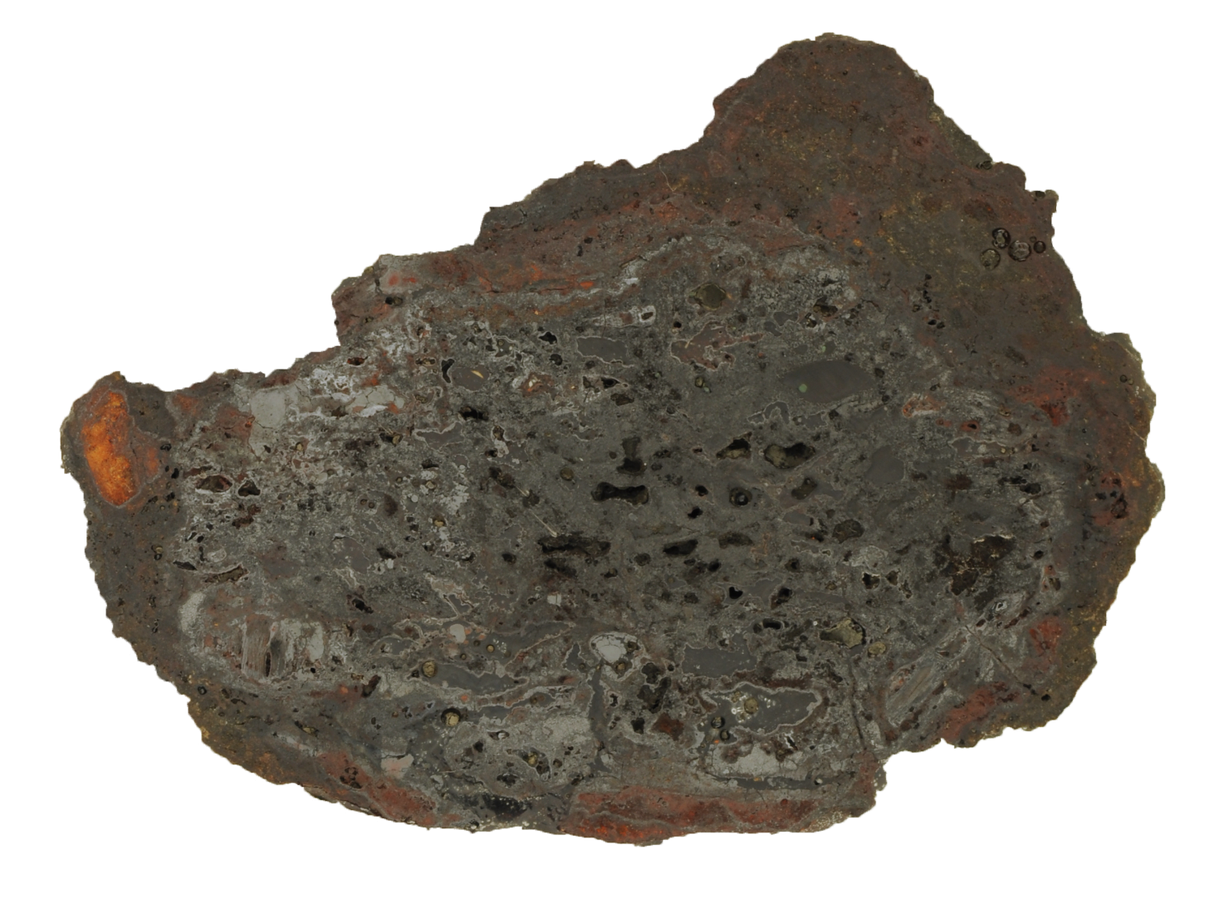
Iron and copper
OEG 603
v
7

Slide 15

Iron and copper
OEG 603
v
7

Slide 16
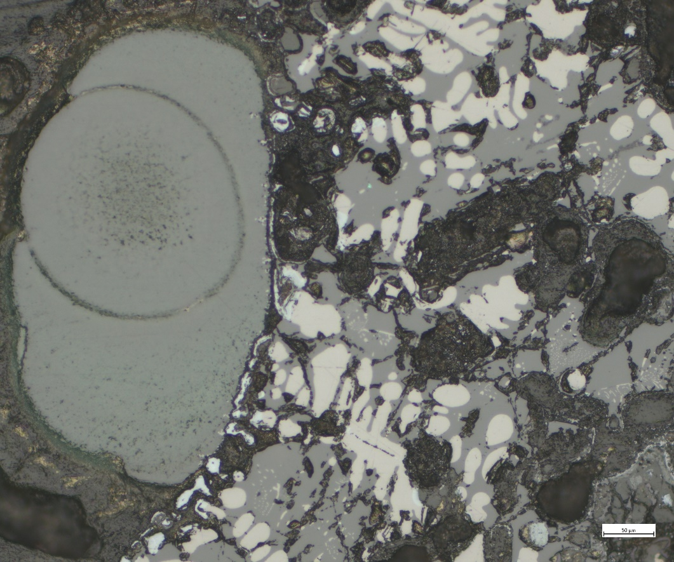
Iron and copper
OEG 603
OM
SEM
7

Slide 17
Provenance
8

Slide 18
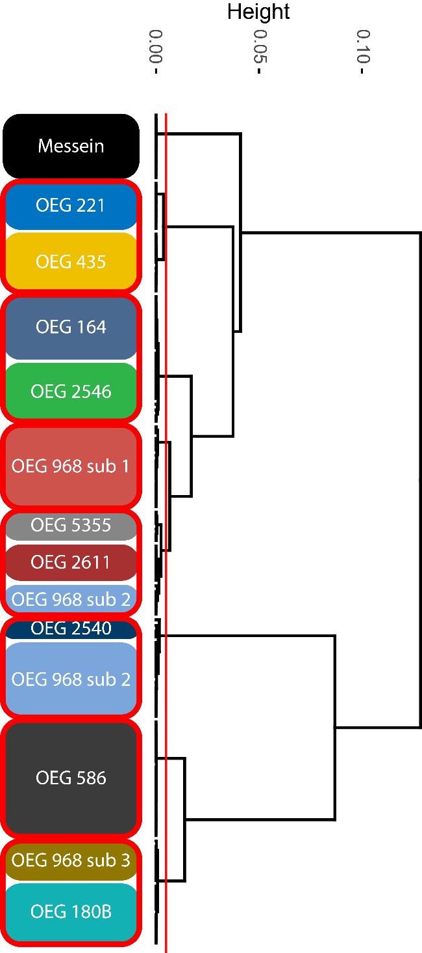
Provenance
8

Slide 19
Provenance
1
2
3
4
5
6
8

Slide 20
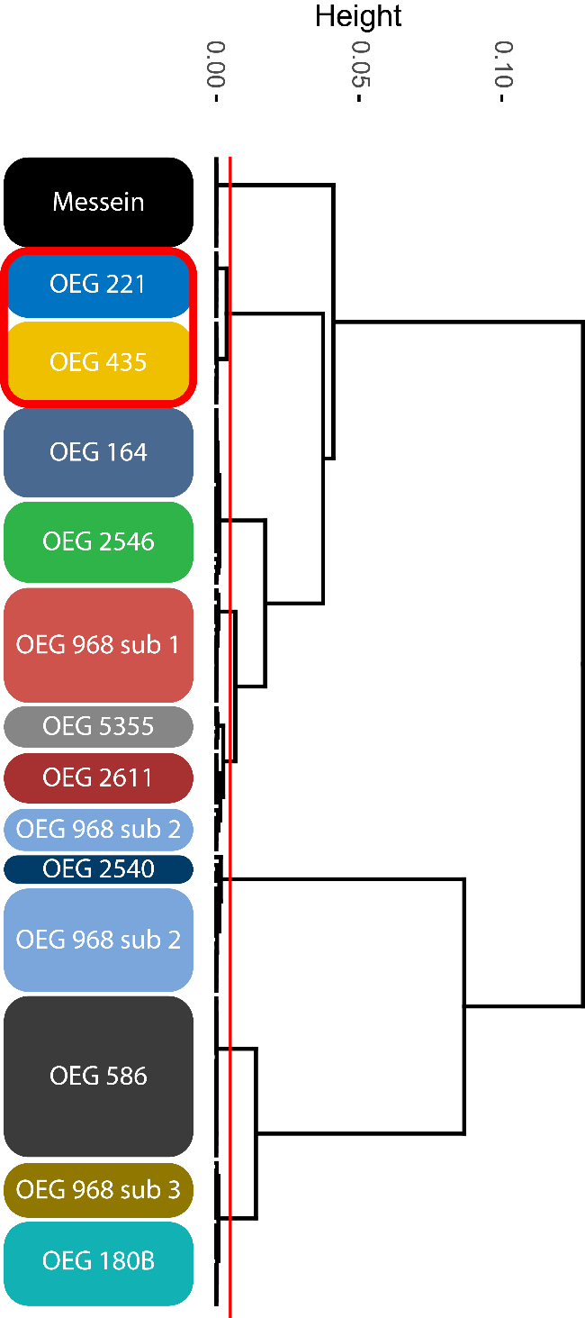
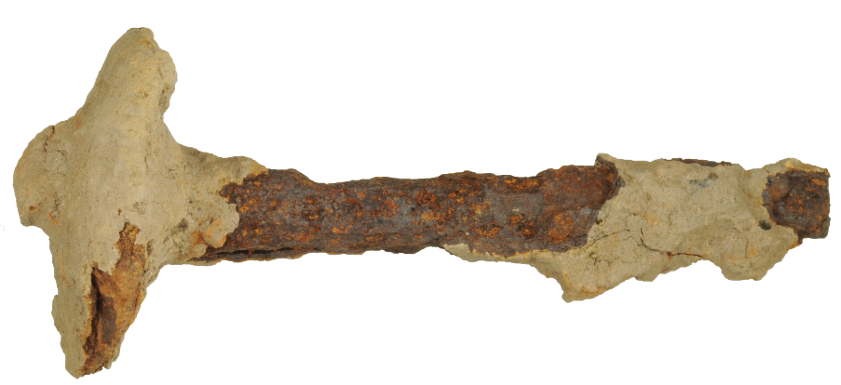
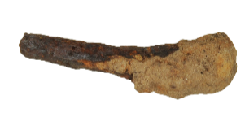
Provenance
OEG 221
1
OEG 435
8

Slide 21
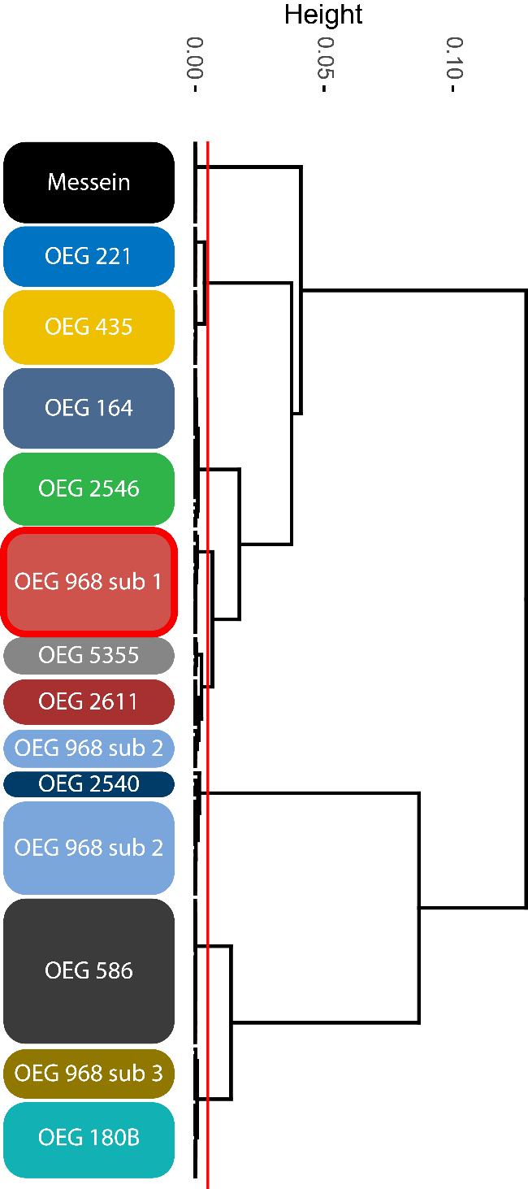

Provenance
3
OEG 968 sub 1
8

Slide 22
Summary
Metallurgy
  Use of quality materials
  Presence of quality finished products
  Tandem iron and copper working
Provenance
  Matches with Lorraine and possibly Swabia
  Most samples unable to be attributed a provenance
Additional sources:
  Netherlands very likely
  England?
  Danube?
9

Slide 23
Conclusion
Despite its rural Nature, Oegstgeest was well integrated into trade at this time
Growing body of evidence that rural settlements in the Rhine Delta at this period were not isolated or disconnected from their surroundings
Further study on the trade of iron: Acies Ferri PhD project
  Merovingian swords and Seaxes
  Study into existing technical traditions
  Understanding the extent of centralisation of weapon production
10

Slide 24
Thank you for listening

