Slide 1
Autobiographical Memory Workshop
19 January 2024
Grenoble
Memories for the COVID-19 pandemic
Christine Bastin & Nawël Cheriet
Nawël Cheriet
PhD 2020-2024

Slide 2
Lived collective events
Personal events
(e.g., my vacation in Scotland, last Christmas dinner…)
Collective events
(e.g., the Ukraine war, the earthquake in Japan…)
LCE
LCE (e.g., the 2021 flooding in my home town, the final of the 2018 FIFA World cup…)

Slide 3
Lived collective events
What are the characteristics of memories for lived collective events in terms of specificity and content?
How do they evolve with time?

Slide 4
Lived collective events
What are the characteristics of memories for lived collective events in terms of specificity and content?
How do they evolve with time?
COVID-19 pandemic = an ideal case because
- it includes happenings at the individual and the community levels
- it is very recent → a window to study the creation and early transformation of memories

Slide 5
Methods
Interviews in ~240 Belgian participants (mean age: 46.7 ± 4.95, range: 18-79; 178 women)
Event type
 | Pandemic | Politics
2021 | Recall as many events as possible that happened regarding the COVID-19 pandemic during the year 2020 | Recall the course of one of the political events that happened in the world in 2020*
2022 | idem | idem
Interview time
* 68%: American presidential election; 22% Black Lives Matters; 9% Belgian government formation
Notes:
N = 249 in 2021
N = 185 + 66 in 2022 (n = 246 after exclusion due to technical problems)

Slide 6
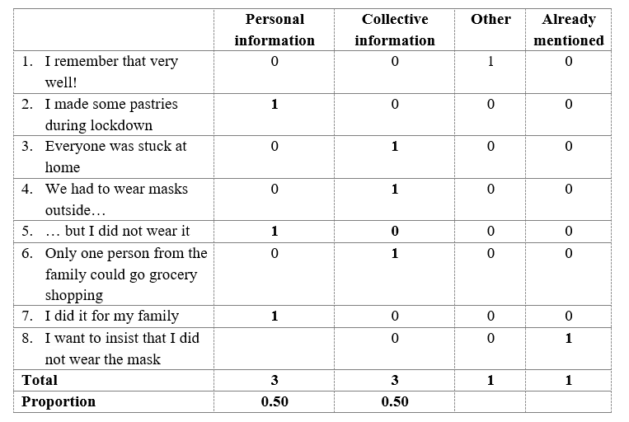
Results
1. Nature of recalled information
Hypotheses:
- Memories for the pandemic should contain more personal information than memories about the political event
- Over time, memories for the pandemic should include fewer information in general and a greater proportion of collective information

Slide 7
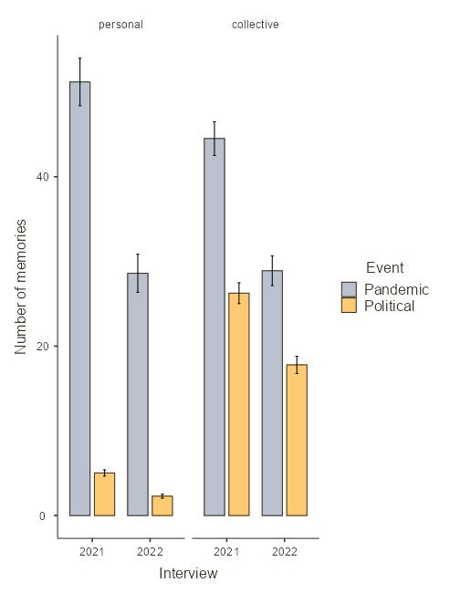
Results
1. Nature of recalled information: Number of info
Significant type of information x event type x interview time interaction (p < .001)
For political event, the number of information decreased with time, but the decrease was similar for personal and collective information, with the latter always dominating.
In contrast, for the pandemic, on the first interview, participants recalled more personal than collective information; with time, both decreased, but more so for the personal information which was recalled to the same extent as collective information on the second interview

Slide 8
Results
Nature of recalled information: Proportion of collective info
Main effect of interview time (p = .001): Greater ratio of collective information in 2022 (M = 0.74) than in 2021 (M = 0.67).
Main effect of the event type (p = .001): Memories for the political event contained a greater proportion of collective information (M = 0.90) than the pandemic event (M = 0.49).
No interaction

Slide 9
Results
2. Automated scoring of internal and external details (van Genugten & Schacter, 2022)
NB: number internal and external details in each sentence across the whole narratives
Hypotheses:
Memories for the pandemic should be more specific than memory for political events.
With time, memories will lose specificity, but more so for political events than for the pandemic.

Slide 10
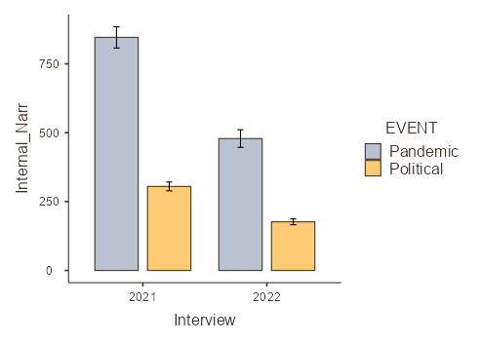
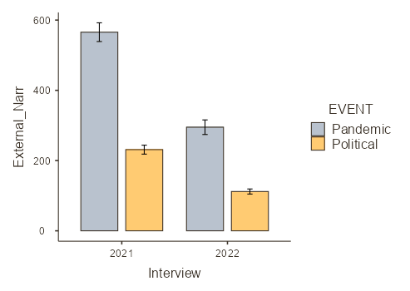
Results
2. Automated scoring of internal and external details (van Genugten & Schacter, 2022)
Internal details
External details
Pandemic > politics
2021 > 2022
Pandemic: 2021 >> 2022
Politics: 2021 > 2022

Slide 11
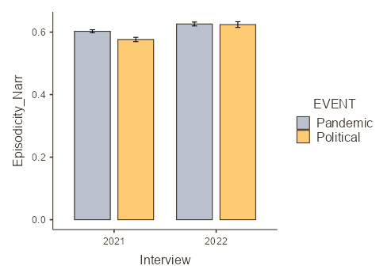
Results
2. Automated scoring of internal and external details (van Genugten & Schacter, 2022)
Ratio of internal over total of details
Pandemic > politics
2022 > 2021
2021: Pandemic > politics
2022: pandemic = politics

Slide 12
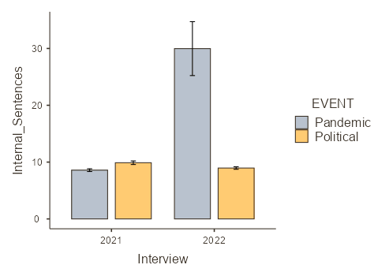
Results
2. Automated scoring of internal and external details (van Genugten & Schacter, 2022)
Ratio of internal over total number of personal and collective information
Pandemic > politics
2022 > 2021
Pandemic: 2022 > 2021
Politics: 2022 = 2021
Notes:
For ratio of external details: same effect, but the interaction shows Pandemic: 2022 > 2021 & Political: 2022 < 2021

Slide 13
Results
3. Lexical content analyses: Word counts with LIWC (Pennebaker et al., 2007)
Event type | Interview time | Interaction
Pandemic > politics: I We Family Friends Positive emotions Anxiety Cognitive processes Covid Health Politics > pandemic: anger | 2021 > 2022: We Family Positive emotions Anxiety Cognitive processes 2022 > 2021: covid | Negative emotions: 2021: pandemic = political 2022: politics > pandemic Covid: Pandemic: 2022 > 2021 Politics: 2022 = 2021

Slide 14
Summary
Memories for a political event (= collective event)
- contains a majority of collective information
- globally lose information over time, but without any change in their nature
Memories for the pandemic (= lived collective event)
- contains initially a majority of personal information
- with time, contains less personal information, which becomes equal in number to collective information
- does not change in terms of specificity over time, but may be more condensed (?)

Slide 15
Thanks

