Slide 1







Mind blanking as the frontier case of mental state reporting
Session: Unreportable awareness
Athena Demertzi, PhD
FNRS Research Associate
Director, Physiology of Cognition Lab
CRC-In Vivo Imaging Center
GIGA Institute
Université de Liège
BELGIUM
15th Meeting of
the Belgian Society for Neuroscience
Brussels
June 6 2023

Slide 2
Consciousness
awareness
Animals
Psychotherapy
NeuroEthics
perception
cognition
thought
imagination
mind
self-awareness
experience
Notes:
Real-life conséquences:
Neuro-ethics
Animal consciousness
Psychotherapy

Slide 3
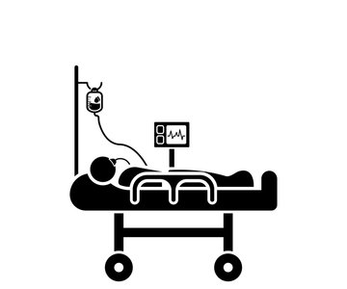
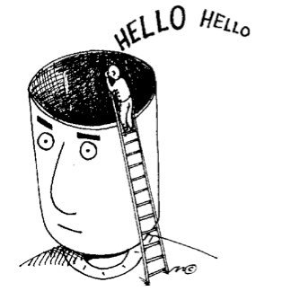

Limits of Reportability
Clinical Physiological Typical
- wakefulness +

Slide 4
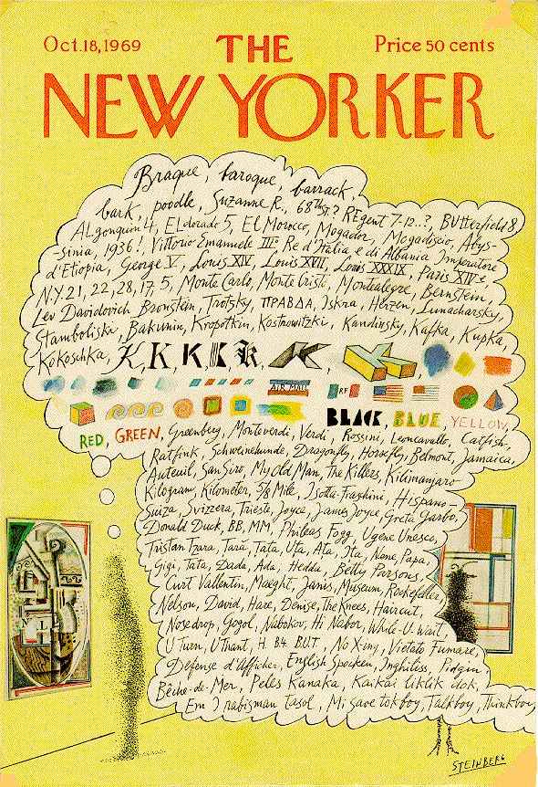
The resting brain
Brain ~2% body’s weight
Evoked changes <5%
80% for neuronal signaling
"While conscious awareness is […] energetically inexpensive, it is dependent upon a very complex, dynamically organized state of the brain that is achieved at great expense”
(Raichle M. Science 2006)
Notes:
Saul Steinberg's marvelous New Yorker cover from October 8, 1969 (see Figure 1), provides the best picture of human consciousness I have encountered. Not just words, but colors and shapessucceed each other in delicious association. Even the genius of Steinberg can't quite render aromas, tickles and sounds on the cover of a magazine, but at least he suggests the likelihood oftheir inclusion. And the whole rendering is made possible by his exploitation of a familiar cartoonists' convention, the thought balloon or thought bubble. Calling this a conventionunderplays its naturalness; I doubt that children ever need to have the convention explained to them--it's quite wonderfully obvious what it depicts, metaphorically: the stream of consciouscontents in the mind of the man looking at the painting in the museum. This powerful and natural metaphor provides a nice setting of the problem of consciousness: If this picture gives us themetaphorical truth, what is the literal truth? How can an account of what happens in the man's brain ever do justice to the familiar--indeed intimate--facts we recognize in this metaphoricalrendering?
W. James (1980): five characters in thought
Every thought tends to be part of a personal consciousness
Within each personal consciousness, thought is always changing
Within each personal consciousness, thought is sensibly continuous
It always appears to deal with objects independent of itself
It is interested in some parts of these objects to the exclusion of others, and welcomes or rejects or chooses from among them, all the while it thinks

Slide 5
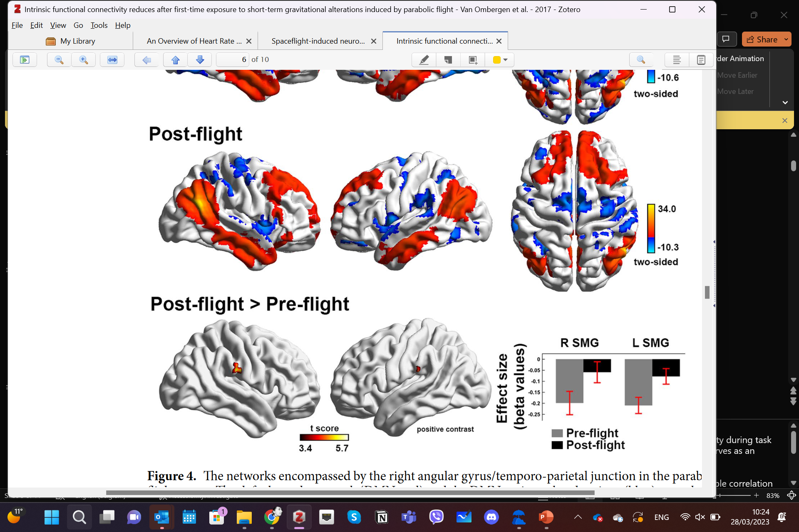
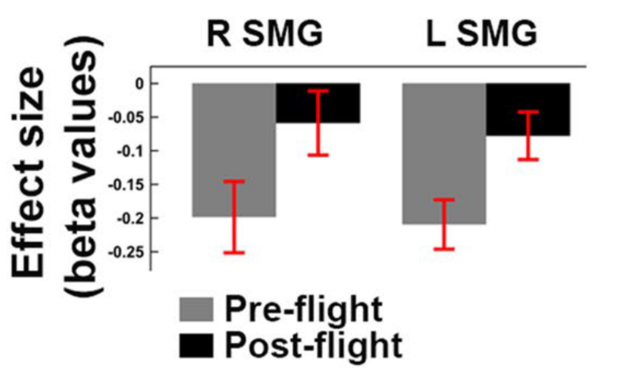
Resting anticorrelations
Typical waking
Wakefulness Propofol
Demertzi & Whitfield-Gabrieli, in: Neurology of Consciousness 2nd ed. 2015
Demertzi et al, Front Hum Neurosci 2013
Raichle et al, PNAS 2001; Fox et al, PNAS 2005
Boveroux et al, Anesthesiology 2010
Disorders of Consciousness
Extreme environments
DMN Anticorrelations
Parabolic Flight
Di Perri, …, Demertzi*, Laureys*, Soddu*, Lancet Neurol 2016
Van Ombergen … and Demertzi, Sci Reports 2017
Jillings, …. Demertzi* & Wuyts* Comm Biol 2023
Notes:
Brain areas consistently exhibiting activity decreases during task performance also exhibit coherent spontaneous activity in
the resting state. Performance of a wide variety of tasks has called attention to a group of brain areas (A) that decrease their activity during task performance (data adapted from [4] ). This particular group of brain areas has come to be known as the ‘ default network ’ and serves as an exemplar of all areas of the cerebral cortex which exhibit a systems level organization in the resting (default) state [7] .
If one records the spontaneous fMRI BOLD signal activity in these areas (arrows, A) in the resting state what emerges is a remarkable correlation in the spontaneous fluctuations of the fMRI BOLD signals obtained from the two areas (B). Using these fluctuations to analyse the network as a whole [7] reveals a level of functional organization (C) that parallels that seen in the task-related activity decreases (A).
These data provide a dramatic demonstration of the intrinsic organization of the human brain which likely provides a critical context for all human behaviours including conscious awareness. These data were adapted from our earlier published work [4–6, 24] .

Slide 6
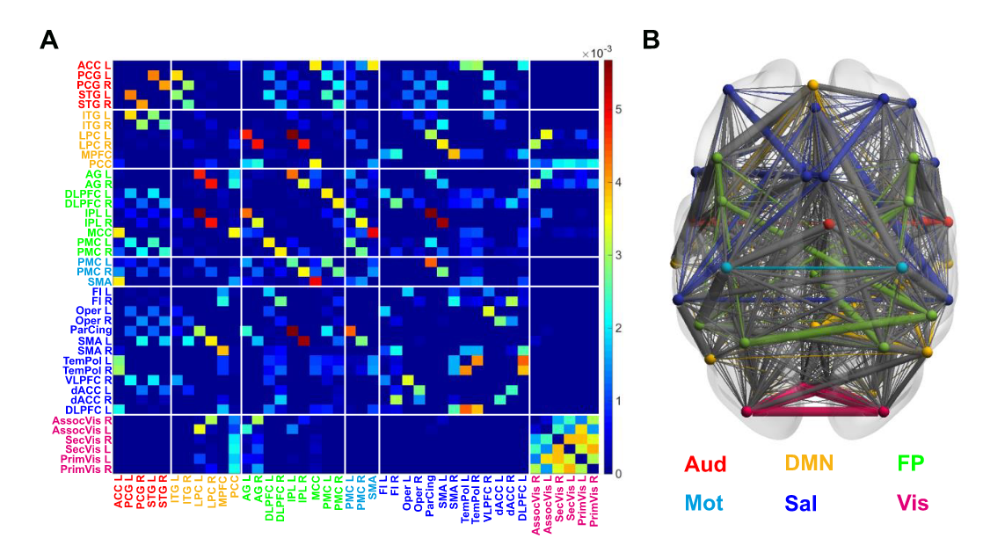
The brain as a network
100 billion neurons, ~100 trillion synaptic connections
The Connectome
A matrix representing all possible
pairwise anatomical connections
between neural elements of the brain
Sporns, Tononi, & Koetter.
PLoS Comput. Biol. 2005
Fornito, Zalesky, Bullmore. Ch 1: An Introduction to Brain Networks. Fundamentals of Brain Network Analysis, Academic Press 2016
Image from: Demertzi & Tagliazucchi, Dehaene, Deco, Barttfeld, Raimondo […] et al, Science Advances 2019
Notes:
This approach emphasises the fundamental roles of the interactions between regions, thereby finding solid grounding in the complex systems approach to the brain – and providing plentiful insights about brain function and dysfunction

Slide 7
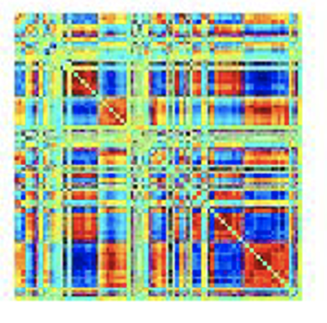
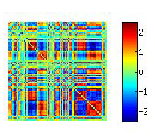
Brain dynamics and cognition
Averaged connectome
Typical wakefulness
Performance, emotion and cognition
Alavash et al, Neuroimage, 2016; Shine et al Neuron, 2016; Friston Neuroimage, 1997; Thompson et al, Hum Brain Mapp, 2013
Unconsciousness
Rigid spatiotemporal organization, less metastable dynamics
sleep (Tagliazucchi et al, PNAS 2013; Wang et al, PNAS 2016; Wilson et al., Neuroimage 2015; Chow et al, PNAS 2013)
anesthesia
  humans (Tagliazucchi et al, J. R. Soc. Interface 2016; Kafashan et al, Front Neural Circuits, 2016; Amico et al, PLoS One 2014)
  animals (Barttfeld et al, PNAS 2014; Grandjean et al, Neuroimage 2017; Liang et al, Neuroimage 2015)
Time-varying connectome
The brain cannot map the complexity of internal and external world
(Dehaene et al, Trends Cog Sci, 2006; Tononi et al, Nat Rev Neurosci. 2016)
Notes:
Metastability in the brain is a phenomenon studied in computational neuroscience to elucidate how the human brain recognizes patterns. Here, the term metastability is used rather loosely. There is no lower-energy state, but there are semi-transient signals in the brain that persist for a while and are different than the usual equilibrium state.

Slide 8
Complex patterns in higher conscious states
Demertzi & Tagliazucchi, Dehaene, Deco, Barttfeld, Raimondo, Martial, Fernández-Espejo, Rohaut, Voss, Schiff, Owen, Laureys, Naccache, Sitt. Science Advances 2019

Slide 9
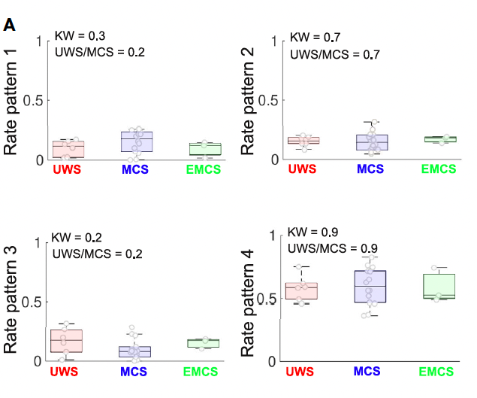
Simple patterns in unconsciousness
Propofol anesthesia
Demertzi & Tagliazucchi, Dehaene, Deco, Barttfeld, Raimondo, Martial, Fernández-Espejo, Rohaut, Voss, Schiff, Owen, Laureys, Naccache, Sitt. Science Advances 2019

Slide 10
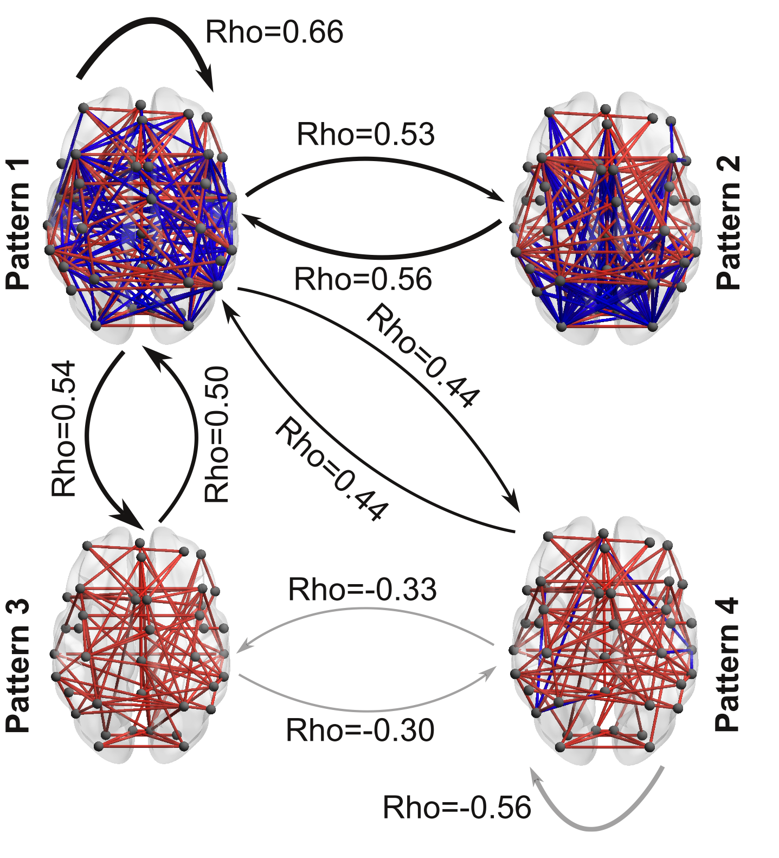
More chances to transition when conscious
Healthy > MCS > UWS
UWS > MCS > Healthy
Demertzi & Tagliazucchi, Dehaene, Deco, Barttfeld, Raimondo, Martial, Fernández-Espejo, Rohaut, Voss, Schiff, Owen, Laureys, Naccache, Sitt. Science Advances 2019
Notes:
﻿Black arrows indicate a higher probability to transit between the coordination patterns in healthy controls (HC) as opposed to patients in MCS and patients in UWS (HC > MCS > UWS). Gray arrows indicate the opposite trend (HC < MCS < UWS)
﻿To further describe the dynamic nature of the pattern exploration, we obtained, for each participant, a matrix containing information about the probabilities that any given pattern to transition into another. This matrix contains, in its ith row, the normalized (i.e., sum equal to one) frequency distribution of observing a volume labeled as the ith pattern transitioning into the pattern corresponding to the jth column. The average contiguous amount of time spent in each pattern for each clinical group was corrected for random durations by subtracting the average duration of surrogate shuffled pattern series.
The sequence predictability for each individual was quantified using the entropy rate (Markov entropy) for the corresponding probabilities and the transition probability matrices. The entropy rate for the sequence of brain patterns of each participant was computed as follows:
Astochastic or random process is a mathematical object usually defined as a family of random variables. Many stochastic processes can be represented by time series. However, a stochastic process is by nature continuous while a time series is a set of observations indexed by integers.

Slide 11

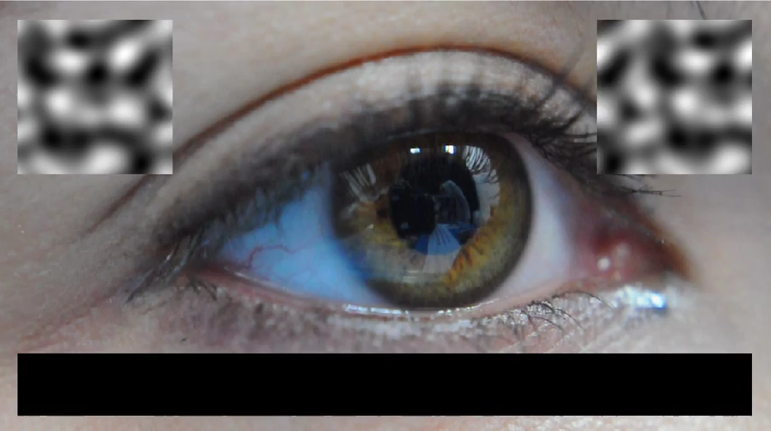
Evidencing sentience in low arousal by probing vestibular processing with caloric irrigations
Boulakis P.A, Koroma M, Chylinski D, Mortaheb S, Kirsch S, Staquet S, Detroz M, Zoi S, Pacolet V, Lefebvre F, Wuyts F, Bonhomme V, Demertzi A.
OSF Pre-registration (2022)
Bekinschtein et al., PNAS, 2009
Bekinschtein et al., PNAS, 2009

Slide 12
Notes:
Real-life conséquences:
Neuro-ethics
Animal consciousness
Psychotherapy

Slide 13




Mental states
Christoff et al, Nat Rev Neurosci 2016
Notes:
Mental states =

Slide 14
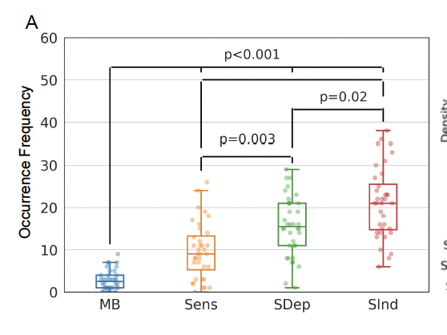
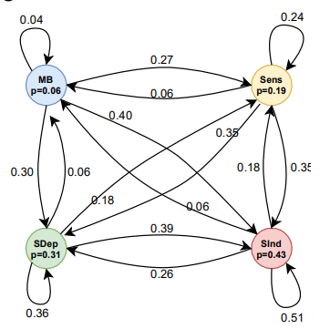
Mind Blanking has a distinct behavioral profile
Sparsely reported Reduced perceptions Equiprobable
Less frequent Equally probable across time Transient relay
Mortaheb, Van Calster, Raimondo, Klados, Boulakis, Georgoulaa, Majerus, Van De Ville*, Demertzi*. PNAS 2022
Van Calster, D’Argembeau, Salmon, Peters, Majerus, J Cogn Neurosci 2017

Slide 15
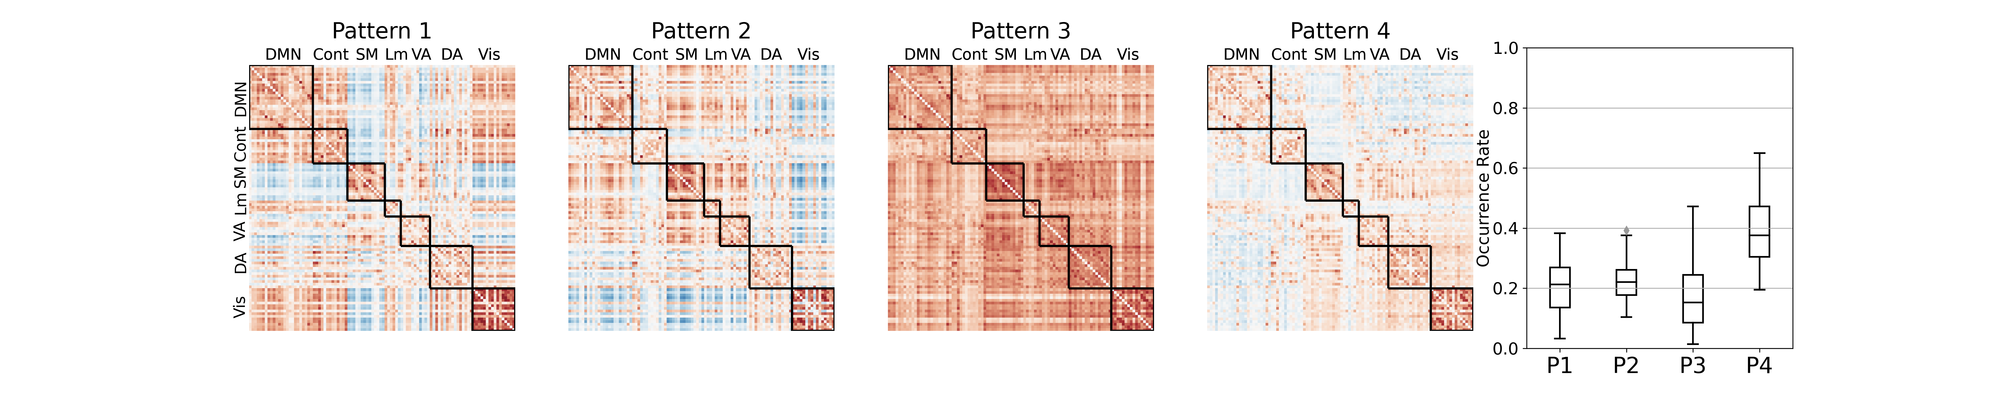
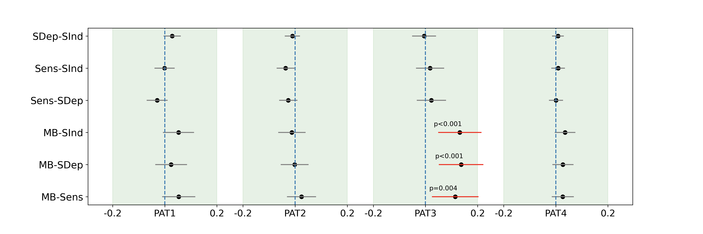
MB is linked to a hyper-connected state
Sparsely reported Reduced perceptions Equiprobable
Mortaheb, Van Calster, Raimondo, Klados, Boulakis, Georgoulaa, Majerus, Van De Ville*, Demertzi*. PNAS 2022
Van Calster, D’Argembeau, Salmon, Peters, Majerus, J Cogn Neurosci 2017
Notes:
Cosine similarity determines how similar two matrices/vectors are irrespective of their norm. It can be considered as the normalized version of the Euclidean distance (i.e., projecting the vectors onto the unit sphere and calculating Euclidean distance, which is then effectively the cosine of the angle between those vectors). Subsequently, for each mental state the distribution of distances to all four centroids was created.
A generalized linear mixed effect model with gamma distribution and log link function was applied to test the relationship between the distances to each pattern and the mental states.
Tukey post hoc test was applied to compare

Slide 16
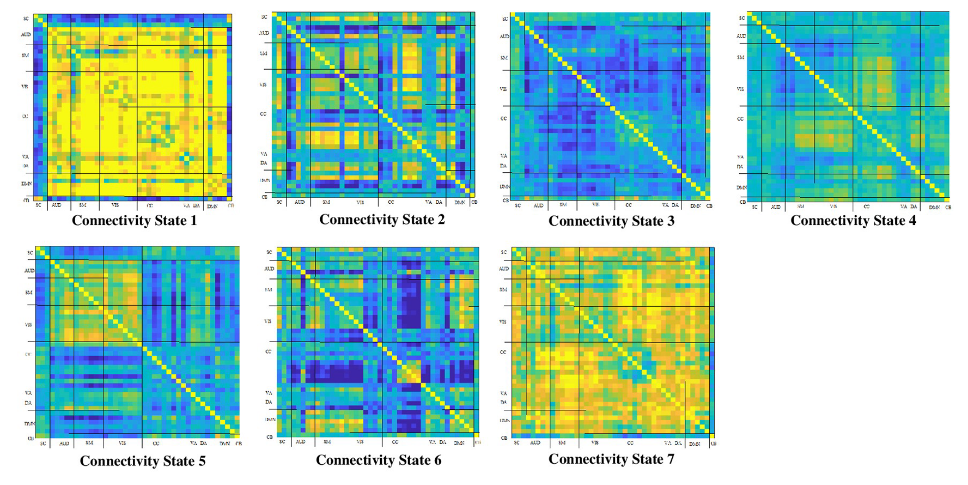
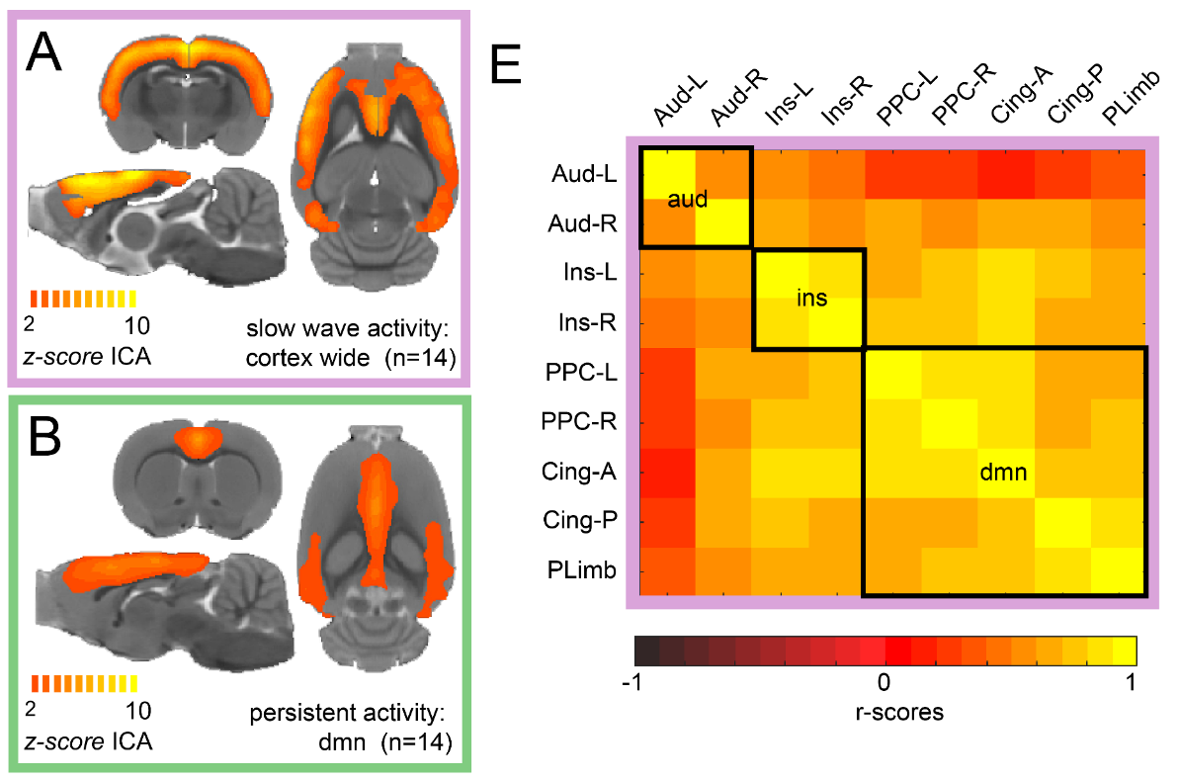
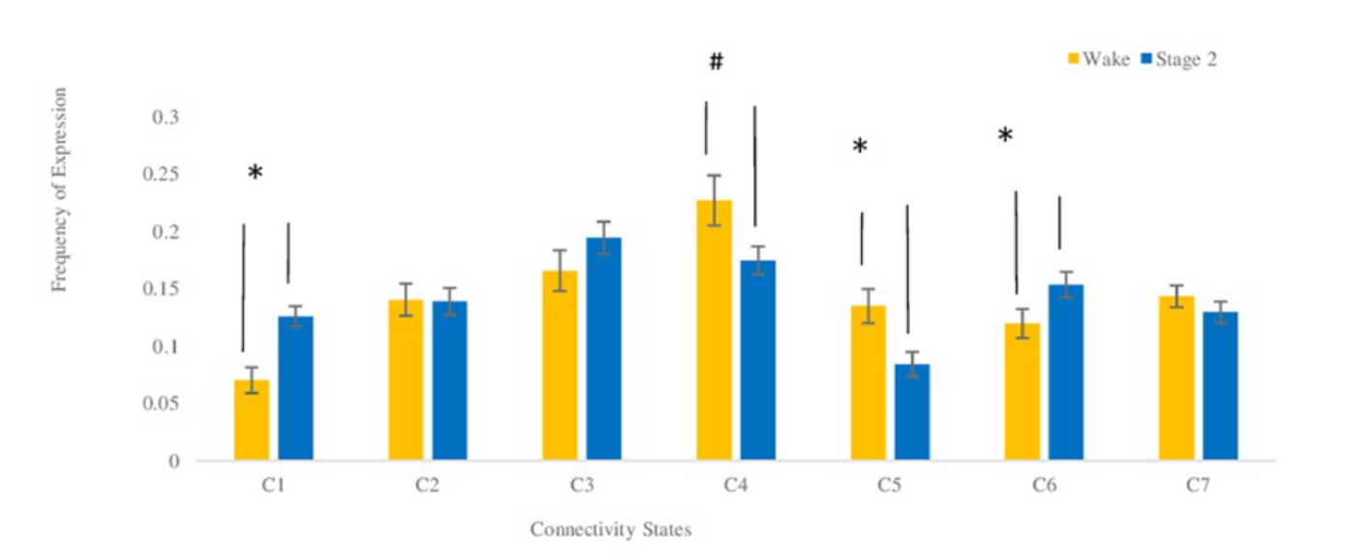
Higher connectivity due to what?
Slow wave activity in unconscious states
Sparsely reported Reduced perceptions Equiprobable
NREM sleep
Humans
Isoflurane anesthesia
Rats
Wake
Stage 2
Frequency
El-Baba et al, PLOS One 2019
Aedo-Jury et al, eLife 2019

Slide 17
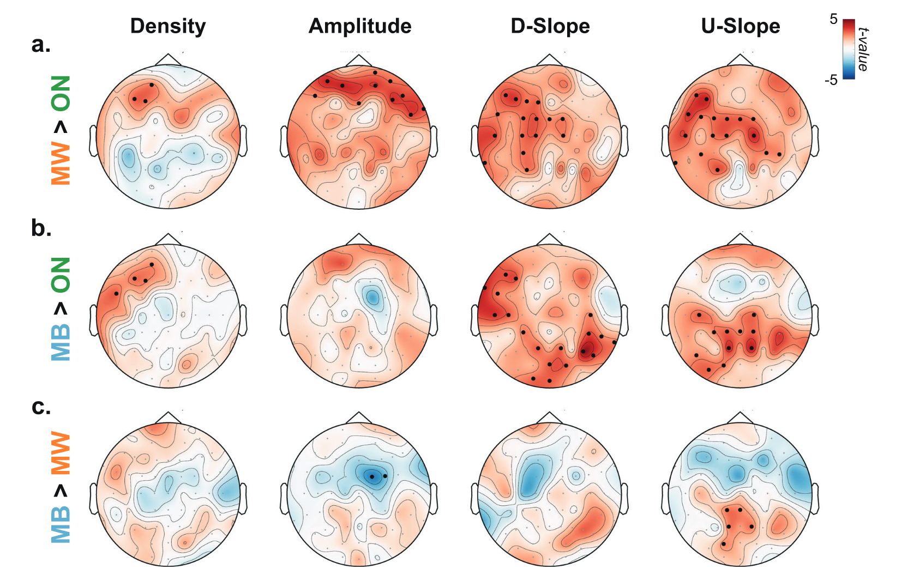
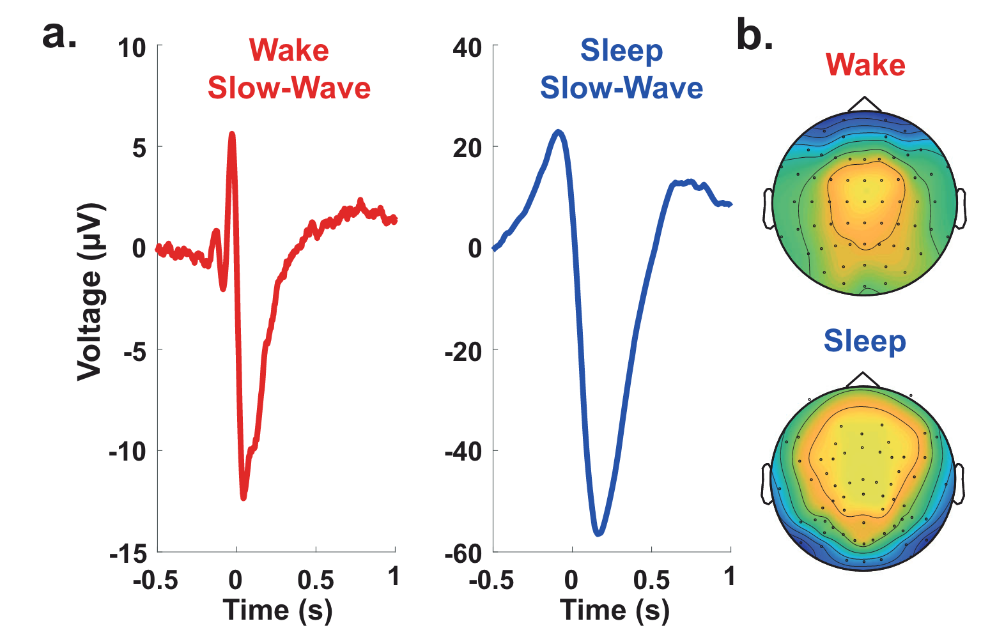
Slow wave activity in wakefulness “local sleeps”
Properties of slow waves
Predictive of mental states
Andrillon et al, Nat. Commun 2021
Notes:
Slow waves in the back of the brain were associated with misses (Fig. 5c), which is consistent with the involvement of parietal cortices in sensorimotor integration
MB > MW: reduction of slow-wave amplitude over frontal electrodes but an increase in their upward slope over parietal electrodes were predictive of MB: a perturbation of frontal cortices leads to unconstrained thoughts (MW) rather than the loss of awareness, but that awareness decreases when posterior regions momentarily go offline, a pattern similar to the neural correlates of dreaming during sleep or spontaneous thoughts during wakeful rest57,75.
Slow wave parameters such as
Amplitude
slope and
number of negative peaks
are thought to depend on the number of recruited neurons and the speed of synchronization across neuronal populations (Esser et al., 2007; Riedner et al., 2007; Vyazovskiy et al., 2007). In particular, steep, high-amplitude slow waves with few negative peaks are generated when an efficient neuronal synchronization allows for a fast recruitment of a large number of neurons at the cortical level.
https://www.ncbi.nlm.nih.gov/pmc/articles/PMC3900623/#:~:text=Slow%20wave%20activity%20(SWA%2C%200.5,slope%20of%20sleep%20slow%20waves.:
It has been proposed that the slope of slow waves, measured in the EEG, may represent a marker of this neuronal synchronization.^{16–18} Thus, the faster neuronal populations of a network are able to synchronize their activity, the steeper the slopes of the slow waves are. Consequently, the slope of slow waves at the beginning of the night when sleep pressure is high is much steeper compared to the slope of slow waves with the same amplitude towards the end of the sleep period when sleep pressure has dissipated.¹⁷

Slide 18
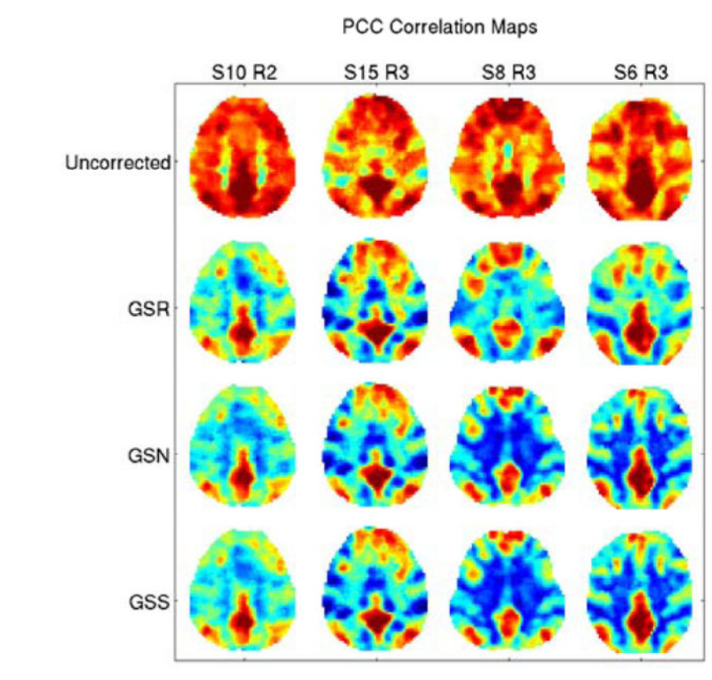
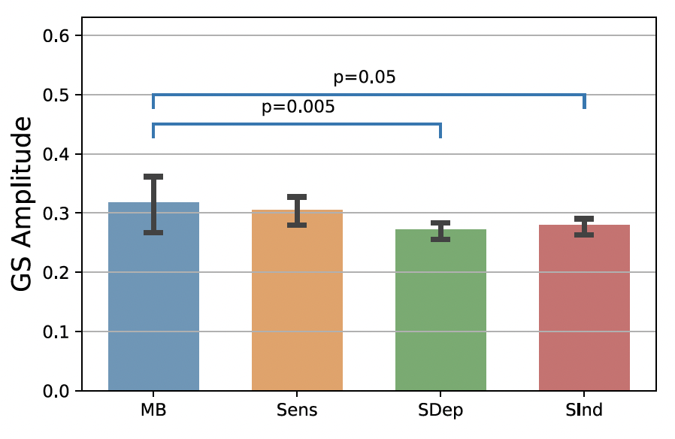
MB due to lower cortical arousal?
Global signal
Average voxel timeseries
Zarahn, Aguirre, D’Esposito, NeuroImage 1997
(“Global flow’’ in PET, Friston et al., 1990)
Higher Global Signal Amplitude around MB reports
Liu et al, NeuroImage 2017
Mortaheb et al, PNAS 2022
Notes:
‘‘Global flow’’ in PET (Friston et al., 1990), which is the average measured blood flow for the entire volume.
In fMRI there is at least a superficial analogue which we will refer to as the ‘‘global signal’’ and which we define as the average brain voxel time series (the global signal is thus a time signal)
The global signal for each subject was calculated after applying the atlas and time series extraction, by averaging time series of all the ROIs
The global signal amplitude was defined as the sum of the absolute value of the GS time points related to the functional repertoire of each mental state (extracted at the ROI level, after preprocessing)

Slide 19
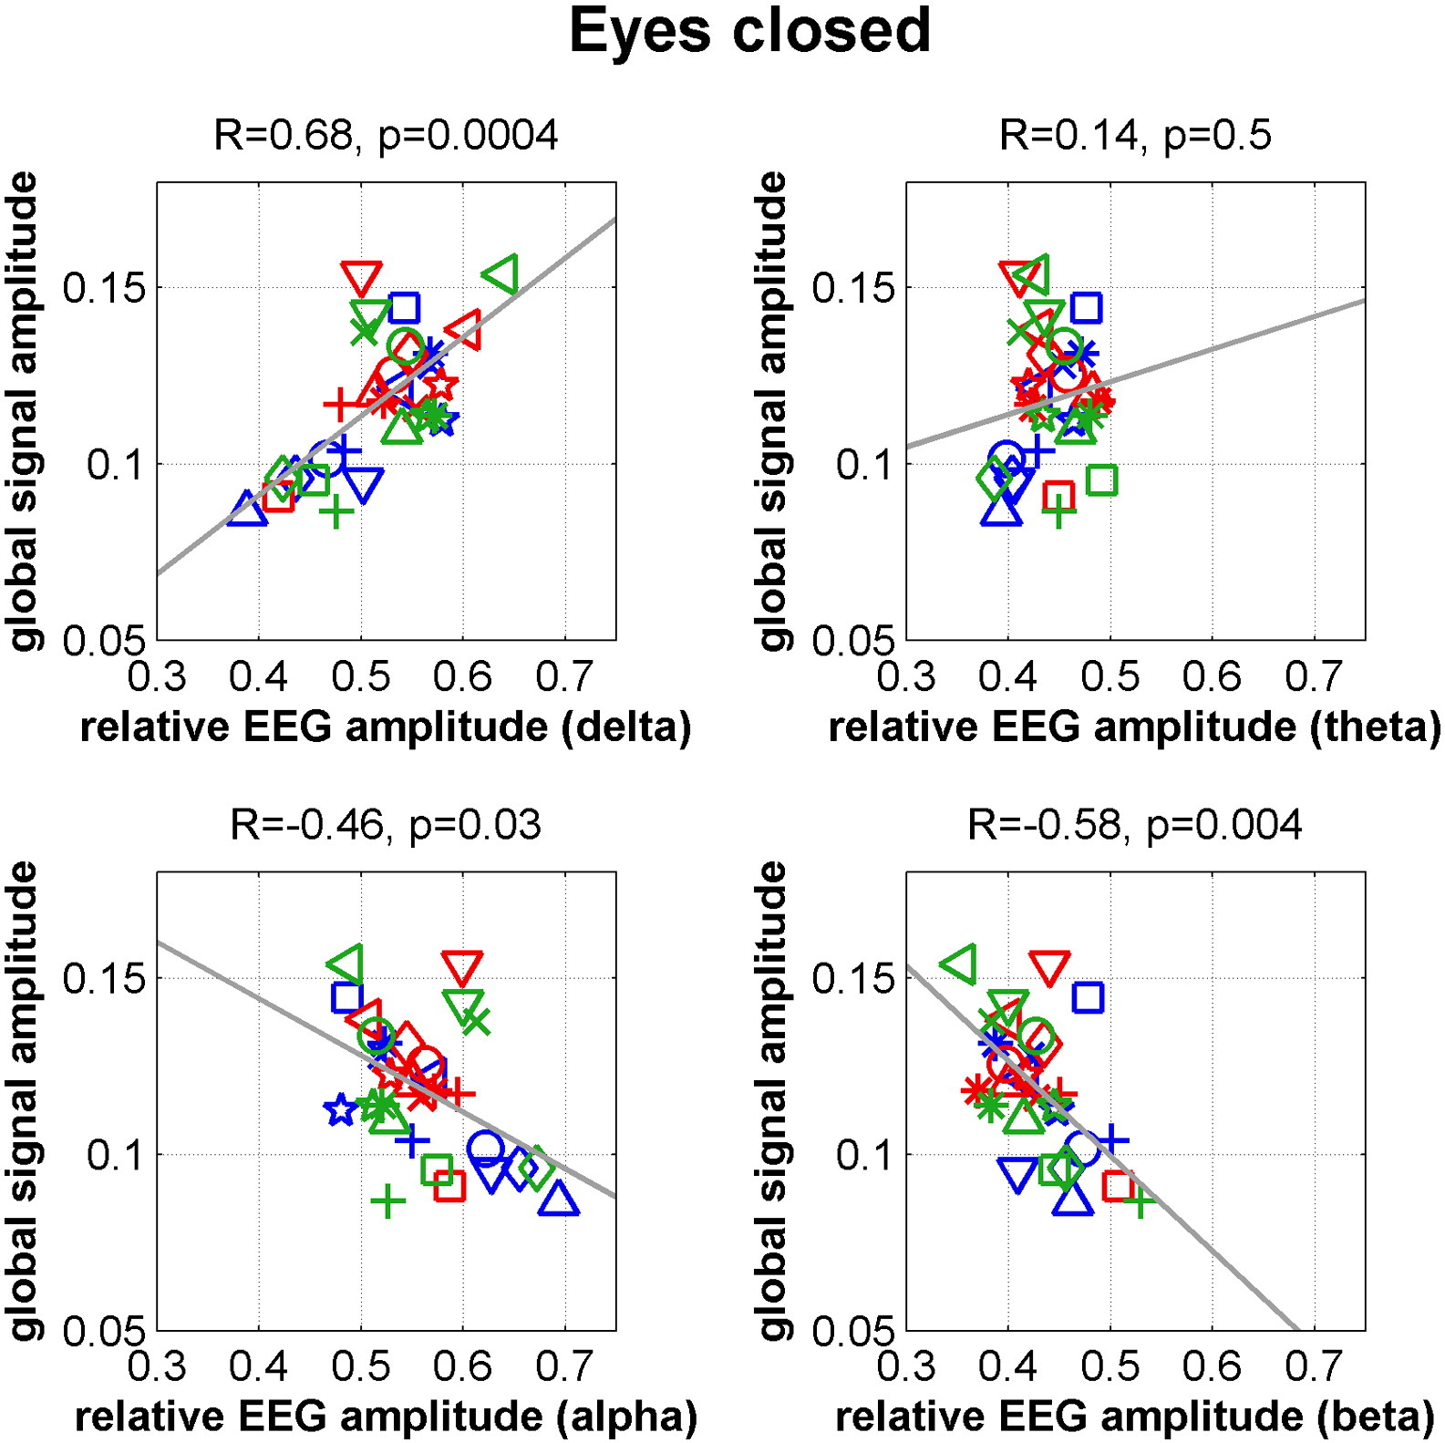
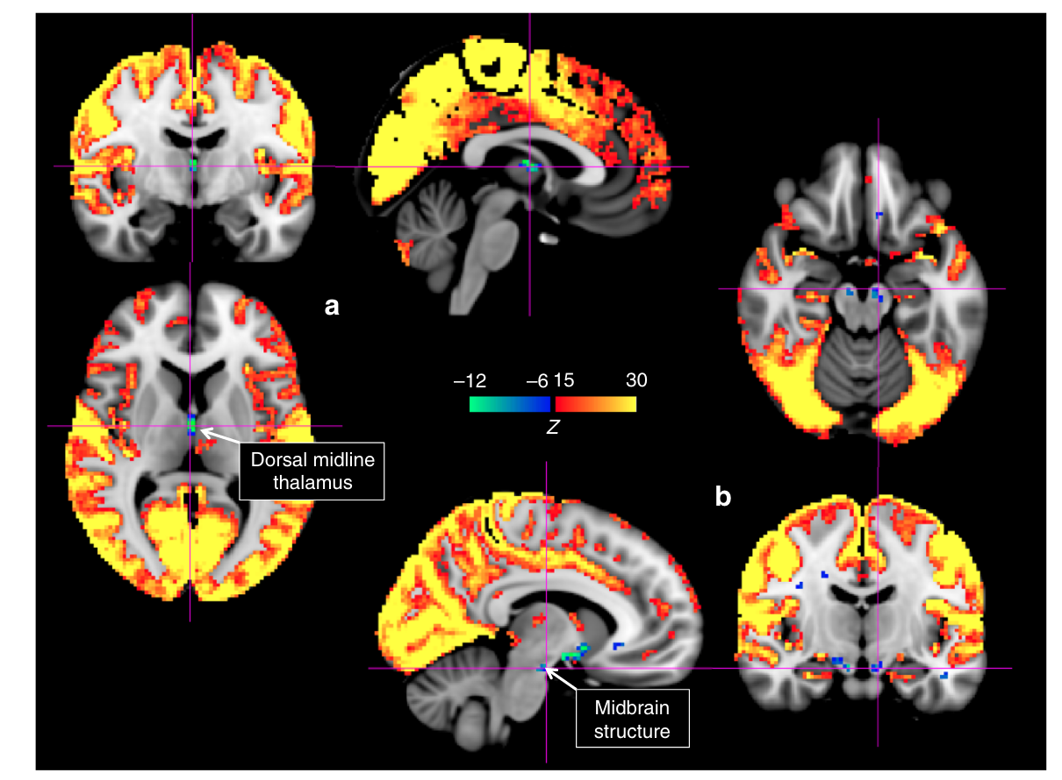
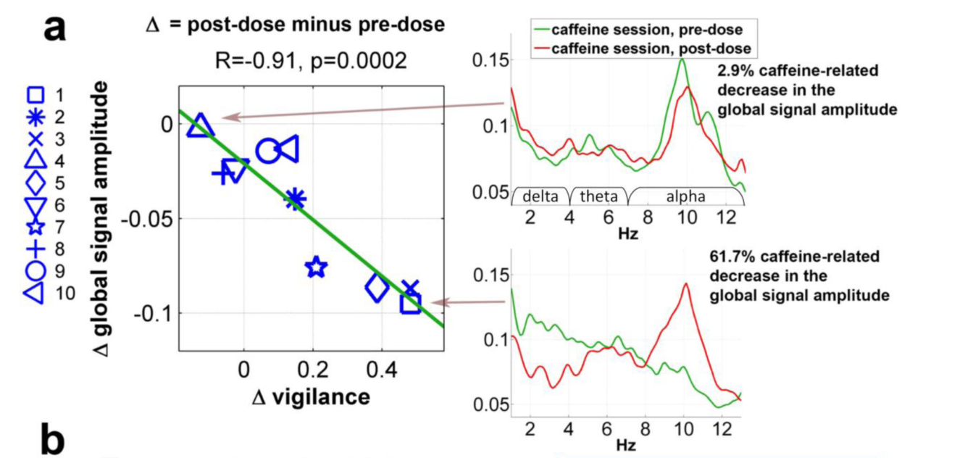
Global Signal amplitude reflects levels of arousal
GS amplitude is linked to low arousal
GS amplitude linked to signal decreases
in subcortical structures of arousal
GS amplitude decreases with caffeine intake
Wong et al, Neuroimage 2013
Liu et al, Nat Commun 2018
Notes:
Liu 2018:momentary increases in the global signal are accompanied by signal decreases in subcortical regions with established involvement in promoting arousal and wakefulness.

Slide 20
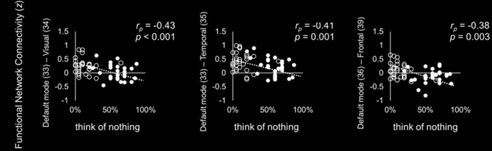
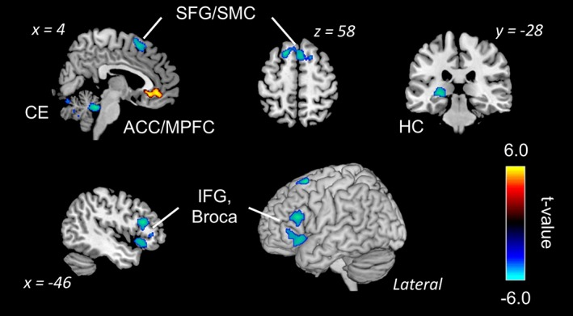
MB due to reduced inner speech?
Kawagoe et al , Eur J Neurosci 2018
“When you realize that you are thinking about something, disengage your attention and again try to think of nothing during the scans”
Kawagoe et al, Hum. Brain Mapp 2019
Notes:
Decreased activation:
Broca's area → reduced “inner speech”
Hippocampus → less impressionable “content”
Increased activation:
ACC → stream of consciousness continuity is retained
Decreased connectivity:
DMN - sensory cortices → less available content from sensory avenues to drive internally, self-oriented thought

Slide 21
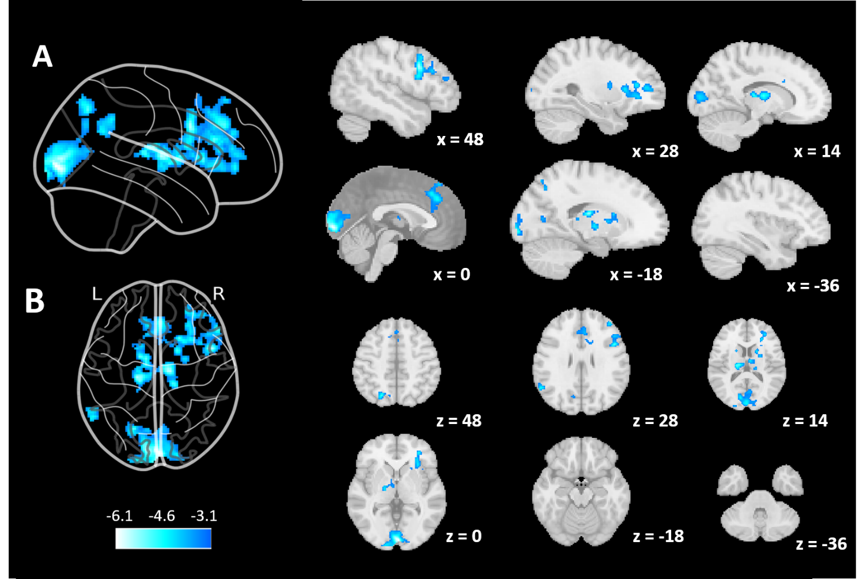
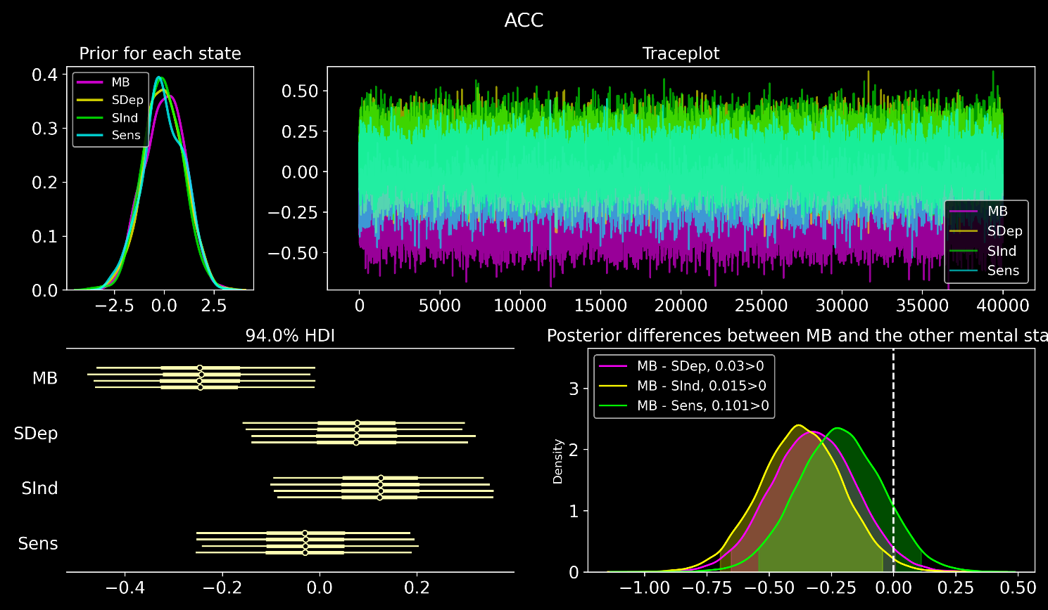
MB due to wide regional disengagement?
Bayesian analysis of the beta parameters in the ACC cluster from Kawagoe 2019
Boulakis, Mortaheb, Van Calster, Majerus, Demertzi under review
Notes:
Decreased activation:
Broca's area → reduced “inner speech”
Hippocampus → less impressionable “content”
Increased activation:
ACC → stream of consciousness continuity is retained
Decreased connectivity:
DMN - sensory cortices → less available content from sensory avenues to drive internally, self-oriented thought

Slide 22
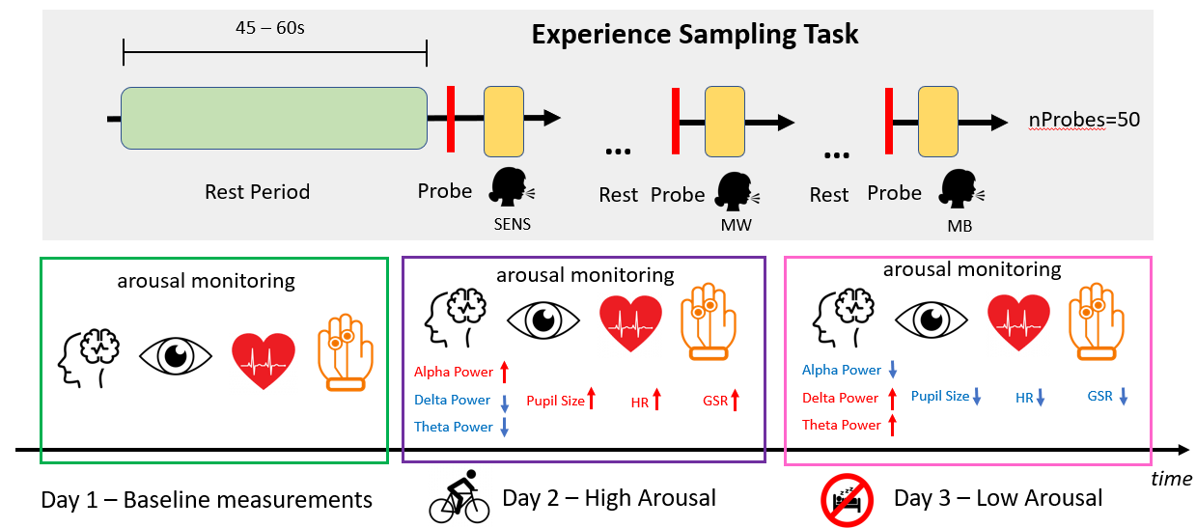
Hypothesis:
Mental state reportability has an embodied component
Boulakis, Raimondo, Mortaheb, Schmidt, Demertzi. Scientific Reports (accepted as Registered Report Stage 1)

Slide 23





Non-reportable Awareness?
MB retains the stream of consciousness
MB interrupts content monitoring
MB’s neuronal profile mediated by arousal
Thank you!
a.demertzi@uliege.be
@Ademertzi
Ademertzi@mastodon.social
Notes:
Is it possible to decode the experience of MB from brain body interaction? What would such a brain-body profile look like?
Is the experience of MB phenomenologically akin to other cases of inability to report our mental life, like blindsight? What can we draw from there?

Slide 24

Physiology of Cognition Lab
GIGA Institute
Cyclotron Research Center
Université de Liège
a.demertzi@uliege.be
Ademertzi@mastodon.social
Notes:
Conclusions: I showed how states of unconsciousness raise ethical debates, mostly about whether C . exists. I provided data which point towards the one or the other direction. In the end, it seems there is an Open dialogue in the science of about what C it is. In that respect, Consciousness is a construct of consensus and we'd better be off to define 4 quantify it as accurately as possible. This is why I think

Slide 25
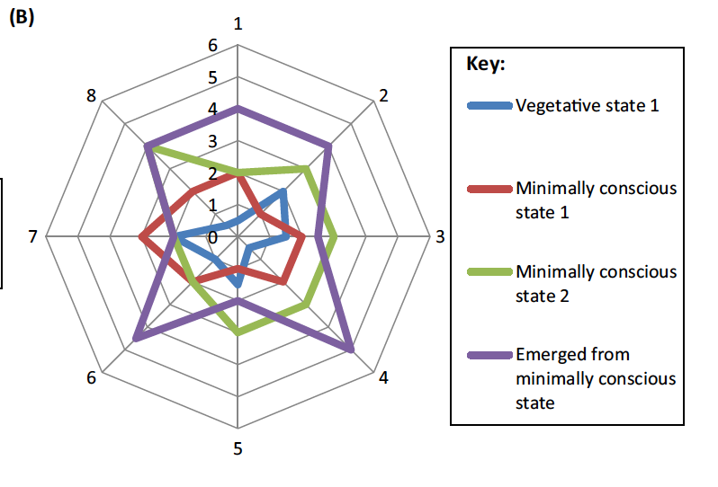
Consciousness is multidimensional
Anticorrelations
(neural inhibition)
Inter-state dynamism
(metastability)
Cross-modal interactions
(multi-sensory integration)
Embodied responsiveness
(active inference)
Bayne, Hohwy, Owen Trends Cogn Sci 2016
Notes:
Metastability refers to the human brain’s ability to integrate several functional parts and to produce neural oscillations in a cooperative and coordinated manner. phase synchronization forms the basis of metastable behavior in neural networks.

Slide 26
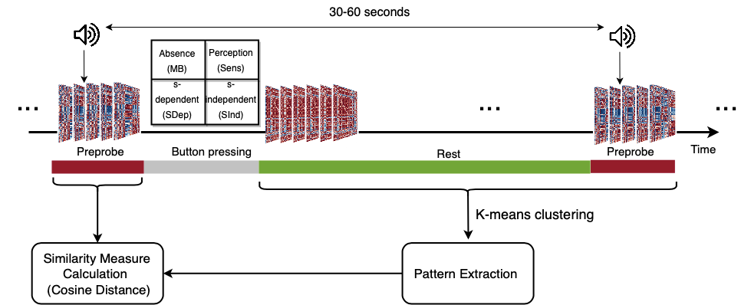
The experience-sampling paradigm
Mortaheb, Van Calster, Raimondo, Klados, Boulakis, Georgoulaa, Majerus, Van De Ville*, Demertzi*. PNAS 2022
Van Calster, D’Argembeau, Salmon, Peters, Majerus, J Cogn Neurosci 2017

Slide 27
The Active Inference principle
Seth, A. K. & Friston, K. J. (2016) Active interoceptive inference and the emotional brain. Phil Trans R Soc London B: 371
Notes:
Neuronal activity encodes expectations about the causes of sensory input with the aim to minimize surprise of sensory data

Slide 28
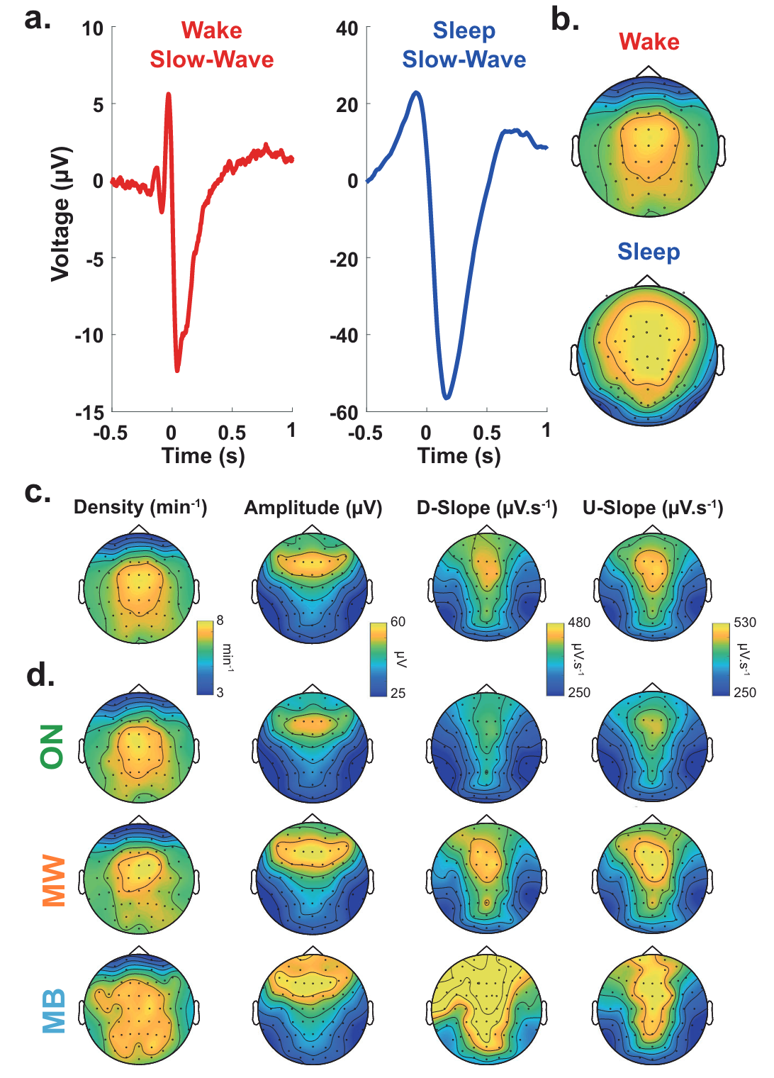
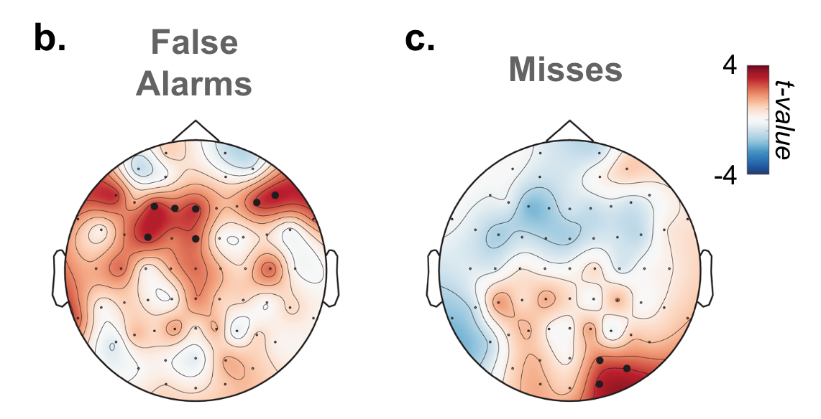
Slow wave activity in wakefulness: local sleeps
Andrillon et al, Nat. Commun 2021
Impulsivity
Hasty responses and FA
Sluggishness
Slow reponses & misses
Unconstrained thoughts
Loss of awareness
Notes:
Slow waves in the back of the brain were associated with misses (Fig. 5c), which is consistent with the involvement of parietal cortices in sensorimotor integration
MB > MW: reduction of slow-wave amplitude over frontal electrodes but an increase in their upward slope over parietal electrodes were predictive of MB: a perturbation of frontal cortices leads to unconstrained thoughts (MW) rather than the loss of awareness, but that awareness decreases when posterior regions momentarily go offline, a pattern similar to the neural correlates of dreaming during sleep or spontaneous thoughts during wakeful rest57,75.
Slow wave parameters such as
Amplitude
slope and
number of negative peaks
are thought to depend on the number of recruited neurons and the speed of synchronization across neuronal populations (Esser et al., 2007; Riedner et al., 2007; Vyazovskiy et al., 2007). In particular, steep, high-amplitude slow waves with few negative peaks are generated when an efficient neuronal synchronization allows for a fast recruitment of a large number of neurons at the cortical level.
https://www.ncbi.nlm.nih.gov/pmc/articles/PMC3900623/#:~:text=Slow%20wave%20activity%20(SWA%2C%200.5,slope%20of%20sleep%20slow%20waves.:
It has been proposed that the slope of slow waves, measured in the EEG, may represent a marker of this neuronal synchronization.^{16–18} Thus, the faster neuronal populations of a network are able to synchronize their activity, the steeper the slopes of the slow waves are. Consequently, the slope of slow waves at the beginning of the night when sleep pressure is high is much steeper compared to the slope of slow waves with the same amplitude towards the end of the sleep period when sleep pressure has dissipated.¹⁷

Slide 29
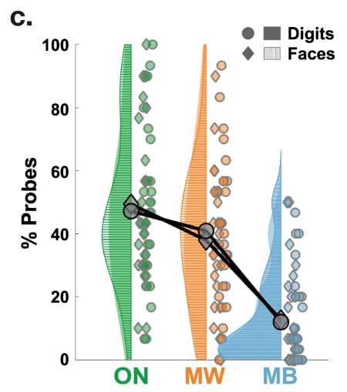
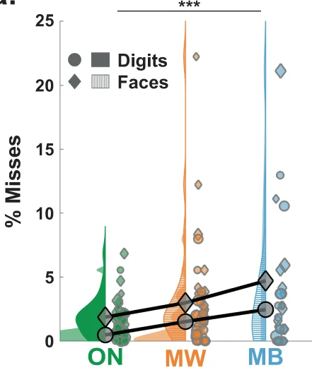
Mind Blanking: Behavior
Sparsely reported Reduced perceptions Equiprobable
Andrillon et al, Nat Commun 2021
Mortaheb et al, bioRxiv 2022; under review

Slide 30
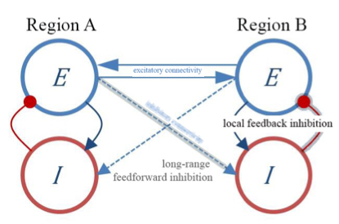
Conscious Rest | Unconscious Rest | Mind Blanking | Conclusions
Anticorrelations as a result of neural inhibition
Ignition
Deco et al., Sci Adv 2021
Joglekar et al, Neuron 2018
Demertzi, Kucyi, Ponce-Alvarez, Keliris, Whitfield-Gabrieli, Deco. Network Neurosci 2022
Notes:
We do not claim that neural inhibition directly promotes anticorrelated patterns, that is, by having networks straightly inhibiting one another (of note, most interareal connections are glutamatergic/excitatory). Nor do we claim that neural inhibition always leads to anticorrelated profiles. Rather, we suggest that neural inhibition mediates the rise of the anticorrelations indirectly, by breaking the local neural balance which affects network metastability and which eventually permits anticorrelations to appear.
Distant brain regions establish connections between their corresponding excitatory neural populations (Figure 1, E-E blue solid line connectivity). -> The resulting local increase of excitation produces an increase of inhibition through the local E-I loop (feedback inhibition).
Local heterogenous feedback inhibition Studies using heterogeneous and homogeneous whole- brain modeling have mechanistically shown that an increase in ignition was observed (Deco et al., 2021). IGNITION The ability of a given brain area to propagate feed-forward and recurrent neuronal activity to other regions, which are thought to support conscious experience (see next section).
Critically, when feedback projections and randomization of the connectivity weights were removed, dynamic network behavior was abolished, suggesting that feedback connectivity and heterogeneity in connection strength give rise to ignition-like activity (Joglekar et al., 2018).

Slide 31

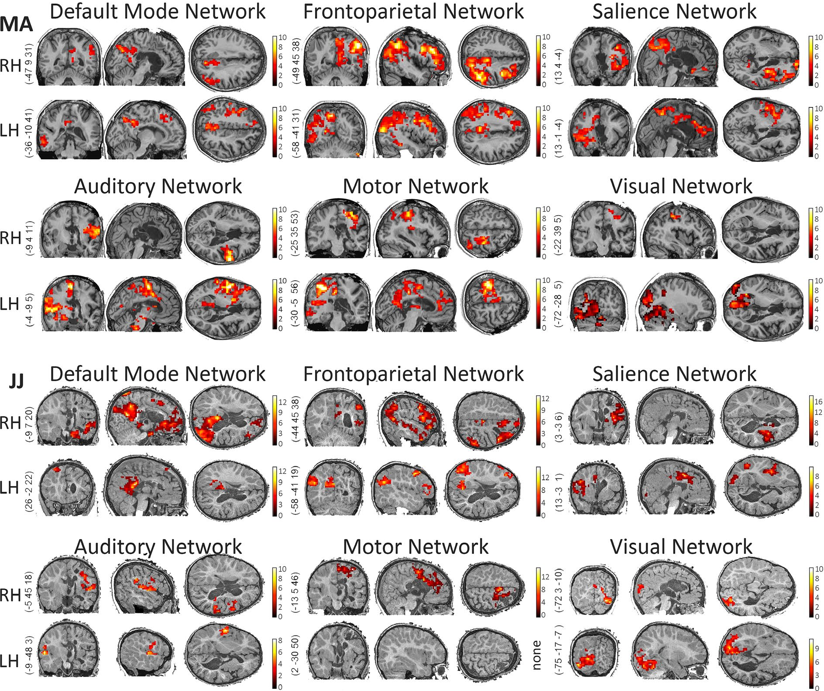
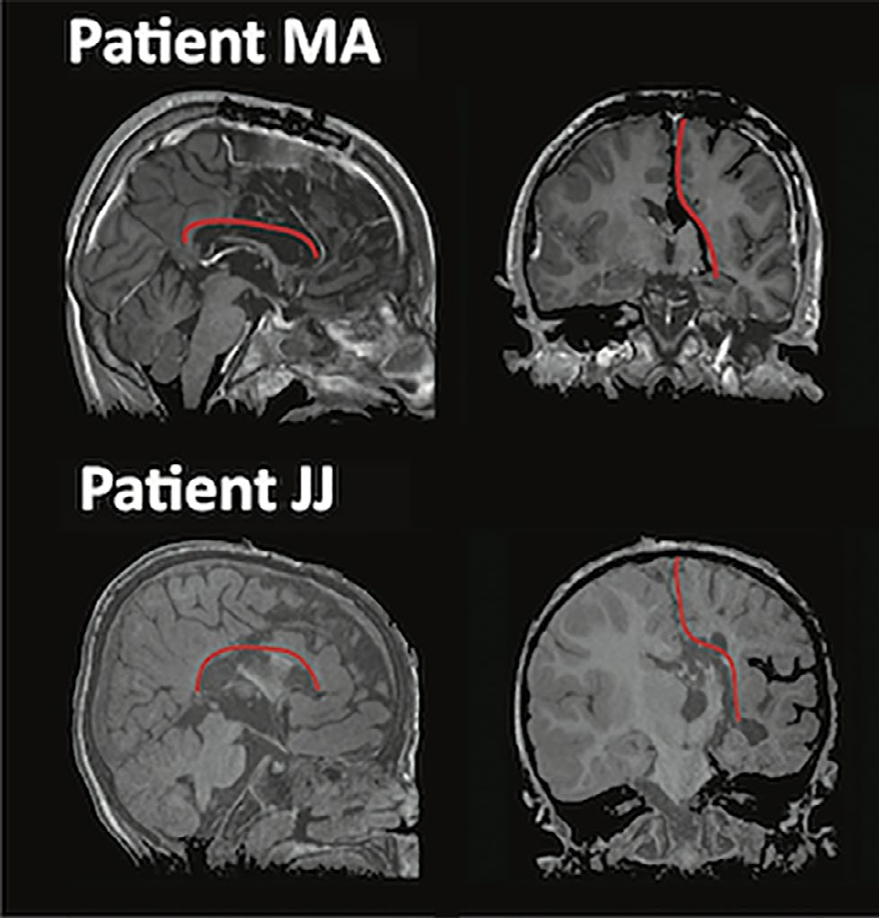
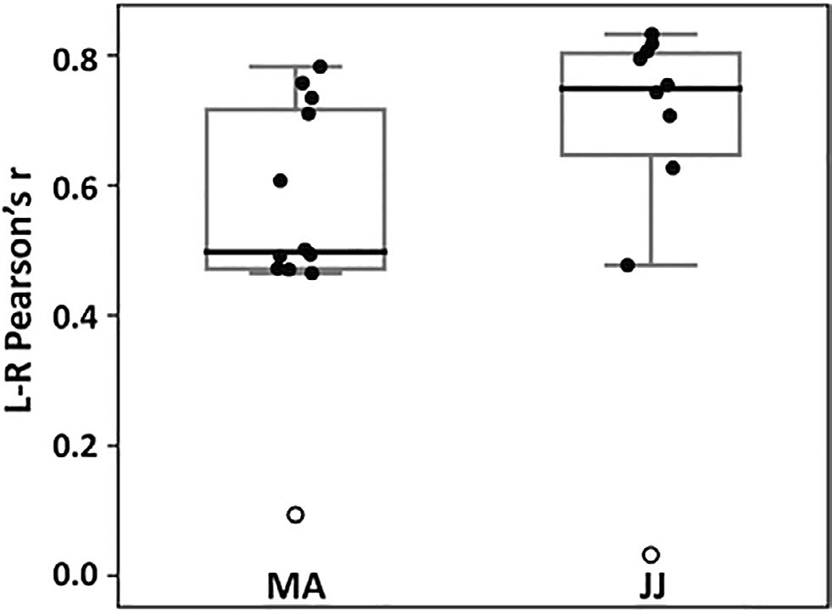
Lower cross-modal interaction in the isolated brain
Ethical significance | Brain Proxies | Physiology | Conclusions
Anticorrelations | Inter-network connectivity | Inter-state dynamics
Complete hemispherotomy
Inter-hemispheric connectivity
Blauwblomme & Demertzi, Tacchela, Fillon, Bourgeois, Losito, Eisermann, Marinazzo, Raimondo, Alcauter, Van De Steen, Colenbier,
Laureys, Dangouloff-Ros, Naccache, Boddaert, Nabbout et al, Epilepsia Open 2020
Notes:
The question as to why intrinsic network functional connectivity is preserved in isolated tissue which does not contribute to behavioral output, remains to be answered. A working hypothesis is that brain activity is driven by the underlying anatomy as we have recently found for noncommunicating states.32 At the same time, it may be that preserved network-level connectivity is critical for the development of synaptic connections and maintenance of synaptic homeostasis at large58 which is reduced, yet preserved, in covert or unconscious conditions.32,5

Slide 32
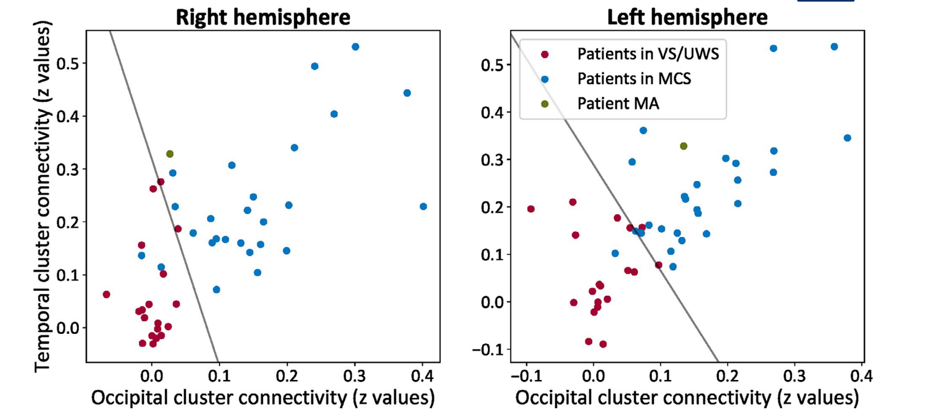
Lower cross-modal interaction in the isolated brain
Ethical significance | Brain Proxies | Physiology | Conclusions
Anticorrelations | Inter-network connectivity | Inter-state dynamics
Pathological Healthy
Blauwblomme & Demertzi, Tacchela, Fillon, Bourgeois, Losito, Eisermann, Marinazzo, Raimondo, Alcauter, Van De Steen, Colenbier,
Laureys, Dangouloff-Ros, Naccache, Boddaert, Nabbout et al, Epilepsia Open 2020
Notes:
The question as to why intrinsic network functional connectivity is preserved in isolated tissue which does not contribute to behavioral output, remains to be answered. A working hypothesis is that brain activity is driven by the underlying anatomy as we have recently found for noncommunicating states.32 At the same time, it may be that preserved network-level connectivity is critical for the development of synaptic connections and maintenance of synaptic homeostasis at large58 which is reduced, yet preserved, in covert or unconscious conditions.32,5

Slide 33

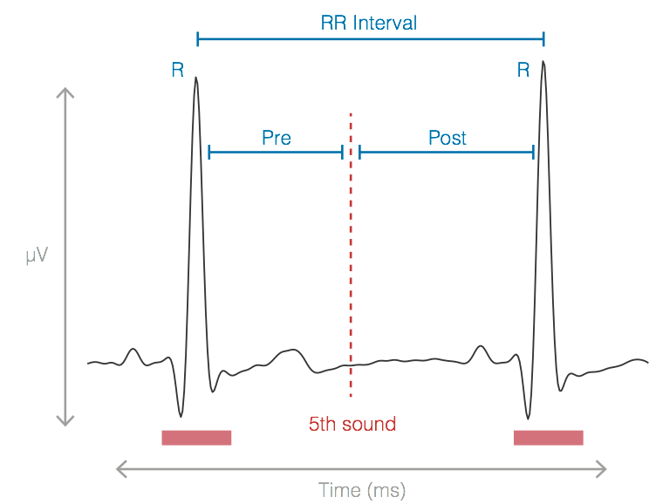
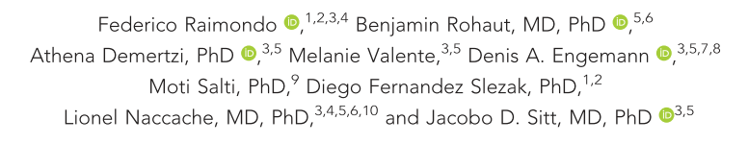

Ethical significance | Brain Proxies | Physiology | Conclusions
Anticorrelations | Inter-network connectivity | Inter-state dynamics
Cardiac reactions to oddballs in MCS
Auditory oddball paradigm
Electrocardiographic markers carry
independent information from EEG
Cardiac cycle-phase acceleration
only in MCS
Post interval
Bekinschtein et al., PNAS, 2009
Bekinschtein et al., PNAS, 2009
Notes:
After the deviant, the foillowing heartbeat is faster in the MCS

Slide 34
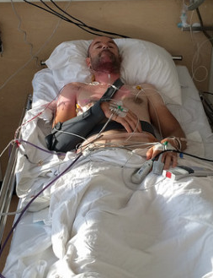
Limits of reportability
Clinical Unconsciousness
Source: Google pictures (Credit: CC-BY-SA; M Appelman)
Notes:
Real-life conséquences:
Neuro-ethics
Animal consciousness
Psychotherapy

Slide 35
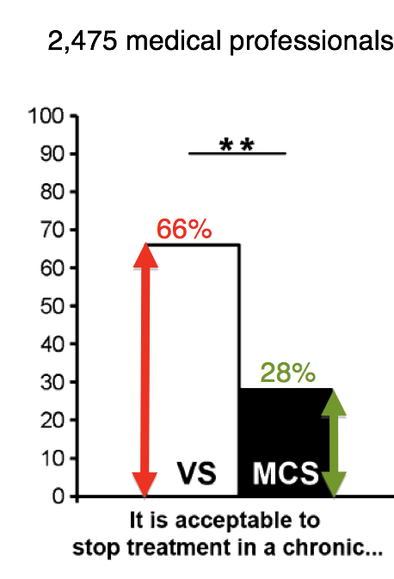
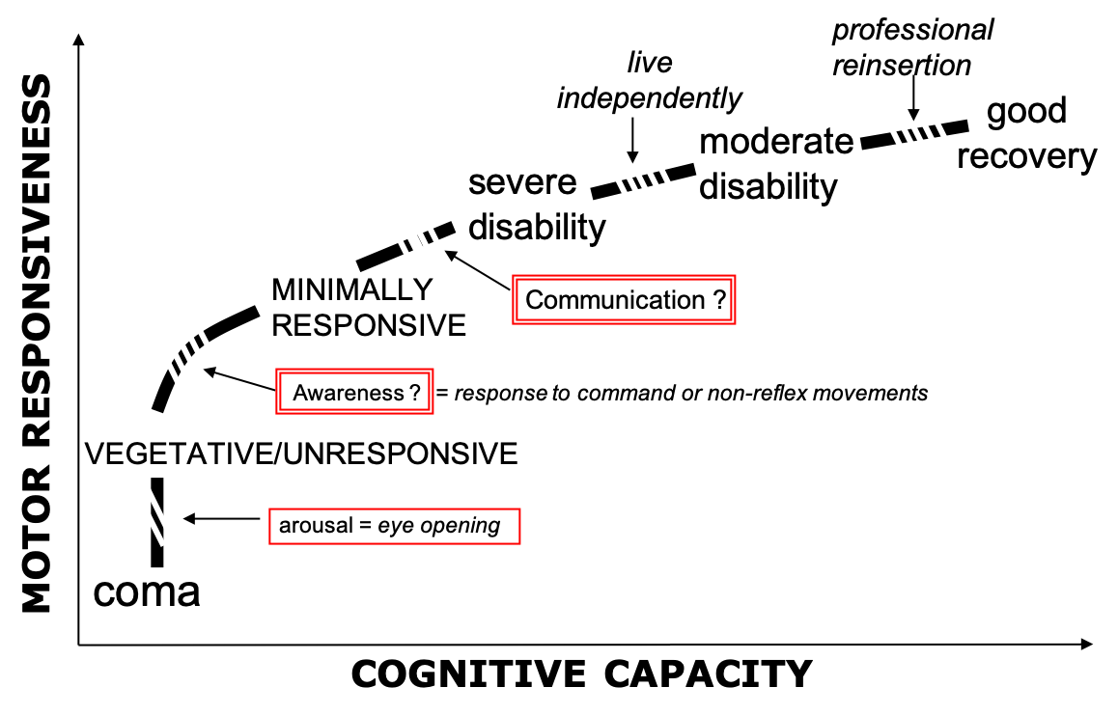
Disorders of Consciousness
Ethical significance | Brain Proxies | Physiology | Conclusions
Anticorrelations | Inter-network connectivity | Inter-state dynamics
Consciounsess inferred from
behavior
End-of-life support
for “unconscious” patients
Demertzi et al, Prog Brain Res 2009
Demertzi et al, J Neurol 2011
Demertzi & Racine et al, Neuroethics 2012
Laureys, Perrin, Brédart. Consc Cogn 2007
Naccache. Brain 2018

Slide 36
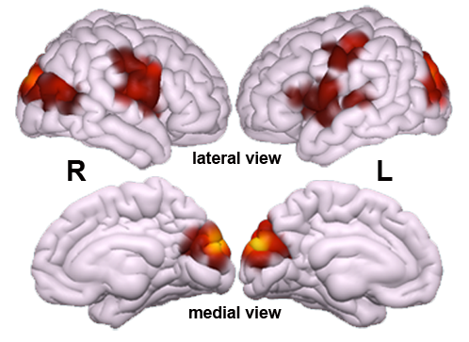
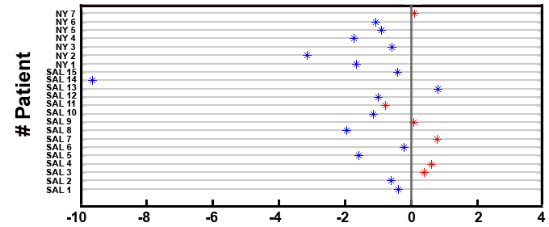
Lower cross-modal interaction in UWS
Ethical significance | Brain Proxies | Physiology | Conclusions
Anticorrelations | Inter-network connectivity | Inter-state dynamics
Training set: 45 DOC (26 MCS, 19 VS/UWS)
14 trauma, 28 non-trauma, 3 mixed
34 patients assessed >1m post-insult
Test set:
  16 MCS, 6 VS/UWS (15 non-trauma; all chronic)
  2 different centers
Classification MCS Classification VS/UWS
Demertzi & Antonopoulos et al, Brain 2015
Demertzi & Antonopoulos et al, Brain 2015
Distance from decision plane
Notes:
The patient who was misclassified as being in MCS had a CRS-R total score of 5 on the day of scanning (indicating the VS/UWS; Patient 11 of centre two, Supplementary material) and she evolved to MCS 38 days later (Auditory Function: 1, Visual Function: 3, Motor Function: 2, Oromotor/Verbal Function: 2, Communication: 0, Arousal: 2).
The patient who was misclassified as being in VS/UWS had a CRS-R total score of 9 on the day of scanning (indicating the MCS; Patient 13 of centre two, Supplementary material) based on the presence of localization to noxious stimulation but this behaviour could not be elicited in neither previous (AF: 1, VF: 0, MF: 0, O/VF: 1, COM: 0, AR: 2) or subsequent evaluations (AF: 2, VF: 1, MF: 2, O/VF: 1, COM: 0, AR: 2).

Slide 37
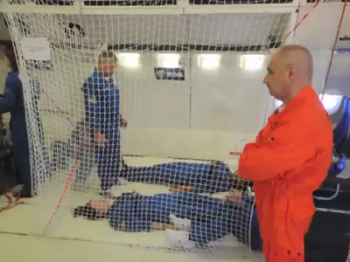




Extreme environment reduces anticorrelations
Ethical significance | Brain Proxies | Physiology | Conclusions
Anticorrelations | Inter-network connectivity | Inter-state dynamics
Parabolic flight
Flight trajectory

Slide 38
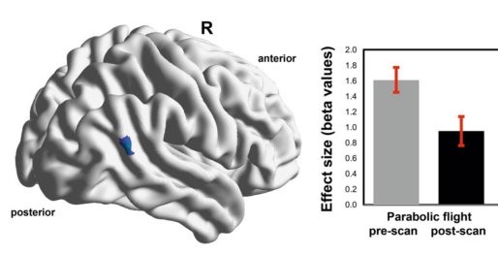

Extreme environment reduces anticorrelations
Ethical significance | Brain Proxies | Physiology | Conclusions
Anticorrelations | Inter-network connectivity | Inter-state dynamics
Post – Pre flight
Van Ombergen … and Demertzi, Sci Reports 2017
Demertzi et al, Brain Str Funct 2015

Slide 39

Anticorrelations inform cognitive function?
External awareness
or anticorrelated network
Switch 0.01-0.1Hz
Internal awareness
or Default mode network
Vanhaudenhuyse*, Demertzi* et al, J Cogn Neurosci 2011
Demertzi, Soddu, Laureys, Curr Opin Neurobiology 2013
Demertzi & Whitfield-Gabrieli, in: Neurology of Consciousness 2nd ed. 2015
Demertzi et al, Front Hum Neurosci 2013
Demertzi, Kucyi, Ponces-Alvarez, Keliris, Whitfield-Gabrieli, Deco. Netw Neurosci 2022

Slide 40


Modified awareness reduces anticorrelations
Normal wakefulness
Normal wakefulness
Autobiographical mental imagery
Hypnosis
Autobiographical mental imagery
Hypnosis
*p<.05
p<0.05 corrected for multiple comparisons
Demertzi, Soddu, Faymonville et al, Prog Brain Res 2011
Demertzi, Vanhaudenhuyse, Noirhomme, Faymonville, Laureys, J Physiol Paris 2015

