Slide 1


A Systematic Procedure for Topological Path Identification with Raw Data Transformation in Electrical Distribution Networks
M. VassallO, A. Bahmanyar, L. Duchesne, A. Leerschool, S. Gerard, T. Wehenkel, D. Ernst
Maurizio Vassallo
University of Liège, Belgium
Smart Grids, Network Digitalization, Network Analysis
mvassallo@uliege.be

Slide 2


About Me
B.Sc.
B.Sc.
M.Sc.

Slide 3



About Me

Slide 4

Introduction
  Topological Path Identification problem (TPI)
    Identifying customers active and backup paths
    inside a power distribution network.
  Customer path: sequence of network elements from a customer to
  an MV/LV transformer
  Active path: customer path that contains no open switches
  Backup path: customer path that contains at least one open switch

Slide 5
Problems
DSOs lack of information about the customer paths.
+
Heterogeneous information across different files
Limited and/or inaccurate data about network's elements
+
=
Impacted capacity for the DSOs to properly identify the customer topological paths

Slide 6
Benefits
Inform customers about network maintenance
Guarantee power supply during emergencies with backup paths
Capability to anticipate potential power quality issues
Plan network investments, such as upgrading transformers or lines

Slide 7
Concepts
Set of elements: E = { e₁, e₂, …, e_{|E |} }

Slide 8
Concepts
Set of elements: E = { e₁, e₂, …, e_{|E |} }
Set of attributes: A = { a₁, a₂, …, a_{|A|} }
  A = { type, coordinate, … }

Slide 9
Concepts
Set of elements: E = { e₁, e₂, …, e_{|E |} }
Set of attributes: A = { a₁, a₂, …, a_{|A|} }
  A = { type, coordinate, … }
Set of types: T = {t₁, t₂, …, t_{|T |}}
  T = { customer, transformer, … }
  e₁.type = customer
  Subset(E, t) = { e ∈ E | e.type = t }

Slide 10
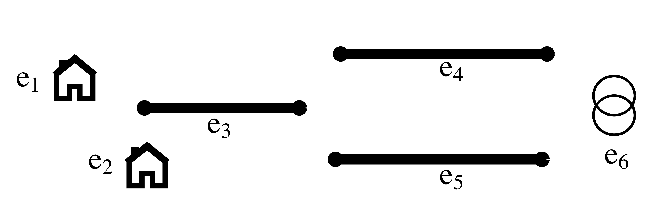
Concepts
Set of elements: E = { e₁, e₂, …, e_{|E |} }
Set of attributes: A = { a₁, a₂, …, a_{|A|} }
  A = { type, coordinate, … }
Set of types: T = {t₁, t₂, …, t_{|T |}}
  T = { customer, transformer, … }
  e₁.type = customer
  Subset(E, t) = { e ∈ E | e.type = t }

Slide 11
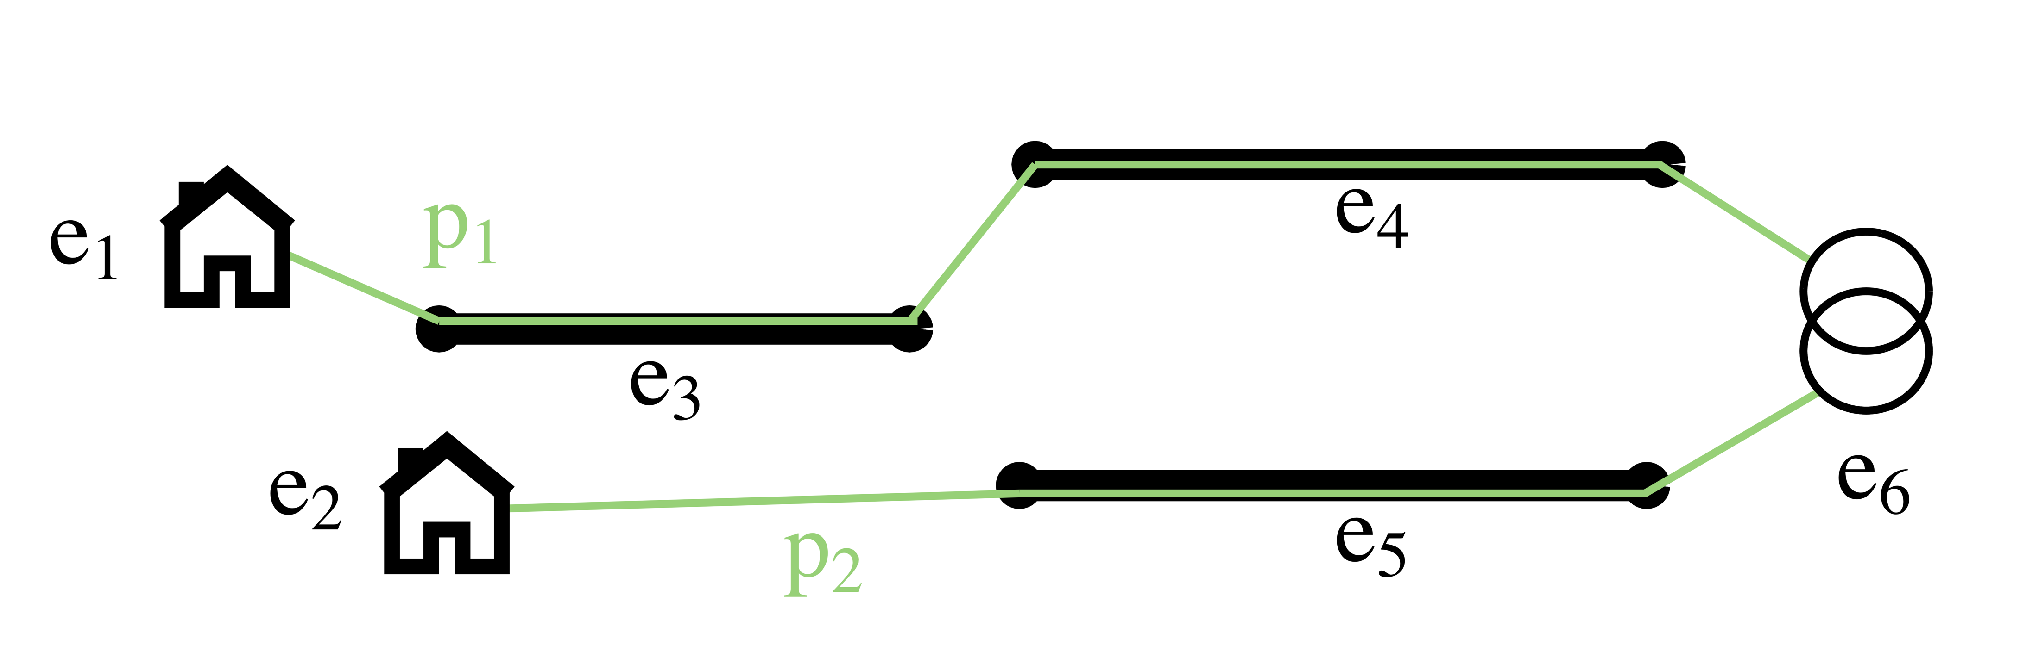
Concepts
Set of paths: P = { p₁, p₂, …, p_{|P |} }
  Represents the set of the real paths from the customers to the transformers

Slide 12
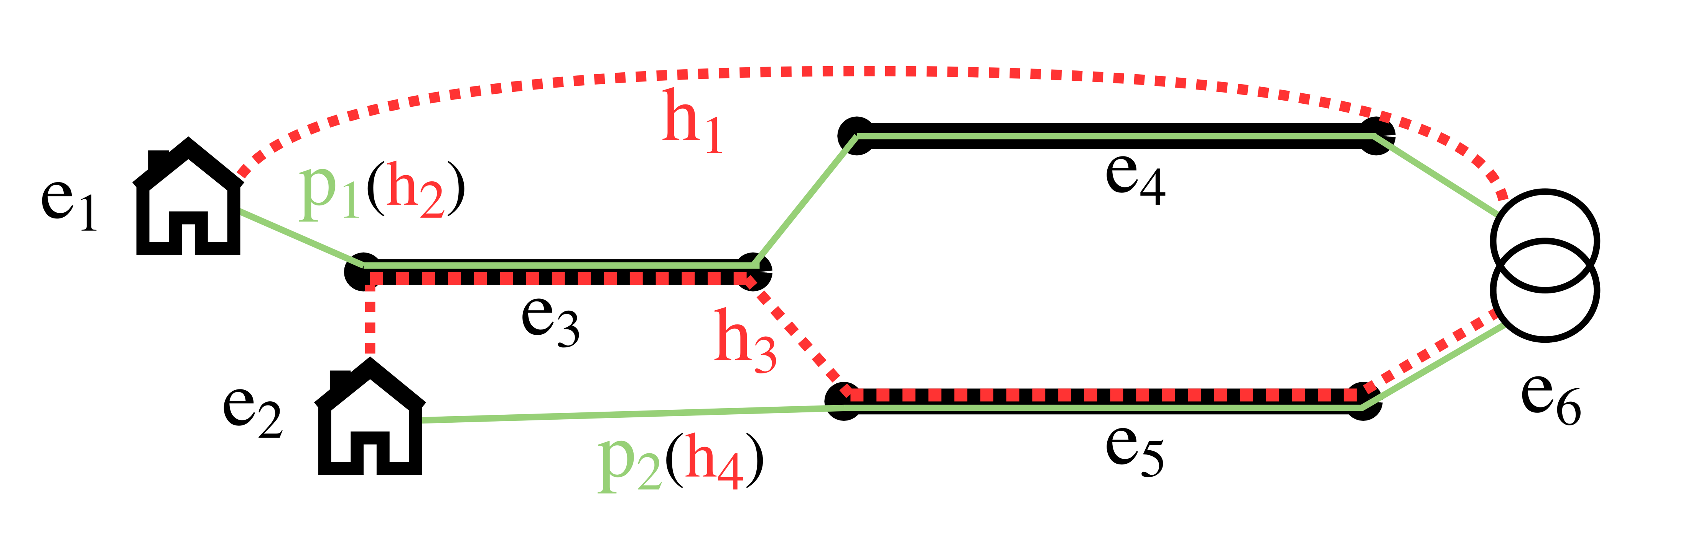
Concepts
Set of paths: P = { p₁, p₂, …, p_{|P |} }
  Represents the set of the real paths from the customers to the transformers
Set of hypothetical paths: H = { h₁, h₂, …, h_{|H |} }
  Represent the space of all possible paths that may exist from any customer to any transformer

Slide 13




Concepts
Raw
information
Transformation
functions
Well-defined
information

Slide 14
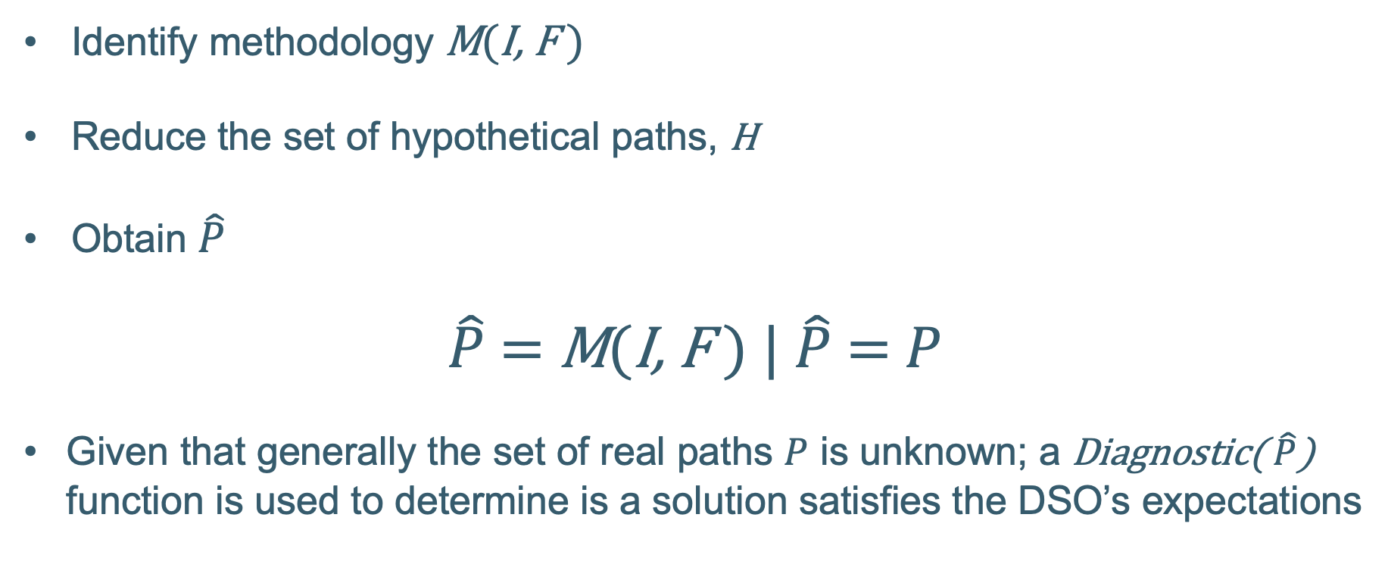
Problem statement
Identify methodology M(I, F )
Reduce the set of hypothetical paths, H
Obtain $\hat{P}$
$\hat{P}$ = M(I, F ) | $\hat{P}$= $P$
Given that generally the set of real paths $P$ is unknown; a Diagnostic( $\hat{P}$) function is used to determine is a solution satisfies the DSO’s expectations

Slide 15
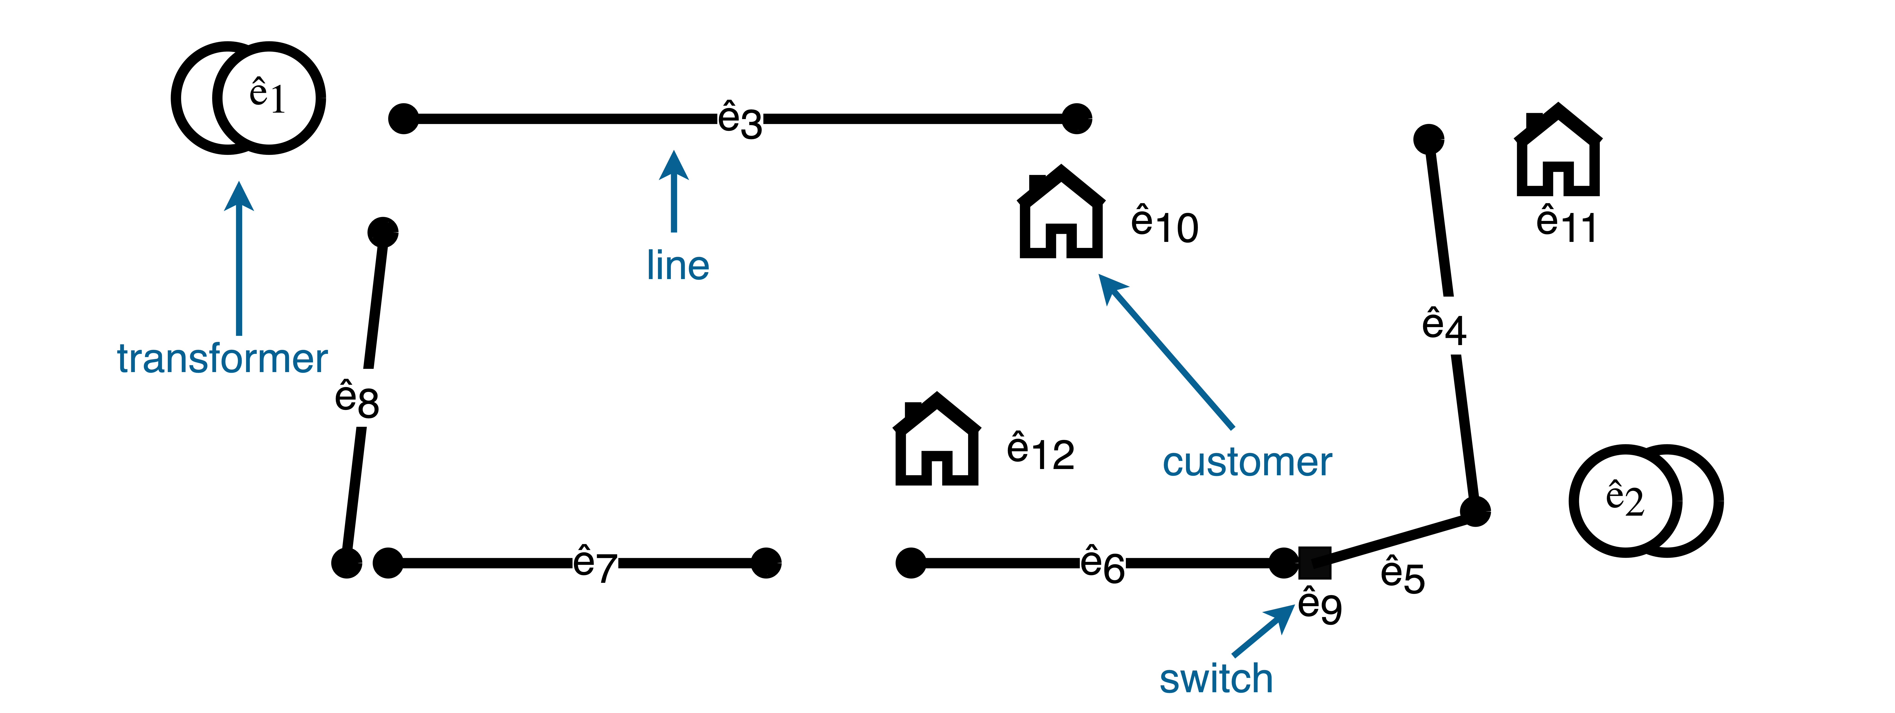
Academic example
i₁: different documents containing data about the network's elements
i’₁: the set of elements, Ê, with their attributes Â
f₁

Slide 16
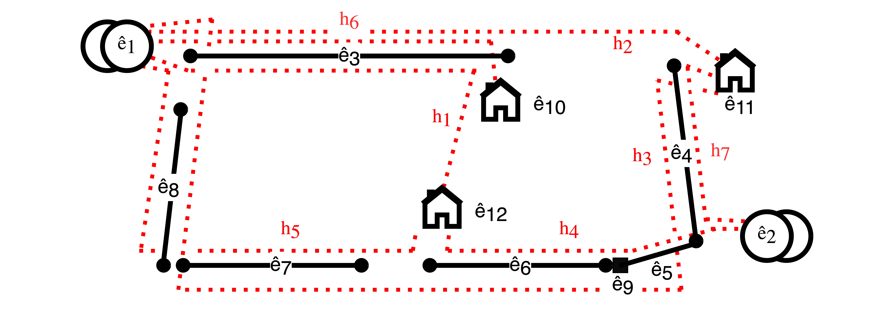
Academic example
No information about customer connections → numerous hypothetical paths
Exclude hypothetical paths that are not compatible with the well-defined information

Slide 17
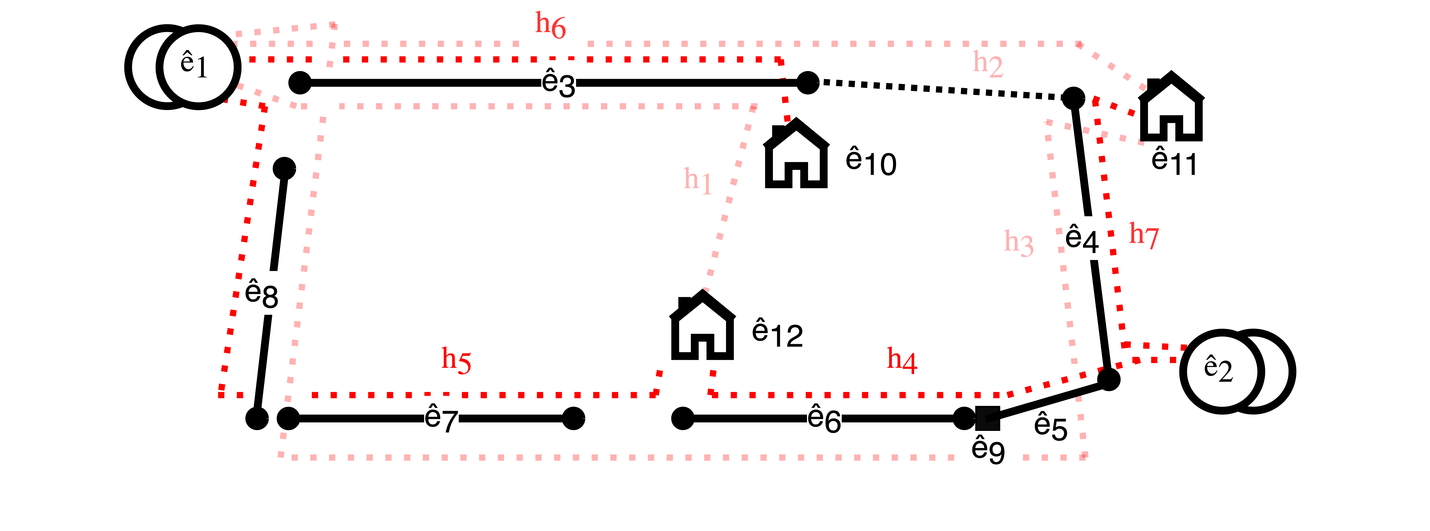
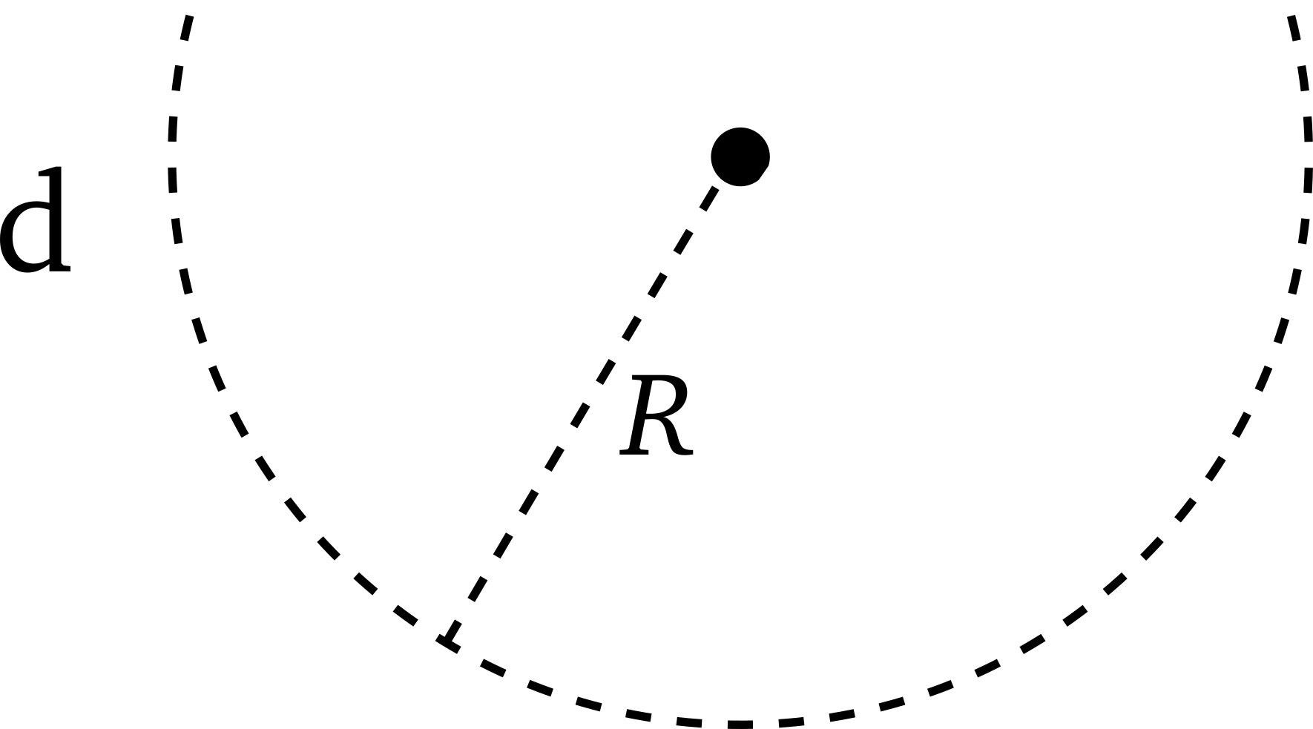
Academic example
i’₂: closest elements are connected together if their distance is lower than R
i'₃: path lengths must be lower than L

Slide 18
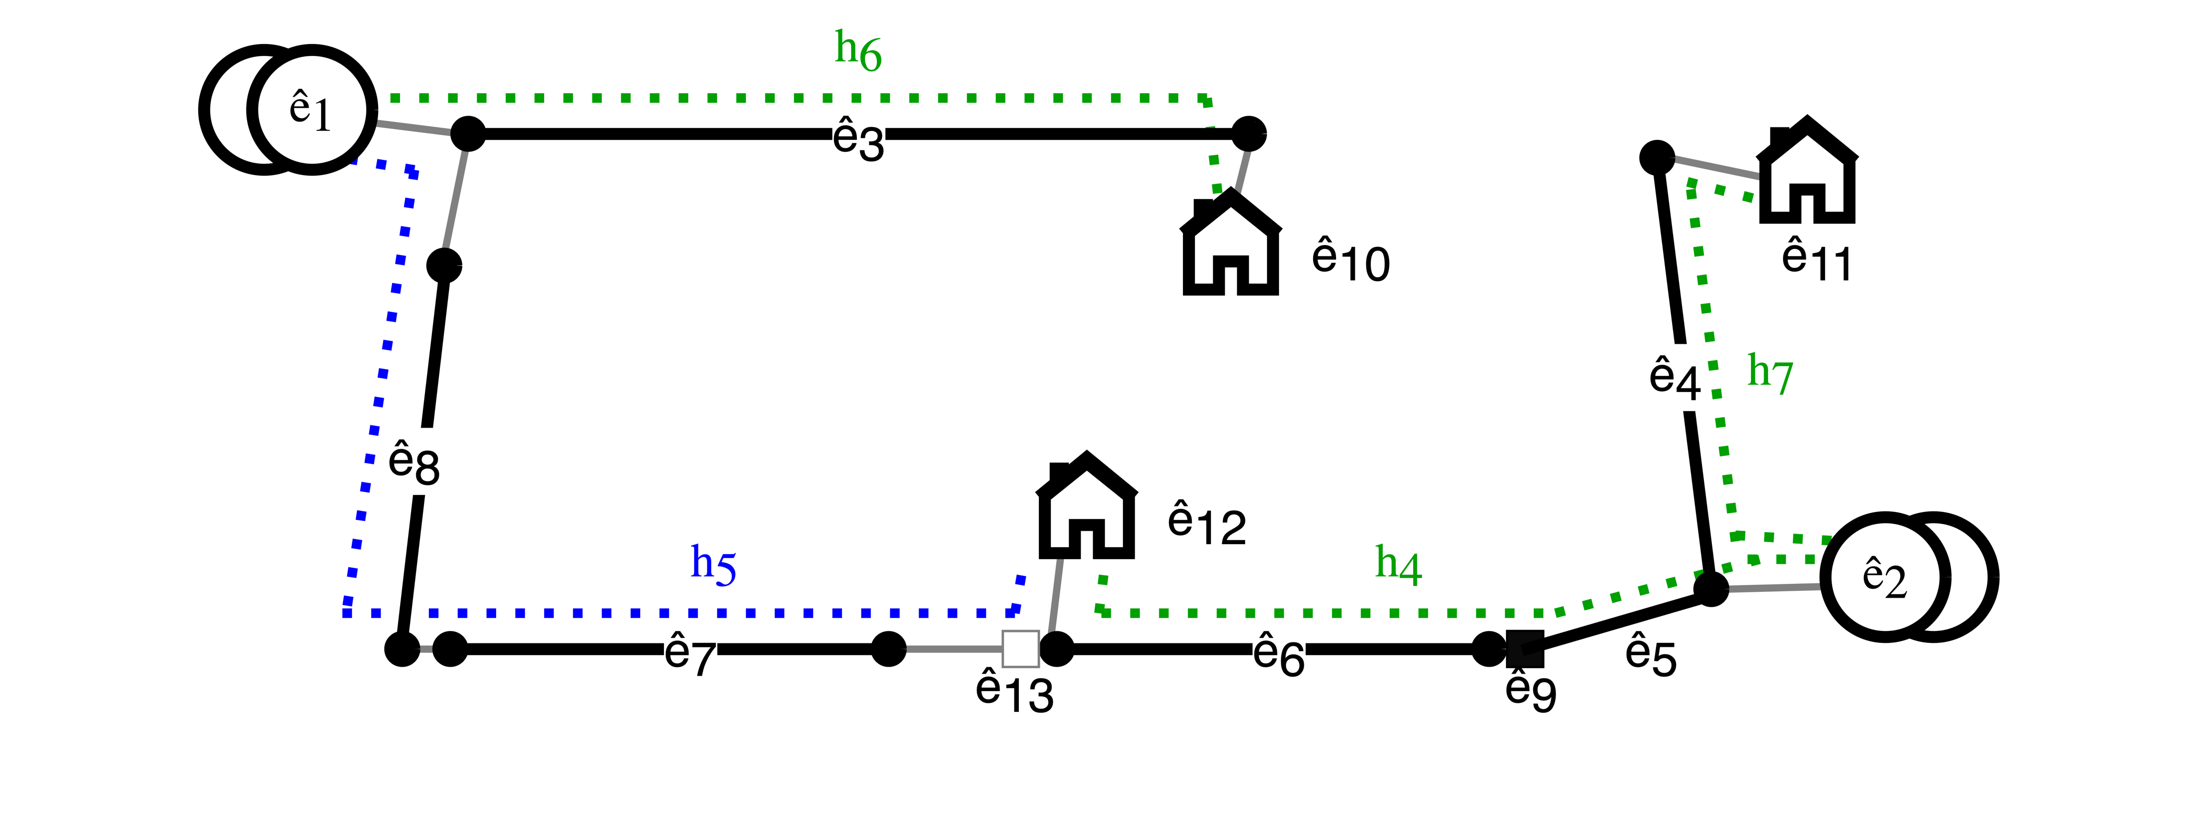
Academic example
i'₄: each customer must have one active path

Slide 19
Keypoints procedure
Generic procedure to solve TPI problem
Heterogeneous data from the DSO
Identify a set of hypothetical paths and reduce it down
Evaluate the solution with a Diagnostic function

Slide 20
Future works
Develop an advanced methodology to solve the TPI problem with an optimization algorithm
Generate a digital twin from the customer paths to power flow calculation
Perform an analysis on the digital twin built

Slide 21
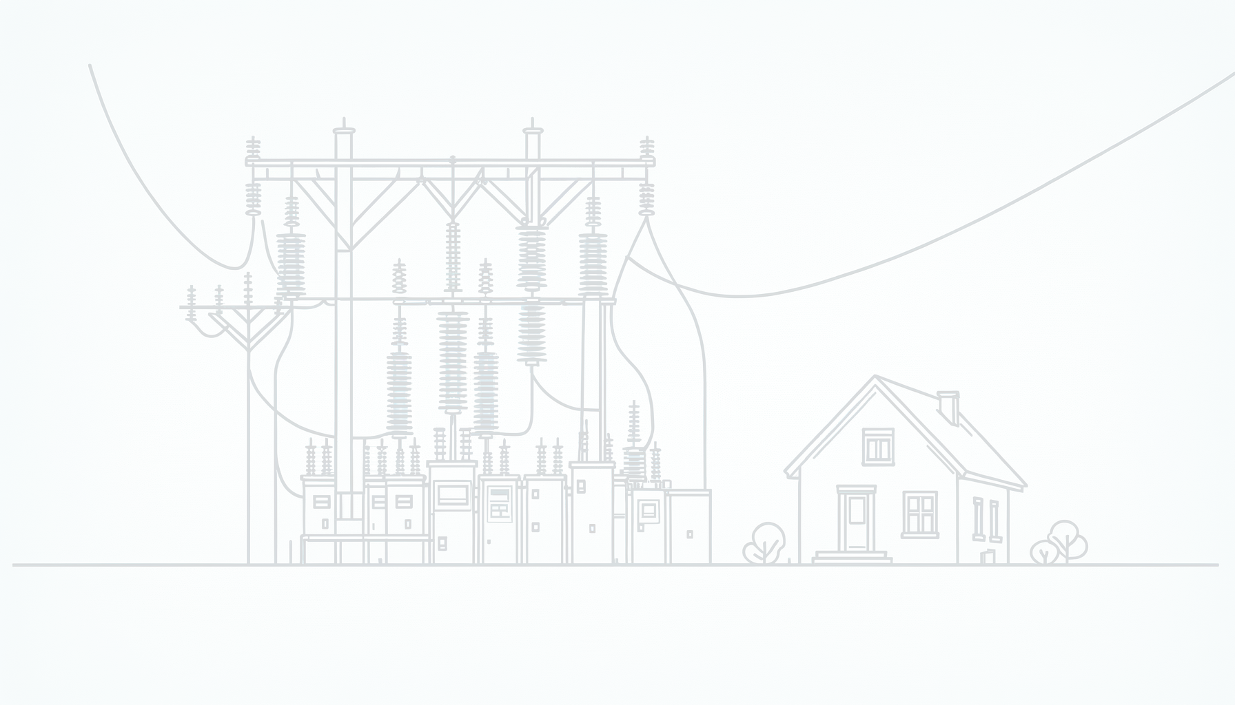



Thanks for the attention

