Slide 1
Thoracic stentgraft for abdominal type 3a endoleak after iBEVAR
Aortic Implanter Meeting
January 15-16, 2024 - Madrid, Spain
Kerzmann Arnaud, MD
Cardiovascular and Thoracic Surgery Department (Pr Defraigne)
CHU Liège
Belgium

Slide 2
Disclosures
Consultant:
BD, Boston Scientific
Grant/research support:
Medicor, iVascular, Artivion, Medtronic

Slide 3
Patient demographics, history and co-morbidities
69 years old man
Arterial hypertension, dyslipidemia, smoker
Chronic obstructive pulmonary disease
Sleep apnea syndrome
Stage 4 chronic kidney disease
Total radical prostatectomy
Lumbar arthrosis
Para-renal abdominal aortic aneurysm with diameter of 59 mm, left common iliac artery aneurysm, right common iliac artery stenosis, left subclavian artery and diaphragmatic aorta angulations, thrombus in the descending thoracic aorta (shaggy aorta)
Notes:
Né le 11/7/1952

Slide 5
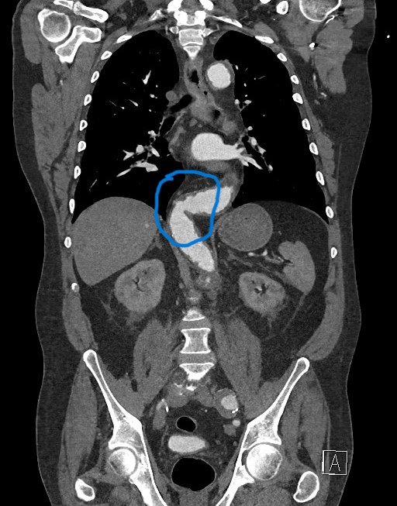
Left subclavian artery angulation Diaphragmatic aorta angulation

Slide 6
Planning
First step: TEVAR with Medtronic Valiant Captivia™ 34mm-34mm-167mm proximal and 36mm-36mm-167mm distal
CSF (cerebrospinal fluid) drainage
Second step: iBEVAR with Jotec E-xtra Design™, Jotec E-Ventus™ in the target vessels, Jotec E-liac™ in the distal aorta, Gore Viabahn VBX™ in the iliac arteries and left hypogastric artery embolization
Left humeral open access for 12F sheath
Percutaneous femoral access both side
No CSF drainage

Slide 7
Per-operative issues
Navigation
Embolization of the coeliac trunk branch
Left external iliac artery bleeding
Long operative time
Blood loss and transfusions
Lower limbs ischemia

Slide 8
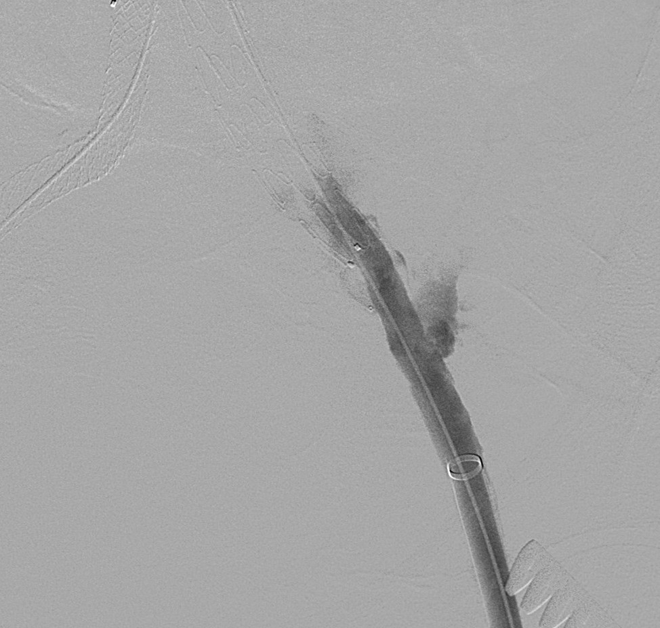
No coeliac trunk → plug left external iliac artery bleeding

Slide 9
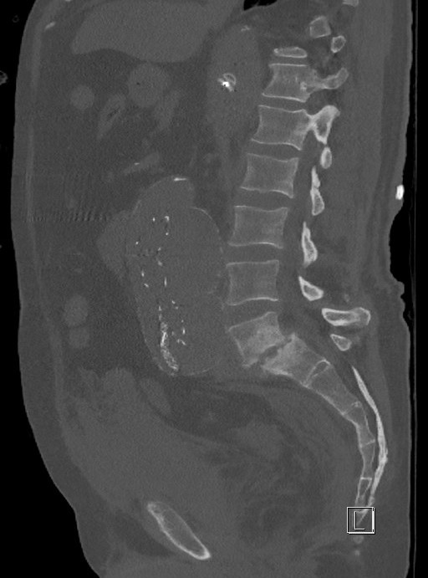
Post-operative complications
Right common femoral artery endarterectomy at day 1
Dialysis
Right 4th anf 5th toes amputation at day 79
Hospital stay 106 days, including rehabilitation

Slide 10
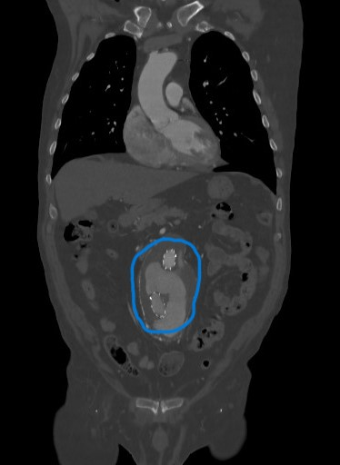
Follow-up
Progressive improvement of the general state, despite dialysis
After 6 months, type 3a endoleak between the iBEVAR and the iliac branched device in the distal aorta
Aneurysm with diameter of more than 10 cm!
→ new procedure

Slide 12
How would you have treated the original aneurysm and how would you treat the type 3a endoleak?
Which strategy for the original para-renal aneurysm?
Which challenges would you anticipate?
How would you prepare for possible complications?
Which strategy for the type 3a endoleak?

Slide 13
How we treated
Right common femoral artery percutaneaus access
Left common femoral artery access for endarterectomy
Stentgrafts catheterization
Relining with Medtronic Valiant Captivia™ 24mm-24mm-112mm
Post-dilation with Medtronic Reliant™ balloon catheter
No complication

Slide 14
Final outcome
26 months follow-up since the iBEVAR and 20 months since the type 3a endoleak management
Patient happy to be alive, despite dialysis
No endoleak at the computed tomography angiography performed 21 months after the iBEVAR (next slide)
shrinkage (9 cm)

Slide 16
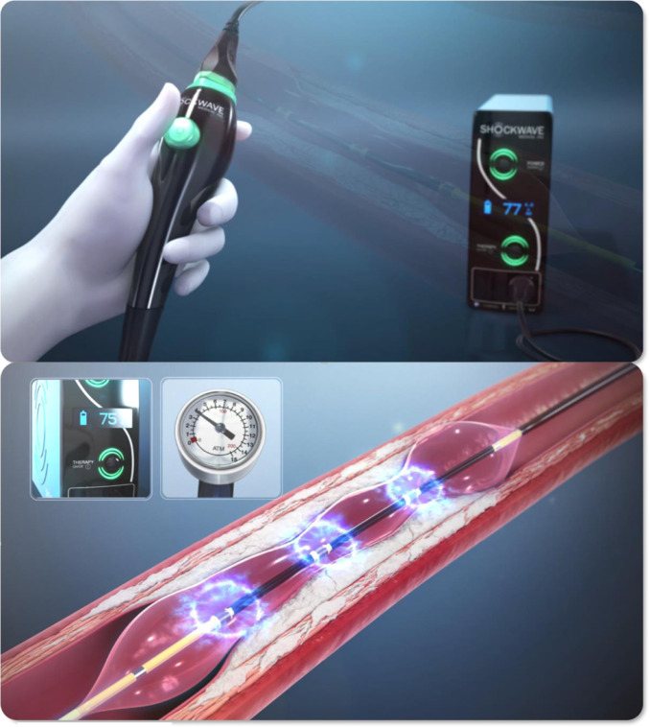
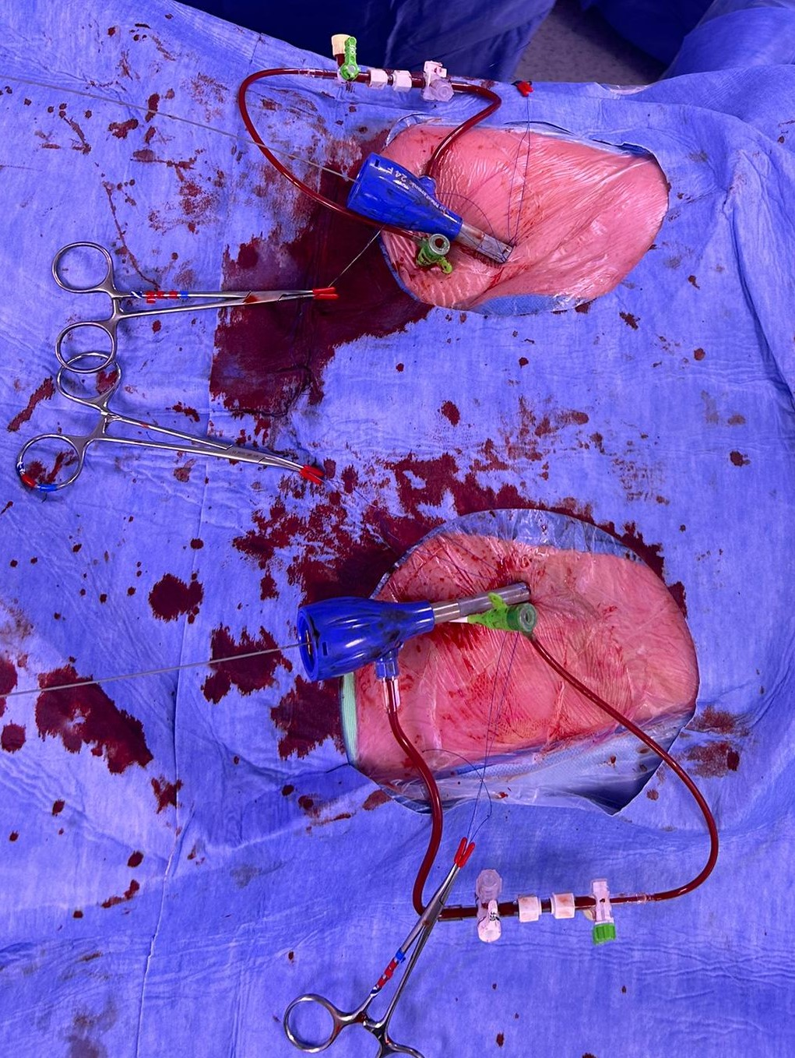
Key learnings
Angulations are always a concern
navigation
positioning
displacement
Access are a concern too
diameter
tortuosities
calcifications (Shockwave™)
lower limb ischemia (lower limb perfusion)
Enough overlapping between stents
Branches might be occluded with plugs
Thoracic graft might be used in the abdomen

Slide 17
Off-label disclaimer
Please note that this case is outside of the device‘s instructions for use (IFU) and Medtronic does not recommend using the device for indications outside the scope of those specified in the labeling and IFU, as it has not been tested and validated for safety and efficacy under these circumstances.
The physician is solely responsible for all decisions and any medical judgment relating to patient diagnosis and treatment, including case selection and sizing of the device.

