Slide 1
Complication of IMA embolization for type 2 endoleak
Aortic Implanter Meeting
January 15-16, 2024 - Madrid, Spain
Kerzmann Arnaud, MD
Cardiovascular and Thoracic Surgery Department (Pr Defraigne)
CHU Liège
Belgium

Slide 2
Disclosures
Consultant:
BD, Boston Scientific
Grant/research support:
Medicor, iVascular, Artivion, Medtronic

Slide 3
Patient demographics, history and co-morbidities
74 years old man​ living in Jamaica
Arterial hypertension, dyslipidemia, former smoker​
AAA​ with diameter of 68 mm, good​ proximal neck,​ good access,​ no thrombus and ​IMA patent
25-10-2016: EVAR without complication, open femoral access both side

Slide 4
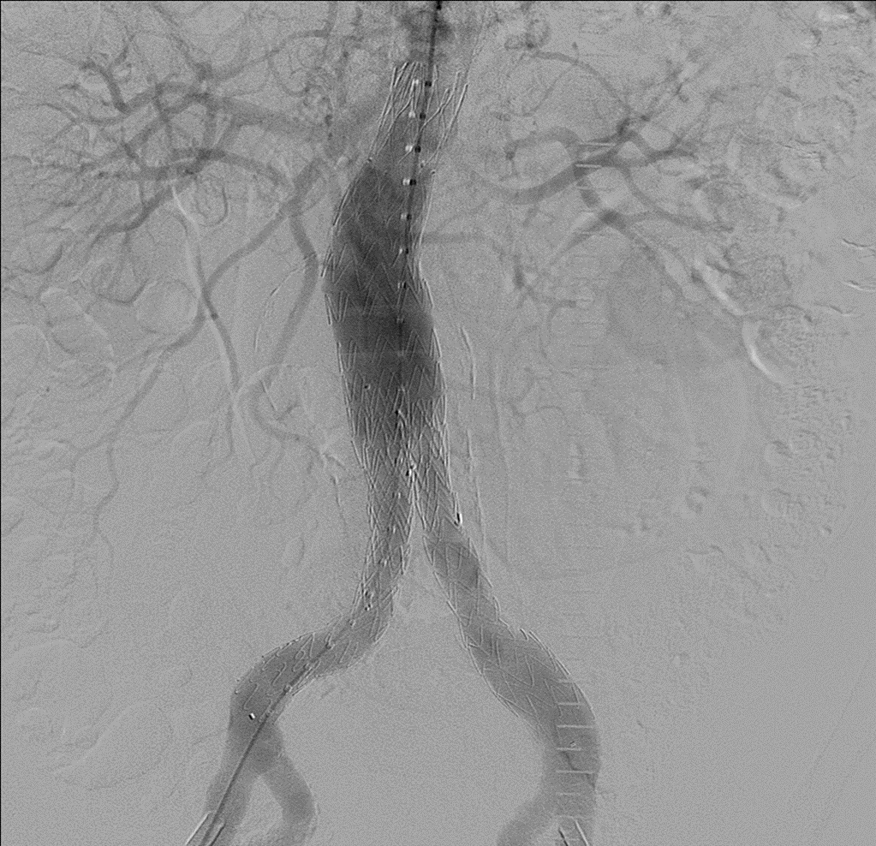
EVAR

Slide 5
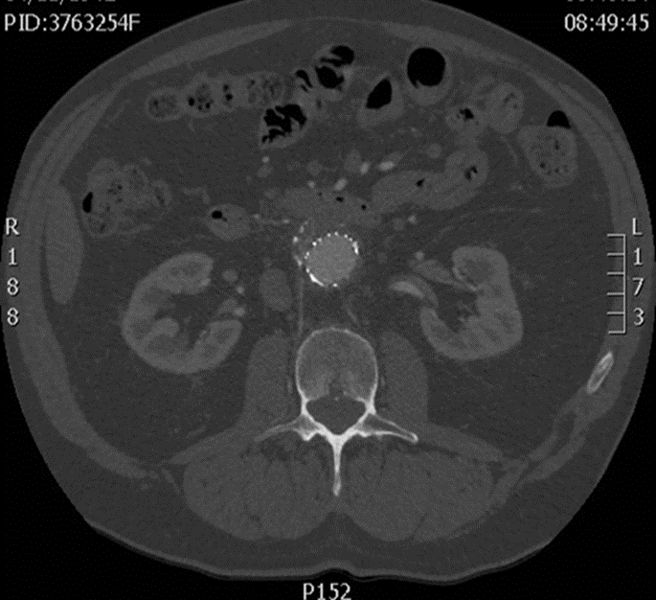
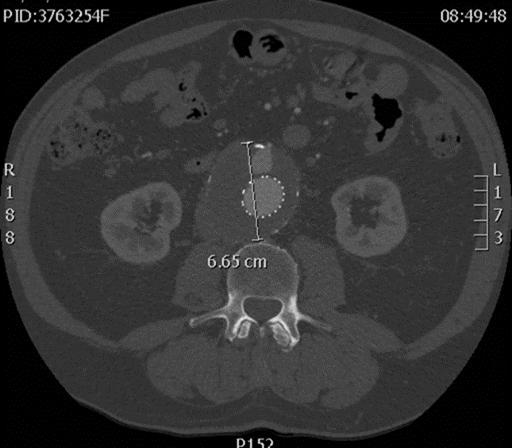
Follow-up at 3 months
Type 2 endoleak, diameter stable but no shrinkage
Lumbar arteries and inferior mesenteric artery patent

Slide 6
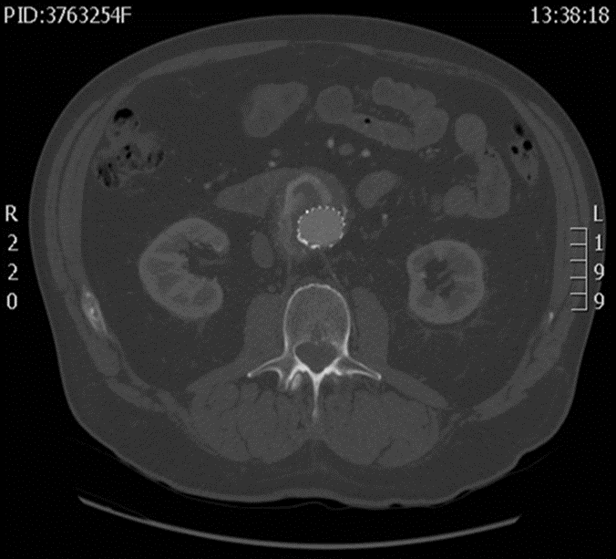
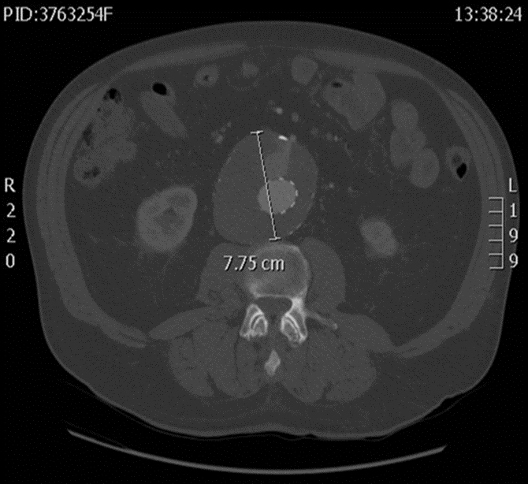
Follow-up at 16 months
Patient fine
Persitent type 2 endoleak and aneurysmal sac enlargement

Slide 8
How would you treat?
Embolization
Which way? Which kind of?
trans-arterial coils
trans-lumbar (micro-)plugs
trans-caval liquid agents
trans-prosthetic others
Laparoscopic ligation?
Open surgery?

Slide 9
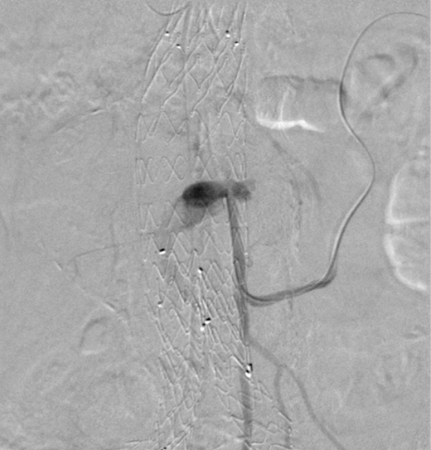
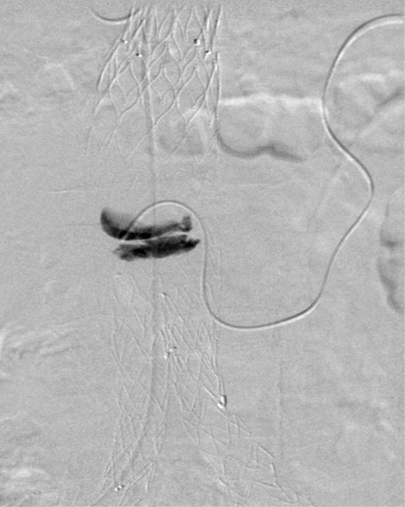
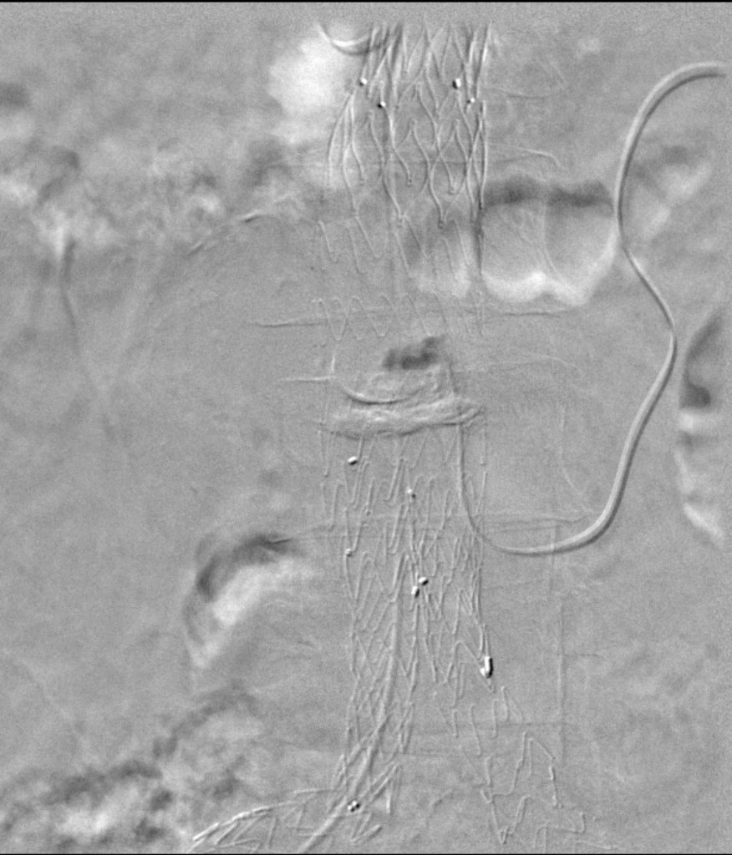
How we treated
Trans-arterial embolization under local anesthesia
With Onyx™ (ethylene-vinyl-alcohol-copolymer liquid embolic agent)
18 months after the EVAR

Slide 10
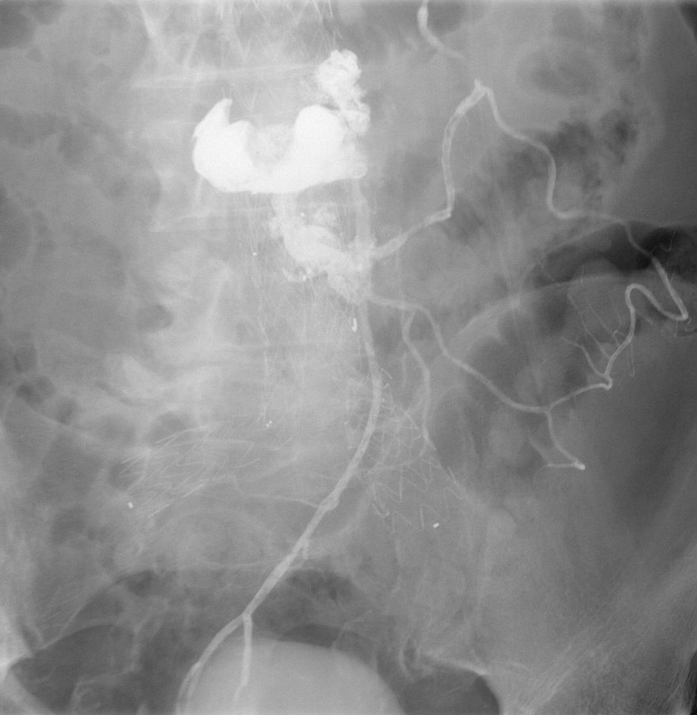
How we treated
After the Onyx™ injection into the aneurysmal sac, the micro-catheter was tied in it and it was necessary to pull it out
When the micro-catheter came out, the liquid flowed into the inferior mesenteric artery and its side branches

Slide 11
Accordingly to how we treated
Sudden abdominal pain
Computed tomography (next slide)
Hartmann’s operation on the same day
colostomy reintegration 3 months later

Slide 13
Final outcome
Patient not happy with the complication and the health care in general
Last follow-up 21 months after the EVAR
Computed tomography angiography: type 2 endoleak due to lumbar arteries patency, with stable diameter at 7,7 cm
Patient decided to withdraw the follow-up and to stay in Jamaica
He suddenly passed away 65 months after the EVAR

Slide 15
Key learnings
Always consider IMA embolization prior to EVAR (3 mm)
Shrinkage is better than stable diameter
Onyx™ needs to be injected very slowly
Microvascular plugs are an option to avoid Onyx™ embolization

