Slide 1
Type B Aortic dissection in a patient with MYLK variants.
TEVAR or Open ?
Vincent Tchana-sato
Dept of cardiovascular surgery
University Hospital of Liege

Slide 2
Disclosure of Interest
Dr Tchana-Sato Vincent
I do not have any potential conflict of interest

Slide 3
Case Report
63 YO male
PMH: Hypertension
Dyslipidemia
Coarctation
Admitted for interscapular pain
Hemodynamically stable

Slide 4
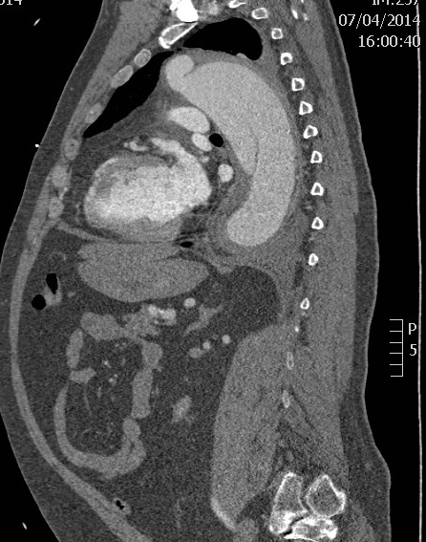
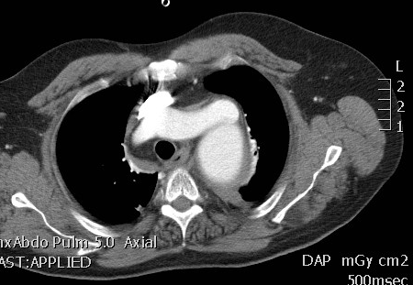
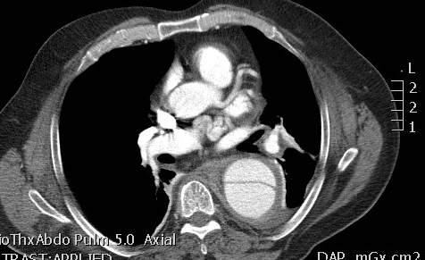
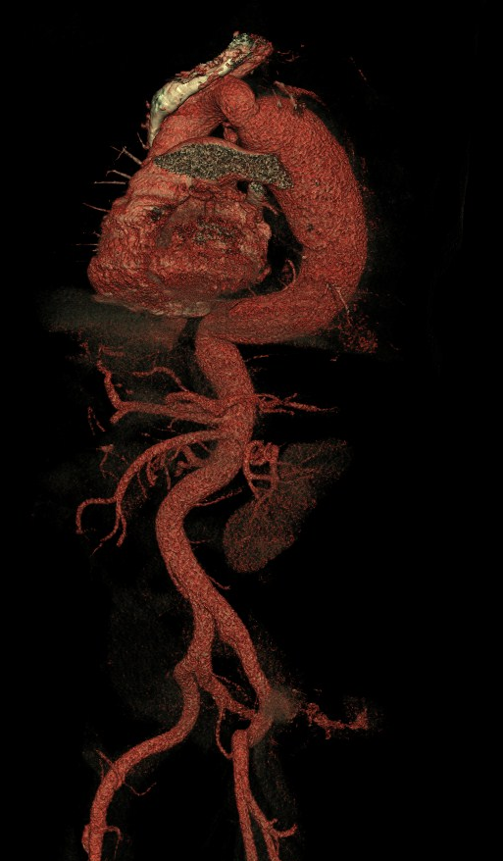
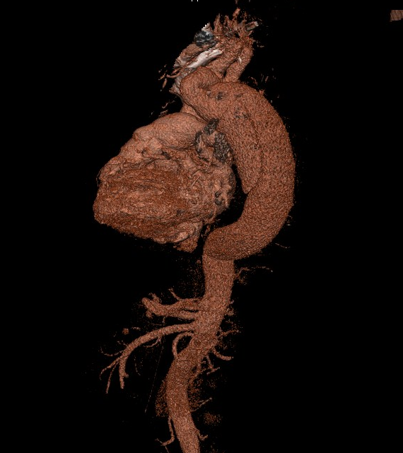
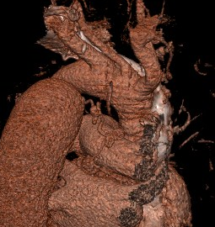
Type B Aortic Dissection

Slide 5
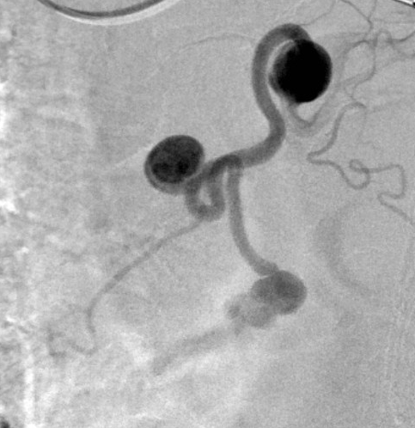
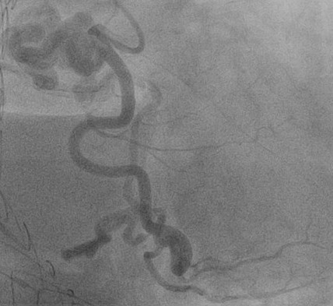
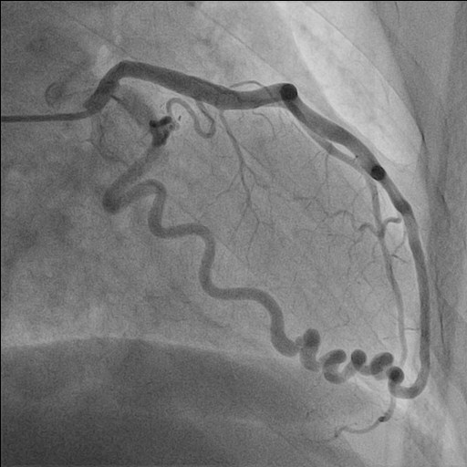
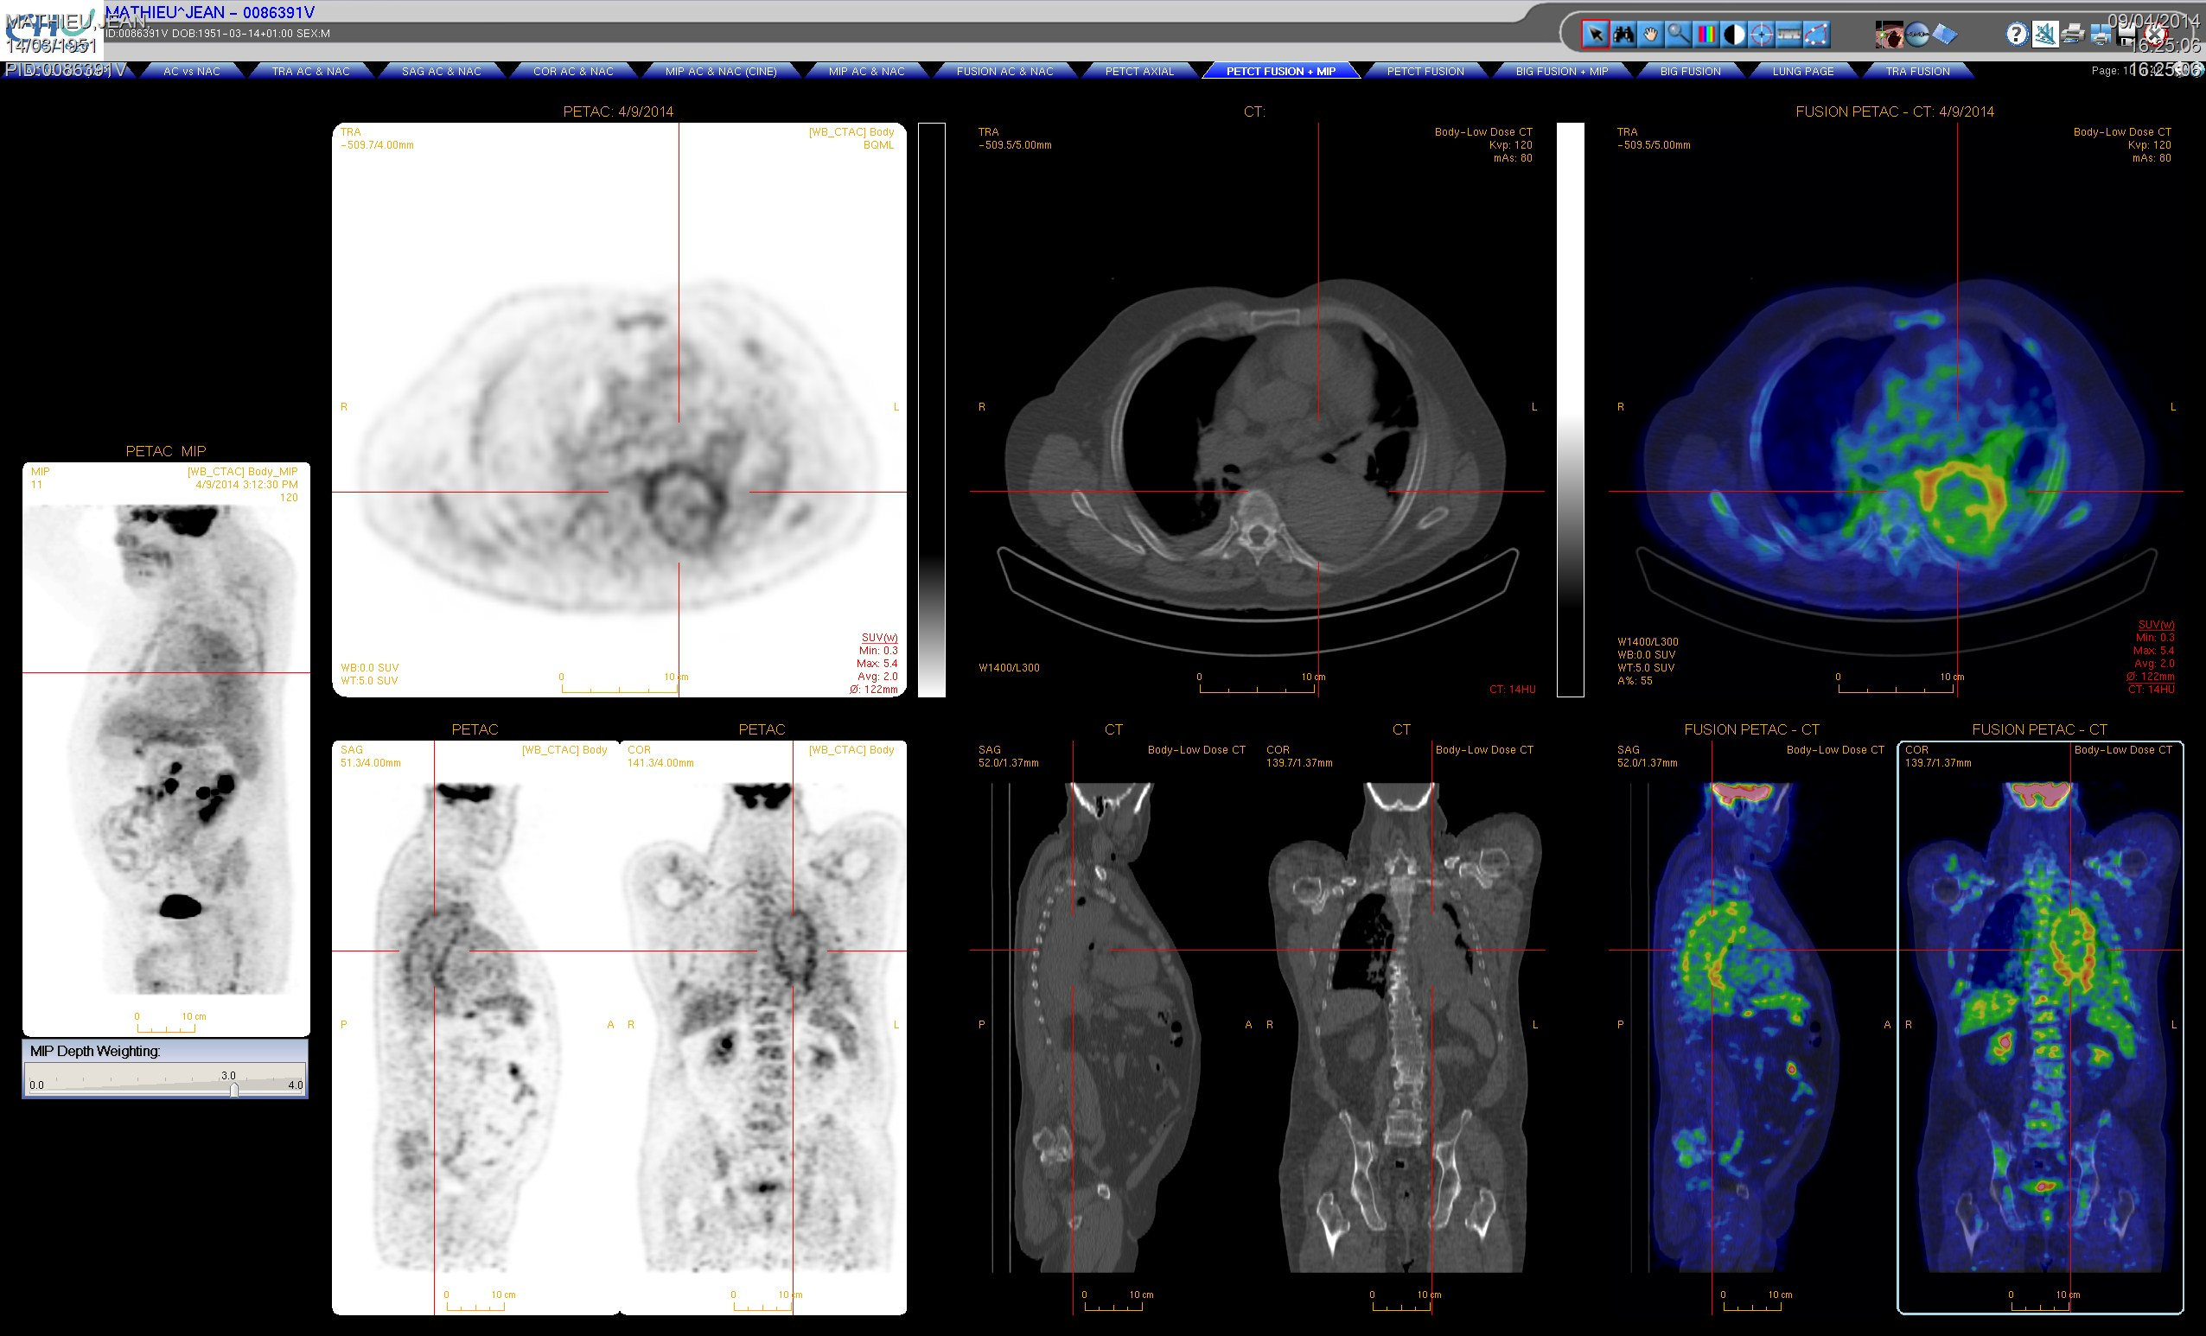

Slide 6
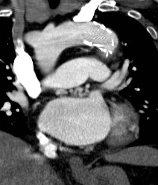
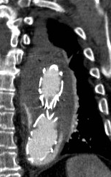
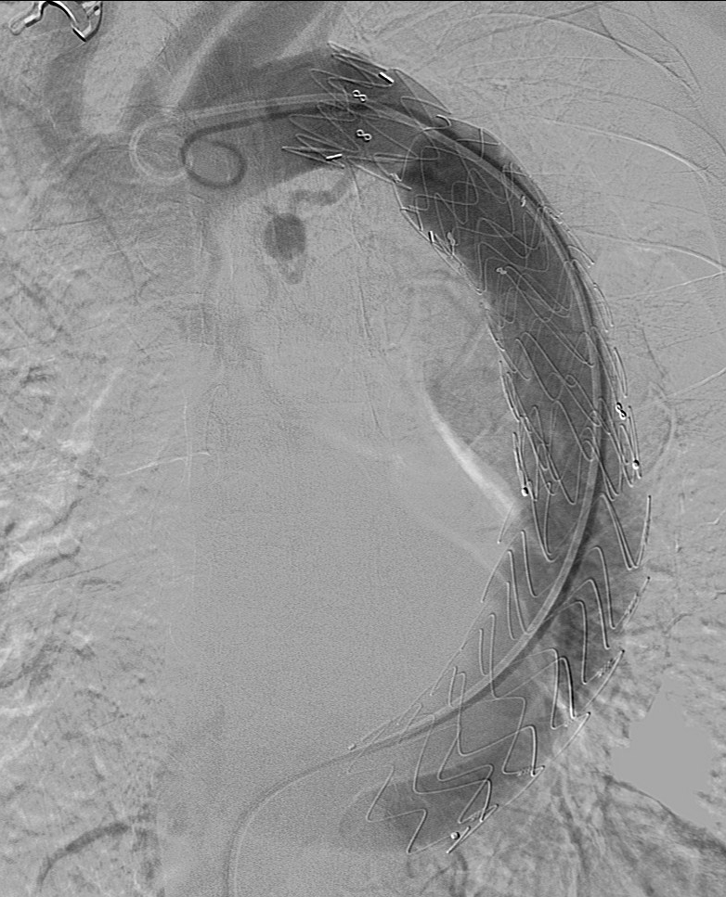
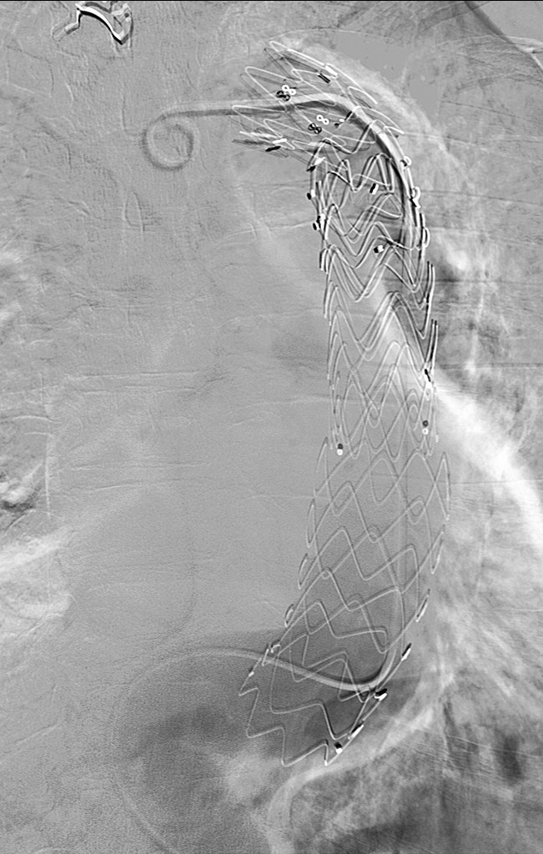
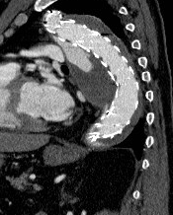
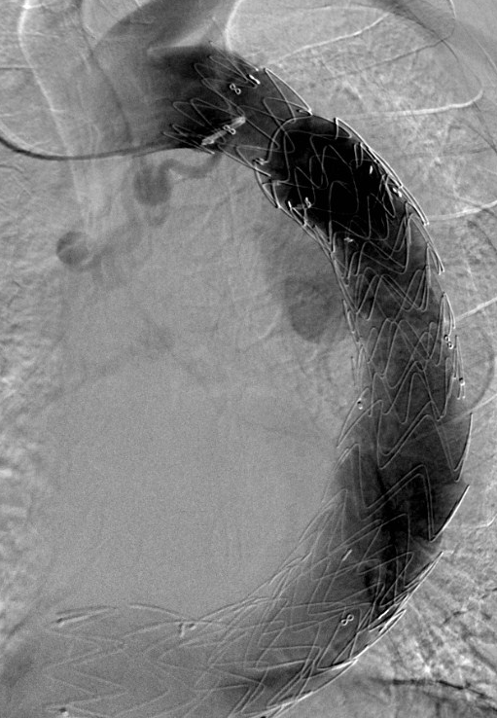
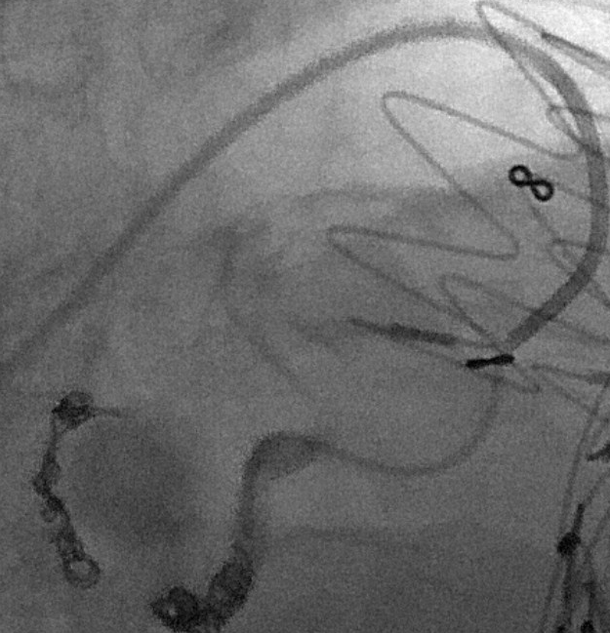
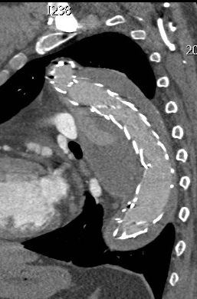
Follow-up
Genome sequencies showed MYLK variant

Slide 8
What is the best solution?
Open Surgery?
Tevar?
No treatment……?

