Slide 1


BLUNT CHEST TRAUMA
Surgical indications
Dr Tchana-sato Vincent
Dept of cardiothoracic surgery
University hospital of Liege

Slide 2
Introduction to chest trauma
2nd leading cause of trauma death after brain injury
Mortality =25%
1st cause of preventable death
<10% of Blunt chest trauma require intervention
Extrathoracic Associated lesions in 66% of cases

Slide 3
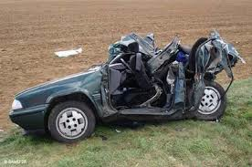
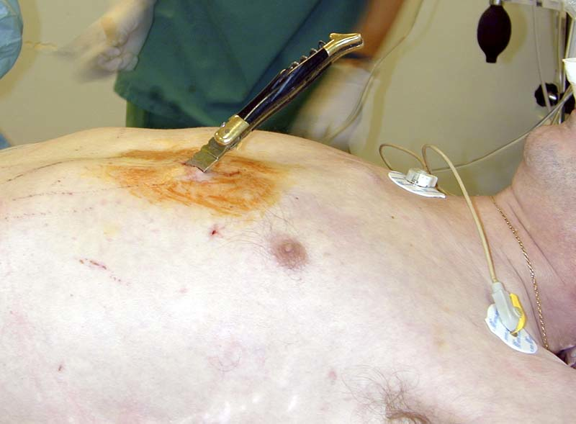
Mechanisms of injury
Blunt injury
(deceleration, compression)
Penetrating injury
Both

Slide 4
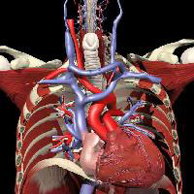
Chest anatomy
Container
Ribs
Sternum
Diaphragm
Dorsal vertebrae
Content
Cardiovascular
Respiratory
esophagus

Slide 5
Lethal Six
Airway obstruction
Tension pneumothorax
Open pneumothorax
Tamponade
Flail Chest
Massive hemothorax

Slide 6
Hidden Six
Thoracic aortic tear
Bronchial disruption
Myocardial contusion
Diaphragmatic tear
Esophageal disruption
Pulmonary contusion

Slide 7
Pneumothorax

Slide 8
Pneumothorax
Traumatic pneumothorax >considered Chest Tube (CT) insertion if:
-symptomatic
-secondary worsening occult pneumothorax
-Tension pneumothorax
No need for CT when small (<1.5 cm), unilateral, w/o respiratory disease and w/o need for Positive pressure ventilation

Slide 9
Tension Pneumothorax
Increased pleural pressure> tracheal deviation+ heart shift+ decreased of venous return
Prompt diagnosis and treatment
Needle decompression closely followed by CT insertion

Slide 10
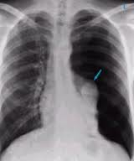
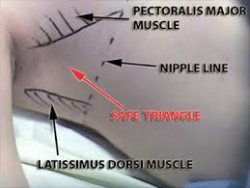
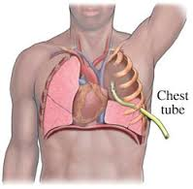
Pneumothorax

Slide 11
Haemothorax

Slide 12
Haemothorax
+/-pneumothorax
CT insertion if symptomatic or >500 CC
VATS indicated at early stage (2-3days) if persistent haemothorax with clot in an hemodynamically stable pt
Thoracotomy at late stage to prevent Empyema, fibrosis,….

Slide 13
Chest wall

Slide 14
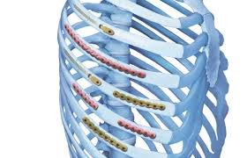
Chest wall injuries
Increased morbi-mortality when
- > 4 ribs
-1st and 2nd Ribs
-#sternum, scapula
Osteosynthesis needed if
-Incarceration of Lung parenchyma
-Broken rib fragment closed to an intrathoracic organ

Slide 15
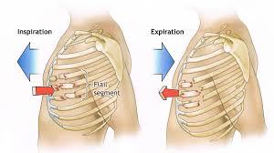
Chest wall injuries
Flail chest
Fixation can be considered if mechanical ventilation is required for > 48 hours

Slide 16
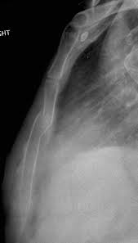
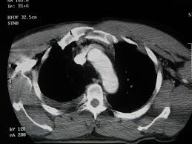
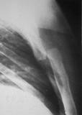
Sternal fracture
Rarely isolated (associated lesions)
Fixation for : -displaced
-overlap/communition
-intractable pain
-respiratory insuffisency

Slide 17
Diaphragmatic rupture

Slide 18
Diaphragmatic rupture
Rare= 0.2-4% of admission for chest/abdominal trauma
70% on the left side
CT-Scan=gold standard for diagnostic
FORMAL SURGICAL INDICATION with timing depending on pt status
Abdominal or thoracic approach (scopy)

Slide 19
Diaphragmatic rupture

Slide 20
Pulmonary lesions

Slide 21
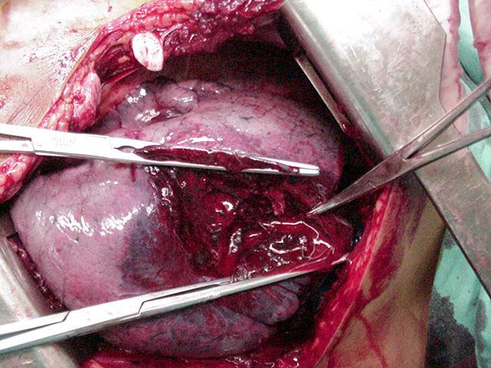
Pulmonary lesions
Heamatoma, contusions or laceration
Conservative treatment +++++
Be careful with fluid overload
Surgery
-severe laceration
-ARDS > VV ECMO

Slide 22
Tracheo-bronchial injuries

Slide 23
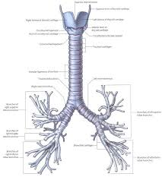
Tracheo-bronchial injuries
Rare=1-2%
Mechanisms: Stretching, compression, fixation
Symptoms: -Respiratory distress (dyspnea)
-Hemoptysis
-SQ emphysema
Trachea : near the carina
Mainstem bronchi: Near the carina, R>L
Associated lesions (esophagus)

Slide 24
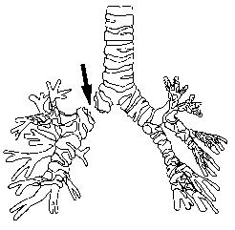
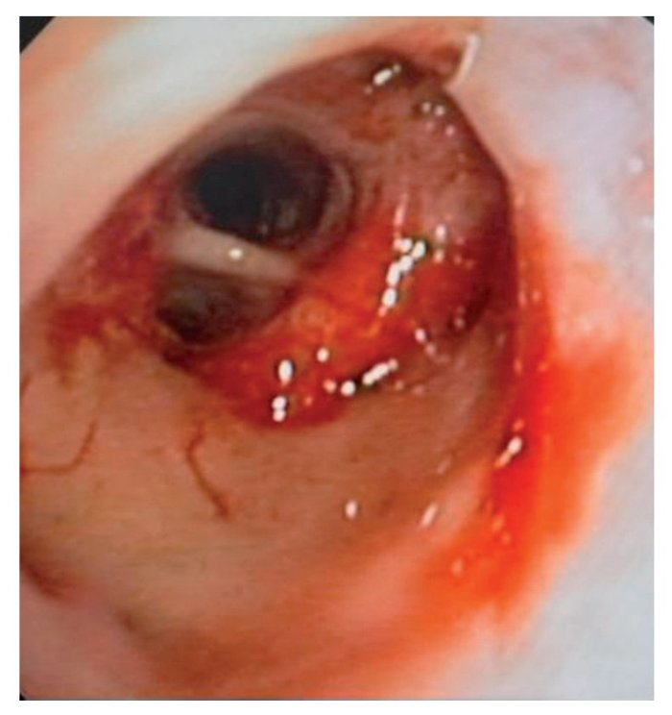
Tracheobronchial injuries
Bronchoscopy> useful tool
Surgery mandatory if -Tear >2 cm
-esophageal prolapse
-mediastinitis
-Massive air leakage
Right thoracotomy (or cervicotomy)

Slide 25
Traumatic thoracic aortic rupture

Slide 26
Traumatic thoracic aortic rupture
Mechanisms -High speed Car accidents
-Fall
Associated thoracic injuries

Slide 27
Types of Aortic tears
Intimal lesion
Thrombus
Parietal hematoma
Medial flap
Pseudoaneurysm
Aortic transsection

Slide 28
Diagnostic tools
Non specific clinical findings
Chest Xray
CT-scan: the best!
MRI? Availability
TEE?

Slide 29
Management
Strict control of the BP and pain
Timing of the operation?
-Debate
-Associated injuries (Abdominal, pelvic, head trauma)
Open vs endovascular surgery

Slide 30
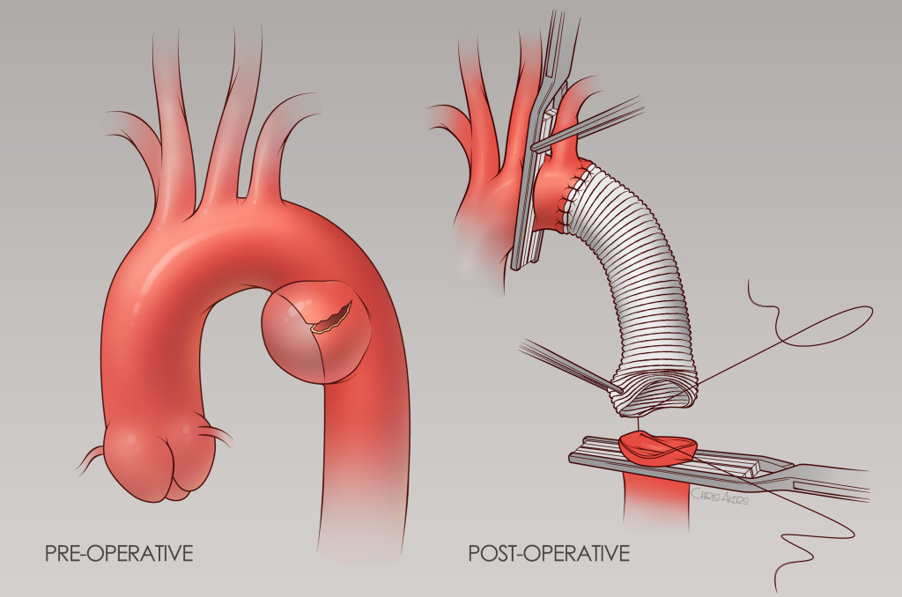
Open Surgery

Slide 31
Open surgery
Results
-Mortality 6-18%
-Morbidity 30%
-Paraplegia 8-10%

Slide 32
Endovascular surgery
Advantages:
-Low dose of heparin
-Low morbidity (non invasive)
But
-Stentgraft availability
-LSC coverage

Slide 33
Endovascular surgery
Technically feasible
Few device related complication
Long-term data required

Slide 34
Rare injuries
Cardiac lesions
Pericardial rupture
Esophageal tear

Slide 35
Blunt Chest trauma
In extremis surgical exploration in an agonal pt > Emergency department thoracotomy (EDT)
Urgent surgical exploration in a drained pt with active bleeding and/or hemodynamic instability> Damage control thoracotomy (DCT)
Assesment of intrathoracic injuries or evacuation of residual hemothorax within 1st 48h hours (VATS)

Slide 36
Conclusion
Less than 10% of BCT require intervention
Polytraumatism
Systematic initial management of the pt
CT-scan in hemodynamic and respiratory stable pts
Severe lesions (Cardiovascular, respiratory, chest wall) are rare but mostly require surgery

