Slide 1

Belgian Reproducibility Network
ULiège local node kick-off meeting
Lightning rounds
December 14, 2023

Slide 2
An ULiège research data repository – the ULiège Dataverse
Judith Biernaux, PhD
RISE
Place du XX Août, 7 (Bât. A1)
B-4000 Liège
Tél : +32 (0)4 366 55 14
jbiernaux@uliege.be
RDA Plenary Cartoons by Auke Herrema.

Slide 3
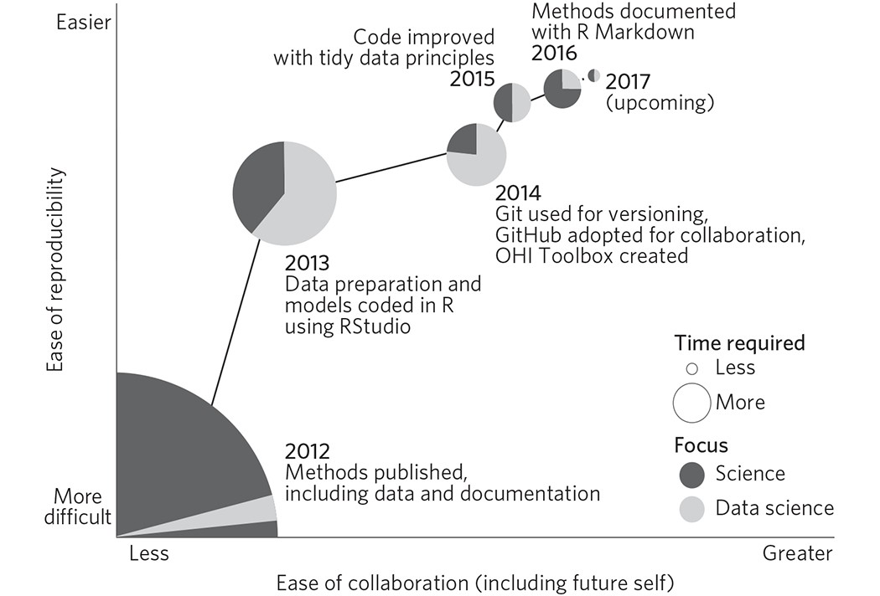
Open data and reproducibility…
Rule of thumb:
More open science
More transparency
More reproducibility
Lowndes, J., Best, B., Scarborough, C. et al. Our path to better science in less time using open data science tools. Nat Ecol Evol 1, 0160 (2017).
https://doi.org/10.1038/s41559-017-0160

Slide 4
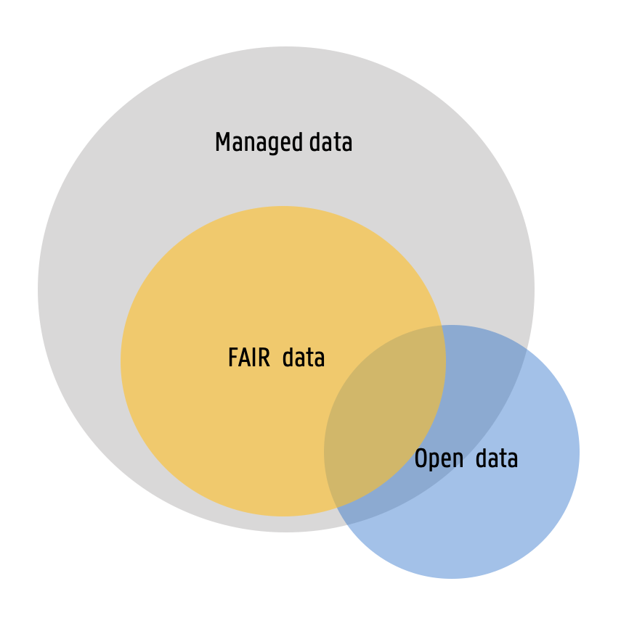
Open data and reproducibility…
But it takes more than just publishing datasets to bring an added value to the world
It takes pulbishing….
… in the right place, where it will be looked for and found
… in a sustainable way (location, format)
… with the right level of accessibility
… with the proper documentation to increase autonomous re-use
… with a whole lot of storytelling for traceability
Only if no applicable regulations or contractual obligations prevent the publication

Slide 5
FAIR data and reproducibility…
Wilkinson, M., Dumontier, M., Aalbersberg, I. et al. The FAIR Guiding Principles for scientific data management and stewardship. Sci Data 3, 160018 (2016).
https://doi.org/10.1038/sdata.2016.18
FAIR principles summary :
Findable
Rich metadata
Including a unique and persistent identifier (DOI)
Registered or indexed in a searchable source
Accessible
Using standard, free, open protocols
That allows for authentication if necessary
Interoperable
Using formats that are as open and free as possible
Using broadly applicable language(s) for knowledge representation
Using controlled vocabularies
Reusable
Released with a clear and accessible license
With a documented provenance
Meeting the community standards
Publishing data in a dedicated data repository usually checks most of these boxes
But how to choose a repository?

Slide 6
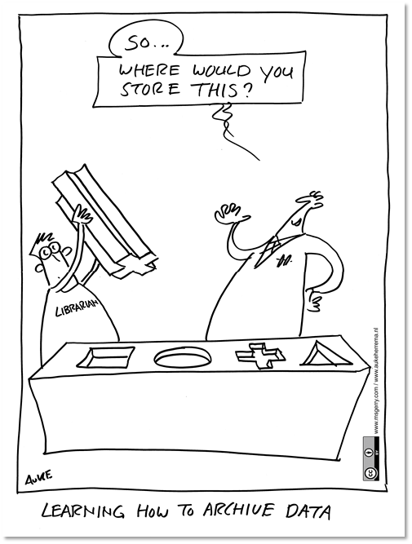
Publishing datasets
A good data repository:
Is recognized by your peers and matches the community standards
Provides a persistent identifier such as a DOI or handle
Comes with a few possibilities for open data licenses
Has high documentation metadata standards with controlled vocabularies (therefore discipline-specific is usually better)
Lets you keep all your rights
Has a certification such as CoreTrustSeal
Note : the editor might suggest that you share the datasets related to a paper as an annex to the paper you are submitting. Not the best move

Slide 7
Publishing datasets
Discipline-specific repository | Some examples : The QDR or Bequali (HSS), CDS (astro), NCBI (genomics), ... Catalogs of directories : Re3data, FAIRsharing (But if you have to look it up in a catalog maybe it is not really community-wide?)
All-purpose repository | Zenodo, OpenAire, OSF… And now, the ULiège Dataverse

Slide 8
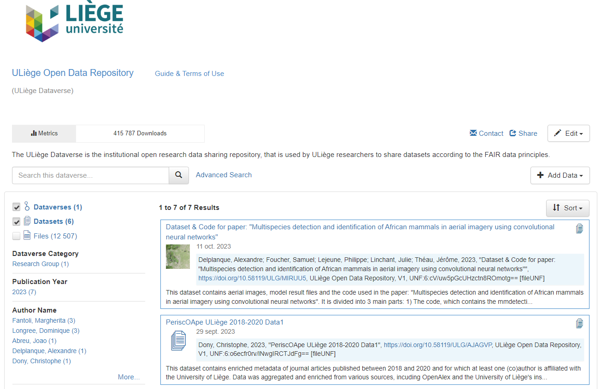
The ULiège Dataverse
dataverse.uliege.be
Works a bit like ORBi but is dedicated to sharing open research data
It provides the possibility to upload dataset files and documentation, with rich metadata fields and generates a DOI for your dataset
Title, authors (identifiers & contact), abstract, keywords (and vocabulary standard), related publications, notes, contributors, distributor, grant information, date of collection, time period, series info, software info, related materials, journal metadata, terms and licences
+ discipline-specific metadata for geospatial data, astro data, HSS data & life sciences data

Slide 9
The ULiège Dataverse
dataverse.uliege.be
Key points :
Any ULiège researcher may publish a dataset in the ULiège Dataverse : only an ULiège and ORCiD identifiers are needed
Checklists and processes are provided in the User Documentation tab
The ULiège Dataverse is operated in-house by ULiège (RISE, ULL and SEGI)
  Support is available when needed
  Before any publication, the admins will proceed to a supporting verification

Slide 10
Want to use the ULiège Dataverse?
dataverse.uliege.be
Browse to the homepage
Connect by clicking on Log In
  Use your ULiège id
  Activate your ORCid if needed
Follow the account creation procedure
You can now use Dataverse to publish datasets, following the documented procedure

Slide 11
The story of the ULiège Dataverse
November 2021
April 1st, 2023
Oct 27, 2023
Late 2020
Mid-2021
Mid-2022
ULL /RISE propose the idea of a data-ORBi as part of the reflexion that would lead to the ULiège OS roadmap
Creation of the CC RDM – involvement of other services and researchers in Dataverse development
SEGI installs the actual, future Dataverse.
CC RDM defines the objectives of the pilot phase
Call for pilot users through CC RDM representatives (and other networks)
First publication
Pilot phase – SEGI, ULL and RISE make adjustments on the Dataverse config based on pilot users feedback. Improvements are made to:
- workflow and user doc
- reviewing process
- technical config (user accounts, PID generation, …)
- licenses availability
- layout, legibility, …
ULL installs a « sandbox Dataverse » for future admins and users to play around

Slide 12
The ULiège Dataverse Roadmap
An ULiège Library + RISE + SEGI collaboration in the making since late 2020
With pilot users since mid-2022 and the first publication on April 1st, 2023
Some milestones remain on the roadmap :
  Better ULiège web pages
  Harvesting
  Certification
  Large datasets policy
  ….
Users are still more than welcome to provide feedback to refine the tool as we discover a larger diversity of needs

Slide 13

The Dataverse team
The Dataverse team is thankful to the pilot users
Joao Abreu
Matthieu Verstraete
Dominique Longrée
Margherita Fantoli
Alexandre Delplanque
Philippe Lejeune
Christophe Dony
Christophe Phillips
Christophe Geuzaine
Angeliki Konstantinidou
Daniela Vintila
Christian Degueldre
Jean-Michel Lafleur
Sébastien Hendrickx
Martin Grignard
Alice Mayer
The Dataverse team is composed of the following superheroes
Paul Thirion
Alessandro Infantino
Jérôme Eeckhout
François Paquot
Laurent Debra
Image : Marvel

Slide 14

RSpace : Electronic Research Notebook
Sabine Wislet, PhD
Associate Professor
Coordinator ERN tool

Slide 15
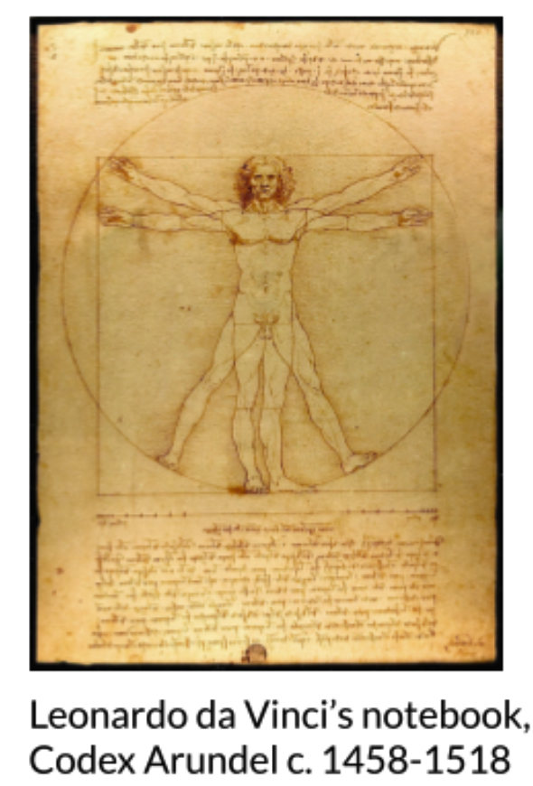
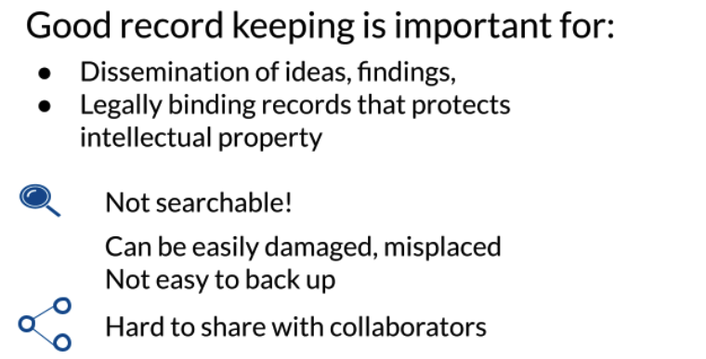

RSpace : Electronic Research Notebook
Electronic Research notebooks help with organization and documentation

Slide 16
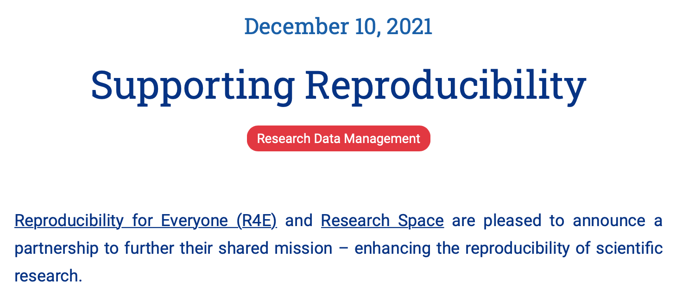
RSpace : Electronic Research Notebook

Slide 17
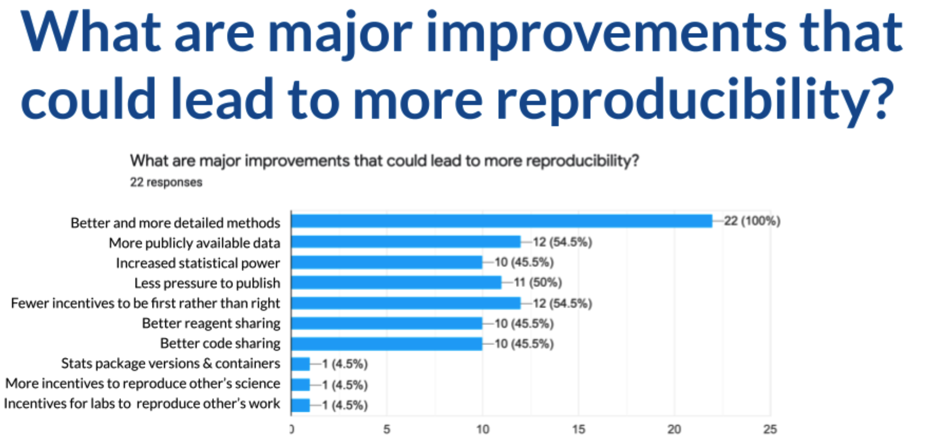
RSpace : Electronic Research Notebook
https://www.repro4everyone.org/resources/intro-reproducibility

Slide 18
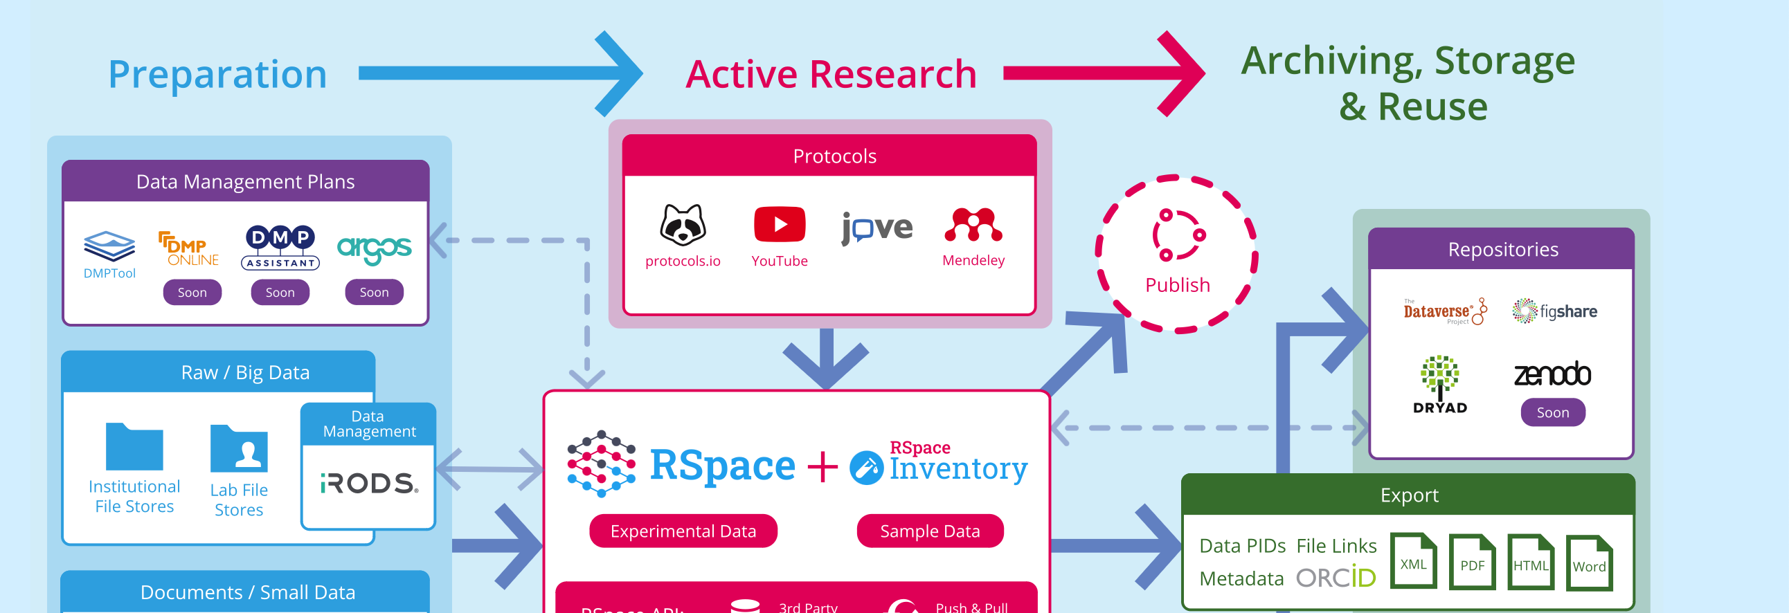
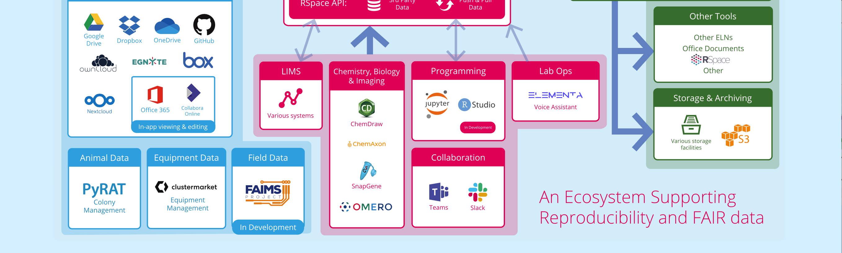
RSpace : Electronic Research Notebook
Ecosystem supporting
Reproducibility
And FAIR Data

Slide 19
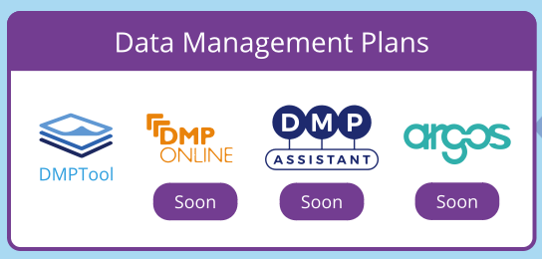
RSpace : Electronic Research Notebook
Ecosystem supporting
Reproducibility
And FAIR Data

Slide 20
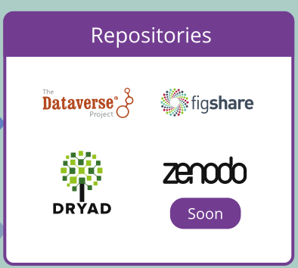
RSpace : Electronic Research Notebook
Ecosystem supporting
Reproducibility
And FAIR Data

Slide 21
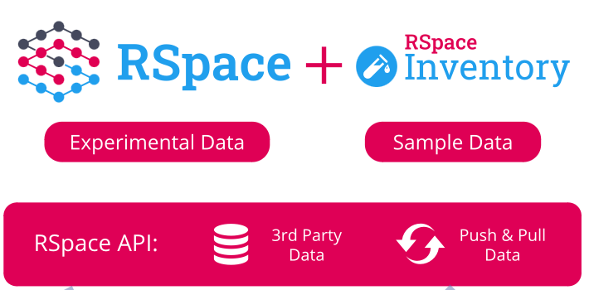
RSpace : Electronic Research Notebook
Ecosystem supporting
Reproducibility
And FAIR Data

Slide 22
RSpace : Electronic Research Notebook
RSpace enables researchers to work together (Collaborative tool) in a way that is centralized, streamlined and secure:
Capture and organize research data
Pull DMP’s directly to Gallery space
Link sample and experiment together
Link to other research tools: Protocols.io, OneDrive, etc.
Link to Uliège research computing storage: i.e GIGA_Mass_Storage
Export data in a variety of formats, including to ULiège Dataverse Repository

Slide 23

RSpace : Electronic Research Notebook
GDPR compliance
HIPAA compliant environment or VRE/Science Gateway
21 CFR 11 or ISO27001 compliant, GLP support
SSO, LDAP/SAML2 support, hierarchic tiered admin
Approuved by Région Wallone
EU and FNRS data management recommandation compliant

Slide 24
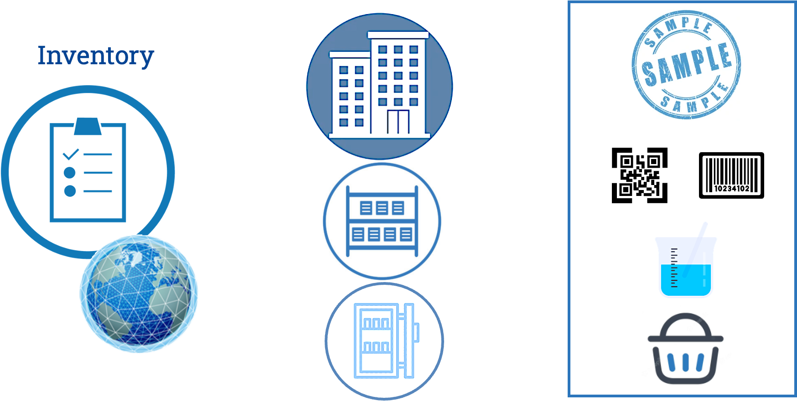
RSpace : Electronic Research Notebook

Slide 25
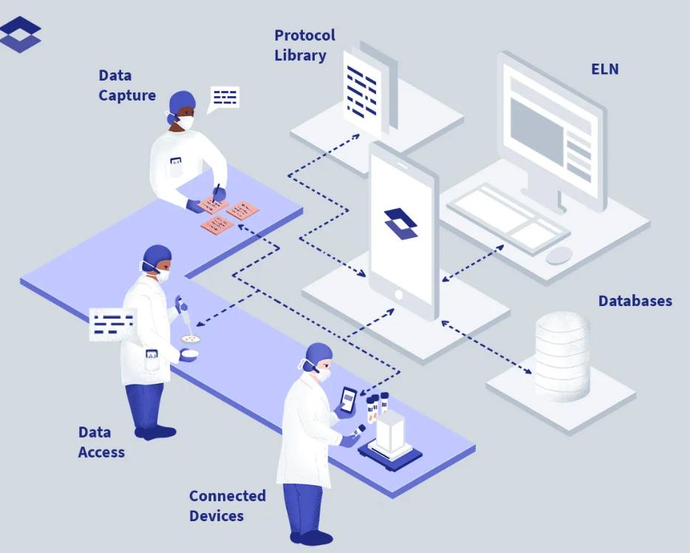
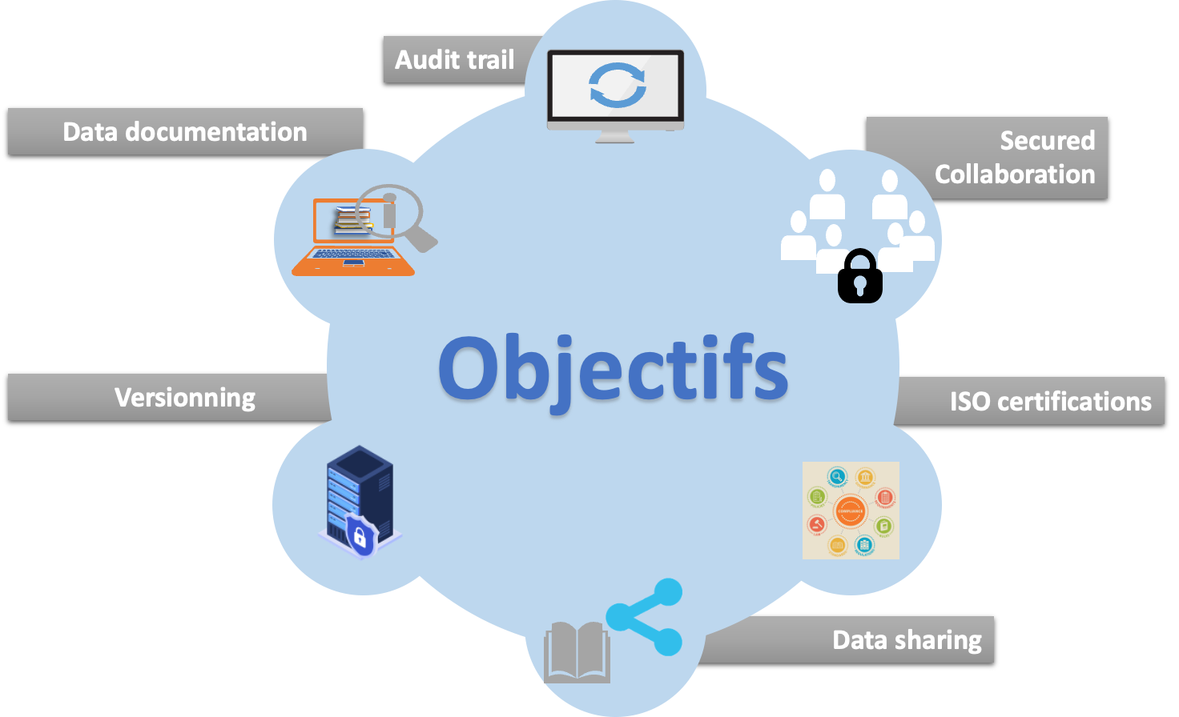
RSpace : Electronic Research Notebook

Slide 26


Need an access to RSpace or more information?
Labis@Uliege.be
Sabine Wislet
Coordinatrice Projet ERN
s.wislet@Uliege.be
Judith Biernaux
Uliège Data Officer
JBiernaux@Uliege.be

Slide 27
Open-source development with code versioning, Git & GitLab
Christophe Phillips, Ir Ph.D.

Slide 28
What is “Version Control”?
"In software engineering, version control (aka. revision control, source control, or source code management) is a class of systems responsible for managing changes to computer programs, documents, large web sites, or other collections of information."
i.e. organize and control revisions of text files.
https://en.wikipedia.org/wiki/Version_control

Slide 29
Why Version Control?
Key questions regarding:
Team work, i.e. many people working on the same files…
  Did you lose your changes to that file because of that?
  Or ended up with incompatible code?
  Who did those changes ?
Time line, i.e. code is changing over time…
  What was the code like “back then”?
  Could you roll back to a previous version?
  When was that feature/bug introduced in the project?
If any of these strike you, then use a VC system !
➔ Git is the way…

Slide 30
What is “Git”?
currently the most popular distributed versioning system
free open-source & cross-platform software
uses specific command lines
very efficient, very powerful… but can also be very complex
thankfully there exist GUIs and IDEs plugins
no global revision numbers, “hashes” instead
created by Linus Torvalds, 1st release in 2005

Slide 31
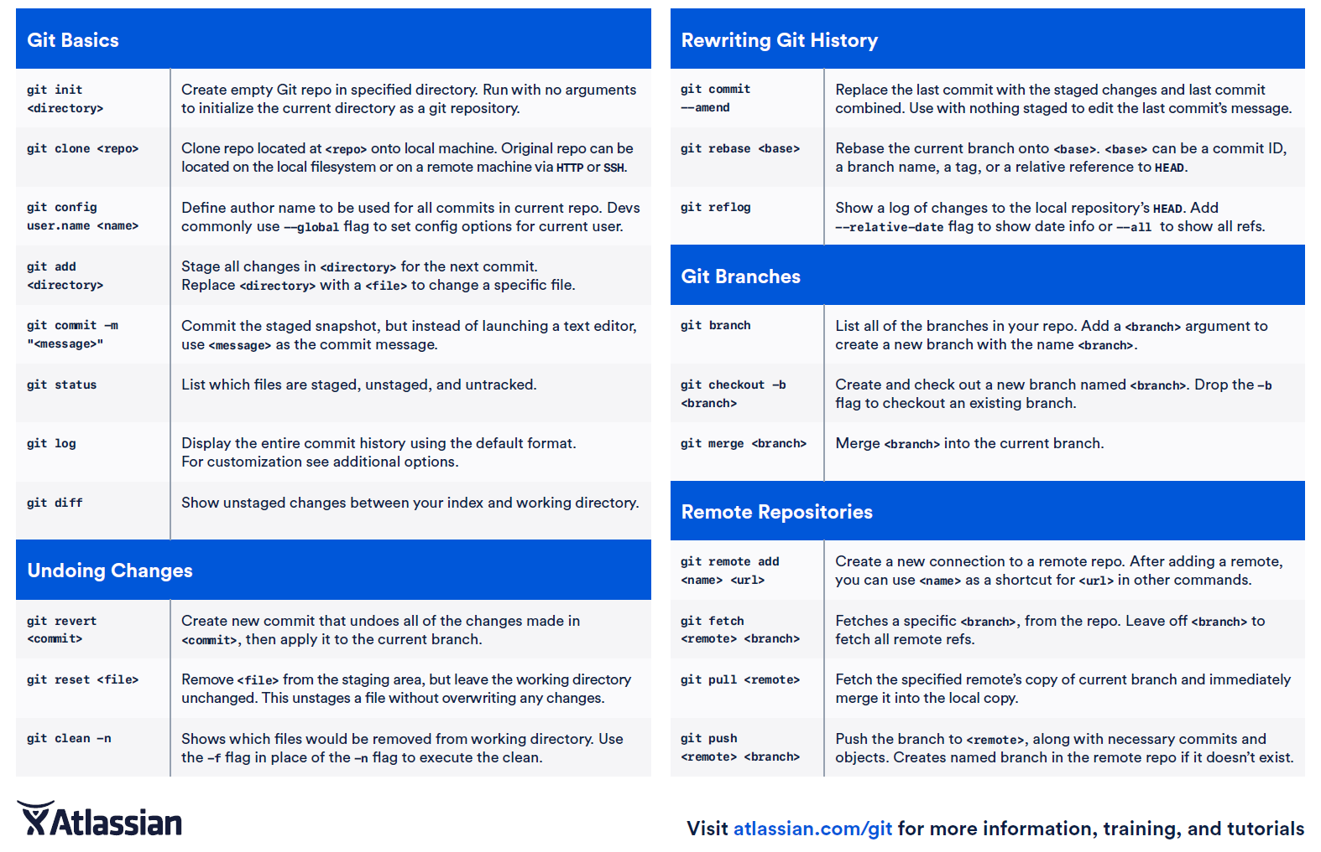
Git Cheat Sheet
“just” 21 basic commands!

Slide 32
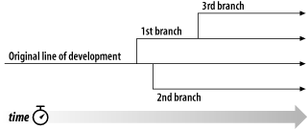
How to…
Create repository or get code from a repository
→ check out/clone code
Work on your code & change some files
→ bug fixes and/or new features
Publish your changes to the repository
→ commit your changes (logical chunks with comments)
Create a new “branch”
→ work on a branch as on
a parallel copy of the code

Slide 33
Text vs. Binary files…
Change tracking works on text-based files
  → Code (.py /.jl /.cpp /…), text (.txt), Markdown (.md), Latex (.tex /.bib),
  comma-/tab-separated values (.csv/.tsv), JSON (.json) files
With light (<10MB) binary files (images, .ppt, .pdf, .doc, .xls, …)
  → Updating overwrites the file…
  but previous versions still available in history!
  → No dataset or heavy binary files !
  (use other tools)

Slide 34
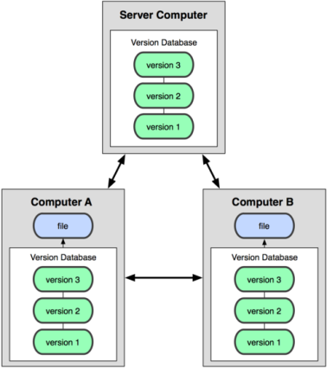
Git & GitLab
Git repository only on your machine
or one single computer/drive
  → risk of losing everything & no easy collaboration
https://gitlab.uliege.be/

Slide 35
Git & GitLab
Git repository only on your machine
or one single computer/drive
  → risk of losing everything & no easy collaboration
⇒ use web-based Git repository hosting
GitLab.uliege.be
  hosted at ULiège, private & public repo’s. ☺
  easy local collaborations + international
GitHub.com (& GitLab.com)
  servers from a private company
  easy international collaborations
https://gitlab.uliege.be/

Slide 36
GitLab features
Code versioning
  + branching, merging, releases
And more…
Issue tracking
  → discuss problems & requests in a forum, keep track of decisions!
Management
  → access rights, visibility, groups/teams, …
Code documentation and Wiki
  → build knowledge for the team

Slide 37
Any good “reasons” not to use Git & Gitlab?
“It’s only a small bit of code to try out an idea on my data…”
  → This is always how it starts and paper follows!
“Nobody else will ever be interested in this…”
  → If you are, someone else will necessarily be!
  (…and it could be you in 3-6 months)
“My code is not ready yet…”
  → The ULTIMATE reason to actually version your code!
Just do it!

Slide 38
Conclusion
Absolutely necessary to manage any project that relies on code, script, batch, text,…
Useful to keep track of changes, improvements & bug fixes
over time + some documentation
Even more so with multiple developers/users
  → start alone → team interest → available to the community
Open science → paper + code + data accessible

Slide 39
Thank you for your attention!

Slide 40
References
J. D. Blischak et al., A Quick Introduction to Version Control with Git and GitHub, PLOS Computational Biology, 12(1): e1004668, 2016, http://dx.doi.org/10.1371/journal.pcbi.1004668
https://en.wikipedia.org/wiki/Version_control
  https://en.wikipedia.org/wiki/Git
  https://git-scm.com/docs
  https://services.github.com/on-demand/downloads/github-git-cheat-sheet.pdf
  http://github.com/ & http://gitlab.com
https://gitlab.uliege.be/
Git GUI: https://desktop.github.com/ & https://gitahead.github.io/gitahead.com/
https://www.campus.uliege.be/cms/c_9096862/fr/services-internet-intranet-offerts

Slide 41

A tool for FAIR data management
Martin Grignard, PhD
Research data manager
GIGA, ULiège

Slide 42
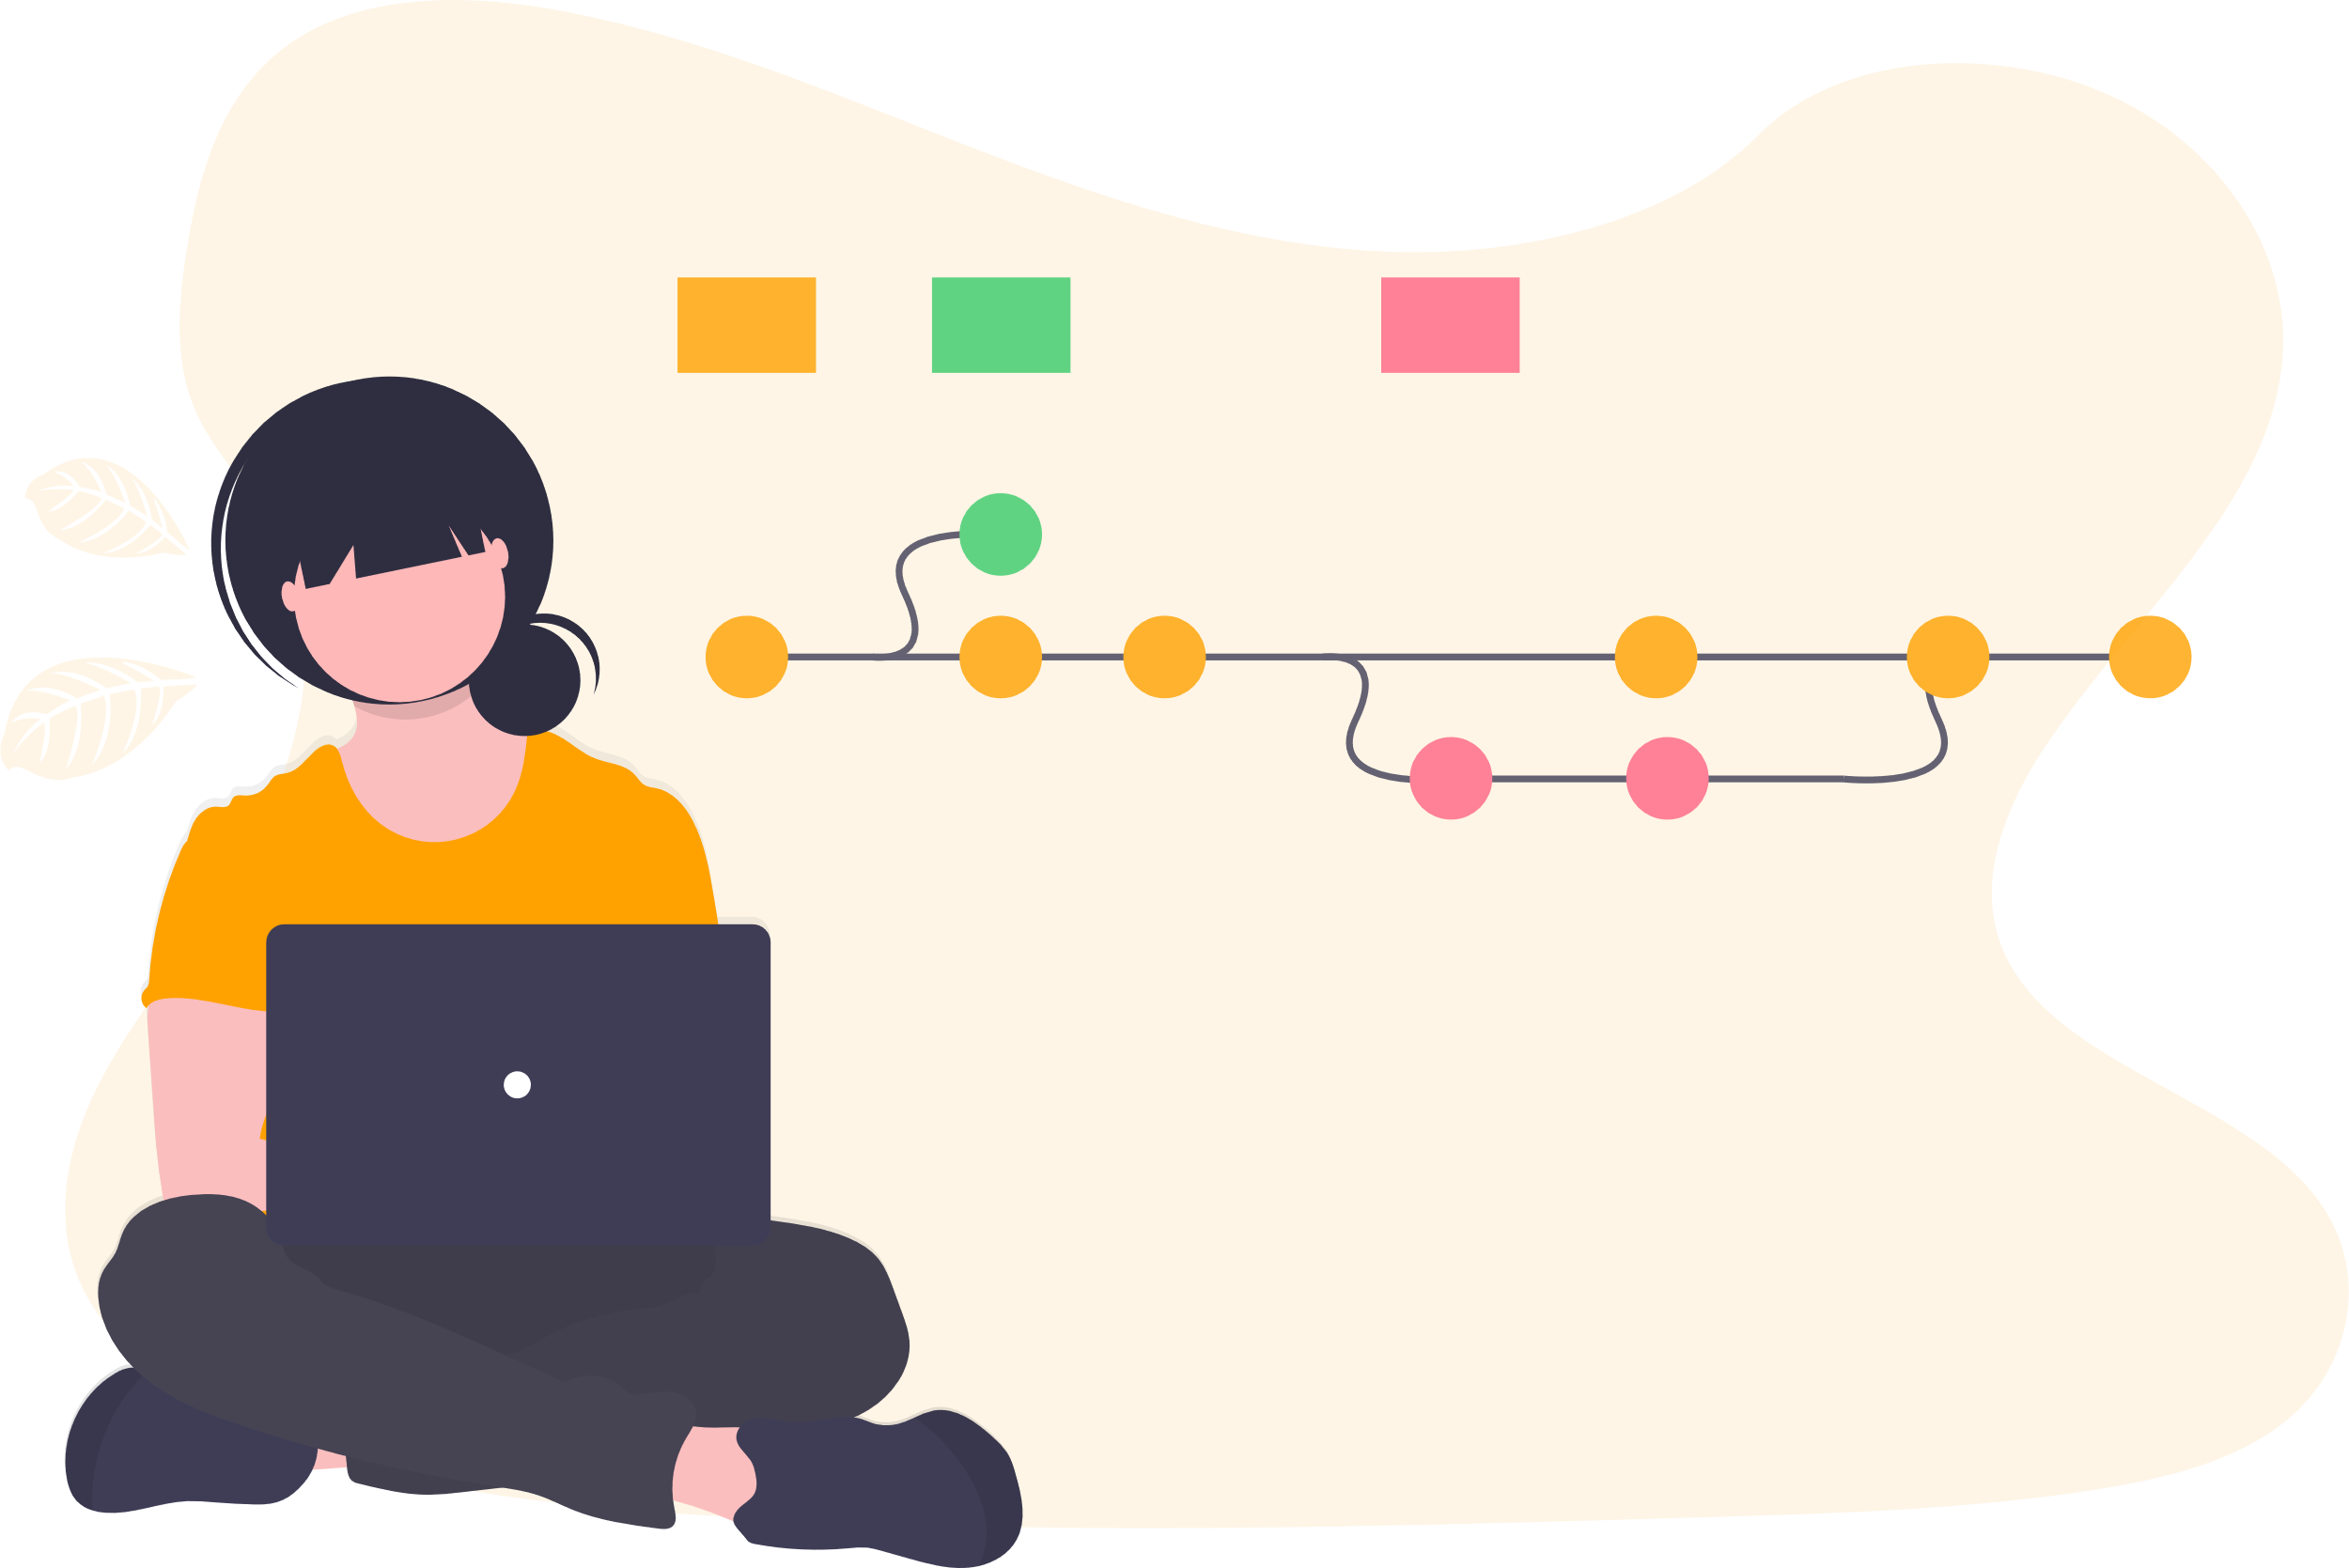
Data are worked on the same way as code is.

Slide 43










Data are not stored
the same way as code is.

Slide 44


Git handles code,
Git-annex handles data.

Slide 46
Halchenko et al., DataLad: distributed system for joint management of code, data, and their relationship, 2021

Slide 47

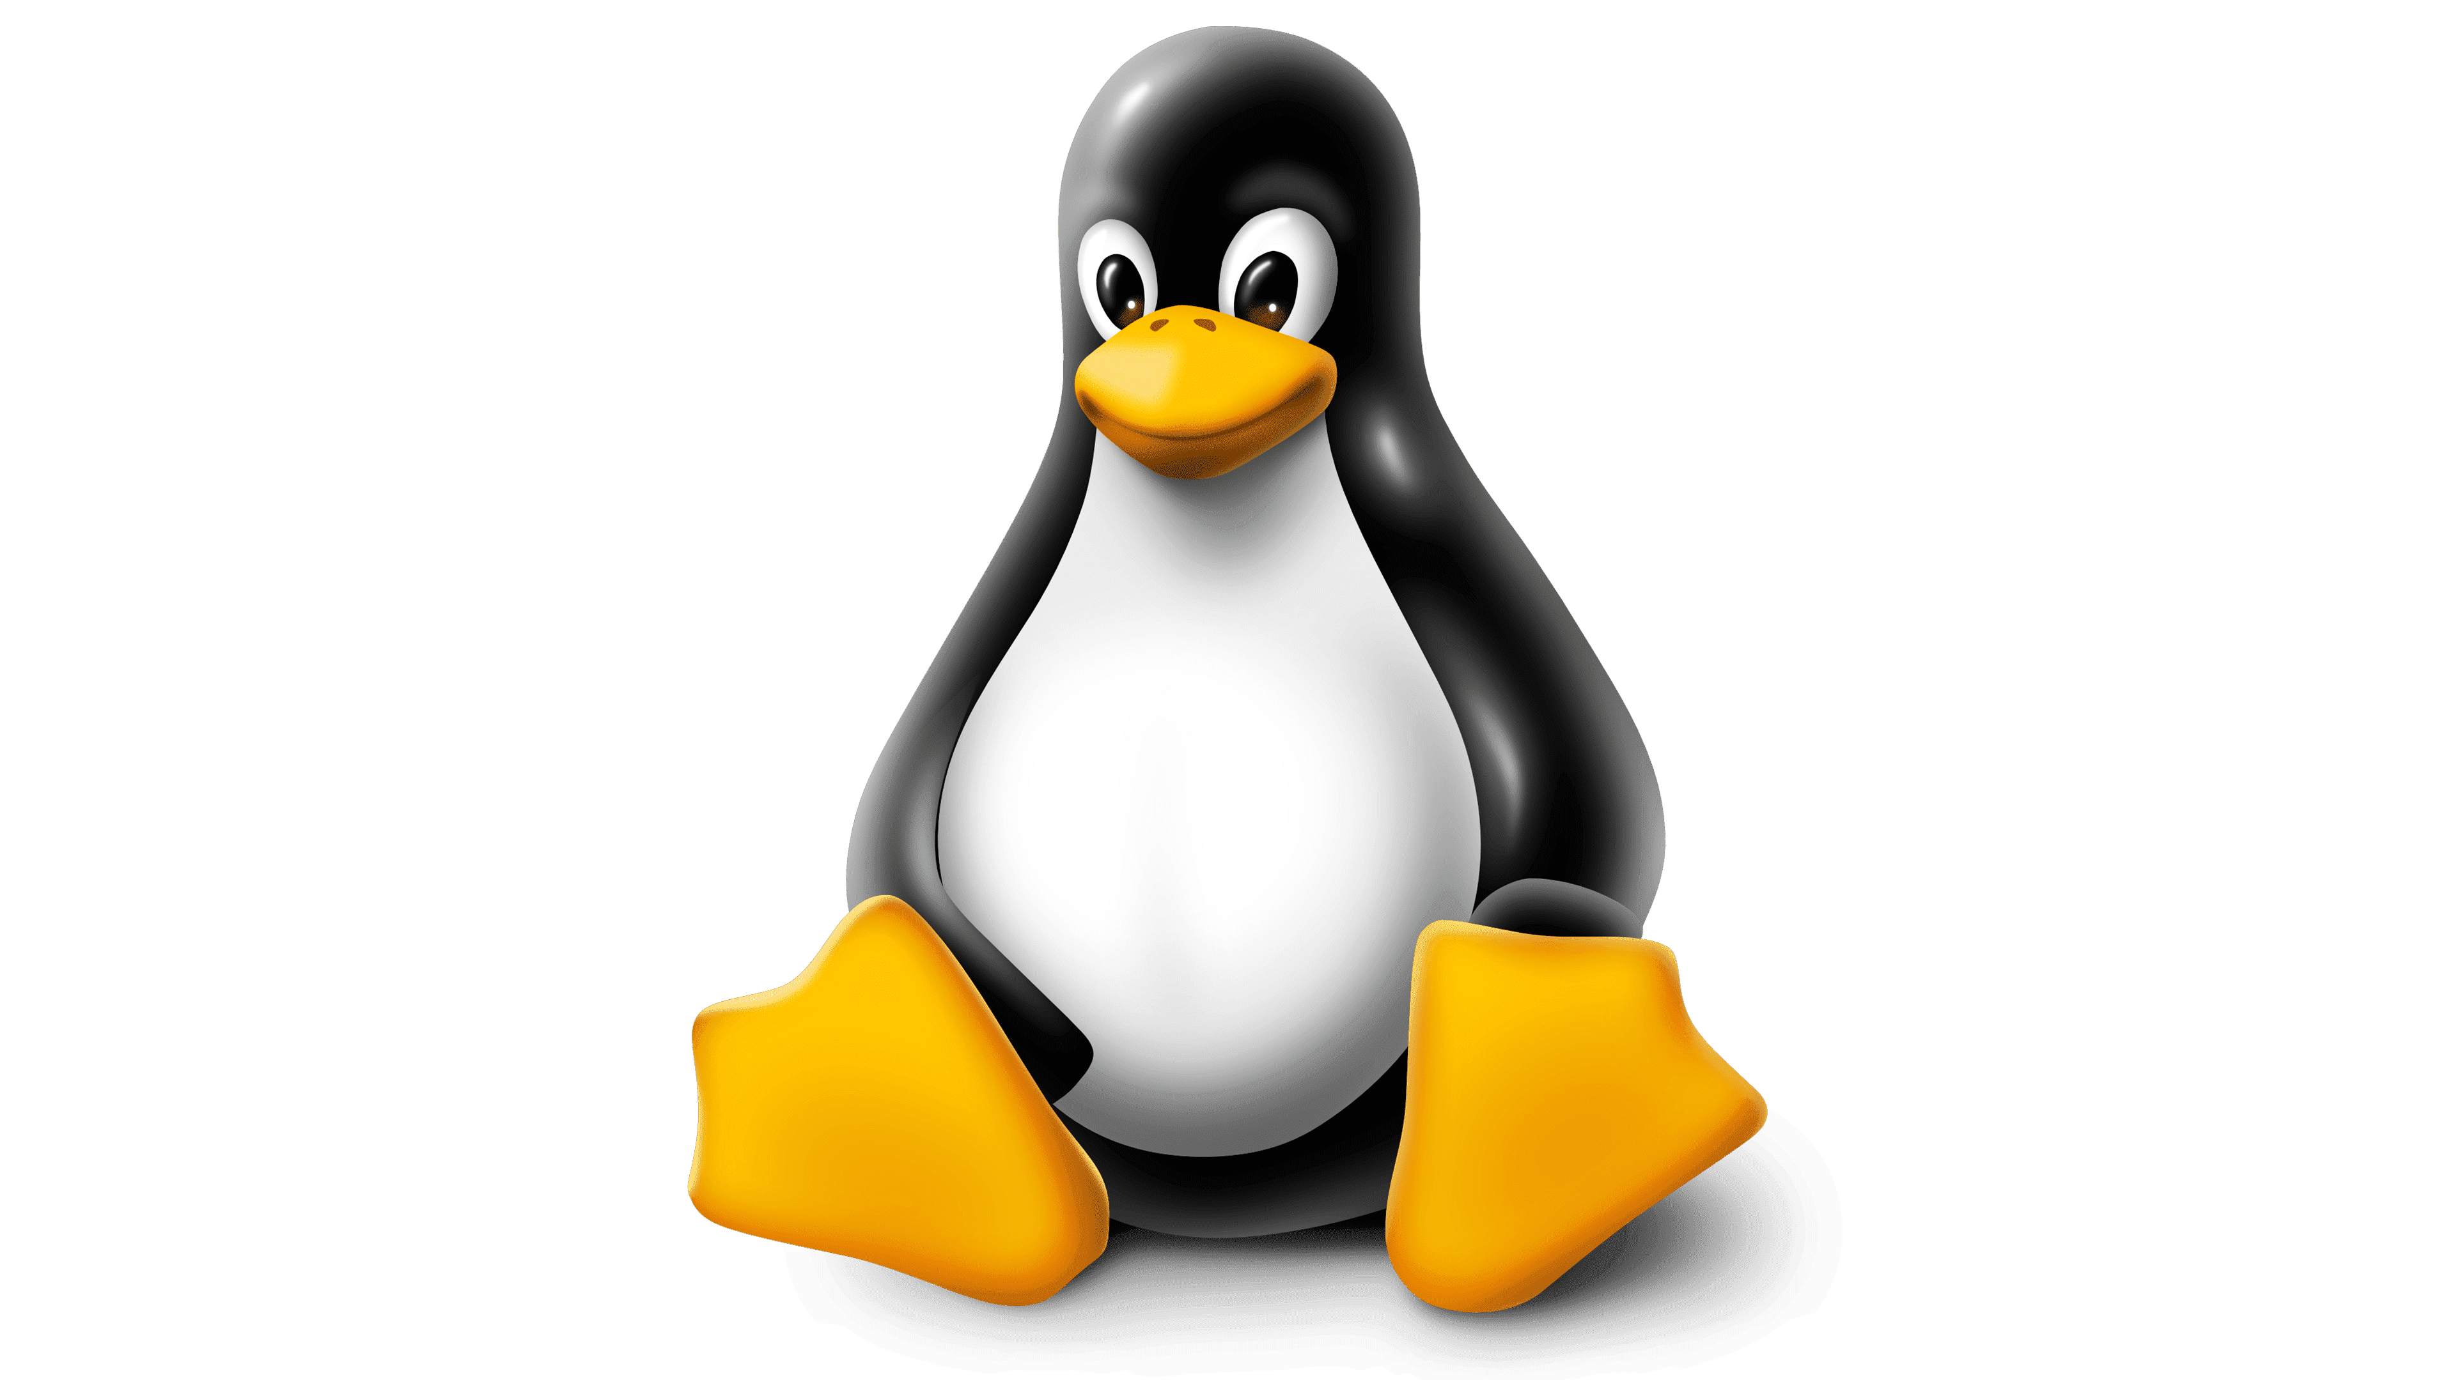
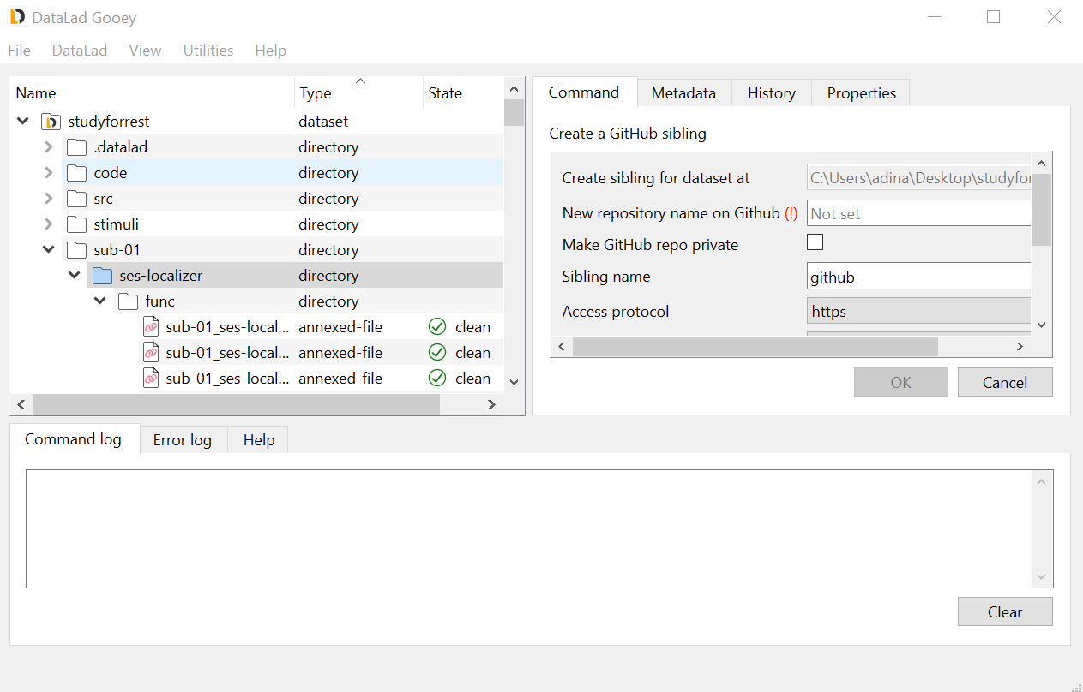
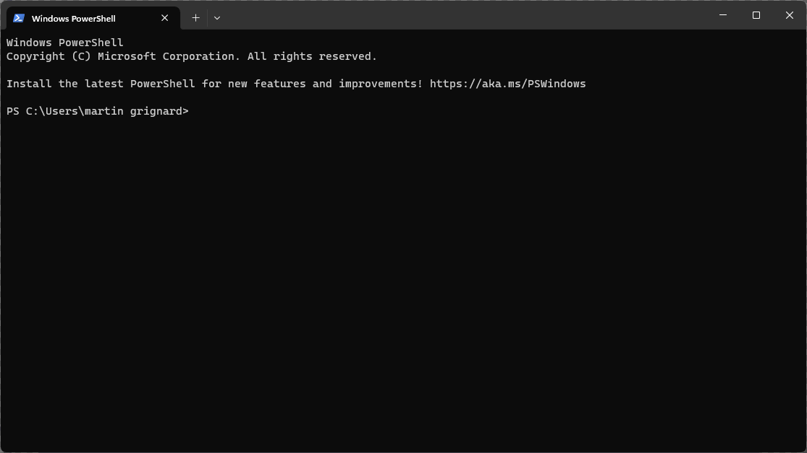


Works on any OS,
from your terminal or gooey™.

Slide 48

$ datalad create [-f]
$ datalad clone
Everything starts
with a dataset.

Slide 49
Modify the
dataset
$ datalad save
Work on your data
step by step.

Slide 50
Local
$ datalad clone
$ datalad update
Remote
Make it accessible,
work with others.
$ datalad create-sibling
$ datalad publish

Slide 51
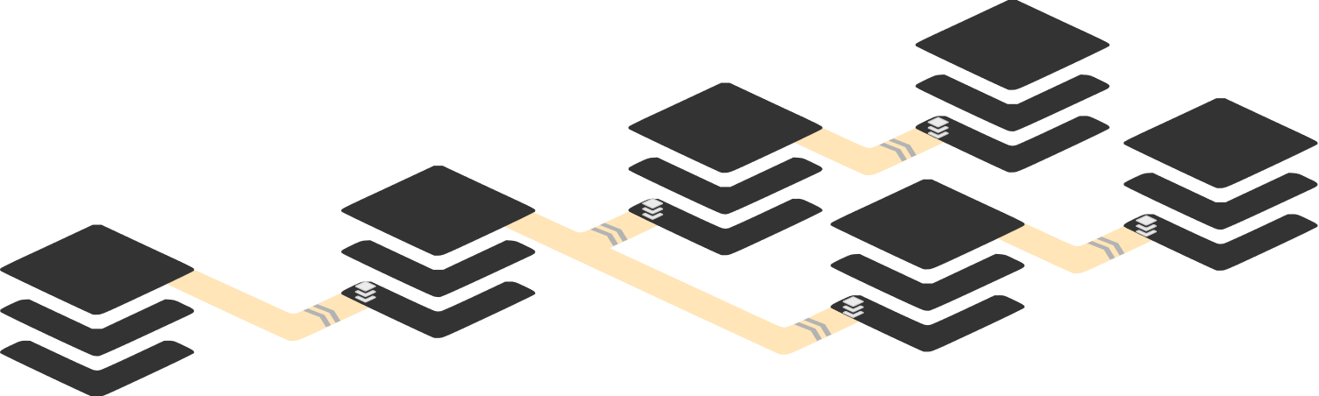
Build your story,
one block at a time with YODA.
$ datalad install

Slide 52
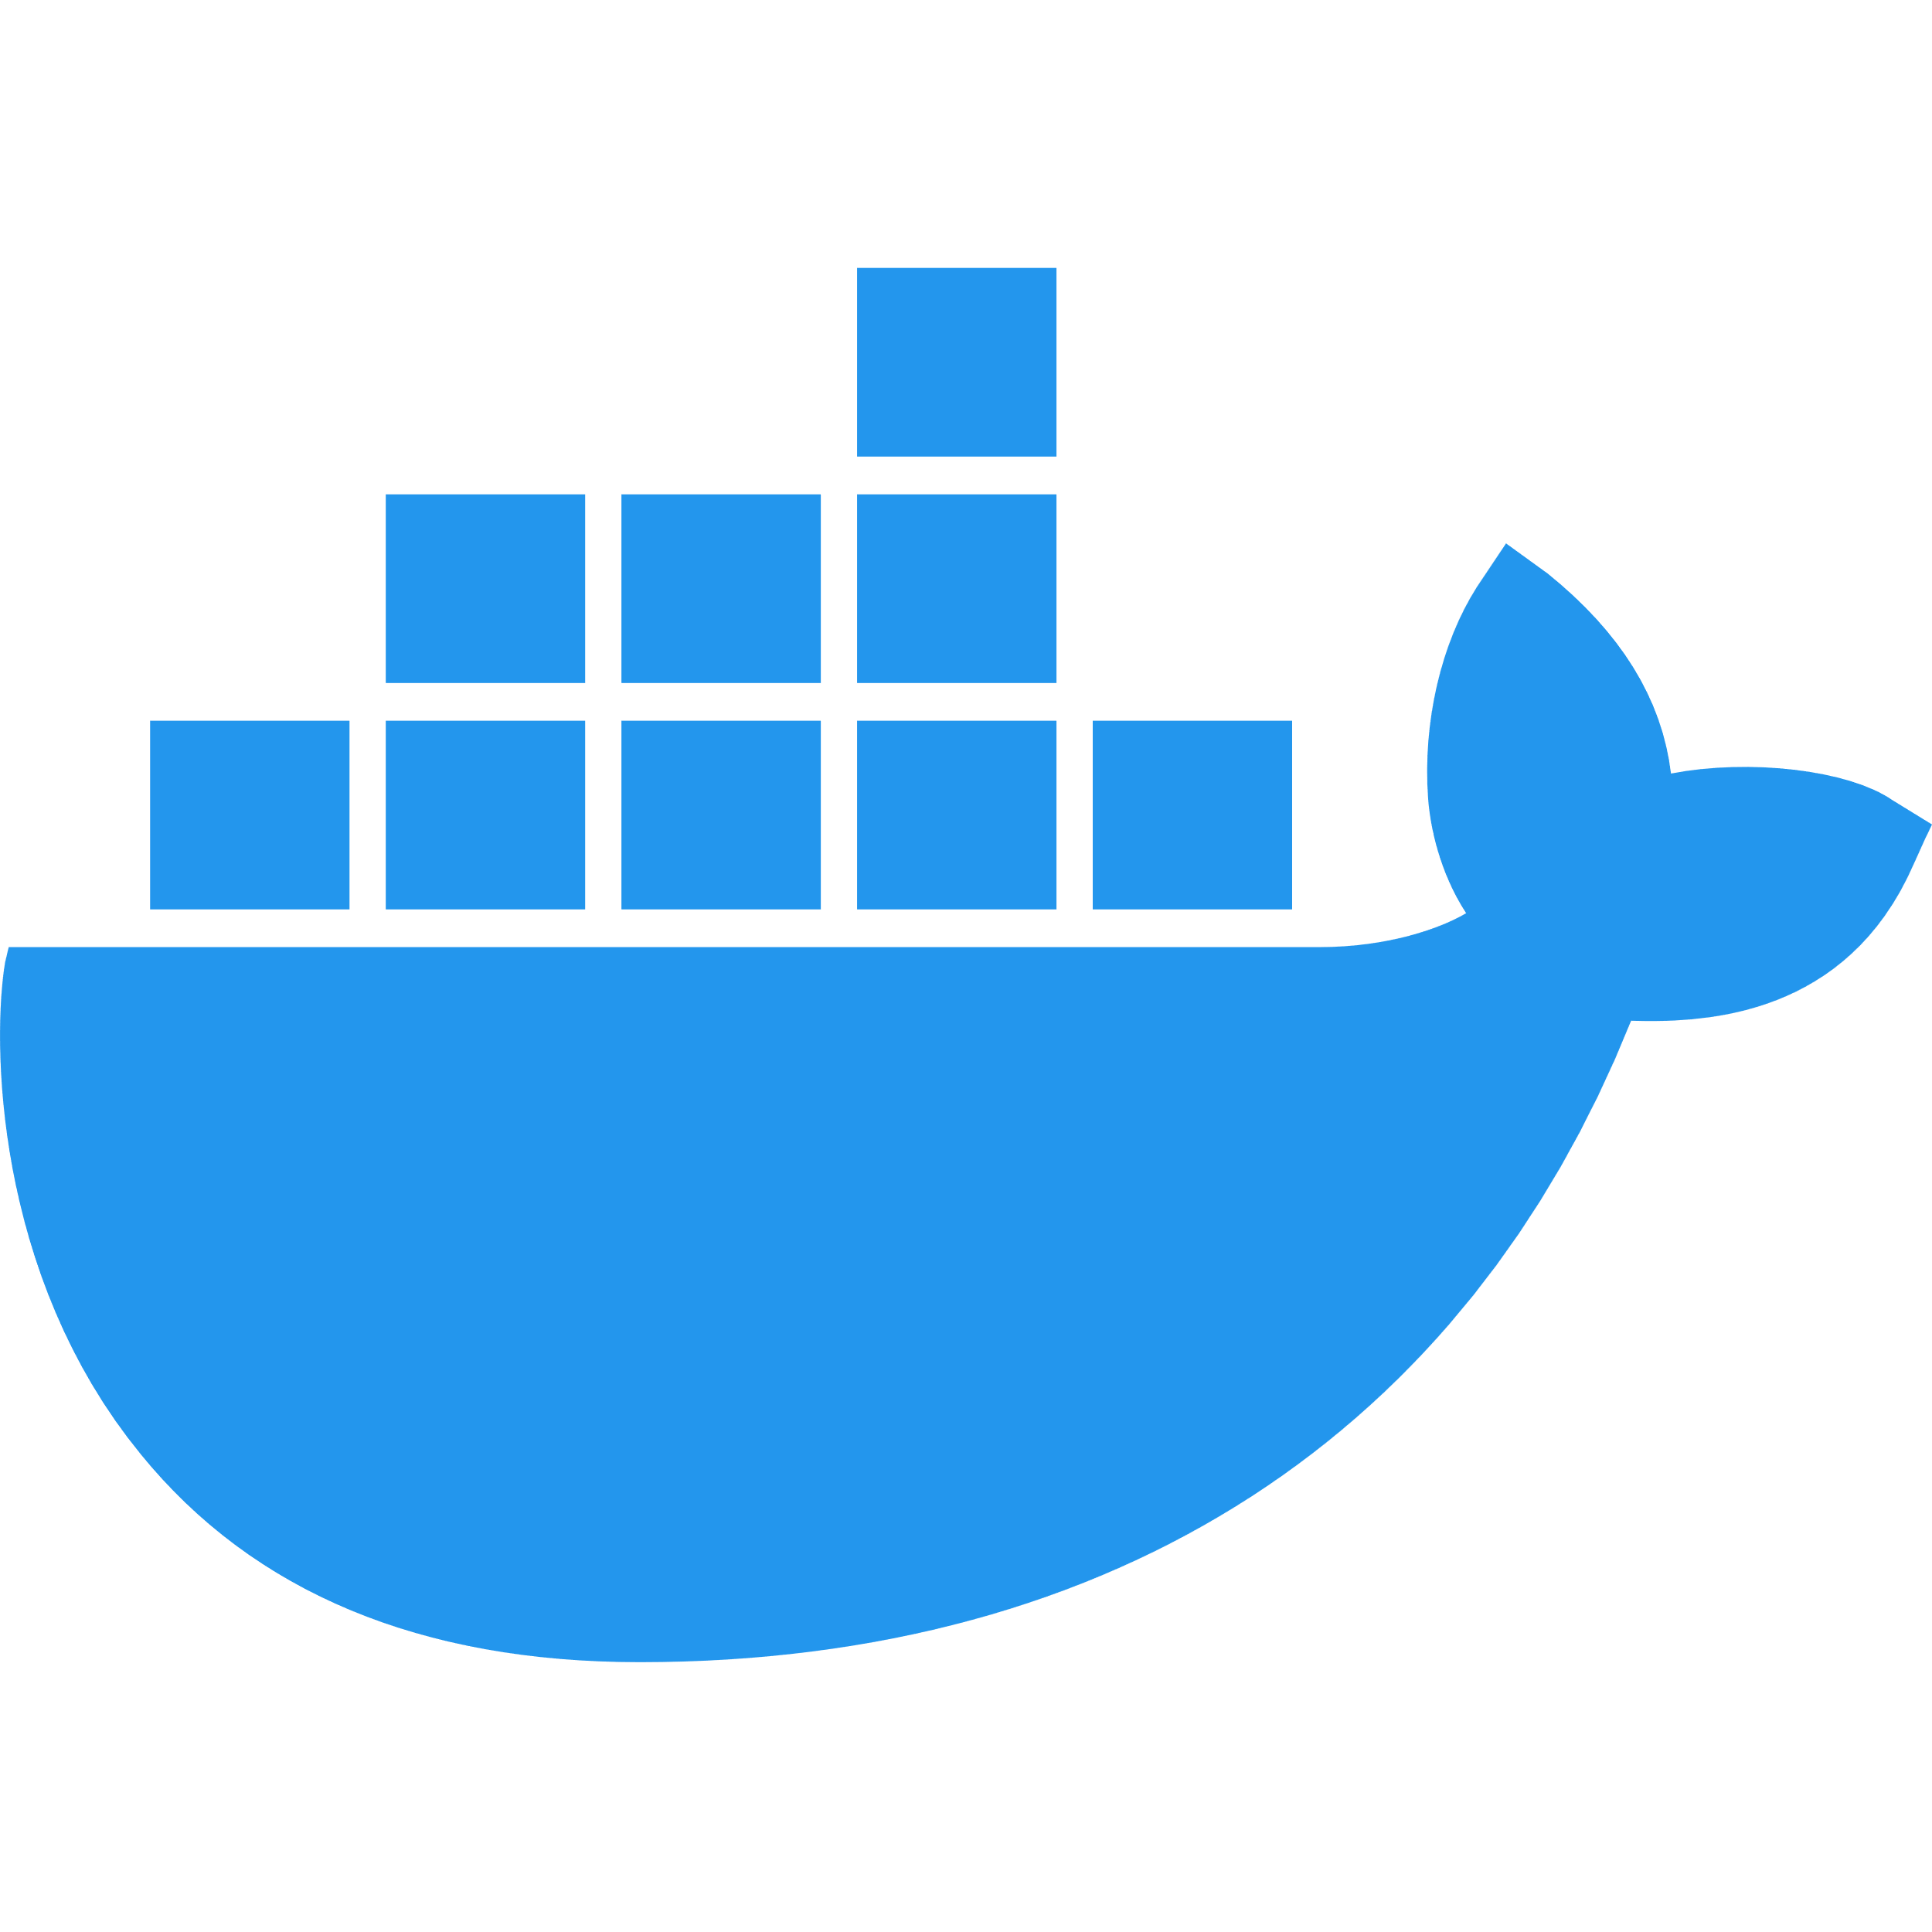


Trace full provenance,
and make it reproducible.
$ datalad run
$ datalad rerun

Slide 53
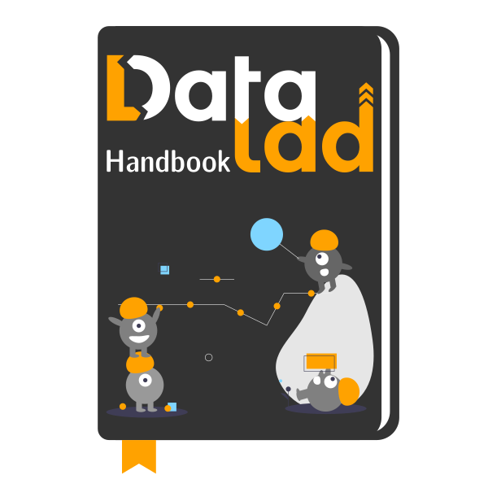
Try Datalad,
read the Handbook.

Slide 54
Belgian Reproducibility Network
ULiège local node kick-off meeting
Thank you for attending !
Stay in touch:
info@reproducibilitynetwork.be
jbiernaux@uliege.be

