Slide 1
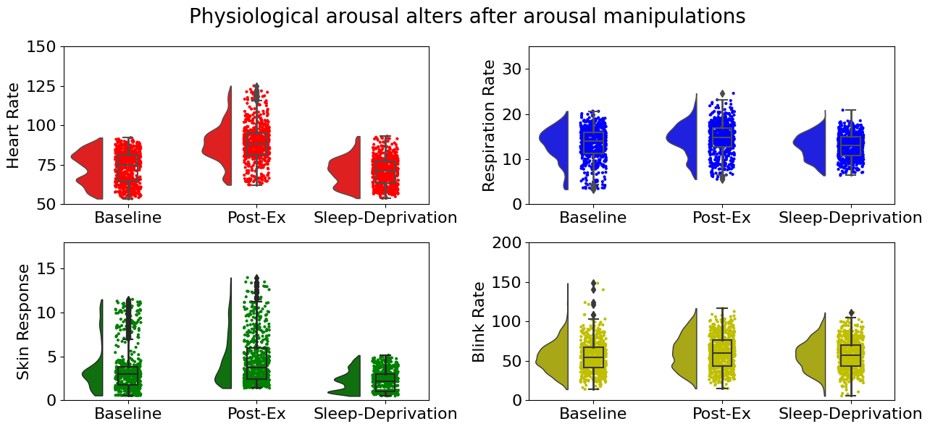
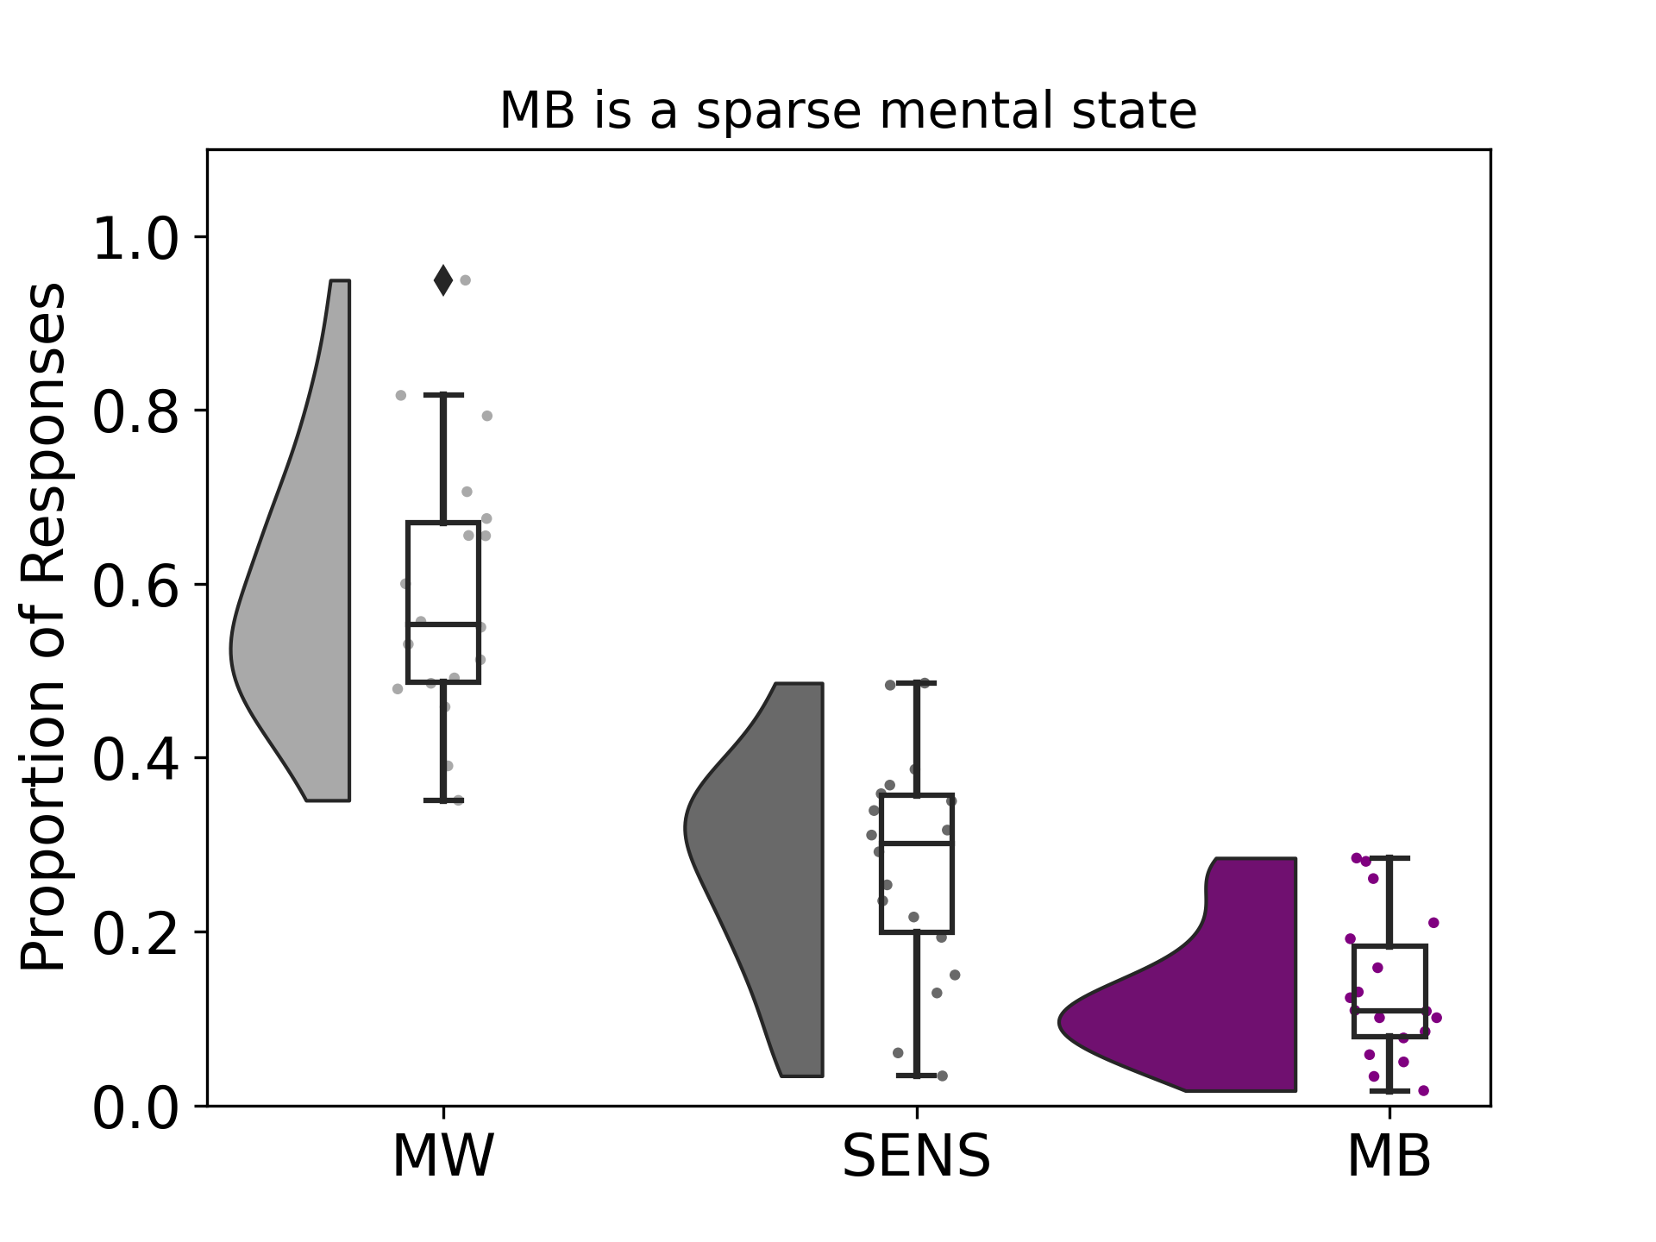
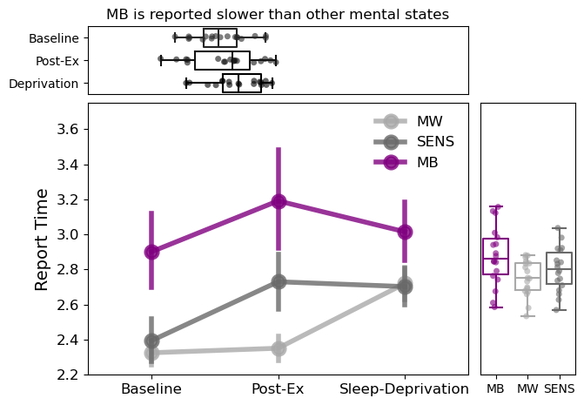
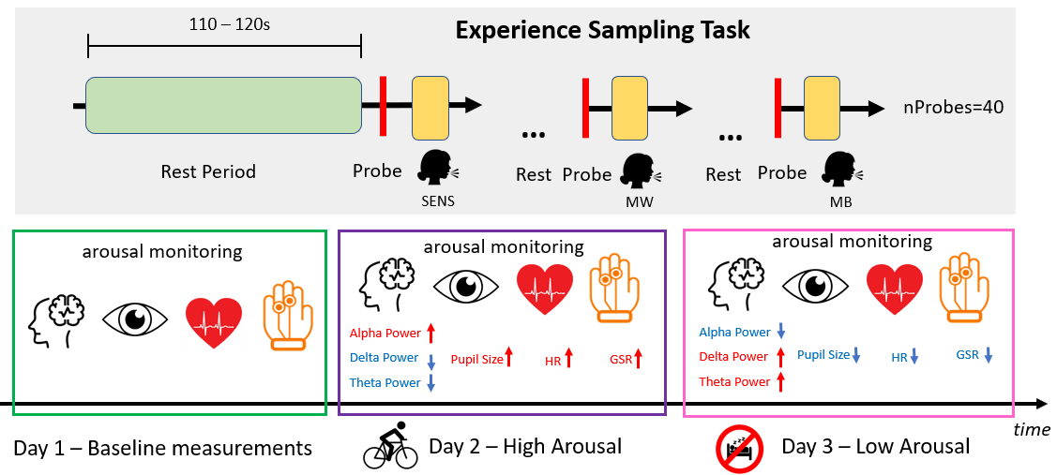
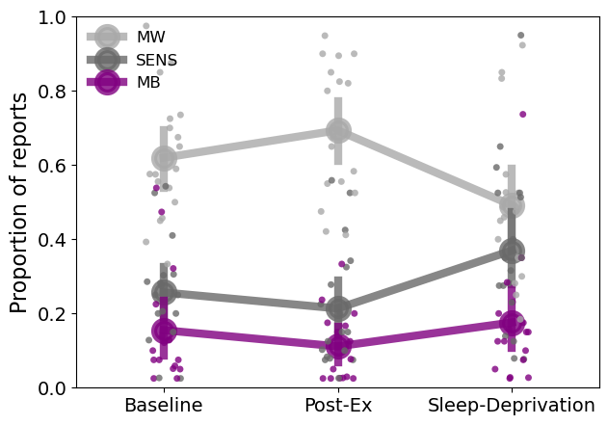
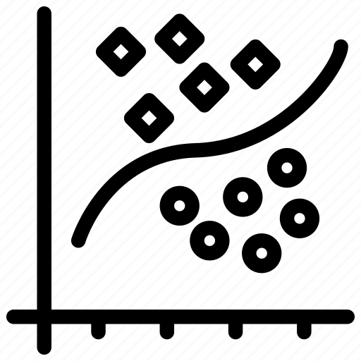
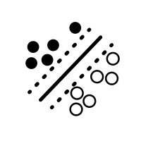
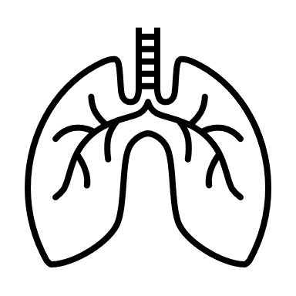
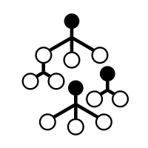
Variations of autonomic arousal mediate mind-blanking report occurrences
Paradeisios Alexandros Boulakis^{1,2}, Federico Raimondo^{3,4}, Sepehr Mortaheb^{1,2}, Christina Schmidt⁵, Athena Demertzi^{1,2,6}
¹Physiology of Cognition Lab, GIGA-CRC In Vivo Imaging Research Unit, GIGA Institute, University of Liège, Liège, Belgium
²Fund for Scientific Research FNRS, Brussels, Belgium
³ Institute of Neuroscience and Medicine, Brain & Behaviour (INM-7), Research Centre Jülich, Jülich, Germany ⁴Institute of Systems Neuroscience, Medical Faculty, Heinrich Heine University Düsseldorf, Düsseldorf, Germany
⁵Sleep & Chronobiology Lab, GIGA-CRC In Vivo Imaging Research Unit, GIGA Institute, University of Liège, Liège, Belgium
⁶Psychology and Neuroscience of Cognition Research Unit, University of Liège, Liège, Belgium
Introduction
Results
Mind-blanking (MB): inability to report any immediate, past, mental state¹
Neuronal correlates of MB point to altered cortical arousal
Whole brain deactivations¹
Cortical Hypersychronization²
High global signal amplitude²
“Local sleeps” during wakefulness³
Gap in experimental knowledge: If an optimal level of arousal promotes mental states with content, will alterations in autonomic arousal promote MB reports?
H1: Deviations from the optimal arousal levels will increase MB reports.
H2: Brain-autonomic coupling can predict MB responses.
***
***
***
***
***
***
***
***
***
One-way ANOVA -> Tukey HSD
Highlighted differences do not support practical equivalence within an effect size of [-.25,25]
Methods
MB is a sparse mental state
MB is reported slower than other states
Experimental Design
High arousal increases the probability of MB, while low arousal decreases it
Sleep Deprivation – Post Exercise
.01
N = 18
3 sessions: Baseline, Post-Exercise, Sleep Deprivation
One week apart
40 resting state blocks (110-120sec) followed by response probe
Sleep schedule was monitored and matched for each participant
Manipulation of arousal was validated by physiological markers
MB
.06
-.16
.10
.26
MW
.11*
SENS
Analysis
-.23*
-.26*
.16*
Signal
Preprocessing
Features
Model Training
Paired-sample t-test
FDR Correction
EEG
Filtering
ICA
Re-reference
Interpolation
Power Spectra
Connectivity
Complexity
Logistic Regression
Discussion
Pupil
Blink removal
Interpolation
MAD removal
Pupil Dynamics
Blink Rate
Multimodal physiological signals can track arousal levels
MB is sparse and reported slower compared to other mental states
High arousal Lower MB probability
Low arousal Higher MB probability
Moving forward
Extract EEG markers
Train brain-body classifiers to identify MB responses
ECG
Filtering
Smoothing
Heart Rate
Heart Variability
Power Spectra
Support Vector Machine
Respiration
Filtering
Smoothing
Breath Rate
Breath Variability
Power Spectra
GSR
Skin Responses
Tonic GSR
Phasic GSR
Random Forest Classifier
Interpolation
Filtering
Smoothing
References
Cross-validation: 5-fold stratified
Optimization metric: F1-score
Train in all samples -> Validate that MB has unique physiological correlates
Leave one subject out -> Generalize relationships to unknown population
Boulakis, P. et al. Whole-Brain Deactivations Precede Uninduced Mind-Blanking Reports. J. Neurosci. (2023).
Mortaheb, S. et al. Mind blanking is a distinct mental state linked to a recurrent brain profile of globally positive connectivity during ongoing mentation. PNAS (2022).
Andrillon, T., , N. et al . Predicting lapses of attention with sleep-like slow waves. Nat Commun (2021).
Find us
Paradeisios.Βoulakis@uliege.be
www.gigaphysiologycognition.uliege.be

