Slide 1

Age-dependent attentional style and arousal regulate the reportability of spontaneous mental states
Boulakis Paradeisios Alexandros, M.A
Neurocog2023
Physiology of Cognition Lab
GIGA CRC In Vivo Imaging
University of Liège
Notes:
Hello everyone, my name is Boulakis Paradeisios and I am a PhD candidate at the Physiology of Cognition Lab in Liege. Today I will be presenting some novel results on a new topic called «mind blanking, which I hope you wil find as interesting as I do

Slide 2



Mental life has blindspots
“ a transient cognitive or emotional state of the organism that can be described in terms of its contents (what the state is 'about') and the relationship that the subject bears to the contents (for example, perceiving, believing, fearing, imagining or remembering)”
Ward and Wegner. 2013. Front Psychol
Christoff et al. 2016. Nat Rev Neurosci
Notes:
The thought centric conception of our mental lives is that they are dominated by mental states, a transient cognitive or emotional state of the organism that can be described in terms of its contents (what the state is 'about') and the relationship that the subject bears to the contents (for example, perceiving, believing, fearing, imagining or remembering)”. A case would be driving, where the content is the road and our attitude towards it is attentiveness. Another mental state would be mind-wandering, where content is defined as reflecting non-immediate items to our environment, and our attitude towards it can vary from runimication to engagement. However, recent studies have shown that people also report something else: absence of any thoughts. These brief periods of mental unreportability, where people claim they are thinking of nothing or their minds went away are termed mind-blanking, and repsent brief periods of phenomenal blank during wakefulness.

Slide 3
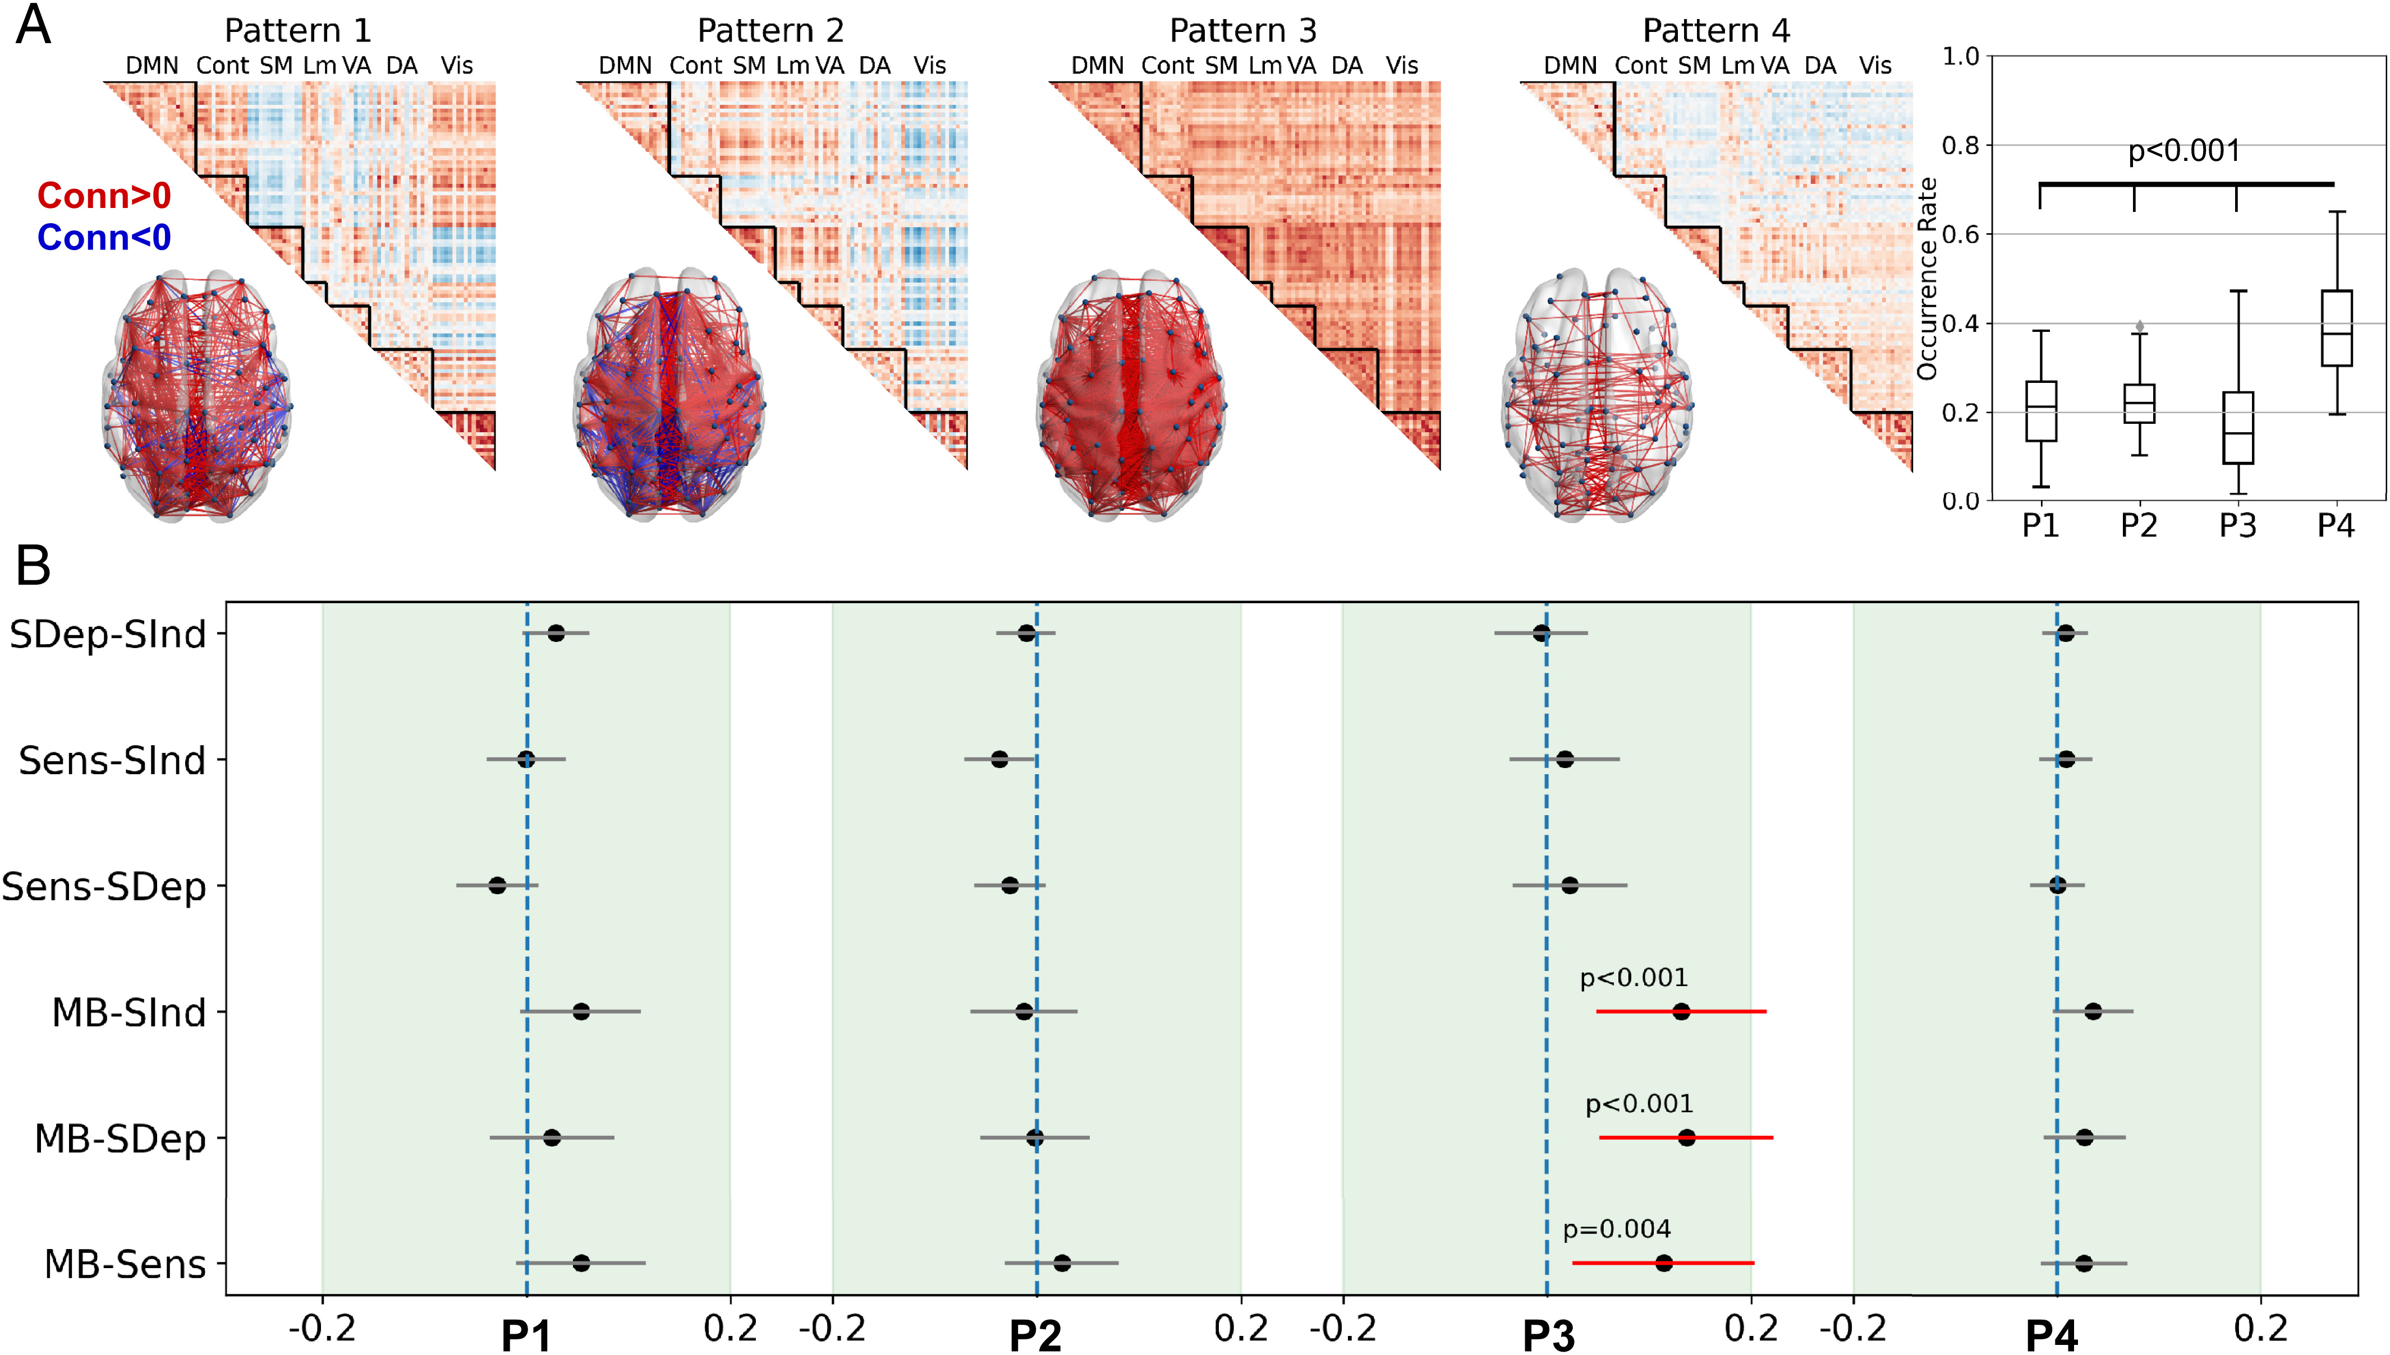
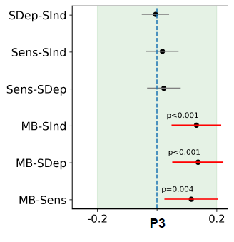
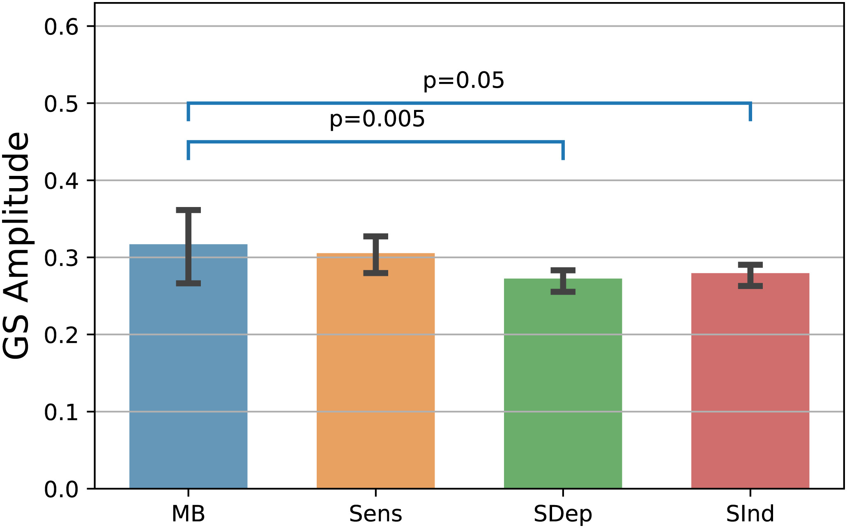
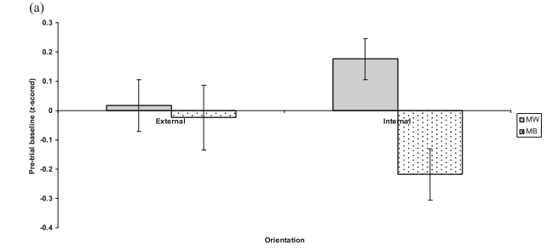
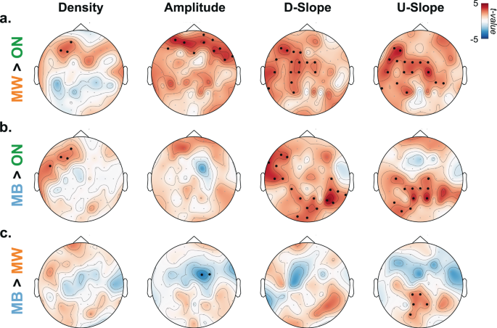
Mind-blanking has distinct neurophysiological correlates
Mortaheb 2022, PNAS
MW MB
MW MB
Andrillon 2021, Nat Comm.
Unsworth and Robinson, 2018, Cogn Affect Behav Neurosci
Notes:
Although mind-blanking research is in its infancy, the neuronal correlates of mind-blanking present present as a stark difference compared to mental states with reportable content. at our lab, we examined the dynamical brain patters preceding this specific experience. By estimating phase dynamical coherence matrices and utilizing a clustering approach on these dynamic matrices, we were able to create 4 representative pattern of the brain connectome. What was most interesting is that neuronal brain configuration preceding mind-blanking is characterized by high inter-areal coherence, meaning high integration and absence of segration in the form of anticorrelations. That was in sharp contrast to mental states with clear content, where the brain characterized by anticcorelated patterns. This pattern meaningfully predicted mind-blanks only at the inclusion of the fmri GS in our analysis. As the GS amplitude is a marker of physiological arousal by proxy of its physiological affent contributions, and the fact it is modulated by arousal stimulants, we believe that this presents us with unique physiological and neuronal information about the brain-body state supporting mind-blanking. In the mean time, on shorter timescales, MB could be differentiated by MW based on the presence of parietal slow waves compared to MW. Slow waves are typical markers of sleep, however intrustions in wakefulness have been associated with attentiona lapses. Their localization has provided some positive results in understanding MB. Finally, pupil, a direct marker of arousal from the ascending arousal system was differentiated between MB and MW.

Slide 4
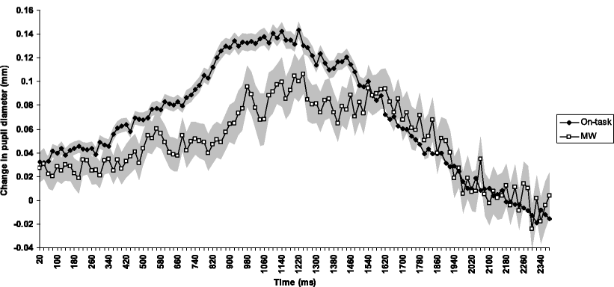
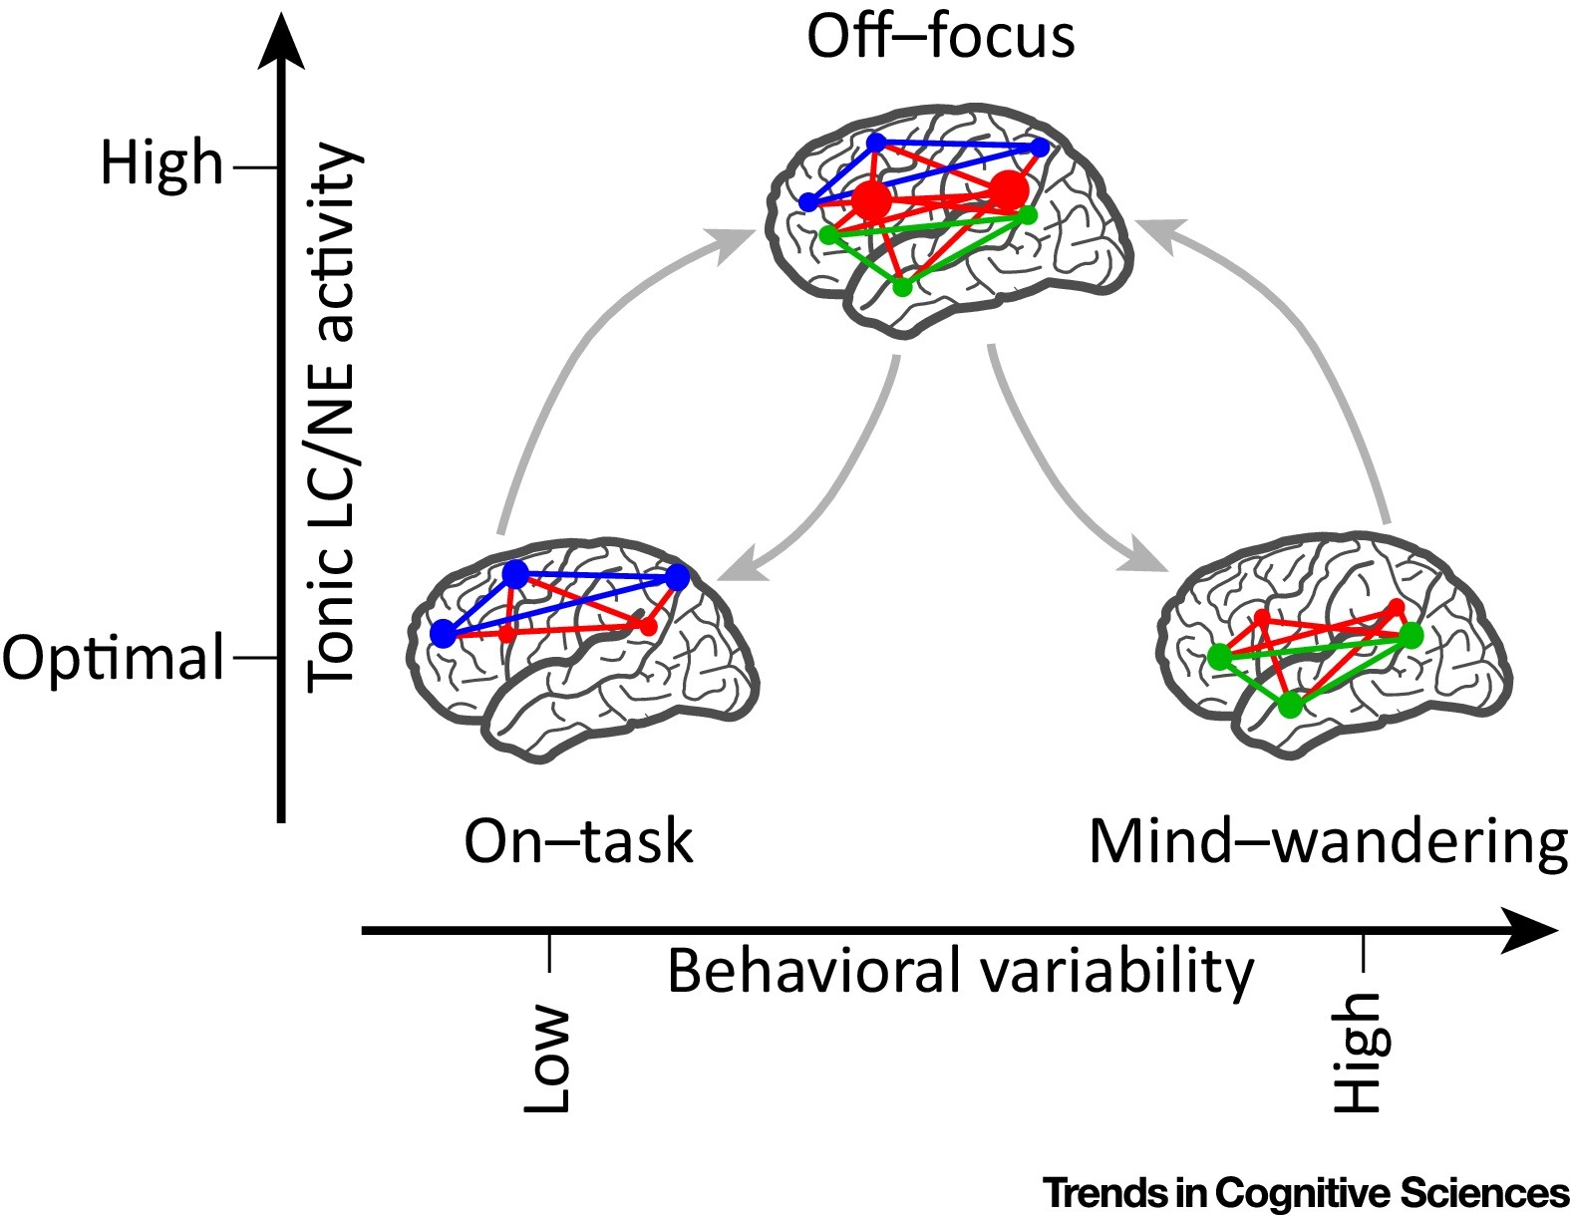
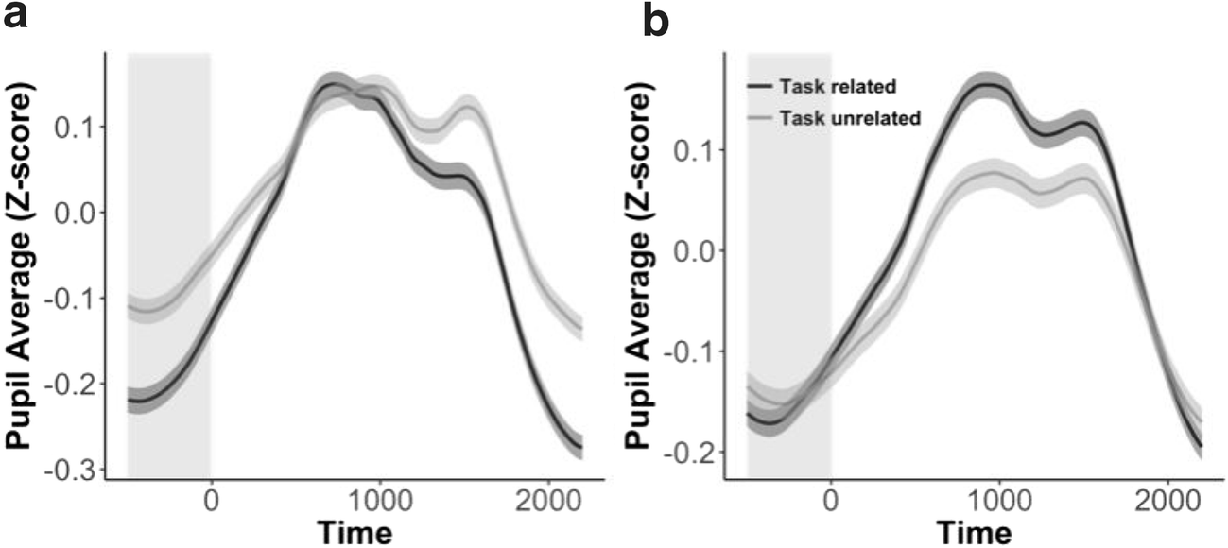
Arousal variations can index thought dynamics
Unsworth and Robinson, 2018, Cogn Affect Behav Neurosci
Mittner, 2016, Trends Cogn. Sci
Jubera-Garcia, 2020, Atten Percept Psychophys.
Notes:
The neuronal ties of arousal and MB come to fill in a discussion on how our thought evolve as a function of arousal.
In the sketched model, Mittner suggests an optimal level of vigilance and cognitive performance is dictated by the current levels of the organism’s arousal, as indexed by the function of arousal generating system in the locus coeruleus. An optimal level of arousal is essential for maintaining performance in directing our thoughts. This includes mind-wandering, as it demands an effort to guide thought-dynamics to the appropriate relevant environment-independent thoughts. Inversely, non-optimal arousal levels will result in exploratory behavior, supported by often competing, non relevant thoughts. Traditionally, LC activity has been indexed by pupillometry. In such a case, the results have been conflicting for this model. Although task-related arousal has been higher then intrusive MW thoughts, separating thoughts as clear and non-clear has not produced positive results. Here, we see that MB not only can potentially account for the whole spectrum of the arousal curve, but can deconvolve exploratory thoughts with absence of thoughts, as MB was grouped under the banner of MW thoughts in previous literature.

Slide 5
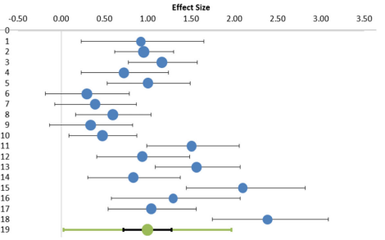
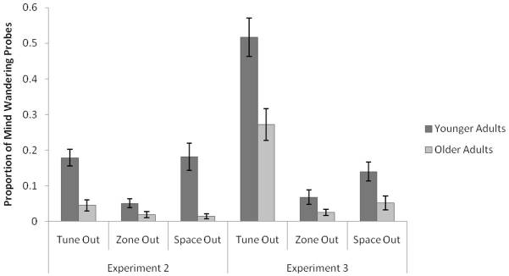
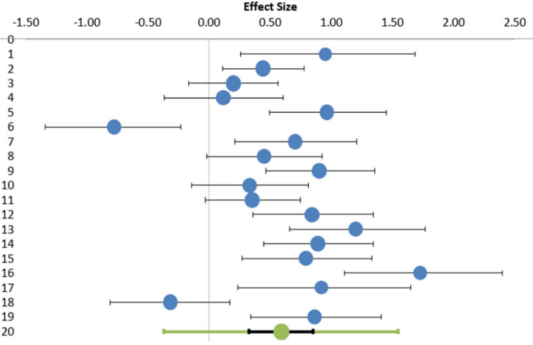
Thought dynamics and attention varies with ageing
Slower Responses
Better Performance
Jackson and Balota, 2012, Psychol Aging
Vallesi, 2021, Psychon Bull Rev.
Notes:
Ageing presents us with an opportunity to get a better understanding of this relationship. Ageing, typically associated with altered physiological arousal and physiological responsivenes, have shown quite a distinct profile of thought dynamics, with fewer MW instances and attentional affordances, with more careful and prudent strategies. Therefore, it presents us with a very interesting population to contrast its thought dynamics.

Slide 6
RQ: How does ageing affect ongoing thinking ?
Ongoing Thinking
Age
Arousal
Attention
H1: Seniors -> lower rates of MW
higher rates of MB
H2: MB will increase in lower arousal
(smaller pupil size).
H3: Mental states is mediated by attentional style.
Notes:
And that’s what we set out to do. We wanted to see how ongoing thinking intersects with age, arousal and attention.

Slide 7
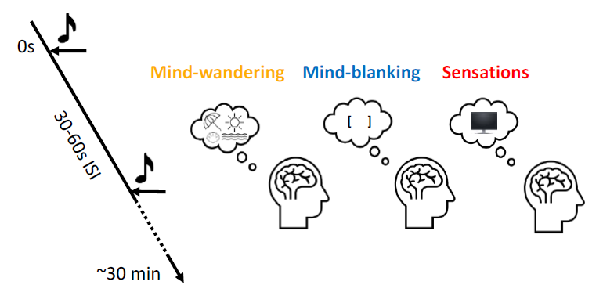
Spontaneous thought experience-sampling
20 Senior (65-75) vs. 20 Young (20-30)
40 trials, resting period ~40s
Arousal: Pupillometry
Attentional Style: Attentional Style Questionnaire
Notes:
During experience-sampling participants are asked to restfully lay in the scanner with eyes open and let their mind wander without any further orientation as to the focus of their thoughts. At random intervals between 30 and 60 seconds, participants are probed with an auditory cue to report the content of their thoughts at the moment preceding the probe using a button press. Four available report categories were presented as available: Mind-Blanking (MB), Sensations (Sens) and MW.

Slide 8
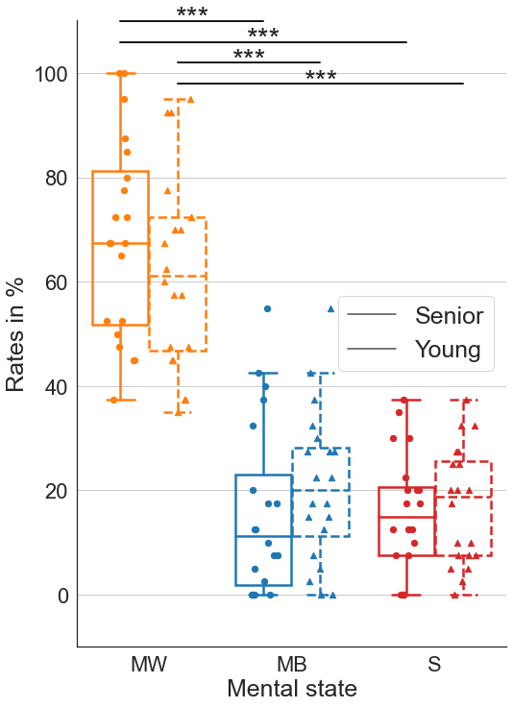
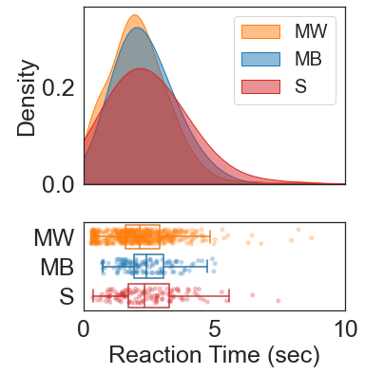
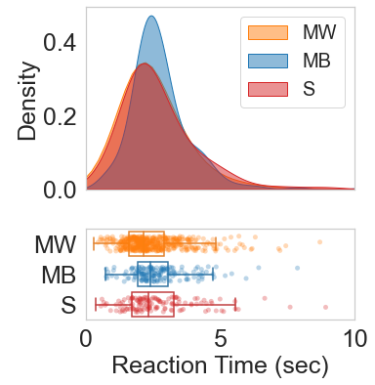
Mental states are reported similarly in both age groups
Seniors
Young Adults
Notes:
Our first results confirmed that mind-blanking is indeed reported less frequently than mental states with content. However, we found no significant difference between the age groups in report frequency
Additionally, we have no positive results on the presence of different report time differences between mental state.

Slide 9
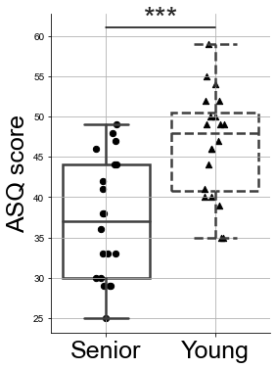
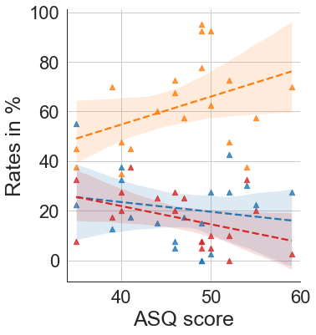
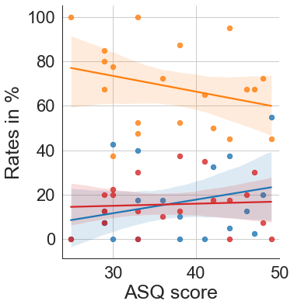
Age reverses the effect of attentional style on mental states
Young Adults
Seniors
Less focused
MW
SENS
MB
MW
SENS
MB
More focused
Notes:
Furthermore, we replicated the result that seniors report higher levels of focus, as marked by lower scores in the ASQ. What was interesting is that age seems to inverse how attentional style affects mental state reports. In younger people, as focus increases, MW reports decrease. Inversely, in seniors, as focus increases, MW reports increase as well. This potentially reflects that MW is a more purposeful mental state, and that seniors put more effort in guiding their MW.

Slide 10
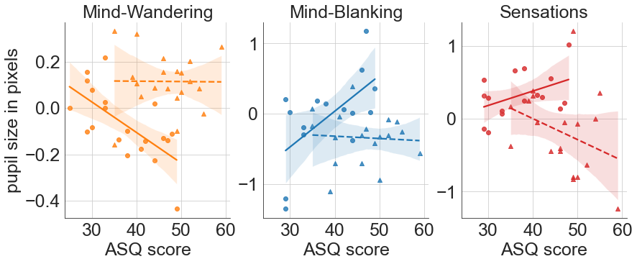
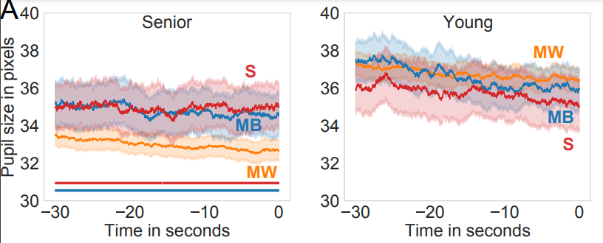
Arousal differentiates mental states only in seniors
*
Notes:
Finally, we examined whether arousal, as indexed by pupil size, can predict mental states. Overall, we found that in seniors, pupil was constricted in MW compared to other mental states. We found no evidence for positive results in young adults. What was additionally interesting for seniors was the fact that, for high attentional control, which before we showed is related with more MB reports, MW and MB was separate based on pupil dilation. More arousal resulted in more MW, less in more MB.

Slide 11
Attentional style interacts with arousal in seniors
Young
Seniors
Young
Seniors
Young
Seniors
Notes:
Focusing in on the role of arousal in mental states in seniors, we see an interaction between arousal and attentional control.

Slide 12
How does ageing affect ongoing thinking ?
Ongoing Thinking
Age
Arousal
Attention
H1: Seniors -> lower rates of MW
higher rates of MB
H2: MB will increase in lower arousal (smaller pupil size)
H3: Mental states are mediated by attentional style
No significant differences
only in seniors with good attentional control.
depending on age group

Slide 13
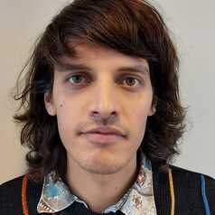









The team
Matthieu Koroma
Aurèle Robert
de Beauchamp
Sepehr Mortaheb
Paradeisios Alexandros
Boulakis
Christine Bastin
Athena Demertzi
Preprint
Code
Data Access

Slide 14
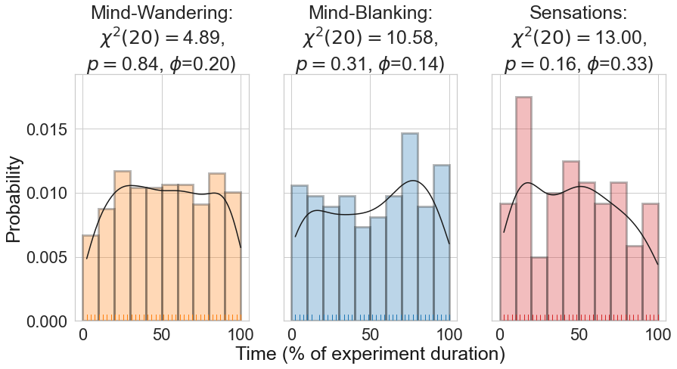
Supplementary 1
Mental states do not differ in their time course

Slide 15
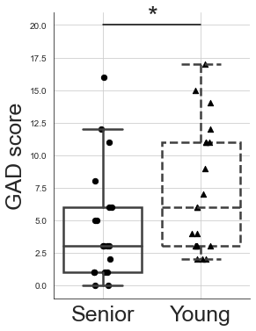
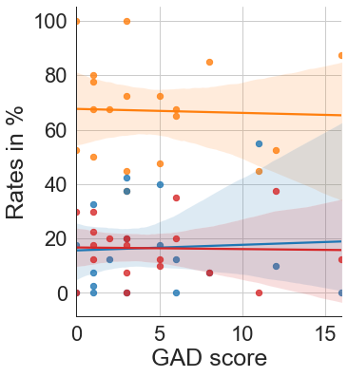
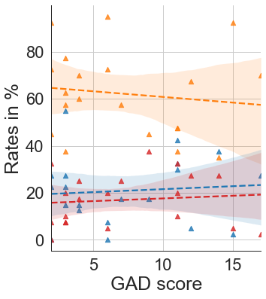
Supplementary 2
No significant interaction between GAD and mental state reports

Slide 16
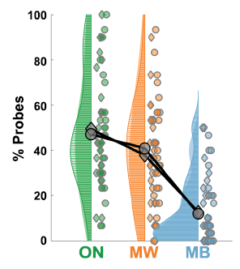
Supplementary 3
MB is a sparse mental state
Andrillon 2021, Nat Comm.
Mortaheb 2022, PNAS

Slide 17
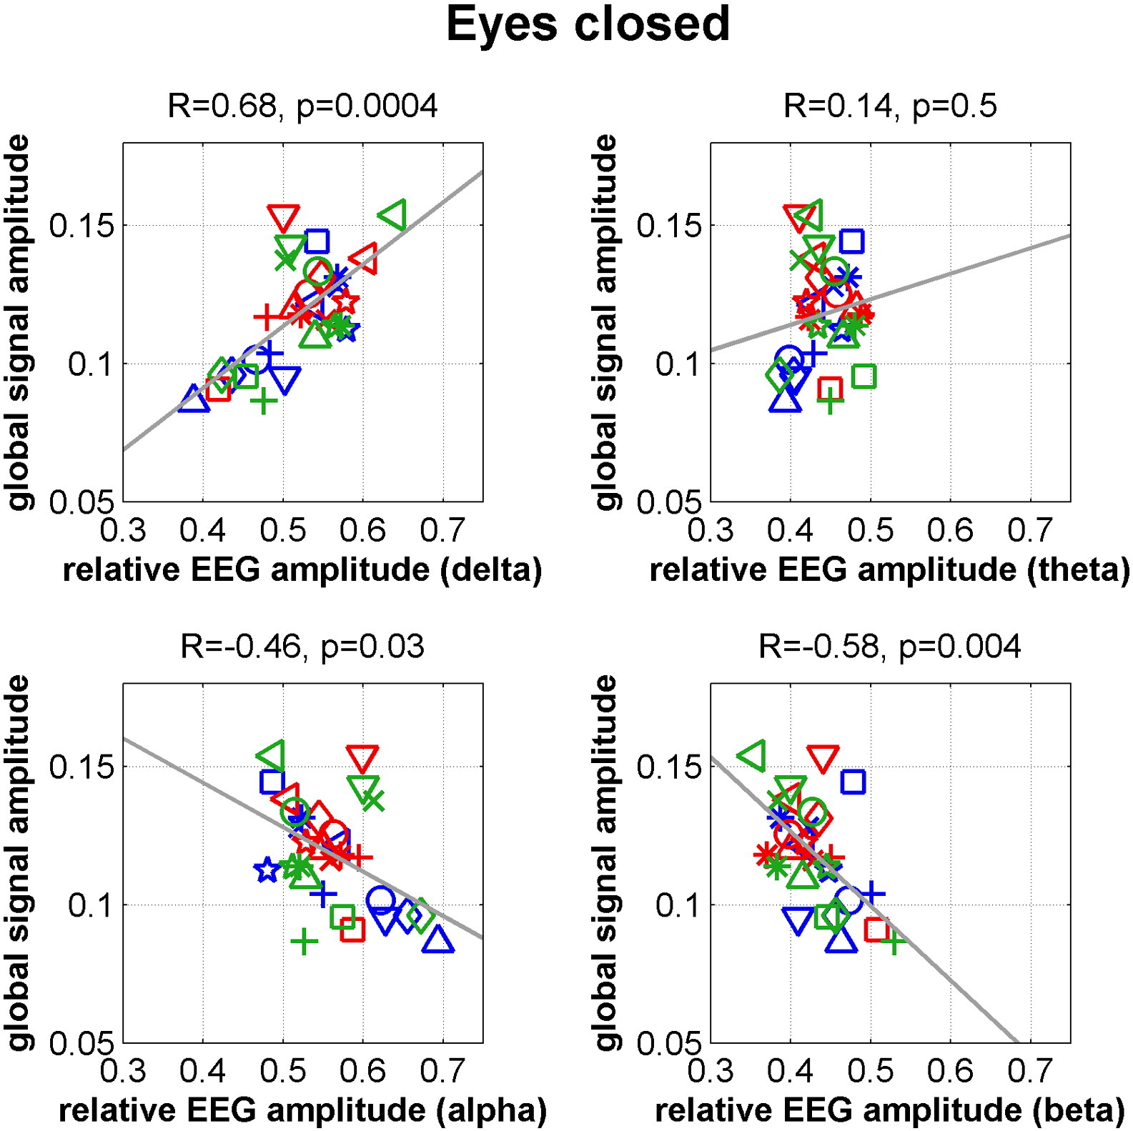
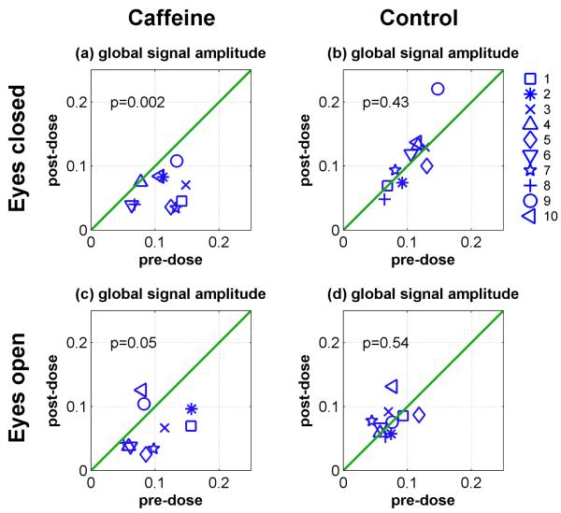
Supplementary 4
The GSA is correlated to cortical arousal
GSA follows EEG vigilance indexes
Wong, 2013, Neuroimage
GSA decreases with arousal stimulants
Wong, 2012, Neuroimage

Slide 18
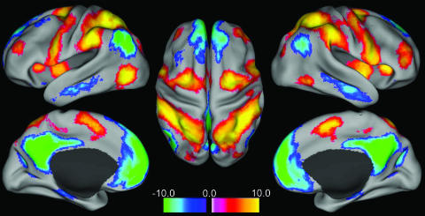
Supplementary 5
Anticorrelations support mental states with thoughts
Fox, 2005, PNAS
Mortaheb, 2022, PNAS

Slide 19
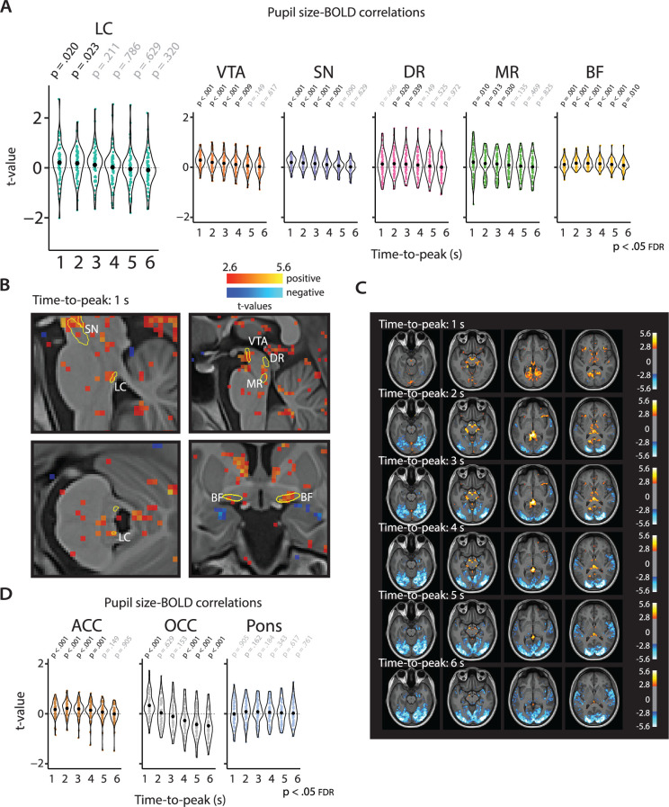
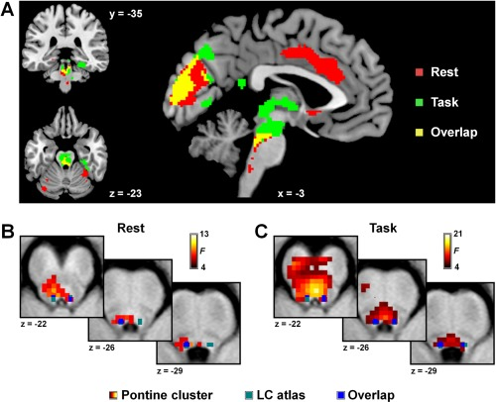
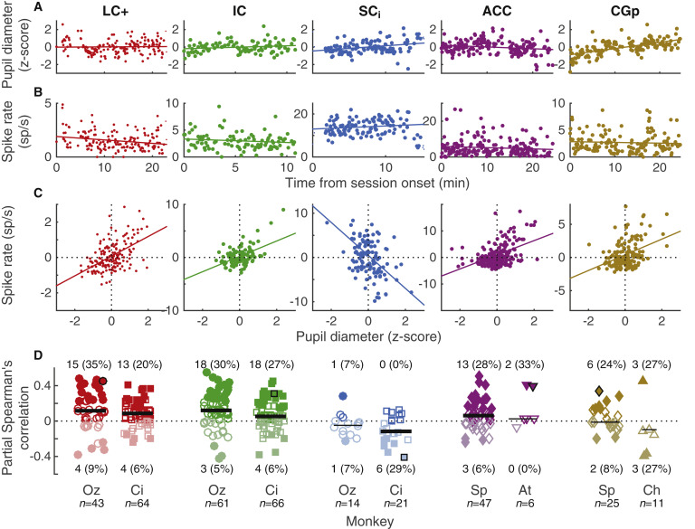
Supplementary 6
Pupil tracks subcortical arousal nuclei
BOLD signal during rest in humans
Lloyd, 2023, eLife
Task and rest in humans
Murphy, 2014, Human Brain Mapp
Spike rate during rest in animals
Joshi, 2016, Neuron

Slide 20
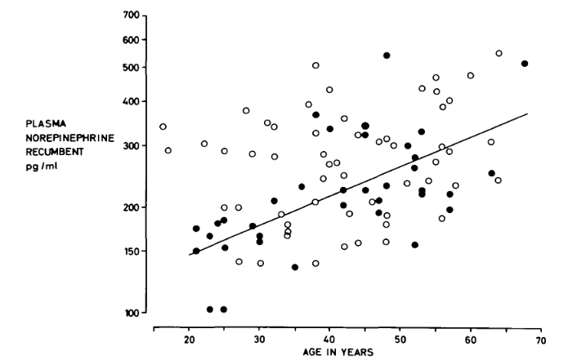
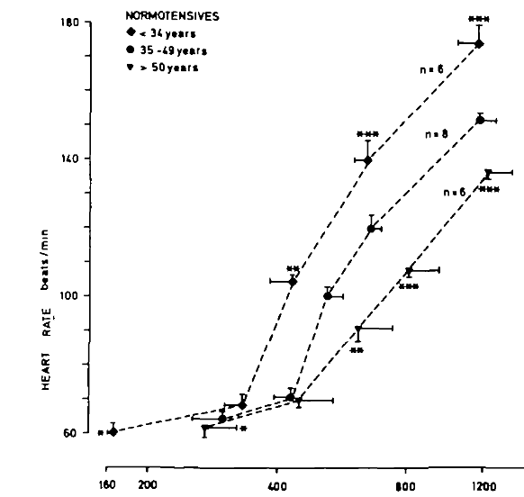
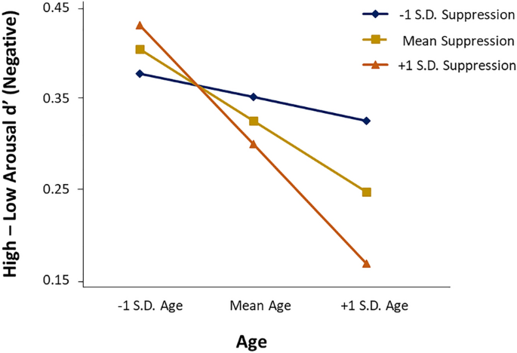
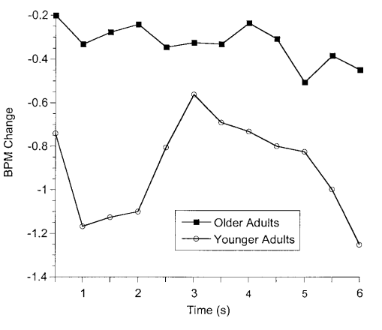
Supplementary 7
Altered arousal in seniors
Bartel, 1980, Hypertension
Physiological Alterations
Decreased androgenic receptor responsiveness
Elevated SNS activity
Mental Strategies
Seniors show increased norepinephrine concentrations
Younger adults show higher HR increase in exercise
More physiologically reactive pending task demands ?
Seniors show reduced arousal related benefits in mnemonic discriminability
Lee, 2023, Sci Rep
Seniors show reduced reactivity to stimuli
Smith, 2005, J Genont Sci: Psychol Sci

