Slide 1
Atherectomy with Drug-Eluting Balloon for Common Femoral Artery Occlusive Disease: 2-Year Experience Arnaud Kerzmann, MD, Evelyne Boesmans, MD, Charlotte Holemans, MD, Delphine Szecel, MD, Vlad-Adrian Alexandrescu, MD, PhD, Jean-Olivier Defraigne, MD, PhD Cardiovascular and Thoracic Surgery Department University Hospital of Liège Belgium November 15, 2023

Slide 2
Disclosures
Arnaud Kerzmann, MD
Consultant:
BD, Boston Scientific
Grant/research support:
Medicor, iVascular

Slide 3
Objectives
Gold standard treatment for occlusive lesions of the common femoral artery used to be endarterectomy.
In recent years, interest for endovascular treatment of the common femoral artery has been increasing¹.
Stenting of the common femoral artery is possible^{1,2} but we believe it is better to avoid it. Calcified arterial lesions are not well treated with drug-coated balloons (DCB) alone³.
¹ Deloose K, Martins I, Neves C, Callaert J. Endovascular treatment for the common femoral artery: is there a challenger to open surgery? J Cardiovasc Surg. 2019;60:8-13.
² Gouëffic Y, Della Schiava N, Thaveau F, Rosset E, Favre JP, Salomon du Mont L, Alsac JM, Hassen-Khodja R, Reix T, Allaire E, Ducasse E, Soler R, Guyomarc'h B, Nasr B. Stenting or Surgery for De Novo Common Femoral Artery Stenosis. JACC Cardiovasc Interv. 2017;10:1344-1354.
³ Fanelli F, Cannavale A, Gazzetti M, Lucatelli P, Wlderk A, Cirelli C, d'Adamo A, Salvatori FM. Calcium burden assessment and impact on drug-eluting balloons in peripheral arterial disease. Cardiovasc Intervent Radiol. 2014;37:898-907.

Slide 4
Objectives
Atherectomy followed by DCB angioplasty do better than atherectomy followed by plain old balloon angioplasty⁴.
Our aim was to evaluate vessel preparation with rotational atherectomy followed by DCB angioplasty to treat common femoral artery calcified occlusive disease.
⁴ Shammas NW, Shammas GA, Jones-Miller S, Shammas WJ, Bou-Dargham B, Shammas AN, Banerjee S, Rachwan RJ, Daher GE. Long-term outcomes with Jetstream atherectomy with or without drug coated balloons in treating femoropopliteal arteries: A single center experience (JET-SCE). Cardiovasc Revasc Med. 2018;19(7 Pt A):771-777.

Slide 5
Methods
Registry
In one Belgian center: University Hospital of Liège
Start in June 2021
Inclusion of all heavy calcified common femoral artery stenosis and chronic total occlusions
Percutaneous treatment: rotational atherectomy followed by DCB angioplasty
Exclusion: embolic occlusive disease, hybrid procedure (endovascular and open surgery), critical acute ischemia
Primary end point: freedom from target lesion revascularization (TLR)

Slide 6
Results
procedures | 56
men | 33
women | 16
mean age | 75 years old (52-93)
arterial hypertension | 84 % (41/49)
smoking or stopped < 3 years | 61 % (30/49)
diabetes (all types) | 39 % (19/49)
dyslipidemia (all types) | 88 % (43/49)
chronic kidney disease | 39 % (19/49 with 3 dialysis)
Rutherford stage 2-3 | 86 % (48/56)
Rutherford stage 4-5-6 | 14 % (8/56)
mean ankle-brachial index | 0,72 (0,2-1,3)
chronic total occlusion | 9 % (5/56)
mean lesion length | 3,9 cm (2-8)
simultaneous angioplasties | 68 % (38/56)
Between June 2021 and September 2023, 49 patients including 7 with bilateral lesions were treated

Slide 7
Results
All procedures were performed under local anesthesia, except 2 under general anesthesia
42 (75 %) were anterograde with 40 controlateral femoral and 2 humeral punctures, and 14 (25 %) were retrograde with ipsilateral superficial femoral puncture
No filter was used
Technical success rate was 100% with 3 deep femoral retrograde punctures
No arterial perforation was observed
No bail-out stent was needed
One asymptomatic embolization in a deep femoral artery side branch

Slide 8
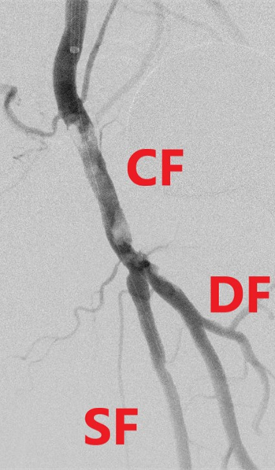
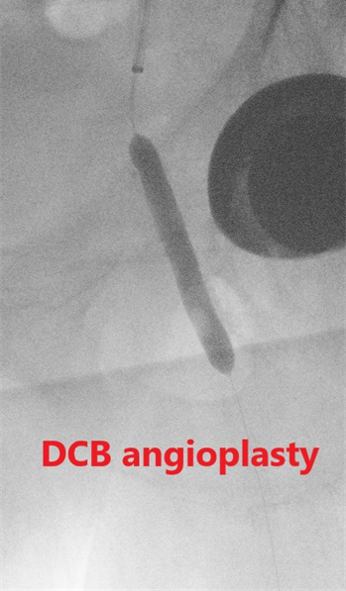
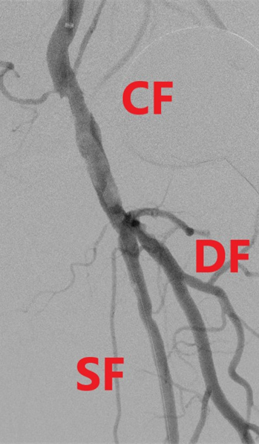
Results

Slide 9
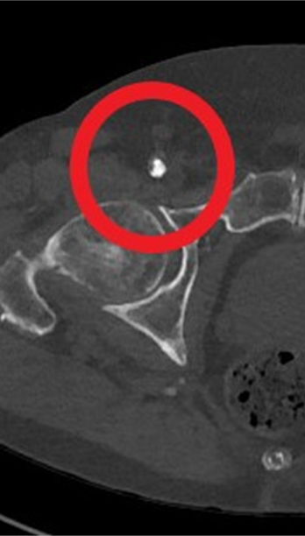
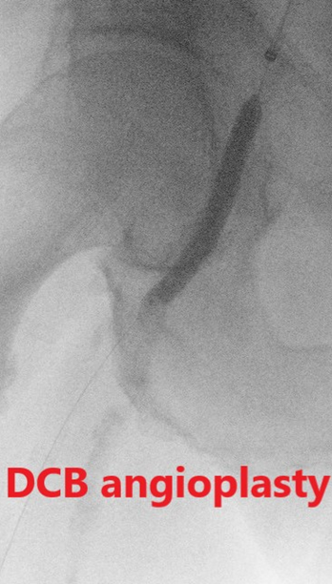
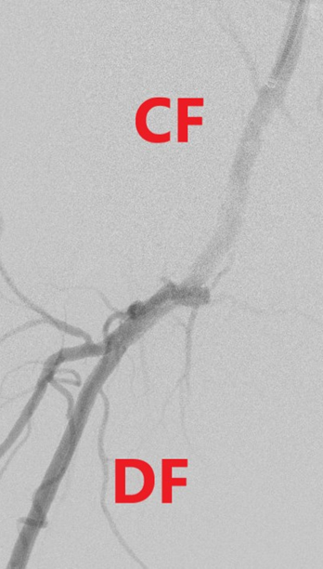
Results

Slide 10
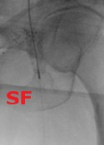
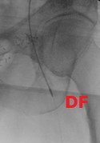
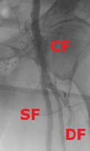
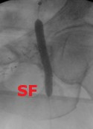
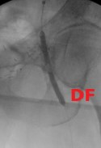
Results Superficial and deep femoral arteries rotational atherectomy

Slide 11
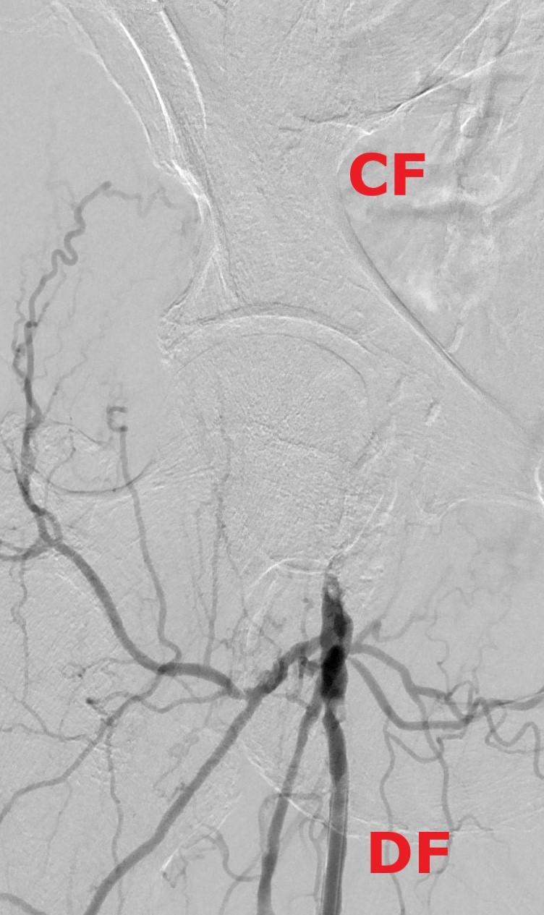
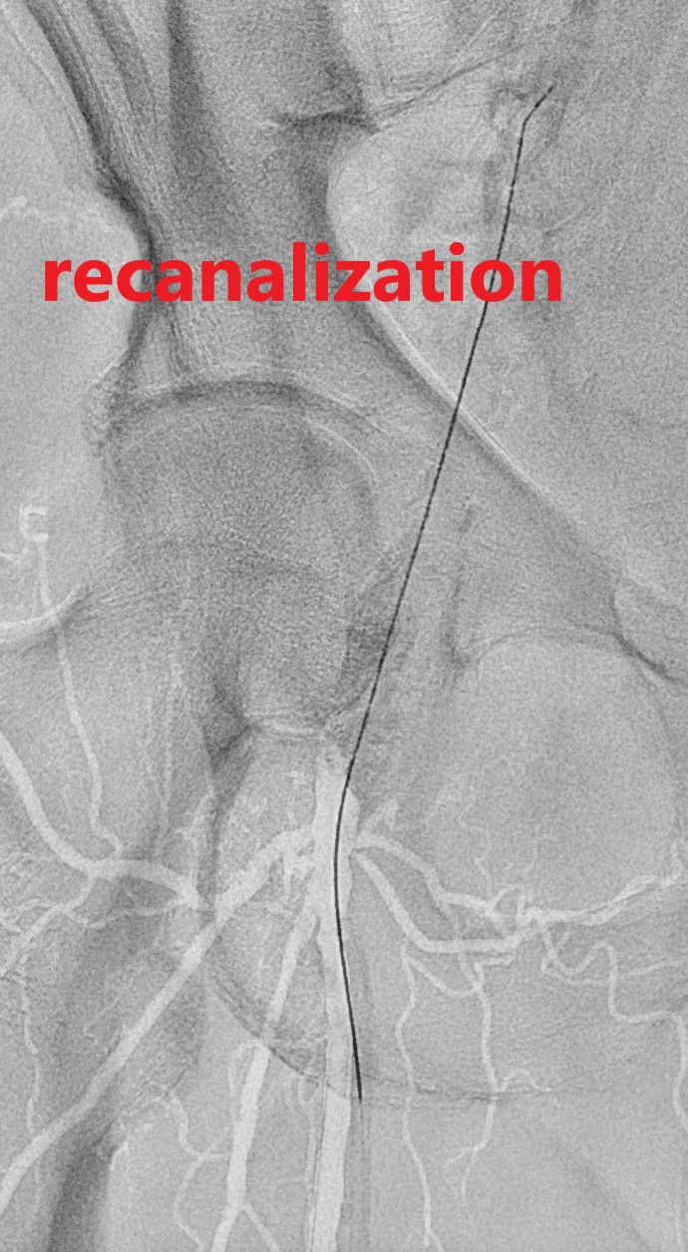
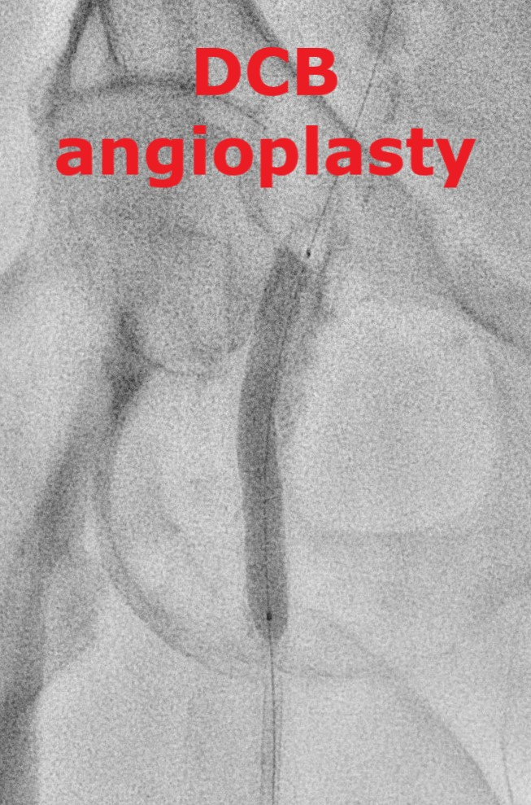
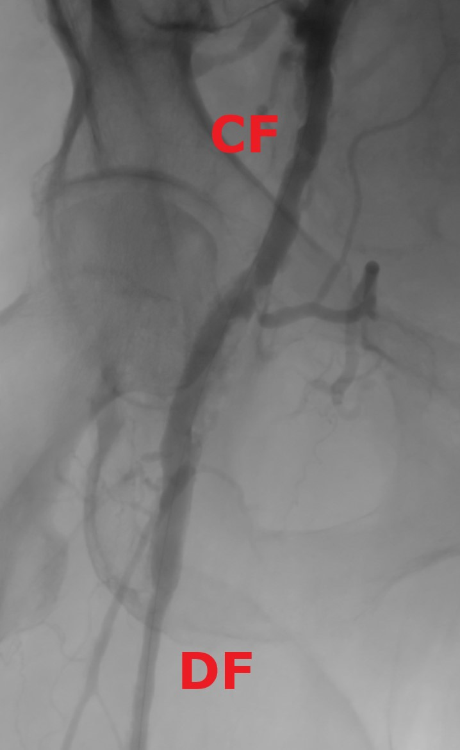
Results Deep femoral artery retrograde puncture

Slide 12
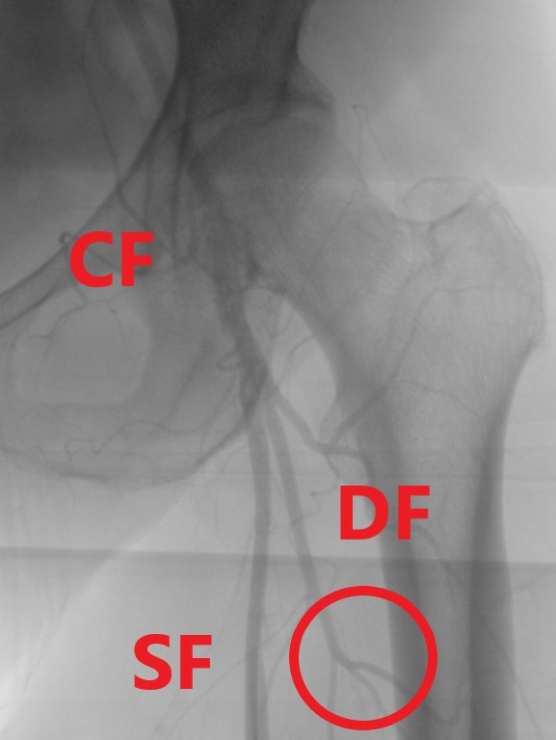
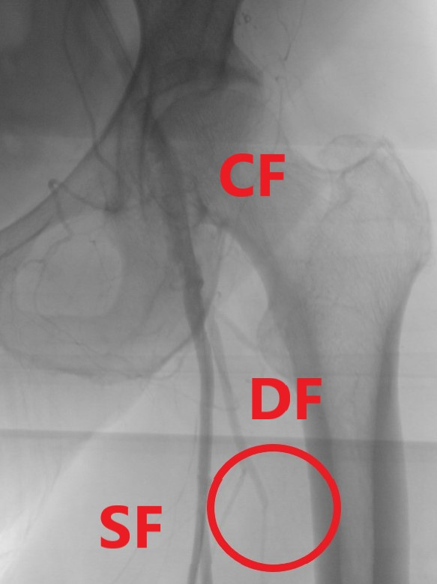
Results
Deep femoral artery side branch embolization

Slide 13
Results
Mean follow-up was 13,4 months
complications | n
mortality at 30 days | 3/49 (MI at D1, AMI D5 and CF D30)
NSTEMI at 30 days | 2/56 (at D1 and D30)
acute kidney injury | 3/56 (5 %)
major amputation | 1 (Rutherford stage 6)
minor amputation | 2 (Rutherford stage 3 and 4)
false aneurysm at the access site | 4/56 (3 thrombin and 1 surgery)
thrombosis at the access site | 2/56 (1 endovascular and 1 surgery)
primary patency (≤ 50% residual stenosis at duplex scan) | 96% (54/56)
freedom from TLR | 91 % (51/56)

Slide 14
Results
All procedures except 5 had improved Rutherford stage
2/5 had recurrent lesion (1 restenosis and 1 reocclusion):
- One redo atherectomy followed by DCB angioplasty 19 months later, for recurrent Rutherford stage 3 due to restenosis.
- One endarterectomy 24 months later for recurrent Rutherford stage 3 due to reocclusion.
3/5 without recurrent lesion needed secondary endarterectomy:
- One for persistent Rutherford stage 3. After the open surgery, the patient had still claudication probably due to underestimated run off vessels disease.
- One with Rutherford stage 6. The patient had secondary ipsilateral femoro-popliteal venous bypass with common femoral endarterectomy. He had later below the knee amputation.
- One with Rutherford stage 3. 14 months later, he developed Rutherford stage 5. He had femoro-popliteal venous bypass with common femoral endarterectomy, BTK angioplasty and 3 toes amputation.

Slide 15
Conclusions
Rotational atherectomy followed by DCB angioplasty for common femoral artery calcified occlusive disease is feasible and safe.
The advantages are
- to avoid the potential complications of the surgical treatment
- to leave nothing behind (no stent)
Freedom from TLR at 13 months: 91%.
Patients selection is essential. The best indication seems to be old patient with intermittent claudication, and the worst CLTI with multi-level extended occlusive disease.

