Slide 1
Simulation-based Bayesian inference for general robotic grasping
Norman Marlier
Aerospace & Mechanical Engineering Department,
Electrical Engineering and Computer Science Department
University of Liège, Belgium

Slide 2
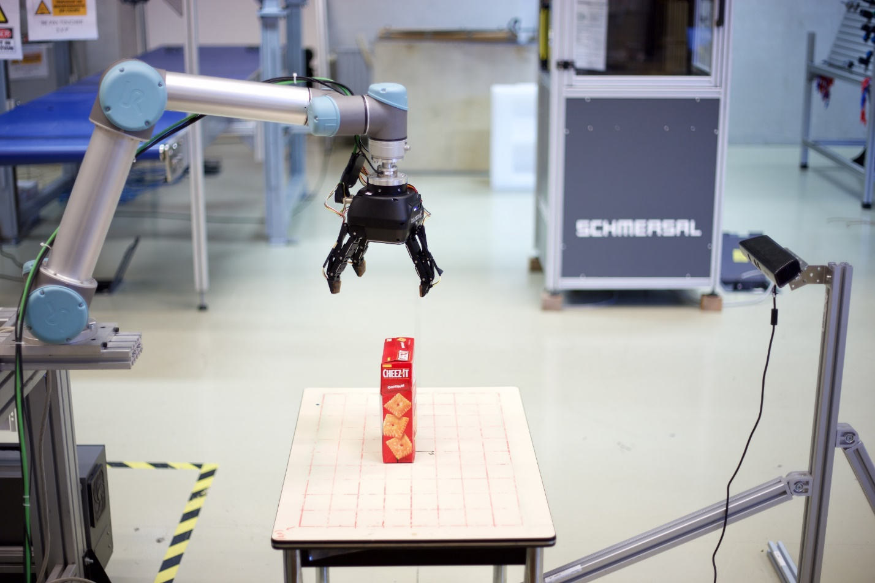
Introduction
Automate the grasping by computing robotic commands
from raw sensor data in a unstructured environment

Slide 3
Real world
Real world is very complex and hard to predict. We often have only a blur picture of it.
Sensors give us raw data with lots of NOISE
We have to make decision under uncertainties
We will use the theory of probabilities to take into account these uncertainties when deciding which command to send.

Slide 4
Bayesian inference
$$p\left(θ | x\right)=\frac{p\left(x | θ\right)}{p\left(x\right)}p(θ)$$
$θ∈$ Θ are the parameters
$x ∈X$ are the observations

Slide 5
Bayesian inference
$$p\left(θ | x\right)=\frac{p\left(x | θ\right)}{p\left(x\right)}p(θ)$$
$θ∈$ Θ are the parameters
$x ∈X$ are the observations
Prior
Expressed beliefs about the parameters

Slide 6
Bayesian inference
$$p\left(θ | x\right)=\frac{p\left(x | θ\right)}{p\left(x\right)}p(θ)$$
$θ∈$ Θ are the parameters
$x ∈X$ are the observations
Likelihood (intractable)
amount of information brought by the data about the parameter value

Slide 7
Bayesian inference
$$p\left(θ | x\right)=\frac{p\left(x | θ\right)}{p\left(x\right)}p(θ)$$
$θ∈$ Θ are the parameters
$x ∈X$ are the observations
Evidence (intractable)
Probability to observe $x$

Slide 8
Bayesian inference
$$p\left(θ | x\right)=\frac{p\left(x | θ\right)}{p\left(x\right)}p(θ)$$
$θ∈$ Θ are the parameters
$x ∈X$ are the observations
Posterior
Updated beliefs given an observation $x$

Slide 9
Since the likelihood and the evidence are intractable, how can we perform Bayesian inference ?

Slide 10
Simulation-based inference
Stochastic simulator
z
Parameters
$$θ$$
Observables
$$x$$
Define an implicit likelihood $p(x|θ)$

Slide 11
Likelihood-to-evidence ratio
$$p\left(θ | x\right)= \frac{p\left(x \right|θ)}{p\left(x\right)}p\left(θ\right)$$
$=r\left(x | θ\right)p(θ)$
$≈\hat{r}\left(x | θ\right)p(θ)$
where $r(x|θ)$ is the likelihood-to-evidence ratio

Slide 12
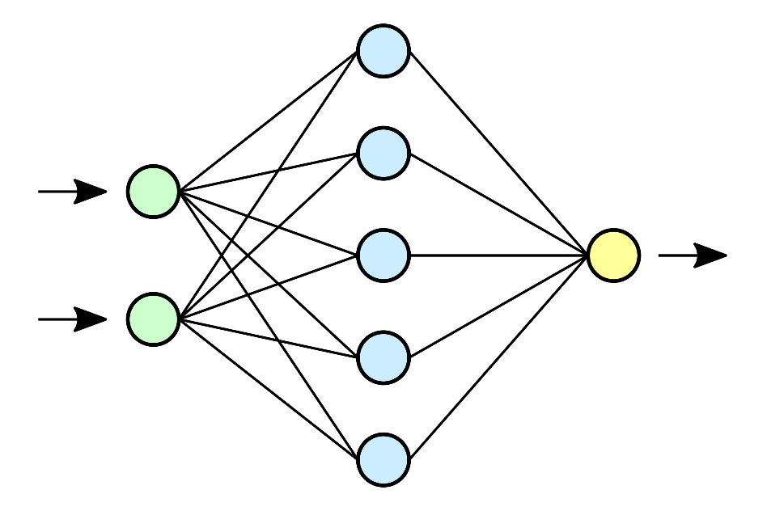
The likelihood ratio trick
$$x, θ \sim p\left(x | θ\right)p(θ)$$
$$y=1$$
$$d(x, θ)$$
$$x, θ \sim p\left(x\right)p(θ)$$
$$y=0$$
Classifier

Slide 13
Neural ratio estimator (NRE)
The solution $d(x, θ)$ found after training approximates the optimal classifier
$$d\left(x,θ\right)≈d^{∗}\left(x, θ\right)= \frac{p(x, θ)}{p\left(x\right)p(θ)+p(x,θ)}$$
Therefore,
$$r\left(x | θ\right)=\frac{p(x|θ)}{p(x)}=\frac{p(x,θ)}{p\left(x\right)p(θ)}≈\frac{d\left(x,θ\right)}{1−d\left(x,θ\right)}=\hat{r}(x|θ)$$

Slide 14
Bayesian Inference for robotic grasping
$$p\left(h | S, V\right)=\frac{p\left(S | h, V\right)}{p\left(S|V\right)}p(h|V)$$
h is the hand configuration
The position of the hand $x∈R^{3}$
The orientation of the hand $R∈SO(3)$
V is the observation (voxel grid from the TSDF)
S is a binary succes metric ($S=1$ means a successful grasping)
Maximum a posteriori
$$h^{∗}={argmax}_{h} p(h|S=1,V)$$
$$h^{∗}≈{argmax}_{h}\hat{r}\left(S=1 | h, V\right)p(h|V)$$
which can be solved by gradient descent

Slide 15
Manifold optimization
However, the orientation $R∈SO(3)$ which makes gradient descent more tricky.
Thus, we rely on Riemannian gradient descent.
Idea:
Project your Euclidean gradients to the tangent plane
$$gradf\left(h\right)=P_{h}(∇f\left(h\right))$$
Follow the geodesic curve through the exponential map
$$h_{k+1}=\exp_{h_{k}}⁡(−α gradf\left(h_{k}\right))$$

Slide 16
Manifold optimization

Slide 17
Sbi for robotic
Advantages
Drawbacks
Only needs simulator
Full posterior distribution
Deal with nonlinear space of rotation
Work with any sensor
As good as the simulator
Needs lots of samples
Difficult to deal large parameter space
As good as the simulator

